Slide 1
Zimmerone Projects summary slides
2017-2026

Slide 2
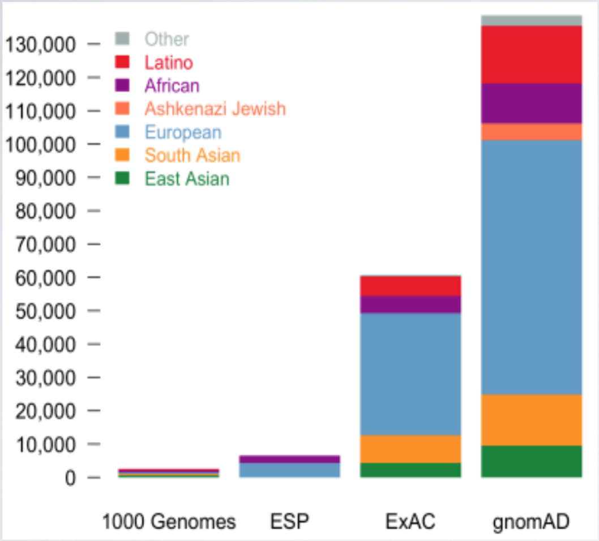
2017 group 1
Summary Figure:
No genes prioritized
Summary:
Project purpose: comparative analysis of personal genomes
Compare the variant in Carl’s genome with those in genomAD and 1000 genome databases
genomic databases are important for understanding the “normal” range of genetic variation
vcfR retrieves online references
ANNOVAR retrieves genome frequencies and annotations

Slide 3
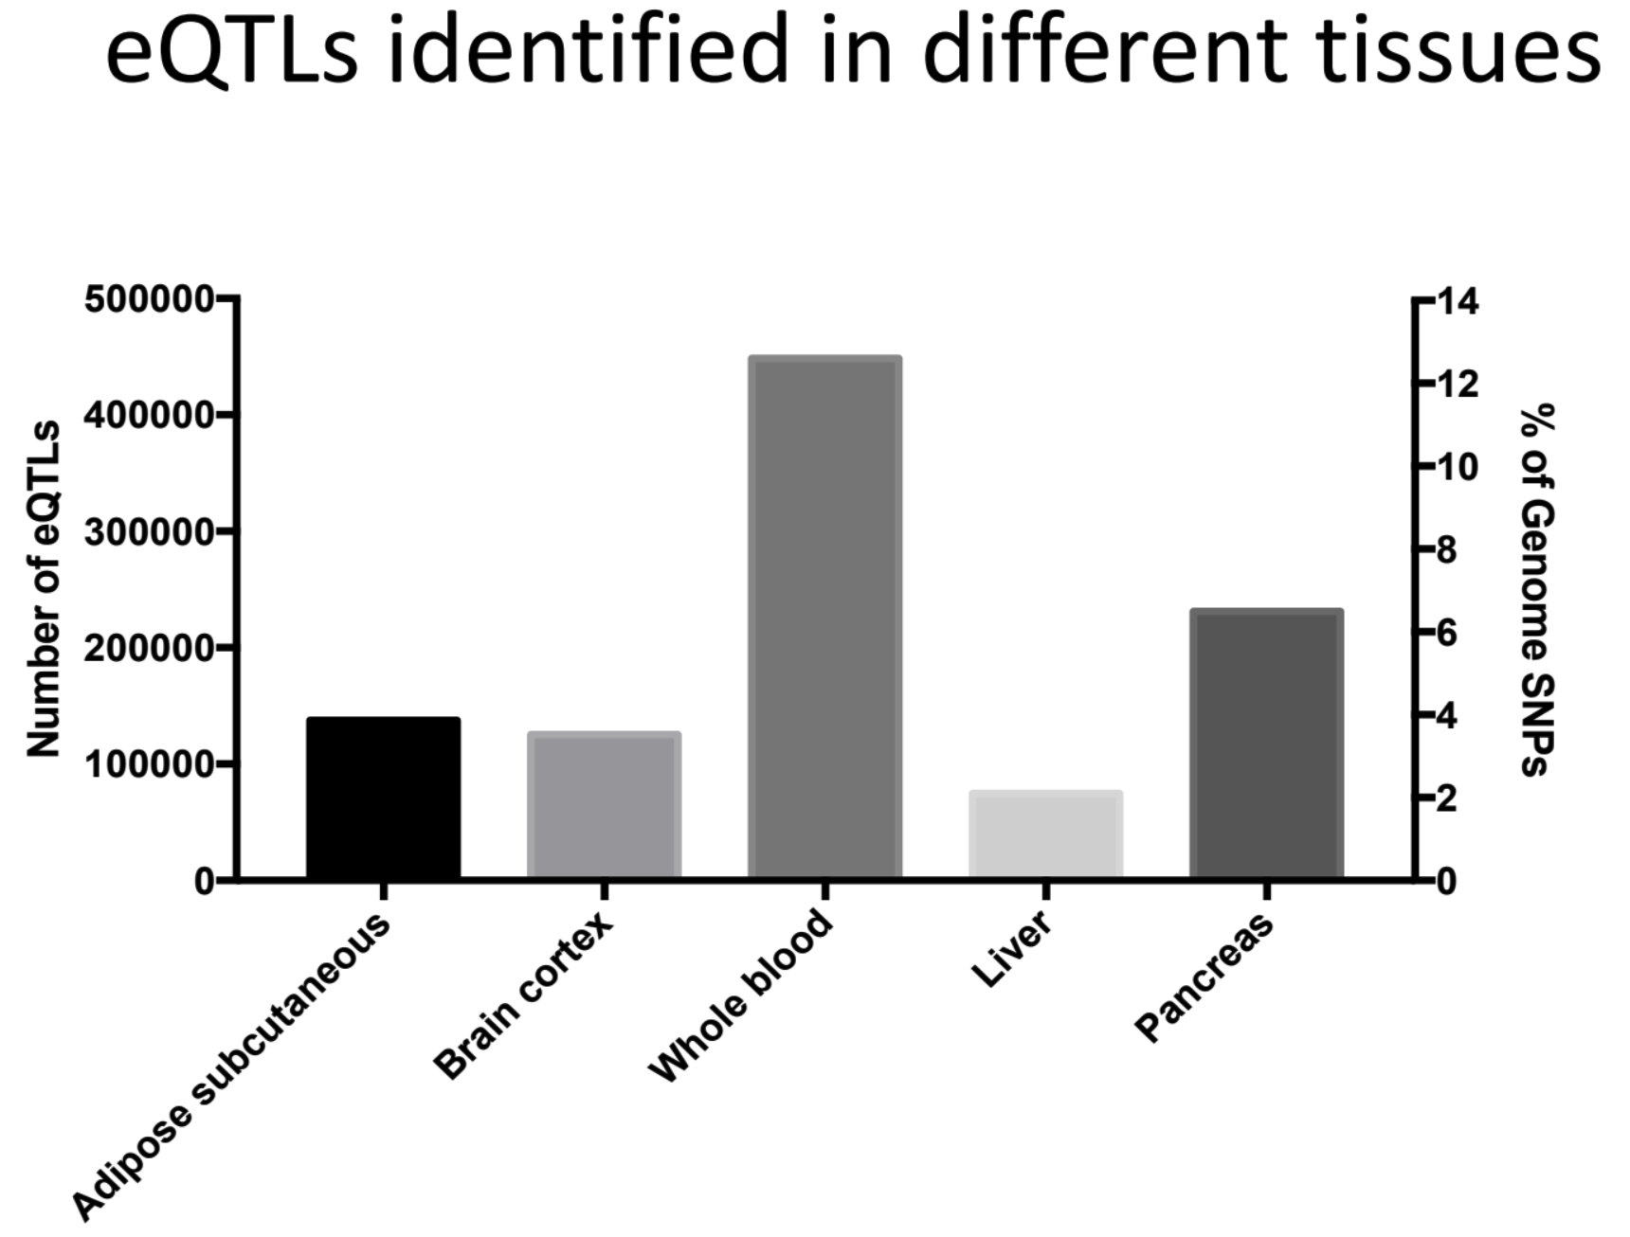
2017 group 2
Summary Figure:
No genes prioritized
Summary:
Project purpose: comparative analysis of personal genomes
Compare the variants in Carl’s genome with those in GTEx databases
Carl’s SNPs are interestingly enriched in immune-related chromosome regions
A small proportion of SNPs serve as eQTLs and regulate the expression of genes (mainly in the immune system)

Slide 4
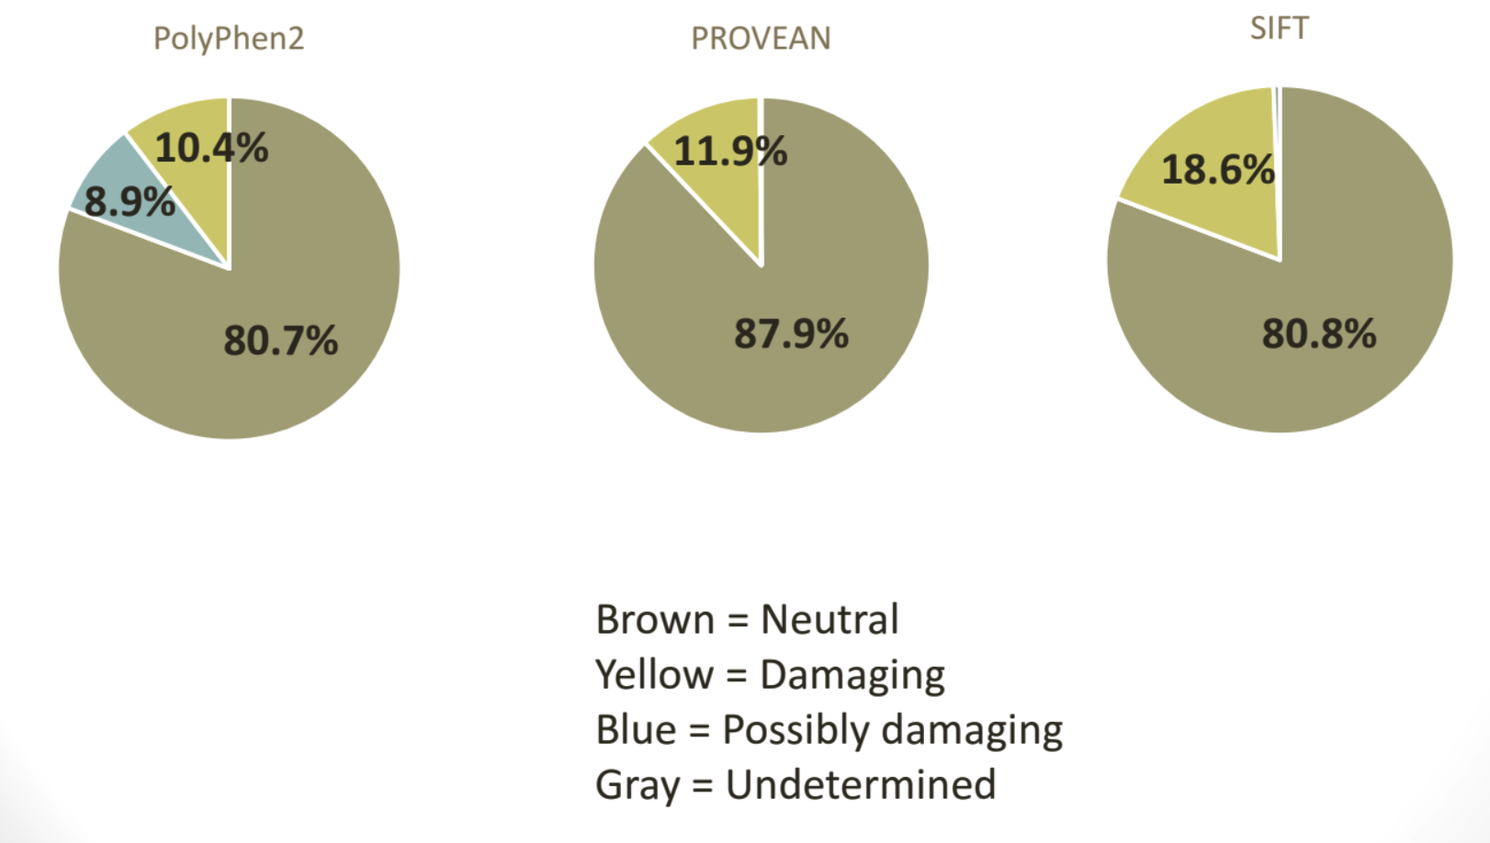
2017 group 3
Summary Figure:
No genes prioritized
Summary:
Project purpose: comparative analysis of personal genomes
Assessing deleteriousness of SNV’s in Carl’s genome
Used PolyPhen2, PROVEAN and SIFT for SNPs classification
Estimated the deleteriousness of a mutation based on properties of amino acids and evolutionary constraint

Slide 5
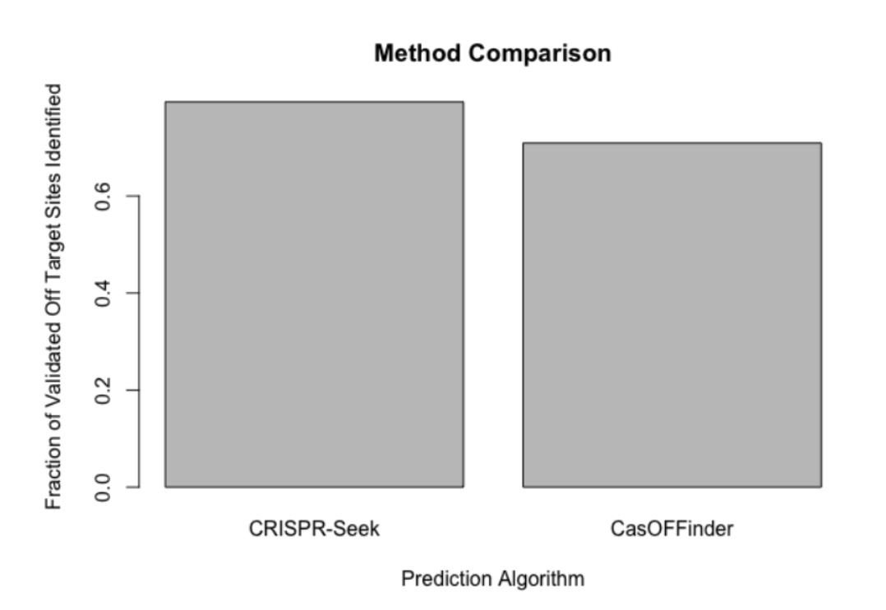
2017 group 4
Summary Figure:
No genes prioritized
Summary:
Project purpose: personal genomes and personalized medicine (CRISPR)
Identifying off-target CRISPR site
Used algorithms Cas-OFF and CRISPR-SEEK to identify off-target CRISPR sites
Results on hg38 showed that CRISPR-Seek predicted 516/650 and CasOFFinder 461/650

Slide 6
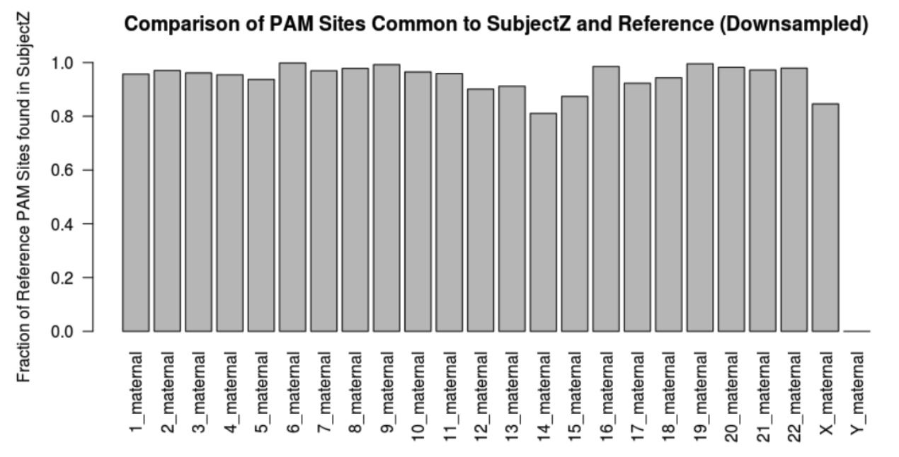
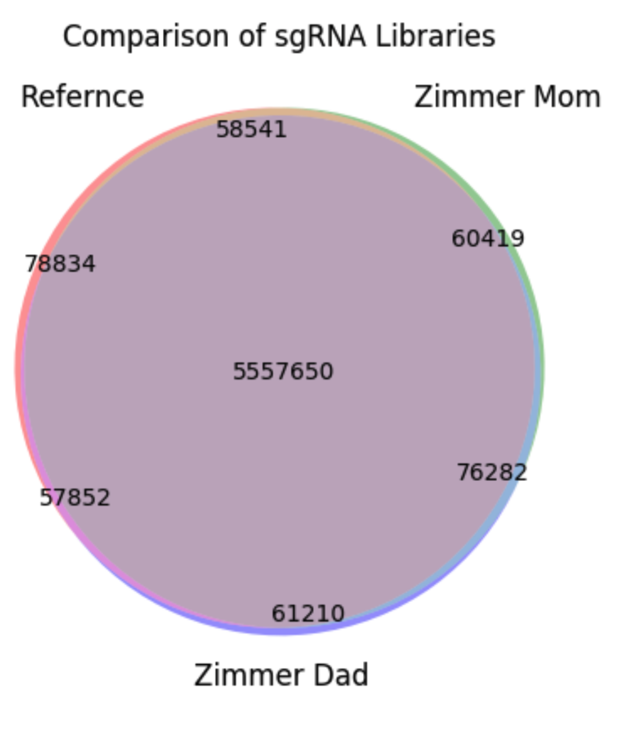
2017 group 5
Summary Figure:
No genes prioritized
Summary:
Project purpose: personal genomes and personalized medicine (CRISPR)
The impact of SNPs on sgRNA sets and off target mutations
Found PAM sites in the human reference genome as well as Carl’s genome and compares the similarity of the two sets:
Many PAM sites with matched upstream sequences are present in Carl’s sets
Generated sgRNA libraries from Carl’s genome and compared it to the reference genome
Zimmer mom and dad have slightly more in common than with either does with the reference

Slide 7
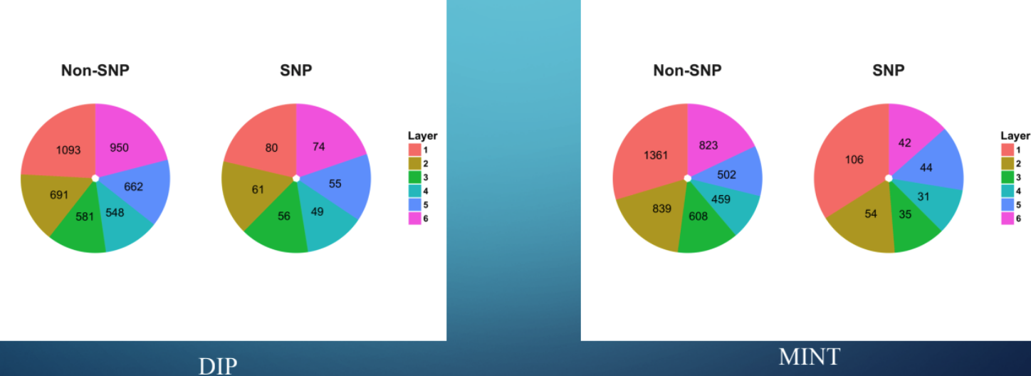
2017 group 6
Summary Figure:
No genes prioritized
Summary:
Project purpose: network analysis of personal genomes
Propose a tool that calculates the degree centrality and betweenness centrality of proteins containing and not containing SNPs in Carl’s genome using a PPI file
Calculated the degree centrality and the betweenness centrality for all nodes in the PPI network
Found no statistically significant difference in distributions of proteins containing SNPs and not containing SNPs
Observed no statistically significant enrichment of proteins/protein types in any hierarchical layers of the PPI network

Slide 8
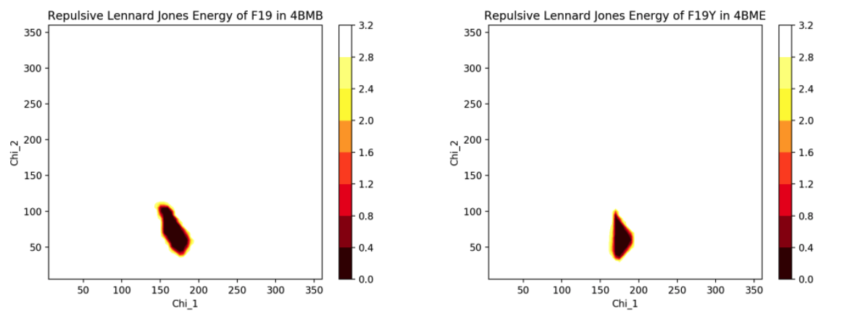
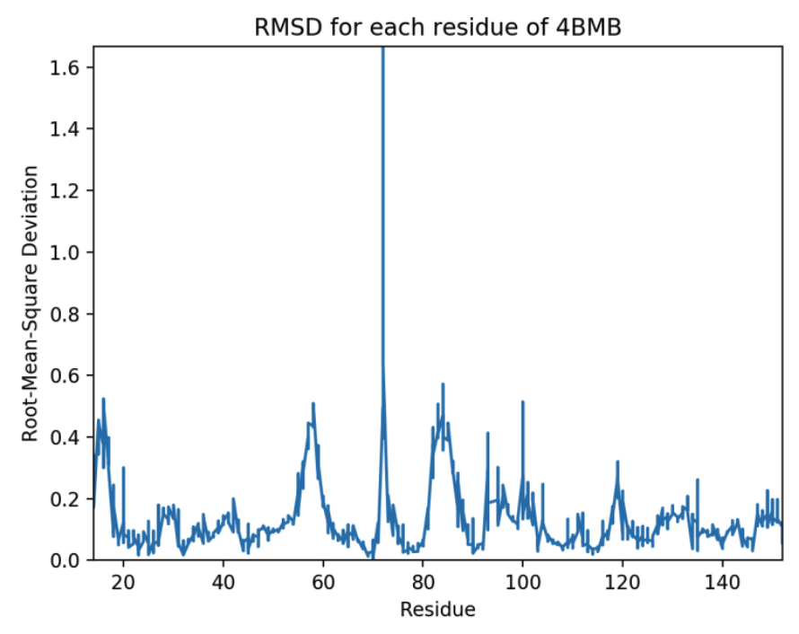
2017 group 7
Summary Figure:
No genes prioritized
Summary:
Project purpose: structural analysis
Analyze the structure of the mutation F19Y found in Carl’s genome for galectin-8
Amino acids mutations can be favorable or unfavorable
Analyzed Carl’s genome for protein galectin-8 mutations
Compared WT vs Mutant’s repulsive energy and RMSD

Slide 9
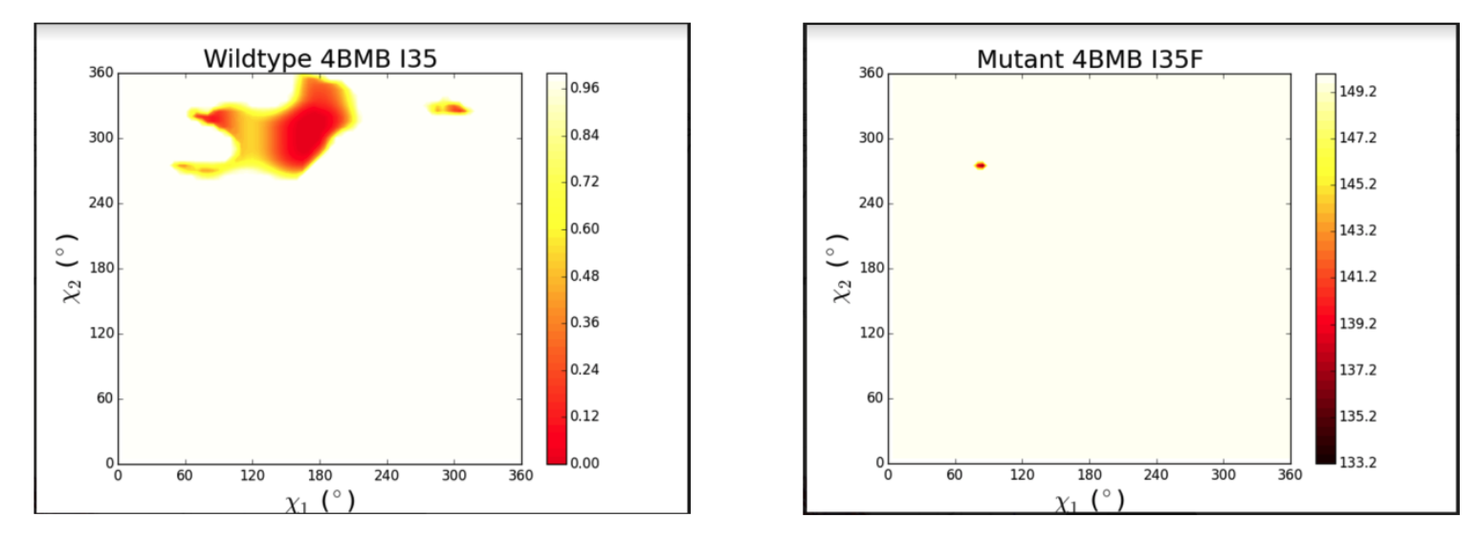
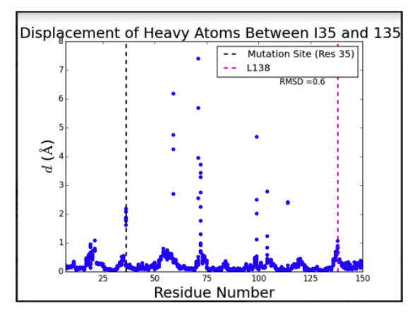
2017 group 8
Summary Figure:
No genes prioritized
Summary:
Project purpose: structural analysis
Analyze the structure of the mutation I35F found in Carl’s genome for galectin-8 at location 35
Amino acid mutations include changes in size, charge, hydrophobic effect, and change in potential energy
Size and charge are important in predicting mutation effects
Side chain angle potential energies increased by I35F mutations
RMSD increased with I35F mutation
Unexpected mutation results (D/E, F/Y)

Slide 10
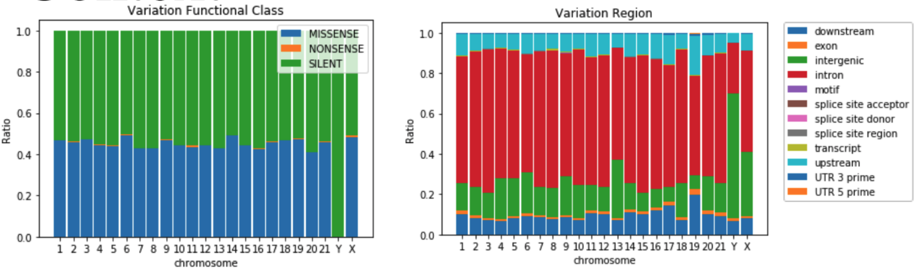
2018 group 1
Summary Figure:
No genes prioritized
Summary:
Project purpose: comparative analysis of personal genomes
Compare Carl’s genome with the Neanderthal data
Neanderthal variants have been observed in humans in a frequency higher than expected by chance; some of these variants are associated with disease risk.
Retrieved Neanderthal data came from The Max Planck Institute and used bedtools intersect to analyze basic statistics of %N SNP composition of Carl’s SNP set

Slide 11
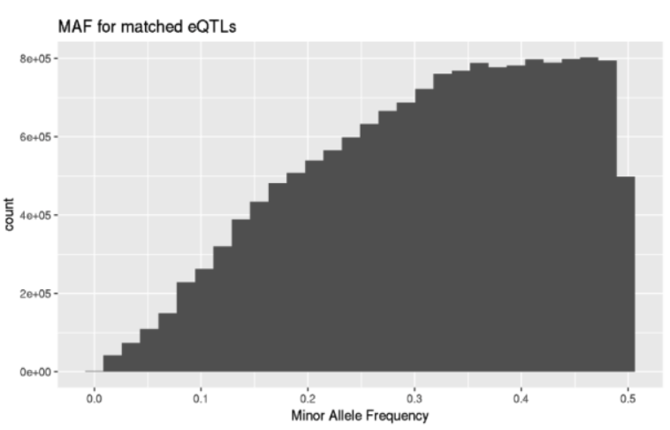
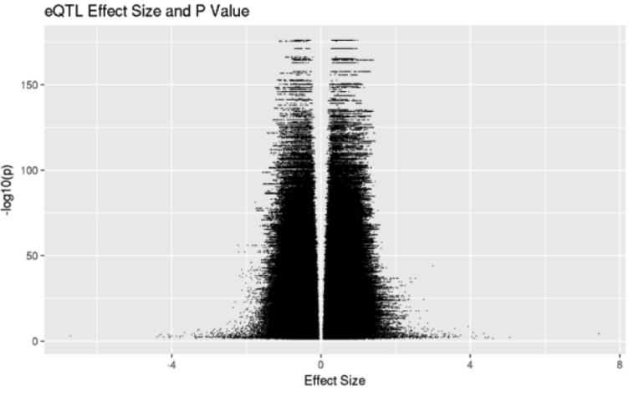
2018 group 2
Summary Figure:
No genes prioritized
Summary:
Project purpose: comparative analysis of personal genomes
Compare the variants in Carl’s genome with those in GTEx databases to assess whether Carl should take up sprinting
Carl’s genome indicates that he:
may have abnormal regulation of axon guidance (related to Parkinson’s)
may have more (or less!) explosive fast-twitch muscles than average
may be at risk for gastrointestinal tract cancer

Slide 12
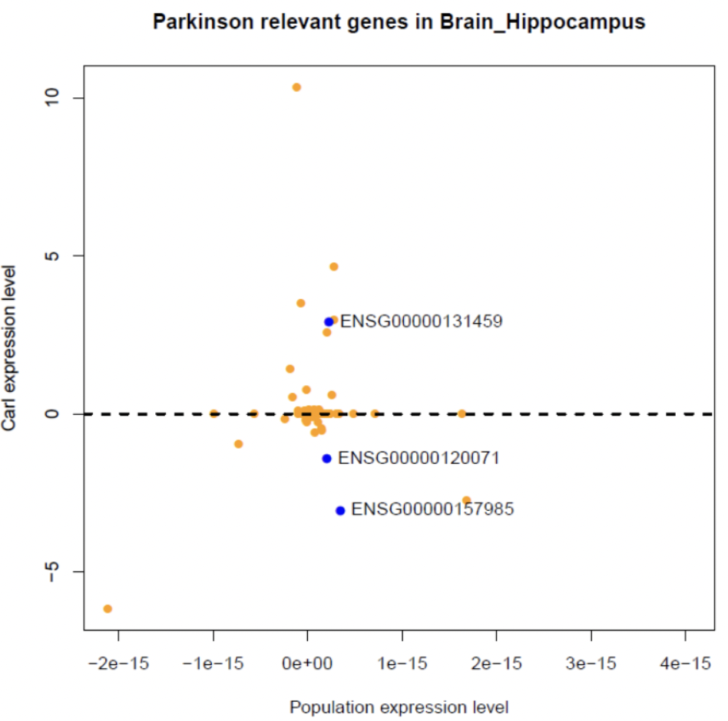
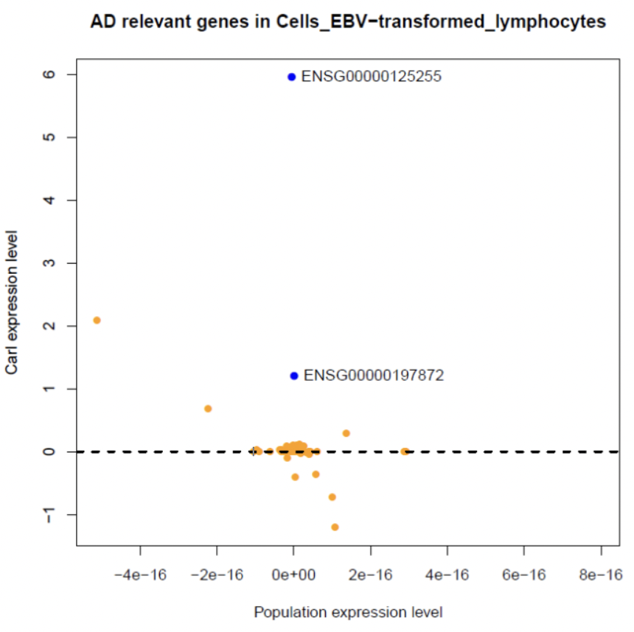
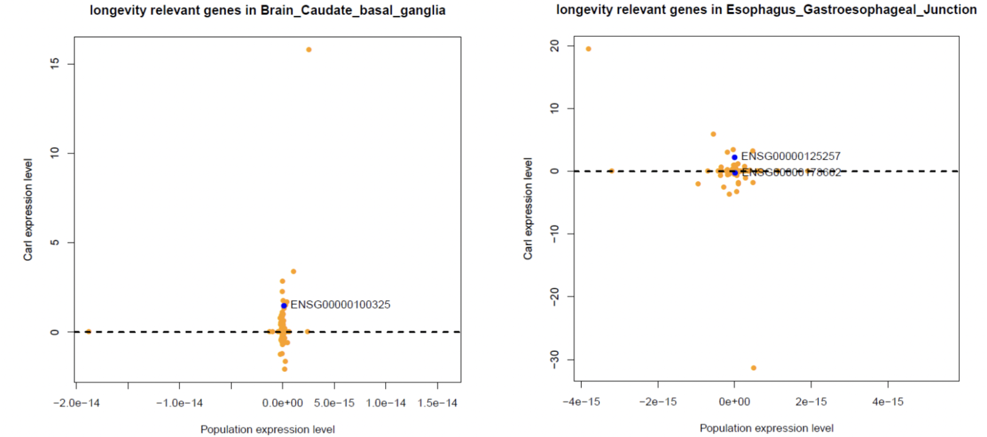
2018 group 3
Summary Figure:
No genes prioritized
Summary:
Project purpose: predict gene expression values from carl's snp information
Potentially higher risk of Parkinson’s disease
Lowered expression level for a protective gene AGAP1
Lowered expression level for a important gene KANSL1 (in mental
development)
Potentially higher risk for Alzheimer’s disease
Increased expression level for a risk gene SLC10A2
More likely to have a longer life span
Increased expression for two protective genes (ASCC2 and MRP4)

Slide 13
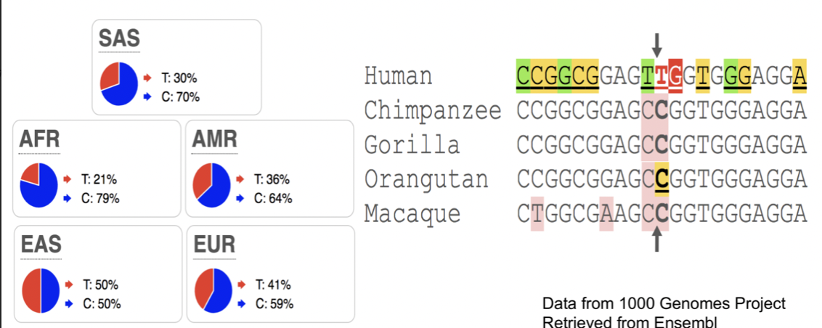
2018 group 4
Summary Figure:
No genes prioritized
Summary:
Project purpose: analyzing a common variant associated with inflammatory response
Investigated in cannabinoid receptor type 2
The CC variant is the common and ancestral variant
Cannabinoid receptor type 2 is involved in immune signaling
Disease significance: the cannabinoid receptor type 2 Q63R variant increases the risk of celiac disease

Slide 14
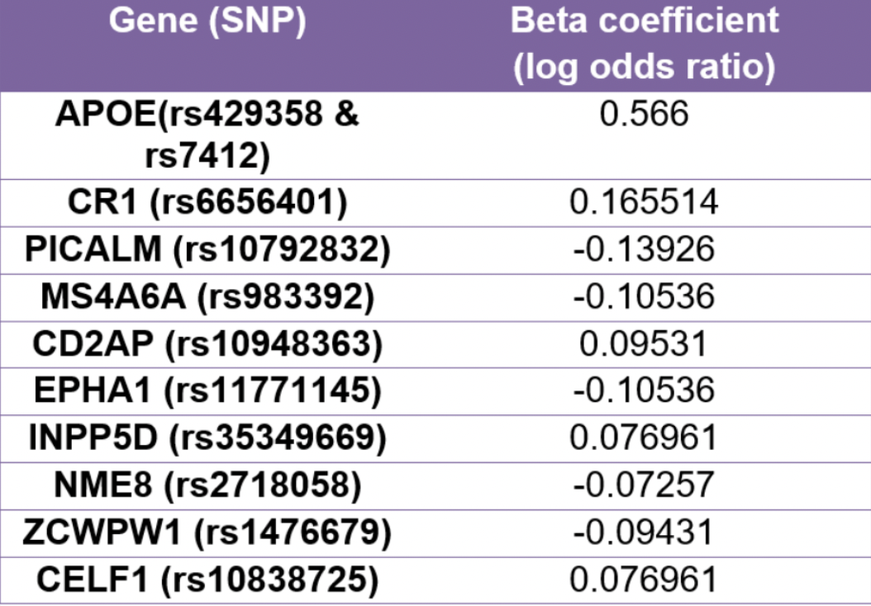
2018 group 5
Summary Figure:
No genes prioritized
Summary:
Project purpose: calculating Carl’s risk for Alzheimer's disease
Alzheimer’s disease phenotype is indicated by the amyloid cascade hypothesis
Carl has 10 out of 22 associated SNPs
Probability of Alzheimer’s is 13.72% vs probability of Alzheimer’s in general population is 10%

Slide 15
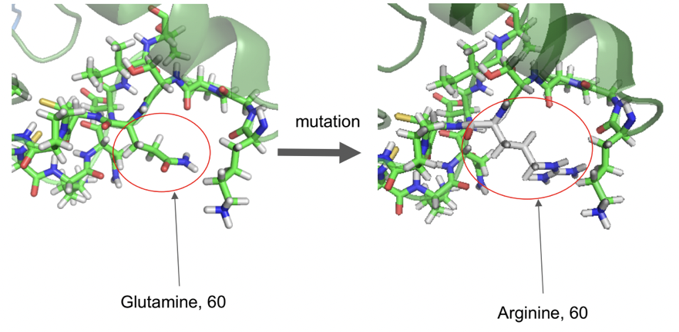
2018 group 6
Summary Figure:
No genes prioritized
Summary:
Project purpose: identifying significant protein-coding mutations in Carl’s genome
Hypothesizes that Carl’s mutation will not drastically decrease protein functionality and thus not increase his risk of developing cancer
Conclusions:
Mutations appear to be tolerated in coding regions
Olfactory receptors
Polarity is preserved among most mutation

Slide 16
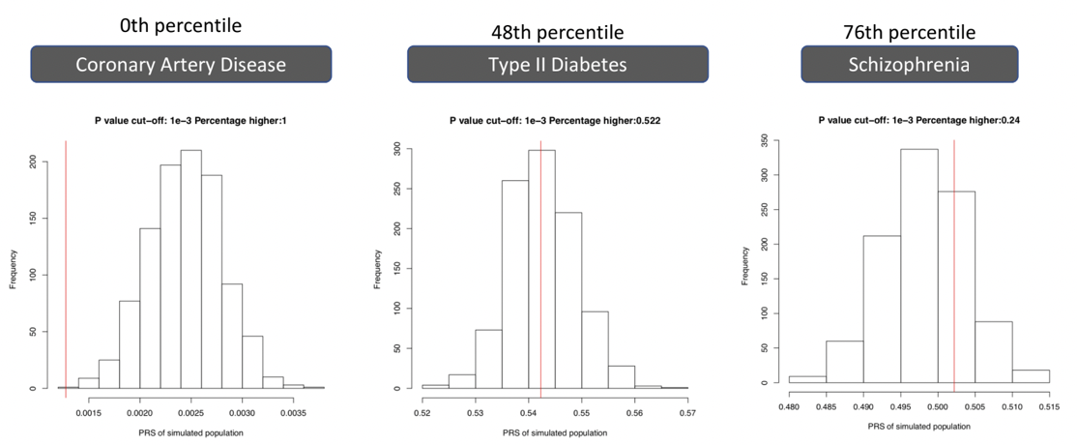
2018 group 7
Summary Figure:
No genes prioritized
Summary:
Project purpose: PRS prediction in coronary artery disease, type II diabetes, and schizophrenia
Pre-processed Carl’s genotype file then calculated his polygenic risk scores for coronary artery disease, type II diabetes, and schizophrenia
Limitations:
PRS is only interpretable when compared to that of cases/controls
Simulation result is not robust and depends heavily on simulation hypothesis

Slide 17
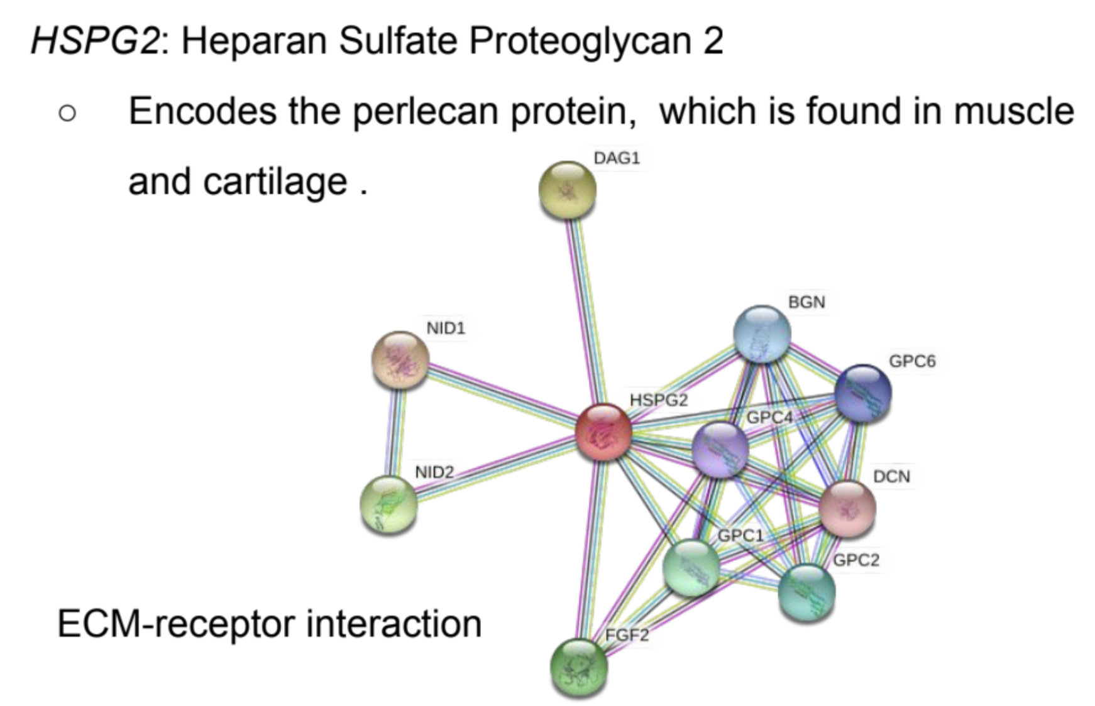
2019 group 1 (chr 1)
Summary Figure:
Top 10 Prioritized Genes
NBPF19
LMX1A
OBSCN
KIAA1324
HSPG2
TESK2
UBXN11
SPATA6
ADORA1
DCAF6
Additional Gene(s)
HRNR
Summary:
Prioritization approach: exonic mutational burden
Downstream analysis: STRING network analysis of protein interactions
Findings:
STRING analysis of the HSPG2 gene shows that Carl has six SNPs associated with Schwartz Jampel syndrome
STRING analysis of the HRNR gene (from the SIFT sorting list) shows that Carl has one SNP that’s associated with eczema in caucasian Europeans
Notes:
HRNR is from sift sorting list

Slide 18
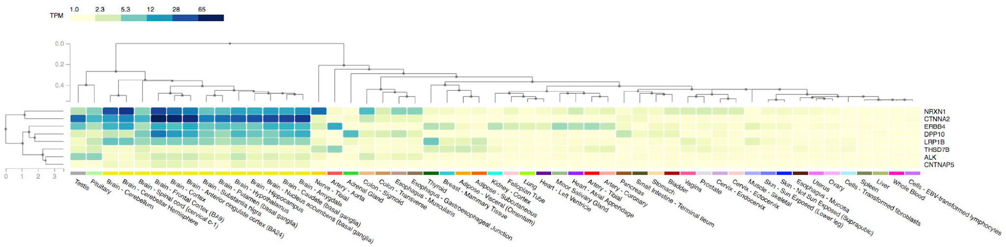
2019 group 2 (chr 2)
Summary Figure:
Top 10 Prioritized Genes
LRP1B
AC007682
CTNNA2
NRXN1
ERBB4
AC009499
ALK
THSD7B
DPP10
CNTNAP5
Additional Gene(s)
C2orf16
Summary:
Prioritization approach: mutational burden
Downstream analysis: gene expression analysis
Findings:
NRXN1,CTNNA2, ERBB4, DPP10, LRP1B have high expression levels in brain
SNP in C2orf16 is associated with the MEtabolic Syndrome

Slide 19
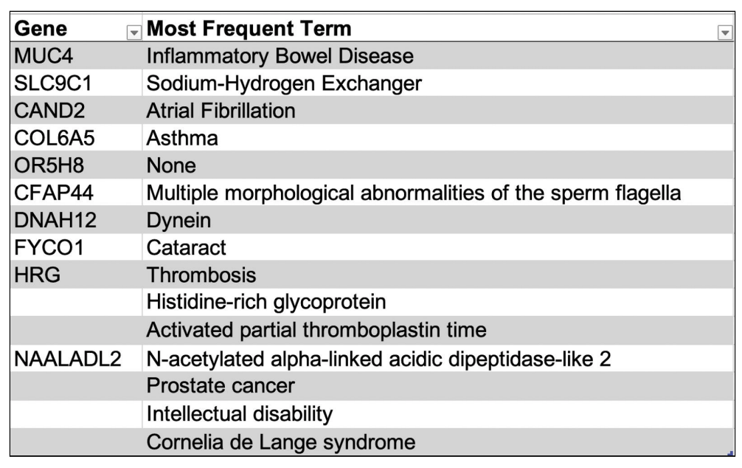
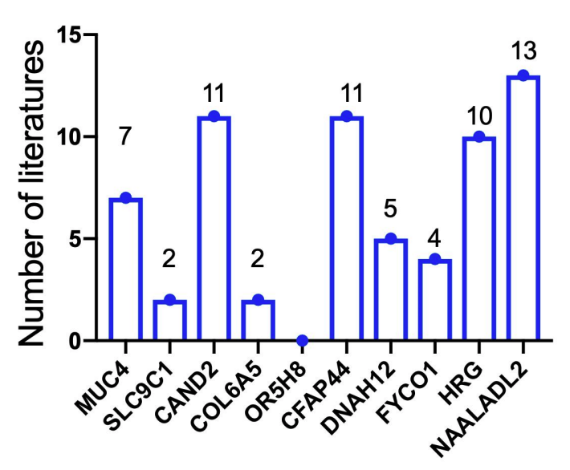
2019 group 3 (chr 3)
Summary Figure:
Top 10 Prioritized Genes
MUC4
SLC9C1
CAND2
C0L6A5
OR5H8
CFAP44
DNAH12
FYC01
HRG
NAALADL2
Summary:
Prioritization approach: number of nonsynonymous SNVs
Downstream analysis: text mining analysis through APIs and PubTator
Findings:
Different SNPs in the same gene may have distinct consequences: one SNP in CAND2 is associated with Atrial fibrillation and Ataxia Telangiectasia while another SNP is related to obesity
Identified a gene that has high rare nonsynonymous SNVs burden: ALDH1L, which has a SNP that’s associated with Cleft Palate

Slide 20
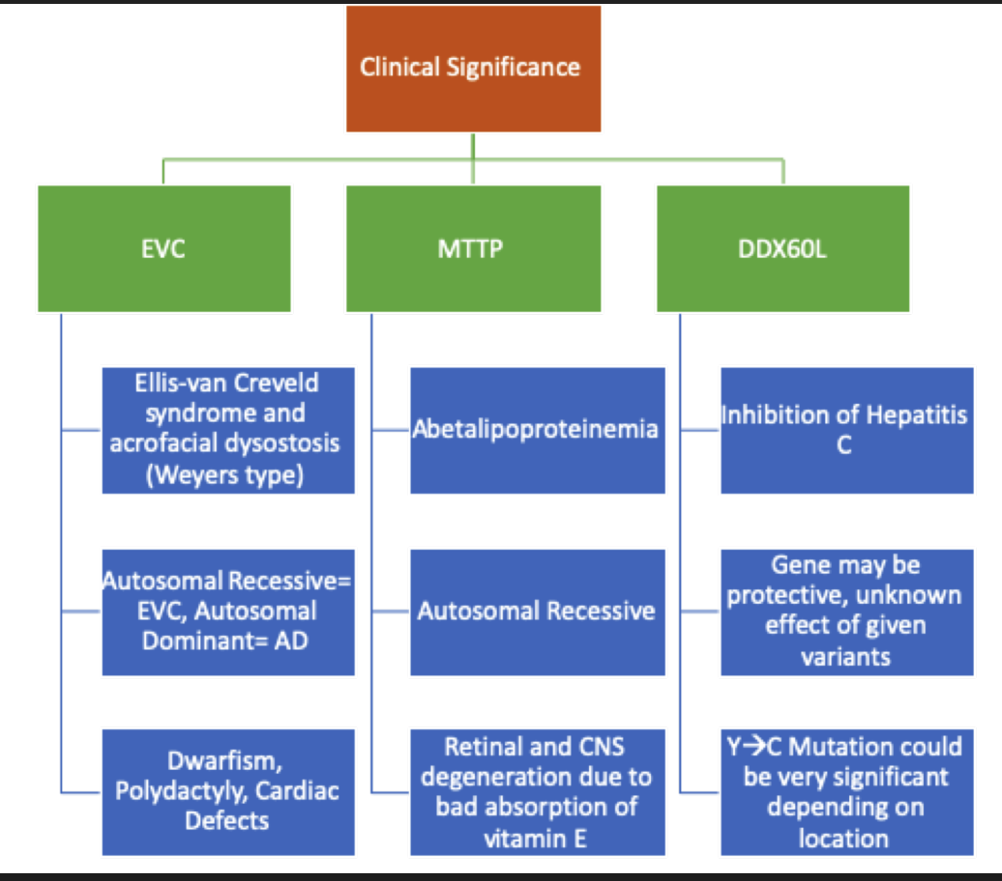
2019 group 4 (chr 4)
Summary Figure:
Top 10 Prioritized Genes
FAT1
DCHS2
DUX4L4
FRAS1
KIAA1211
MTTP
NEIL3
PIGG
SHROOM3
ALKPK1
Summary:
Prioritization approach: mutational burden of nonsynonymous variants
Downstream analysis: PDB structural analysis
Findings:
Found three variants DDX60L has that could potentially reduce the ability of this protein’s ability to perform its protective function
However, without structural information this is highly speculative
Found variation in MTTP, a gene associated with abetalipoproteinemia when functionality is reduced

Slide 21
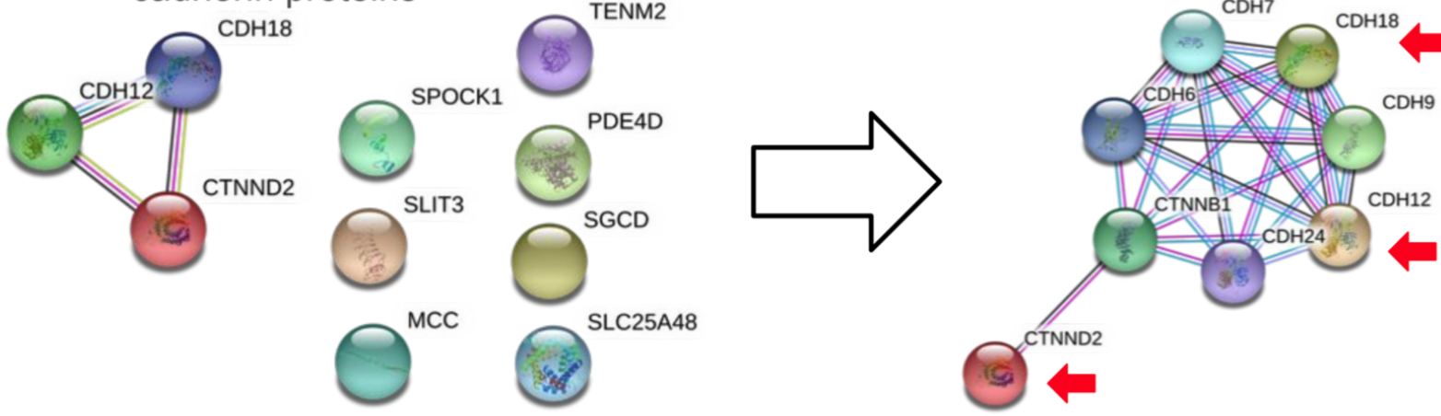
2019 group 5
(chr 5)
Summary Figure:
Top 10 Prioritized Genes
CDH12
CDH18
PDE4D
CTNND2
SGCD
SPOCK1
MCC
SLC25A48
TENM2
SLIT3
Summary:
Prioritization approach: mutational burden
Downstream analysis: STRING network analysis
Findings:
Genes from original mutational burden analysis shows connection with cadherin proteins
Carl has high mutational burden for multiple genes linked to CDH12
Chromosome 5p deletion including CDH12 causes cri-du-chat syndrome

Slide 22
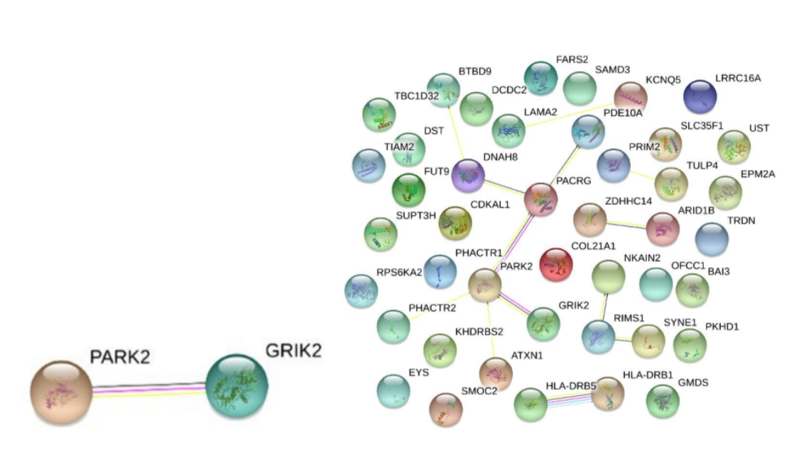
2020 group 1 (chr 6)
Summary Figure:
Top 10 Prioritized Genes
HLA-DRB1
HLA-DRB5
HLA-DRB6
HLA-DRA
HLA-DQA1
HLAB
GRIK2
PACRG
DDR1
CCHCR1
Summary:
Prioritization approach: Putative variant impact and total count of variants
Downstream analysis: STRING network analysis
Findings:
Biggest Aggregation of rare SNVs are located near a gene complex (HLA) coding for major histocompatibility complex on Chromosome 6
PACRG has high degrees in the network analysis and are associated with Parkinson Disease

Slide 23
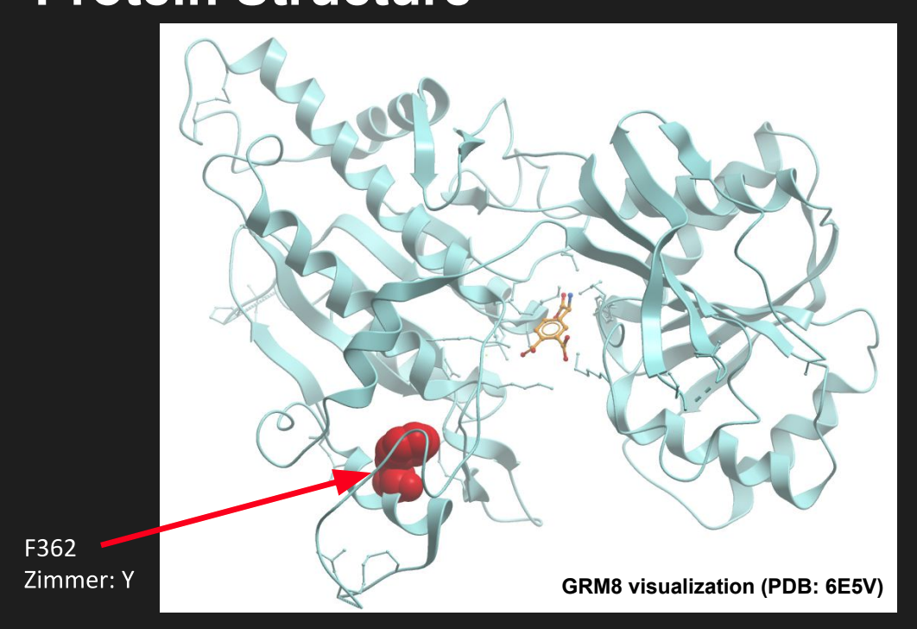
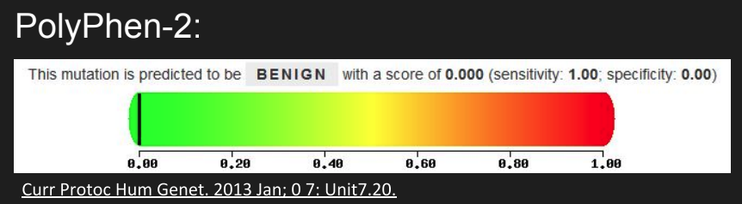
2020 group 2 (chr 7)
Summary Figure:
Top 10 Prioritized Genes
CNTNAP2
MAGI2
PTPRN2
DPP6
SDK1
DGKB
AUTS2
HDAC9
GRM8
PDE1C
Summary:
Prioritization approach: mutational burden
Downstream analysis: PDB structural analysis
Findings:
Among the top 10 most mutated genes on chromosome 7, there are 6 missense variants within 4 genes
Only one variant, conferring a protein, is characterized: GRM8
PolyPhen analysis shows that substitution at pos 362 from F to Y is predicted to be tolerated

Slide 24
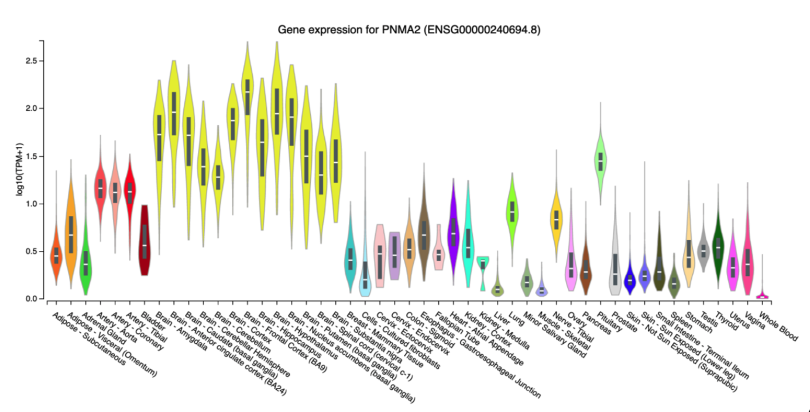
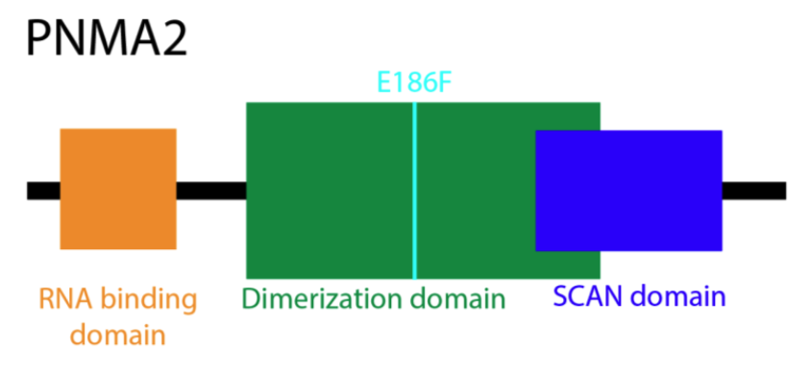
2020 group 3 (chr 8)
Summary Figure:
Top 10 Prioritized Genes
CSMD1
SGCZ
LINC02055
NRG1
DLGAP2
DLC1
CSMD3
CCDC26
PSD3
NKAIN3
Additional Gene(s)
PNMA2
Summary:
Prioritization approach: mutational burden
Downstream analysis: gene expression analysis
Findings:
PNMA2 is highly expressed in the brain and is implicated in cancer and neurological disorders
PNMA2 C>T causes nonsynonymous variant which lies in the dimerization domain
Notes:
Then we studied how their expression profiles vary across tissues. We
review the known functional roles of the ten genes with the highest mutational burden and an
additional one called PNMA2.

Slide 25
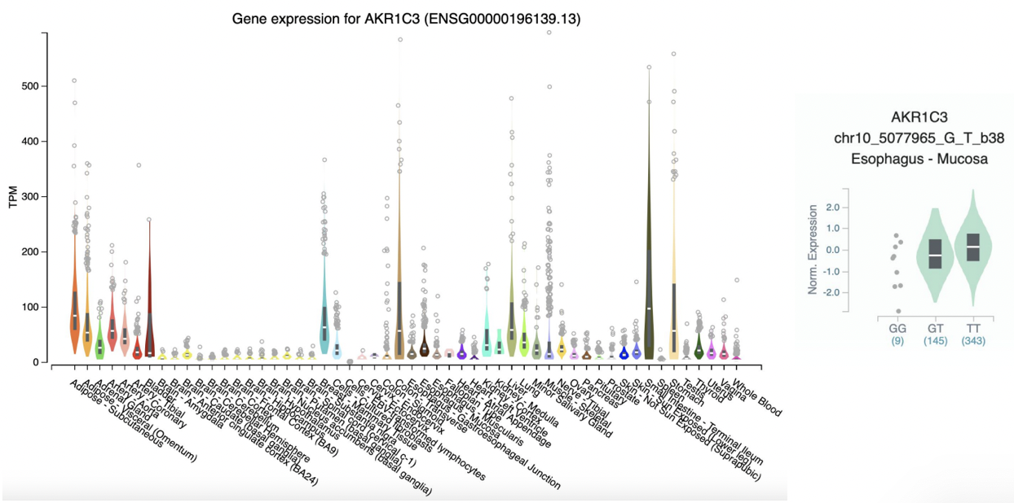
2020 group 4 (chr 9)
Summary Figure:
Top 10 Prioritized Genes
PTPRD
ASTN2
TRPM3
LINGO2
KDM4C
GLIS3
ADAMTSL1
CCDC171
BNC2
PCSK5
Summary:
Prioritization approach: mutational burden
Downstream analysis: gene expression analysis
Findings:
ADAMTSL1 is an interesting genes that’s involved in extracellular matrix organization
BNC2 is found to be strongly associated with congenital lower urinary-tract obstruction
Gene PTPRD has been implicated as a locus for restless legs syndrome and genetic variants of PTPRD are associated with bronchial asthma

Slide 26
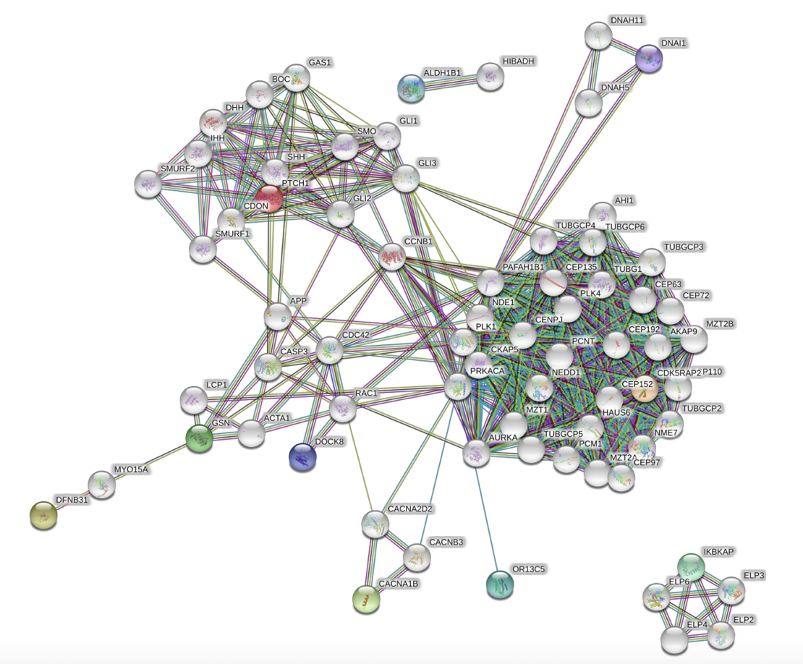
2020 group 5 (chr 10)
Summary Figure:
Top 10 Prioritized Genes
AKR1E2
AKR1C2
AKR1C3
TMEM254-AS1
ASAH2B
WDR37
SEPHS1
PTCHD3
SNCG
PITRM1
Summary:
Prioritization approach: mutational burden
Downstream analysis: STRING network analysis
Findings:
Rare, deleterious variant found within ASAH2B
PTCHD3 variant found to be associated with decreased risk for cataracts
AKR1E2 stop gained mutation is associated with lower height and fat-free body mass; AKR1C2 splice-donor variant is associated with lower weight, fat-free body mass; AKR1C3 stop gained mutation is associated with lower fat-free body mass and basal metabolic rate

Slide 27
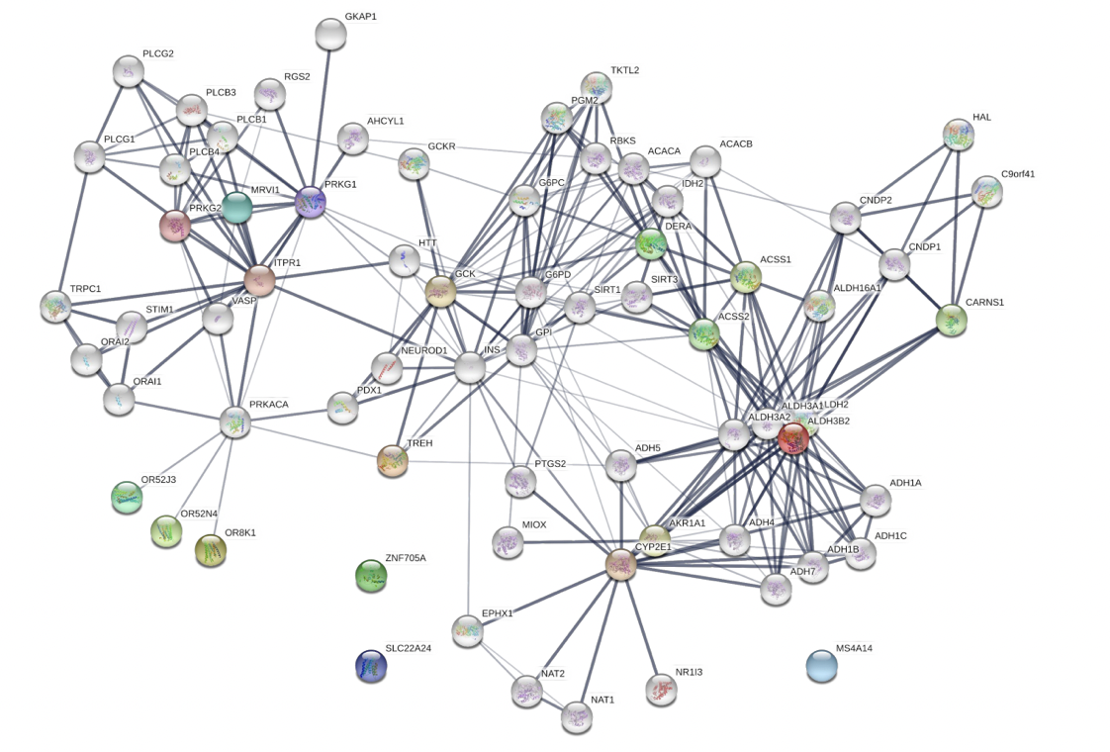
2020 group 6 (chr 11)
Summary Figure:
Top 10 Prioritized Genes
SLC22A24
CASP12
OR52J3
ZNF705E
ALDH3B2
MRVI1
OR52N4
TREH
MS4A14
OR8K1
Summary:
Prioritization approach: impact score using SnpEff
Downstream analysis: STRING network analysis
Findings:
Several olfactory receptors were found in this analysis
Some genes were involved in metabolic processes

Slide 28
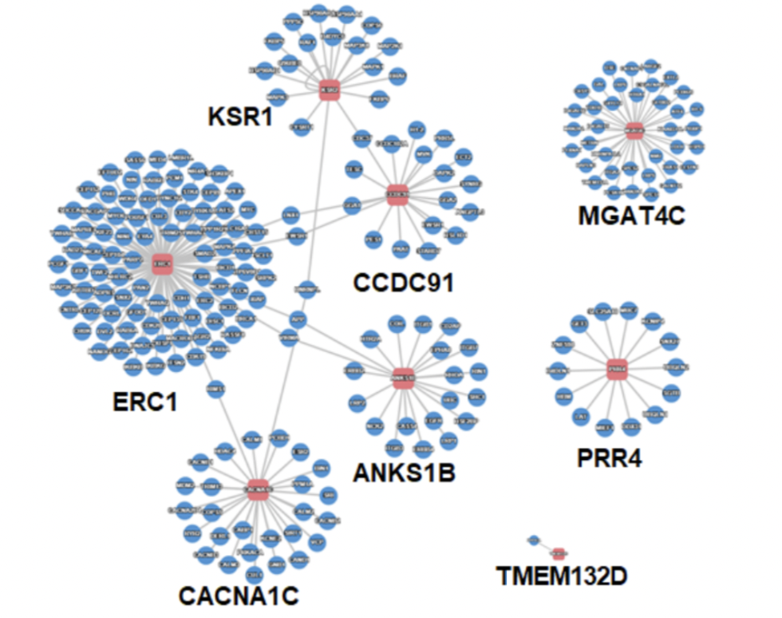
2021 group 1 (chr 12)
Summary Figure:
Top 10 Prioritized Genes
TMEM132D
MGAT4C
PRR4
ANKS1B
FAM19A
ERC1
CACNA1C
KSR2
TAS2R14
CCDC91
Summary:
Prioritization approach: mutational burden
Downstream analysis: PINA and STRING network analysis
Findings:
mutations may be relevant to taste transduction pathway
ERC1 expression is associated with a number of genes correlated with cancer prognosis; KSR2 interacts with MAPK (signaling-pathway involved in oncogenesis)
alternative approach to gene ranking finds interesting gene:
KSR2 variant related to facial morphology

Slide 29
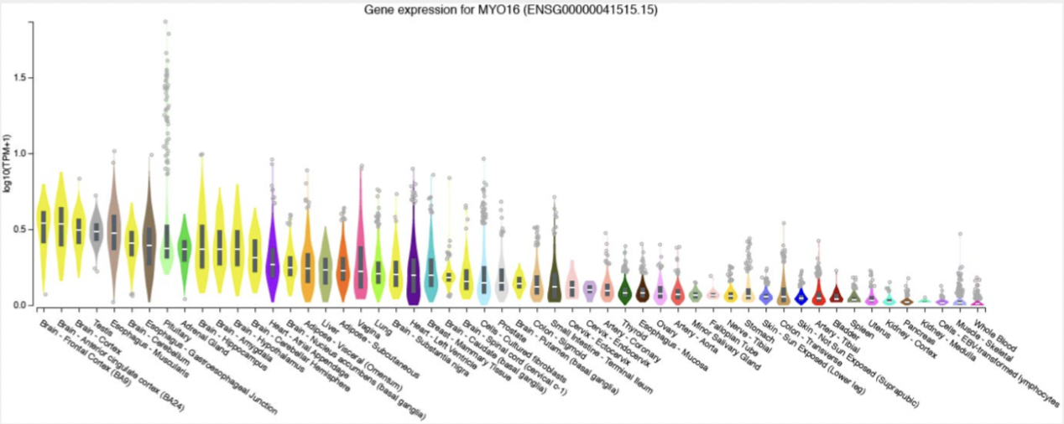
2021 group 2 (chr 13)
Summary Figure:
Top 10 Prioritized Genes
MYO16
ATP8A2
ATP11A
MCF2L
FARP1
PCDH9
DLEU1
RNF219-AS1
CCDC169
DIAPH3
Summary:
Prioritization approach: mutational burden
Downstream analysis: gene expression analysis
Findings:
MYO16 has genetic association with Autism Spectrum Disorder
Deletions of gene DLEU1 are found at high rates in patients with lymphocytic leukemia

Slide 30
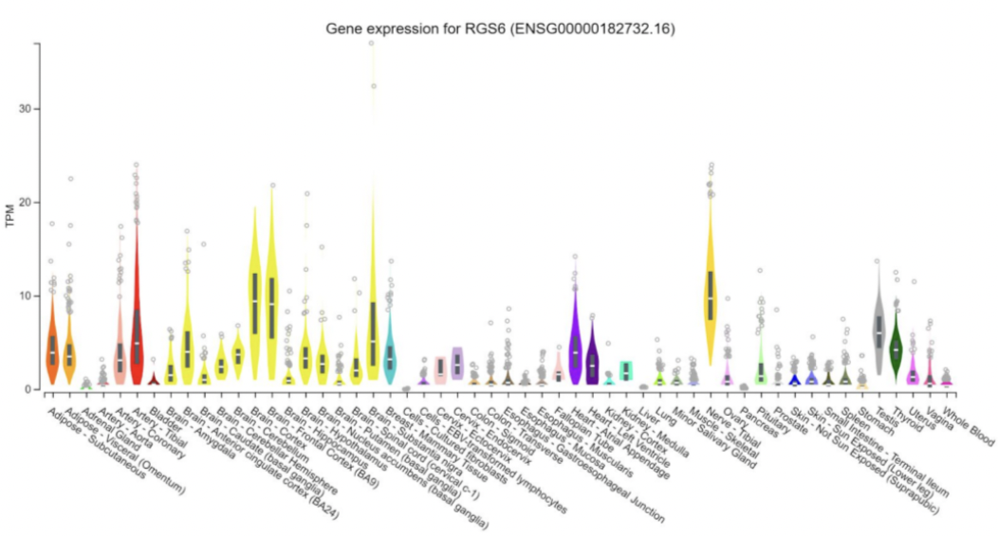
2021 group 3 (chr 14)
Summary Figure:
Top 10 Prioritized Genes
RGS6
LINC00871
FOXN3
MDGA2
NPAS3
NRXN3
RAD51B
NUBPL
SLC25A21
AKAP6
Summary:
Prioritization approach: mutational burden
Downstream analysis: gene expression analysis
Findings:
RGS6 modulates neuronal and cardiovascular activities, through regulating G protein signaling
MDGA2 is overall highly expressed in brain tissues but also highly expressed in testis

Slide 31
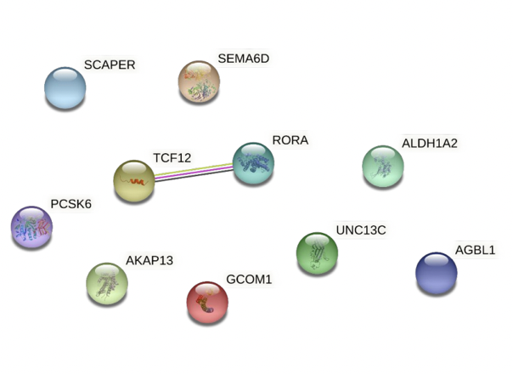
2021 group 4 (chr 15)
Summary Figure:
Top 10 Prioritized Genes
ALDH1A2
RORA
SEMA6D
AKAP13
PCSK6
TCF12
SCAPER
GCOM1
UNC13C
AGBL1
Summary:
Prioritization approach: mutational burden
Downstream analysis: STRING network analysis
Findings:
Two genes [RORA/TCF12] predicted to interact
RORA and TCF12 are implicated in TH17 cell differentiation pathway
Potential implications of RORA/TCF12 mutation
RORA: neurodevelopmental delay; epilepsy; cerebral ataxia
TCF12: coronal craniosyntosis; anaplastic oligodendroma

Slide 32
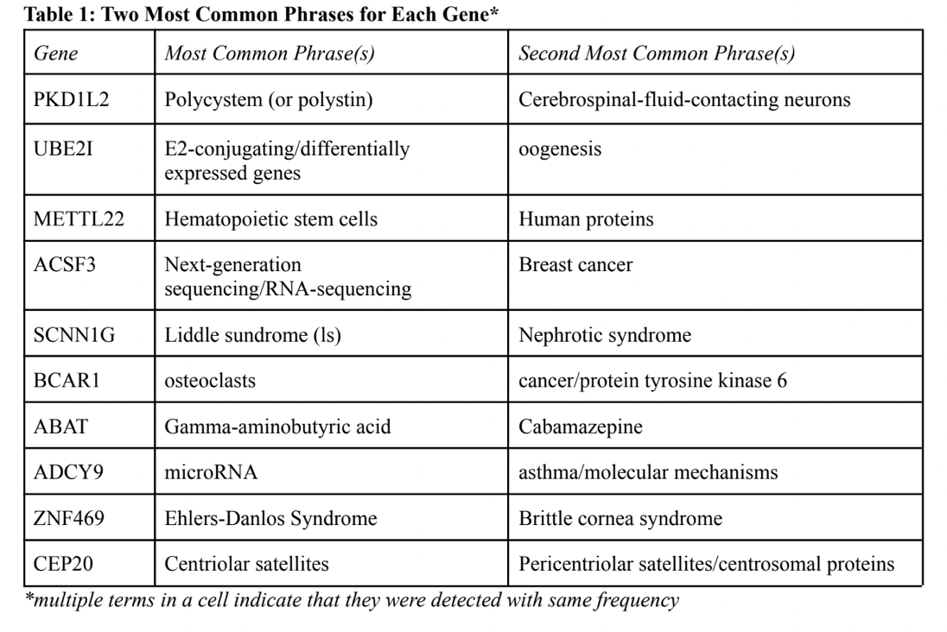
2021 group 5 (chr 16)
Summary Figure:
Top 10 Prioritized Genes
PKD1L2
METTL22
ZNF469
UBE2I
SCNN1G
ADCY9
ACSF3
BCAR1
ABAT
CEP20
Summary:
Prioritization approach: mutational burden
Downstream analysis: text mining analysis
Findings:
SCNN1G is associated with liddle syndrome
ADCY9 if part of the G-protein signaling cascade that begins with beta-adrenergic receptor activation
ACSF3 is associated with combined malonic and methylmalonic aciduria

Slide 33
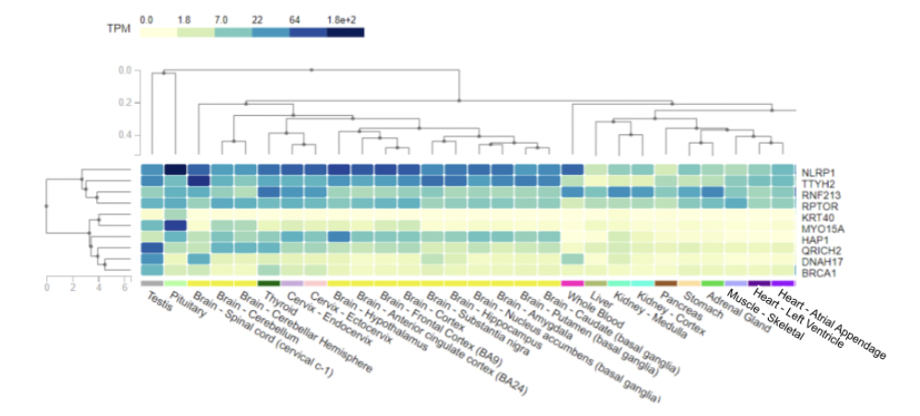
2021 group 6 (chr 17)
Summary Figure:
Top 10 Prioritized Genes
MYO15A
RNF213
KRT40
HAP1
BRCA1
RPTOR
TTYH2
DNAH17
NLRP1
QRICH2
Summary:
Prioritization approach: mutational burden
Downstream analysis: gene expression analysis
Findings:
DNAH17 has highest (24) SNVs
Missense mutations are associated with flagellar mutations and asthenozoospermia
Asthenozoospermia is only one of the causes of male infertility
Investigated if Carl’s DNAH17 has a variant that increases risk of asthenozoospermia

Slide 34
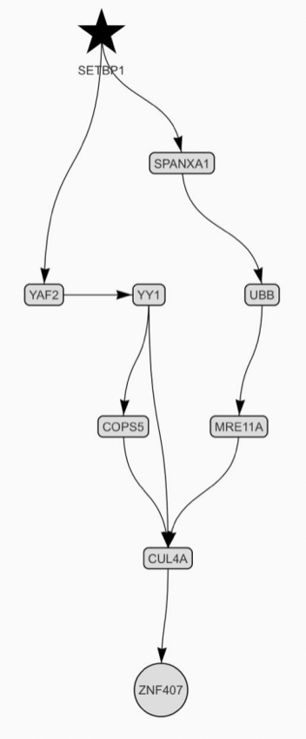
2022 group 1 (chr 18)
Summary Figure:
Top 10 Prioritized Genes
ZNF407
SETBP1
PIEZO2
MYL12B
DCC
ZNF532
RAB27B
PTPRM
ANKRD12
DOK6
Summary:
Prioritization approach: impact score using SnpEff
Downstream analysis: network analysis using KNIT
Findings:
The network identified seems to be related to DNA damage repair/DNA replication
ZNF407 is affected by WDR5 that could lead to colon cancer progress
Mutation in SETBP1 is associated with Schinzel-Giedion midface retraction syndrome

Slide 35
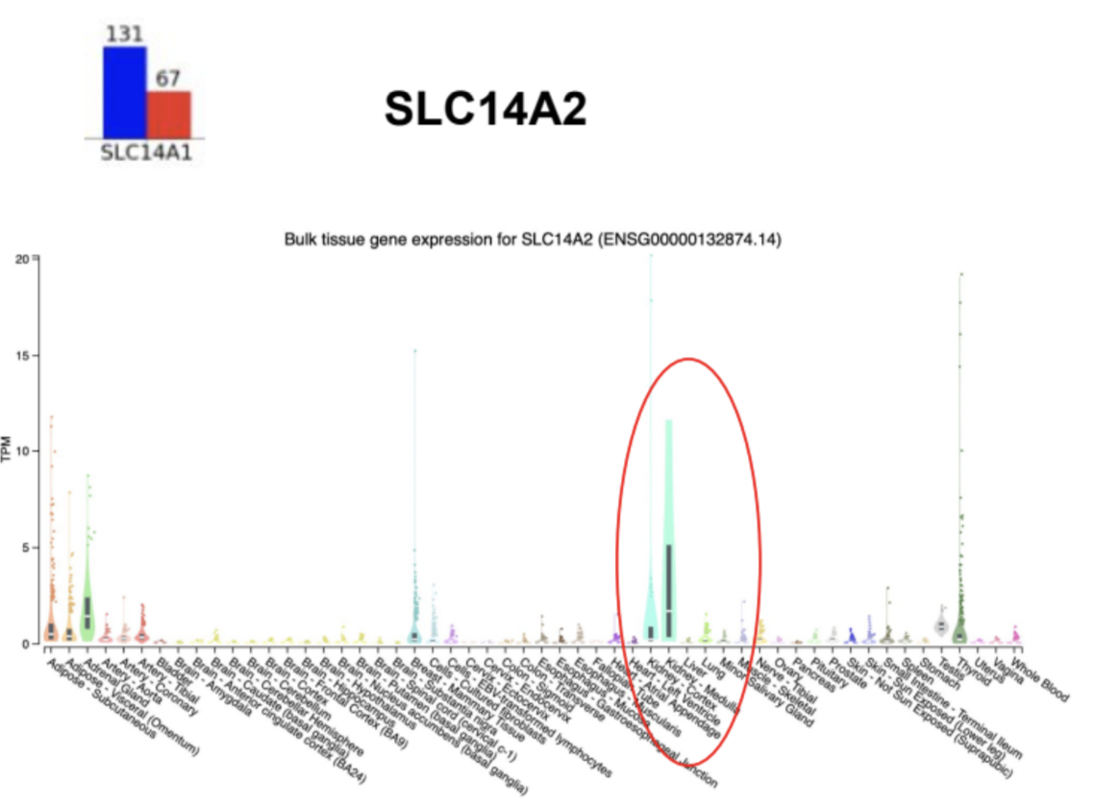
2022 group 2
(chr 18)
Summary Figure:
Top 10 Prioritized Genes
SLC14A2
L3MBTL4
DOK6
PIGN
DCC
PIEZO2
DLGAP1
PTPRM
LINC00907
AQP4-AS1
Summary:
Prioritization approach: mutational burden
Downstream analysis: gene expression analysis and structural analysis
Findings:
Comparison of gene expression levels of target genes indicates mutations affect tissue-specific genes and ubiquitous genes
Protein structure illuminate the possible effects of the mutational burden, since several amino acid were changed in the structures. However, fortunately, none affected active sites or protein protein interfaces

Slide 36
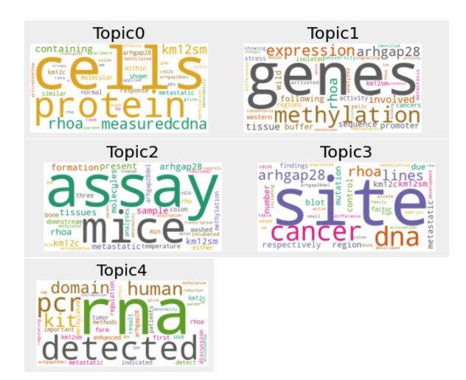
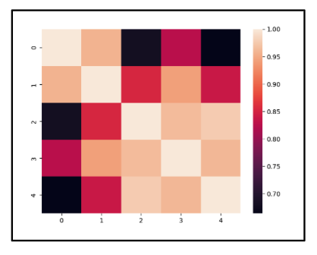
2022 group 3 (chr 18)
Summary Figure:
Top 10 Prioritized Genes
MBP
LDLRAD4
SMAD2
SMCHD1
PIGN
PIEZO2
ALPK2
NEDD4L
CD226
ARHGAP28
Summary:
Prioritization approach: mutational burden
Downstream analysis: text mining analysis
Findings:
NEDD4L has the highest correlation with the word hypertension
It is involved in blood pressure maintenance
CD226 has a correlation of 0.79 with the word autoimmune
It is indeed associated with many autoimmune diseases including refractory celiac disease

Slide 37
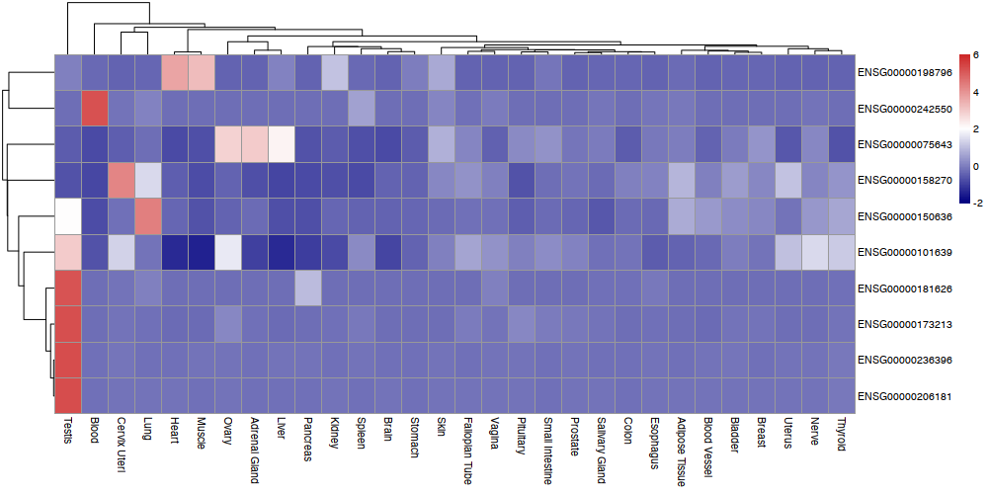
2022 group 4 (chr 18)
Summary Figure:
Top 10 Prioritized Genes
ALPK2
CEP192
SERPINB10
ANKRD62
MOCOS
SLC35G4
COLEC12
ELOA2
TUBB8B
CCDC102B
Summary:
Prioritization approach: mutational burden of non-synonymous mutations
Downstream analysis: gene expression analysis
Findings:
Most prioritized genes are expressed in heart and testes tissues
The most saturated association in list is cancer/cell cycle regulation
ALPK2 is associated with developmental processes primarily in heart
Almost all mutations observed are in unstructured regions and not disruptive to the protein structure

Slide 38
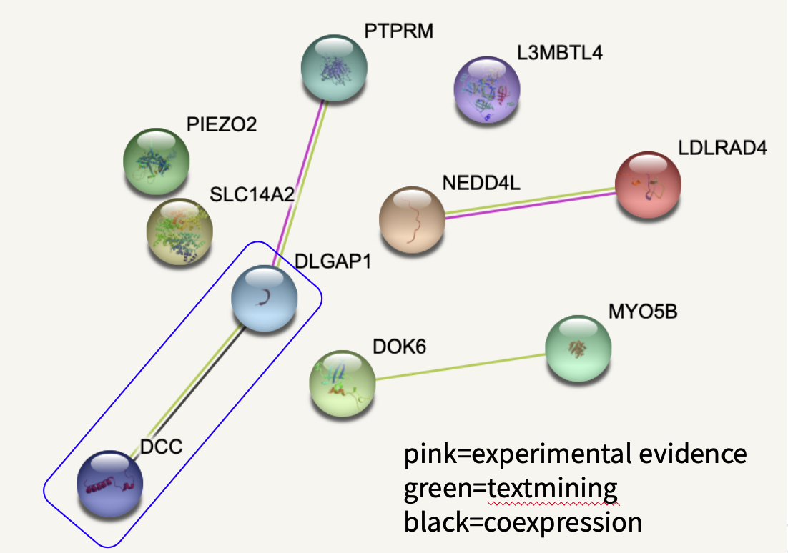
2022 group 5 (chr 18)
Summary Figure:
Top 10 Prioritized Genes
DCC
DLGAP1
PIEZO2
PTPRM
AQP4-AS1
DOK6
MYO5B
LINC00907
L3MBTL4
DSEL-AS1
Summary:
Prioritization approach: mutational burden
Downstream analysis: gene expression analysis and STRING network analysis
Findings:
Some of these genes expressed in few tissues consistent with known function
Differential expression may point to non-canonical functions: DCC in testis (tumor suppression) : PIEZO2 in lungs (stretch sensation)
Mutated genes are pieces in larger pathways: disruption → downstream effects

Slide 39
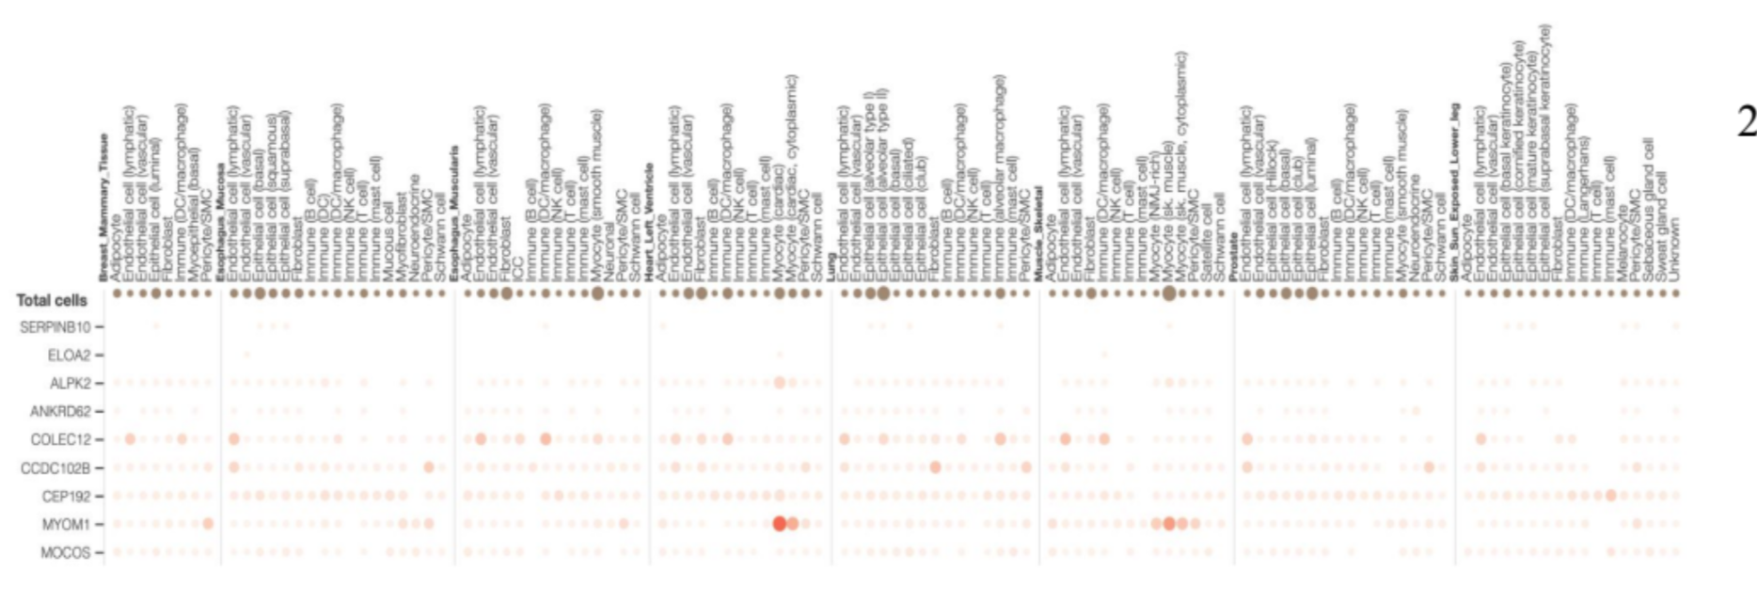
2022 group 6 (chr 18)
Summary Figure:
Top 10 Prioritized Genes
ALPK2
CEP192
SERPINB10
ANKRD62
MOCOS
SLC35G4
COLEC12
ELOA2
TUBB8B
CCDC102B
Summary:
Prioritization approach: nonsynonymous exonic mutational burden
Downstream analysis: gene expression analysis (single cell analysis)
Findings:
Gene expression profiles suggest that differentially expressed genes may associate with tissue-specific functions
Most genes are associated with polymorphisms and are part of disease-proliferation pathways and mechanisms.

Slide 40
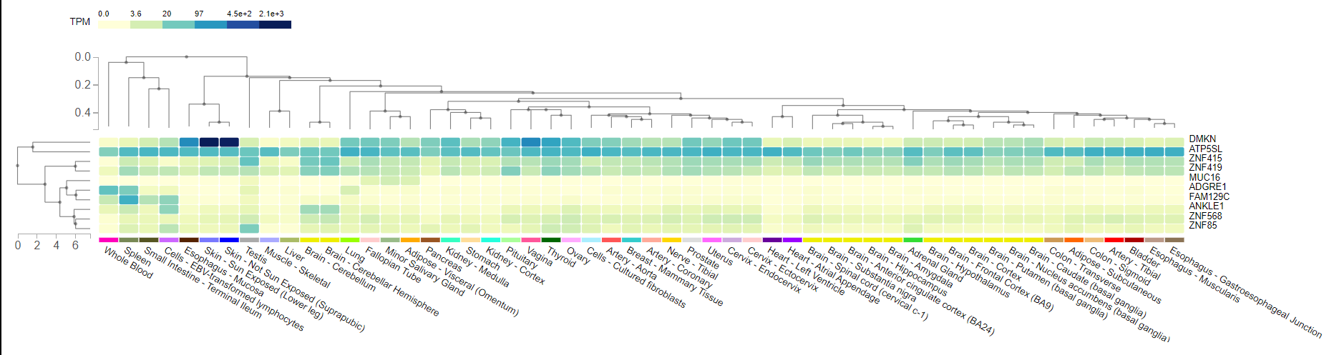
2023 group 1 (chr 19)
Summary Figure:
Top 10 Prioritized Genes
MUC16
ZNF85
ANF568
DMKN
ZNF419
ANKLE1
ZNF415
FAM129C
EMR1
ATP5SL
Summary:
Prioritization approach: mutational burden, count number of high/moderate impact mutations on each gene
Downstream analysis: gene expression analysis
Findings:
MUC16 has 71 moderate impact mutations
MUC16 high expression in the Visceral adipose, cervix, salivary gland
ZNF419 has 7 high impact mutations, most of any other genes
ZNF419, ZNF569, and ZNF415 predict enabling DNA-Binding transcription factor activity

Slide 41
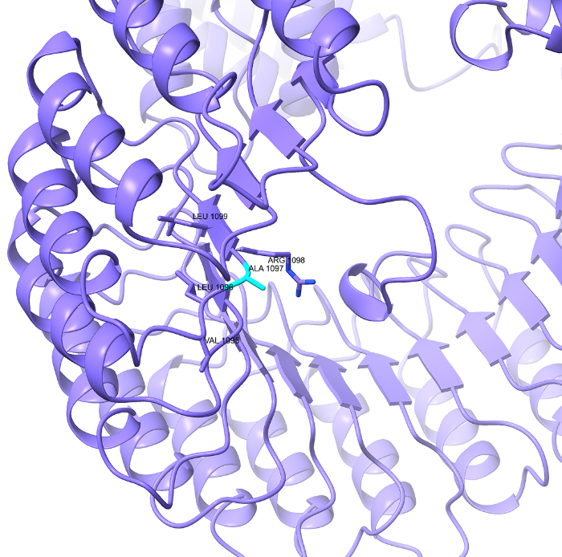

2023 group 4 (chr 19)
Summary Figure:
Top 10 Prioritized Genes
Perilipin-4
ZNF225
CYP2A7
ANKRD62
ZNF568
CYP2A7
MUC16
ZNF568
J3KP41
P06213
Summary:
Prioritization approach: mutational burden
Downstream analysis: protein structure analysis
Findings: none

Slide 42


2023 group 2 (chr 19)
Summary Figure:
WT
MUT
Top 10 Prioritized Genes
CACNA1A
VSTM2B-DT
ZNF675
INSR
ZNF536
LINC02987
MUC16
GNG7
ENSG00000269110
KDM4B
Summary:
Prioritization approach: mutational burden
Downstream analysis: structure prediction of wildtype and mutant ZNF675 protein
Findings:
Valine to alanine substitution (V197A) on exon 4 of ZNF675 causes a notable change in the protein structure
ZNF675 is co-expressed with other zinc finger proteins that maybe involved in transcriptional regulation via the NFkB pathway.
Low specificity of ZNF675 protein in tissue makes it difficult to characterize its physiologic role.

Slide 43



2023 group 3
(chr 19)
Summary Figure:
Top 10 Prioritized Genes
CD3EAP
XRCC1
OR7G2
OR10H5
LILRB4
KIR2DL3
KIR2DL1
KIR3DL2
ZFP28
GP6
CD3EAP
XRCC1
OR7G2
Summary:
Prioritization approach: exonic mutational burden
Downstream analysis: protein structure analysis
Findings:
Resistance to Cisplatin-based cancer treatment
Dysregulation of certain immune cell subtypes ability to distinguish host and tumor cells
Dysregulation of collagen-based platelet adhesion
Notes:
One Slide Summary (Wenya or Burhan)

Slide 44



2023 group 5 (chr20)
Summary Figure:
Gene: MTG2
Mutation:P267L
Top 10 Prioritized Genes
CTSZ
MTG2
SLC52A3
PROKR2
HELZ2
LAMA5
TMC2
JPH2
KIAA1755
PTPRT
Summary:
Prioritization approach: exonic SNP number
Downstream analysis: (1) Pymol visualization and global lDDT; (2) Local lDDT and AlphaFold2 sequence coverage analysis
Findings:
Benign mutation P267L on MTG2 alters the secondary structure from loop to α-helix
All 9 SNPs we studied are benign
Loop regions tend to have low sequence coverage and local lDDT
44

Slide 45


2023 group 6 (chr 20)
Summary Figure:
Arg3079
Trp3079
LAMA5
R3079W
Top 10 Prioritized Genes
LAMA5
HELZ2
JPH2
PTPRT
CDH4
DNAJC5
RAB22A
EU95_1860
5LC52A3
SIGLEC2
Summary:
Prioritization approach: exonic mutational burden
Downstream analysis: protein structure analysis
Findings:
No disease-associated variants identified
No variants caused significant changes in protein structures
Most genes with the highest mutational burden regulate cell structure and integrity
Mutations in proteins were non-deleterious since they occurred in loops or did not disrupt important interfaces.
Notes:
Prioritization:
Protein Summary Results:
Hi all, this is group 2 and we were assigned chromosome 20. We prioritized Dr. Zimmer’s genes based on exonic mutational burden, meaning that we prioritized genes that had the most mutations in all of their exons combined. We first prioritized genes based on number of mutations from the transcription start site and end site, but given our goal of visualizing how mutations affect protein structure, we then refined our selection based on nonsynonymous exonic mutational burden. This resulted in a set of 10 genes, which you see on the slide. The proteins that these genes code for have a diverse set of functions.
The proteins we investigated spanned laminin, sialoadhesin, and cadherin proteins responsible for cell attachment, enzymes such as helicase, transacylases, and phosphatases, structural proteins such as junctophilin needed for excitation coupling and cardiomyocytes, and chaperone proteins. Ultimately we found that there were no significant changes or deleterious mutations as many of the mutations were in loop regions and were permissive to the overall protein structure. Even among genes with high mutational burden with the two highest number of exonic mutations being 30 and 26, these mutations were either synonymous or missense mutations in non-disruptive, loop regions of the protein. Many of the missense mutations were natural variants and none were associated with disease – even if the mutation was to an amino acid with highly different biochemical properties. Overall, we did not find medically devastating changes in chromosome 20. Thank you for listening.

Slide 46

2023 group 7 (chr 20)
Summary Figure:
Top 10 Prioritized Genes
TAF4
FERMT1
MROH8
BPIFB4
KIAA1755
MYH7B
SIRPG
HELZ2
SIGLEC1
LAMA5
Summary:
Prioritization approach: exonic mutational burden
Downstream analysis: tissue gene expression analysis
Findings:
BPIFB4 is associated with longevity and decreased heart disease
SIGLEC1 is an immune marker with high lung expression. Low expression is correlated with severe COVID-19 disease

Slide 47


2023 group 8 (chr 20)
Summary figure:
Top 10 Prioritized Genes
MACROD2
CDH4
PTPRT
PLCB1
SLC24A3
PAK5
CFAP61
EYA2
TSHZ2
SLX4IP
Summary:
Prioritization approach: exonic and intronic mutational burden
Downstream analysis: gene expression at bulk and single-cell levels
Findings:
We observed little correlation in bulk or single-cell data between mutational burden and specificity of expression by tissue
scRNA-seq gives more detailed picture of how cells in a given tissue express mutationally burdened genes
Further work is required to uncover functional significance of mutations we observed and how it relates to tissue expression

Slide 48



2023 group 9
(chr 21)
Summary Figure:
IFNAR2
TPTE
UMODL1
Top 10 Prioritized Genes
UMODL1
PCNT
TPTE
SON
LSS
LIPI
IFNAR2
WDR4
N6AMT1
COL6A2
Phenylalanine → Serine
Leucine → Proline
Threonine → Methionine
Summary:
Prioritization approach: mutational burden
Downstream analysis: Compare the variant in Carl’s genome with those in genomAD and 1000 genome databases
Findings:
Structure of mutation found using AlphaFold
Studies on mutations found using UNIPROT (most mutations did not have significant effect)
Notes:
To investigate Carl’s gene mutations, first we used ANNOVAR to annotate genetic variants, which we ranked by the number of AA changes caused by variants. We chose the top 10 and conducted a literature review for these on UNIPROT, a database of protein sequence and functional information. In this presentation, we synthesized the interesting findings, for the genes that were well-studied and led to phenotypic effect, and located the site of structural change using AlphaFold.

Slide 49

2023 group 10
(chr 21)
Summary Figure:
Top 10 Prioritized Genes
1. UMODL1
2. KRTAP12-2
3. KRTAP10-10
4. PCNT
5. KRTAP10-7
6. LCA5L
7. COL18A1
8. IFNAR2
9. KRTAP10-1
10. KRTAP10-3
Summary:
1. Prioritization approach: Non-synonymous mutations
2. Downstream analysis: Gene expression analysis
3. Findings:
Gene expression levels in tissues seem to be highly correlated with function
Protein-coding mutations in UMODL1 have been associated with various conditions like myopia or effects on hormones
PCNT has shown to be a positive association betwee non-synonymous mutations in mood disorders.
Notes:
To investigate Carl’s gene mutations, first we used ANNOVAR to annotate genetic variants, which we ranked by the number of AA changes caused by variants. We chose the top 10 and conducted a literature review for these on UNIPROT, a database of protein sequence and functional information. In this presentation, we synthesized the interesting findings, for the genes that were well-studied and led to phenotypic effect, and located the site of structural change using AlphaFold.

Slide 50



2023 group 11
(chr 21)
Summary Figure:
Top 10 Prioritized Genes
IFNAR2
IL10RB
CBR3
BACH1
KRTAP 10-1
KRTAP 10-11
TPTE
ADAMTS
KRTAP 13-2
KRTAP 10-6
Summary:
1. Prioritization Approach: Identifying protein-encoding genes with highest mutational burden on chromosome 21 of Carl Zimmer
2. Downstream Analysis: Protein Structural Analysis on Genes with High Mutational Burden and show clinical significance with PyMol
3. Findings
Three clinically significant mutations were observed on chromosome 21 of Carl Zimmer
Mutation(s) of IFNAR2 and IL10RB is expected to increase susceptibility to viruses
Mutation of CBR3 is expected to pose no functional consequence
Notes:
To investigate Carl’s gene mutations, first we used ANNOVAR to annotate genetic variants, which we ranked by the number of AA changes caused by variants. We chose the top 10 and conducted a literature review for these on UNIPROT, a database of protein sequence and functional information. In this presentation, we synthesized the interesting findings, for the genes that were well-studied and led to phenotypic effect, and located the site of structural change using AlphaFold.

Slide 51



2023 group 12 (chr 21)
Summary Figures:
Top 10 Prioritized Genes
DSCAM
RUNX1
NCAM2
KCNJ6
TSPEAR
GRIK1
ERG
APP
CHODL
BACH1
Summary:
Prioritization approach: protein coding genes with highest mutational burden
Downstream analysis: protein structure (rSASA) analysis with NetSurfP
Findings:
APP causes protein aggregates that are well-linked to Alzheimer’s: found no protein coding variants GRIK1 L902S has a correlation with ADHD
it is a cationic channel in the Cerebellum and hypothalamus; binds to excitatory neurotransmitter L-glutamate
Notes:
encoding amyloid beta precursor protein

Slide 52


Slide 53


Slide 54


Slide 55


Slide 56


Slide 57


Slide 58


Slide 59


Slide 60


Slide 61


Slide 62


Slide 63


Slide 64


Slide 65


Slide 66


Slide 67


Slide 68

2026 group 4 (chr Y)
Summary Figure:
Top 10 Prioritized Genes
PCDH11Y
USP9Y
UTY
NLGN4Y
DDX3X
KDM5D
ZFY
TBL1Y
EIF1AY
RPS4Y1
Summary:
Prioritization approach: curated mutational burden method
Downstream analysis: Protein structure visualization
Findings:
Most variants associated with genes on chrY were in the introns
Only 4 genes had exonic variants, only 2 of 4 had missense variants
Missense variants lied in the disordered regions and are unlikely to affect overall function and structure of the protein

Slide 69




Slide 70


Slide 71


Slide 72


