Slide 1
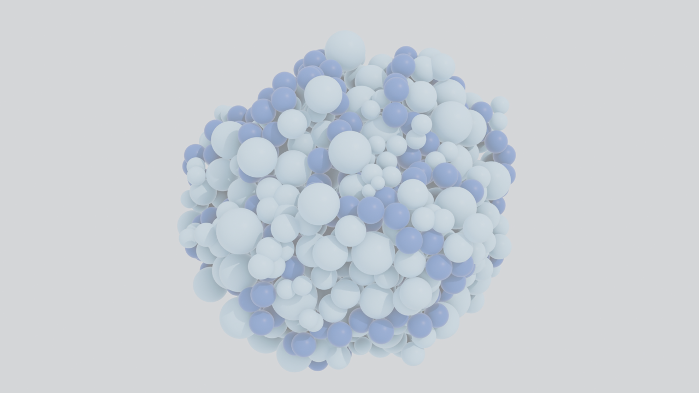
Proteins as Coarse-Grained Polymers
Jake Sumner 10/10/25
O’Hern Group

Slide 2
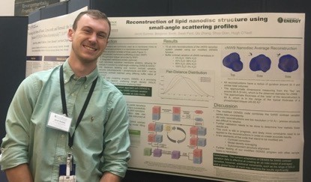
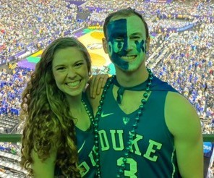
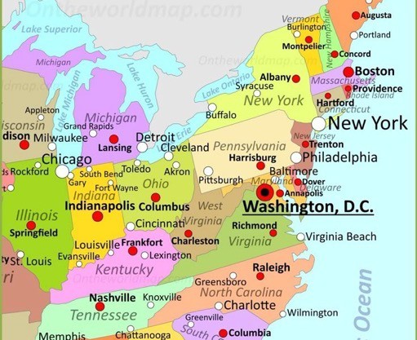
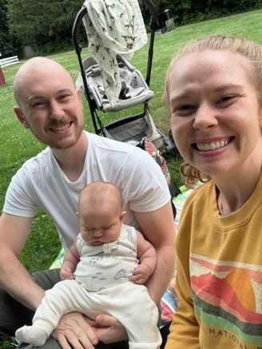
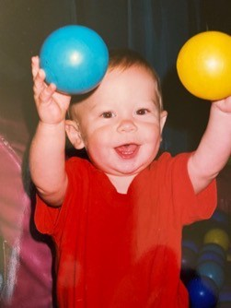
Where am I from?

Slide 3
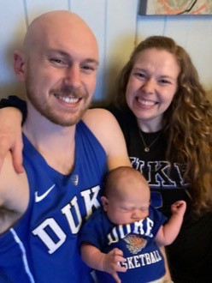

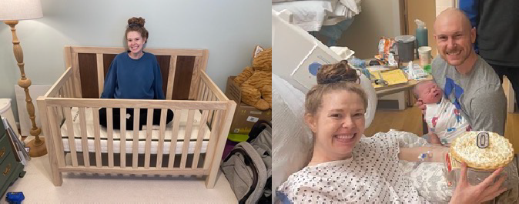





Baby Thomas

Slide 4
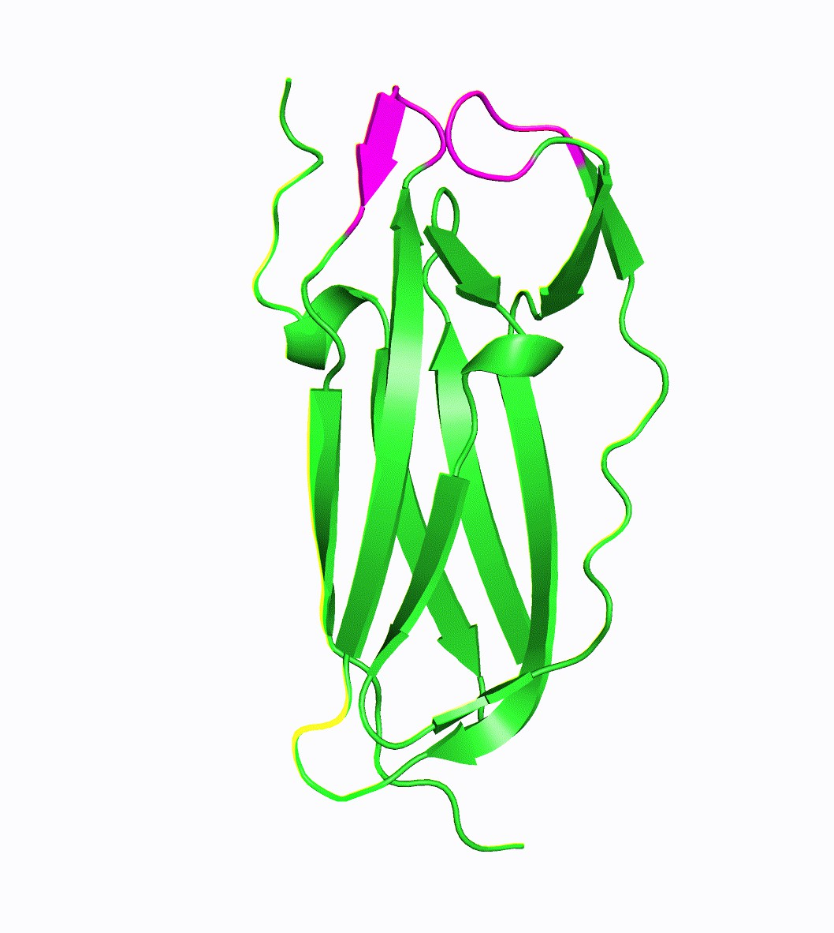
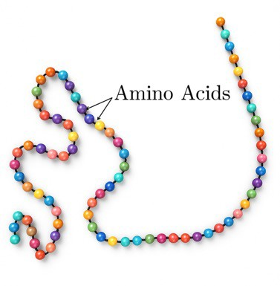
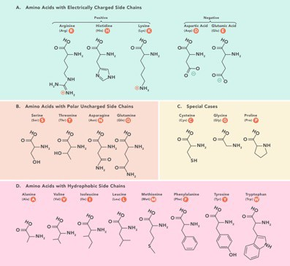
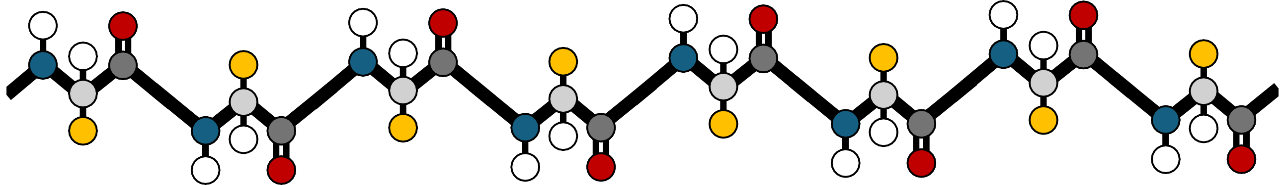
What defines a protein?
Size? Shape?
Arrangement?
H
O
H
O
H
O
H
O
H
H
N
H
C
R
N
H
C
R
N
C
R
N
C
R
C↵
C↵
C↵
C
C↵
C↵
C↵
C↵
↵
R
N
C
R
N
C
R
N
H
C
R
N
H
C
H
H
H
O
H
O
H
O
H
O

Slide 5
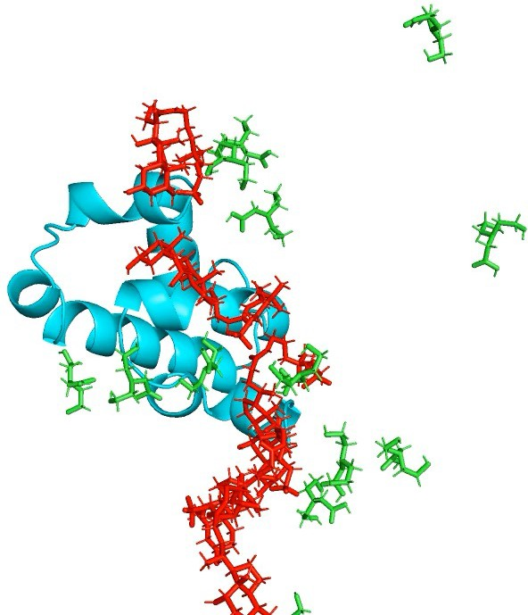
How do we study protein dynamics computationally?
Molecular dynamics simulations allow us to study protein dynamics with high resolution
Atomic-level resolution
Simulations can run for ns-ms
We can also study protein
interactions with other molecules
WW domain fragment (cyan) interacting with CHAPS (red) and bicine (green) – 500ns run

Slide 6
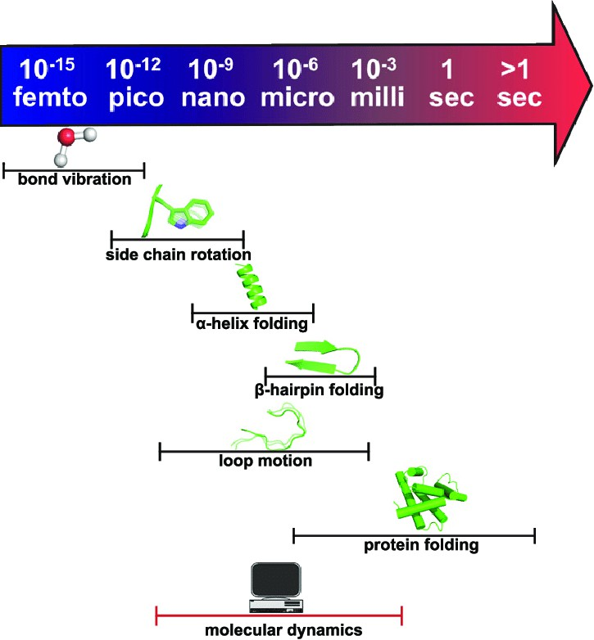
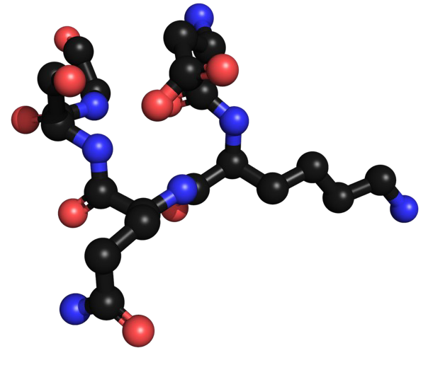
Molecular dynamics simulations aren’t perfect
Bonded interaction terms
Bond stretching
Angle bending
Dihedral torsions
Improper dihedrals
Backbone torsion coupling terms
Cross-term torsion-torsion corrections
Out-of-plane bending terms
Solvent and polarization corrections
Generalized Born implicit solvent
Surface area solvation energy
Polarization corrections
Induced dipole interactions
Non-bonded interaction terms
Lennard-Jones van der Waals
Electrostatic Coulomb
1-4 Lennard-Jones scaling interactions
1-4 electrostatic scaling interactions
Hydrogen bond/Directional corrections
Explicit hydrogen bond potentials
Orientation-dependent hydrogen bonds
Inaccessible to MD!
Werner et al., Adv. Drug Delivery Rev. (2011)

Slide 7
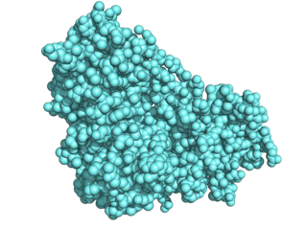
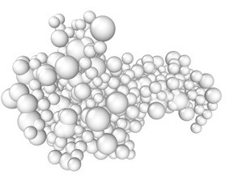
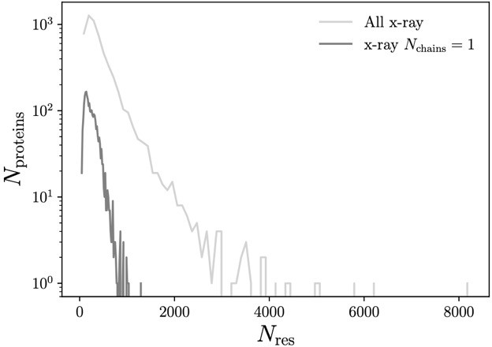
Our approach: study protein folding with coarse-
grained polymer models
Our dataset:
2531 high resolution, monomeric x-ray crystal structures from PISCES
All atom - 2GGP Coarse-grained
Coarse-grained models are:
Faster to simulate
As complex as we choose

Slide 8










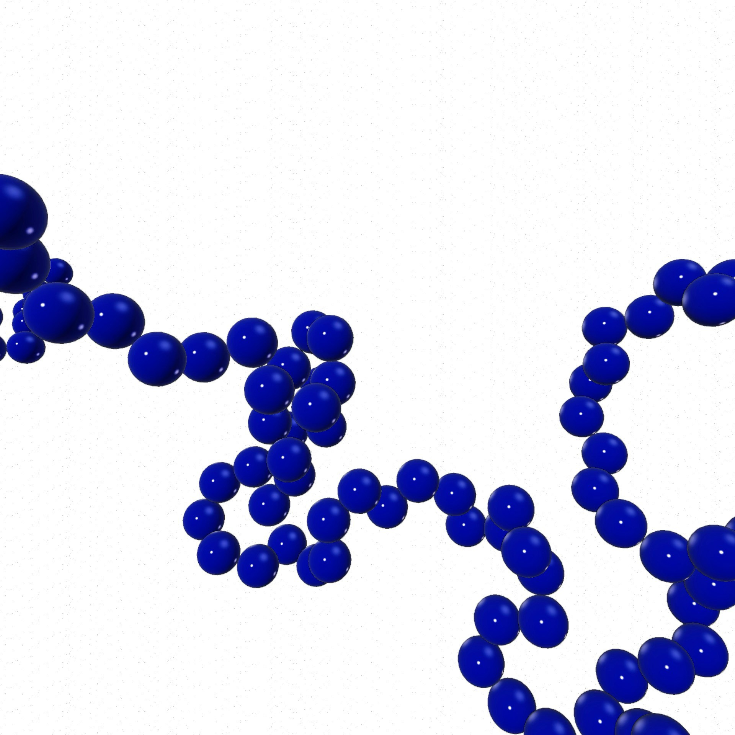
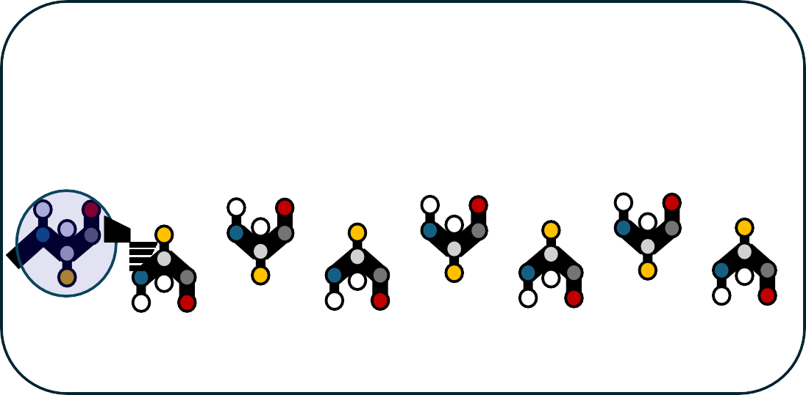
Simulation Protocol
Basic potentials of the model
H_{H} O_{O}
H_{H}
O_{O}
H_{H}
N_{N}
O_{O}
C_{C}
H_{H} O_{O}
N_{N} ^{HH} C_{C}
^{CC↵}↵
RR
H_{H}
R_{R}
^{CC}↵↵
N
H_{H}
^{CC}↵↵
C
R
H_{H}
^{CC}↵↵
RR
R_{R}
R_{R}
^{CC}↵↵
NN _{HH} CC
HH OO
N_{N} C_{C}
N
C
R
^{CC}↵↵
NN _{HH} CC
CC↵
CC
↵
↵↵
RR
NN
HH
CC
RR
NN _{HH} CC
HH OO
H^{H}
O^{O}
HH OO
Damped MD with central force.
NVE Simulation to randomize starting configuration
H O
H
O
H
O
H
H
O
H
R
N
H
C
R
N
H
C
R
N
C
R
N C
C↵
C↵
C
C↵
C↵
C↵
C↵
R
N
C↵
C
R
N
↵
C
R
N
C
R
N
H
C
H
H
H
H
O
H
O
H
O
H
O

Slide 9
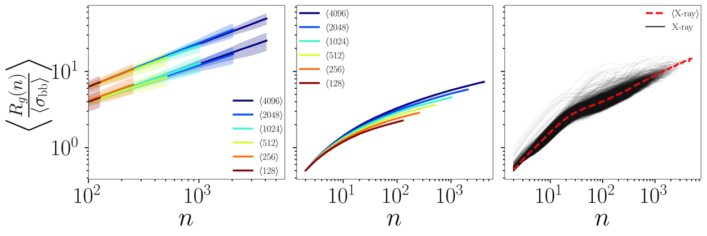
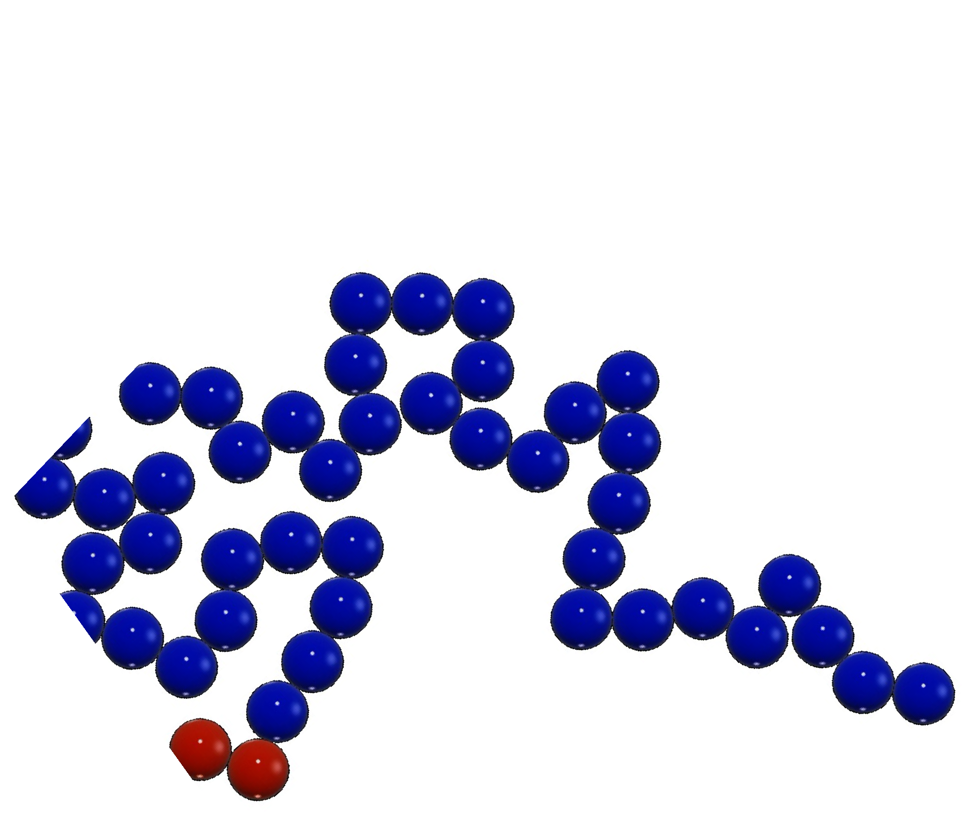

Subpolymer radius of gyration is unique for proteins
R_{g} (n) / n⌫
R_{g} (n) 6/ n⌫ R_{g} (n) 6/ n⌫
Collapsed
Random Walk
Protein
Crystal Structures
Random Walks
Computing R_{g} (n)
"
#1/2
j
j
X
k=i
1
X
1
subpolymer
size n = 5
R (i, j) =
(~r_{k} - h~r_{k} i)²
, h~r i =
~r
g
j - i +1
k
j - i +1
k
k=i

Slide 10
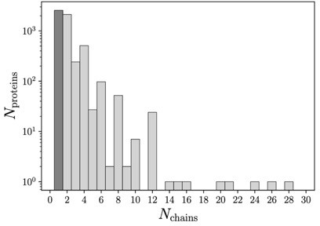
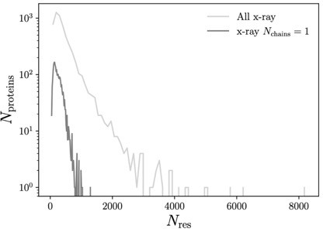
Our dataset
2531 x-ray crystal structures from the Dunbrack 1.8 dataset
We filtered the dataset from its original >5000 structures to the final 2531
Only single chain proteins
Proteins with multiple chains could be confounding in this study
Protein-protein interactions cause solvent occluded areas, which we don’t want to consider here.
𝑅! 𝑛 calculation doesn’t work

Slide 11
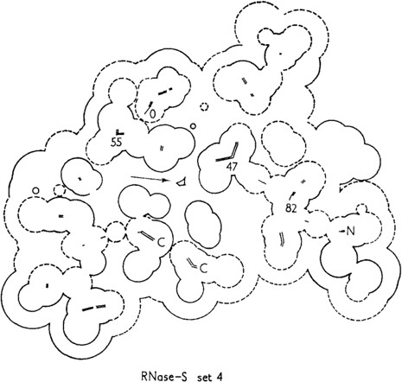






relative Solvent Accessible Surface Area (rSASA)
SASA_{res}
SASAtotal
SASA_{res}
rSASA =
SASAtotal
Richards, Ann Rev Biophys Bioeng (1977)

Slide 12
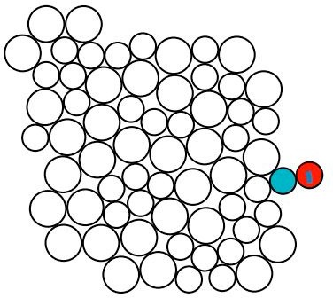
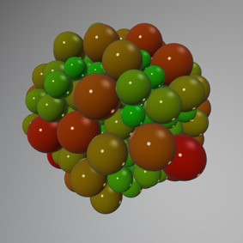
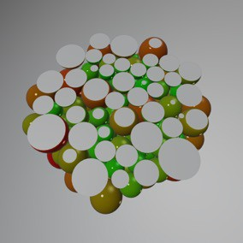
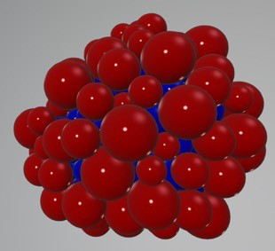
rSASA and identifying surface particles
Dr. A. Grigas
For proteins, the probe diameter is typically the size of a water molecule

Slide 13
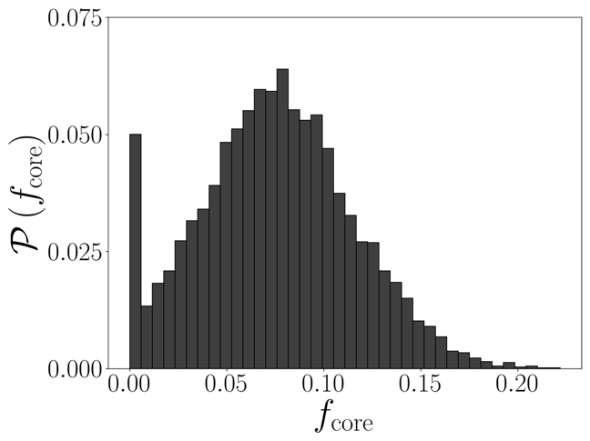
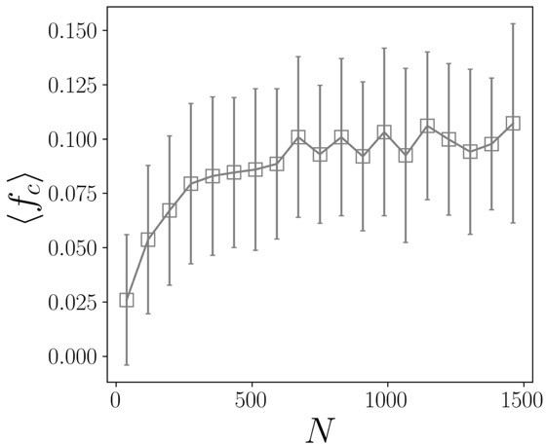
Fraction of amino acids in the core
Ncore
f =
c
N
How can we determine if an amino acid is in the core?

Slide 14
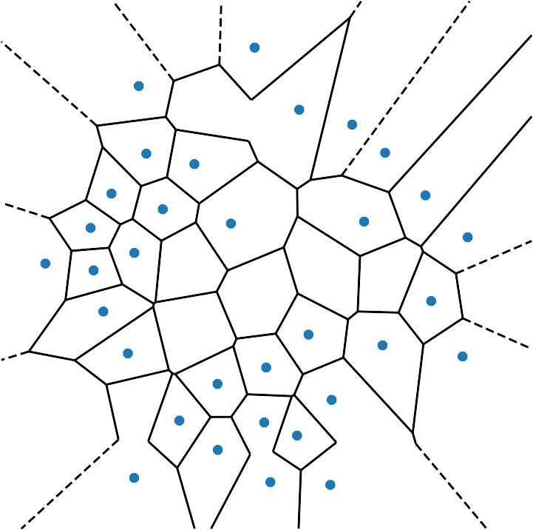
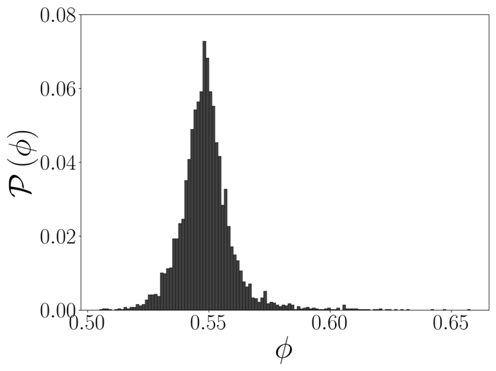
Core packing fraction
Surface
X-Ray Crystal Structures
Vcore amino acids
cp =
Vcore cells
Logan J, Sumner J, et al. In Press at PRE (2025)

Slide 15



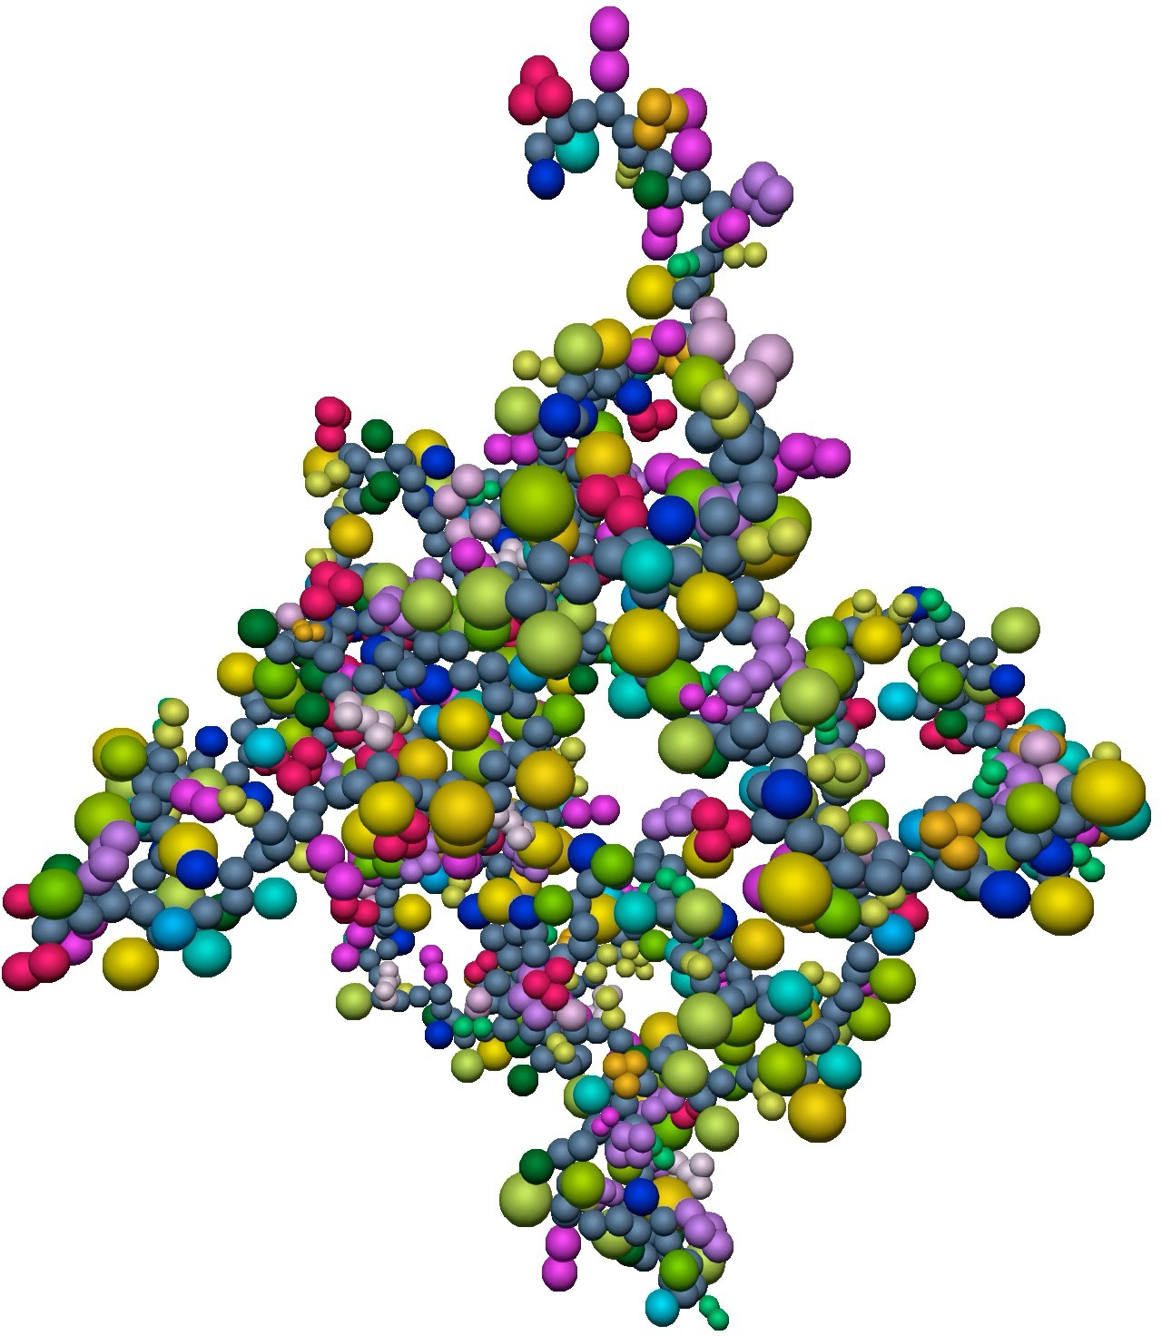
Simulation Protocol
Build coarse-grained (CG) model
using the same length (and
sometimes sequence identity) as
the x-ray crystal structure
Run CG model through NVE
simulation, purely repulsive
simulation for 10 million steps with
random starting velocities to
randomize the starting state
After NVE is done, impose a radial
force towards the center of
geometry of the polymer so the
polymer collapses
Non-bonded interactions are
always purely repulsive.

Slide 16
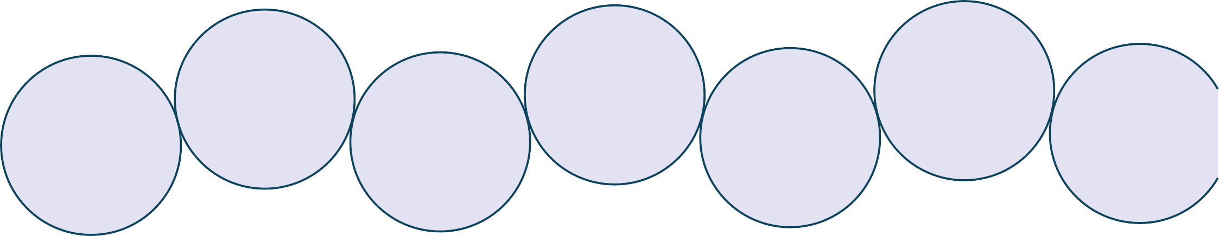
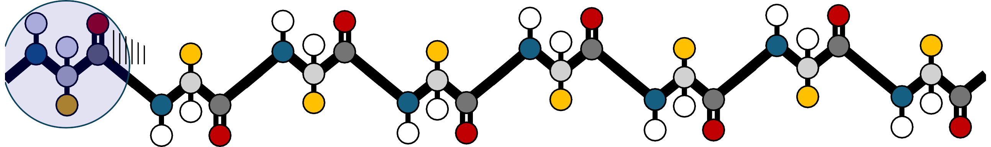
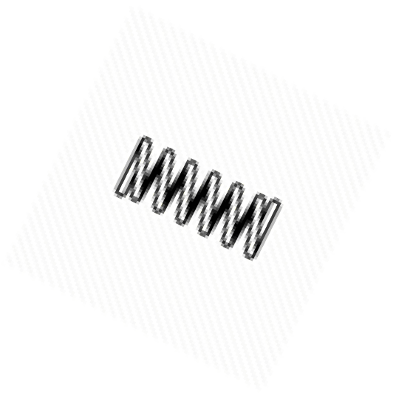

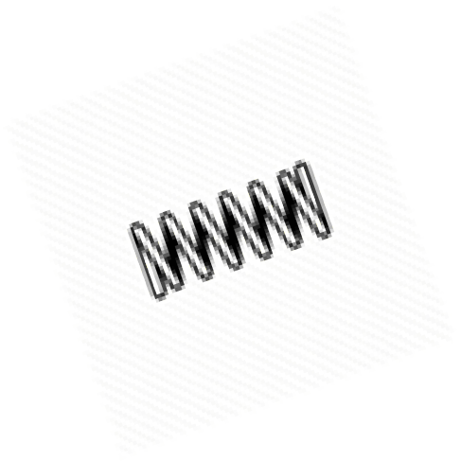





Simplest Coarse-grained protein model
Collapsed random walk (CRW)
H
O
H
_{O} H O
^{H} _{C R} N ^{H} C R
C
C_{↵ C↵} ↵ _{C↵}
R N _{H} C ^{R N} _{H} H O ^{H}
H
O
H
N
H
C
R
N
C
R
N
C↵
C↵
C↵
C↵
R
N
C
C
R
N
H
C
H
H
O
O
H
O
Logan J, Sumner J, et al. In Press at PRE (2025)

Slide 17
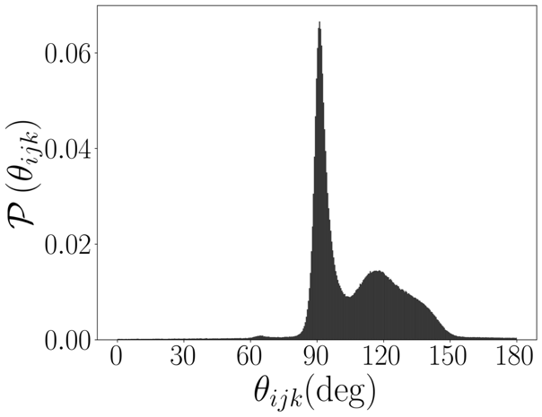
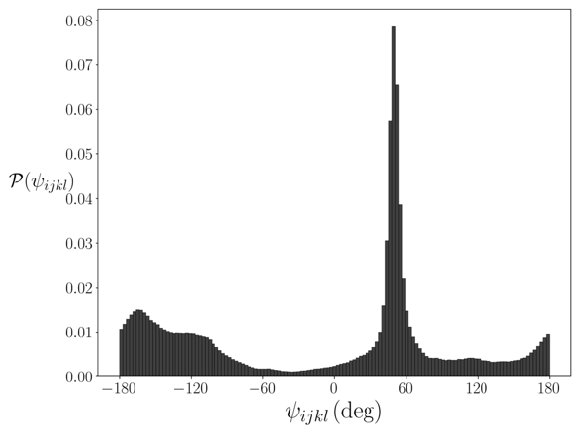
Fixing the bond and dihedral angles
Bond Angle Distribution
Protein Crystal Structures
Logan J, Sumner J, et al. In Press at PRE (2025)

Slide 18
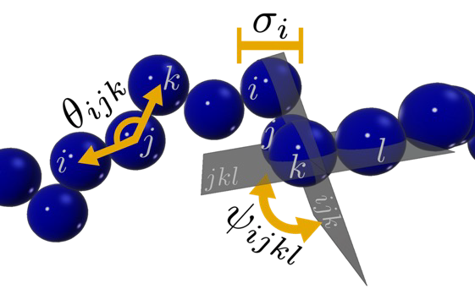
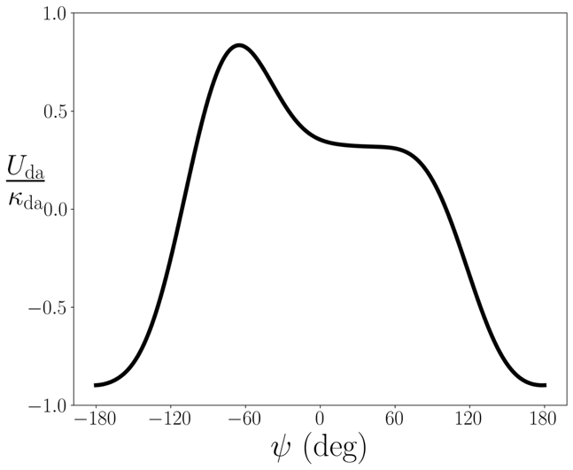

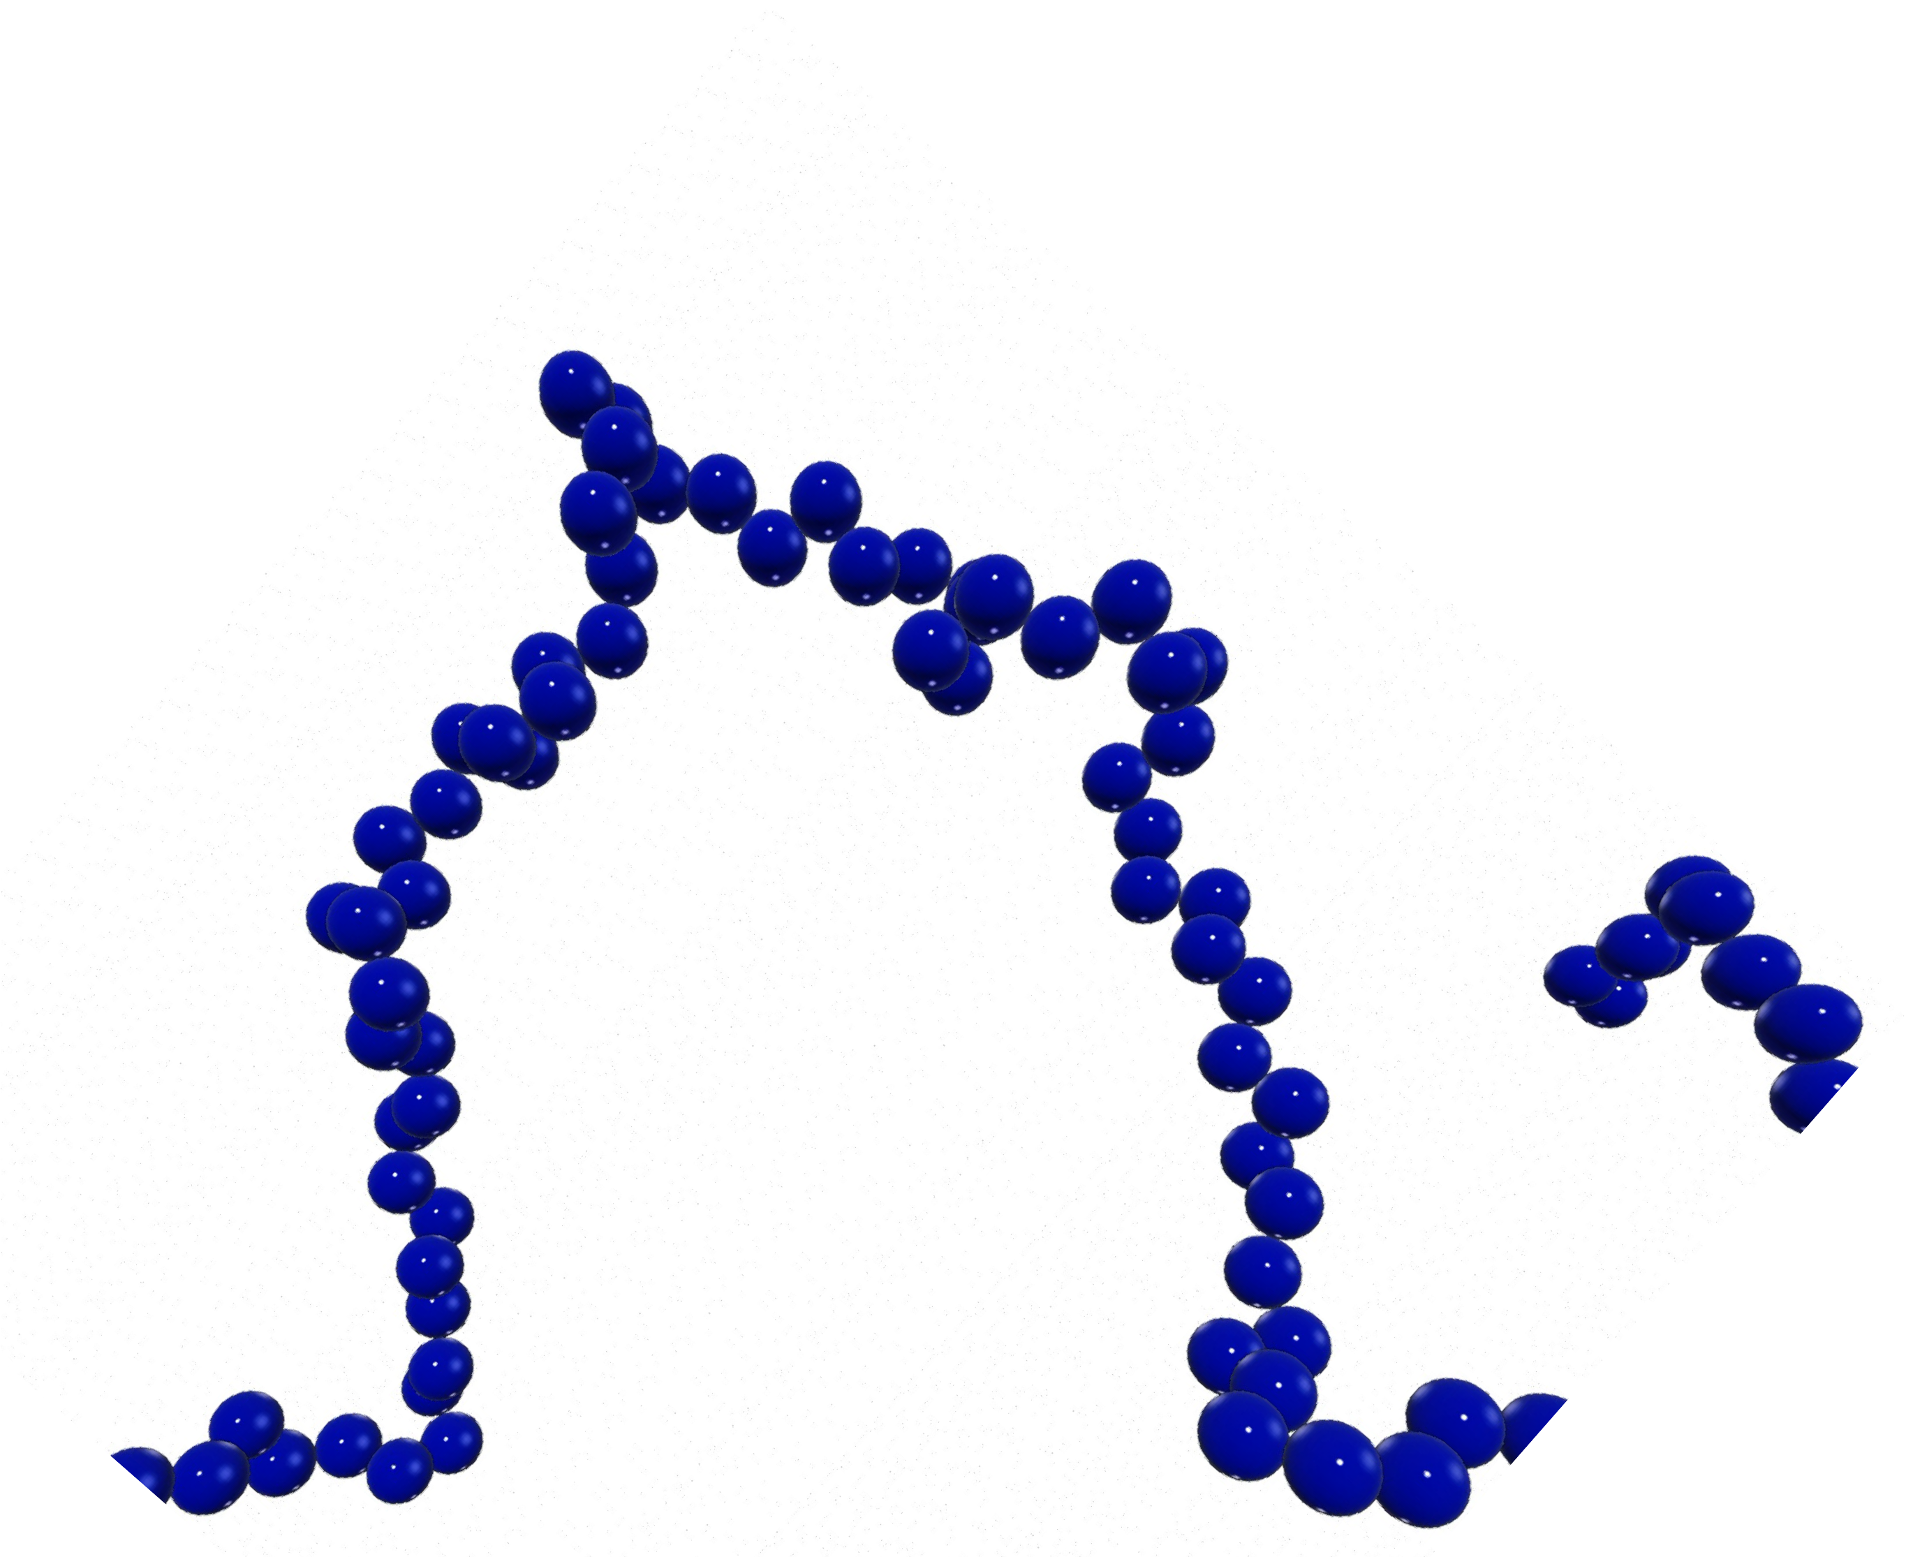



Bond Angle Dihedral Angle (BADA) Model
Dihedral Potential Energy
4
X X
hijkli s=1
⇥
⇤
Uda( ijkl) = da
A cos (s )+ B sin (s )
s
ijkl
s
ijkl
Logan J, Sumner J, et al. In Press at PRE (2025)

Slide 19
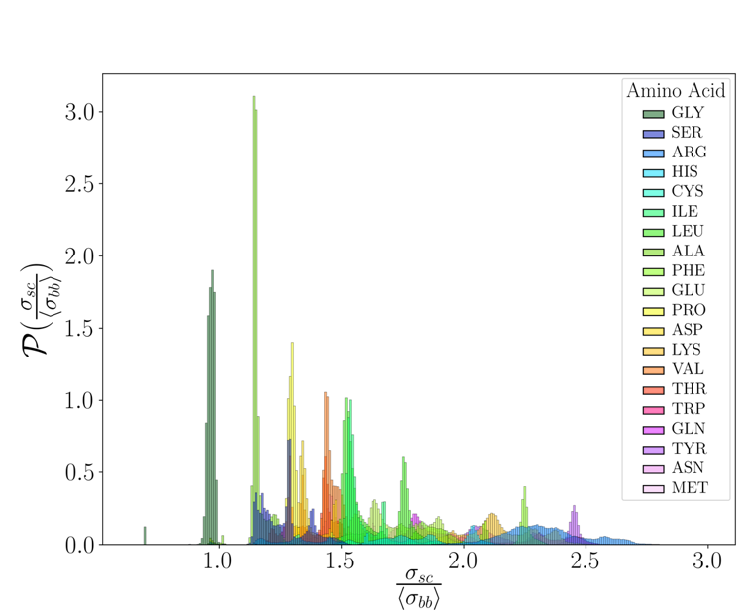

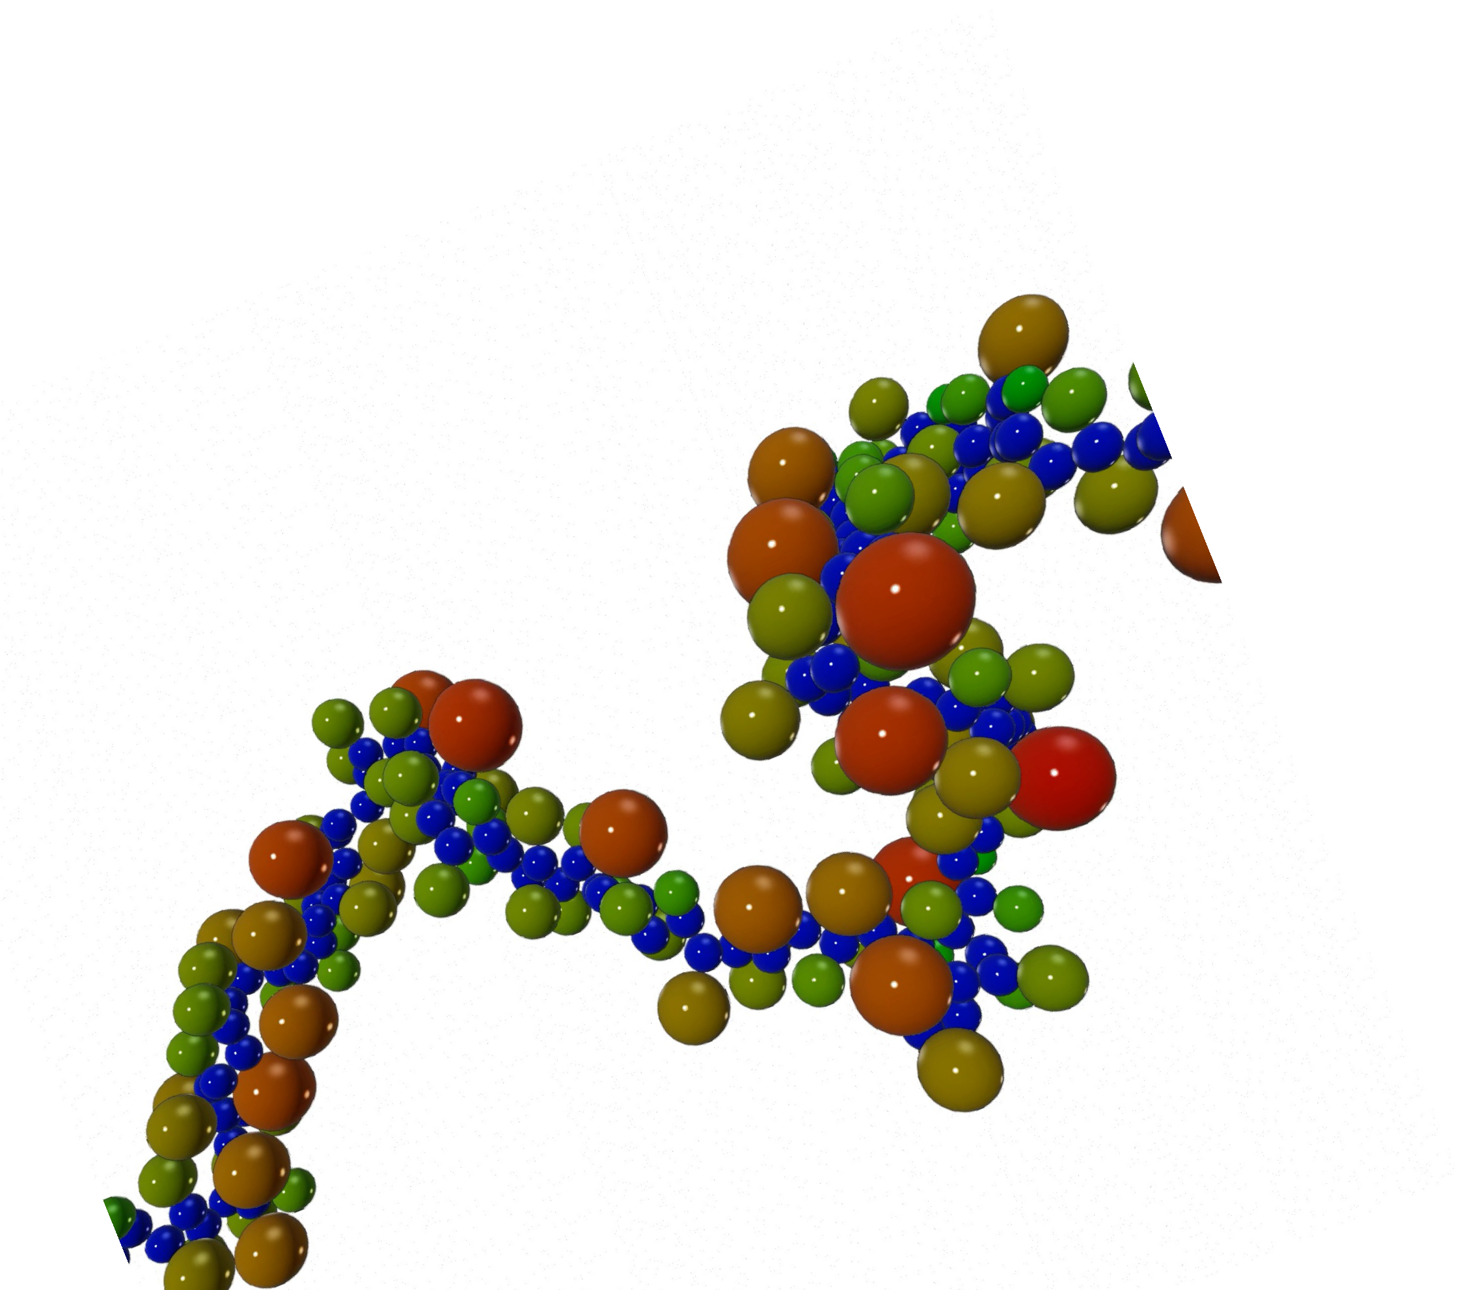


Freely-Jointed Side Chain (FJSC) and InSeq models
Particle geometry has a large impact on the folding of a polymer.
The simplest way to include anisotropy and begin to account for amino acid conformations.
When these are ”in-sequence”, we refer to it as the “InSeq” model
Logan J, Sumner J, et al. In Press at PRE (2025)

Slide 20
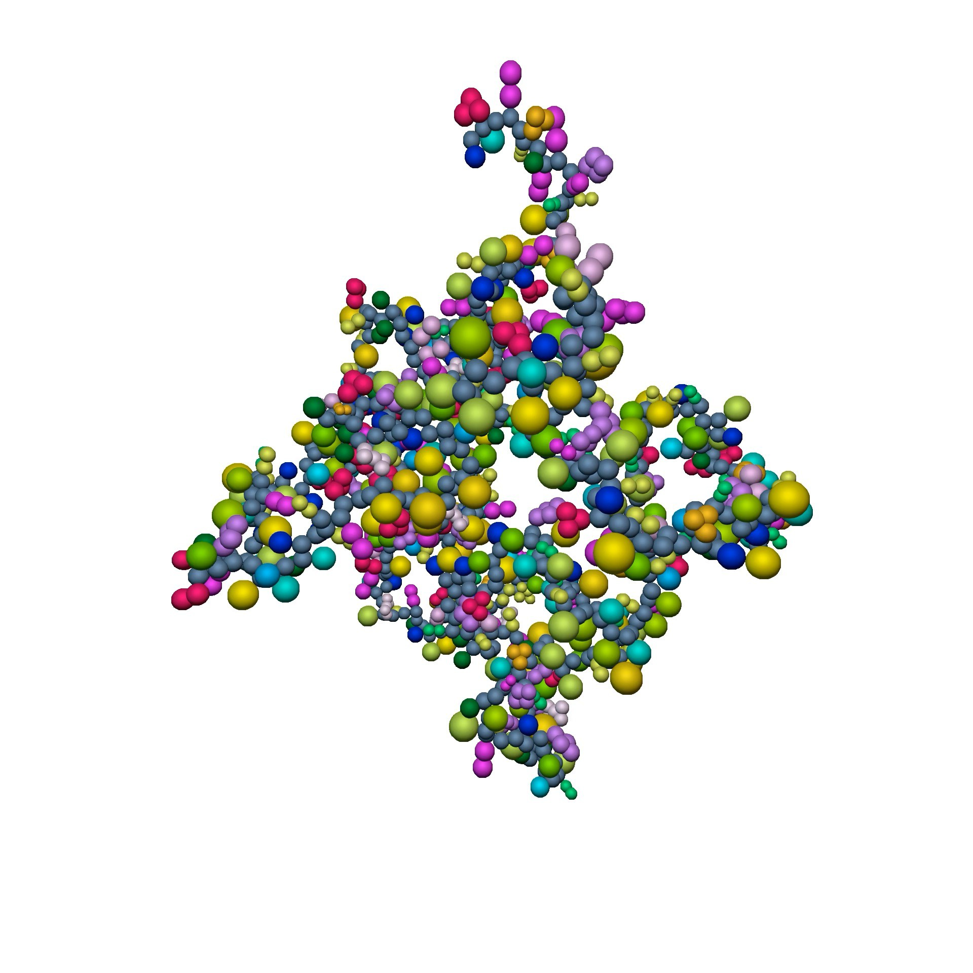
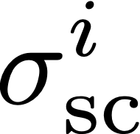
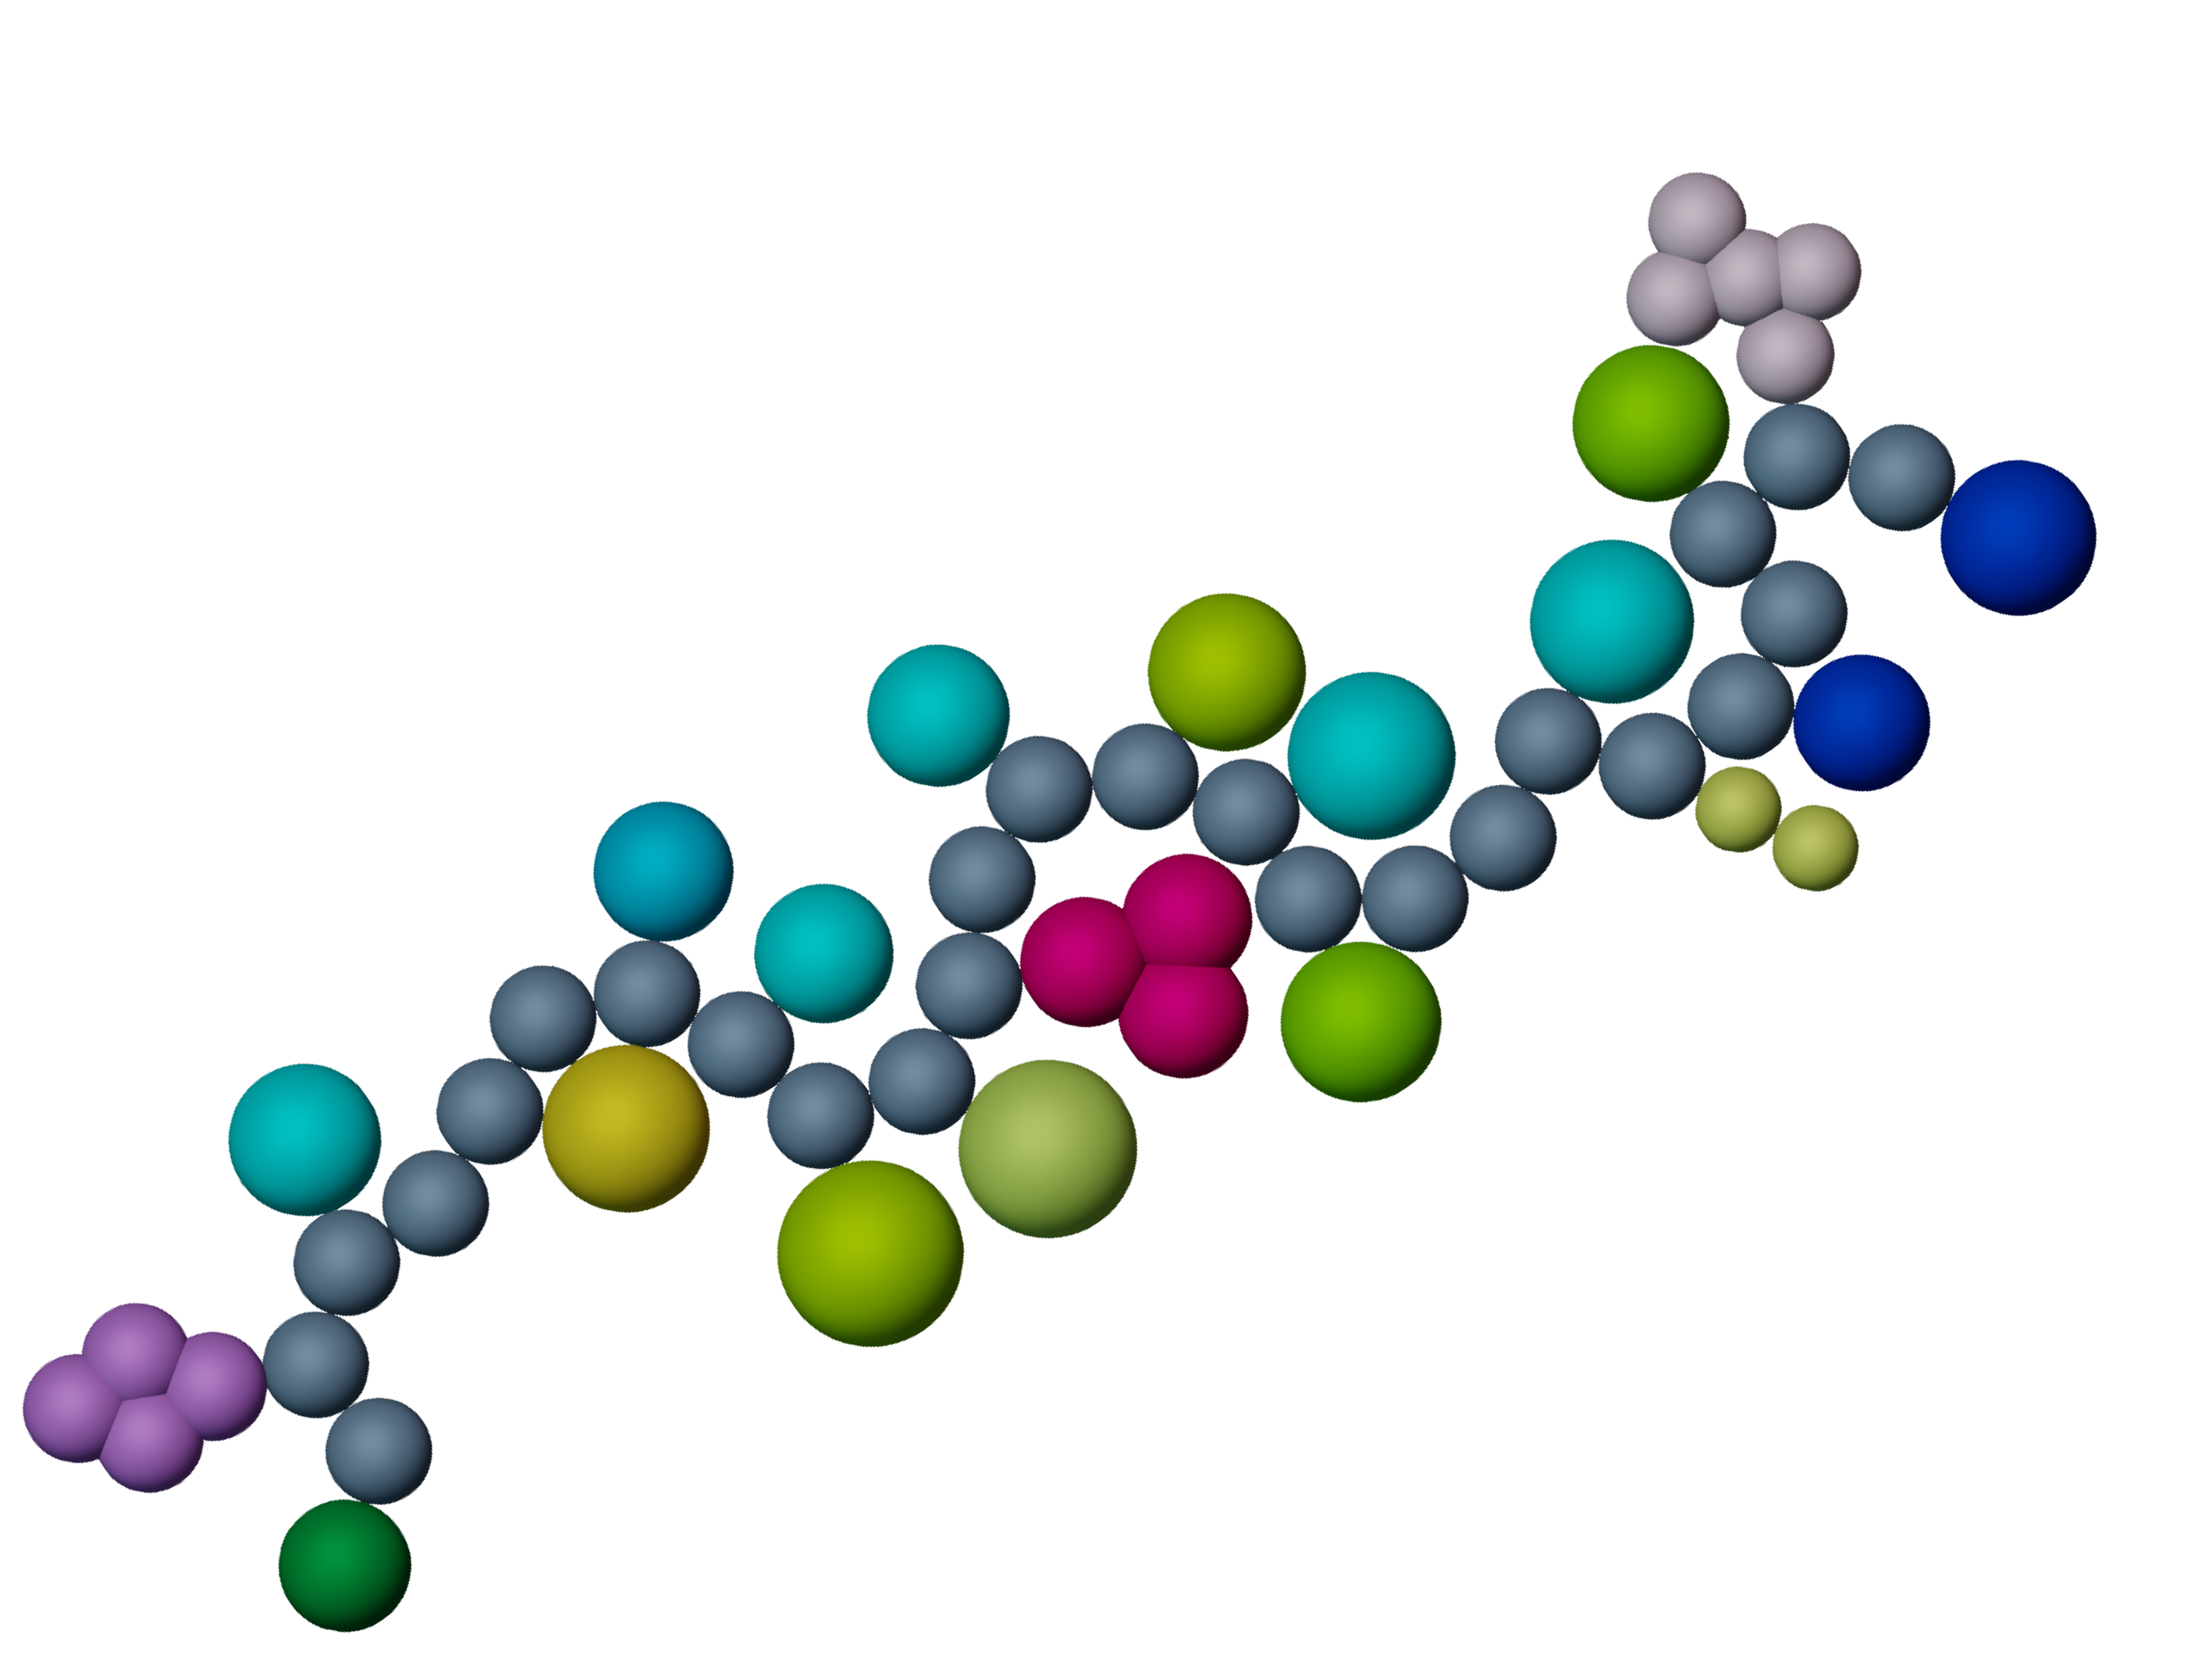
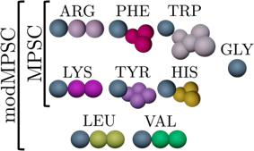

Multi-particle side chain (MPSC) model
Adds more side chain detail on top of the detail added in previous models, similar to the ”Martini” coarse-grained model (Souza et al. Nature Methods 2021)
Only changes detail of 7 or 9 amino acid side chains
The side chains are still freely jointed about
the backbone sphere
modMPSC is the modified model
Side chains that are modified as part of the model
Logan J, Sumner J, et al. In Press at PRE (2025)

Slide 21
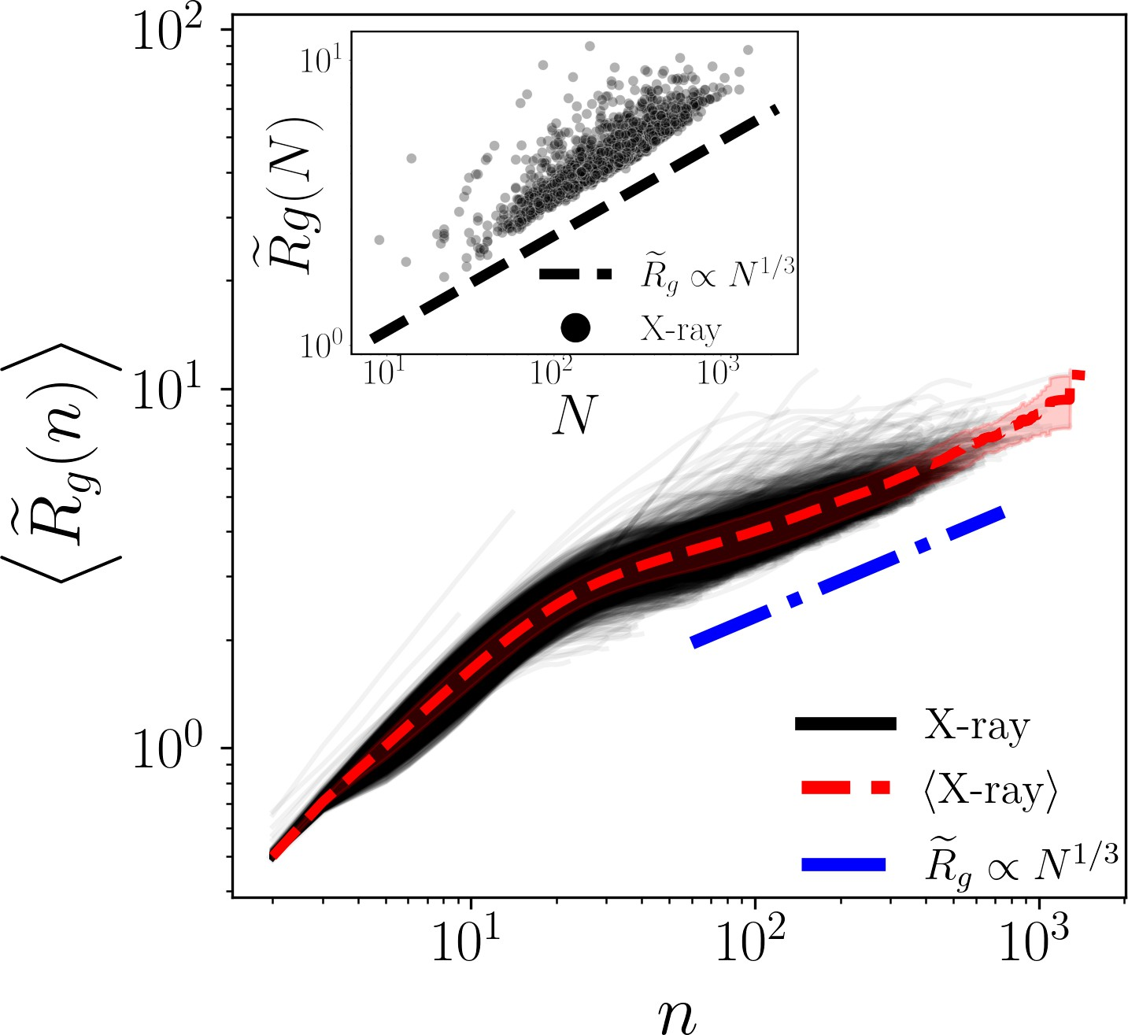
Reminder: Rg(n) of proteins
The Rg(n) trajectory of folded, globular proteins have characteristic scaling similar to that of a double power law.
We know that folded, globular proteins have this behavior, so we want our coarse-grained models to match this as best as we can.
Logan J, Sumner J, et al. In Press at PRE (2025)

Slide 22

Rg(n) of the coarse grained models
We find that Rg(n)
trajectories are only
10¹
matched well with the
addition of a side chain
representation (FJSC and above)
The modMPSC/MSPC
^{D}R^{f}_{g}(n)^{E}
models match the x-ray
structures very closely
CRW BADA FJSC
In Seq
MPSC
modMPSC X-ray
Only bond-angle, dihedral-
10⁰
angle, and side chain
representations are used
to restrain the molecule –
NOTHING ELSE!
10¹
10²
10³
n
Logan J, Sumner J, et al. In Press at PRE (2025)

Slide 23



Which models were had the closest Rg(n)?
0.25
10¹
0.20
(h i)
₂E
g
h g i
e
0.15
^{D}R^{f}_{g}(n)^{E}
MSE R
X-ray
e
CRW BADA FJSC
In Seq
MPSC
modMPSC X-ray
R
0.10
10⁰
D
0.05
10¹
n
10²
10³
0.00
CRW
BADA
FJSC
In Seq
MPSC
modMPSC
Logan J, Sumner J, et al. In Press at PRE (2025)

Slide 24

Fraction core visualization
Surface: Blue Core: Yellow

Slide 25





Fraction Core
5NW3
Core of 5NW3
Logan J, Sumner J, et al. Under review at PNAS (2025)

Slide 26


Packing fraction results
X-ray crystal structures
Surface
Vcore amino acids
cp =
Vcore cells
Logan J, Sumner J, et al. In Press at PRE (2025)

Slide 27


Improvements of the MPSC model
The average packing fraction of residues that we corrected (bold) improve when implementing the MPSC and the modMPSC models over the InSeq model
Logan J, Sumner J, et al. In Press at PRE (2025)

Slide 28

Structure factor also improves with model complexity
3.0
CRW BADA FJSC
In Seq
MPSC
modMPSC X-ray
2.5
2.0
1.5
1.0
0.5
hS(q)i
0.0
0.5
1.0
1.5
qæ_{bb}
2º
2.0
2.5
3.0
Logan J, Sumner J, et al. In Press at PRE (2025)

Slide 29
Conclusions and Future Directions
We were able to identify the minimal protein model that can recapitulate all 4 metrics: 𝑅! 𝑛 , 𝑆 𝑞 , 𝑓"#$% , and ⟨𝜙⟩
The modMPSC model can even accurately model the average packing fraction of each amino acid type
Moving forward, we will try to make this model fold in a more ”natural” way
Including weak attractive/repulsive interactions between side chains based on their charge
Create a potential based on the predicted rSASA of each amino acid in the sequence to see how well that folds the protein

Slide 30





Special thanks to these special people!

