Slide 1


Computational modeling of protein structure
Zhuoyi (Joey) Liu
O’Hern Lab
04/15/2026
Notes:
NIH

Slide 2
Outline
Protein folding and protein structure determination
  Protein folding
  Protein structure determination techniques
  Protein data bank
Protein structure prediction using Alphafold
  Multiple sequence alignment
  AlphaFold1
  AlphaFold2
  AlphaFold3
Important questions to be answered
  Protein structures in cell
  Protein design
  Protein mutations
Quantifying the effect of mutations on protein structures
  Dataset and metrics
  The local effect induced by mutations
AlphaFold mutation prediction accuracy

Slide 3
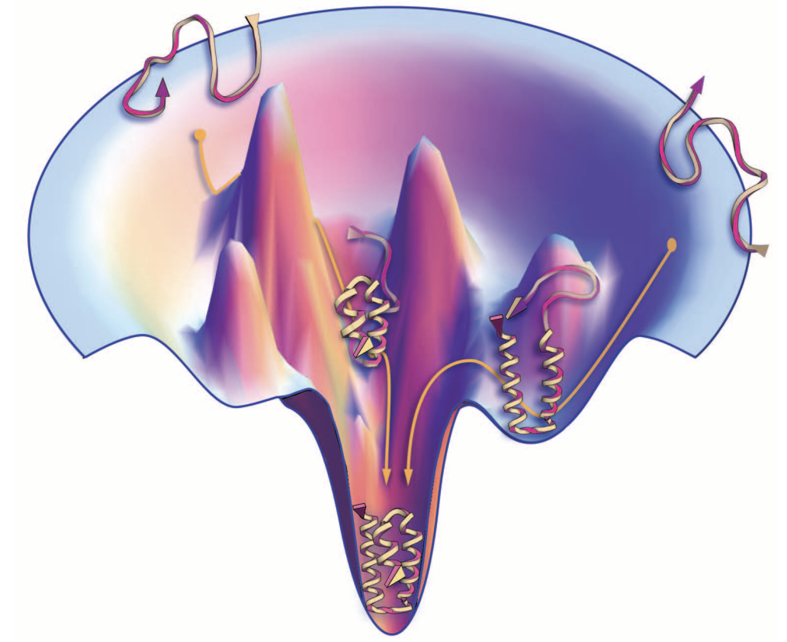
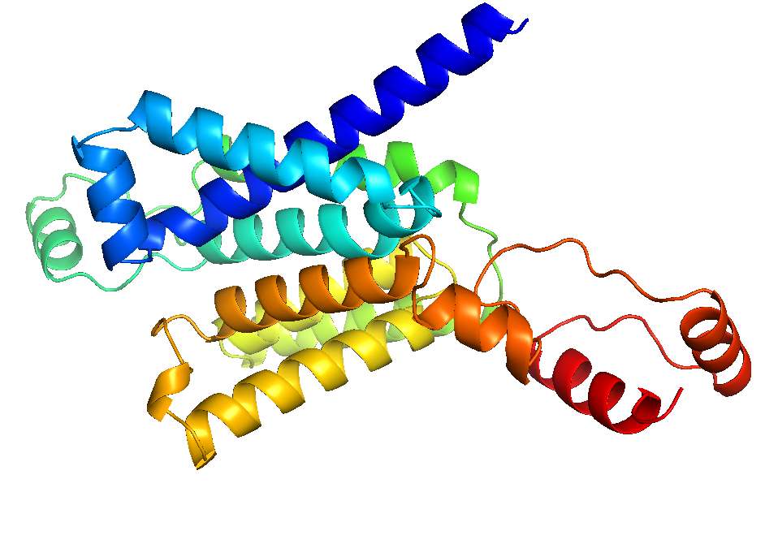
Protein folding
What is ‘unique’ folded 3D structure of a protein based on its amino acid sequence?
Sequence:
LINWRCMRVMIKMLKFHDVRWLICC…
Folding
Structure:
Dill and Maccallum Science (2012)

Slide 4
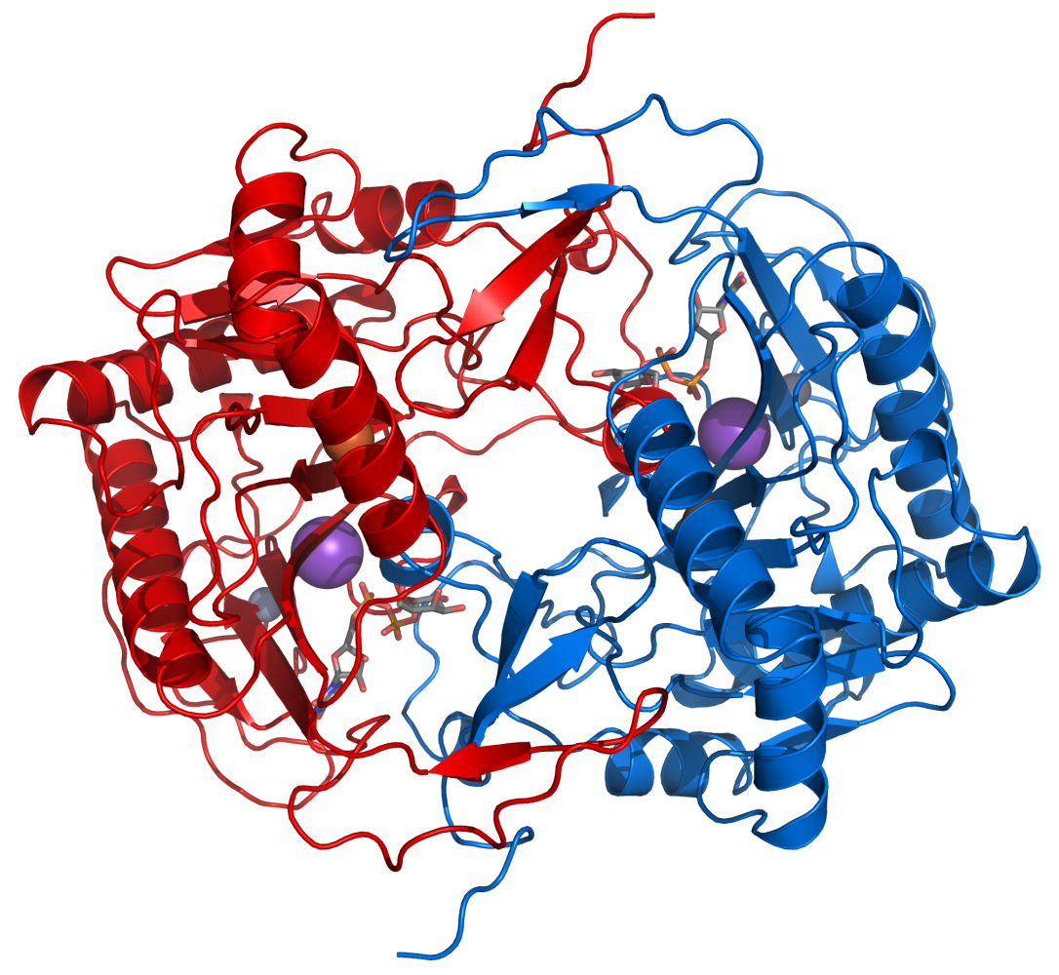
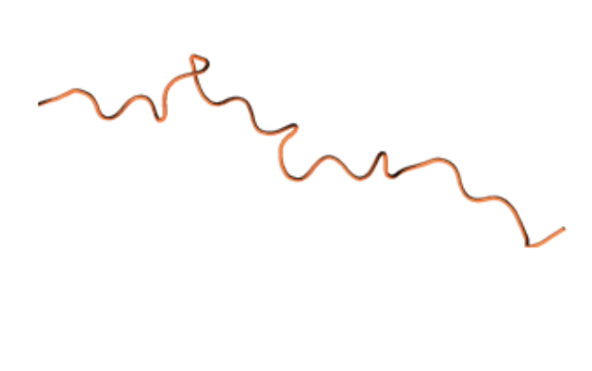
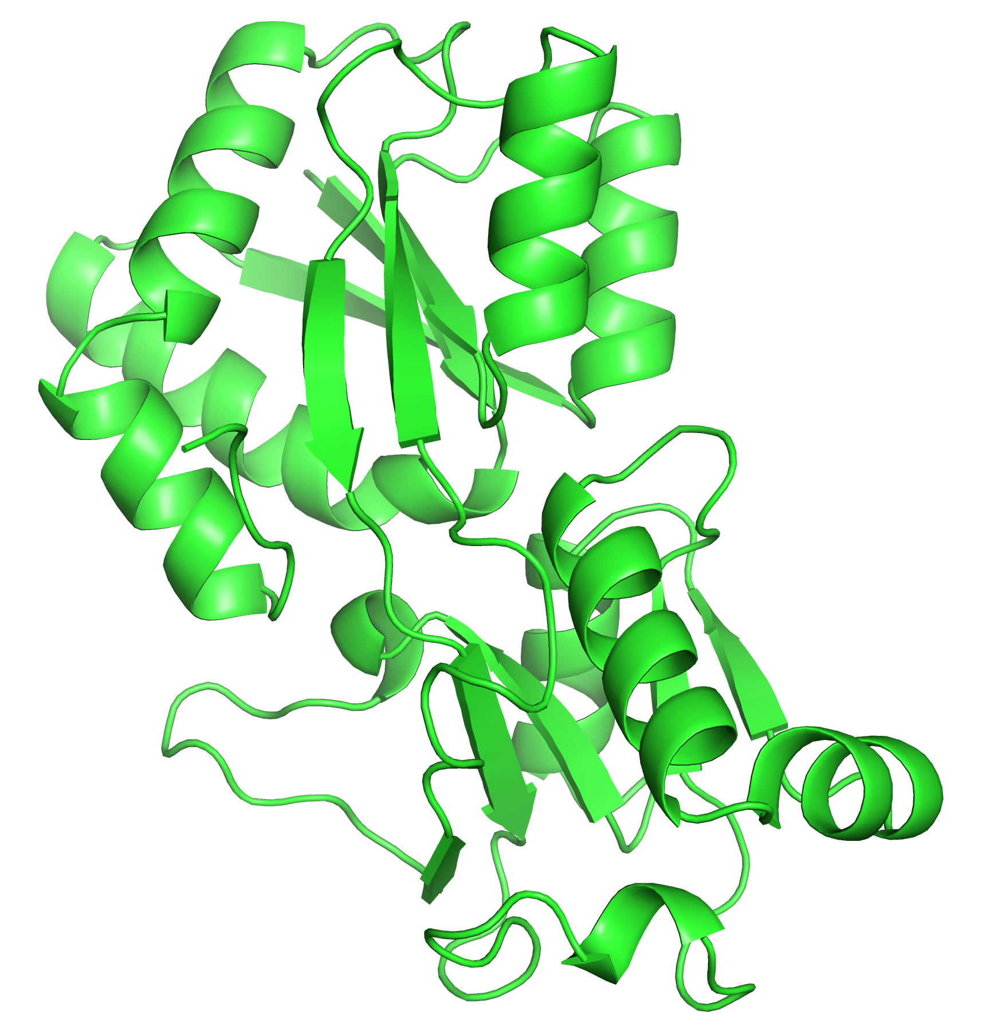
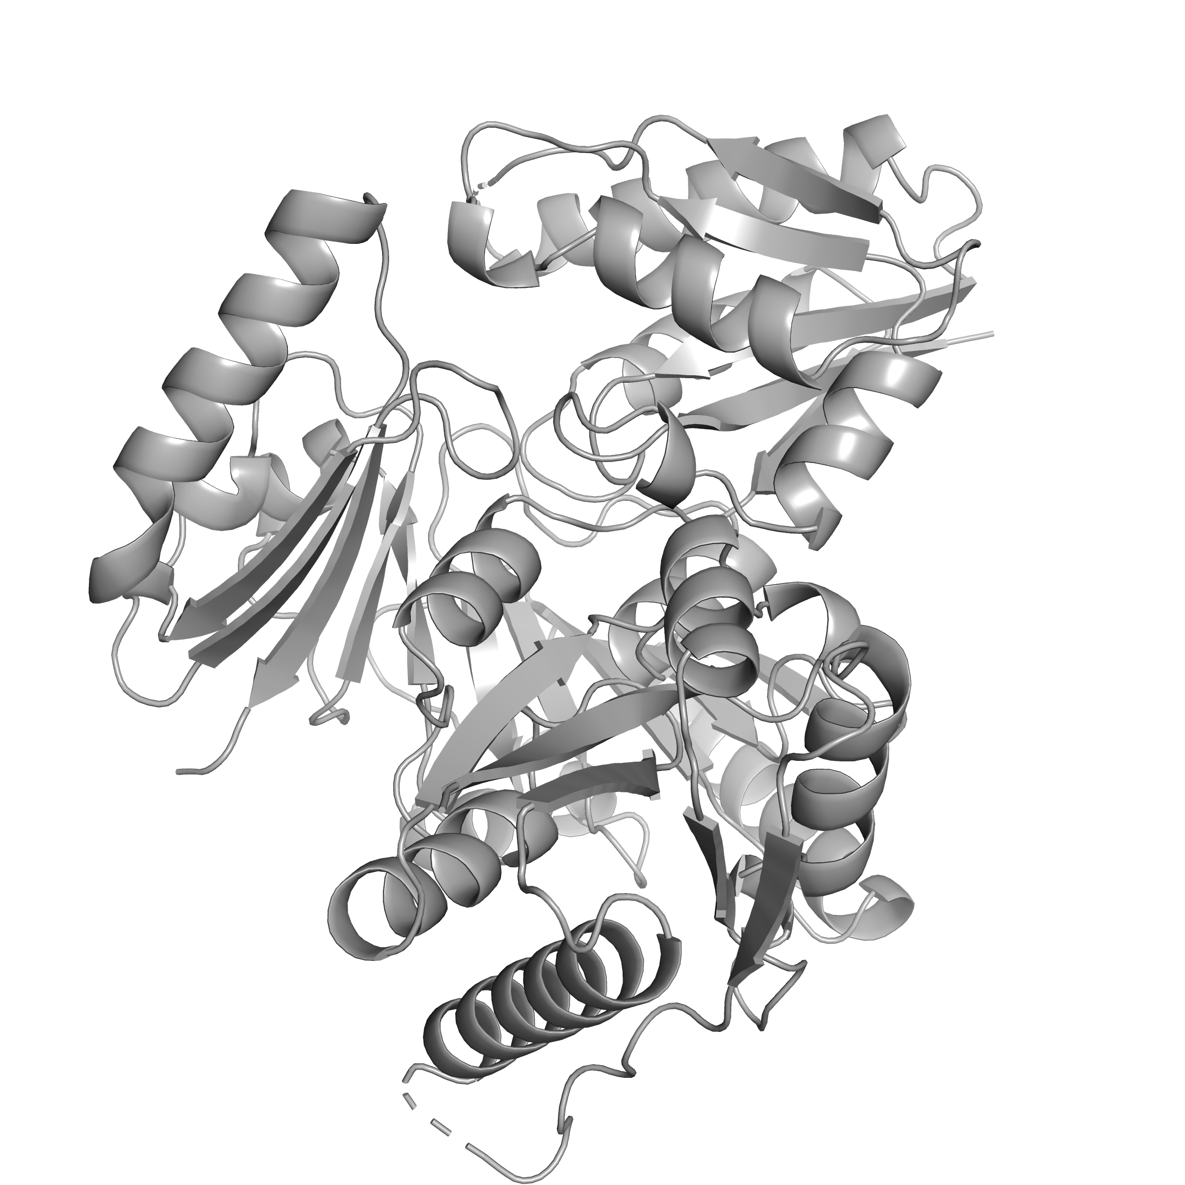
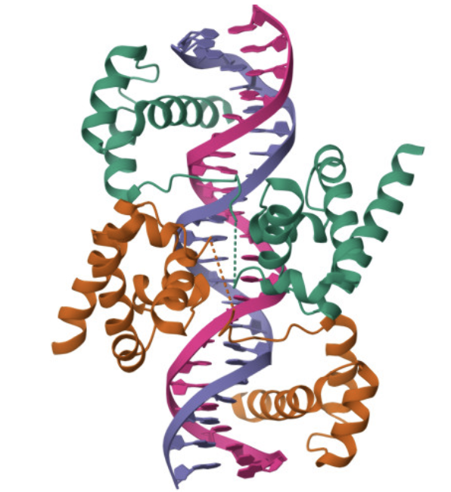
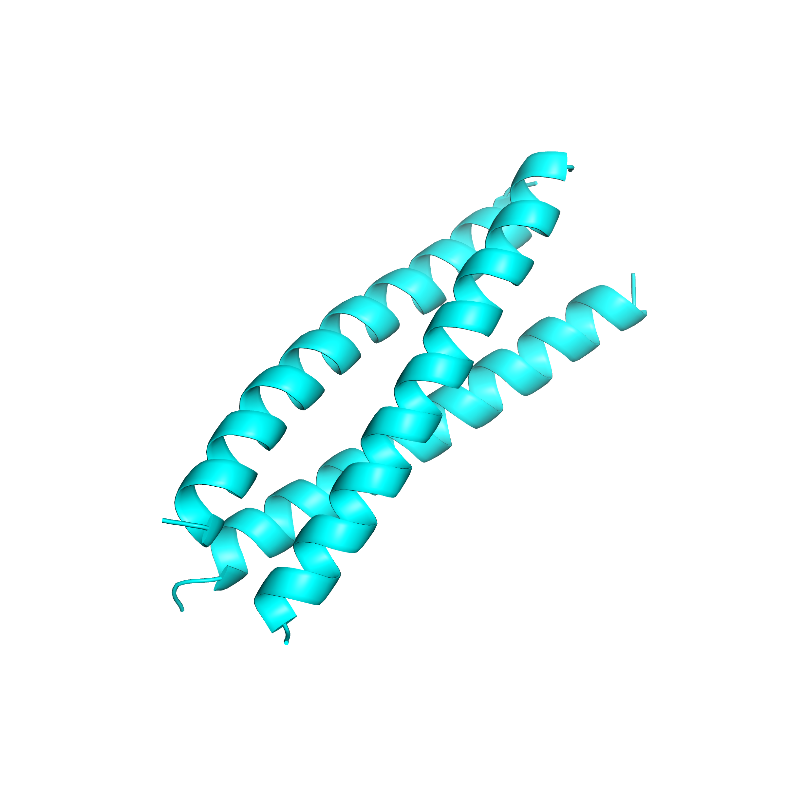
Diversity in protein structure
Monomer
Multimers
Protein-nucleic acid complexes
Protein-ligand complexes
Intrinsic disordered proteins
https://www.rcsb.org/

Slide 5
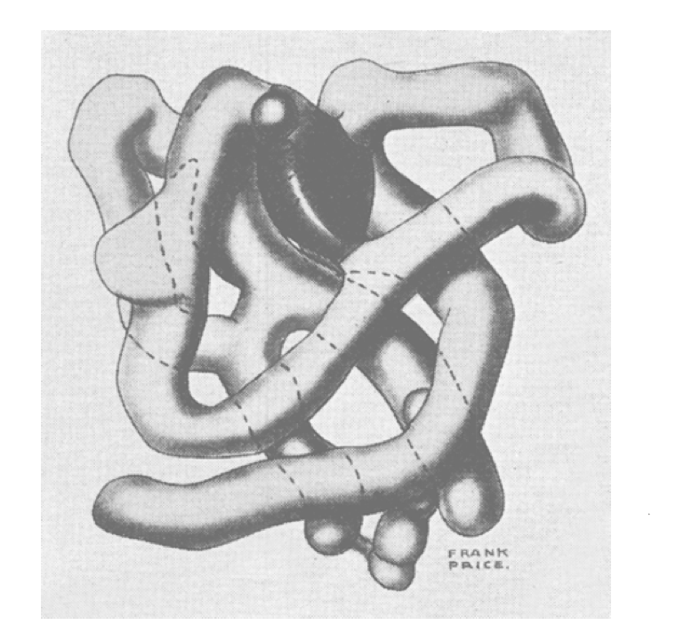
Protein structure determination
Myoglobin: first high resolution protein crystal structure
Kendrew et al. Nature (1958)

Slide 6
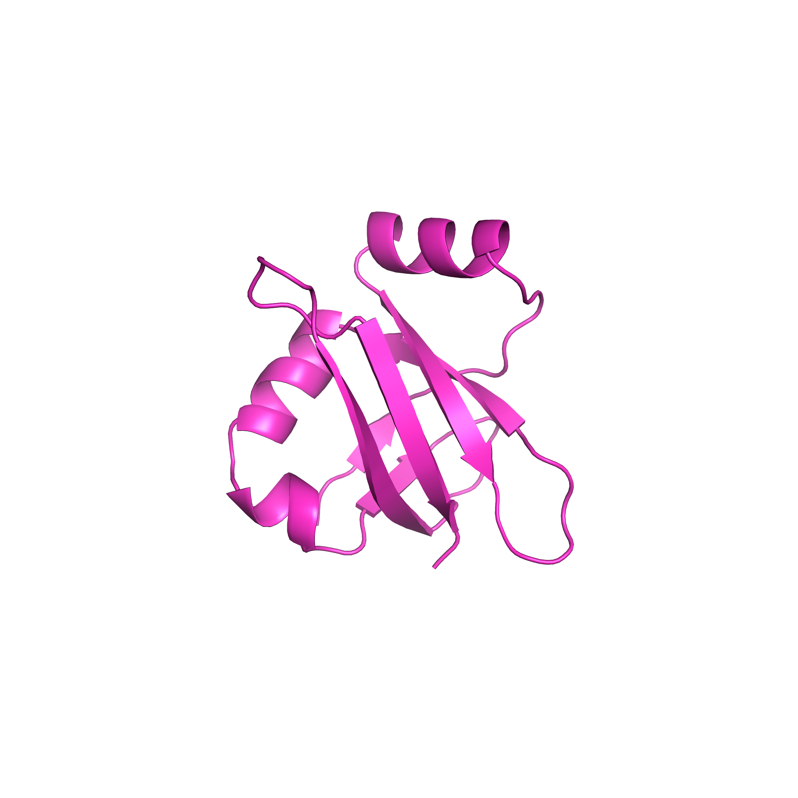
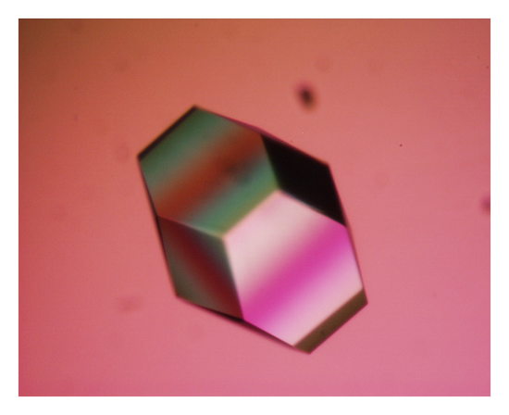
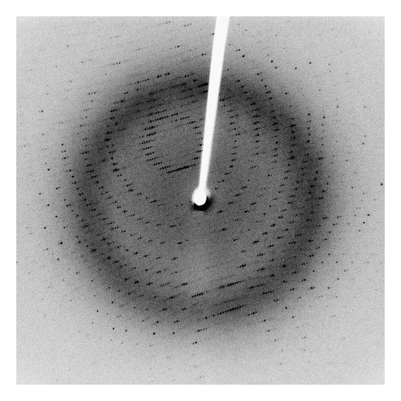
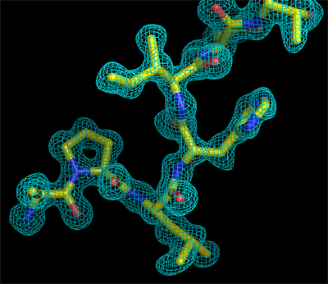
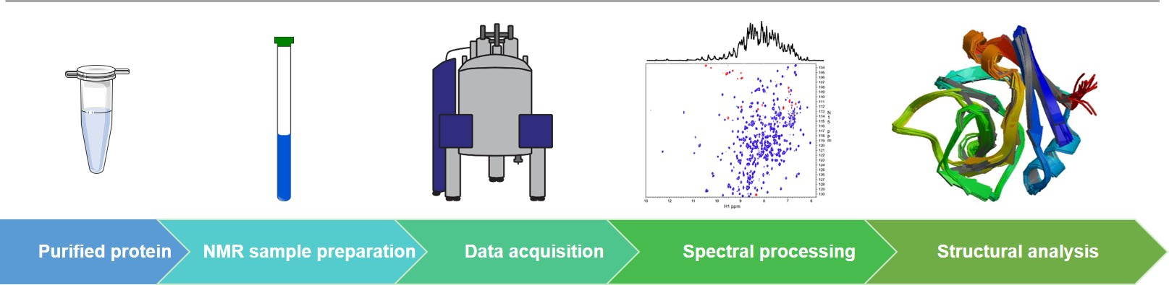
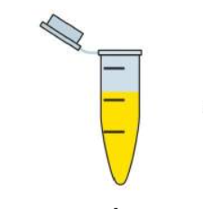
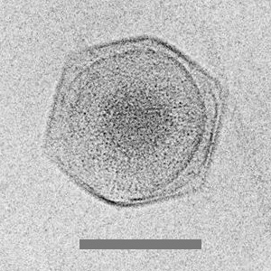
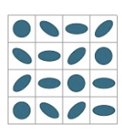
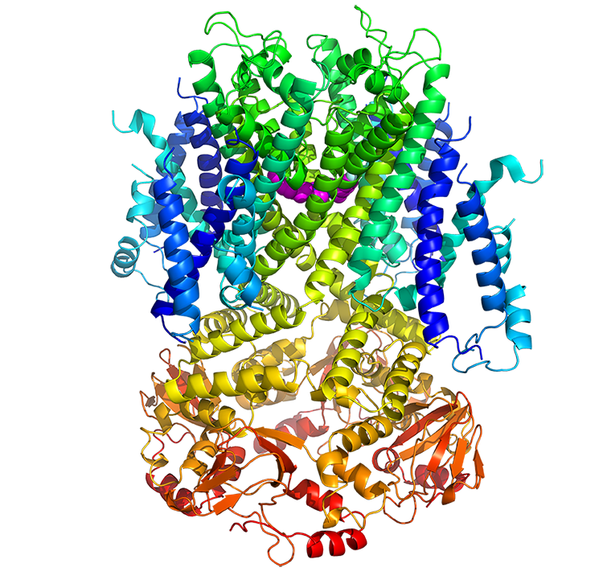
Protein structure determination
X-ray crystallography
Protein crystallization
X-ray diffraction
Electron density map
Structure determination
NMR spectroscopy
Sample preparation
NMR data collection
Signal assignments and restraints generation
Structure determination based on restraints
Cryo-EM
Sample preparation
Cryo-EM imaging
Data processing
Structure reconstruction
Kendrew et al. Nature (1958)
Williamson et al. Journal of Molecular Biology (1985)
Ling et al. Protein Science (2019)

Slide 7
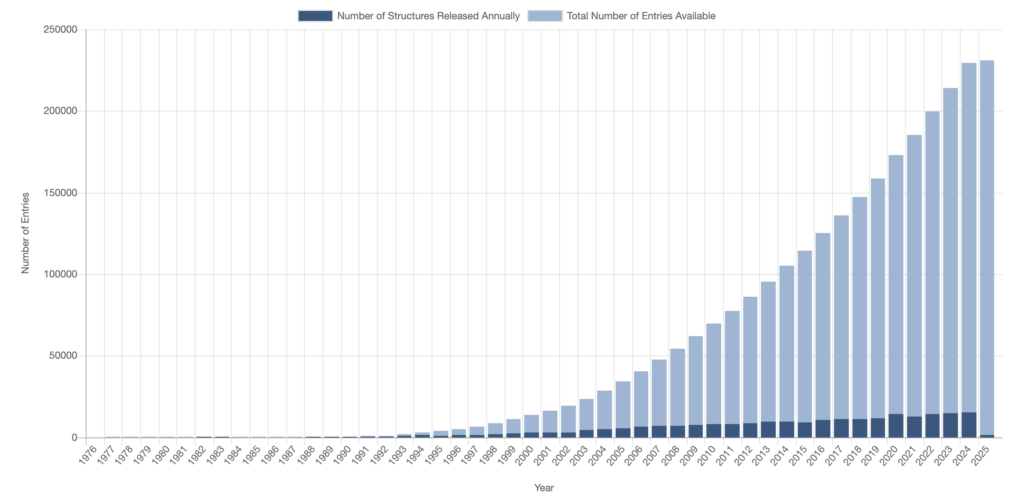
PDB
The number of total number of structures being solved
https://www.rcsb.org/

Slide 8
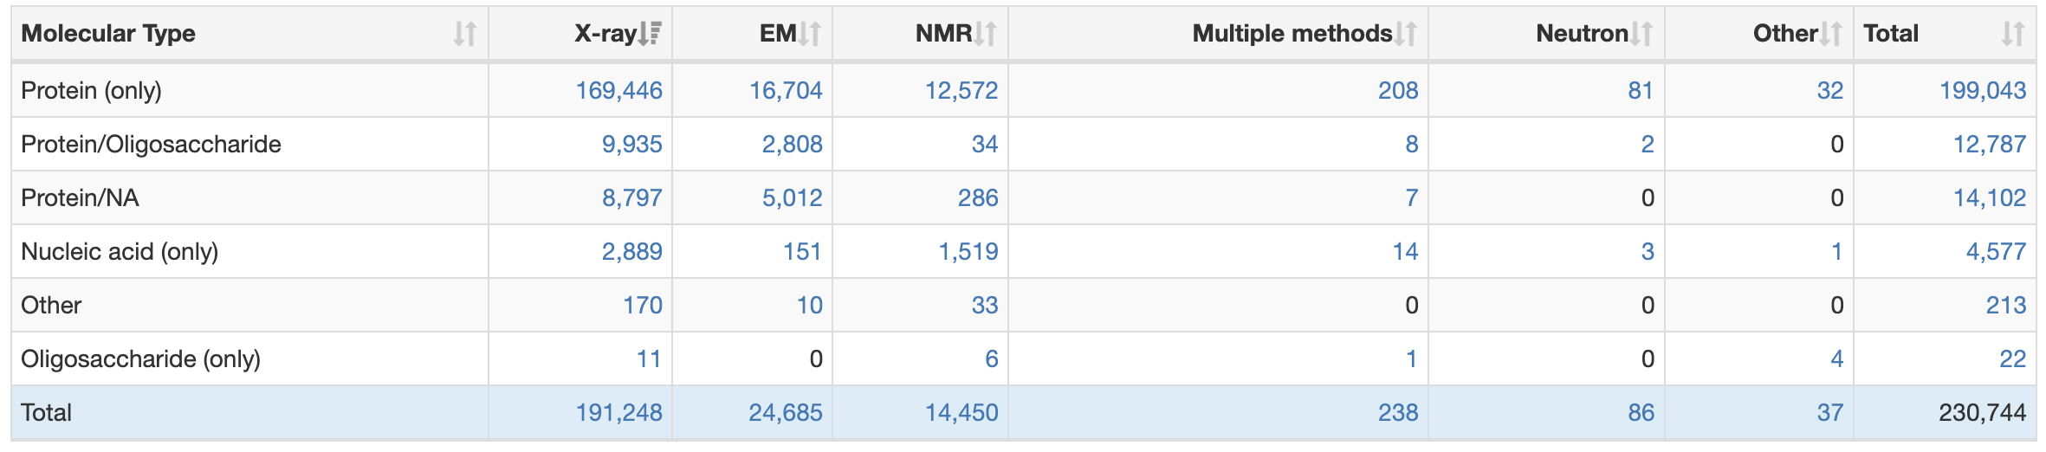
PDB
https://www.rcsb.org/

Slide 9
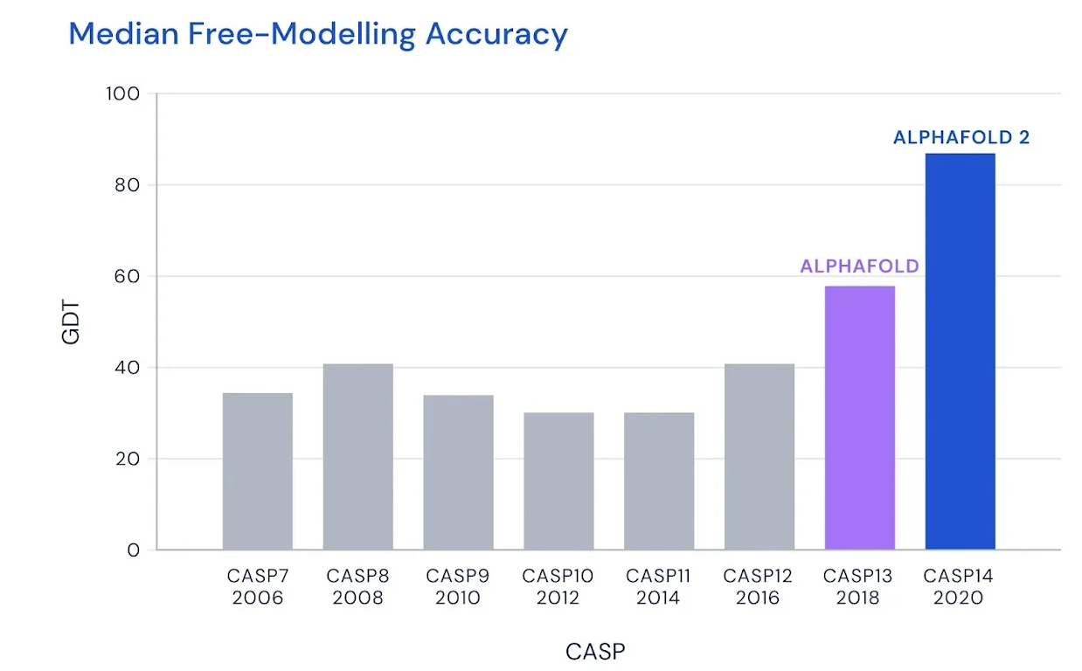
CASP
The Global Distance Test (GDT) is a metric used to compare the structural similarity between the predicted structure and the ground truth, ranging from 0 to 100
https://deepmind.google/discover/blog/alphafold-a-solution-to-a-50-year-old-grand-challenge-in-biology/

Slide 10



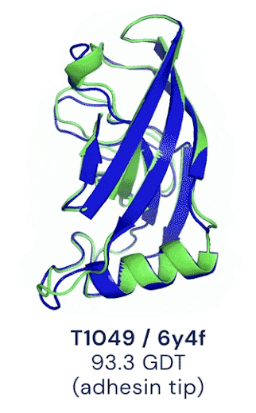
Deep learning for protein structure prediction
Protein sequence
Multiple sequence alignment
Structure template
CNN
Residual neural network
Transformer
Diffusion model
Predicted constraints
Predicted amino acid block coordinates
Predicted all-atom coordinates
https://deepmind.google/discover/blog/alphafold-using-ai-for-scientific-discovery-2020/

Slide 11
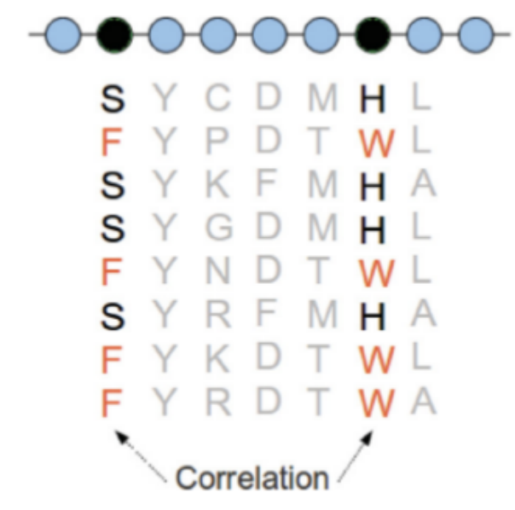
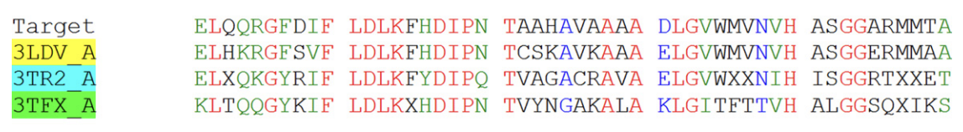
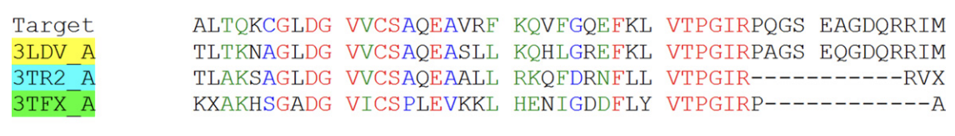
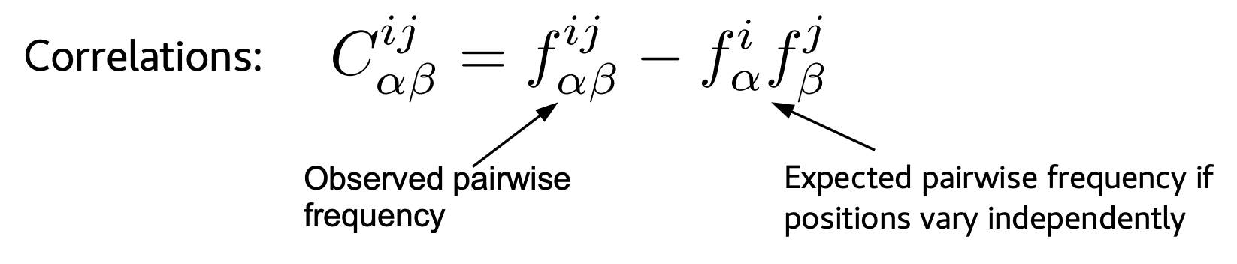
Multiple sequence alignment
Residues that are frequently mutated may be on the surface
Residues that coevolve may be in contact
It is extremely useful to use MSA to infer contacts, secondary structure, and domain organization
Lovkvist et al. PRE (2013)

Slide 12
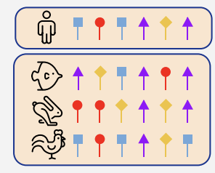
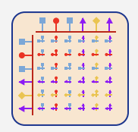
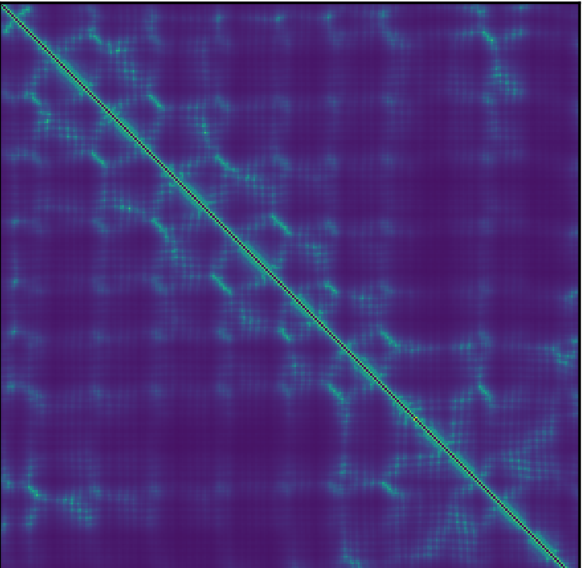
Input information
r
r
r
s
r
r
Amino acid type
Mutation frequency
Gap frequency
Every sequences that hit (after clustering)
Amino acid distribution in each cluster
Coevolutionary coupling matrix
Contact probability matrix
Template distance matrix
Senior et al. Nature (2020)

Slide 13
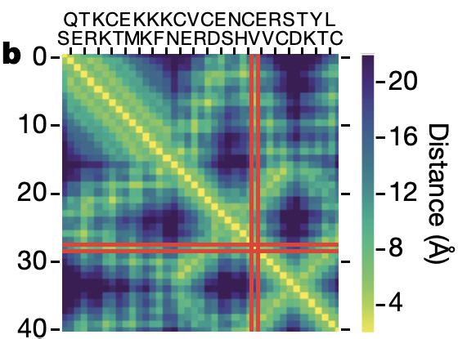
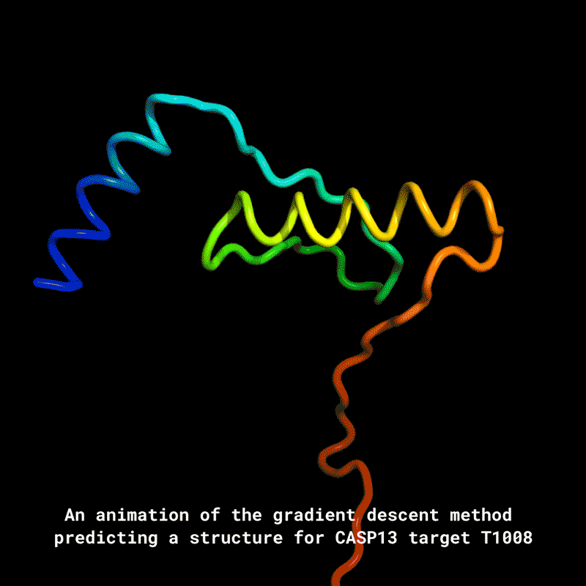
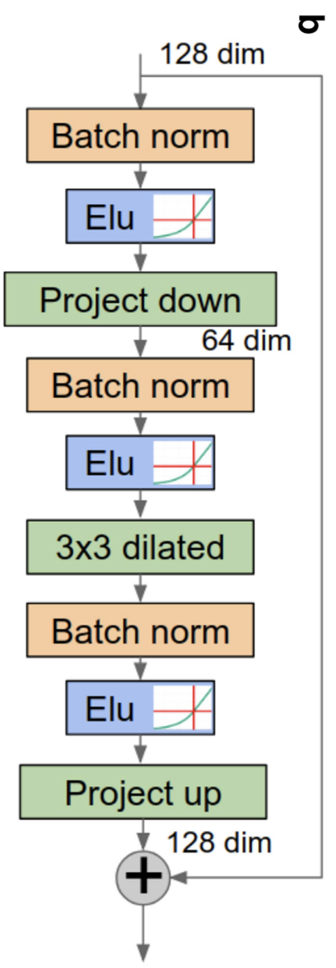
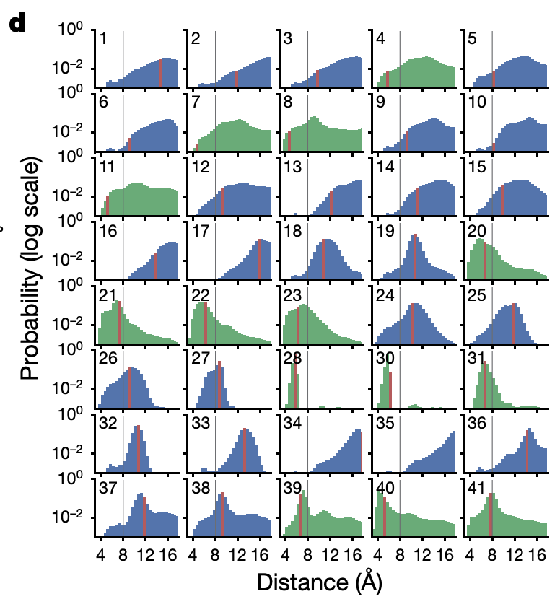
AlphaFold 1
Predict
Energy Minimization
Think of it as an image recognition problem
However, distance map lose information about 3D structure and the effect of distance prediction error on 3D structure would be large
Senior et al. Nature (2020)
Notes:
Predict distance map as well as dihedral angle

Slide 14
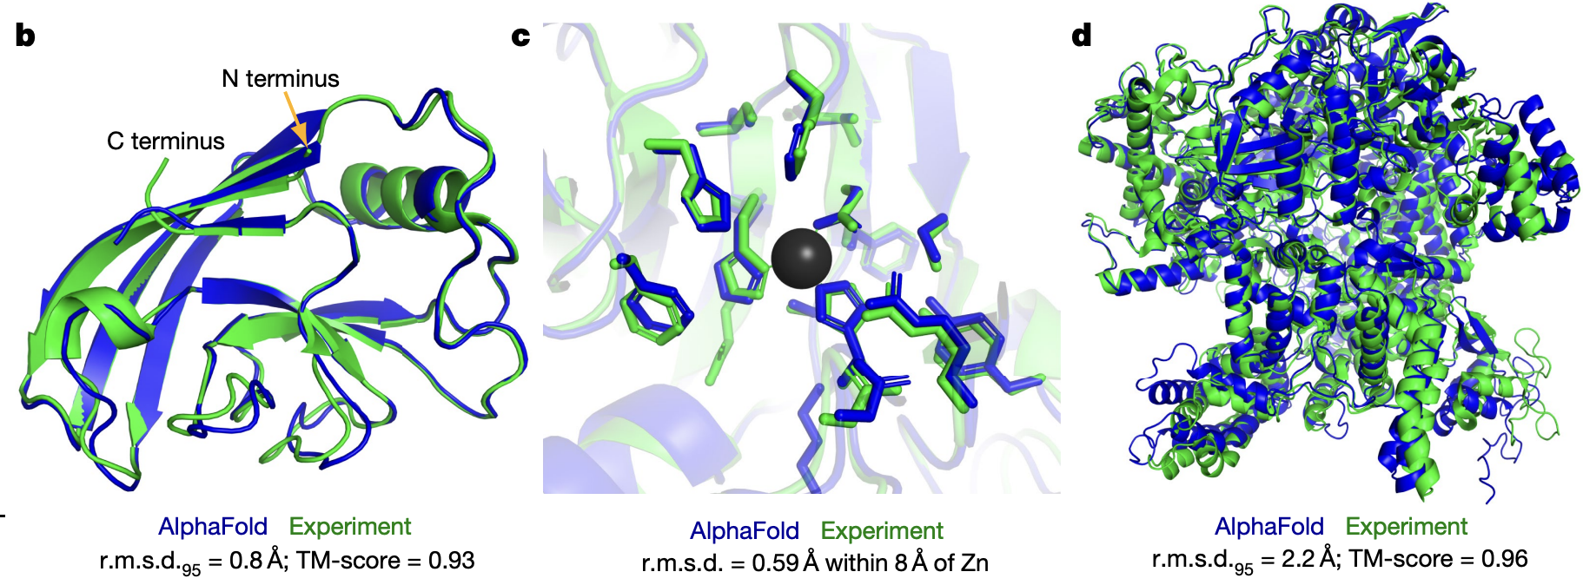
AlphaFold 2 result
Jumper et al. Nature (2021)

Slide 15
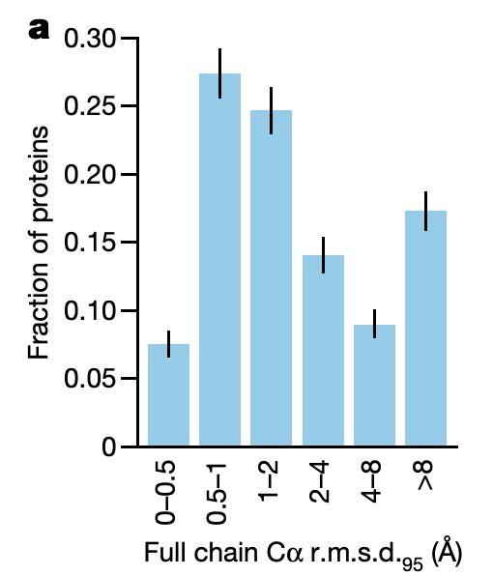
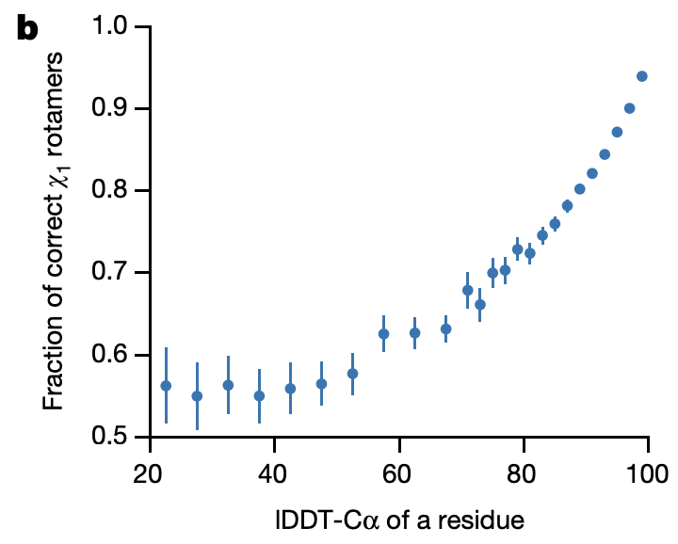
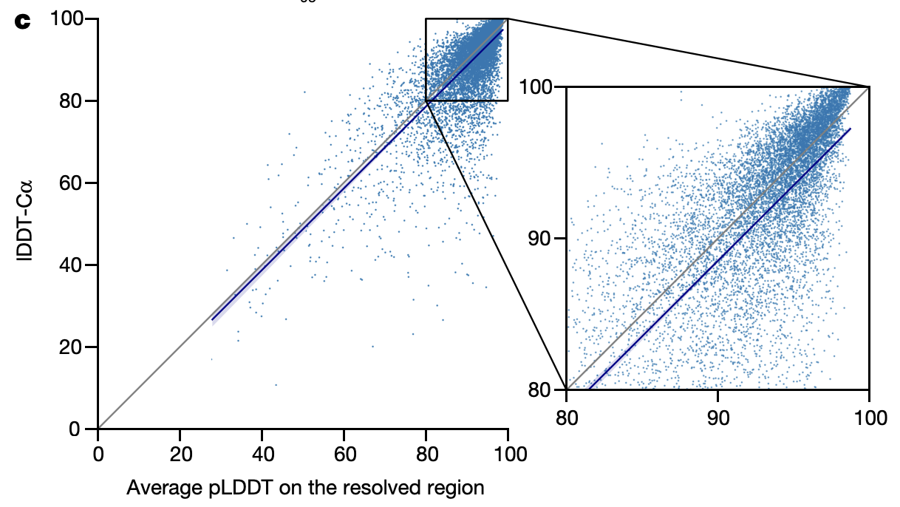
AlphaFold 2 result
Overall structure prediction accuracy in terms of backbone, side chain and confidence score
Jumper et al. Nature (2021)

Slide 16
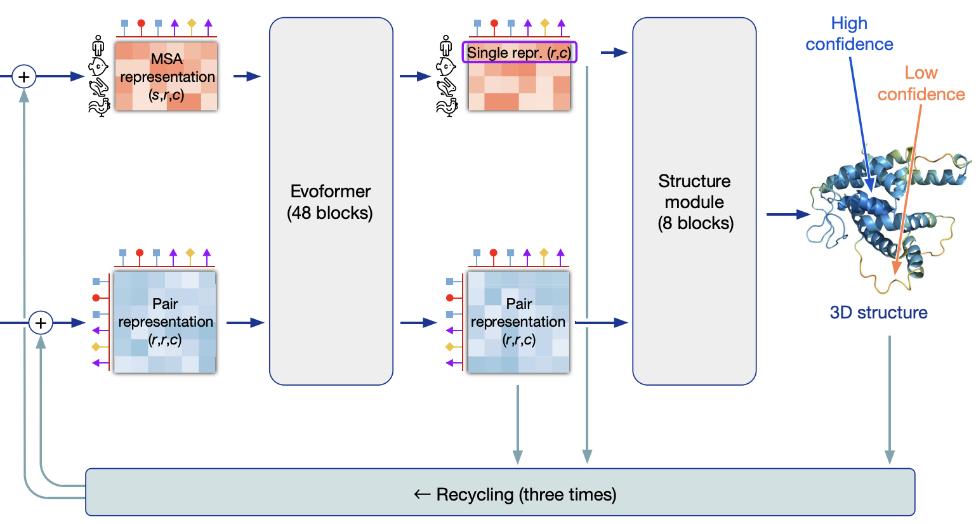
AlphaFold 2 architecture
MSA sequence information
MSA pairwise information
Template pairwise information
Think of it as a language processing problem
s is the number of aligned sequences, r is the number of residues, c is the number of channels
Jumper et al. Nature (2021)

Slide 17
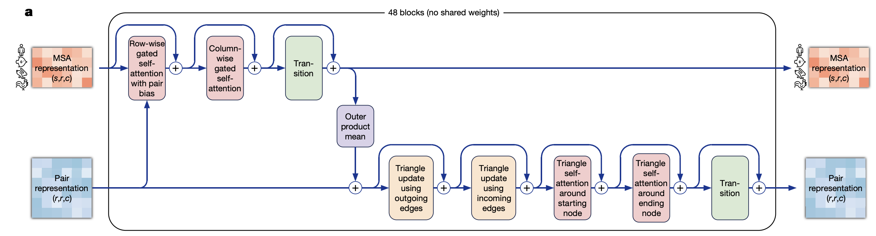
AlphaFold 2 architecture
Evoformer module makes use of the attention mechanism in deep learning to process sequence information
Jumper et al. Nature (2021)

Slide 18
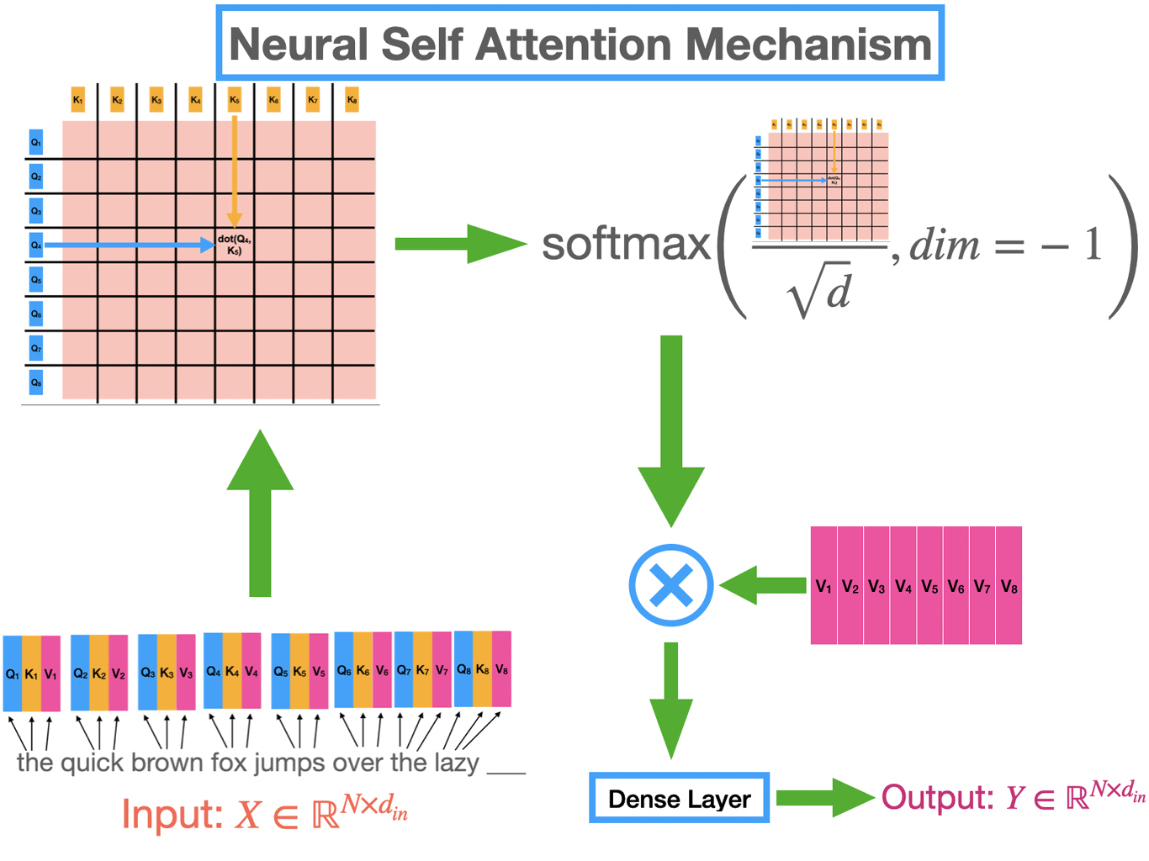
Attention mechanism
Evoformer module makes use of the attention mechanism in deep learning to process sequence information
https://learnopencv.com/attention-mechanism-in-transformer-neural-networks/

Slide 19
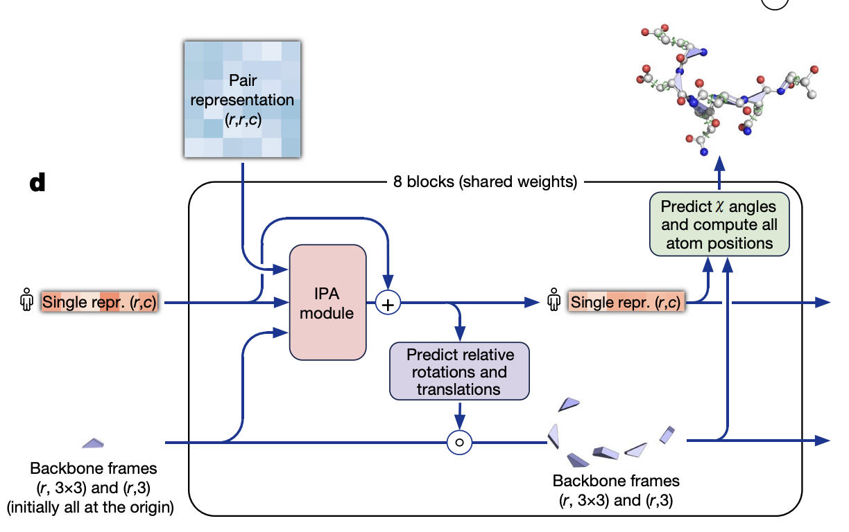
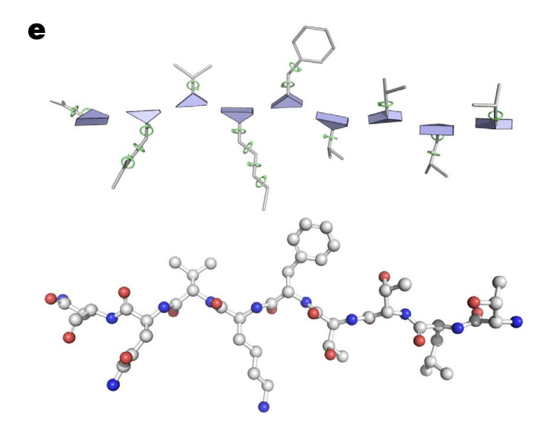
AlphaFold 2 architecture
Structure module predicts the rotation and translational matrix for backbone frames and side chain angles from inputs
Jumper et al. Nature (2021)

Slide 20
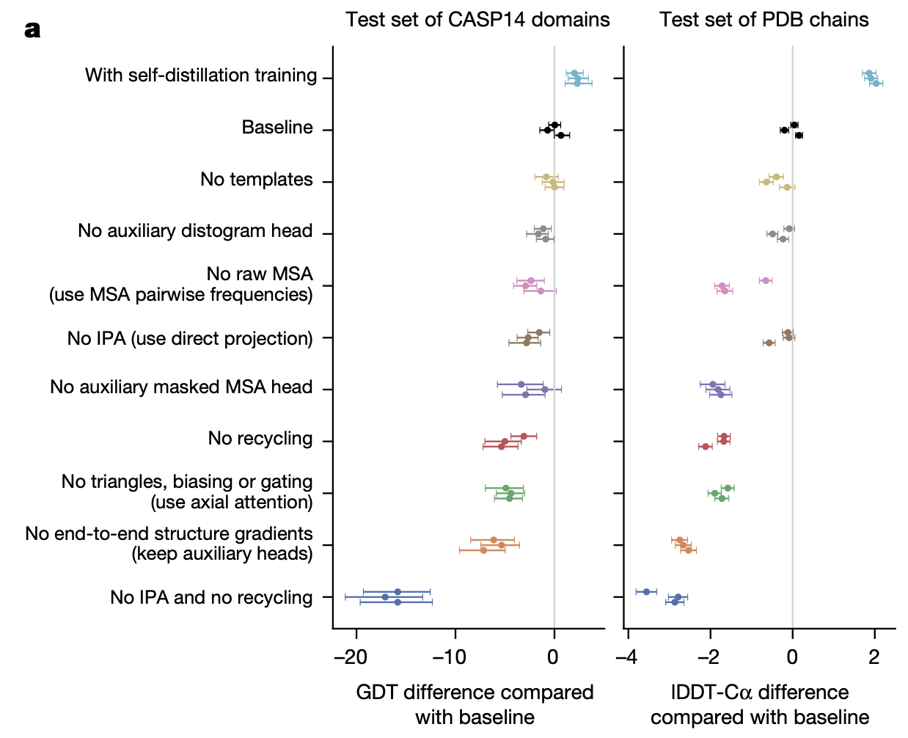
AlphaFold 2 training technique
  Self distillation training: the model learns from its own high-confidence predictions to improve performance
  Recycling: feeds its own output back into itself multiple times to refine predictions
  Loss function L = 0.5L_{FAPE} + 0.5L_{aux} + 0.3L_{dist} + 2.0L_{msa} + 0.01L_{conf}
Jumper et al. Nature (2021)
Notes:
L_{FAPE}: the difference between predicted atom coordinates and the ground truth after alignment
L_{aux}: backbone and sidechain torsion angle loss
L_{msa}: the cross-entropy loss of reconstructing the residue that has been randomly Masked out
L_{dist}: the cross-entropy of comparing predicted distance matrix to the ground truth
L_{conf}: the cross-entropy of comparing predicted structure to ground truth for pLDDT training

Slide 21
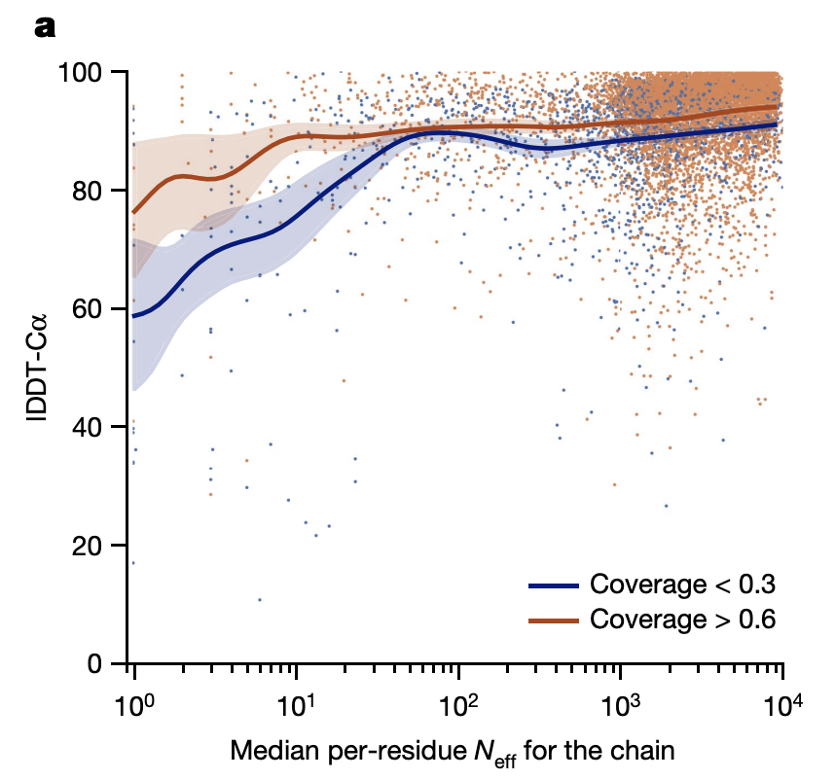
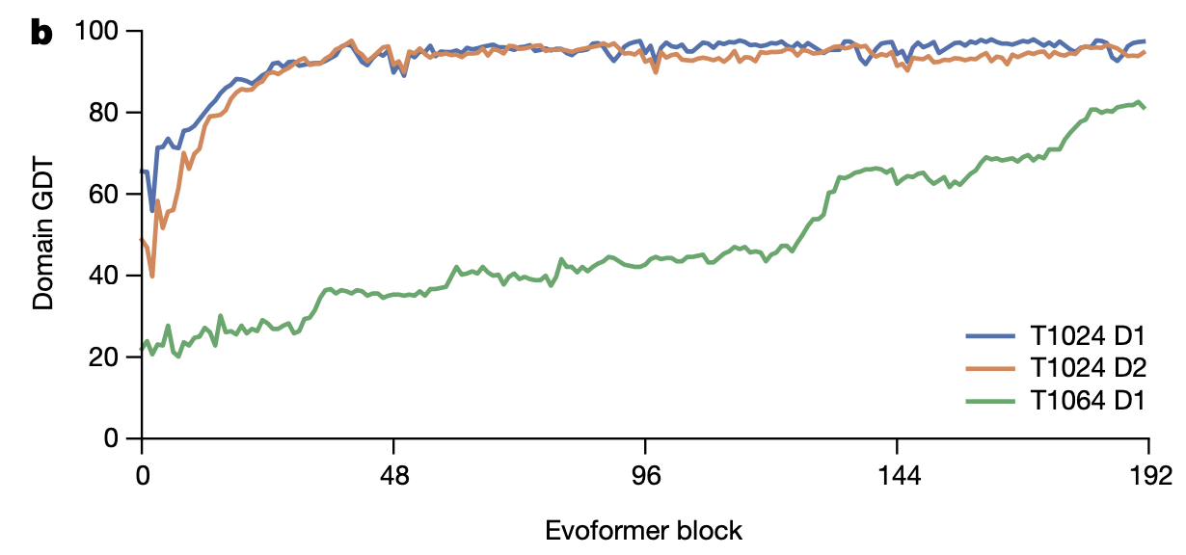
AlphaFold 2 discussion
The effect of Evoformer block on model accuracy
The effect of MSA depth and sequence coverage on prediction accuracy
Jumper et al. Nature (2021)

Slide 22
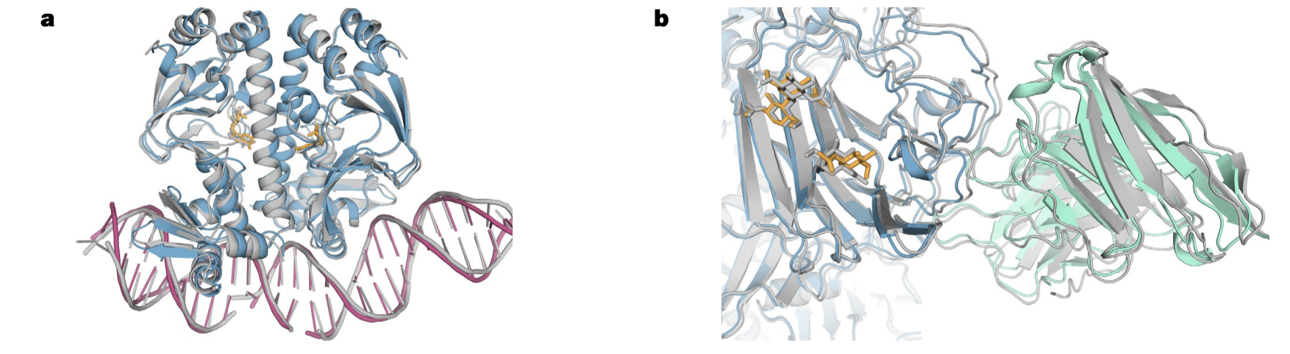
AlphaFold 3 result
Abramson et al. Nature (2024)

Slide 23
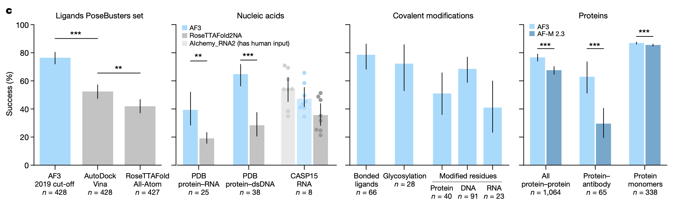
AlphaFold 3 performance
Outperform other specialized methods among different tasks
Didn’t actually ‘solve’ the problem. Scoring function is still needed
Abramson et al. Nature (2024)

Slide 24
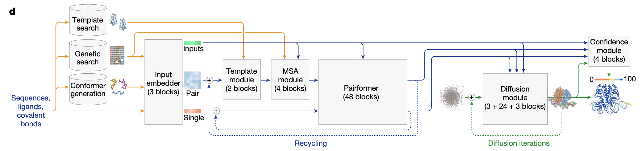
AlphaFold 3 architecture
Similar to alphafold2
Directly go from all-atom random coordinates to 3D structure using generative diffusion model
Abramson et al. Nature (2024)

Slide 25
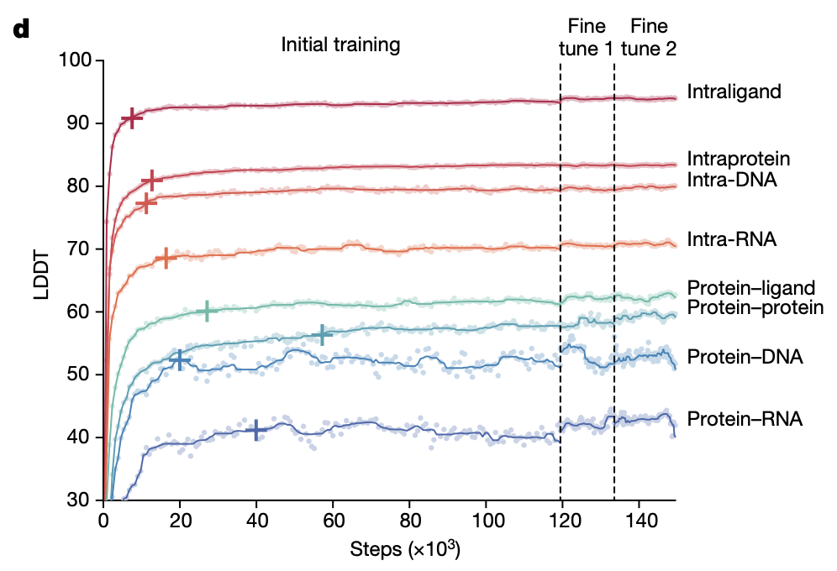
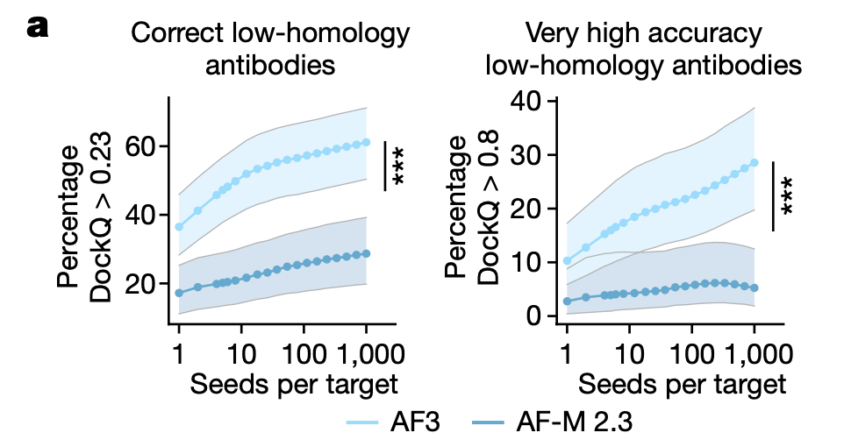
AlphaFold 3 discussion
Limitation: overlap, wrong disordered region, cannot report dynamics, generates different structures from different random seeds but still need to rank them using scoring function
Abramson et al. Nature (2024)

Slide 26

AlphaFold 3 discussion
Limitation: overlap, wrong disordered region, cannot report dynamics, generates different structures from different random seeds but still need to rank them using scoring function
Abramson et al. Nature (2024)

Slide 27


Protein design
The progress of protein design
Huang et al. Nature (2016)
Watson et al. Nature (2023)

Slide 28

Protein structures in cell
X-ray crystallography
NMR spectroscopy
Cryo-EM
Over 200,000 protein structures are solved in vitro, while only 3 proteins are solved in vivo at atomistic detail
What are the protein structures in cell?
Kendrew et al. Nature (1958)
Williamson et al. Journal of Molecular Biology (1985)
Ellis, Trends in Biomedical Science (2001)
Notes:
5-40% cytoplasmic volume could be occupied

Slide 29





Protein mutations
Glutamate
Valine
Point mutations can cause significant structural change, misfolding and aggregation, thus associated with disease
The mutant of hemoglobin protein changes the shape of the protein, leading to abnormal aggregation of hemoglobin that deforms red blood cells into a sickle shape.
The mutant of Human prion protein is associated with degeneration of neurons and amyloid plaque formation due to protein aggregation
Prabantu et al. Front Mol Biosci (2021)
Ramadas et al. Front Med (2023)
Prabhakaran et al. Biopolymers (1993)

Slide 30
Discussion
Alphafold2 can be used to solve protein monomer folding
Alphafold3 can solve protein complexes structures from sequence
  Scoring function is still needed to evaluate the structures
Future directions
  There is much to be done in the field of protein design
  Protein in-cell structures need to be determined
  The effect of mutations is not well-understood

Slide 31











Local deformation metrics
$$S_{p}$$
$$S_{q}$$
$$i$$
$$r_{ij}^{q}$$
$$i$$
$$r_{ij}^{p}$$
$$j$$
$$j$$
RMSD is a global metric that needs alignment
Duplicates can undergo large scale motion with little local deformation
We calculate the alignment free local deformation D for each residue i by comparing their local environments between two structures
Neighbors j are found using Voronoi tessellation
Voronoi cells are bounded to the solvent accessible surface to prevent unphysical contact between domains
Olechnovic et al. Proteins (2017)

Slide 32




Structural change induced by point mutation
Benign mutant of Human Glutathione Transferase has no effect on the local structure

Slide 33



Structural change induced by point mutation
Mutant of KPC-2 shows a peak in local deformation at the mutation site
Deformation induced by point mutation deceases as moved away from the mutation site

Slide 34



Structural change induced by point mutation
Mutant of KRAS shows large local deformation at and near the mutation site, leading to partially refolding

Slide 35




The local effect of mutations
Find X-ray crystal structures that have >= 5 duplicates and their associated single point mutants, with no nucleic acids, should not be heteromers and have resolution < 3.5A
>7000 duplicates-mutants sequence pairs
β = sequence distance from the mutation site
r = spatial distance from the mutation site, binned at each 1A
level = number of Voronoi shells away from the mutation site
On average, the magnitude of local structural deformation decreases as the distance from the mutation site increases
Notes:
Change all plots to ratio

Slide 36



AlphaFold mutation deformation prediction accuracy
D^{mut}
log(D^{mut}/D^{dup})
Each data point represents the Pearson correlation of Sequences with Z-score > cutoff between ground truth deformation and AlphaFold predicted deformation
Notes:
Put rSASA on this plot

Slide 37



Physical features that distinguish the local effect of mutations
Pearson = 0.59
The ratio of aggregate change in rSASA around the mutation site between mutant and duplicates has a ~0.6 correlation with deformation

Slide 38



Deformation prediction accuracy
D^{mut}
log(D^{mut}/D^{dup})
Z-score = ${{(\overline{D}}_{i}^{mut}−{\overline{D}}_{i}^{dup})}/{std(D_{i}^{dup})}$
Blue: correlation between ground truth deformation and ground truth delta rSASA
Red: correlation between ground truth deformation and AlphaFold predicted deformation

Slide 39
Discussion
Local deformation can be used to evaluate the effect of amino acid mutation on protein structure
The structural effect of single point mutations is highly localized
AlphaFold3 fails to predict the deformation of single point mutation, especially for high-deforming ones
The local deformation induced by mutation correlate well with the change in solvent accessible surface area without bias

Slide 40
Thanks!

