Slide 1
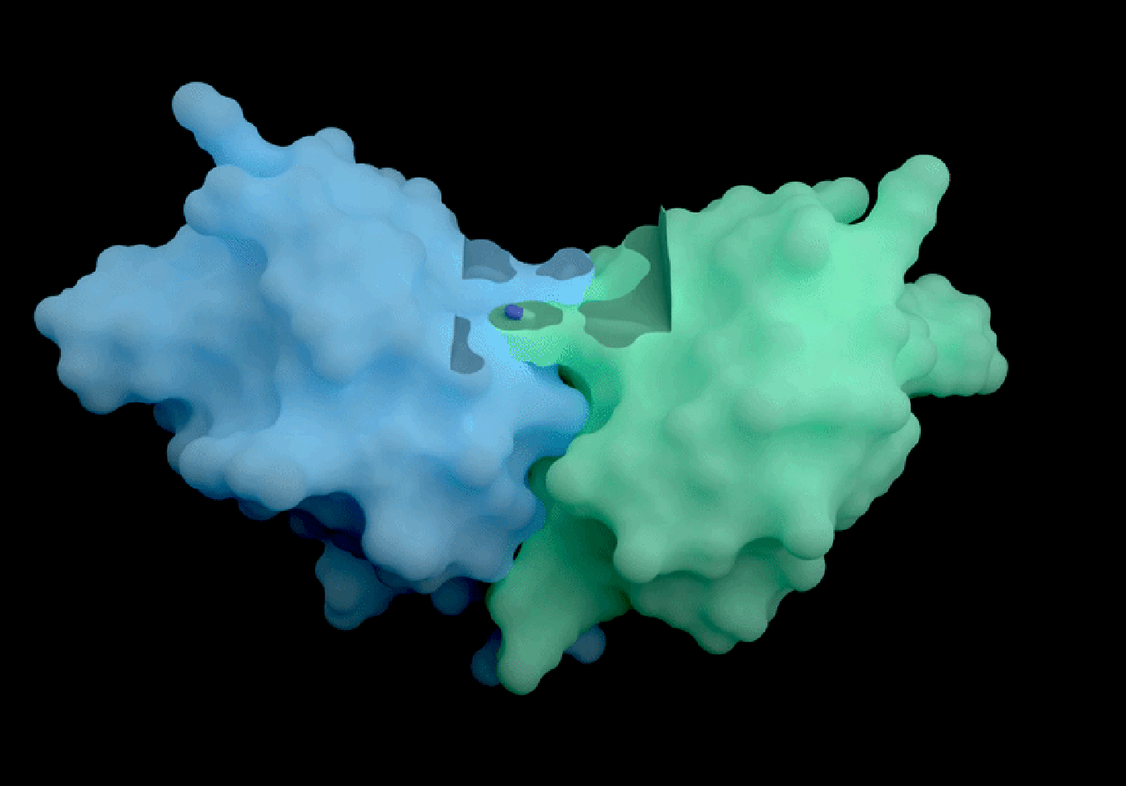
Generative AI for Protein Design
From Biochemical Knowledge to ML Objectives
Anna Su
CBB 7520 Spring 2026
GIF from Isomorphic lab: proteins interact with potential therapeutic molecules
Notes:
RECAP and HIGHLIGHT:
The loss function is crucial for neural networks because it provides the essential quantitative feedback signal that enables the model to learn and adjust its parameters (theta, which include weights and biases) to improve prediction accuracy.

Slide 2
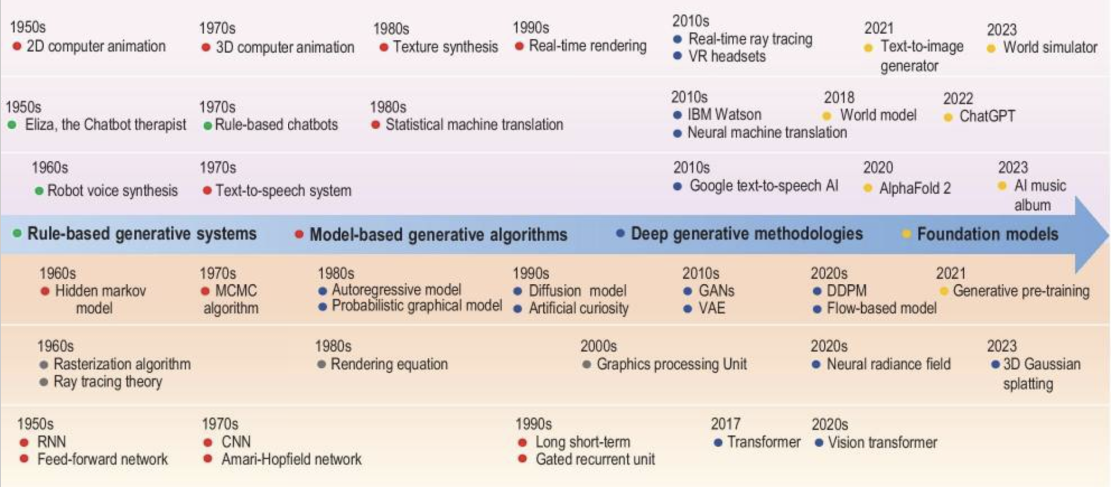
Timeline of GenAI Development
Generative artificial intelligence: a historical perspective
Notes:
Reading on GenAI timeline: https://www.linkedin.com/pulse/history-through-timeline-1-generative-ai-yassmin-abdallah-q4ddf/

Slide 3



Job Descriptions of ML Scientist Roles
Domain translation:
From biological and chemical domain knowledge to concrete machine learning objectives
Apply world-leading ML algorithms to drug discovery
Apply state-of-the-art generative approaches to molecular and protein engineering

Slide 4
Today’s Objectives
How to go from biological and chemical knowledge to ML objectives?
How to choose the appropriate data representation and model architecture depending on the biochemical application (representation vs generation)?
Technical Knowledge
Recap VAE, GNN, Transformer (if time allows)
Introduce Diffusion models and Flow-based models

Slide 5
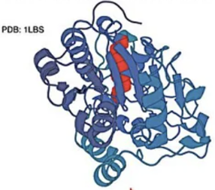
Case 1: Redesign a Protein to Expose a Buried Helix
Context: By changing a buried, inert helix to a surface-exposed one, we can create new binding sites, enzymatic active sites, or sites for post-translational modification.
Task: Redesign the sequence of a protein to expose its buried helix to the surface

Slide 6
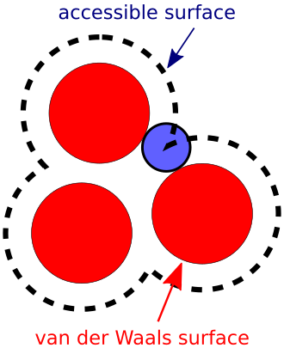
Case 1: Redesign a Protein to Expose a Buried Helix
Biological Question:
How to increase surface accessibility of a specific region?
Altering Solvent Accessible Surface Area (SASA) values of residues in the region
ML Objective Translation:
Biological Goal | ML Objective
Expose the buried helix | Increase per-residue SASA for the helix
Ensure foldability | Generated sequence should be evolutionarily plausible

Slide 7
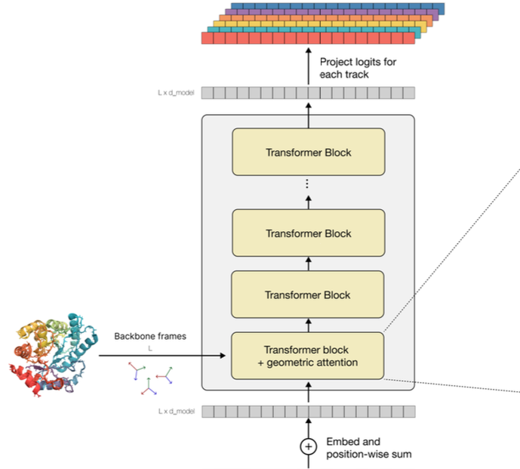
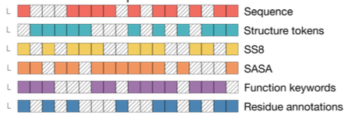
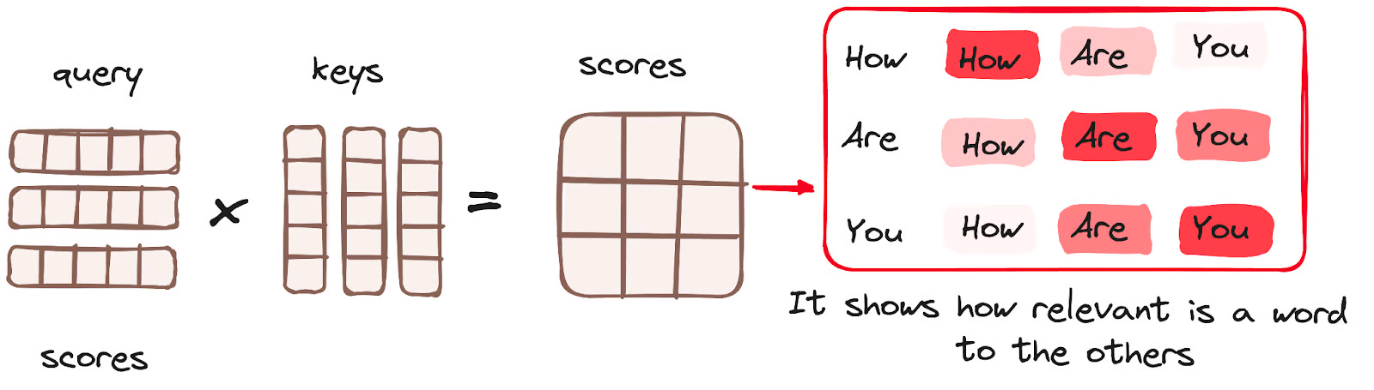
Case 1: Redesign a Protein to Expose a Buried Helix
Potential Models:
Transformer model
  ESM3
Input tracks
Attention score computation recap
Simulating 500 million years of evolution with a language model
Notes:
A masked multimodal autoencoder that learns joint distributions over sequence, structure, and function through tokenization and conditional generation.
Every token (whether an amino acid or a functional annotation) projects into a Query (Q), Key (K), and Value (V) vector.
The model calculates the attention score by comparing the Query of one token to the Keys of all other tokens.
The multi-modality allows joint reasoning, for example, an amino acid token to attend to function tokens.
RECAP:
Attention scores are computed based on query, key, value
Query: a vector representing a specific token from the input
Key: a vector corresponding to each token in the input
Value: associated with a key. Derived from the input embeddings through a learned transformation. Gets emphasized in the output if a query and and a key match well (high attention score)

Slide 8
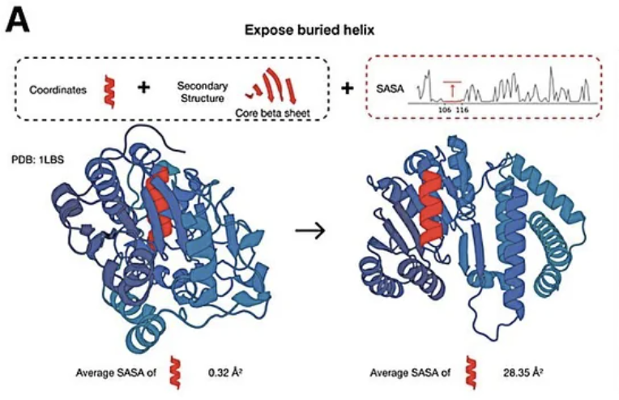
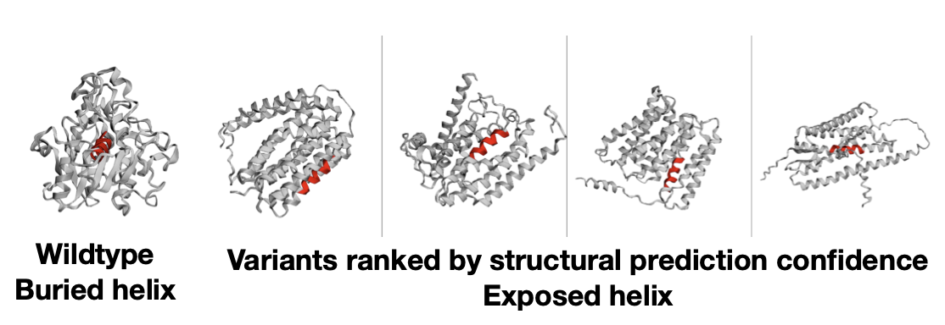
Case 1: Redesign a Protein to Expose a Buried Helix
Results:
Simulating 500 million years of evolution with a language model

Slide 9
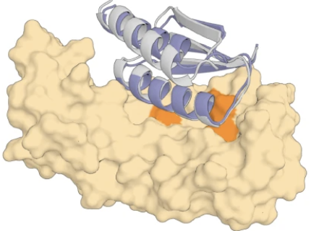
Case 2: De Novo Enzyme Design
Context: Influenza hemagglutinin (HA) plays an important role in the first step of influenza virus (IFV) infection. Designed protein binders for HA offer clinical potential as potent antivirals to inhibit viral entry.
Task: Given HA’s protein surface, generate a completely new protein backbone that forms a high-affinity interface with the target then design a sequence that folds into this backbone.
Potential binder
HA

Slide 10
Case 2: De Novo Enzyme Design
Biological Questions:
Question | Why It Matters for ML
Do we care about chirality in the design? Yes, to prevent generating mirror-image proteins that could not exist in nature | Needs a model that respects the "handedness"
What are "hotspot residues"? Key target residues that contribute most to binding energy — the binder must contact these | Defines the conditioning signal: specify which residues on the target surface the binder must engage
What makes a protein foldable? Hydrophobic core, secondary structure packing, no steric clashes | The generated backbone must be designable — a sequence must exist that folds into it
How do we validate computationally? Does the designed sequence fold back to the intended structure? | Test using AlphaFold2 / ESMFold

Slide 11
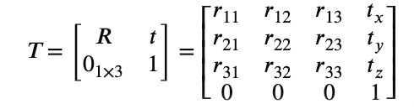
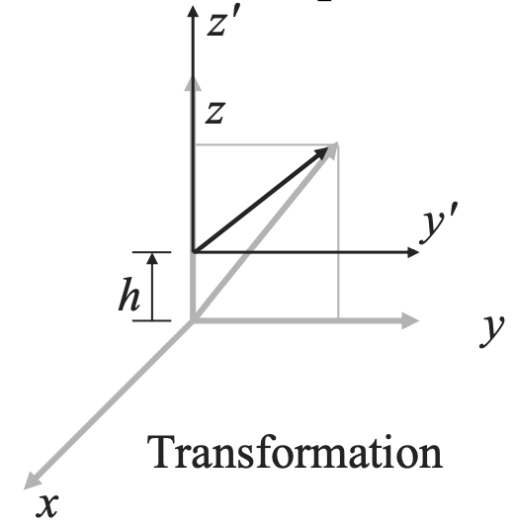
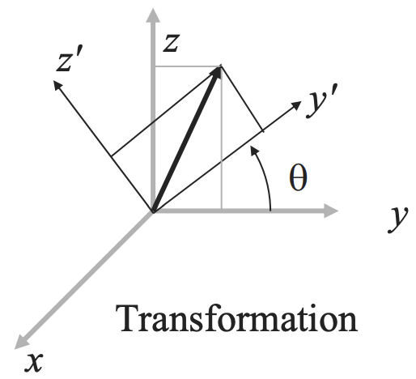
Case 2: De Novo Enzyme Design
ML Objective Translation:
Biological Goal | ML Objective | Data Representation
Create a backbone complementary to the target surface | Conditional 3D generation: generate backbone frames conditioned on the target structure + hotspot residues | Residue frames lives on SE(3) (R ∈ SO(3), t ∈ ℝ³)
Find a sequence that folds to this backbone | Inverse folding: maximize P(sequence | backbone) | 3D graph → sequence tokens
Verify it folds correctly | Self-consistency: RMSD(designed backbone, prediction) < 2 Å | Sequence → 3D coordinates
SE(3) group expressed as a 4 x 4 homogeneous transformation matrix
translation
rotation
V Kumar, course MEAM 620, UPenn
Notes:
SE(3) - Special Euclidean group in 3D
In a SE(3) equivariant model, if the input protein is translated or rotated, the internal representation and output property prediction would change accordingly (equivariant). If the input is reflected, the internal representation and output prediction would change completely instead of simply mirrored as the model treats this reflected input as a different object.

Slide 12
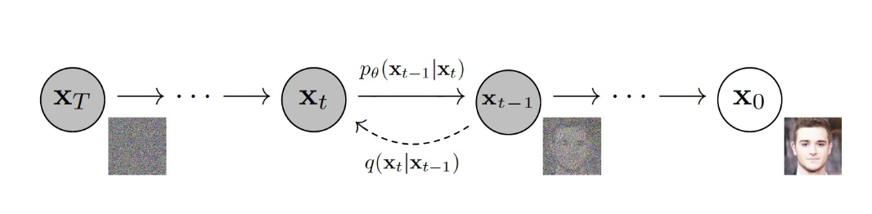
Case 2: De Novo Enzyme Design
Potential Model for backbone generation:
Diffusion
Backward diffusion process: generate high-quality samples from random noise
Forward diffusion process: transforms images into noise
Key idea: generates data by learning to reverse a “noising” process
De novo design of protein structure and function with RFdiffusion

Slide 13
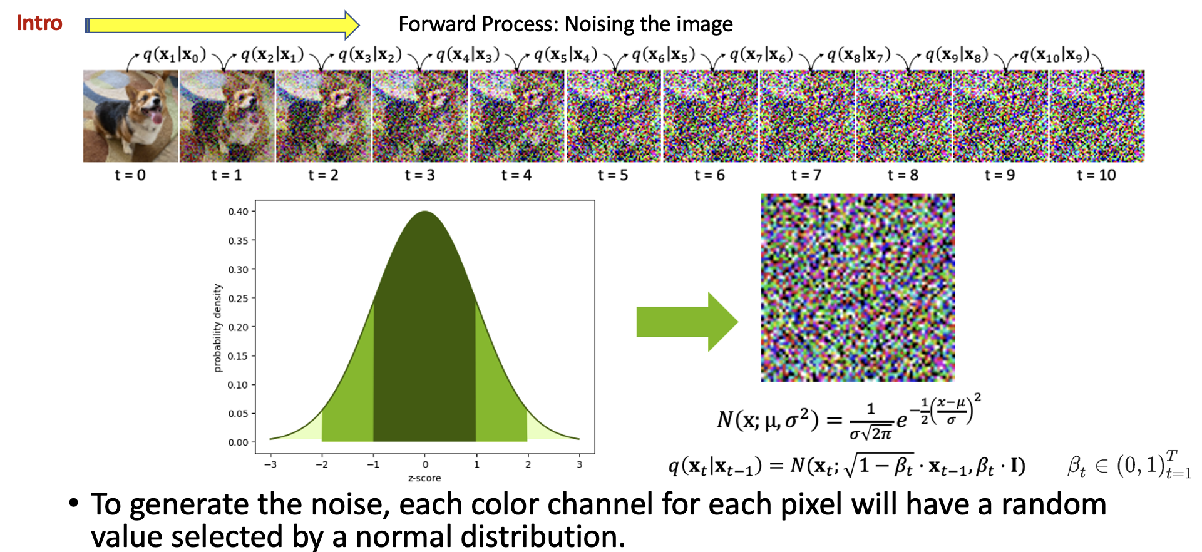
Case 2: De Novo Enzyme Design
Potential Model:
Diffusion
Slide from NVIDIA
Notes:
To noise the image $x_{t}$ at time step $t$, all the possible pixel values for $x_{t+1}$ will follow a normal distribution.
“q” - the probability distribution we use to generate a noisy image at each timestep
“Beta schedule” or “Variance Schedule” $β_{t}$
How much noise we add at each timestep
increases in the forward process
Since probability of the next step is only conditioned on the previous step, the forward process is a Markov chain

Slide 14
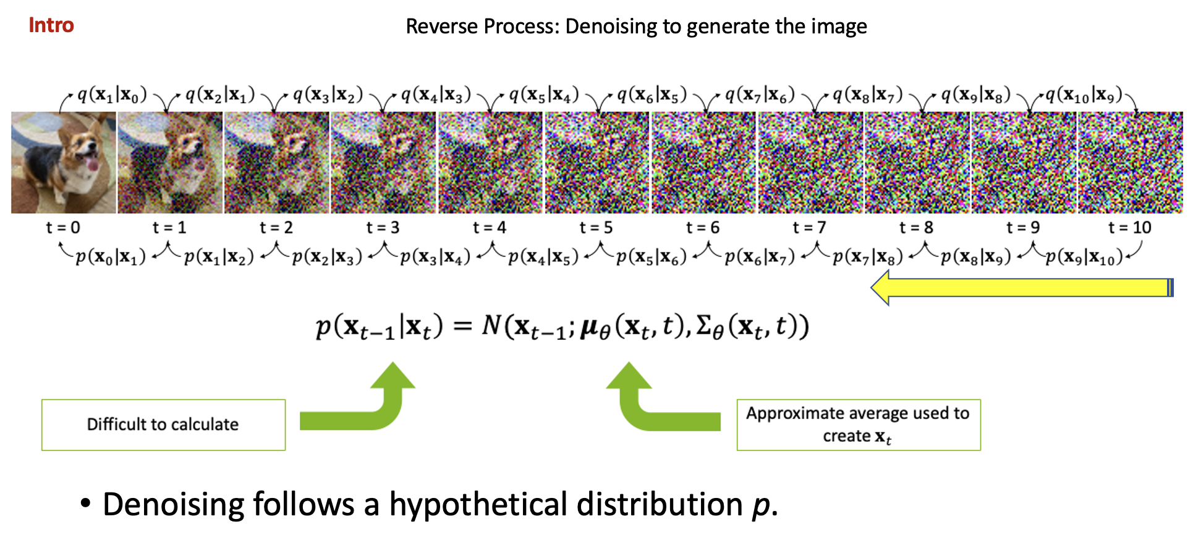
Case 2: De Novo Enzyme Design
Potential Model:
Diffusion
Slide from NVIDIA
Notes:
The reverse process is also a Markov chain.
$p$ – the hypothetical distribution we use to denoise
There are practically infinite ways noise can be added at timestep $t$.
$μ_{t}$represents what the average image would be at timestep $t−1$.
$Σ_{θ}$ represents some model of noise at the previous timestep.
It’s challenging to know what that model of noise is exactly, so our neural network will attempt to emulate.
We may not know what this p distribution is, but we know it exists because of evidence $x_{t}$

Slide 15
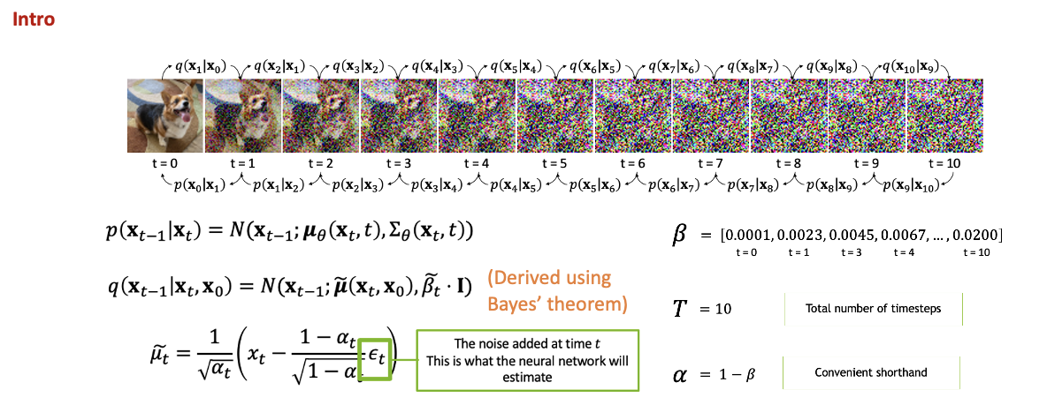

Case 2: De Novo Enzyme Design
Potential Model:
Diffusion
Slide from NVIDIA
Notes:
We can try to reverse the q distribution.
Since we know exactly what this distribution is for the forward process, we can create an estimate for $x_{t−1}$ from $x_{t}$ and $x_{0}$.
We can create $\tilde{μ_{t}}$, an estimate for what the average image at timestep $t$ would look like. We know our neural network is decent at recognizing added noise $ε_{t}$.
We will use our network to predict the noise, plug in our values of $α$, and this will help us predict what an image at the previous timestep could look like.

Slide 16
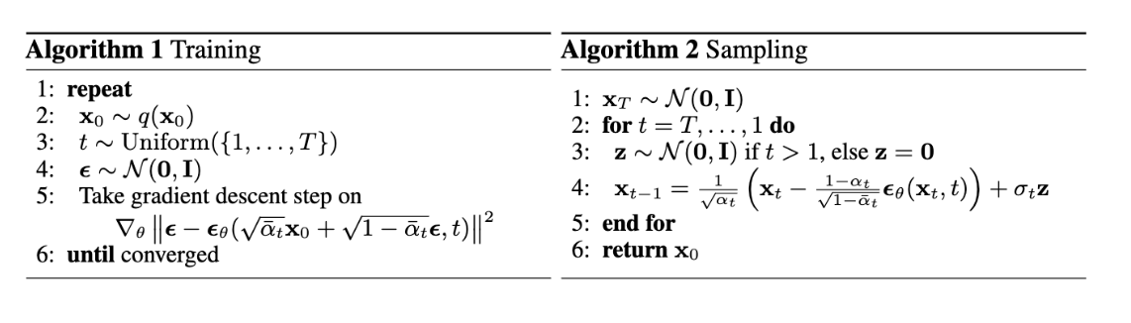
Case 2: De Novo Enzyme Design
Potential Model:
Diffusion
adds noise over timesteps in the forward process and learns the reverse using gradient descent
samples from N(0,1) and take reverse steps based on predicted noise to generate an image
Note:
Slide from CPSC 6440
Notes:
Training:
A neural network is trained to predict the noise added at each step.
The model parameters are updated using gradient descent to minimize the difference between the predicted noise and the actual noise added during the forward process.
Alg 1 step 5: take the gradient of the L2 loss between the sampled noise and the predicted noise
Inference:
Alg 2 step 3-4: sample fresh noise at each time step and compute the previous less noisy image.
The first term subtracts a scaled version of the predicted noise from the current noisy image $x_{t}$.
The σₜz term re-adds a small amount of controlled stochasticity at each step, which is what makes this a stochastic sampler (DDPM) rather than a deterministic one

Slide 17
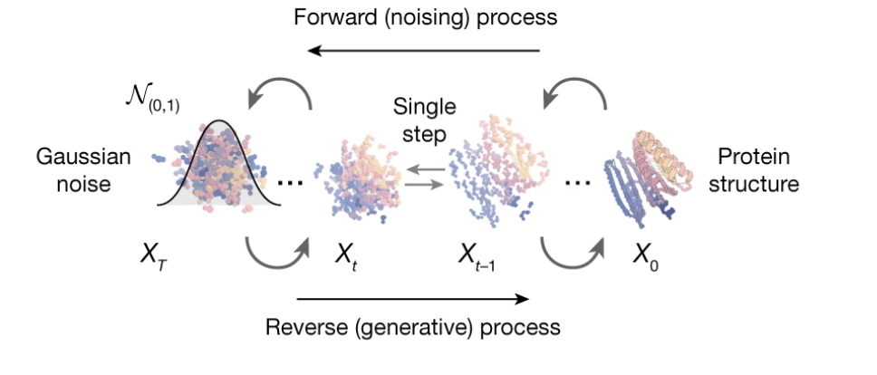
Case 2: De Novo Enzyme Design
Potential Model:
Diffusion
  RFDiffusion
De novo design of protein structure and function with RFdiffusion
Notes:
The data being noised/denoised is the protein backbone — specifically the rigid body frames (rotation + translation) of each residue.
At t=0: a real, folded protein backbone
At t=T: the residue frames have been noised into essentially random orientations and positions

Slide 18
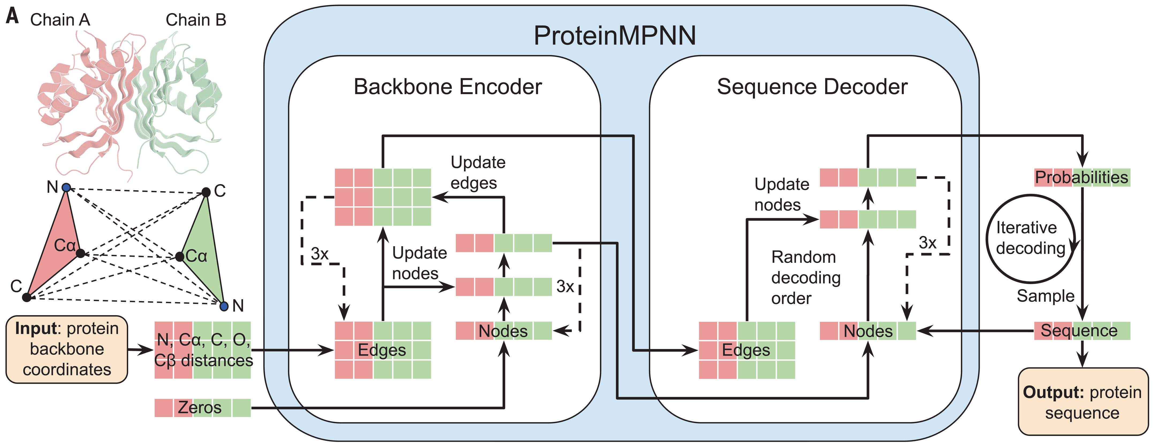
Case 2: De Novo Enzyme Design
Potential Model for sequence design:
GNN
  ProteinMPNN (Designing Sequences for RFDiffusion Backbones)
Robust deep learning–based protein sequence design using ProteinMPNN
Notes:
Distances between N, Cα, C, O, and virtual Cβ are encoded and processed using a message-passing neural network (Encoder) to obtain graph node and edge features. The encoded features, together with a partial sequence, are used to generate amino acids iteratively in a random decoding order.

Slide 19
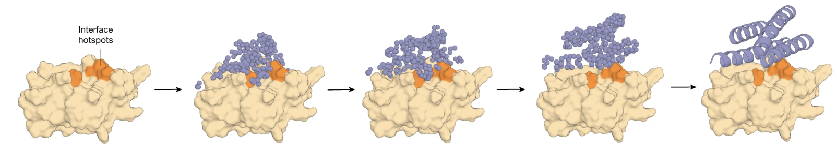
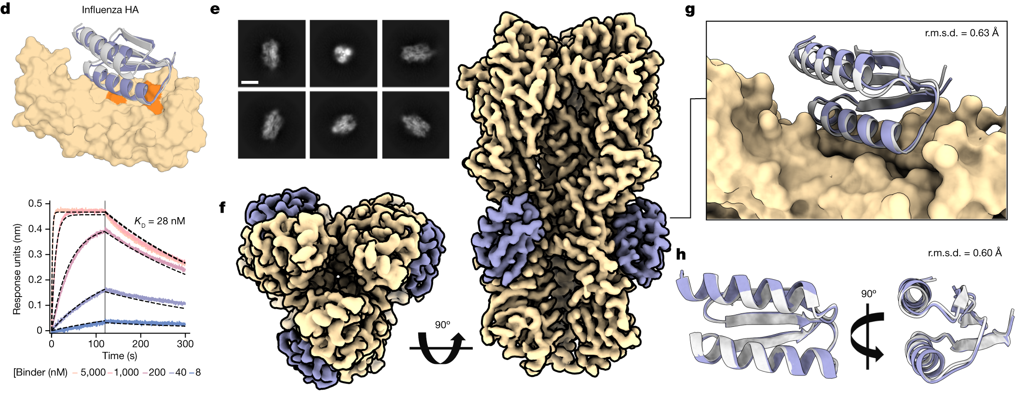
Case 2: De Novo Enzyme Design
Results:
De novo design of protein structure and function with RFdiffusion
Notes:
a. RFdiffusion generates protein binders given a target and specification of interface hotspot residues
d. The highest affinity HA binder, HA_20, binds with a K_{D} of 28 nM
f. cryo-EM 3D reconstruction of the complex shows that the designed binder is bound to H1 along the stem of all three subunits
g. the cryo-EM structure of the HA_20 binder in complex closely matches the design model
h. structure of the HA_20 binder (purple) superimposed on the design model (grey)

Slide 20
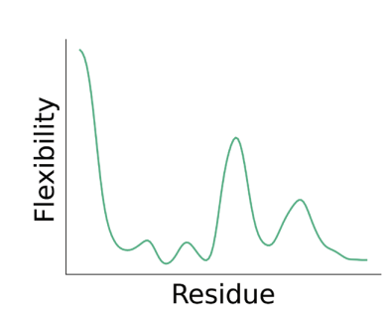
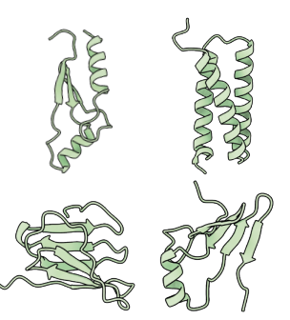
Case 3: Flexibility-Conditioned Protein Structure Design
Context: Protein flexibility is critical for function: enzyme catalysis requires flexible active-site loops, molecular recognition requires induced fit, allosteric signaling requires coordinated domain motions.
Task: Design proteins whose flexibility profile matches a user-specified target

Slide 21
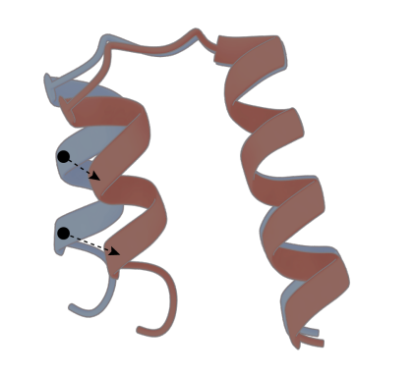
Case 3: Flexibility-Conditioned Protein Structure Design
Biological Questions:
Question | Why It Matters for ML
Should we consider local or global flexibility? Local per-residue flexibility. If a rigid helix moves as a domain, the global alignment assigns it high RMSF even though it is locally stiff. | Defines the target conditioning signal — a 1D vector of RMSF (Root Mean Square Fluctuation) values
Can static structure predict flexibility? Partially — loops/termini tend to be flexible, packed cores tend to be rigid — but the relationship is complex | Needs a learned predictor
Notes:
Per-residue RMSF (Root Mean Square Fluctuation) from molecular dynamics — measures how much each residue moves over time

Slide 22
Case 3: Flexibility-Conditioned Protein Structure Design
ML Objective Translation:
Biological Goal | ML Objective | Data Representation
Predict flexibility from structure | Regression: backbone 3D coords → per-residue RMSF (Discriminative) | 3D structure → scalar per residue
Generate backbone with target flexibility | Conditional 3D generation: sample backbone conditioned on RMSF profile (Generative) | Noise → residue frames, conditioned on 1D flexibility vector
Verify designed backbone is foldable | Self-consistency: ProteinMPNN → ESMFold → scRMSD | Backbone → sequence → predicted structure
Notes:
Compute scRMSD by aligning the ESMFold predicted protein structure with the generated backbone

Slide 23
Case 3: Flexibility-Conditioned Protein Structure Design
Potential Models:
Equivariant GNN for flexibility prediction
Input: Protein backbone 3D coordinates
(no sequence info making it applicable to de novo designed proteins)
Output: Per-residue RMSF prediction
SE(3)-equivariance: Predictions are equivariant to rotations/translations of the input — physically correct since flexibility is an intrinsic property

Slide 24
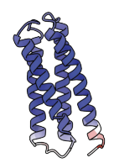
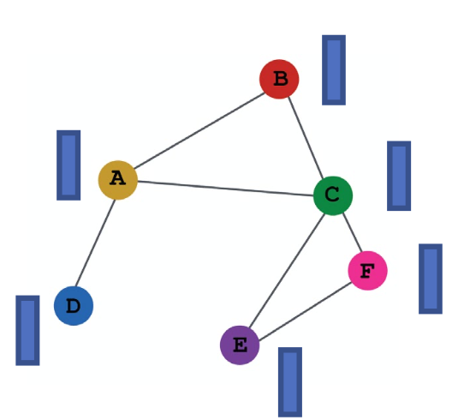
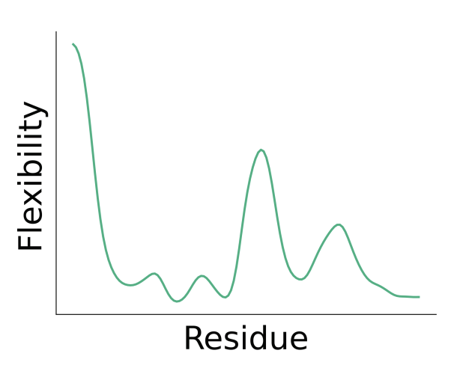

Case 3: Flexibility-Conditioned Protein Structure Design
Potential Models:
Equivariant GNN
SE(3)-Equivariant GNN
h_{A}^{l}
h_{A}^{l+1}
z_{AD}^{l}
z_{AD}^{l+1}
Input 3D coordinates
of protein backbone atoms
Layer l
Layer l+1
Flexibility-conditioned protein structure design with flow matching
Notes:
Step 1: build 1 SE(3) frame per residue using the backbone atoms
Step 2: represent the entire backbone of N residues as a sequence of N SE(3) frames
Step 3: Compute the initial node and edge features from these N frames
Step 4: Pass these node/edge features through the message passing blocks for node and edge updates.
Step 5: An MLP layer for readout - a single scalar for each residue’s flexibility prediction

Slide 25
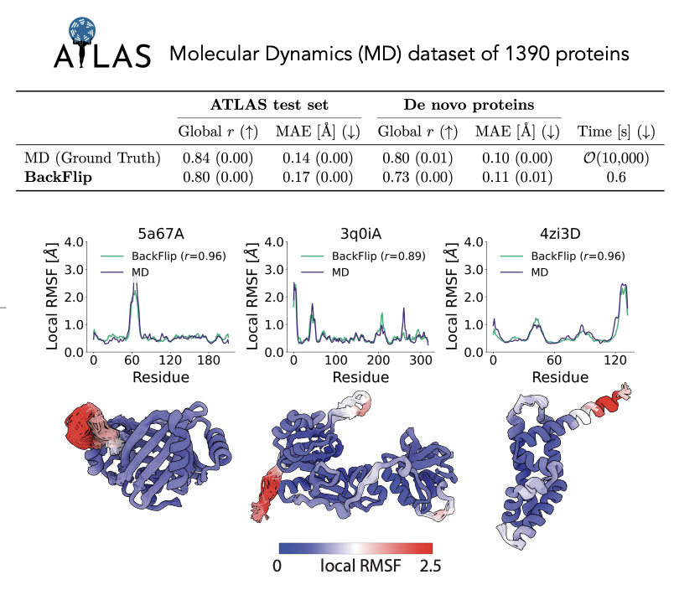
Case 3: Flexibility-Conditioned Protein Structure Design
Results:
Flexibility-conditioned protein structure design with flow matching

Slide 26
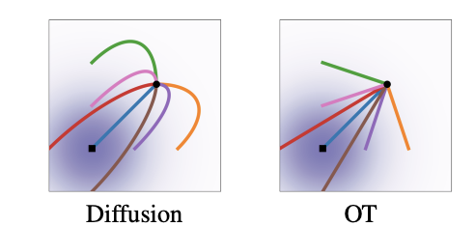
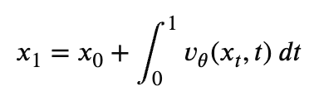
Case 3: Flexibility-Conditioned Protein Structure Design
Potential Models:
Flow-based generative models
Predict the direction and speed from noise to data.
Even simpler than DDPM!
Encoder (Conv)
μ
Decoder (Deconv)
x
z
x’
VAE
q(z|x)
p(x|z)
σ
Forward (Noise)
Reverse (denoise)
q(x_{t}|x_{t-1})
p(x_{t-1}|x_{t})
x₀
x₁
…
x_{T}
…
The "noise" added is a random variable ε
Diffusion
x’₁
x’₀
x₀
v_{θ}(xₜ, t)Δt
v_{θ}(xₜ, t)Δt
The ”velocity" v is a deterministic direction toward the target x₁
Flow-matching
x_{0.1}
…
x_{0.5}
…
x_{0.9}
x₁
Flow Matching for Generative Modeling
Notes:
Top: VAE - Compresses data into a low-dimensional "latent space" and reconstructs it, often used as a bottleneck to make diffusion faster.
Middle: Flow-based - Learns a direct, linear, straight path from noise to data. Uses Ordinary Differential Equations (ODEs) to achieve high-quality generation in fewer steps (10–50).
Bottom: Diffusion - Learns to reverse a noise process, typically taking many small, stochastic (random) steps (50–1000+).

Slide 27
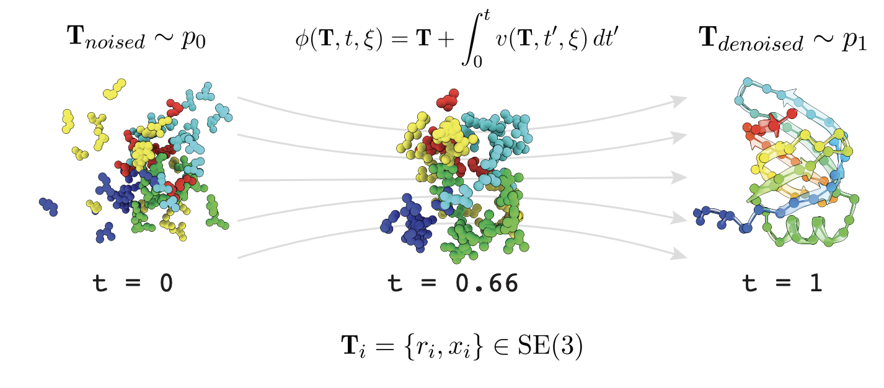
Case 3: Flexibility-Conditioned Protein Structure Design
Potential Models:
Flow matching
Flexibility-conditioned protein structure design with flow matching
Notes:
Step 1: Pick a pair of noised and denoised data points
Step 2: Interpolate a straight-path between them
Step 3: Compute the velocity for this path $v_{t}=p_{1}+p_{0}$
Step 4: Train a NN to predict the velocity of this path using a mean squared error (MSE) loss
Step 5: Inference: start with noise $p_{0}$, use an ODE solver (Euler or Runge-Kutta) to follow the learned velocity field $v$ from $t=0$ to $t=1$ to arrive at the denoised data point $p_{1}$

Slide 28
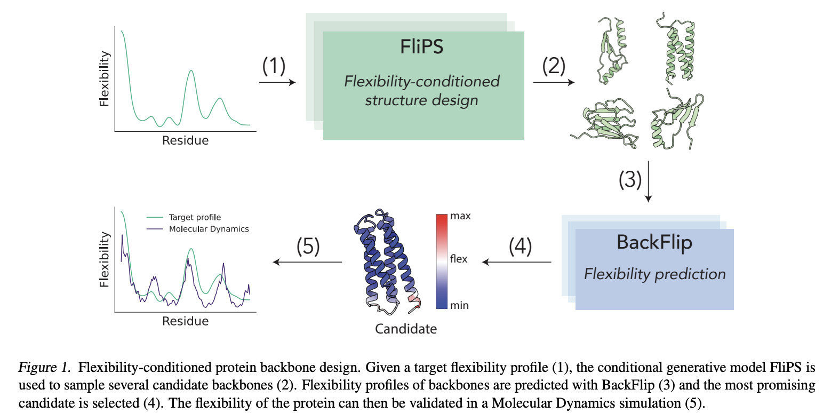
Case 3: Flexibility-Conditioned Protein Structure Design
Potential Models:
Flow matching for backbone generation
Flexibility-conditioned protein structure design with flow matching

Slide 29
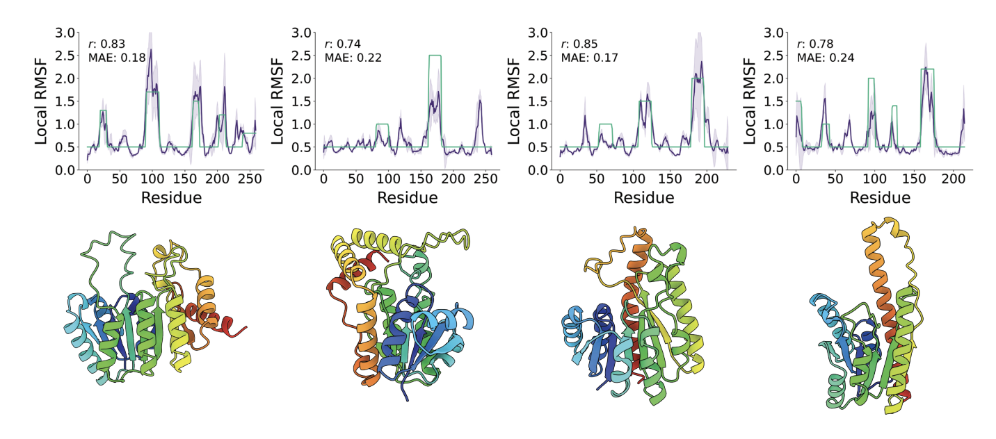
Case 3: Flexibility-Conditioned Protein Structure Design
Results:
Flexibility-conditioned protein structure design with flow matching

Slide 30
Takeaway
The biology tells us which data representation is natural — and the data representation tells us which architecture to use.
Data representation:
Tokens
Graphs
Architecture:
Transformer
GNN
DDPM
Flow-matching

Slide 31
References
GenAI for protein design papers:
Hayes, T., Rao, R., Akin, H., Sofroniew, N. J., Oktay, D., Lin, Z., Verkuil, R., Tran, V. Q., Deaton, J., Wiggert, M., Badkundri, R., Shafkat, I., Gong, J., Derry, A., Molina, R. S., Thomas, N., Khan, Y. A., Mishra, C., Kim, C., … Rives, A. (2025). Simulating 500 million years of evolution with a language model. Science, 387(6736), 850–858. https://doi.org/10.1126/science.ads0018 (Focus on Supplementary Information sections A.1.5. for Transformer and A.1.6. for Geometric Attention)
Watson, J. L., Juergens, D., Bennett, N. R., Trippe, B. L., Yim, J., Eisenach, H. E., Ahern, W., Borst, A. J., Ragotte, R. J., Milles, L. F., Wicky, B. I. M., Hanikel, N., Pellock, S. J., Courbet, A., Sheffler, W., Wang, J., Venkatesh, P., Sappington, I., Torres, S. V., … Baker, D. (2023). De novo design of protein structure and function with RFdiffusion. Nature, 620(7976), 1089–1100. https://doi.org/10.1038/s41586-023-06415-8 (Focus on Fig. 1. See Supplementary Information sections 2.1 for diffusion formulation and 2.6 for geometric invariances)
Dauparas, J., Anishchenko, I., Bennett, N., Bai, H., Ragotte, R. J., Milles, L. F., Wicky, B. I. M., Courbet, A., de Haas, R. J., Bethel, N., Leung, P. J. Y., Huddy, T. F., Pellock, S., Tischer, D., Chan, F., Koepnick, B., Nguyen, H., Kang, A., Sankaran, B., … Baker, D. (2022). Robust deep learning–based protein sequence design using ProteinMPNN. Science, 378(6615), 49–56. https://doi.org/10.1126/science.add2187 (Focus on Fig. 1)
Viliuga, V., Seute, L., Wolf, N., Wagner, S., Elofsson, A., Stühmer, J., & Gräter, F. (2025). Flexibility-Conditioned Protein Structure Design with Flow Matching. Proceedings of the 42nd International Conference on Machine Learning, Vancouver, Canada. PMLR 267, 2025. https://openreview.net/forum?id=890gHX7ieS (Focus on 2.1 and 4.1)
Original Diffusion and Flow-matching papers on image generation:
Ho, J., Jain, A., & Abbeel, P. (2020). Denoising Diffusion Probabilistic Models.
Lipman, Y., Chen, R. T. Q., Ben-Hamu, H., Nickel, M., & Le, M. (2023). Flow Matching for Generative Modeling.

Slide 32
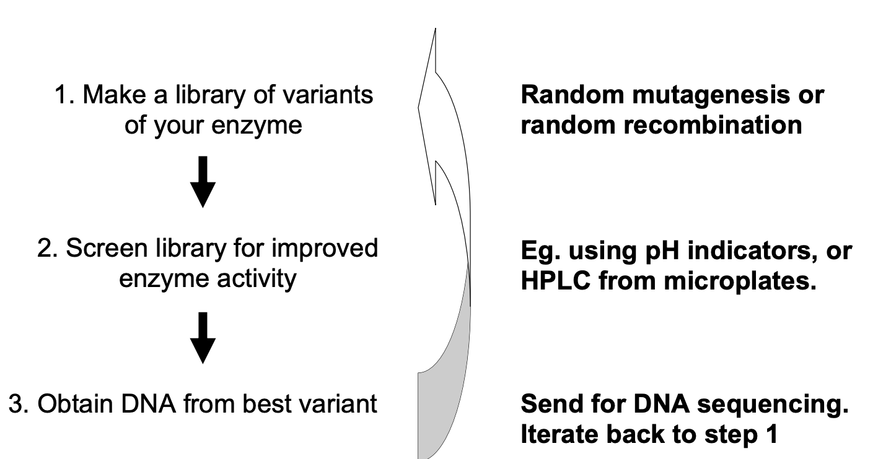
Q&A
Q: How was protein design done before the AI era?
A: Rational Design (Physics-based simulation) + Directed Evolution (library construction of random genetic mutations)
This traditional route typically takes years in the Discovery to Phase I window which the AI-guided route can compress significantly.
D. E. Shaw has brought an AI-guided cancer drug into Phase III clinical trials.
Figure source: Paul Dalby, course BENG0031, University College London, 2021

