Slide 1

Biomedical Data Science (GersteinLab.org/courses/3520)
Network Topology – Generation Models (26m10c)
Last edit in spring ’25. Very similar to 2022’s 22m10c &
2021’s M10c [which has a video].
Mark Gerstein
Yale U.

Slide 2
Network Topology
Simple Mathematical Models for Interpreting Complex Topology: ER Model & Small World Networks

Slide 3
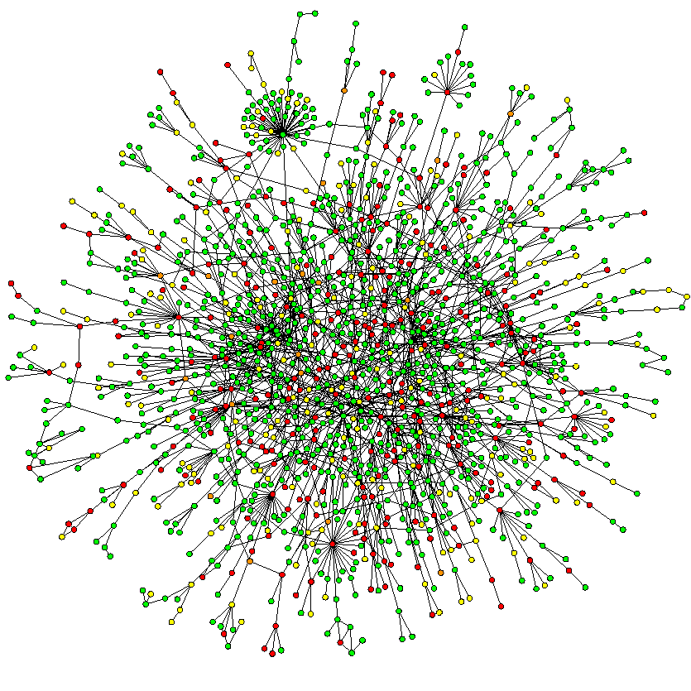
Models for networks of complex topology
Erdos-Renyi (1960)
Watts-Strogatz (1998)
Barabasi-Albert (1999)
A Barabási & R Albert
"Emergence of scaling in random networks,"
Science 286, 509-512 (1999).

Slide 4
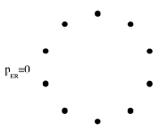
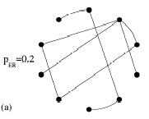
The Erdős-Rényi [ER] model (1960)
Start with N vertices and no edges
Connect each pair of vertices with probability P_{ER}
Important result: many properties in these graphs appear quite suddenly, at a threshold value of P_{ER}(N)
  If P_{ER}~c/N with c<1, then almost all vertices belong to isolated trees
  Cycles of all orders appear at P_{ER} ~ 1/N

Slide 5
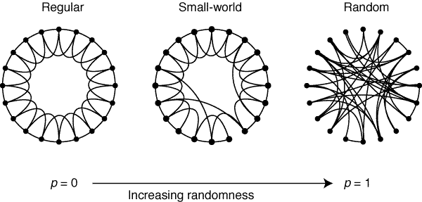
The Watts-Strogatz [WS] model (1998)
Start with a regular network with N vertices
Rewire each edge with probability p
For p=0 (Regular Networks):
  high clustering coefficient
  high characteristic path length
For p=1 (Random Networks):
  low clustering coefficient
  low characteristic path length
QUESTION: What happens for intermediate values of p?

Slide 6
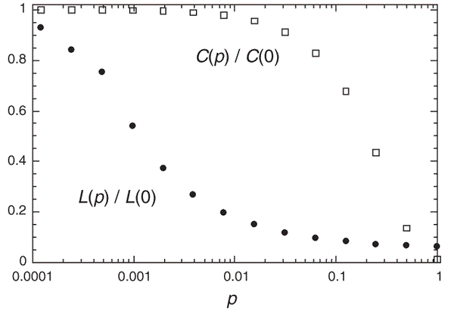
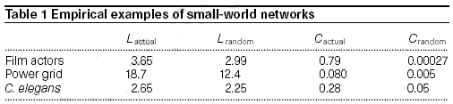
1) There is a broad interval of p for which L is small but C remains large
2) Small world networks are common :
Notes:
There is a quick drop of L due to the introduction of few “short cuts”

Slide 7
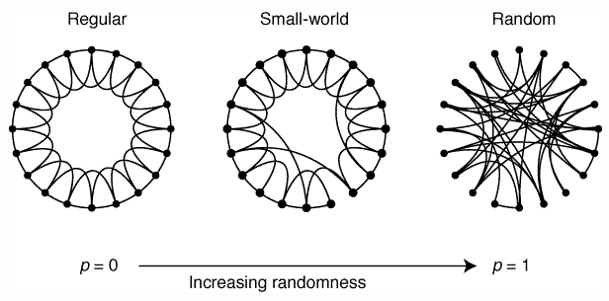
Small world network
A simple connected graph G exhibiting two properties:
  Large Clustering Coefficient: Each vertex of G is linked to a relatively well-connected set of neighboring vertices, resulting in a large value for the clustering coefficient C(G);
  Small Characteristic Path Length: The presence of short-cut connections between some vertices results in a small characteristic path length L(G).
local connectivity and global reach
Watts and Strogatz (1998), Nature, Collective dynamics of ‘small-world’ networks

Slide 8
Network Topology
Simple Mathematical Models for Interpreting Complex Topology: BA Model & Scale Free Networks

Slide 9
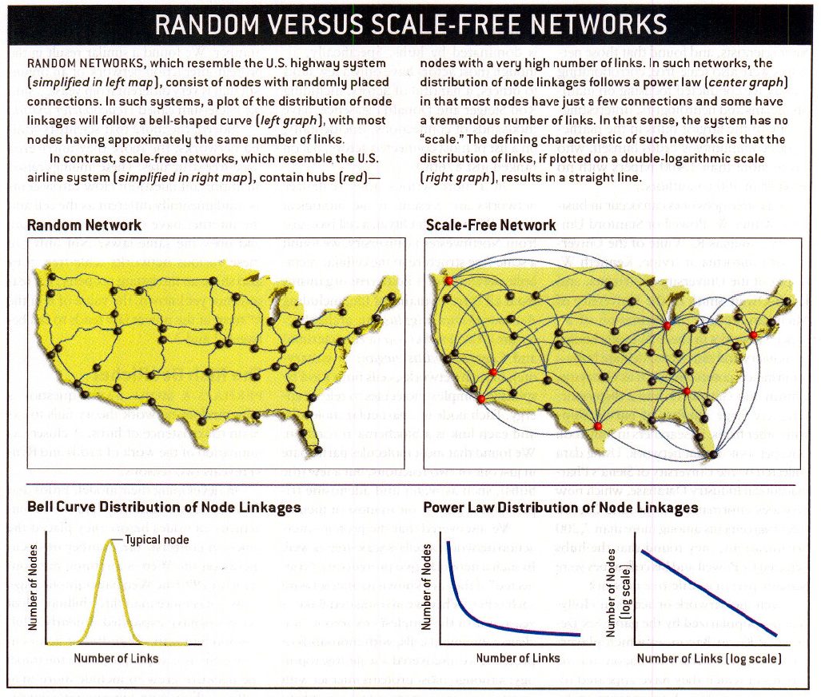
Random v Scale-free Networks
[From Barabasi & Bonabeau, Sci. Am., May '03]

Slide 10
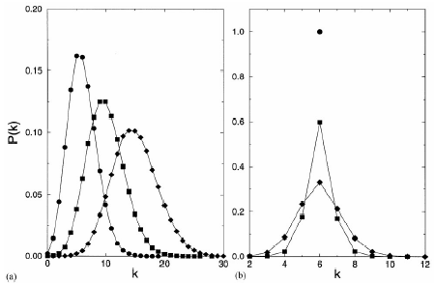
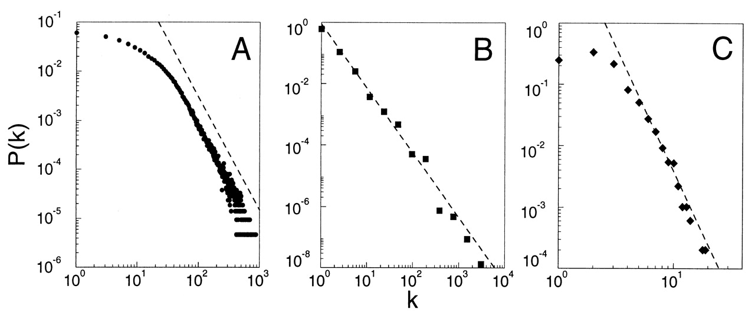
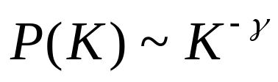
The Barabási-Albert [BA] model (1999)
Look at the distribution of degrees
ER Model
ER Model
WS Model
actors
power grid
www
The probability of finding a highly connected node decreases exponentially with k

Slide 11
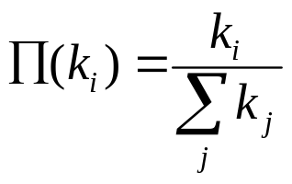



● two problems with the previous models:
    1. N does not vary
    2. the probability that two vertices are connected is uniform
GROWTH: starting with a small number of vertices m₀ at every timestep add a new vertex with m ≤ m₀
PREFERENTIAL ATTACHMENT: the probability Π that a new vertex will be connected to vertex i depends on the connectivity of that vertex:

Slide 12
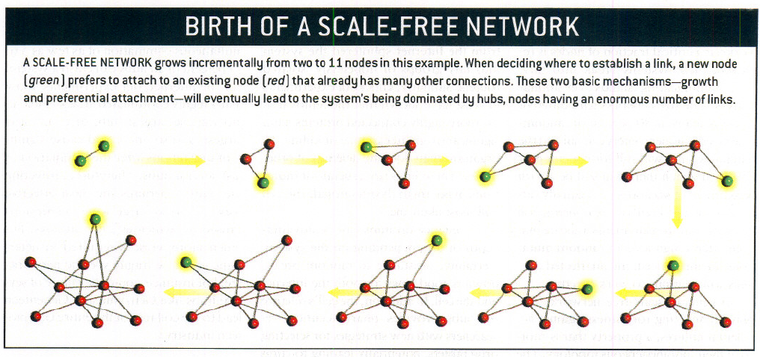
Birth of Scale-Free Network
[From Barabasi & Bonabeau, Sci. Am., May '03]

Slide 13
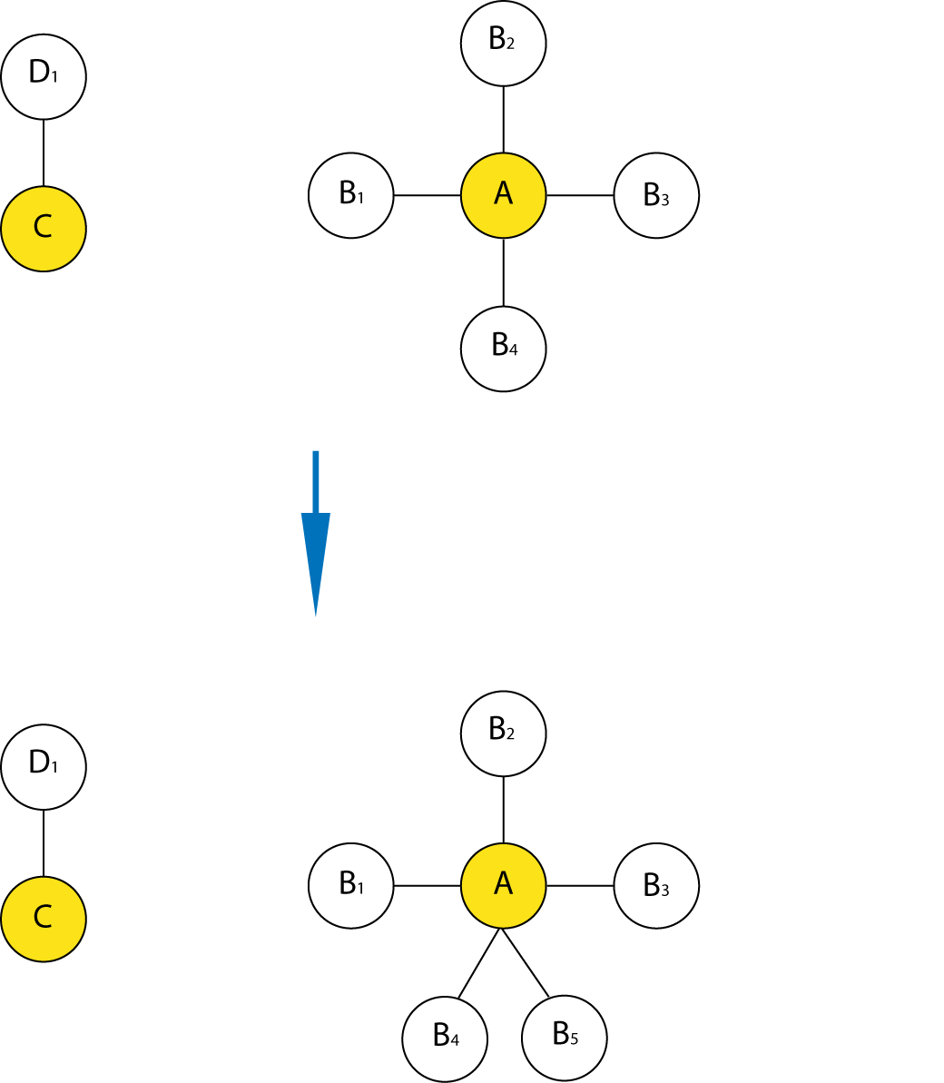
SCALE FREENESS GENERALLY EVOLVES THROUGH PREFERENTIAL ATTACHMENT (THE RICH GET RICHER)
The Duplication Mutation Model
Description
  Theoretical work shows that a mechanism of preferential attachment leads to a scale-free topology
  (“The rich get richer”)
  In interaction network, gene duplication followed by mutation of the duplicated gene is generally thought to lead to preferential attachment
The interaction partners of A are
more likely to be
duplicated
Gene duplication
  Simple reasoning: The partners of a hub are more likely to be duplicated than the partners of a non-hub
Source: Albert et al. Rev. Mod. Phys. (2002) and Middendorf et al. PNAS (2005)

Slide 14
SCALE FREENESS GENERALLY EVOLVES THROUGH PREFERENTIAL ATTACHMENT (THE RICH GET RICHER)
The Duplication Mutation Model
Description
  Theoretical work shows that a mechanism of preferential attachment leads to a scale-free topology
  (“The rich get richer”)
  In interaction network, gene duplication followed by mutation of the duplicated gene is generally thought to lead to preferential attachment
The interaction partners of A are
more likely to be
duplicated
Gene duplication
  Simple reasoning: The partners of a hub are more likely to be duplicated than the partners of a non-hub
Source: Albert et al. Rev. Mod. Phys. (2002) and Middendorf et al. PNAS (2005)

Slide 15
References
Barabási, A., & Bonabeau, E. (2003). Scientific American, 288(5), 60–69.
Scale-Free networks.
https://doi.org/10.1038/scientificamerican0503-60
Lectures.gersteinlab.org

