Slide 1

Biomedical Data Science (GersteinLab.org/courses/3520)
Network Topology – Network Quantities (26m10b)
Last edit in spring ’26, adding in Louvain compared to ‘25. Very similar to 2021’s M10b [which has a video].
Mark Gerstein
Yale U.

Slide 2
Degree of a node: the number of edges incident on the node
i
Degree of node i = 5

Slide 3
Network parameters
Number of incoming and outgoing connections
Incoming connections = 2.2
each gene is regulated by ~2 TFs
In-degree
Outgoing connections = 20.2
each TF regulates ~20 genes
Connectivity
Out-degree

Slide 4
Clustering coefficient
Clustering Coefficient:
  Ratio of existing links to maximum number of links for neighbouring nodes
  Example:
For A:
  3 neighbours
  2 existing link
  3 possible links
  Clustering coefficient
    C_{A}=2/3
A
C
B
D
Example from: http://www.learner.org/courses/mathilluminated/units/11/textbook/04.php

Slide 5
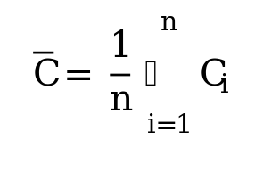
Clustering coefficient
Average Coefficient:
  Average of clustering coefficients of all nodes n
  Measure of inter-connectedness of the network
  Global property
Example:
  Clustering coefficient:
  C_{A}=2/3 C_{B}=2/3
  C_{C}=1/3 C_{D}=1/3
  Average coefficient =
  1/4(2/3+2/3+1/3+1/3)= 0.5
A
C
B
D
Example from: http://www.learner.org/courses/mathilluminated/units/11/textbook/04.php

Slide 6
Path length
Number of edges along a path
Path length = 3
Meaning:
  Number of intermediate TFs to reach final target
  Indication of how immediate a response is
i
1
2
j

Slide 7
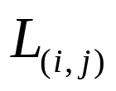
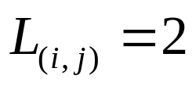
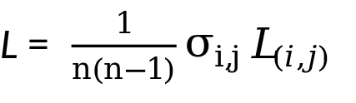
Characteristic path length (Average path length )
Path length
Shortest path length:
  is the minimum number of edges that must be traversed to travel from a vertex i to another vertex j of a graph G
i
Graph Theory Terminology (Batten, pp. 92-105)
j
The characteristic path length L of a graph is the average of the for every possible pair (i,j)
Networks with small values of L are said to have the “small world property”
http://en.wikipedia.org/wiki/Average_path_length

Slide 8
Network motifs
Regulatory modules within the network
SIM
MIM
FBL
FFL
[Alon U, 2007, Nature Reviews Genetics, Network motifs: theory and experimental approaches]

Slide 9
FFL = Feed-forward loops
SBF
Yox1
Pog1
Tos8
Plm2
[Alon U, 2007, Nature Reviews Genetics]
Notes:
First region shows feedback loop of SBF to itself and also Tos 4 to the original SBF and MBP factors

Slide 10
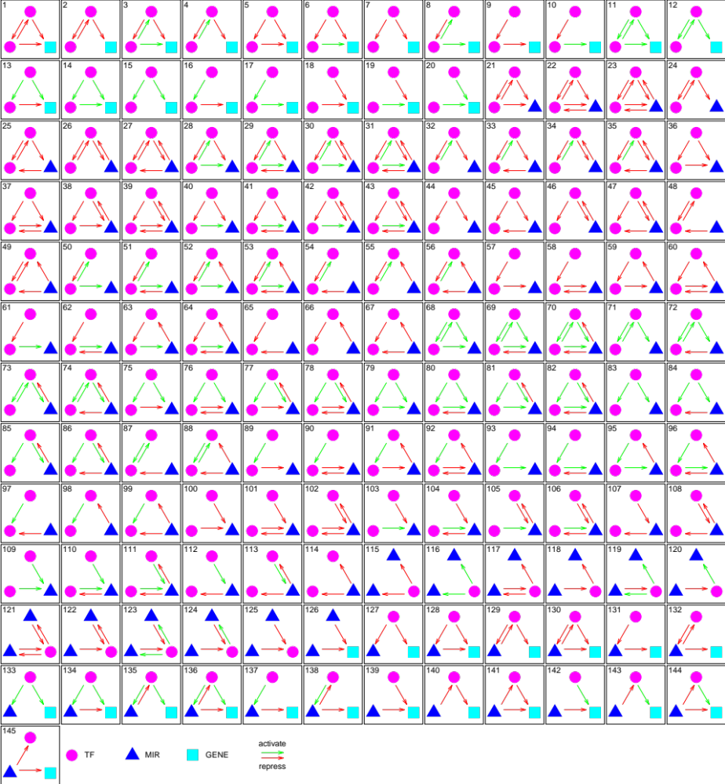
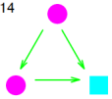
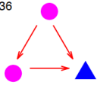
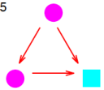
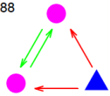
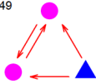
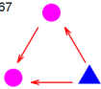
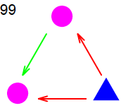
Network Motifs
7 Motifs
Over-represented
FFL involving
miRNA & 2 TFs
All Motifs
[Science 330:6012; Cheng et al. PLOS CB ‘11]
Notes:
5 and 14 coherent FFL
36.. Same but replace by MIR
88 49, toggle switch
57 and 99. MIR tends to shut down…
why do we want to remove the TF?
it stops generating the target, but the removal of TF is actually a waste. it's not logical to say that this is a cost-effective process. moreover, it delays the response time. however, in the usage of miRNA, it blocks the translation of TF protein without destroying the TF mRNA. i think this is an advantage compared to TF FFL loop.

Slide 11
Cliques
Fully connected sub-components
Related measures
k-cores : For all vertices in a graph G have degree at least k
K
[Hogue et al, BMC BIOINFORMATICS, 2003]
Problem: High-throughput experiments are prone to missing interactions

Slide 12
Predicting protein interactions by completing defective cliques
One solution—defective cliques
If proteins P and Q interact with a clique K of proteins which all interact with each other, then P and Q are more likely to interact with each other
P, Q, and K form a defective clique
P
Q
K
[Yu et al. Bioinformatics (2006)]

Slide 13
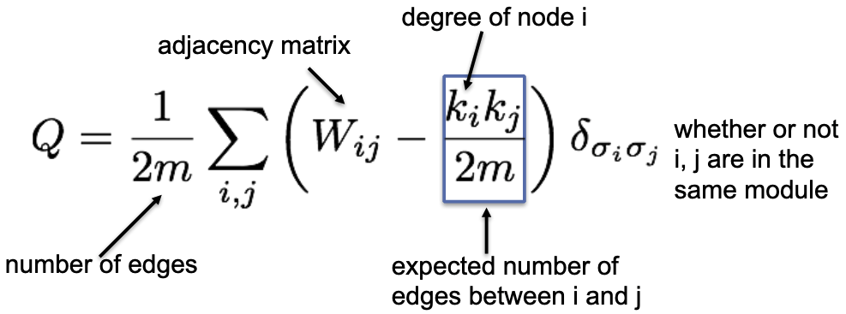
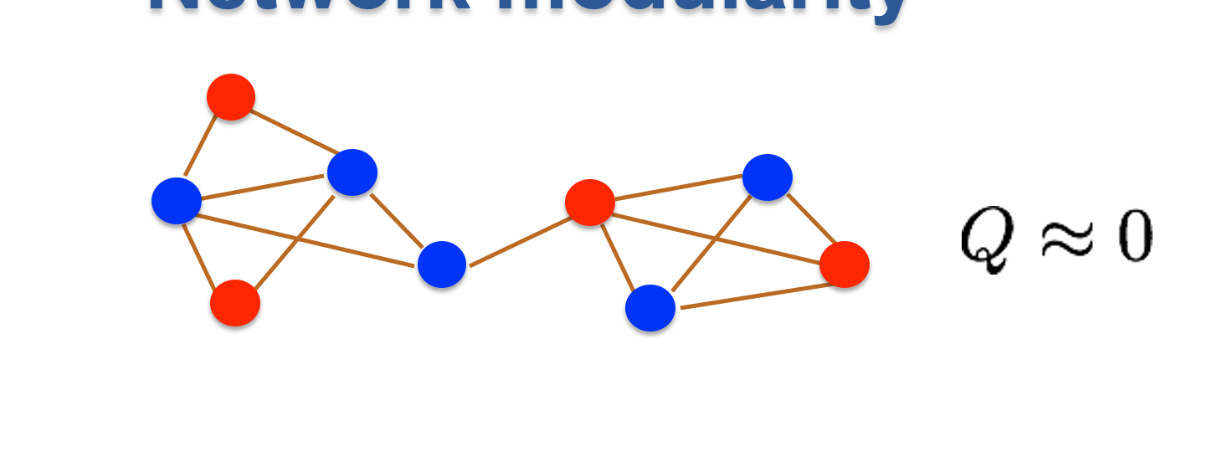
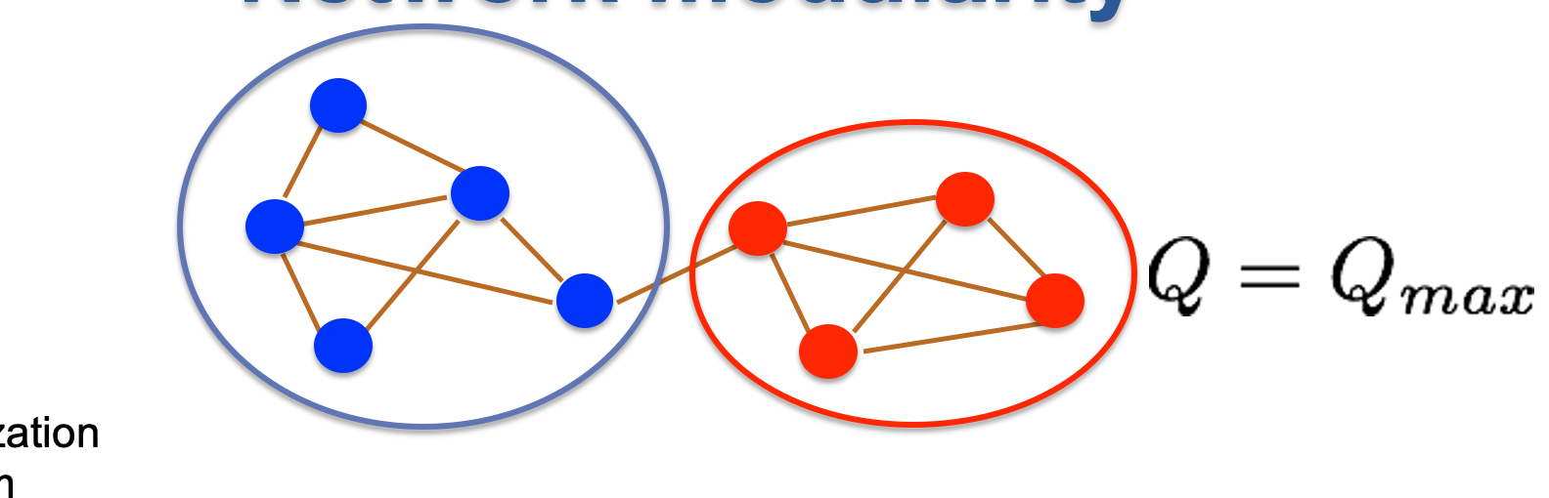
Modularity for Communities
(Calculation of Modularity Q)
B
1
D
9
Q ∝ 41
A
10
9
8
E
Q ∝ 22
C
3
W_ij | A | B | C | D | E
A | - | 9 | 8 | - | -
B | 9 | - | 10 | 1 | -
C | 8 | 10 | - | - | 2
D | - | 1 | - | - | 9
E | - | - | 2 | 9 | -
 | A | B | C | D | E
k_i | 17 | 20 | 21 | 10 | 12
Lectures.GersteinLab.org -
Newman Phys. Rev. E 2004

Slide 14
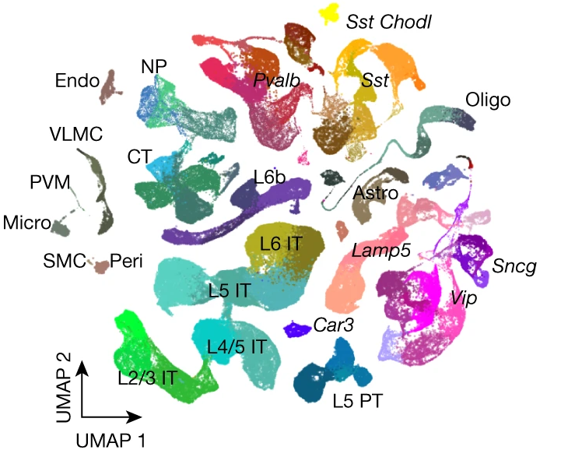
Application of
Modularity:
Clustering to
Determine
Cell Types
(More Later)
Clustering for cell typing often uses connectivity based approaches (discussed earlier)…
[Yao et al. (‘21) Nature]
Lectures.GersteinLab.org -

Slide 15
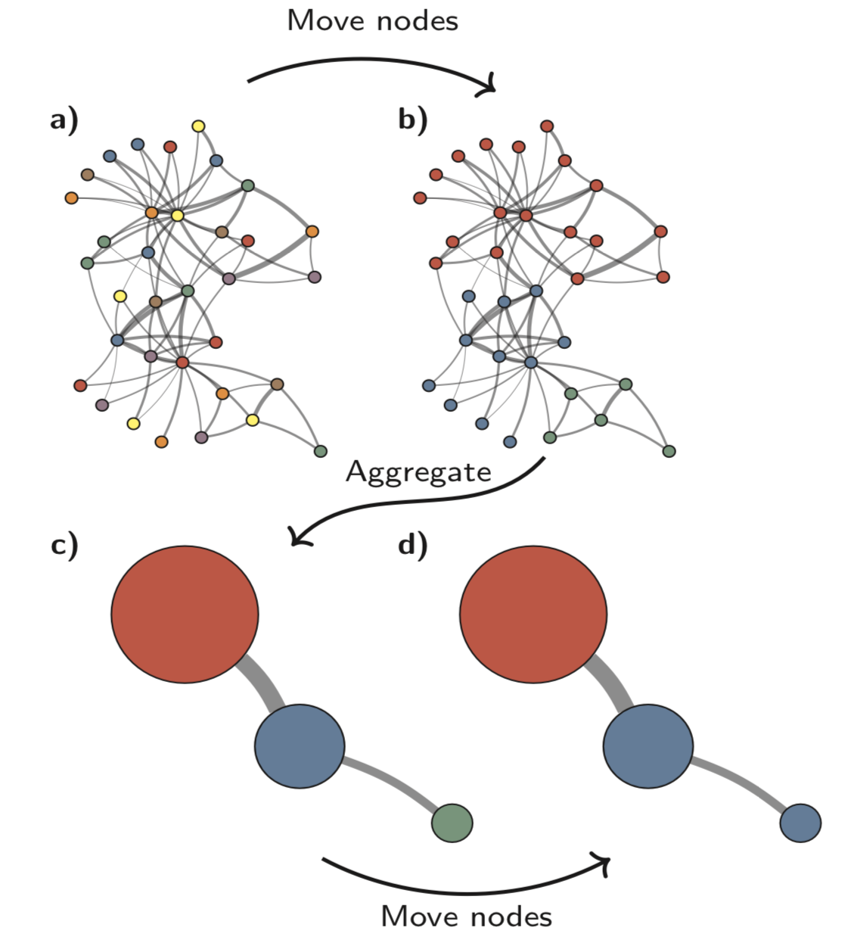
Louvain maximizes modularity
(Overall Algorithm Flow)
#1 Start:
Each node (cell) having its own community.
#2 Moving nodes:
Repeat scanning all nodes until no change increases Q (from a to b)
{{
Move each node to the one of its neighbor communities
that maximizes ΔQ;
Or start a new community
}}
#3 Aggregate:
Turn each community into a node.
Edges between communities are added up as the weight.
#4 Repeat from #2
Stop at desired resolution
(Leiden similar to Louvain)
Traag et al. Scientific Reports 2019
Lectures.GersteinLab.org -

Slide 16
References
McGillivray, P., Clarke, D., Meyerson, W., Zhang, J., Lee, D., Gu, M., Kumar, S., Zhou, H., & Gerstein, M. (2018). Annual Review of Biomedical Data Science, 1(1), 153–180.
Network analysis as a grand unifier in biomedical data science. https://doi.org/10.1146/annurev-biodatasci-080917-013444
(Section 2.)
Blondel, V. D., Guillaume, J., Lambiotte, R., & Lefebvre, E. (2008). J Stat Mech Theory & Expt., 2008(10), P10008.
Fast unfolding of communities in large networks.
https://doi.org/10.1088/1742-5468/2008/10/p10008
(Overview of Louvain clustering upgrade; read the methods section)
Lectures.gersteinlab.org

