Slide 1
RNN & GNN
Weihao Zhao
Mar. 2, 2026

Slide 2
Contents
Recurrent Neural Networks (RNN)
Attention & Transformers
Graph Neural Networks (GNN)

Slide 3
Recurrent Neural Networks (RNN)
RNN

Slide 4
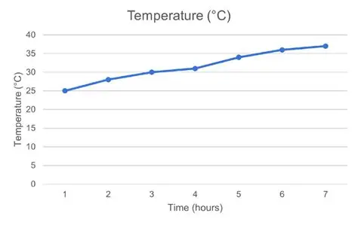
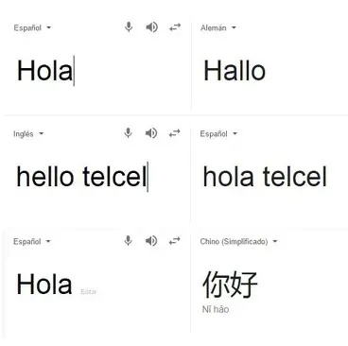
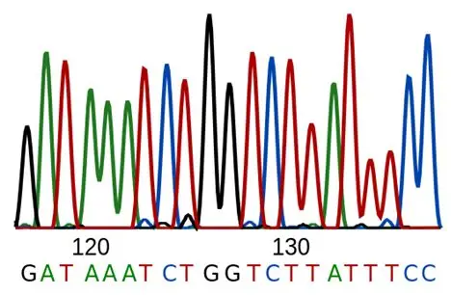
Sequence data with variable length is abundant in real world
RNN
Notes:
Sequence information as in natural language, time-series data, and biological sequences

Slide 5
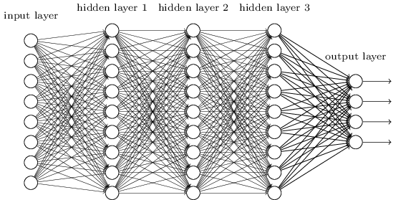
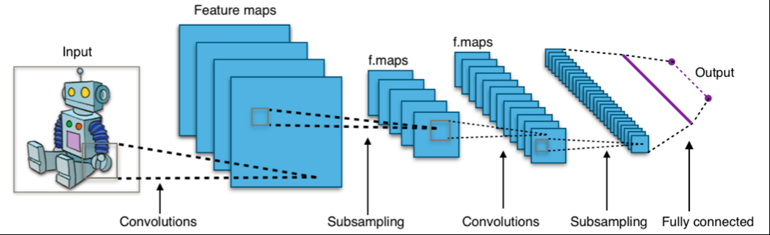
Standard NN and CNN could not deal with input with variable length
RNN
Notes:
They deal with fixed length/size input dataset, which have an upper limit.

Slide 6
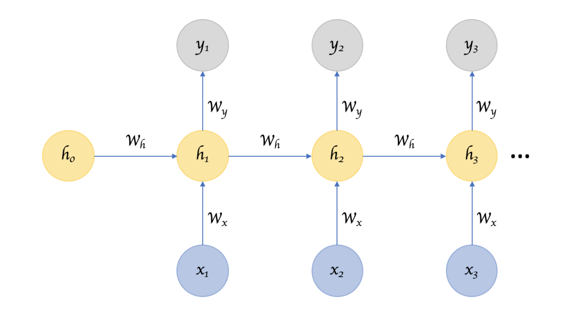
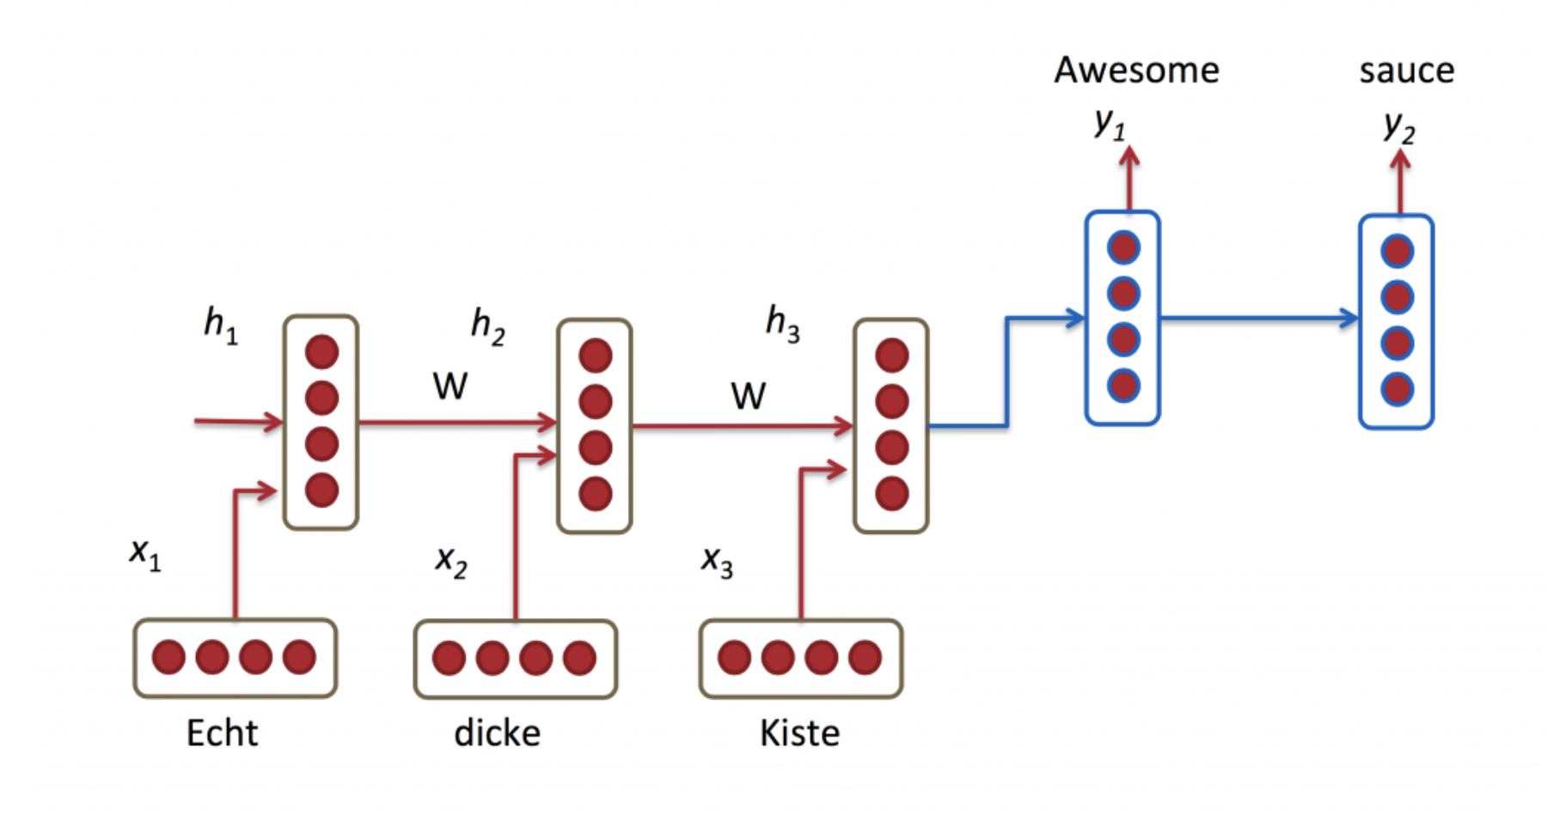
Recurrent Neural Networks could process sequence data with memory to previous parts
Encoder
Decoder
https://iq.opengenus.org/types-of-neural-networks/
https://blog.csdn.net/mwcxz/article/details/129600591
RNN
Notes:
Start with a hidden state, given one input token, update the hidden state and the output token.
Encoder & Decoder

Slide 7
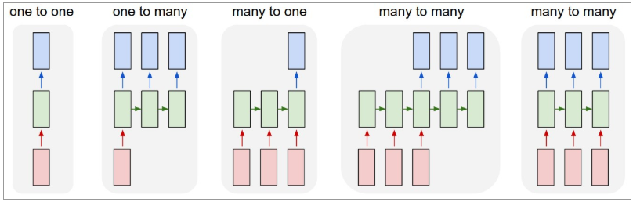
RNN is capable of multiple kinds of sequence-oriented tasks
https://www.researchgate.net/publication/331000984_Predictive_Fusion_Model_for_Multi-Modal_Data_Streams
RNN
Notes:
Depending on the input/output sequence requirement, we can use different combinations of encoder and decoder to perform different kinds of task on sequence data.

Slide 8
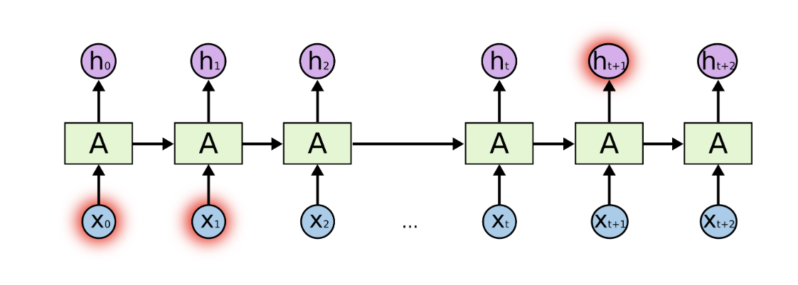
Vanila RNN might fail to remember long term relationship
https://colah.github.io/posts/2015-08-Understanding-LSTMs/
RNN
Notes:
As the hidden state was updated over and over again, earlier inputs and their effect on the hidden state could diminish.

Slide 9
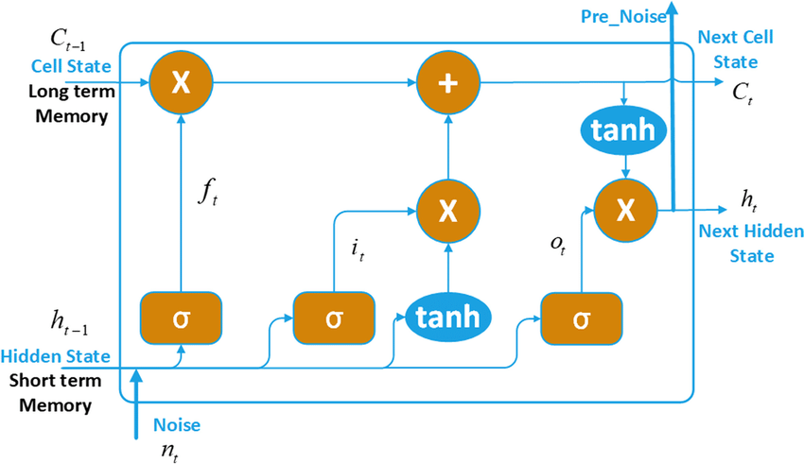
LSTM (Long/Short-Term Memory) memorizes information from inputs no matter near or far away
https://www.researchgate.net/publication/355754860_Noise_prediction_of_chemical_industry_park_based_on_multi-station_Prophet_and_multivariate_LSTM_fitting_model
RNN
Notes:
Different levels of information propagation help to memorize information from recent tokens and tokens long ago.

Slide 10
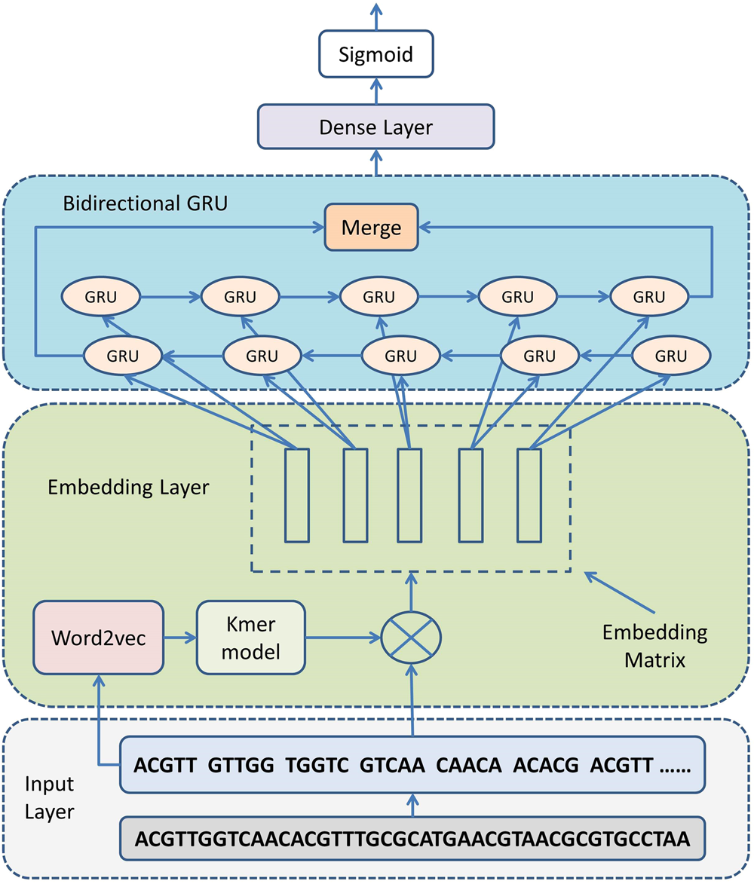
Application of RNN on DNA sequence
Shen et al., Sci Rep. 2018
RNN
Notes:
A group of researchers utilized GRU (gated recurrent unit, a special form of RNN) to predict transcription factor binding site across genome.

Slide 11
Attention & Transformers
Transformers

Slide 12
Another way of solving the problem with RNN?
All input sequence ”tokens” are the same in vanilla RNN
– Can we allow the model to selectively choose which part of the sequence it want?
https://colah.github.io/posts/2015-08-Understanding-LSTMs/
Transformers
Notes:
As the hidden state was updated over and over again, earlier inputs and their effect on the hidden state could diminish. LSTM could alleviate, but cannot fully solve the problem.
Reason for forgetting the earlier tokens: all tokens are the same, and hidden states will be overwritten

Slide 13
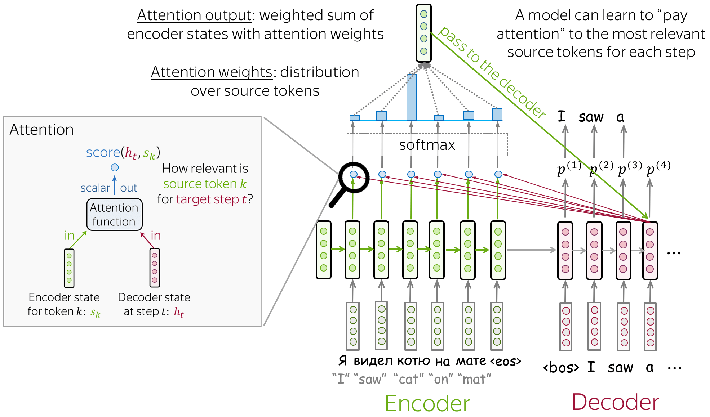
Define attention to address the long-range dependencies in RNN
Attention: a technique used in deep learning that allows the model to selectively focus on specific areas of the input data when making predictions.
https://medium.com/analytics-vidhya/implementation-of-neural-machine-translation-using-attentions-3b36337a5b23
Transformers
Notes:
2 benefits:
Decoder can have access to previous hidden layers in encoders
Attention allows different activity of previous hidden layers

Slide 14
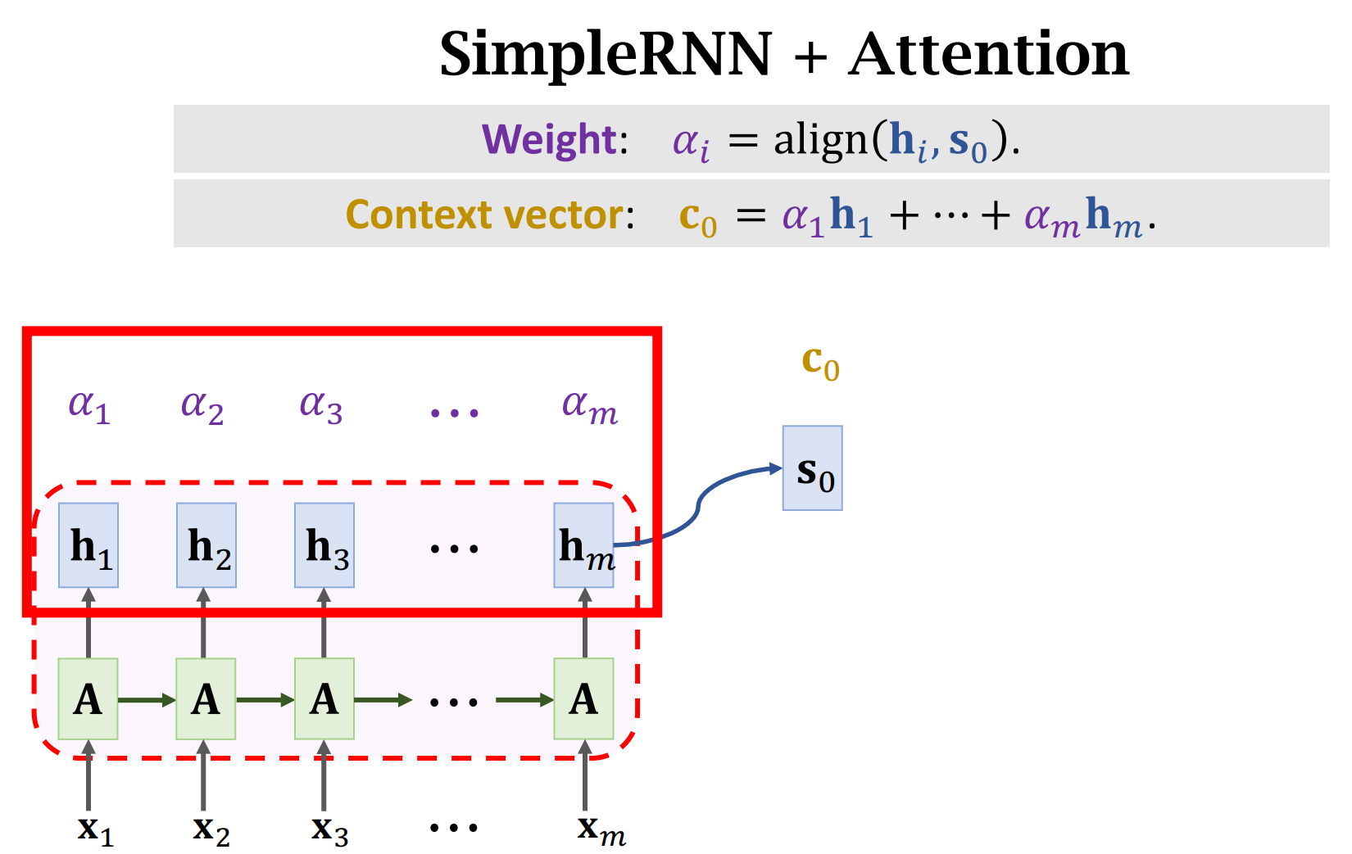
Calculation of attention in RNN
https://github.com/wangshusen/DeepLearning/blob/master/Slides/9_RNN_8.pdf
Transformers
Notes:
Attention is calculated by two steps:
Get the score between previous hidden layers and the current hidden layer (attention/weight by neural network)
Calculate the final hidden context for the decoder by averaging the hidden layers using the attention weight (after softmax)

Slide 15
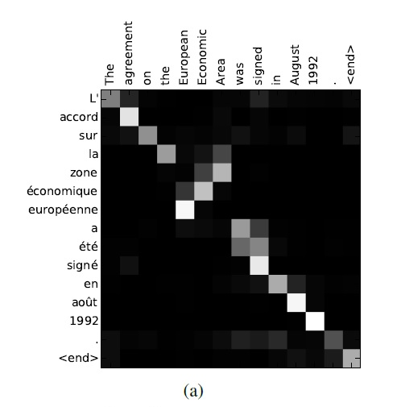
Attention can also help explain the model
https://arxiv.org/abs/1409.0473
Transformers
Notes:
Attention shows which input token is more important in determining the corresponding output token

Slide 16

Actually… attention is all you need
The dominant sequence transduction models are based on complex recurrent or convolutional neural networks that include an encoder and a decoder. The best performing models also connect the encoder and decoder through an attention mechanism. We propose a new simple network architecture, the Transformer, based solely on attention mechanisms, dispensing with recurrence and convolutions entirely. (Vaswani et al., 2017)
Self-attention: an attention mechanism relating different positions of a single sequence in order to compute a representation of the sequence
Embedding: a way to represent discrete objects (like words, images, audio, or graph nodes) as dense numerical vectors in a continuous space
Transformers
Notes:
Attention is more important than we thought, as it reveals the deep connection between the input and output sequence, and sometimes within the input sequence itself.
Is it possible that we can build a model to deal with sequences and capture their essence without a complex structure/labeled data?

Slide 17
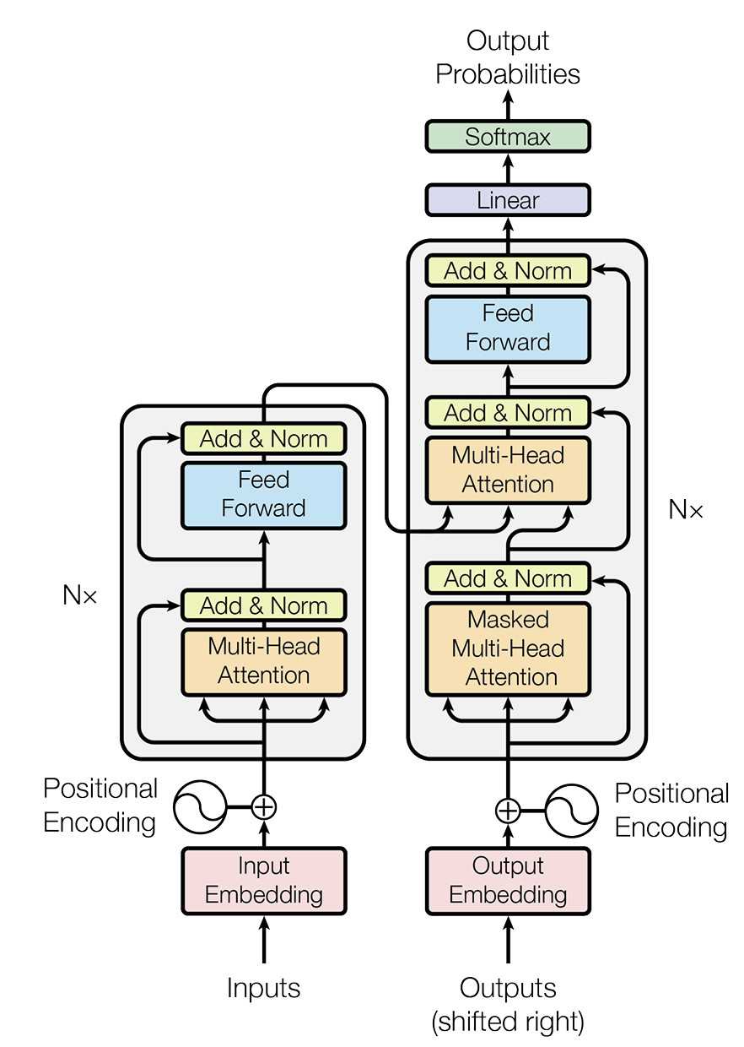
Overall architecture of transformers
Decoder
Encoder
https://arxiv.org/abs/1706.03762
Transformers
Notes:
Transformers are composed of multiple encoders and decoders, and they can be stacked in any form depending on the input sequence and the output task.

Slide 18
Embedding for input and output sequence
Embedding: produce a vector for each input/output token
Concatenated with positional encoding (produce a value for each token’s place in the sequence), this becomes the input to the Multi-Head Attention
https://arxiv.org/abs/1706.03762
Transformers
Notes:
Transformers are composed of multiple encoders and decoders, and they can be stacked in any form depending on the input sequence and the output task.

Slide 19
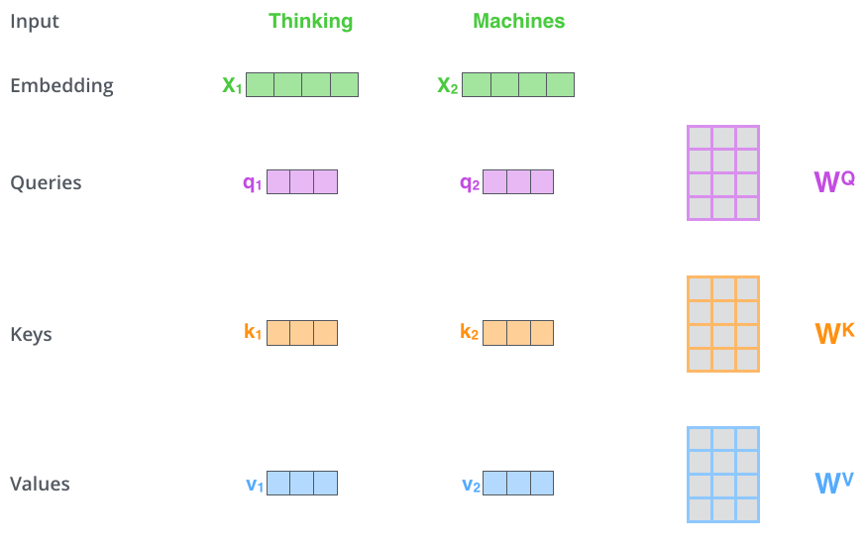
Multi-Head Self-Attention
Attention is calculated by first projecting the input embedding as query, key, and value
https://blog.csdn.net/2301_82275412/article/details/147088123
https://arxiv.org/abs/1706.03762
Transformers
Notes:
Matrix multiplication generates queries, keys, and values. WQ/WK/WV are matrices to be trained.
Credit to 3Blue1Brown
Query – what the token asks for (nouns asking for adjectives)
Key – what the token provides (I am an adjective)
Value – how strong should the connection be

Slide 20
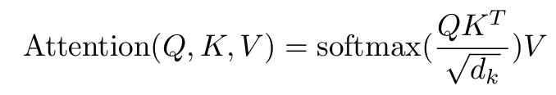
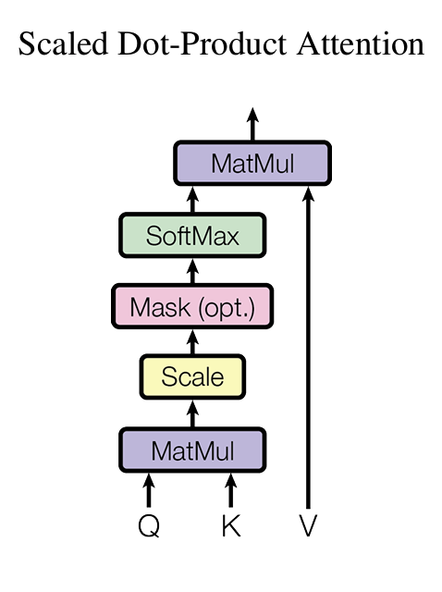
Multi-Head Self-Attention
After we have the query, key, and value, attention is calculated as:
https://blog.csdn.net/2301_82275412/article/details/147088123
https://arxiv.org/abs/1706.03762
Transformers

Slide 21
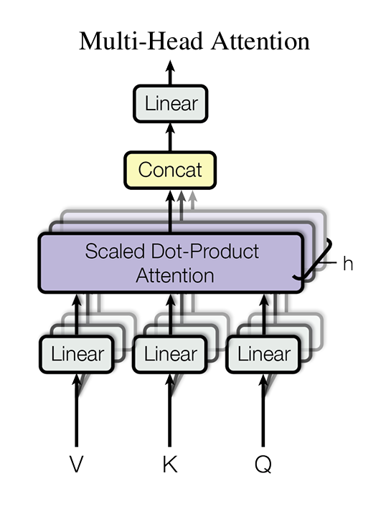
Multi-Head Self-Attention
Multi-Head means that the attention calculation will happen many times in parallel, catching different levels of context.
https://arxiv.org/abs/1706.03762
Transformers

Slide 22
Feed forward layers and normalization
Add more linear layers to the attention matrix, then combine with the original attention, normalize to unit variance
https://arxiv.org/abs/1706.03762
Transformers

Slide 23
Masked Multi-Head Self-Attention
Similar to previous Multi-Head Self-Attention, but will mask future tokens to avoid peeking
https://arxiv.org/abs/1706.03762
Transformers

Slide 24
Multi-Head Attention in decoder layer
The query comes from the decoder itself or the previous decoder layer
The key and value comes from the encoder layer
Output probability of the next token
https://arxiv.org/abs/1706.03762
Transformers

Slide 25
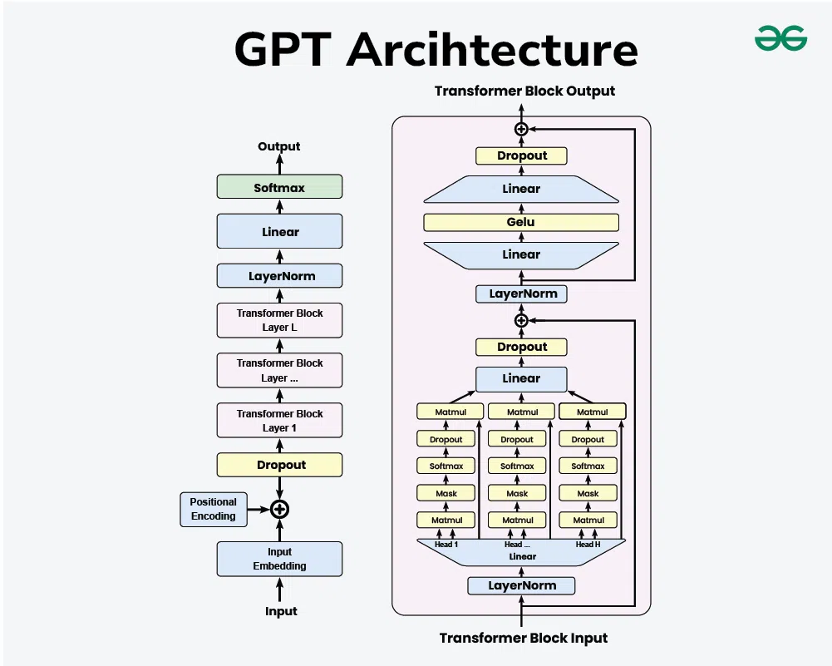
Transformer is the foundation of current LLM and AI wave
https://yozm.wishket.com/magazine/detail/2696/
Transformers
Notes:
GPT: generative pre-trained transformer
Contains only decoders, trained to predict the next token based on previous context

Slide 26
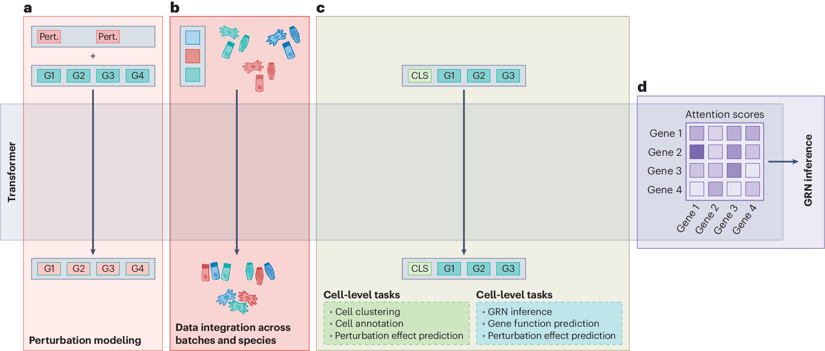
Application of transformer in bioinformatics
Szałata et al., Nat. Methods. 2024
Transformers
Notes:
The transformer model can also be trained on single-cell data and perform various tasks.

Slide 27
Graph Neural Networks (GNN)
GNN

Slide 28
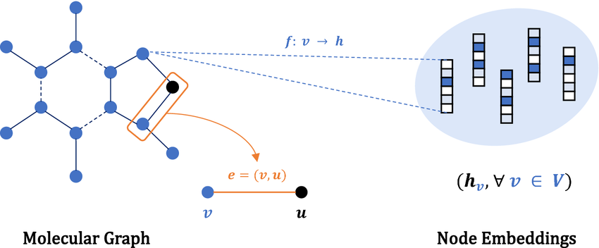
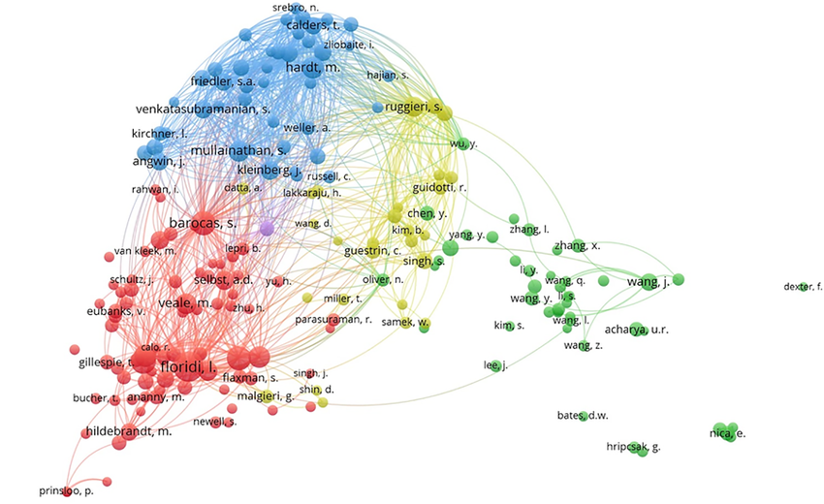
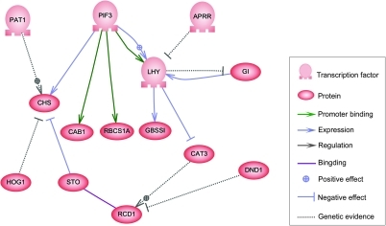
Some real-world data exists as networks
GNN
Notes:
Citation network, social network, molecule as a network, gene regulatory network

Slide 29
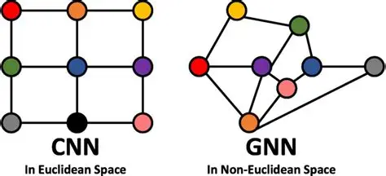
CNN is actually a special form of GNN
https://www.researchgate.net/publication/343821039_A_Survey_on_Deep_Learning-Based_Vehicular_Communication_Applications
GNN
Notes:
Images can be seen as a network, where each pixel is a node, and each pixel is connected to points around it.
Generalize convolution to graph…

Slide 30
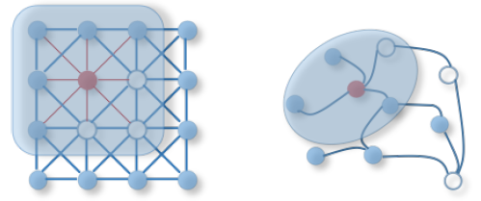
Design a new convolution layer for graphs
https://ichi.pro/setsumei-kanona-gurafunyu-rarunettowa-ku-ni-mukete-76922387246544
GNN
Notes:
Convolutional layers on graphs must handle nodes with any number of neighbors. The output will not be a fixed-size matrix. Aggregate information from neighboring nodes.

Slide 31
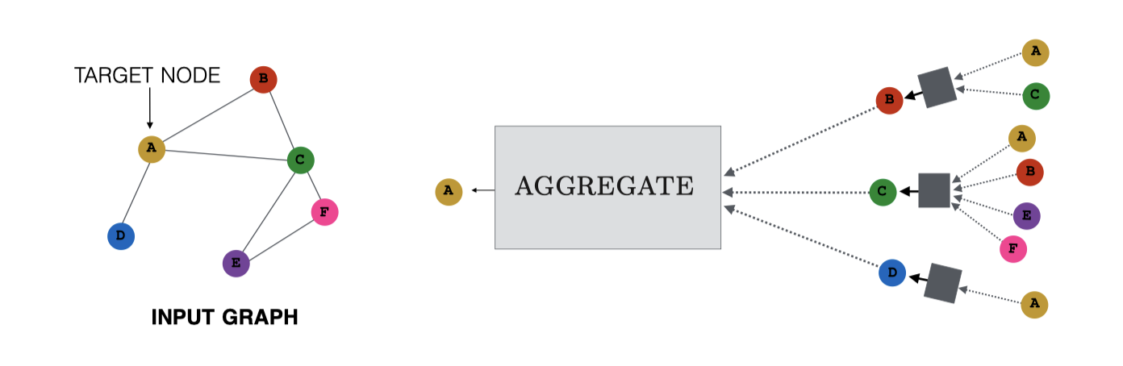
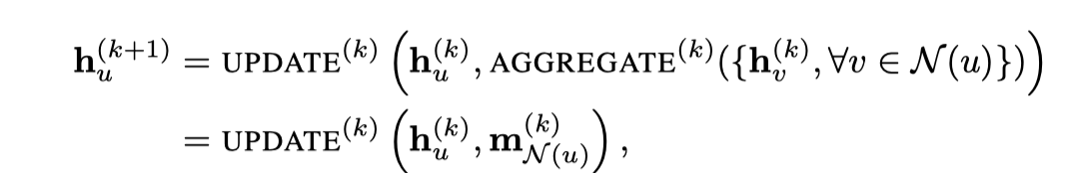
Convolution through aggregation
https://www.researchgate.net/publication/364071895_An_Integer_Programming_Approach_Reinforced_by_a_Message-passing_Procedure_for_Detecting_Dense_Attributed_Subgraphs
GNN
Notes:
Each node of a graph in GNN has a vector as its feature, and the information will be aggregated by a neural network and an aggregation function (usually mean). Then the aggregated information from neighbors will be integrated with the current value of the node and through another neural network (UPDATE), leading to the generation of node value in the next layer.

Slide 32

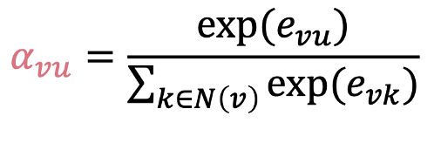
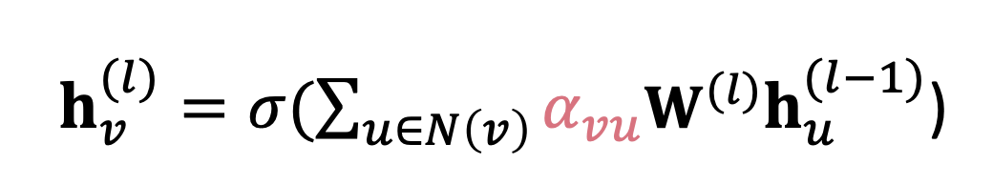
Graph attention in aggregation
We can also apply attention mechanism to the mean function used to aggregate neighboring information to allow the model selectively focus on specific nodes
GNN
Notes:
Calculate the attention value as e_vu, softmax it, and apply the attention weight to the aggregation function.

Slide 33
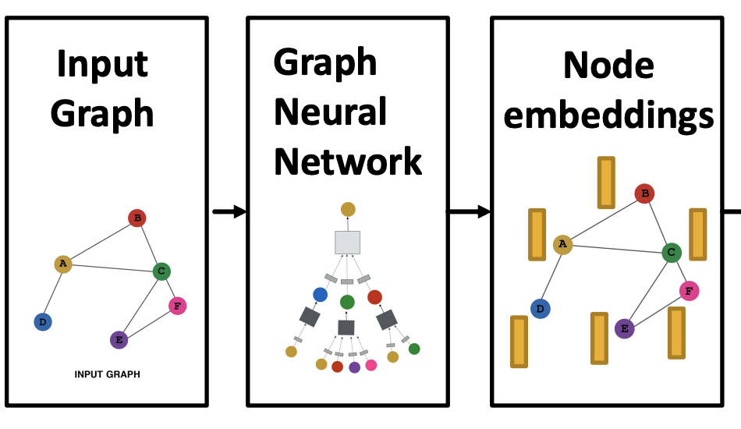
Training a GNN to perform tasks from different level
After convolution, each node will have a specific embedding from the aggregation of information. The embedding of nodes can then be applied to different tasks:
Node-level tasks (classify a node using its embedding)
Edge-level tasks (predict new edges between nodes using the embedding of the two nodes)
Graph-level tasks (classify the whole graph using merged embedding of all nodes)
GNN
Notes:
GNN can be used to learn the embedding of all nodes in a network, and then perform different tasks depending on the prediction head added to the graph convolutional layer.

Slide 34
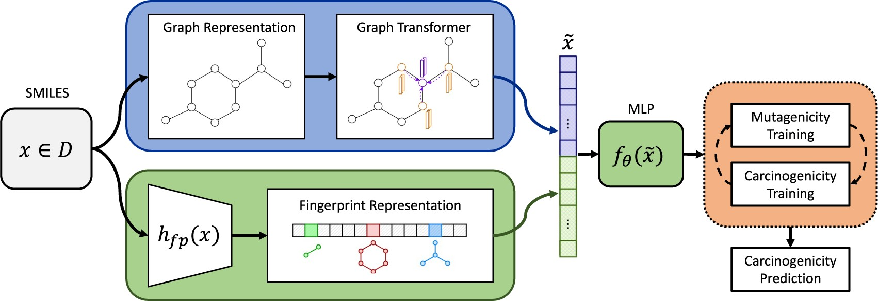
Application of GNN in computational biology
Molecule carcinogenicity prediction: CONCERTO
Fradkin et al., Bioinformatics. 2022
GNN
Notes:
As one molecule can be represented as a graph, you can combine with other features to learn an embedding of the molecule and use it to perform prediction. Predict carcinogenicity. Hot topic in drug discovery.

Slide 35
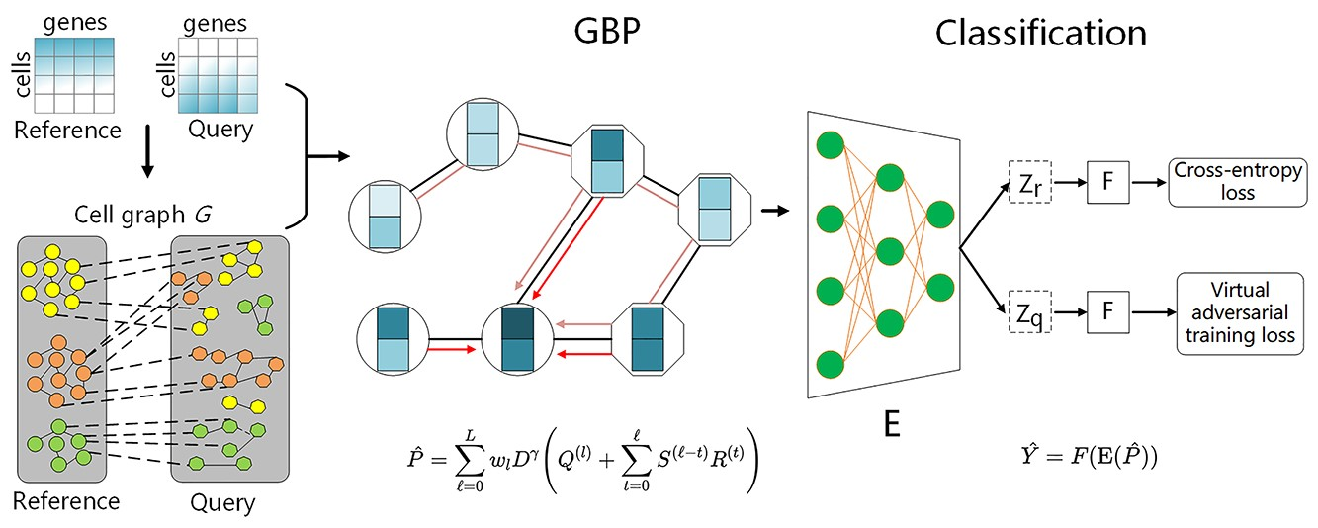
Application of GNN in computational biology
scRNA-seq cell classification: GraphCS
Zeng et al., Brief Bioinform. 2023
GNN
Notes:
Cells will be connected to a graph based on their gene expression profile similarity, and classify their cell-type by connection to reference data.

Slide 36
Take home message of today
RNN is capable of reading a sequence input with variable length and generating predictions or new sequences based on context.
Attention helps alleviate the long-term dependency problem by allowing models to choose which previous context to focus on.
Transformer further expands the application of attention and uses multi-head self-attention to create an embedding of the input sequence.
GNN can perform convolution on a graph structure and generate embeddings for all nodes, useful for various levels of tasks.

Slide 37
Suggested reading
RNN:
https://arxiv.org/abs/1808.03314 (short review on RNN and LSTM)
Shen Z, Bao W, Huang DS. Recurrent Neural Network for Predicting Transcription Factor Binding Sites. Sci Rep. 2018 Oct 15;8(1):15270. doi: 10.1038/s41598-018-33321-1. PMID: 30323198; PMCID: PMC6189047.

Slide 38
Suggested reading
Transformer:
https://arxiv.org/abs/1706.03762 (Attention is all you need)
Two YouTube videos very helpful for understanding the transformer: (strongly recommend 3Blue1Brown)
  https://www.youtube.com/watch?v=wjZofJX0v4M
  https://www.youtube.com/watch?v=eMlx5fFNoYc
Szałata A, Hrovatin K, Becker S, Tejada-Lapuerta A, Cui H, Wang B, Theis FJ. Transformers in single-cell omics: a review and new perspectives. Nat Methods. 2024 Aug;21(8):1430-1443. doi: 10.1038/s41592-024-02353-z. Epub 2024 Aug 9. PMID: 39122952.

Slide 39
Suggested reading
GNN:
https://github.com/thunlp/GNNPapers?tab=readme-ov-file#chemistry-and-biology (too many papers, select what interests you)
Fradkin P, Young A, Atanackovic L, Frey B, Lee LJ, Wang B. A graph neural network approach for molecule carcinogenicity prediction. Bioinformatics. 2022 Jun 24;38(Suppl 1):i84-i91. doi: 10.1093/bioinformatics/btac266. PMID: 35758812; PMCID: PMC9235510.
Zeng Y, Wei Z, Pan Z, Lu Y, Yang Y. A robust and scalable graph neural network for accurate single-cell classification. Brief Bioinform. 2022 Mar 10;23(2):bbab570. doi: 10.1093/bib/bbab570. PMID: 35018408.
Notes:
Cells will be connected to a graph based on their gene expression profile similarity, and classify their cell-type by connection to reference data.

Slide 40
Thanks for your listening!

