Slide 1
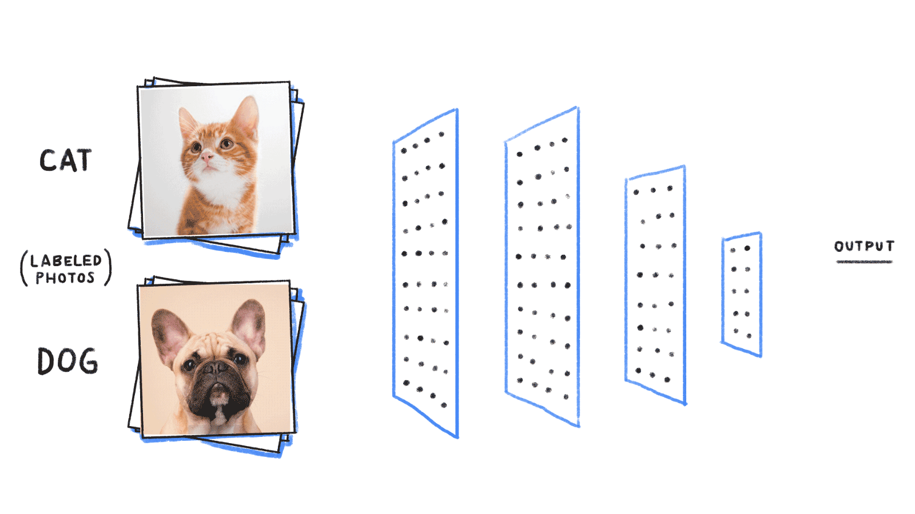
Deep Learning Fundamentals I:
Artificial Neural Network (26t3)
Zhiyuan (Andy) Chu
CBB 752 Spring 2025
(adapted from Donghoon Lee, Jiahao Gao)
Photo credit: bit.ly/2ScVugE

Slide 2
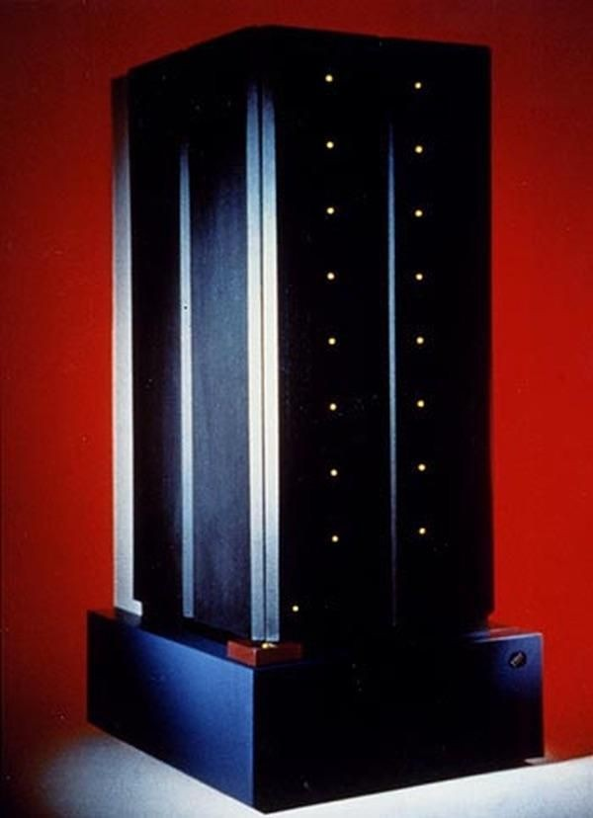
What is it?

Slide 3
What is it?
Deep Blue
(the chess computer)

Slide 4

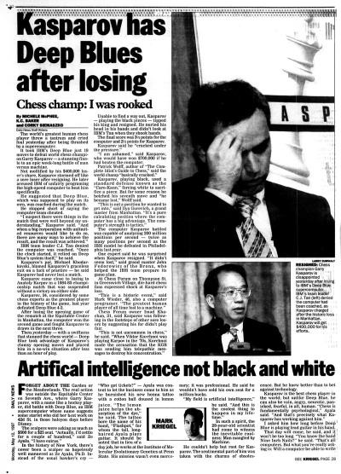
In 1997, Deep Blue, IBM's supercomputer, defeats chess world champion Garry Kasparov

Slide 5
Brute-force computing, evaluating 200 million positions per second
Search depth: 6-8 moves, up to 20+
Predefined parameters from analyzing thousands of master games
Opening database: 4,000+ positions, 700,000+ grandmaster games
Endgame database: All five-piece endgames & many six-piece endgames

Slide 6
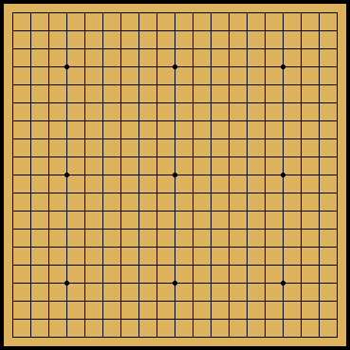
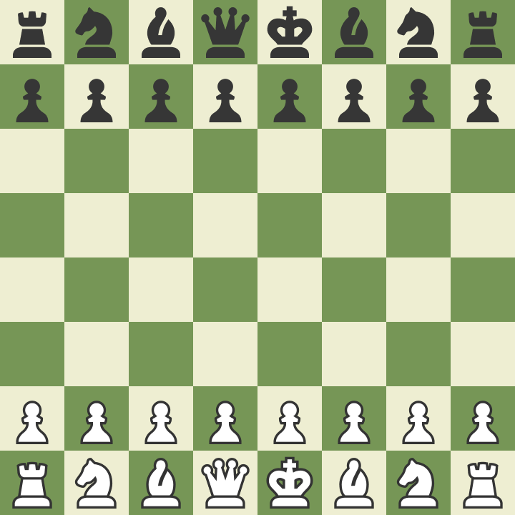
What about Weiqi (Go)?
8 x 8
19 x 19

Slide 7

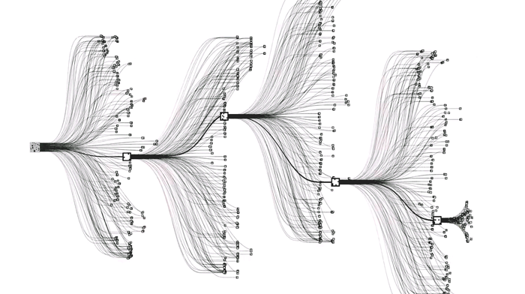
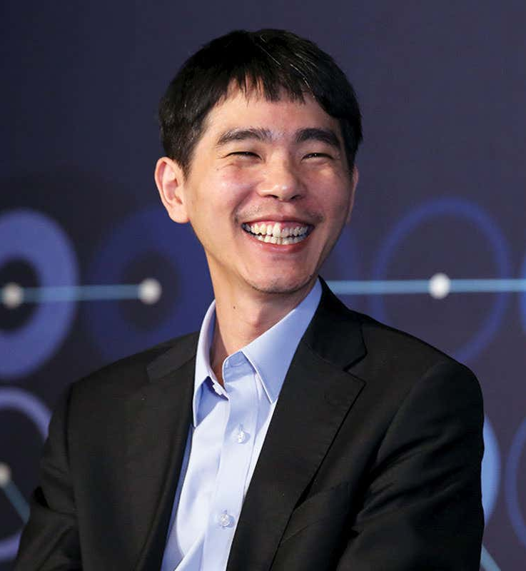
AlphaGo (AlphaGo Lee) defeated the world champion, Lee Sedol in 2016
Then the world champion Ke Jie, in 2017 (AlphaGo Master)
Chess ~35 moves per turn, Go ~250
Notes:
AlphaGo’s displays of game-winning creativity, in some cases finding moves that challenged millennia of Go wisdom.
AlphaGo takes a totally different approach, replacing these hand-crafted rules with a deep neural network and general purpose algorithms that know nothing about the game beyond the basic rules.

Slide 8
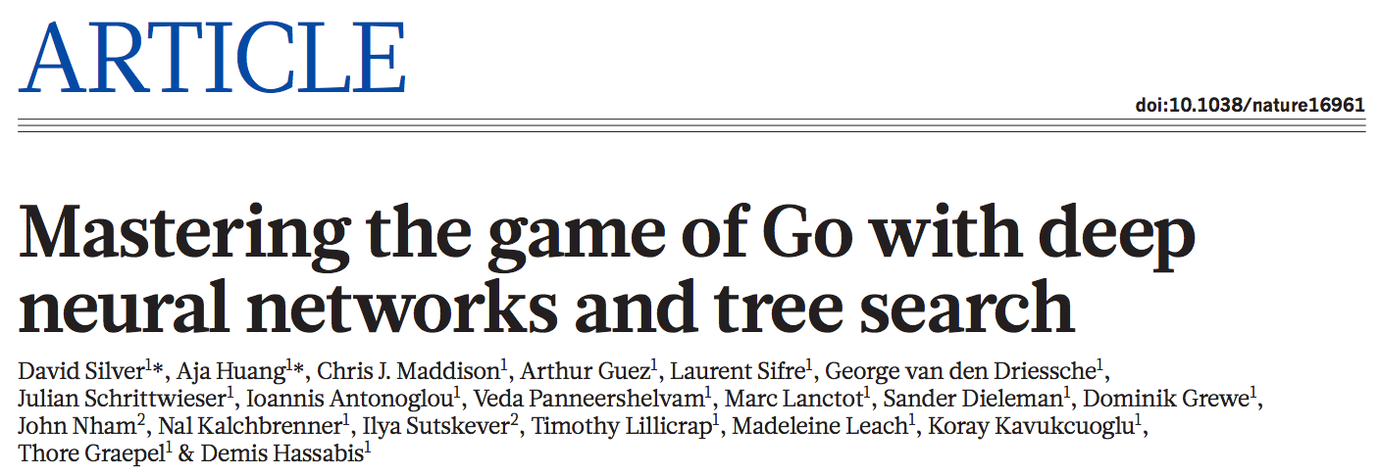

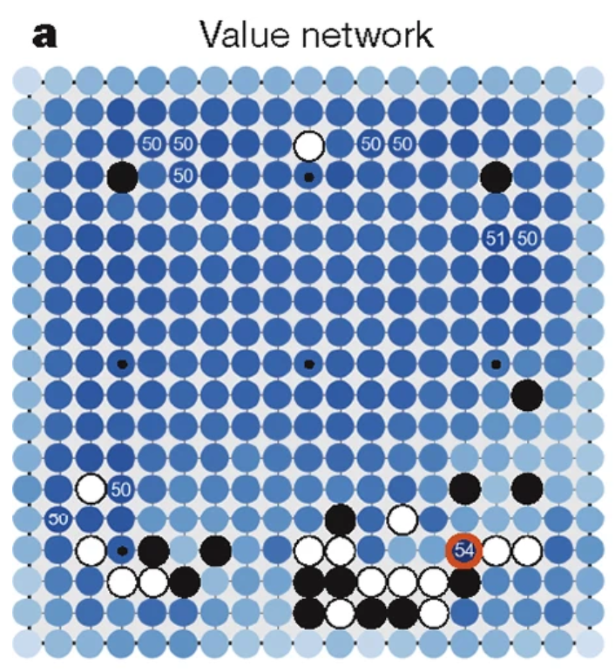
January 2016
Reinforcement learning
Notes:
Google DeepMind
training two deep neural networks to work in tandem
the number of possible games is vast (10^761 compared, for example, to the estimated 10^120 possible in chess)

Slide 9
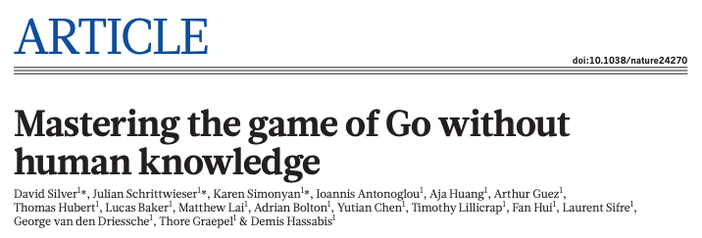
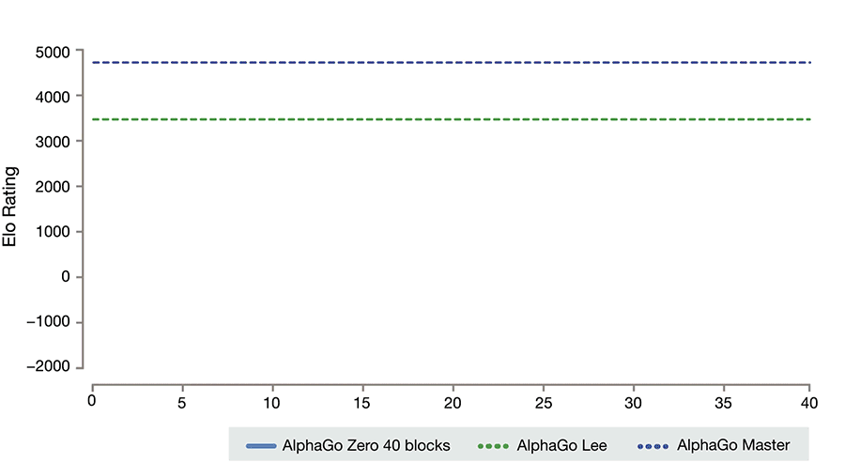
October 2017
Notes:
the earlier versions of AlphaGo which trained on thousands of human amateur and professional games to learn how to play the game
Reinforcement learning:
AlphaGo Zero bypasses this process and learns to play the game of Go without human data, simply by playing games against itself.

Slide 10
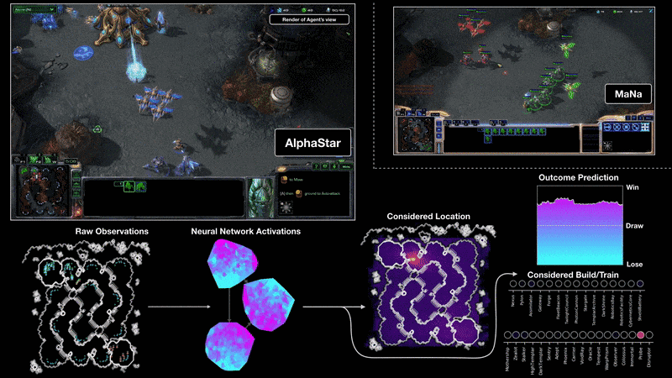
December 2018
partial observability, long horizons, and complex strategies

Slide 11
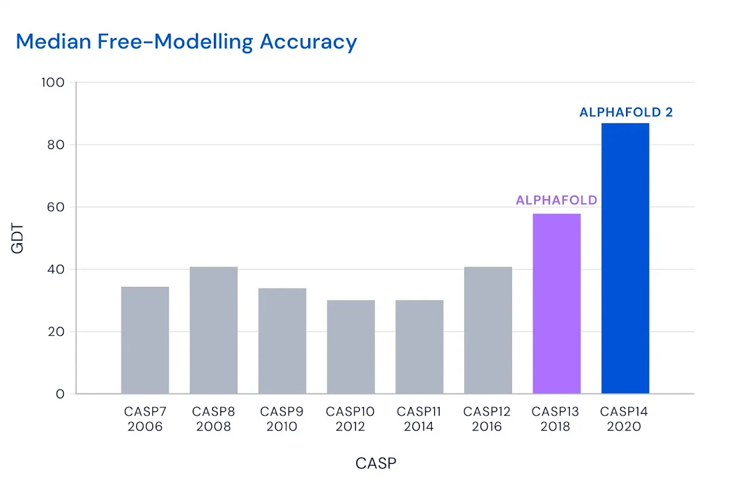
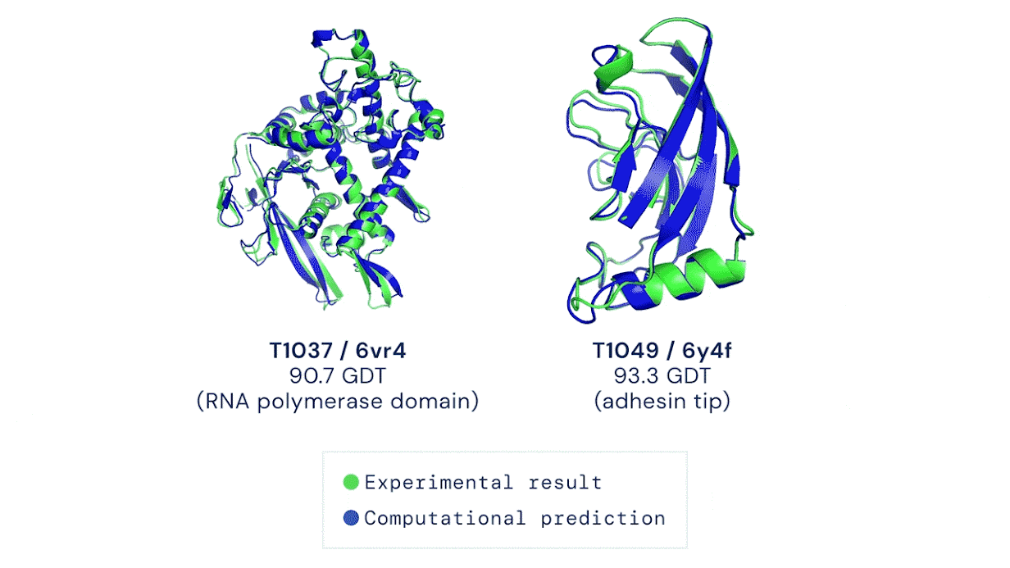
Deep learning in biomed: AlphaFold
Christian Anfinsen postulated in his acceptance speech for the 1972 Nobel Prize: a protein’s amino acid sequence should fully determine its structure.
Levinthal‘s paradox: it would take longer than the age of the known universe to enumerate all possible configurations of a typical protein by brute force. Yet in nature, proteins fold spontaneously, some within milliseconds.
Critical Assessment of Structure Prediction (CASP) is a “world championship” for protein structure prediction taking place every two years since 1994.
Notes:
Nobel prize

Slide 12
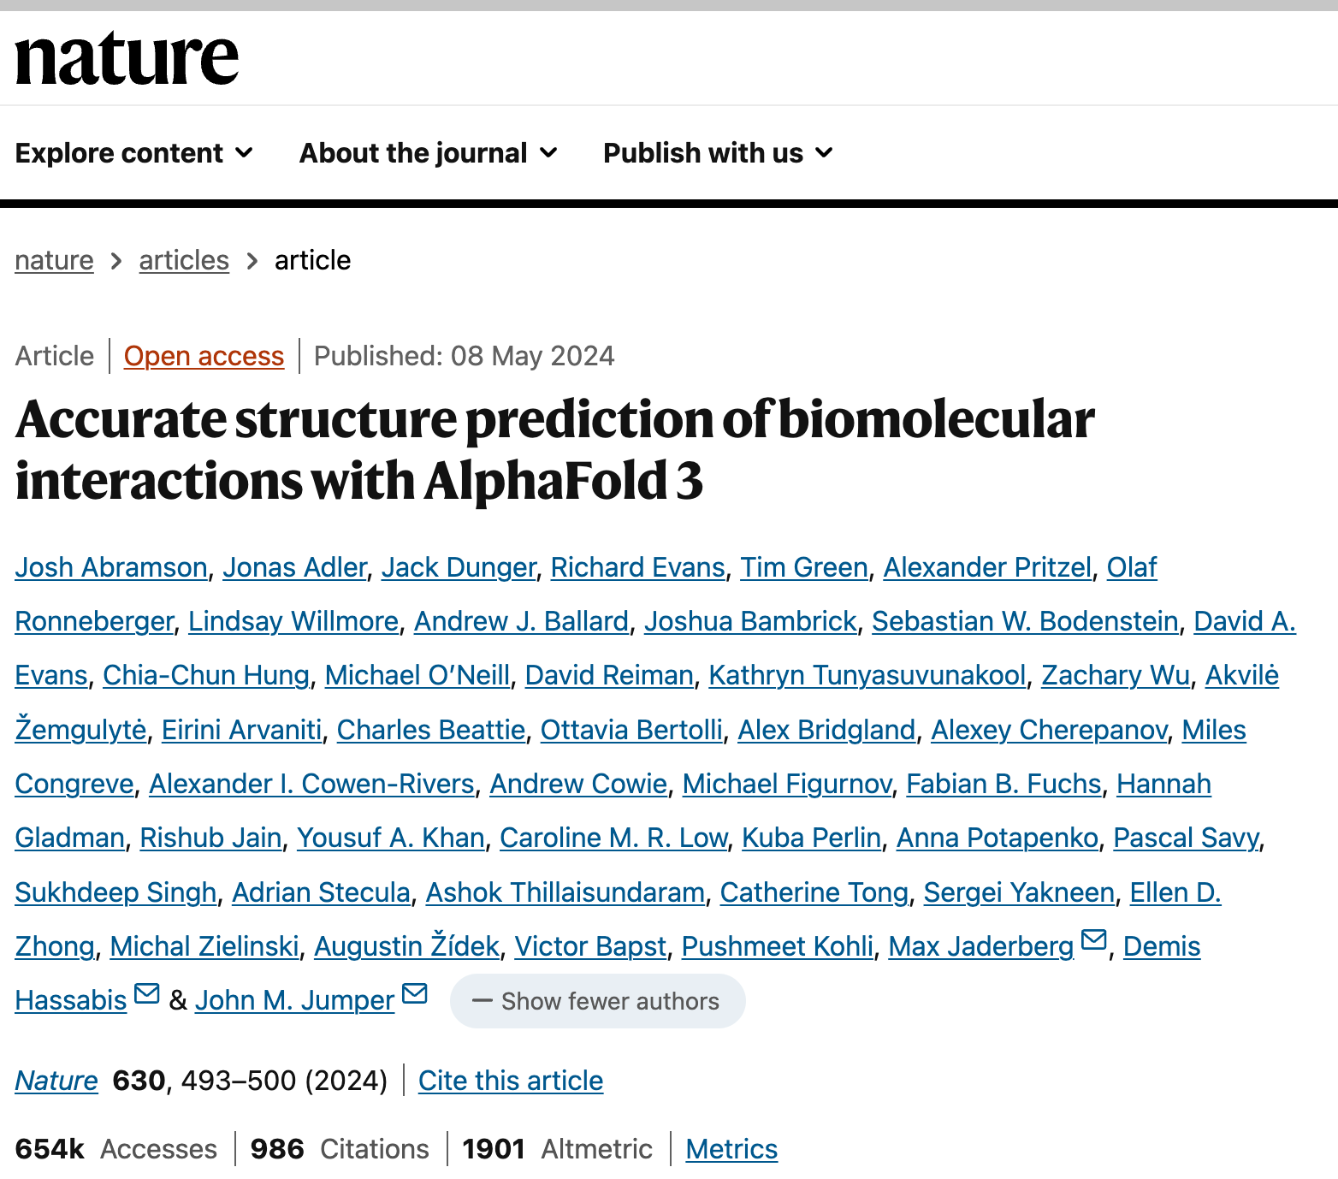
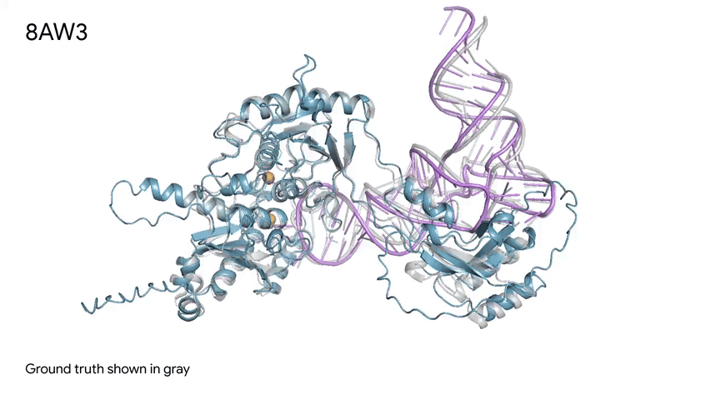
Deep learning in biomed: AlphaFold
Tb ADAT2/3 deaminase in complex with tRNA
More accurate than AlphaFold2 in predicting single protein structures.
More precise prediction of protein complexes and its extension of its applications from proteins to other molecules.
More accurately predicts the effect of covalent modifications like bonded ligands, glycosylation, modified protein residues and nucleic acid bases on proteins, RNA or DNA.
Notes:
figuring out the 3D shape of a protein purely from its genetic sequence is a complex task that scientists have found challenging for decades
CASP taking place every two years since 1994
Targets for structure prediction are either structures soon-to-be solved by X-ray crystallography or NMR spectroscopy

Slide 13
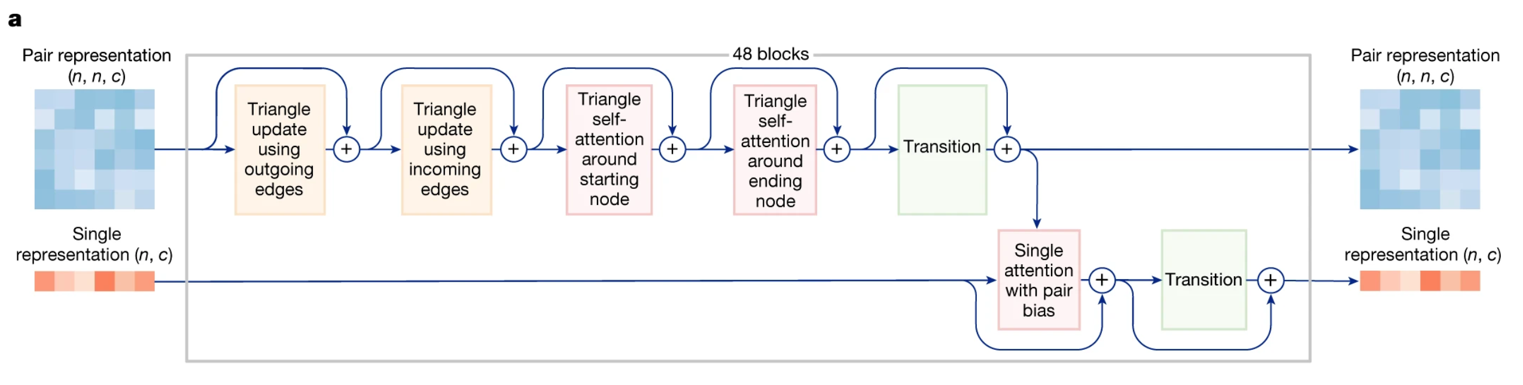
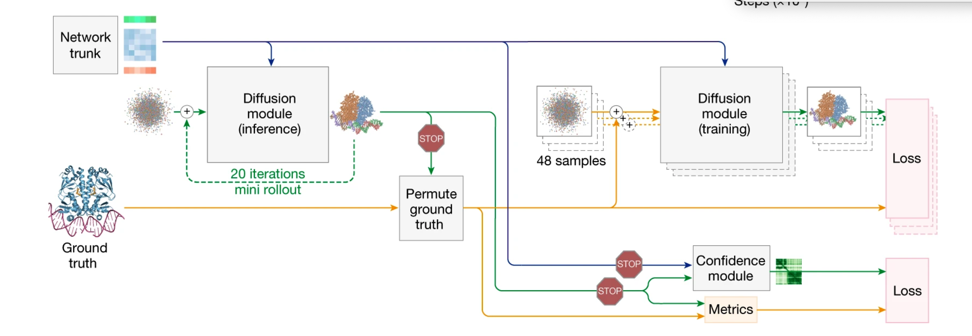
AF3’s core architecture: Pairformer (Self-Attention & Transformer)
AF3 employs a Diffusion-based (generative modelling) approach structure prediction
AF3 replaces the ReLU activation function in the model’s transition blocks with SwiGLU
Notes:
figuring out the 3D shape of a protein purely from its genetic sequence is a complex task that scientists have found challenging for decades
CASP taking place every two years since 1994
Targets for structure prediction are either structures soon-to-be solved by X-ray crystallography or NMR spectroscopy

Slide 14
AF3’s core architecture: Pairformer (Self-Attention & Transformer)
AF3 employs a Diffusion-based (generative modelling) approach structure prediction
AF3 replaces the ReLU activation function in the model’s transition blocks with SwiGLU
Notes:
figuring out the 3D shape of a protein purely from its genetic sequence is a complex task that scientists have found challenging for decades
CASP taking place every two years since 1994
Targets for structure prediction are either structures soon-to-be solved by X-ray crystallography or NMR spectroscopy

Slide 15
Deep neural net!
Notes:
figuring out the 3D shape of a protein purely from its genetic sequence is a complex task that scientists have found challenging for decades
CASP taking place every two years since 1994
Targets for structure prediction are either structures soon-to-be solved by X-ray crystallography or NMR spectroscopy

Slide 16
Deep Neural Network
16

Slide 17
1.1 McCulloch–Pitts neuron (1943)
Input X₁
Input X₂
Input X₃
Output Y
…
Daniel Shiffman - The Nature of Code
Input X_{n}
Receive input
Integrate & process signals (activation)
Generate output
17
McCulloch, W. S., & Pitts, W. (1943). A logical calculus of the ideas immanent in nervous activity. The bulletin of mathematical biophysics, 5, 115-133.

Slide 18



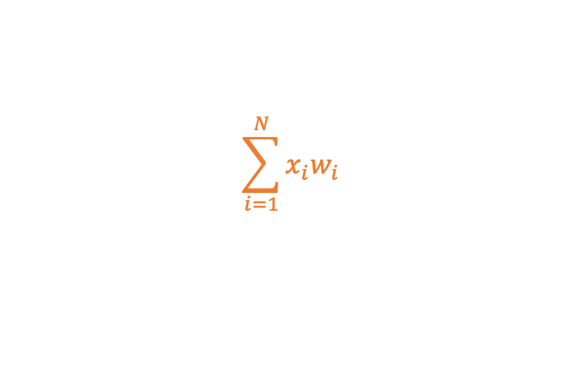



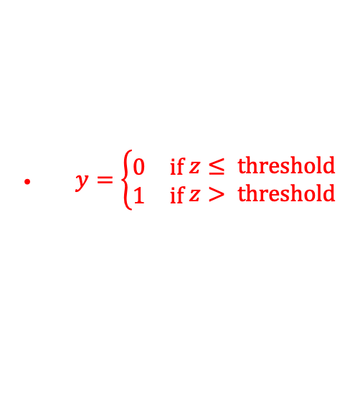

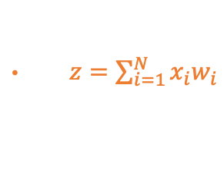

1.1 McCulloch–Pitts neuron (1943)
$$w_{1}$$
Processor
$$x_{1}$$
$$w_{2}$$
$$x_{2}$$
Output Y
$$\sum_{i=1}^{N}{x_{i}w_{i}}$$
$$w_{3}$$
$$y=σ(z)$$
$$x_{3}$$
$x=[x_{1}{,x}_{2},x_{3}]$
$w=[w_{1},w_{2},w_{3}]$
$z=\sum_{i=1}^{N}{x_{i}w_{i}}$
$y=\left\{\begin{aligned}\begin{matrix}0 & \text{if} \end{matrix}z≤ \text{threshold} \\ \begin{matrix}1 & \text{if} \end{matrix}z> \text{threshold}\end{aligned}\right.$
18

Slide 19
1.1 McCulloch–Pitts neuron (1943)
Weight ω₁
Input X₁
Processor
Weight ω₂
Input X₂
Weight ω₃
Output Y
Input X₃
…
Weight ω_{n}
Input X_{n}
  Multiply each binary input by its weight
  Sum all weighted inputs
  Compare the sum with the threshold
  Output binary 1/0 (representing whether the neuron is fired)
19
McCulloch, W. S., & Pitts, W. (1943). A logical calculus of the ideas immanent in nervous activity. The bulletin of mathematical biophysics, 5, 115-133.

Slide 20
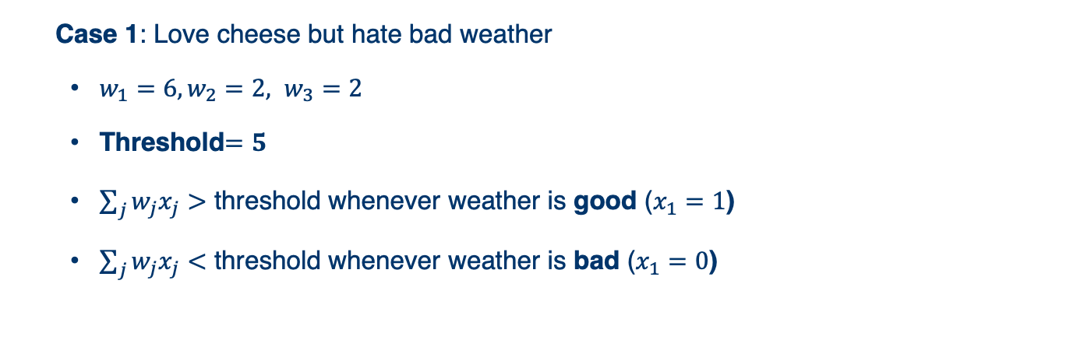

Example: Decide whether to attend a cheese festival
Rainy?
ω₁ = 6
Processor
Input X₁
Friend?
ω₂ = 2
Input X₂
Output Y
Far?
ω₃ = 2
  Threshold$=5$
Input X₃
  Case 1: Love cheese but hate bad weather
  $w_{1}=6, w_{2}=2, w_{3}=2$
  Threshold$=5$
  $\sum_{j}{w_{j}x_{j}}>$ threshold whenever weather is good ($x_{1}=1$)
  $\sum_{j}{w_{j}x_{j}}<$ threshold whenever weather is bad ($x_{1}=0$)
20

Slide 21
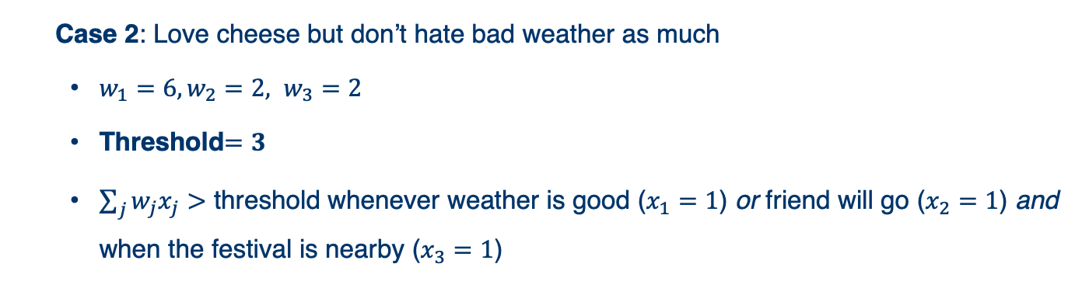

Example: Decide whether to attend a cheese festival
Rainy?
ω₁ = 6
Processor
Input X₁
Friend?
ω₂ = 2
Input X₂
Output Y
Far?
ω₃ = 2
  Threshold$=3$
Input X₃
  Case 2: Love cheese but don’t hate bad weather as much
  $w_{1}=6, w_{2}=2, w_{3}=2$
  Threshold$=3$
  $\sum_{j}{w_{j}x_{j}}>$ threshold whenever weather is good ($x_{1}=1$) or friend will go ($x_{2}=1$) and when the festival is nearby ($x_{3}=1$)
21

Slide 22
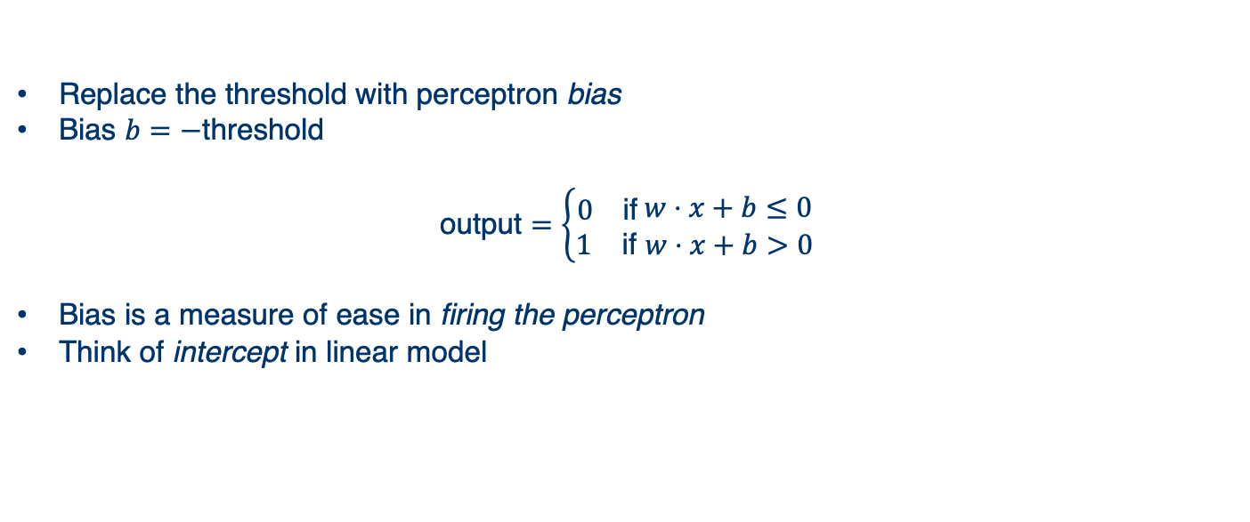
1.2 Perceptron (Rosenblatt,1958) - bias
Bias
Processor
Weight ω₁
Input X₁
Weight ω₂
Output Y
Input X₂
…
Weight ω_{n}
Input X_{n}
Replace the threshold with perceptron bias
Bias $b=−$threshold
$$\text{output}=\left\{\begin{aligned}\begin{matrix}0 & \text{if} \end{matrix}w⋅x+b≤0 \\ \begin{matrix}1 & \text{if} w⋅x+b>0\end{matrix}\end{aligned}\right.$$
Bias is a measure of ease in firing the perceptron
Think of intercept in linear model
22
22

Slide 23
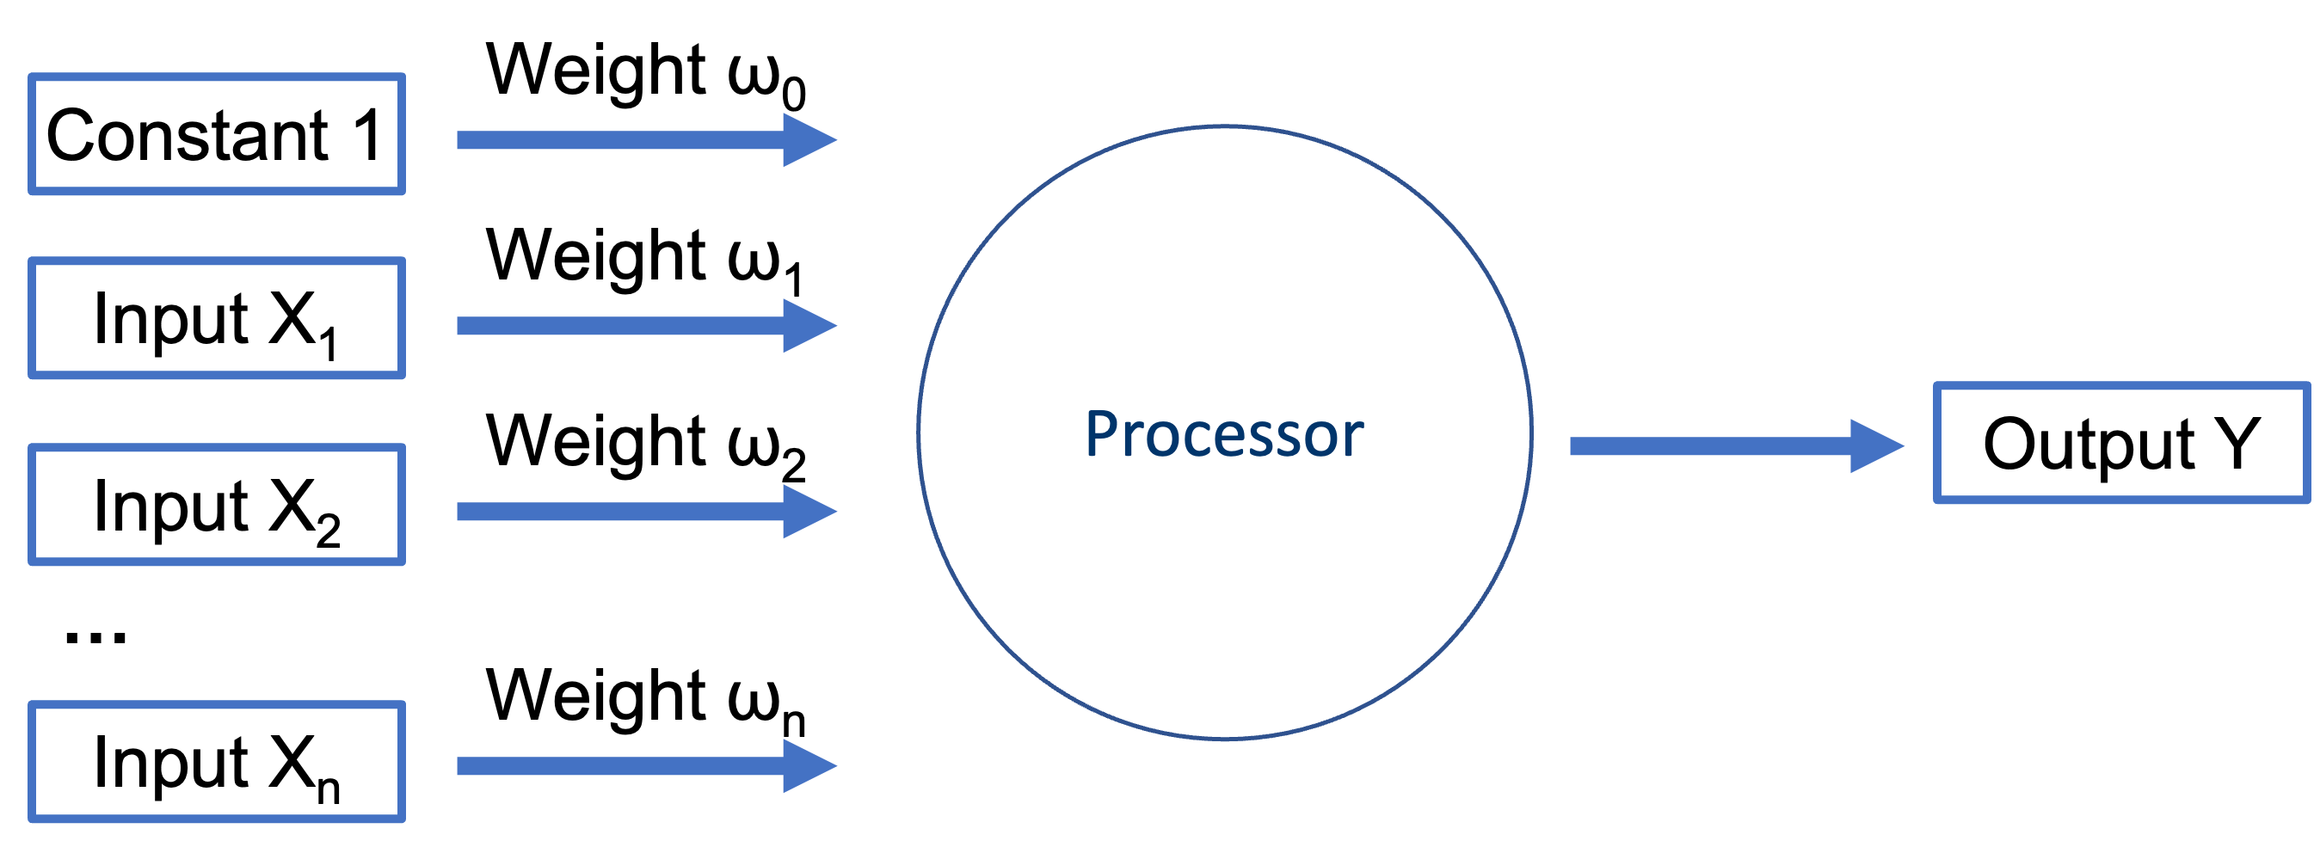
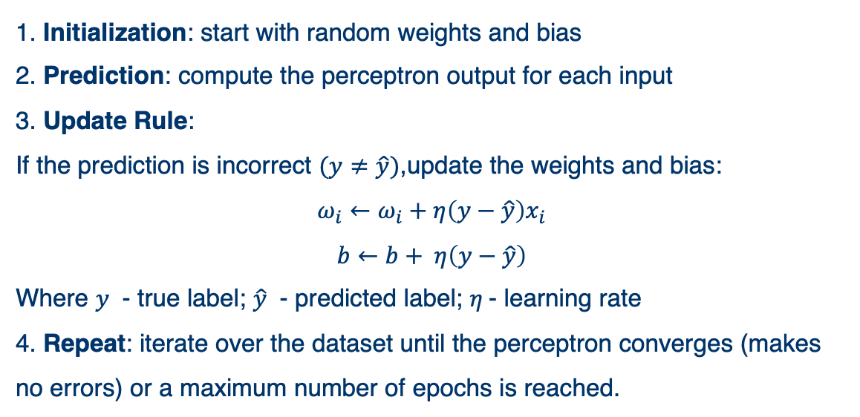
1.2 Perceptron (Rosenblatt,1958) - training
1. Initialization: start with random weights and bias
2. Prediction: compute the perceptron output for each input
3. Update Rule:
If the prediction is incorrect $(y≠\hat{y})$,update the weights and bias:
$$ω_{i}←ω_{i}+η\left(y−\hat{y}\right)x_{i}$$
$$b←b+ η\left(y−\hat{y}\right)$$
Where $y$ - true label; $\hat{y}$ - predicted label; $η$- learning rate
4. Repeat: iterate over the dataset until the perceptron converges (makes no errors) or a maximum number of epochs is reached.
23
23

Slide 24
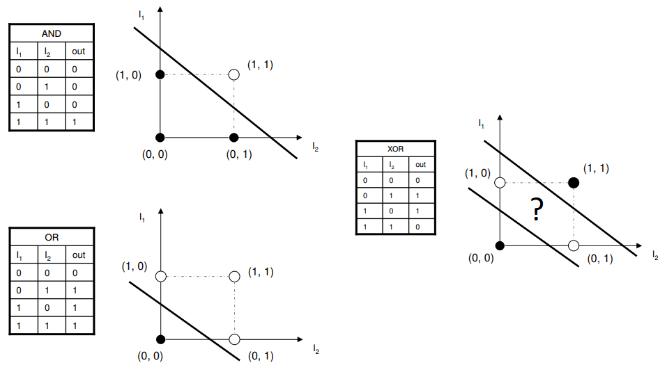
1.3 The XOR problem
XOR, or exclusive or, is a logical operator that compares two inputs and returns true if only one of them is true.
The decision boundary of a single-layer perceptron is a linear hyperplane
Single-layer perceptrons are only capable of learning linearly separable patterns
24
24

Slide 25
1.3 The XOR problem
How to solve the problem?
Add nonlinearity & Go deeper!
25
25

Slide 26
Multi-Layer Perceptron
26

Slide 27
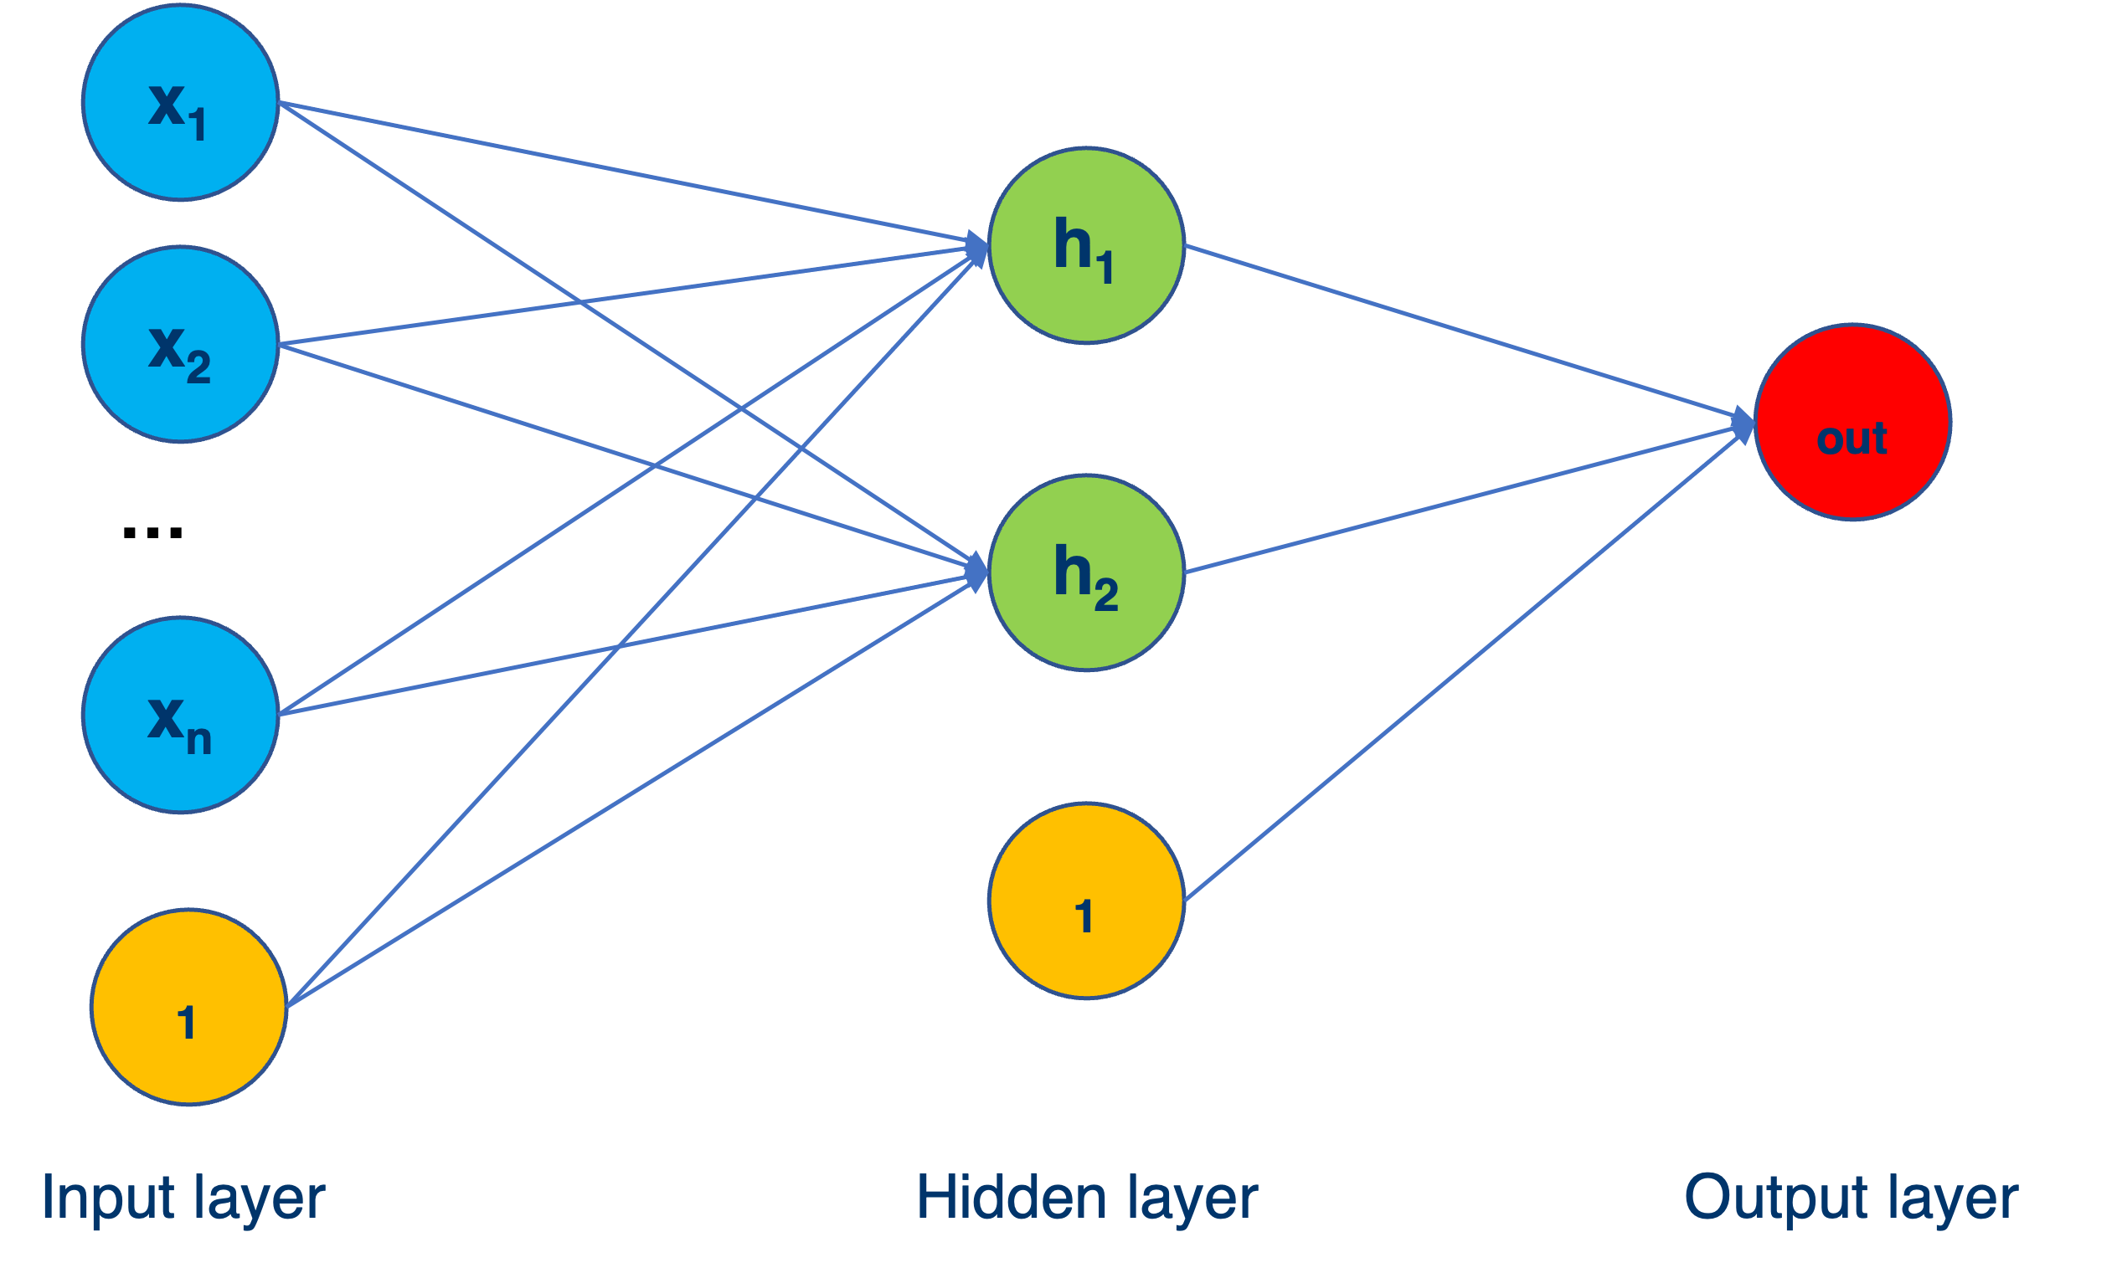
2.1 Modern MLP structure
Input Layer:
takes raw data as input
number of neurons = number of input features
Hidden layers:
extract features using weighted connections
use activation functions (e.g., sigmoid, ReLU)
Output layer:
produces predictions
number of neurons = number of output classes
(e.g., 1 for regression, n for classification)
https://playground.tensorflow.org
27
27

Slide 28
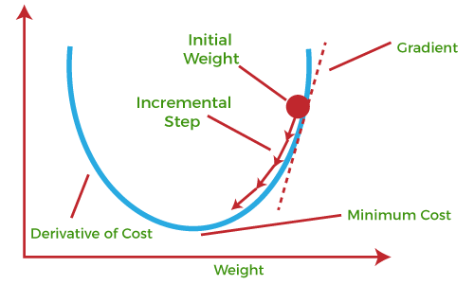
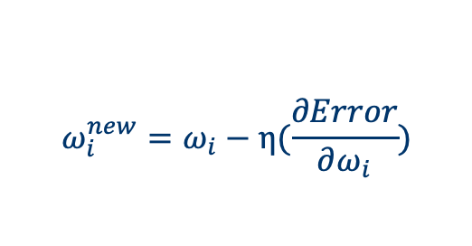
2.2 Backward propagation
i₁
W₁
h₁
W₂
W₅
OUT
W₃
W₆
i₂
h₂
W₄
$$ω_{i}^{new}=ω_{i}−η(\frac{∂Error}{∂ω_{i}})$$
Purpose:
Minimizes the error by adjusting weights
Efficiently computes gradients using the chain rule
Process:
1. Forward Propagation: Compute predictions.
2. Error/Loss Calculation: Compare predictions to the true labels.
3. Backward Propagation: Calculate gradients of the loss function w.r.t. weights.
4. Weight Update: Adjust weights using gradient descent.
28
28

Slide 29
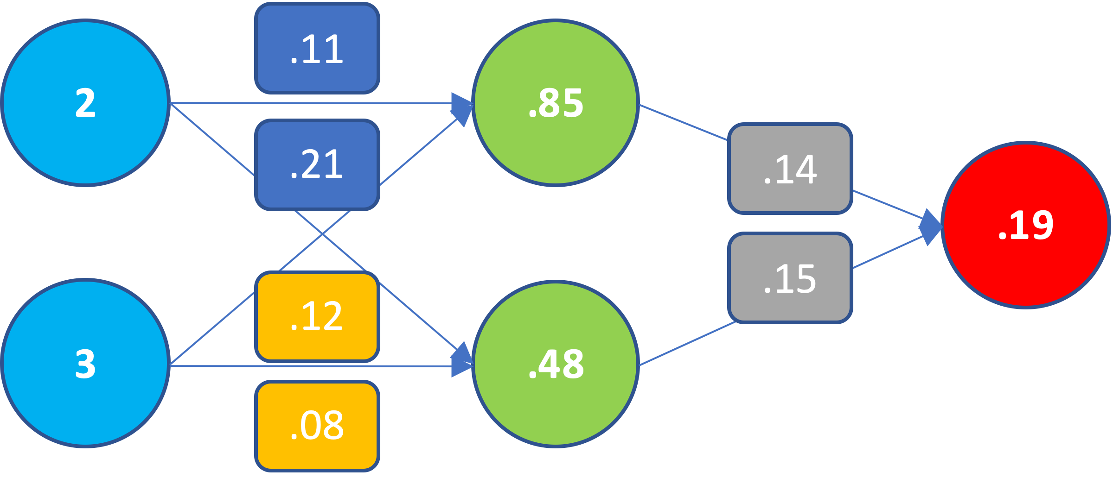
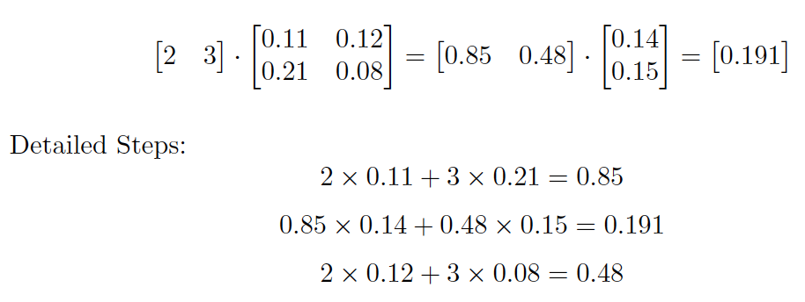
2.2 Backward propagation
Step 1. Forward Propagation
29
29
Notes:
The rules of back prop + chain rule high level more the notion of gradient descent/ stochastic gradient descent (the concept of mini-batch)

Slide 30
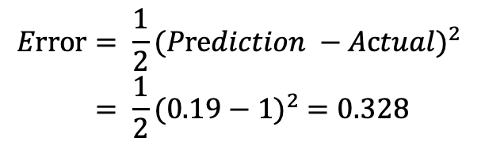
2.3 Backward propagation
1
Prediction
Actual
Step 2. Error Calculation
$$Error= \frac{1}{2}{(Prediction −Actual)}^{2}$$
$$= \frac{1}{2}{(0.19−1)}^{2} =0.328$$
(½ is added to ease the calculation of the derivative)
30
30

Slide 31
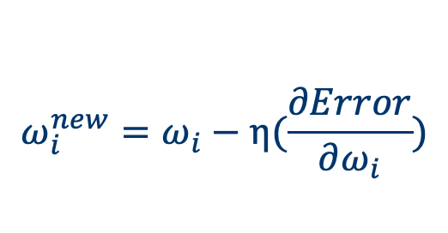
2.3 Backward propagation
1
Prediction
Actual
Step 3. Backward Propagation
$$ω_{i}^{new}=ω_{i}−η(\frac{∂Error}{∂ω_{i}})$$
31
31

Slide 32
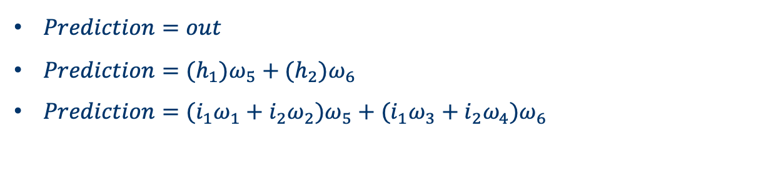
2.3 Backward propagation
1
Prediction
Actual
Step 3. Backward Propagation
$Prediction=out$
$Prediction={(h}_{1})ω_{5}+{(h}_{2})ω_{6}$
$Prediction={(i}_{1}ω_{1}+i_{2}ω_{2})ω_{5}+{(i}_{1}ω_{3}+i_{2}ω_{4})ω_{6}$
32
32

Slide 33
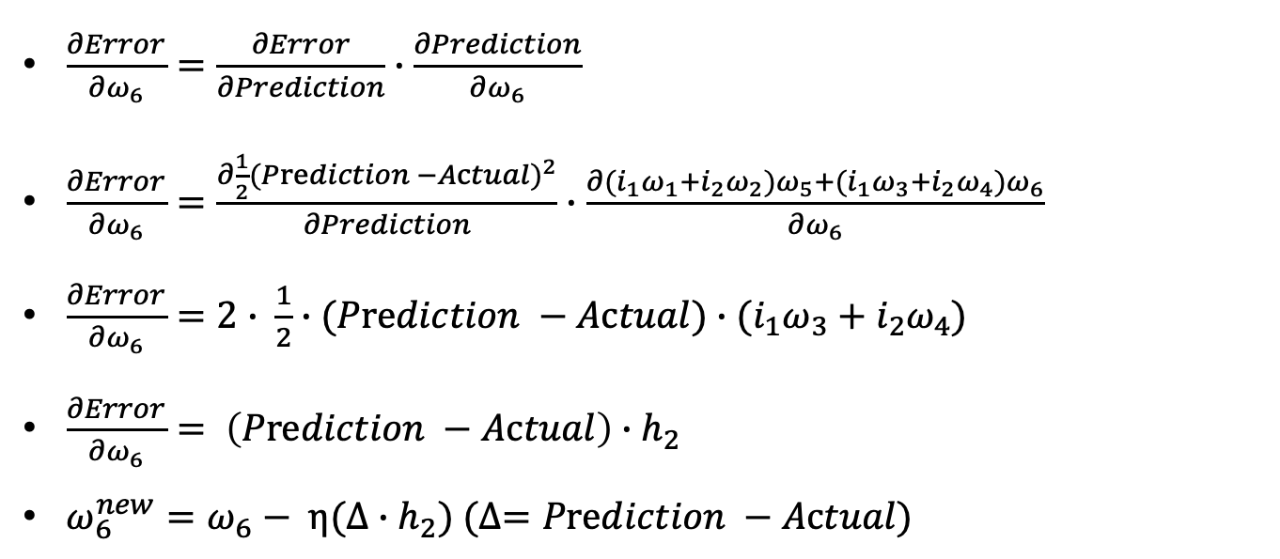
2.3 Backward propagation
i₁
W₁
h₁
W₂
W₅
OUT
W₃
W₆
i₂
h₂
W₄
$\frac{∂Error}{∂ω_{6}}=\frac{∂Error}{∂Prediction}∙\frac{∂Prediction}{∂ω_{6}}$
$\frac{∂Error}{∂ω_{6}}=\frac{∂\frac{1}{2}{(Prediction −Actual)}^{2}}{∂Prediction}∙\frac{∂{(i}_{1}ω_{1}+i_{2}ω_{2})ω_{5}+{(i}_{1}ω_{3}+i_{2}ω_{4})ω_{6}}{∂ω_{6}}$
$\frac{∂Error}{∂ω_{6}}=2∙ \frac{1}{2}∙(Prediction −Actual)∙{(i}_{1}ω_{3}+i_{2}ω_{4})$
$\frac{∂Error}{∂ω_{6}}= \left(Prediction −Actual\right)∙h_{2}$
$ω_{6}^{new}=ω_{6}− η(∆∙h_{2}) (∆=Prediction −Actual)$
33
33

Slide 34
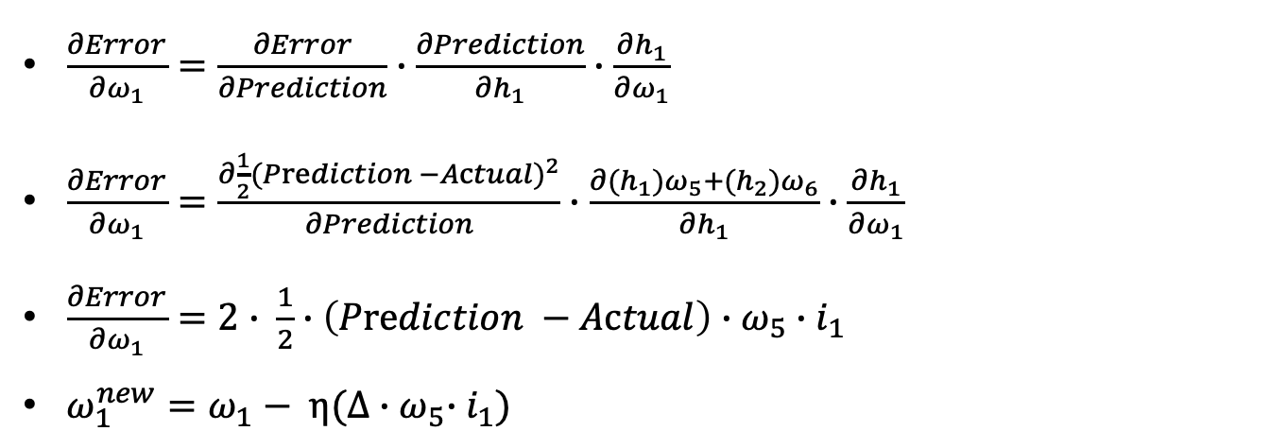
2.3 Backward propagation
i₁
W₁
h₁
W₂
W₅
OUT
W₃
W₆
i₂
h₂
W₄
$\frac{∂Error}{∂ω_{1}}=\frac{∂Error}{∂Prediction}∙\frac{∂Prediction}{∂h_{1}}∙\frac{∂h_{1}}{∂ω_{1}}$
$\frac{∂Error}{∂ω_{1}}=\frac{∂\frac{1}{2}{(Prediction −Actual)}^{2}}{∂Prediction}∙\frac{∂{(h}_{1})ω_{5}+{(h}_{2})ω_{6}}{∂h_{1}}∙\frac{∂h_{1}}{∂ω_{1}}$
$\frac{∂Error}{∂ω_{1}}=2∙ \frac{1}{2}∙\left(Prediction −Actual\right)∙ω_{5}∙i_{1}$
$ω_{1}^{new}=ω_{1}− η(∆{∙ω}_{5}∙i_{1})$
34
34

Slide 35
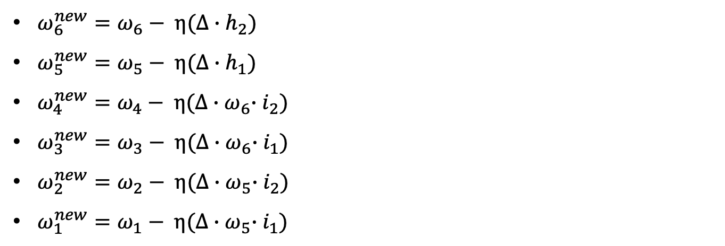
2.3 Backward propagation
i₁
W₁
h₁
W₂
W₅
OUT
W₃
W₆
i₂
h₂
W₄
$ω_{6}^{new}=ω_{6}− η(∆∙h_{2})$
$ω_{5}^{new}=ω_{5}− η(∆∙h_{1})$
$ω_{4}^{new}=ω_{4}− η(∆{∙ω}_{6}∙i_{2})$
$ω_{3}^{new}=ω_{3}− η(∆{∙ω}_{6}∙i_{1})$
$ω_{2}^{new}=ω_{2}− η(∆{∙ω}_{5}∙i_{2})$
$ω_{1}^{new}=ω_{1}− η(∆{∙ω}_{5}∙i_{1})$
35
35

Slide 36
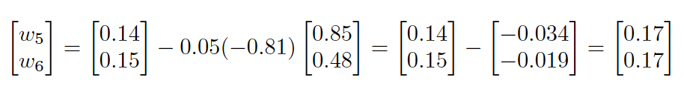
2.3 Backward propagation
i₁
W₁
h₁
W₂
W₅
OUT
W₃
W₆
i₂
h₂
W₄
$$η=0.05; ∆=0.19−1=−0.81$$
36
36

Slide 37
2.3 Backward propagation
1
Prediction
Actual
37
37

Slide 38

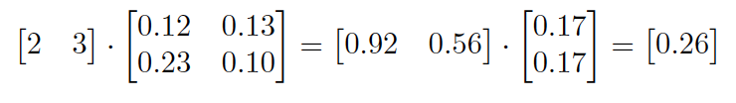
2.3 Backward propagation
1
Prediction
Actual
38
38

Slide 39
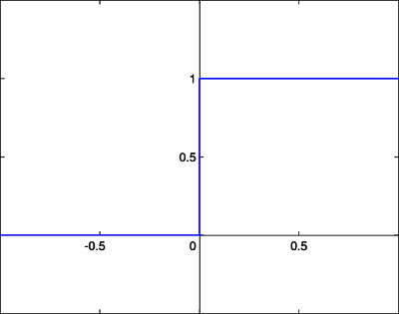
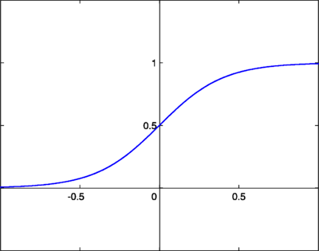

2.3 Activation Function
step function
sigmoid function
  In artificial neural networks, the activation function abstracts the rate of action potential firing in a neuron.
  The simplest activation function is binary: the neuron either fires or doesn’t.
  Modern activation functions, like the sigmoid, introduce a region of uncertainty and are differentiable, enabling efficient optimization using gradient-based methods.
39
39
https://en.wikipedia.org/wiki/Activation_function

Slide 40
1.1 McCulloch–Pitts neuron (1943)
Input X₁
Input X₂
Input X₃
Output Y
…
Daniel Shiffman - The Nature of Code
Input X_{n}
Receive input
Integrate & process signals (activation)
Generate output
40
McCulloch, W. S., & Pitts, W. (1943). A logical calculus of the ideas immanent in nervous activity. The bulletin of mathematical biophysics, 5, 115-133.

Slide 41
2.3 Activation Function
step function
sigmoid function
  In artificial neural networks, the activation function abstracts the rate of action potential firing in a neuron.
  The simplest activation function is binary: the neuron either fires or doesn’t.
  Modern activation functions, like the sigmoid, introduce a region of uncertainty and are differentiable, enabling efficient optimization using gradient-based methods.
41
41
https://en.wikipedia.org/wiki/Activation_function

Slide 42
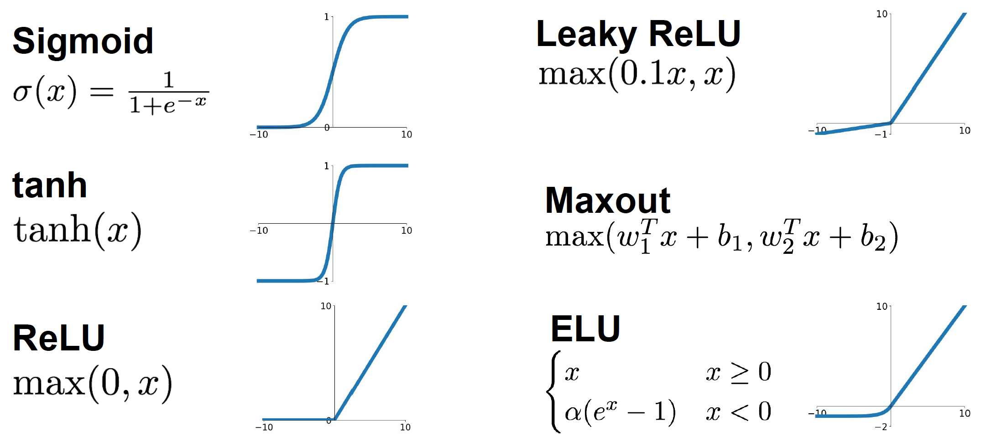
2.3 Activation Function
42
Image taken from Stanford’s CS231n class
42

Slide 43
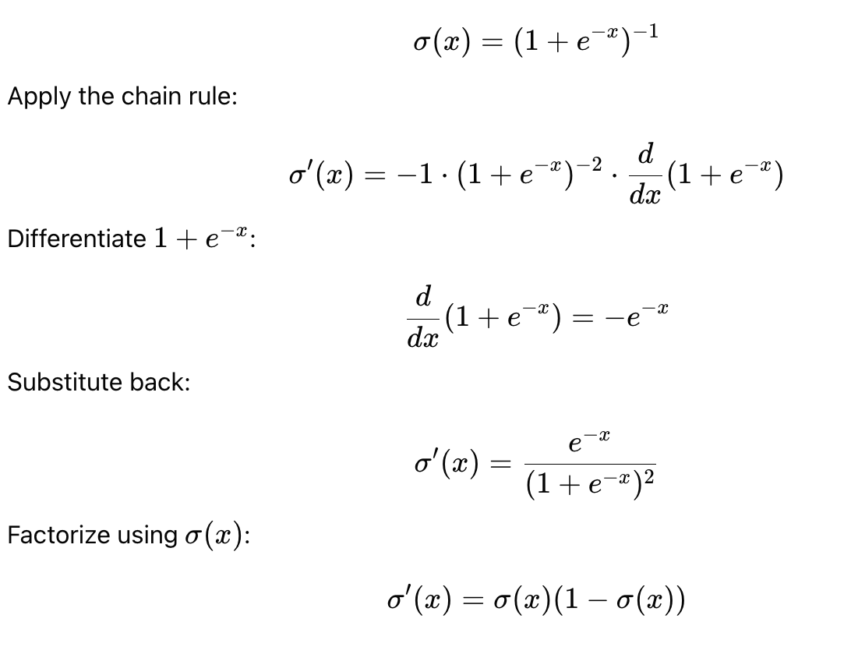
2.3 Activation Function
Example: Derivative of the Sigmoid Activation
43
43

Slide 44
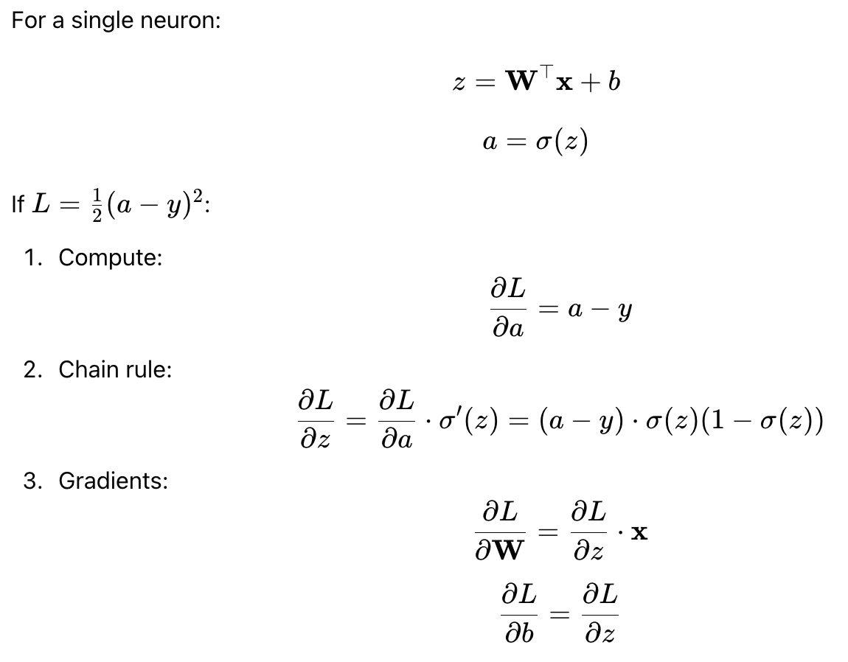
2.3 Activation Function
Example: Backpropagation with (Sigmoid) Nonlinear Activation
44
44

Slide 45
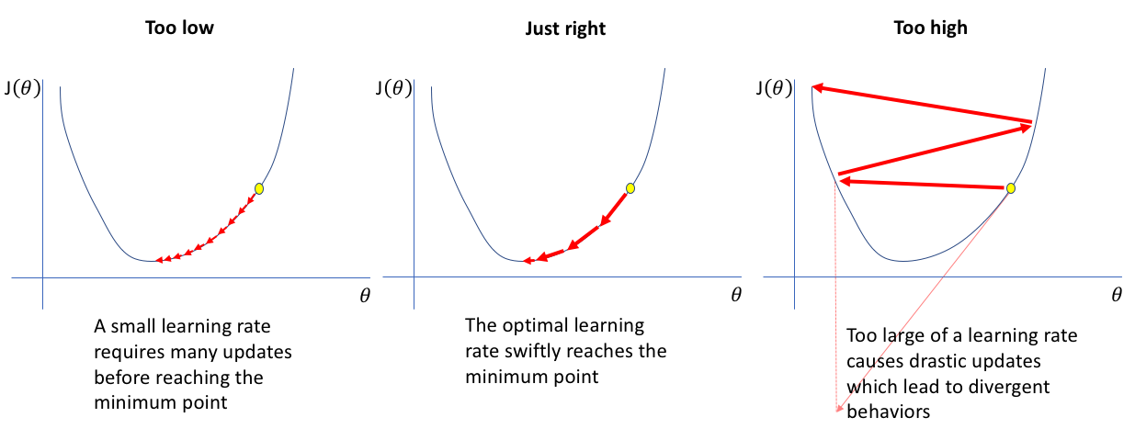
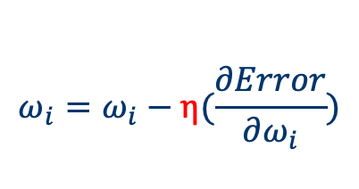
2.4 Several Key Concepts in Deep Learning
$$ω_{i}=ω_{i}−η(\frac{∂Error}{∂ω_{i}})$$
Learning rate
45
45

Slide 46
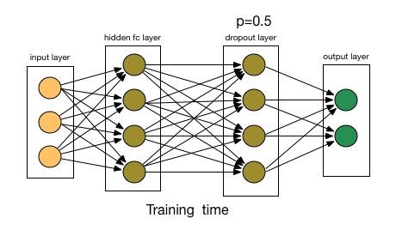
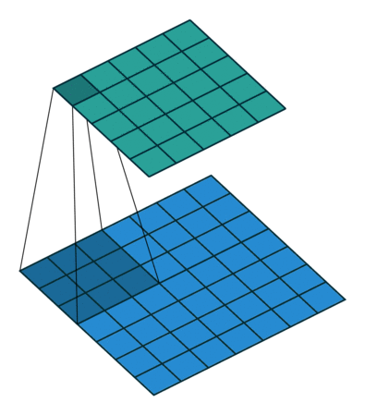
2.4 Several Key Concepts in Deep Learning
Dropout
Dropout is a regularization technique designed to reduce overfitting in neural networks.
The basic idea is to randomly "drop" (i.e., set to zero) a fraction of the neurons during each training iteration.
This means that for each mini-batch, a different subset of neurons is inactive, forcing the network to learn more robust features that are not overly reliant on any single neuron.
A convolutional layer is a core component of convolutional neural networks (CNNs) designed to automatically learn and extract features from input data—most commonly images.
Focuses on a small region of the input (called the receptive field).
CNN (RNN, GNN, …)
Notes:
Dropout the concept of regularization; LASSO

Slide 47
2.5 What’s Deep Learning?
TL;DR: Basically a rebranding of neural networks
Networks with multi-layer structure - two or more hidden layers - are called deep neural networks
Use learning algorithms so that the network can automatically learn the weights and biases
Stochastic gradient descent (SGD) and back-propagation to train deep networks (since 80s and 90s)
People now routinely train networks with >10 hidden layers
Perform far better on many problems than shallow neural networks, i.e., networks with just a single hidden layer

Slide 48
Caveats
Requires lots of training data
Designing and optimizing a “net” is hard (lots of parameters)
Blackbox approach: (arguably) hard to interpret results
Consensus: the performance improvement from adding additional hidden layers (i.e., second or third, etc.) is very small. One hidden layer is sufficient for the large majority of problems
So what about size of the hidden layer(s)? How many neurons? There are some empirically-derived rules-of-thumb, of these, the most commonly relied on is 'the optimal size of the hidden layer is usually between the size of the input and size of the output layers’
Jeff Heaton, author of Introduction to Neural Networks in Java offers a few more. “In sum, for most problems, one could probably get decent performance (even without a second optimization step) by setting the hidden layer configuration using just two rules: (i) number of hidden layers equals one; and (ii) the number of neurons in that layer is the mean of the neurons in the input and output layers.”

Slide 49
Suggested readings
Free online books
An Introduction to Statistical Learning, Chapter 10, Deep learning: https://www.statlearning.com/
The Nature of Code by Daniel Shiffman- 10. Neural Networks (easy to read): http://natureofcode.com/book/chapter-10-neural-networks/
Neural Networks and Deep Learning by Michael Nielsen: http://neuralnetworksanddeeplearning.com/index.html
Review articles
Yann LeCun, Yoshua Bengio, Geoffrey Hinton. Deep learning. Nature 521, 436–444 (28 May 2015)

Slide 50

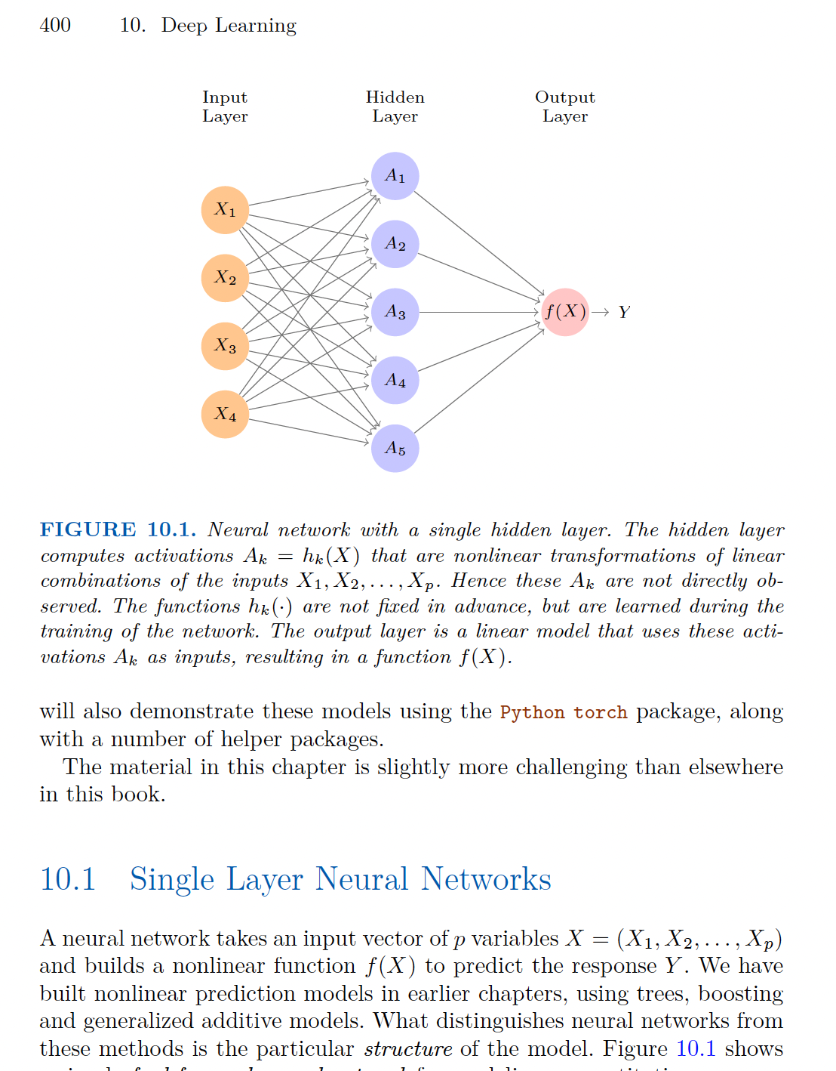

Slide 51
Thanks!

