Slide 1

Biomedical Data Science (GersteinLab.org/courses/3520)
Unsupervised Datamining – SVD (26m9c)
Last edit in spring ’25. Condensing by ~3 slide deletions from 2022’s 22m9c,
which is similar to
2021’s M9c [which has a video].
Mark Gerstein
Yale U.

Slide 2
Unsupervised Mining
SVD
Puts together slides prepared by Brandon Xia with images from
Alter et al. papers

Slide 3
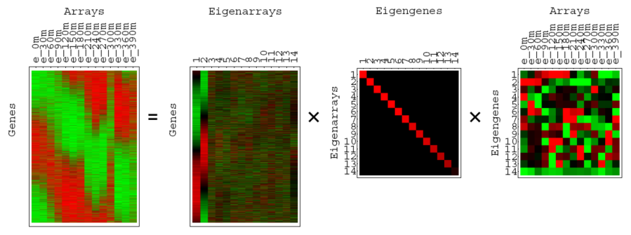
SVD for microarray data
(Alter et al, PNAS 2000)

Slide 4
A = USV^{T}
A is any rectangular matrix (m ≥ n)
Row space: vector subspace generated by the row vectors of A
Column space: vector subspace generated by the column vectors of A
  The dimension of the row & column space is the rank of the matrix A: r (≤ n)
A is a linear transformation that maps vector x in row space into vector Ax in column space

Slide 5
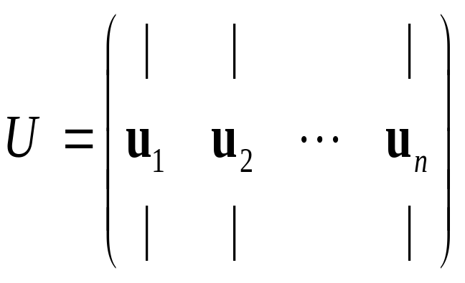
A = USV^{T}
U is an “orthogonal” matrix (m ≥ n)
Column vectors of U form an orthonormal basis for the column space of A: U^{T}U=I
u₁, …, u_{n} in U are eigenvectors of AA^{T}
  AA^{T} =USV^{T} VSU^{T} =US² U^{T}
  “Left singular vectors”

Slide 6
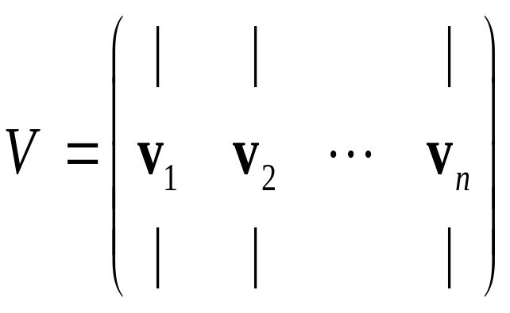
A = USV^{T}
V is an orthogonal matrix (n by n)
Column vectors of V form an orthonormal basis for the row space of A: V^{T}V=VV^{T}=I
v₁, …, v_{n} in V are eigenvectors of A^{T}A
  A^{T}A =VSU^{T} USV^{T} =VS² V^{T}
  “Right singular vectors”

Slide 7
A = USV^{T}
S is a diagonal matrix (n by n) of non-negative singular values
Typically sorted from largest to smallest
Singular values are the non-negative square root of corresponding eigenvalues of A^{T}A and AA^{T}

Slide 8
AV = US
Means each Av_{i} = s_{i}u_{i}
Remember A is a linear map from row space to column space
Here, A maps an orthonormal basis {v_{i}} in row space into an orthonormal basis {u_{i}} in column space
Each component of u_{i} is the projection of a row of the data matrix A onto the vector v_{i}

Slide 9
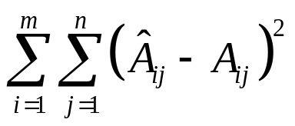
SVD as sum of rank-1 matrices
an outer product (uv^{T} ) giving a matrix rather than the scalar of the inner product
A = USV^{T}
A = s₁u₁v₁^{T} + s₂u₂v₂^{T} +… + s_{n}u_{n}v_{n}^{T}
s₁ ≥ s₂ ≥ … ≥ s_{n} ≥ 0
What is the rank-r matrix A that best approximates A ?
  Minimize
A = s₁u₁v₁^{T} + s₂u₂v₂^{T} +… + s_{r}u_{r}v_{r}^{T}
Very useful for matrix approximation
LSQ approx. If r=1, this amounts to a line fit.

Slide 10
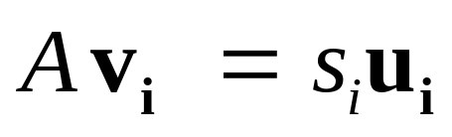
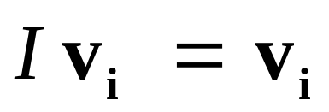
Geometry of SVD in row space
A as a collection of m row vectors (points) in the row space of A
s₁u₁v₁^{T} + s₂u₂v₂^{T} is the best rank-2 matrix approximation for A
Geometrically: v₁ and v₂ are the directions of the best approximating rank-2 subspace that goes through origin
s₁u₁ and s₂u₂ gives coordinates for row vectors in rank-2 subspace
v₁ and v₂ gives coordinates for row space basis vectors in rank-2 subspace
y’
y
x’
x

Slide 11
Unsupervised Mining
Intuition on interpretation of SVD in terms of genes and conditions

Slide 12
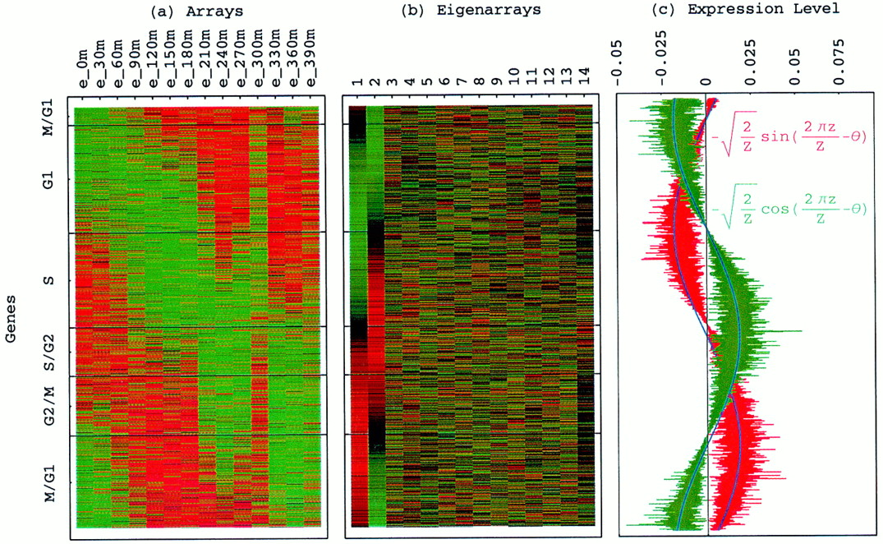
Genes sorted by correlation with top 2 eigengenes
Alter, Orly et al. (2000) Proc. Natl. Acad. Sci. USA 97, 10101-10106
Copyright ©2000 by the National Academy of Sciences

Slide 13
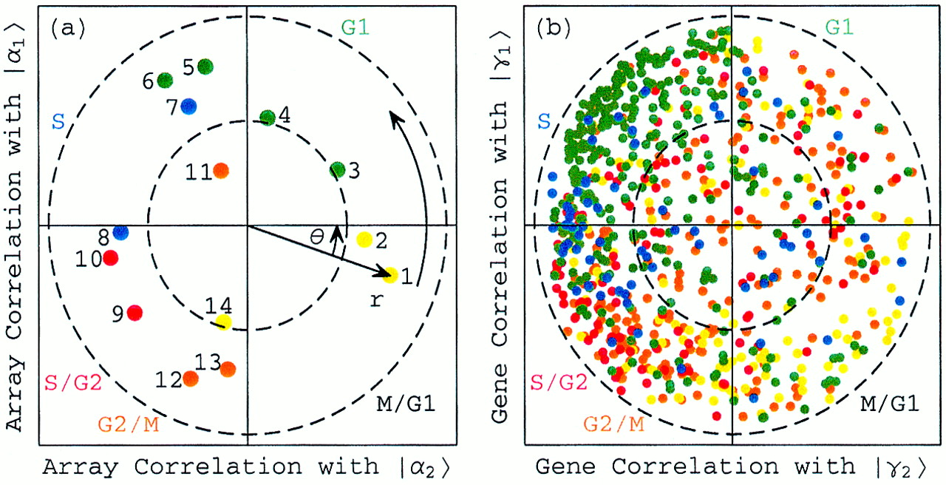
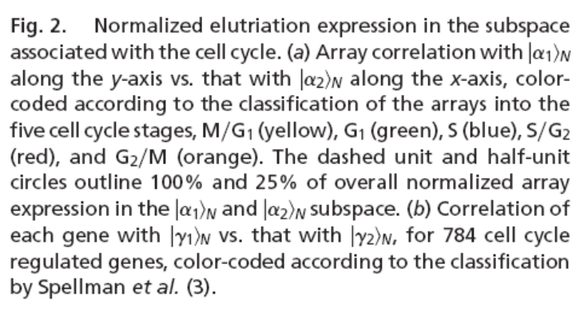
Normalized elutriation expression in the subspace associated with the cell cycle
Alter, Orly et al. (2000) Proc. Natl. Acad. Sci. USA 97, 10101-10106
Copyright ©2000 by the National Academy of Sciences

Slide 14
References
James, Gareth, Witten, Daniela, Hastie, Trevor, Tibshirani, Robert
An Introduction to Statistical Learning: with Applications in R
[ ISLR (2nd edition) ]
https://www.amazon.com/Introduction-Statistical-Learning-Applications-Statistics/dp/1071614177/ + https://www.statlearning.com
(Chapters 6.3.1 [up to section on “The Principal Components Regression Approach”] and 12.2 gives background on PCA/SVD.)
Alter, O., Brown, P. O., & Botstein, D. (2000). PNAS, 97(18), 10101–10106.
Singular value decomposition for genome-wide expression data processing and modeling.
https://doi.org/10.1073/pnas.97.18.10101
(Example discussed in class.)

