Slide 1

Biomedical Data Science (GersteinLab.org/courses/3520)
Unsupervised Mining – General Clustering (26m9a)
Last edit in spring ’26. Adding in network as matrix & some small cuts. Similar to 2022’s 22m9a &
2021’s M9a [which has a video].
Mark Gerstein
Yale U.

Slide 2
Unsupervised Mining
Columns & Rows
of the Data Matrix

Slide 3
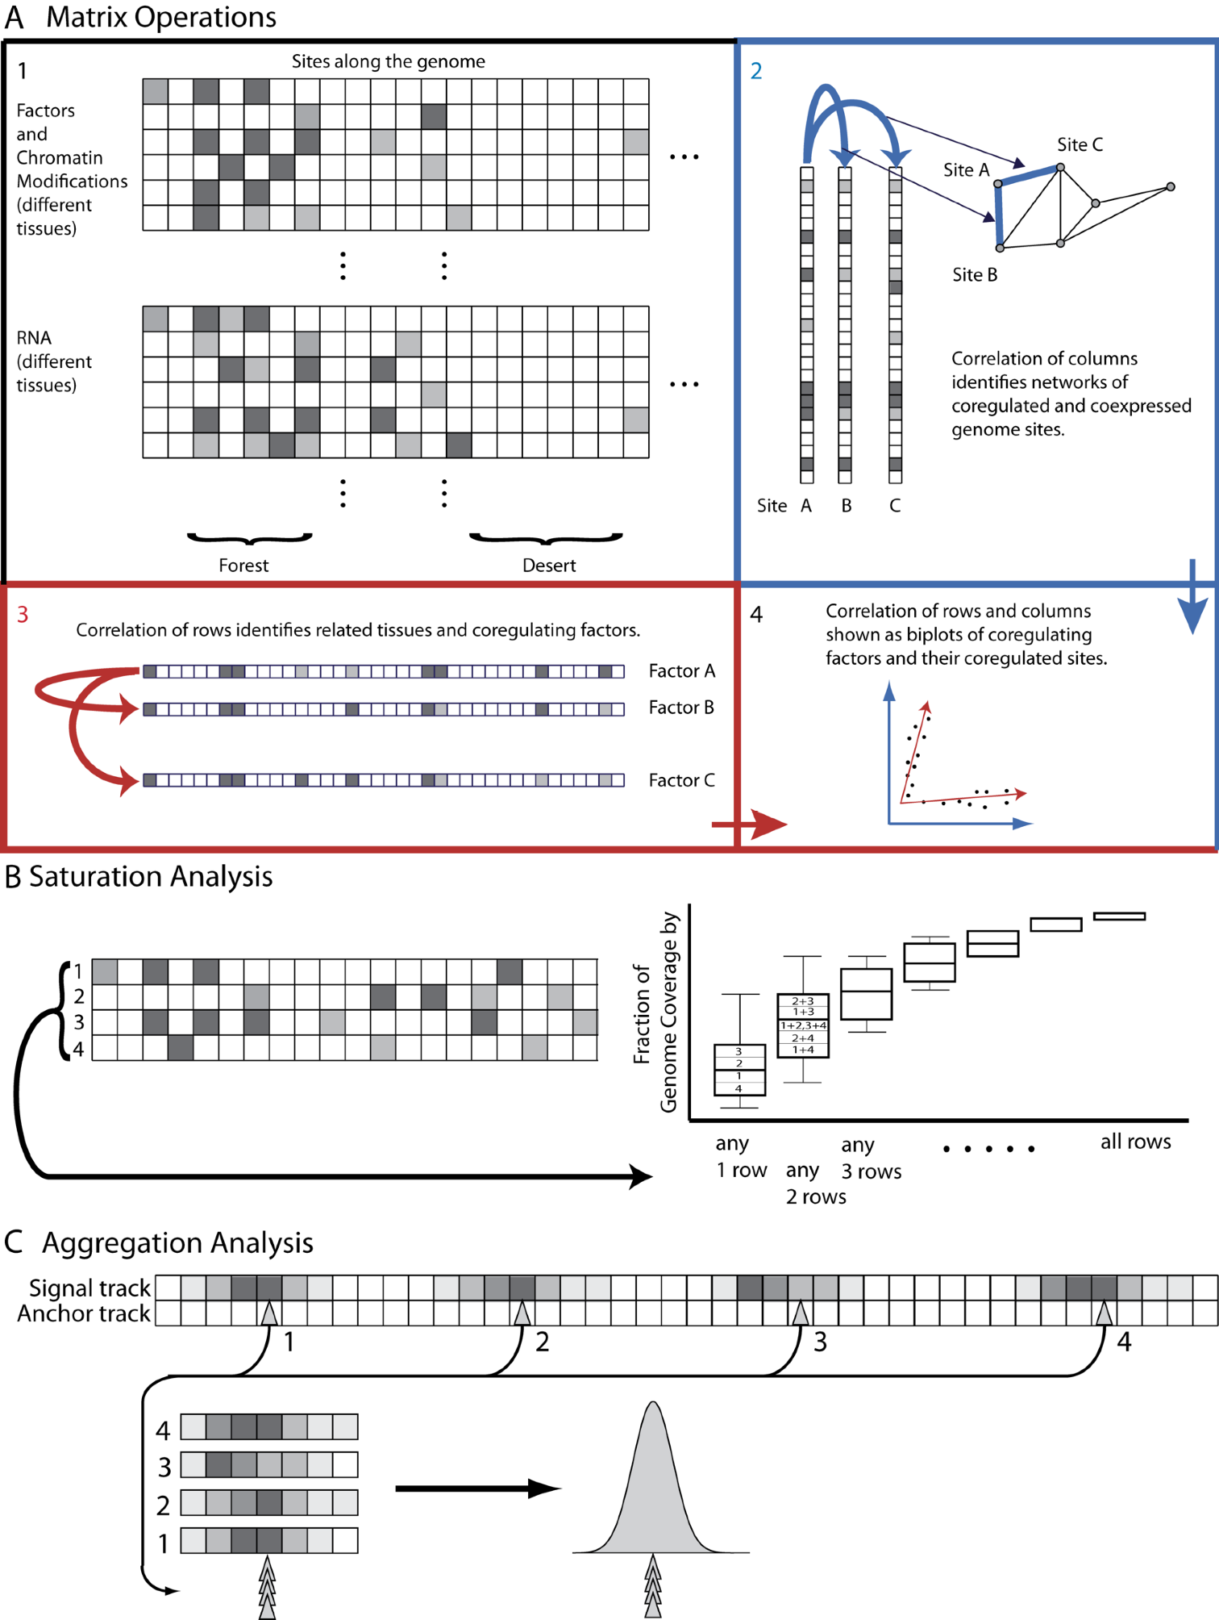
Structure of Genomic Features Matrix

Slide 4
Unsupervised Mining
  Simple overlaps & enriched regions
  Clustering rows & columns (networks)
  PCA/SVD (theory + appl.)
  Biplot
  RCA
  CCA
  tSNE
  LDA
  (Embedding from Variational Autoencoders)

Slide 5
Genomic Features Matrix: Deserts & Forests

Slide 6
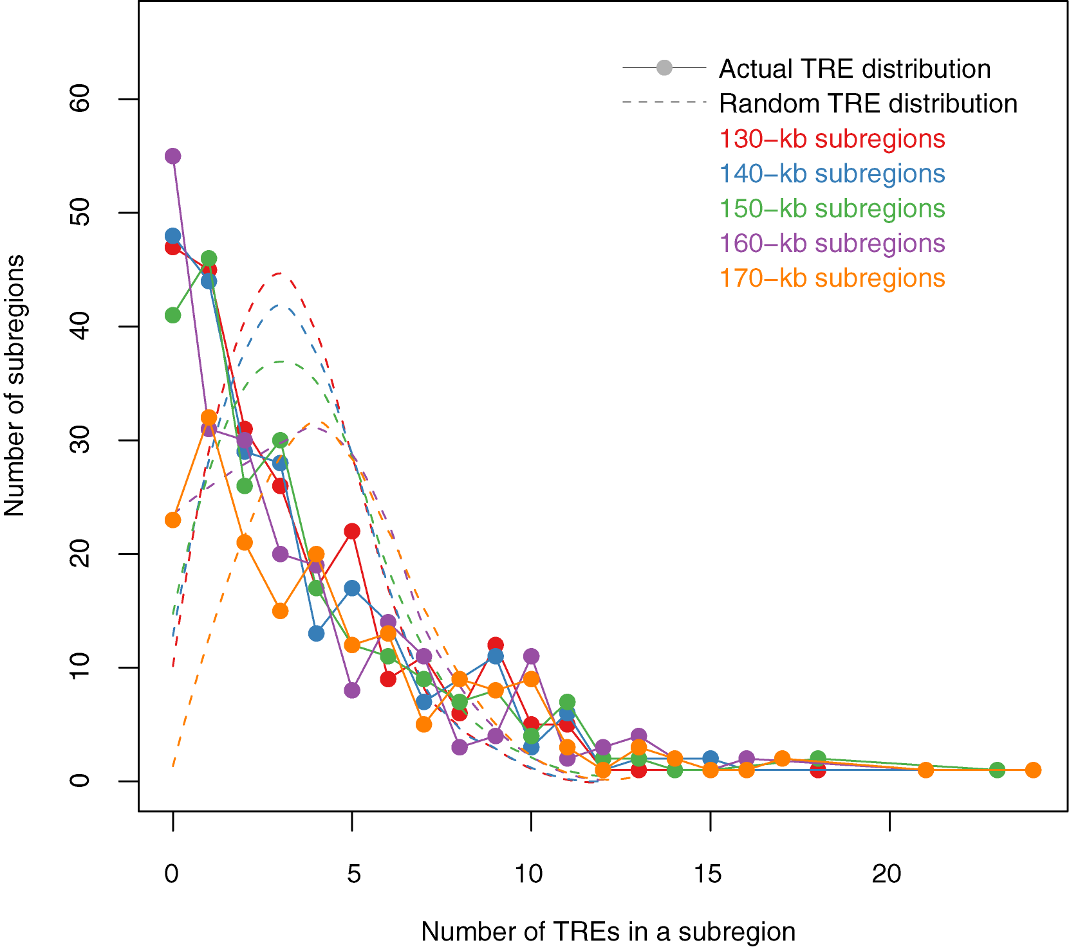
Modelling Distribution of Genomic Elements & Looking for Outliers
TREs (Genomic Elements) are not evenly distributed throughout the genome
The actual TRE distribution is power-law.
The null distribution is ‘Poissonesque.’
Many genomic subregions with extreme numbers of TREs.
Zhang et al. (2007) Gen. Res.

Slide 7
Aggregation & Saturation
[Nat. Rev. Genet. (2010) 11: 559]

Slide 8
Expression Clustering

Slide 9
Correlating Rows & Columns
[Nat. Rev. Genet. (2010) 11: 559]

Slide 10
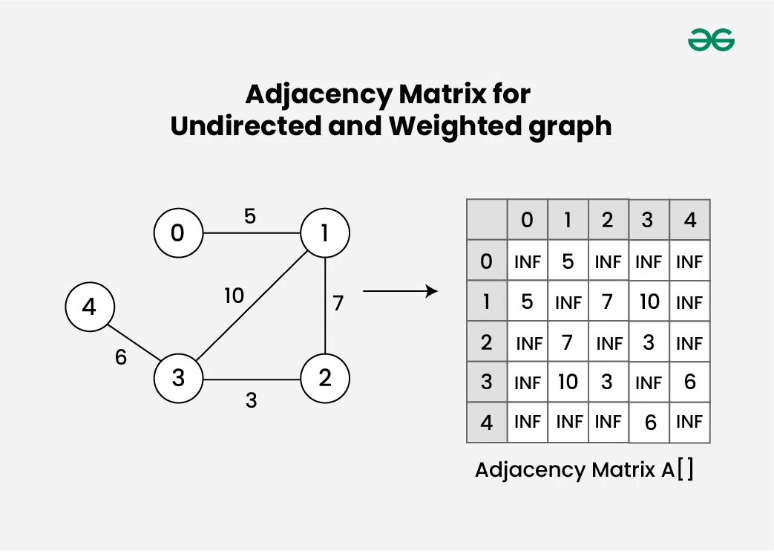
Seeing a Network as a Matrix
(More Later)
[https://www.geeksforgeeks.org/dsa/adjacency-matrix/]

Slide 11
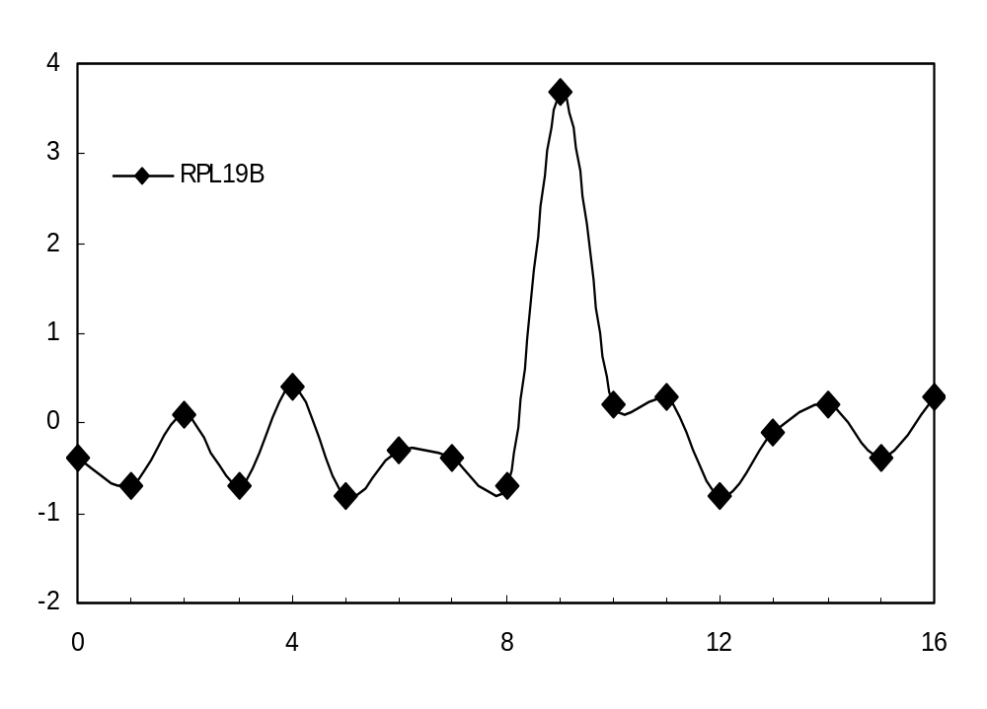
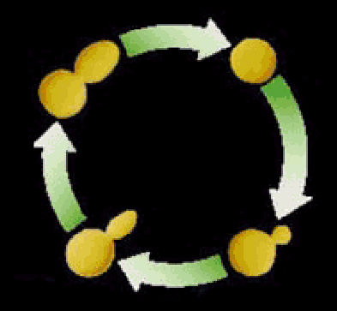

Clustering the yeast cell cycle to uncover interacting proteins
[Brown, Davis]
mRNA expression level (ratio)
Time->
Microarray timecourse of
1 ribosomal protein
Notes:
REM: Picking interesting relationships between genes pairs from ~18M possibilities

Slide 12
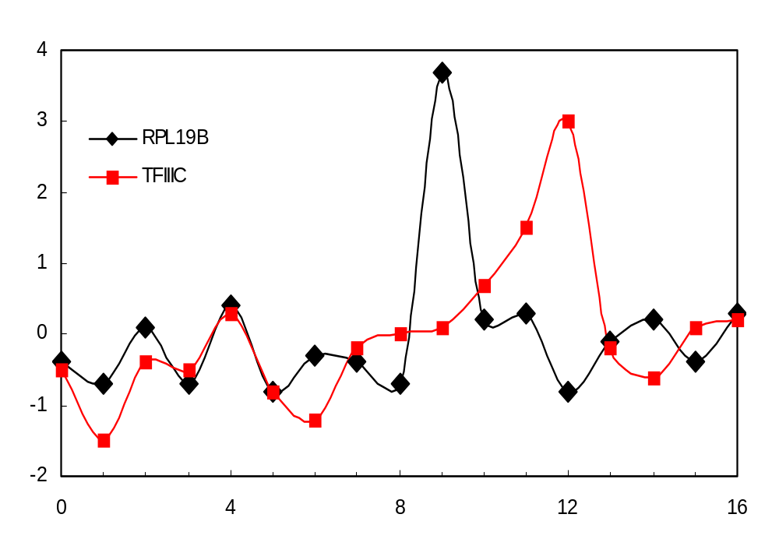
Clustering the yeast cell cycle to uncover interacting proteins
mRNA expression level (ratio)
Time->
Random relationship from ~18M
Notes:
REM: Picking interesting relationships between genes pairs from ~18M possibilities

Slide 13
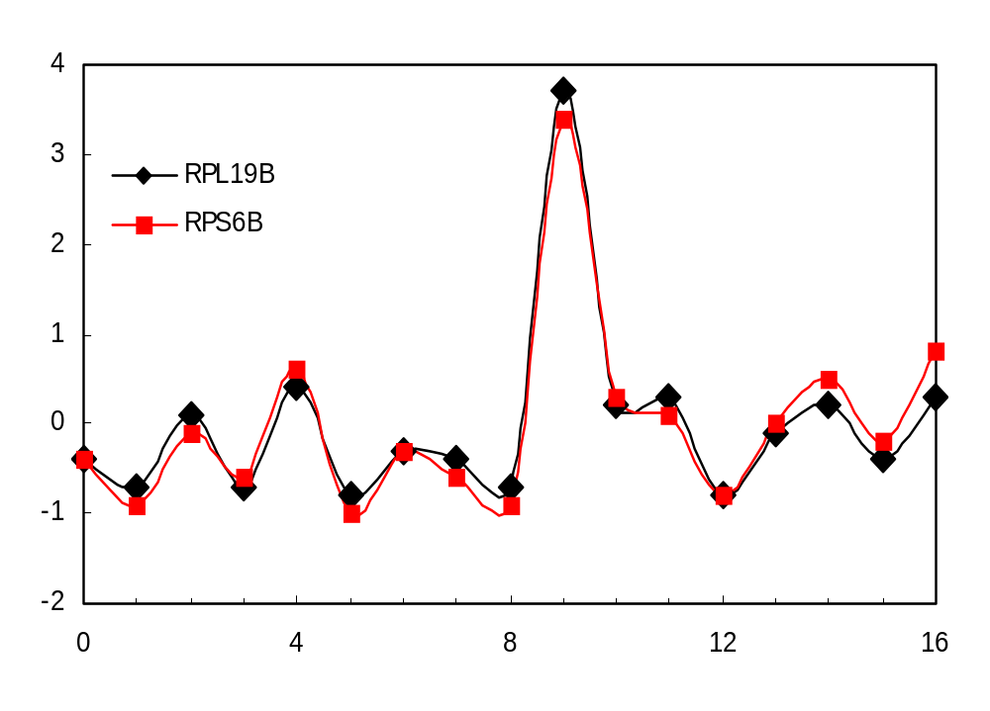
Clustering the yeast cell cycle to uncover interacting proteins
[Botstein; Church, Vidal]
mRNA expression level (ratio)
Time->
Close relationship from 18M
(2 Interacting Ribosomal Proteins)
Notes:
REM: Picking interesting relationships between genes pairs from ~18M possibilities

Slide 14
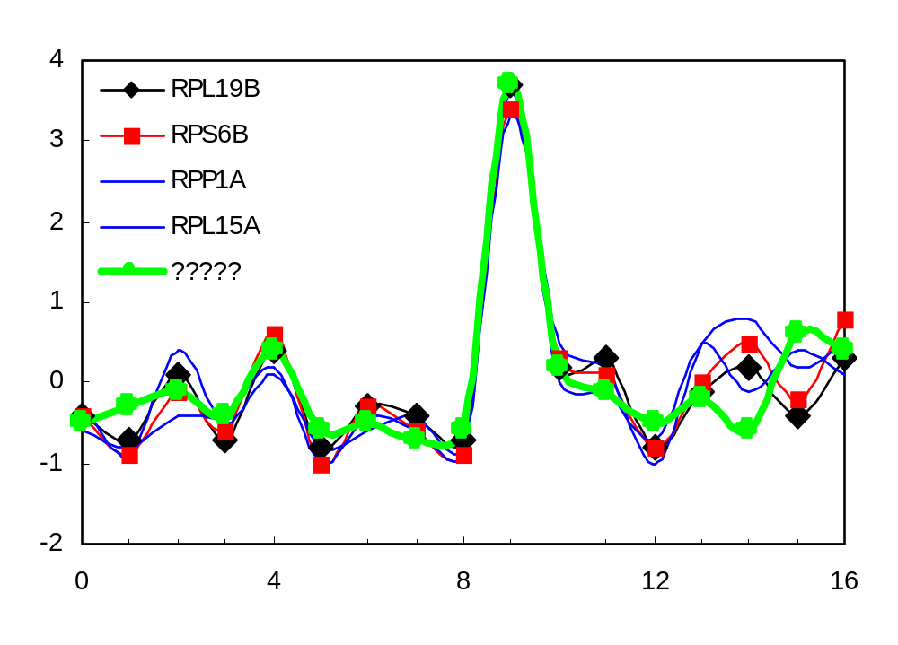
Clustering the yeast cell cycle to uncover interacting proteins
mRNA expression level (ratio)
Time->
Predict Functional Interaction of
Unknown Member of Cluster
Notes:
REM: Picking interesting relationships between genes pairs from ~18M possibilities

Slide 15
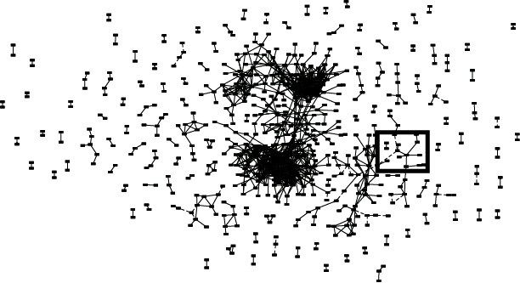
Global Network of Relationships
(More Later)
~470K significant
relationships
from ~18M possible

Slide 16
Unsupervised Mining
General Thoughts on Clustering

Slide 17
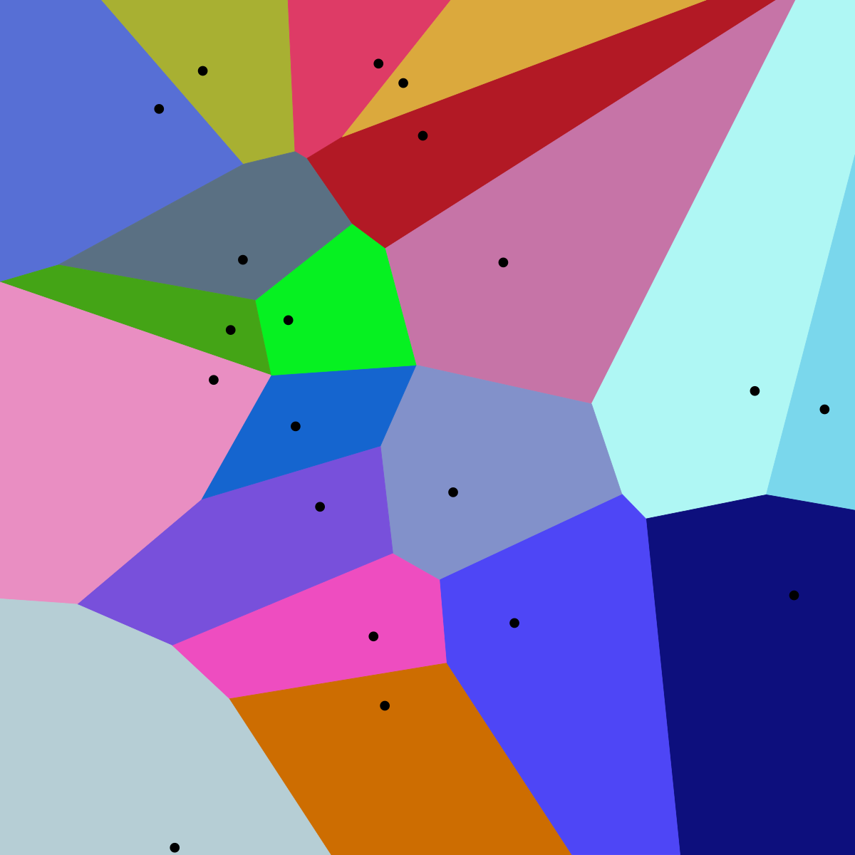
Centroid-based Methods
Optimizes a center vector to find data clusters
Clusters data into a Voronoi diagram, which is interpretable
Assumes a spherical shape for the clusters centered around the center vector
E.g. K-means clustering
  Heavily parameterized by K
  Optimized by Lloyd’s algorithm
Image reference:
https://upload.wikimedia.org/wikipedia/commons/thumb/5/54/Euclidean_Voronoi_diagram.svg/1200px-Euclidean_Voronoi_diagram.svg.png

Slide 18
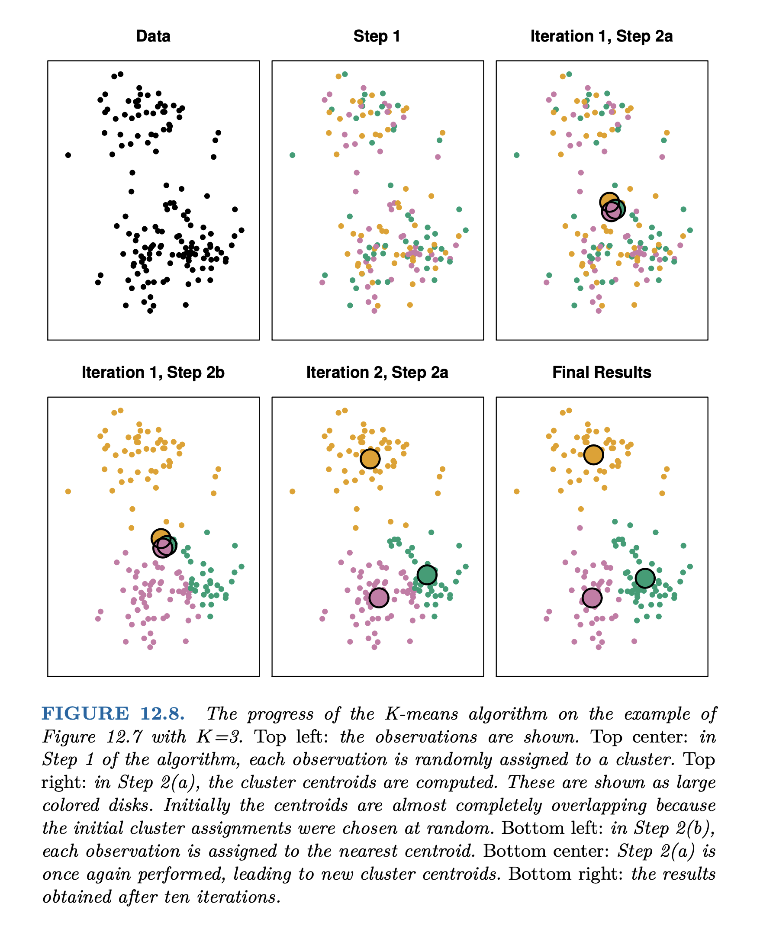
K-means
(1) Pick k (e.g. 3) random points as putative cluster centers.
(2) Group the points to be clustered by the center to which they are closest.
(3) Take the mean of each group and repeat, with the means now at the cluster center.
(4) Stop when the centers stop moving.
[ISLR, Chapter 12]

Slide 19
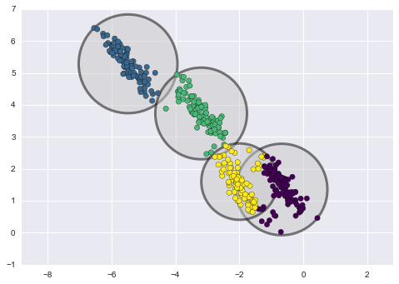
Distribution-based Methods
(More Later)
Clusters are defined as samples from certain distributions
Assumes the shape and number of distributions
E.g. Gaussian Mixture Model Clustering
  Can easily overfit by increasing the number of distributions
LDA & tSNE
Image reference: https://towardsdatascience.com/gaussian-mixture-models-d13a5e915c8e

Slide 20
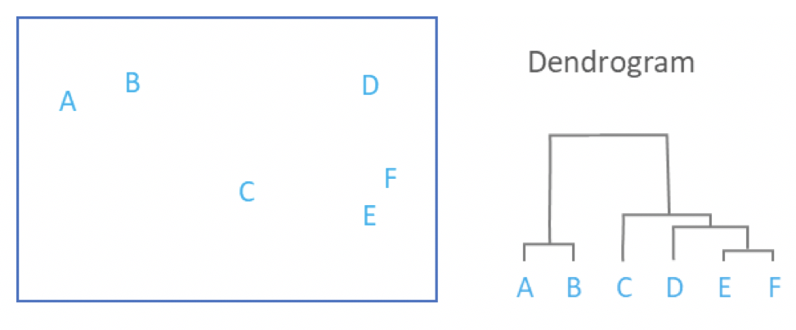
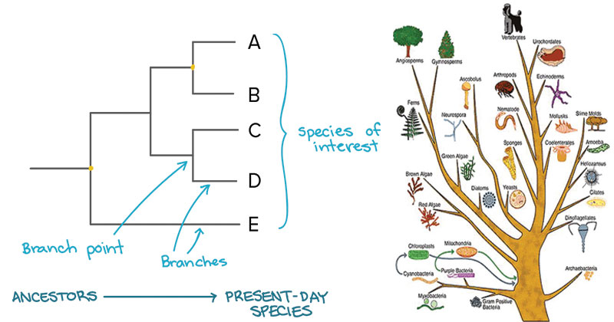
Connectivity-based Methods
Each data point start in their own cluster
Iteratively merge clusters together based on some evaluation of distance to form a hierarchical structure
Can be represented by a dendrogram (data point on one axis while tracking merge history on another axis)
No definitive cut off, but can be used to trace developmental pseudo-time
E.g. Hierarchical clustering & sequence trees (such as those for multiple alignment [mentioned earlier])
Image references:
https://46gyn61z4i0t1u1pnq2bbk2e-wpengine.netdna-ssl.com/wp-content/uploads/2018/03/Screen-Shot-2018-03-28-at-11.48.48-am.png
https://microbenotes.com/how-to-construct-a-phylogenetic-tree/

Slide 21
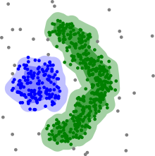
Density-based Methods
Utilize sparse regions and reachability to define clusters
Assumes some range parameter
E.g. DBSCAN
Pro: Fast - O(nlogn) runtime
Con: Some data points will not be assigned a cluster (undefined) because they are unreachable
Edge detection
Image reference: https://upload.wikimedia.org/wikipedia/commons/thumb/0/05/DBSCAN-density-data.svg/440px-DBSCAN-density-data.svg.png

Slide 22
Semi-supervised Approaches

Slide 23
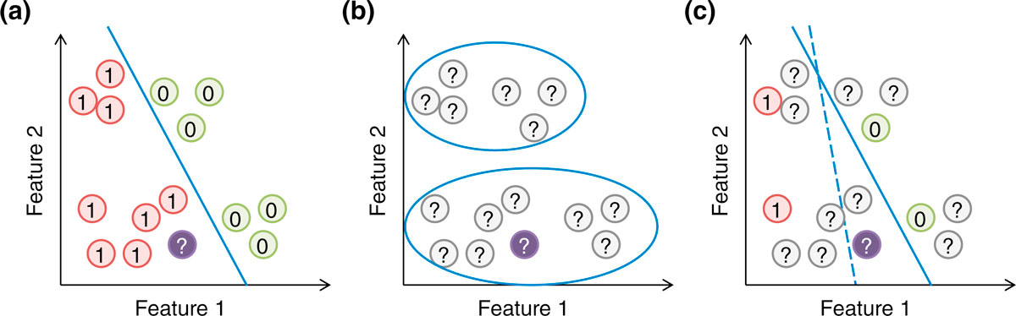
Semi-supervised Methods
Supervised & Unsupervised:
Can you combine them? YES
  RHS (c) shows modifying the optimum decision boundary in (a) by "clustering" of unlabeled points
[Yip et al. Genome Biol. ('13)]
Supervised, unsupervised and semi-supervised learning. (a) In supervised learning, the model (blue line) is learned based on the positive and negative training examples, and the genomic region without a known class label (purple circle) is classified as positive according to the model. (b) In unsupervised learning, all examples are unlabeled, and they are grouped according to the data distribution. (c) In semi-supervised learning, information of both labeled and unlabeled examples is used to learn the parameters of the model. In this illustration, a purely supervised model (dashed blue line) classifies the purple object as negative, while a semi-supervised model that avoids cutting at regions with a high density of genomic regions (solid blue line) classifies it as positive.

Slide 24
References
James, Gareth, Witten, Daniela, Hastie, Trevor, Tibshirani, Robert
An Introduction to Statistical Learning: with Applications in R
[ ISLR (2nd edition) ]
https://www.amazon.com/Introduction-Statistical-Learning-Applications-Statistics/dp/1071614177/ + https://www.statlearning.com
(Chapter 12.1 and 12.4 gives background on Clustering.)
Peixeiro, M. (2021, December 11). Towards Data Science. Medium.
The complete Guide to Unsupervised Learning
https://towardsdatascience.com/the-complete-guide-to-unsupervised-learning-ecf8b676f2af
(Optional extra background on clustering)

