Slide 1

Biomedical Data Science (GersteinLab.org/courses/3520)
Network Prediction (26m10e)
Last edit in spring ’26. Further cuts compared to 2025,
which has a video.
Mark Gerstein
Yale U.

Slide 2
Predicting Networks via Bayesian Integration
Problem Motivation

Slide 3
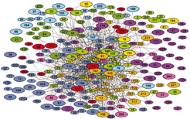
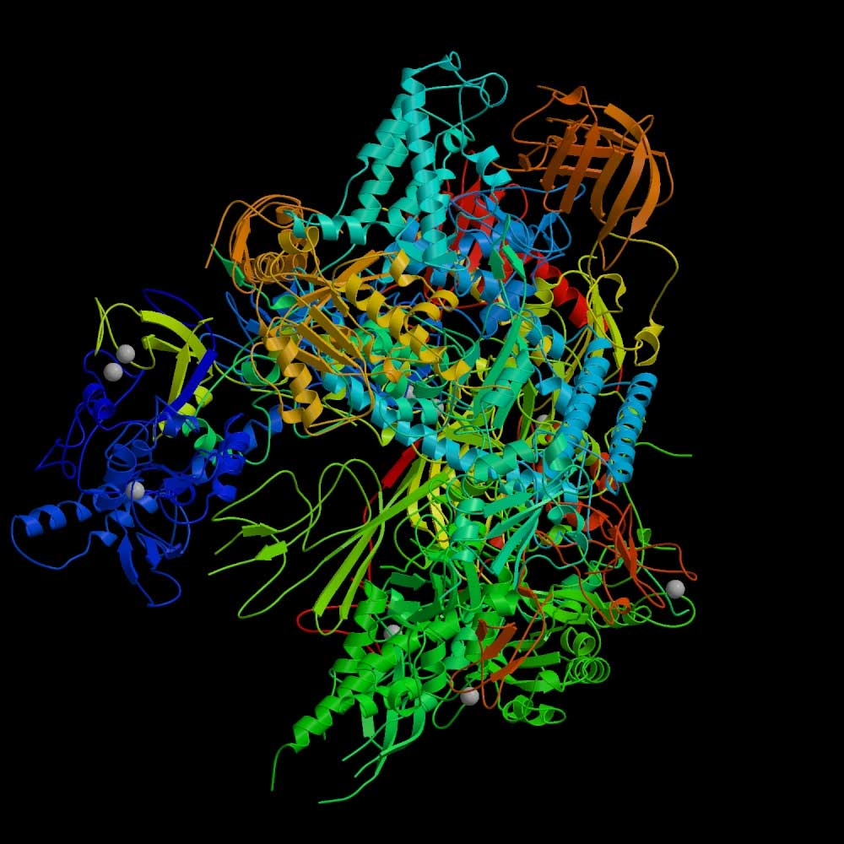
RNA polymerase II: Structure
Which subunits interact?
Based on Binding
experiments
Compare with Gold Std. Structure
5
3
6
2
8
1
9
12
10
11
Source: Cramer et al., 2000, Science, 288:632-633
Source: Edwards et al., 2002, Trends in Genetics

Slide 4
Binding Experiments on Subunit Pairs
(Noisy Information Sources)
Subunits
1
1
1
1
1
1
1
1
1
2
2
2
2
2
2
2
2
3
3
3
3
3
3
3
5
5
5
5
5
5
6
6
6
6
6
8
8
8
8
9
9
9
10
10
12
Subunits
2
3
5
6
8
9
10
11
12
3
5
6
8
9
10
11
12
5
6
8
9
10
11
12
6
8
9
10
11
12
8
9
10
11
12
9
10
11
12
10
11
12
11
11
12
Pull-down 1
1
1
0
1
0
1
0
1
1
0
1
0
1
0
1
1
1
0
1
1
1
1
0
1
0
0
0
0
0
0
1
0
0
0
0
Pull-down 2
1
1
1
1
0
1
0
1
1
0
1
0
1
0
1
1
1
0
1
1
0
1
0
1
0
0
0
0
0
0
0
0
0
0
0
Pull-down 3
1
1
1
0
1
0
0
1
0
Cross-linking
1
1
1
1
1
0
1
1
1
1
1
0
1
1
1
1
1
1
0
1
Far Western 1
1
1
1
1
1
0
0
0
0
0
0
1
0
0
0
Far Western 2
1
1
1
1
1
1
1
1
1
1
0
0
0
1
0
0
0
0
0
0
0
0
0
0
0
0
0
0
0
0
Far Western 3
1
0
0
0
1
0
Interaction experiments
before structure was known

Slide 5
RNA Polymerase II: Gold-Standards
Subunits
1
1
1
1
1
1
1
1
1
2
2
2
2
2
2
2
2
3
3
3
3
3
3
3
5
5
5
5
5
5
6
6
6
6
6
8
8
8
8
9
9
9
10
10
12
Subunits
2
3
5
6
8
9
10
11
12
3
5
6
8
9
10
11
12
5
6
8
9
10
11
12
6
8
9
10
11
12
8
9
10
11
12
9
10
11
12
10
11
12
11
11
12
Gold-Standard Positive (GSTD+): 13
Gold-Standard Negative (GSTD-): 32
5
3
6
2
8
1
9
12
10
11

Slide 6
Assess Quality and Coverage of PPints
Subunits
1
1
1
1
1
1
1
1
1
2
2
2
2
2
2
2
2
3
3
3
3
3
3
3
5
5
5
5
5
5
6
6
6
6
6
8
8
8
8
9
9
9
10
10
12
Subunits
2
3
5
6
8
9
10
11
12
3
5
6
8
9
10
11
12
5
6
8
9
10
11
12
6
8
9
10
11
12
8
9
10
11
12
9
10
11
12
10
11
12
11
11
12
Pull-down 1
1
1
0
1
0
1
0
1
1
0
1
0
1
0
1
1
1
0
1
1
1
1
0
1
0
0
0
0
0
0
1
0
0
0
0
Pull-down 2
1
1
1
1
0
1
0
1
1
0
1
0
1
0
1
1
1
0
1
1
0
1
0
1
0
0
0
0
0
0
0
0
0
0
0
Pull-down 3
1
1
1
0
1
0
0
1
0
Cross-linking
1
1
1
1
1
0
1
1
1
1
1
0
1
1
1
1
1
1
0
1
Far Western 1
1
1
1
1
1
0
0
0
0
0
0
1
0
0
0
Far Western 2
1
1
1
1
1
1
1
1
1
1
0
0
0
1
0
0
0
0
0
0
0
0
0
0
0
0
0
0
0
0
Far Western 3
1
0
0
0
1
0
GSTD+
GSTD-
True
False

Slide 7
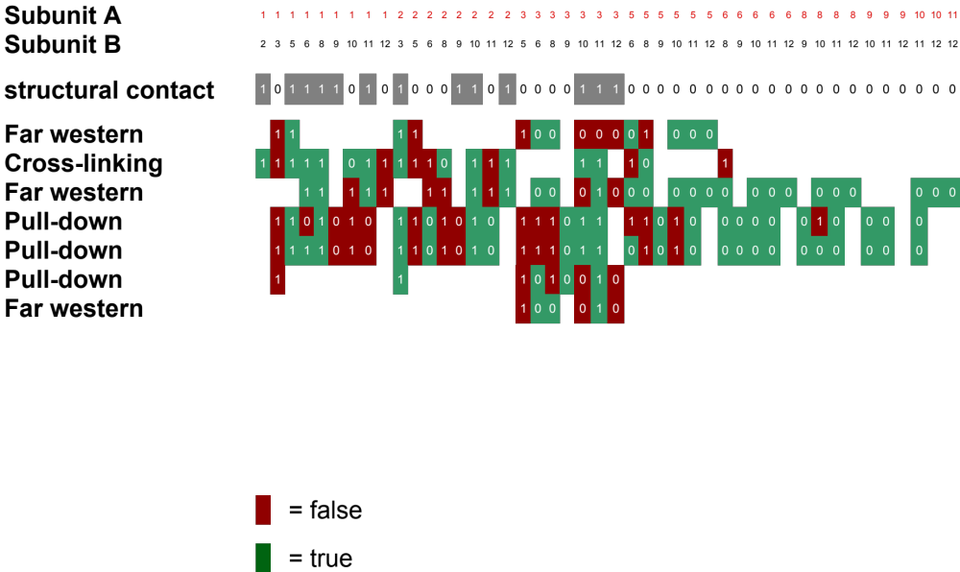
Re-drawn in a different color scheme

Slide 8
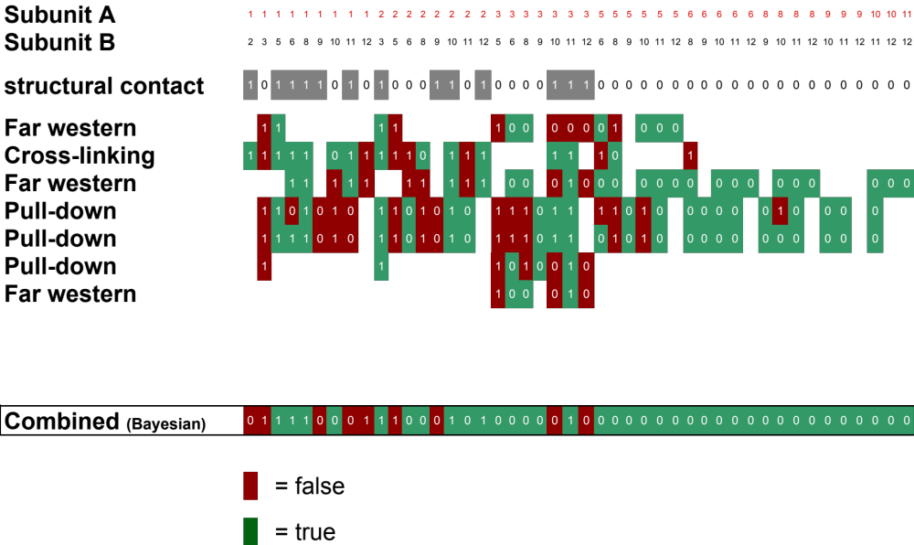

Data integration: RNA polymerase II
Integrate using naive Bayes classifier

Slide 9
Data integration: RNA polymerase II
Integrate using naive Bayes classifier

Slide 10
Data integration: RNA polymerase II
Integrate using naive Bayes classifier
(Cross validate)

Slide 11
Predicting Networks via Bayesian Integration
Formalism

Slide 12
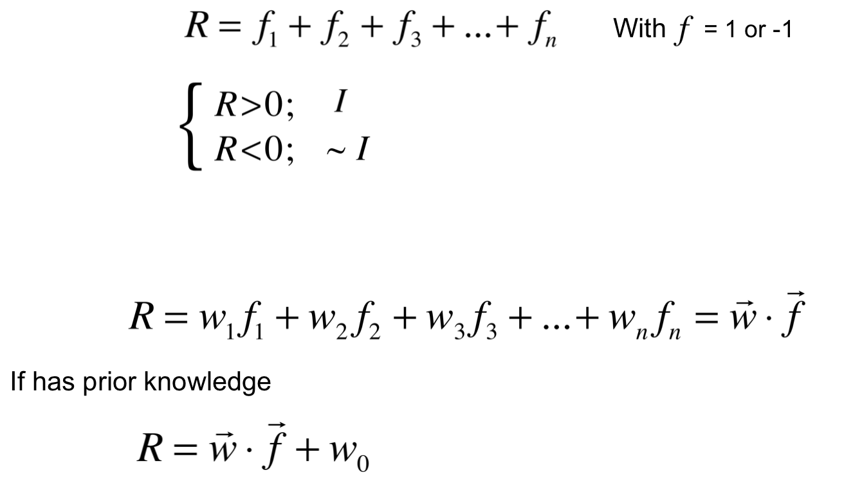
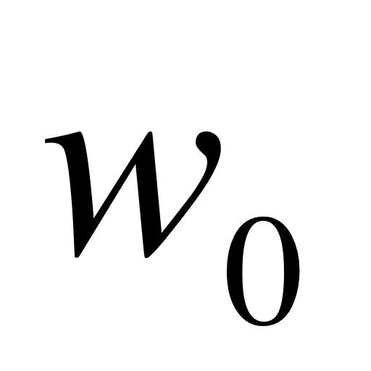
Supervised
Classification by Weighted Voting
Similar form to many other classifiers – e.g. SVC, LDA, logistic
(see ISLR for comparison)
Simple Vote:
Interact
If
No interaction
Modify with feature weight:

Slide 13
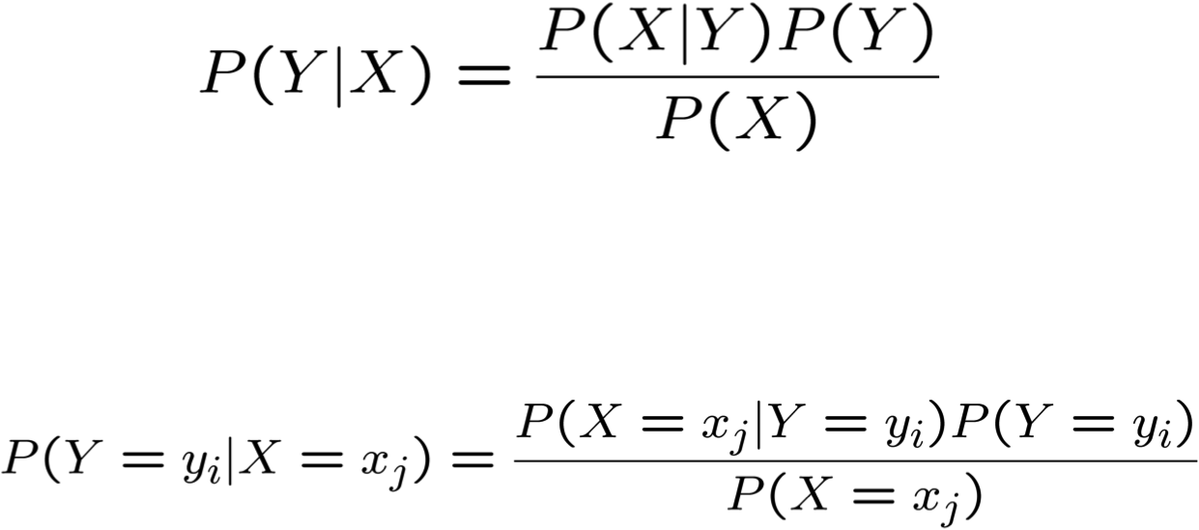
Bayes Rule
Which is shorthand for:
[From Mitchell, Machine Learning]

Slide 14
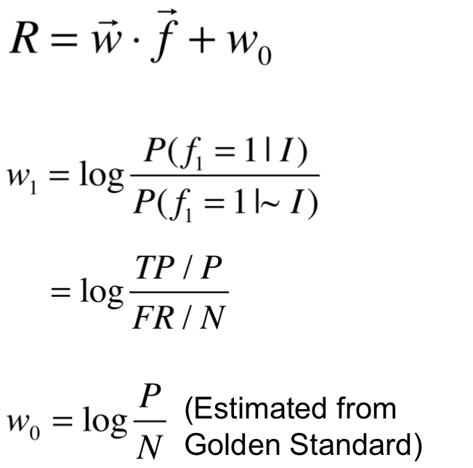
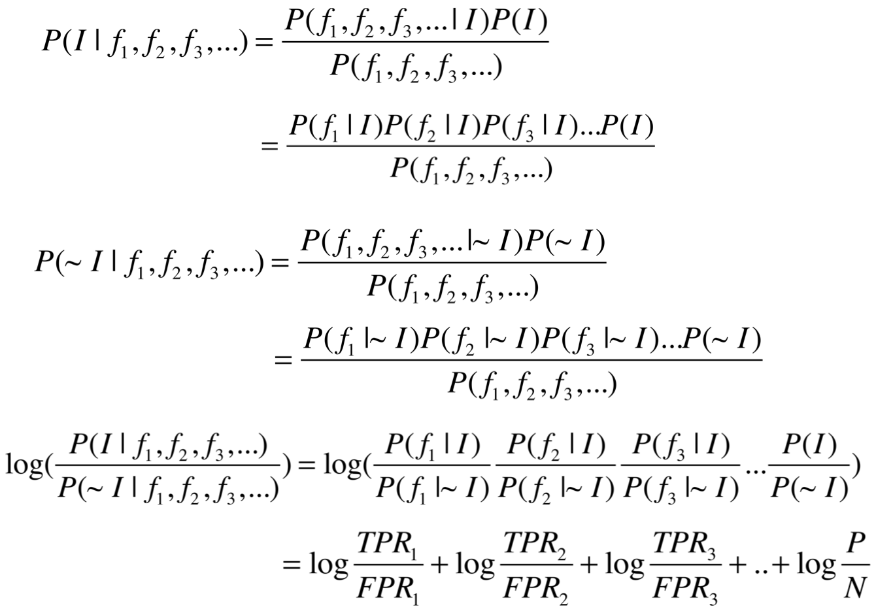
More Bayes Rule
FP / N
Assume
independent
(Naïve Bayes)

Slide 15
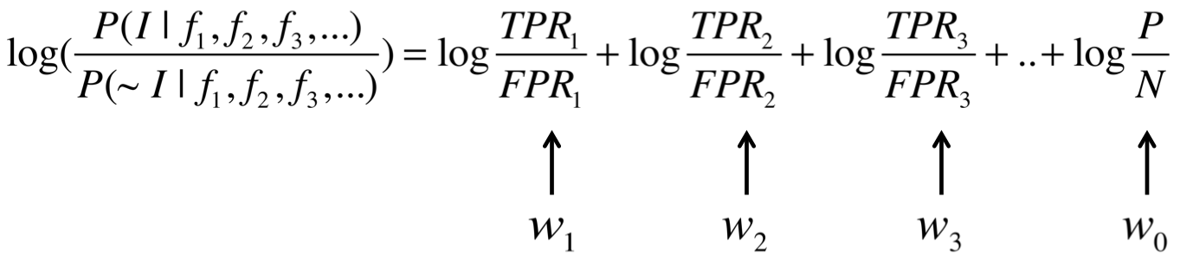
Update form of Bayes Rule
Updating our prior odds (w₀) by successively adding
likelihood ratio terms (w₁,w₂,w₃)
for each feature to get a final posterior odds
This simple additive update form supposedly,
secretly invented by A Turing during WWII
[Spiegelhalter & Brooks, The Art of Uncertainty (‘25)]

Slide 16
Predicting Networks via Bayesian Integration
Worked Example
(for reference)

Slide 17
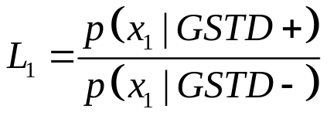
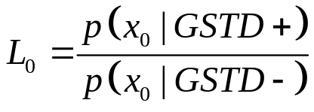
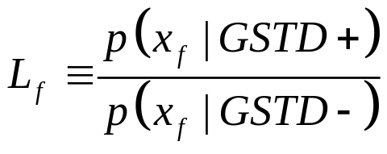
Likelihood Ratios
Subunits
1
1
1
1
1
1
1
1
1
2
2
2
2
2
2
2
2
3
3
3
3
3
3
3
5
5
5
5
5
5
6
6
6
6
6
8
8
8
8
9
9
9
10
10
12
Subunits
2
3
5
6
8
9
10
11
12
3
5
6
8
9
10
11
12
5
6
8
9
10
11
12
6
8
9
10
11
12
8
9
10
11
12
9
10
11
12
10
11
12
11
11
12
Pull-down 1
1
1
0
1
0
1
0
1
1
0
1
0
1
0
1
1
1
0
1
1
1
1
0
1
0
0
0
0
0
0
1
0
0
0
0
Likelihood Ratio
for Feature f:
GSTD+
GSTD-
True
False

Slide 18
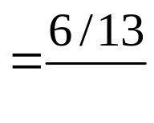
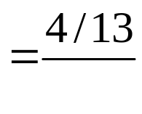
Calculating Likelihood Ratios
Subunits
1
1
1
1
1
1
1
1
1
2
2
2
2
2
2
2
2
3
3
3
3
3
3
3
5
5
5
5
5
5
6
6
6
6
6
8
8
8
8
9
9
9
10
10
12
Subunits
2
3
5
6
8
9
10
11
12
3
5
6
8
9
10
11
12
5
6
8
9
10
11
12
6
8
9
10
11
12
8
9
10
11
12
9
10
11
12
10
11
12
11
11
12
Pull-down 1
1
0
1
0
0
1
0
1
1
1
GSTD+
GSTD-
True
False

Slide 19
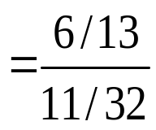
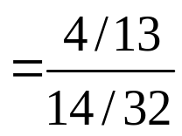
Calculating Likelihood Ratios
Subunits
1
1
1
1
1
1
1
1
1
2
2
2
2
2
2
2
2
3
3
3
3
3
3
3
5
5
5
5
5
5
6
6
6
6
6
8
8
8
8
9
9
9
10
10
12
Subunits
2
3
5
6
8
9
10
11
12
3
5
6
8
9
10
11
12
5
6
8
9
10
11
12
6
8
9
10
11
12
8
9
10
11
12
9
10
11
12
10
11
12
11
11
12
Pull-down 1
Pull-down 1
1
1
1
0
1
0
1
1
0
1
1
1
0
0
1
1
0
1
0
0
1
1
1
1
1
1
0
0
1
1
1
1
1
1
0
0
1
1
0
0
0
0
0
0
0
0
0
0
0
0
1
1
0
0
0
0
0
0
0
0
=1.34
=0.70
GSTD+
GSTD-
True
False

Slide 20
Calculating Likelihood Ratios
Subunits
1
1
1
1
1
1
1
1
1
2
2
2
2
2
2
2
2
3
3
3
3
3
3
3
5
5
5
5
5
5
6
6
6
6
6
8
8
8
8
9
9
9
10
10
12
Subunits
2
3
5
6
8
9
10
11
12
3
5
6
8
9
10
11
12
5
6
8
9
10
11
12
6
8
9
10
11
12
8
9
10
11
12
9
10
11
12
10
11
12
11
11
12
Pull-down 1
1
1
0
1
0
1
0
1
1
0
1
0
1
0
1
1
1
0
1
1
1
1
0
1
0
0
0
0
0
0
1
0
0
0
0
Pull-down 2
1
1
1
1
0
1
0
1
1
0
1
0
1
0
1
1
1
0
1
1
0
1
0
1
0
0
0
0
0
0
0
0
0
0
0
Pull-down 3
1
1
1
0
1
0
0
1
0
Cross-linking
1
1
1
1
1
0
1
1
1
1
1
0
1
1
1
1
1
1
0
1
Far Western 1
1
1
1
1
1
0
0
0
0
0
0
1
0
0
0
Far Western 2
1
1
1
1
1
1
1
1
1
1
0
0
0
1
0
0
0
0
0
0
0
0
0
0
0
0
0
0
0
0
Far Western 3
1
0
0
0
1
0
Pull-down 1
L1 = (6/13) / (11/32) = 1.34
L0 = (4/13) / (14/32) = 0.70
Pull-down 2
L1 = (7/13) / (9/32) = 1.91
L0 = (2/13) / (16/32) = 0.31
Pull-down 3
L1 = (2/13) / (3/32) = 1.64
L0 = (2/13) / (2/32) = 2.46
Cross-linking
L1 = (10/13) / (7/32) = 3.52
L0 = (0/13) / (3/32) = 0
Far Western 1
L1 = (2/13) / (4/32) = 1.23
L0 = (3/13) / (6/32) = 1.23
Far Western 2
L1 = (6/13) / (5/32) = 2.95
L0 = (2/13) / (17/32) = 0.29
Far Western 3
L1 = (1/13) / (1/32) = 2.46
L0 = (2/13) / (2/32) = 2.46
GSTD+
GSTD-
True
False

Slide 21

Data Integration: ROC-Curve
Subunits
1
1
1
1
1
1
1
1
1
2
2
2
2
2
2
2
2
3
3
3
3
3
3
3
5
5
5
5
5
5
6
6
6
6
6
8
8
8
8
9
9
9
10
10
12
Subunits
2
3
5
6
8
9
10
11
12
3
5
6
8
9
10
11
12
5
6
8
9
10
11
12
6
8
9
10
11
12
8
9
10
11
12
9
10
11
12
10
11
12
11
11
12
Pull-down 1
1
1
0
1
0
1
0
1
1
0
1
0
1
0
1
1
1
0
1
1
1
1
0
1
0
0
0
0
0
0
1
0
0
0
0
Pull-down 2
1
1
1
1
0
1
0
1
1
0
1
0
1
0
1
1
1
0
1
1
0
1
0
1
0
0
0
0
0
0
0
0
0
0
0
Pull-down 3
1
1
1
0
1
0
0
1
0
Cross-linking
1
1
1
1
1
0
1
1
1
1
1
0
1
1
1
1
1
1
0
1
Far Western 1
1
1
1
1
1
0
0
0
0
0
0
1
0
0
0
Far Western 2
1
1
1
1
1
1
1
1
1
1
0
0
0
1
0
0
0
0
0
0
0
0
0
0
0
0
0
0
0
0
Far Western 3
1
0
0
0
1
0
3.52
18.2
11.1
13.9
26.6
0.22
0
2.25
10.4
18.2
11.1
2.25
0
0.22
26.6
2.25
10.4
12.7
5.52
3.68
0.53
19.5
132
2.16
0.52
0
0.22
0.91
0.08
0.36
0.22
0.22
0.06
0.06
0.29
0.22
0.12
0.06
0.29
0.22
0.22
0
0.06
0.29
0.29
Combined (Bayes)
1
1
1
1
1
0
0
0
1
1
1
0
0
0
1
0
1
1
0
0
0
1
1
0
0
0
0
0
0
0
0
0
0
0
0
0
0
0
0
0
0
0
0
0
0
GSTD+
“Weighted Voting”
GSTD-
True
False

Slide 22
Data Integration: ROC Curve
Subunits
1
1
1
1
1
1
1
1
1
2
2
2
2
2
2
2
2
3
3
3
3
3
3
3
5
5
5
5
5
5
6
6
6
6
6
8
8
8
8
9
9
9
10
10
12
Subunits
2
3
5
6
8
9
10
11
12
3
5
6
8
9
10
11
12
5
6
8
9
10
11
12
6
8
9
10
11
12
8
9
10
11
12
9
10
11
12
10
11
12
11
11
12
3.52
18.2
11.1
13.9
26.6
0.22
0
2.25
10.4
18.2
11.1
2.25
0
0.22
26.6
2.25
10.4
12.7
5.52
3.68
0.53
19.5
132
2.16
0.52
0
0.22
0.91
0.08
0.36
0.22
0.22
0.06
0.06
0.29
0.22
0.12
0.06
0.29
0.22
0.22
0
0.06
0.29
0.29
Combined (Bayes)
1
1
1
1
1
0
0
0
1
1
1
0
0
0
1
0
1
1
0
0
0
1
1
0
0
0
0
0
0
0
0
0
0
0
0
0
0
0
0
0
0
0
0
0
0
Majority
1
1
1
1
1
0
1
0
1
1
1
0
1
0
1
0
1
1
0
0
0
0
1
0
0
1
0
0
0
0
0
0
0
0
0
0
0
0
0
0
0
0
0
0
0
Intersection
1
1
1
0
1
0
0
0
1
1
1
0
0
0
1
0
1
1
0
0
0
0
0
0
0
0
0
0
0
0
0
0
0
0
0
0
0
0
0
0
0
0
0
0
0
Union
1
1
1
1
1
0
1
1
1
1
1
1
1
0
1
1
1
1
1
1
0
1
1
0
1
1
0
1
0
0
1
0
0
0
0
0
1
0
0
0
0
0
0
0
0
1.0
0.8
0.6
Bayesian Integration
Majority
Intersection
Union
TPR=TP/P=Sensitivity
0.4
GSTD+
GSTD-
0.2
True
ROC Curves of RNA Polymerase II
False
0.2
0.4
0.6
0.8
1.0
FPR=FP/N=1-Specificity

Slide 23
Predicting Networks via Bayesian Integration
Feature Correlation

Slide 24
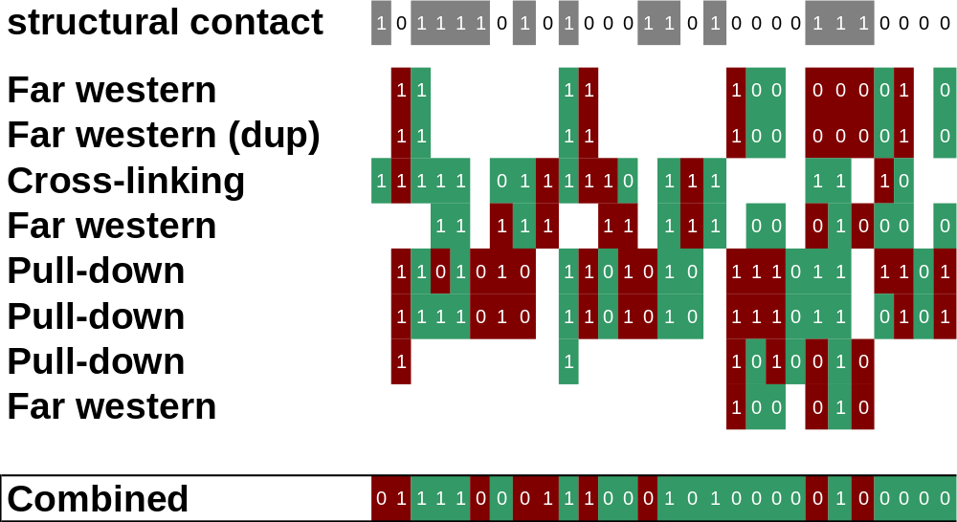
Correlations between similar features

Slide 25
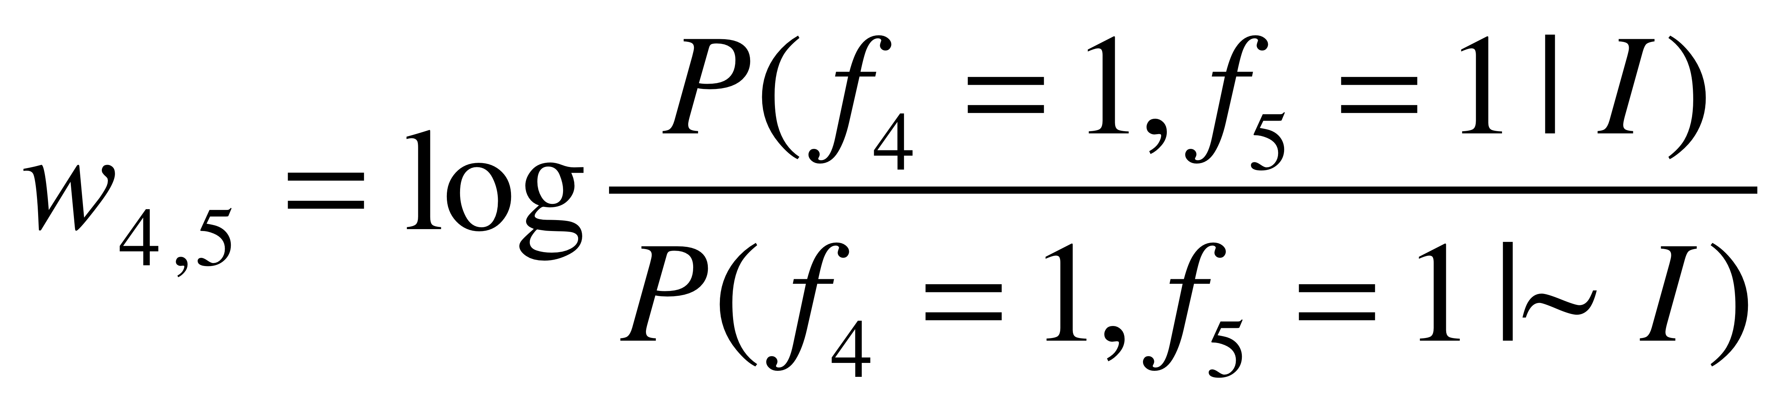
Feature Correlation and Fully Connected Bayes
GS | 1 | 0 | 0 | 1 | 1 | 1 | …
F1 | 1 | 0 | 0 | 1 | 0 | 0 | ...
F2 | 1 | 0 | 0 | 1 | 0 | 0 | …
F3 | 0 | 0 | 1 | 0 | 1 | 0 | …
F4 | 0 | 1 | 0 | 0 | 1 | 0 | …
F5 | 0 | 1 | 0 | 0 | 1 | 0 | …
F6 | 1 | 0 | 1 | 1 | 0 | 0 | …

Slide 26
Predicting Networks via Bayesian Integration
Bayesian Networks

Slide 27
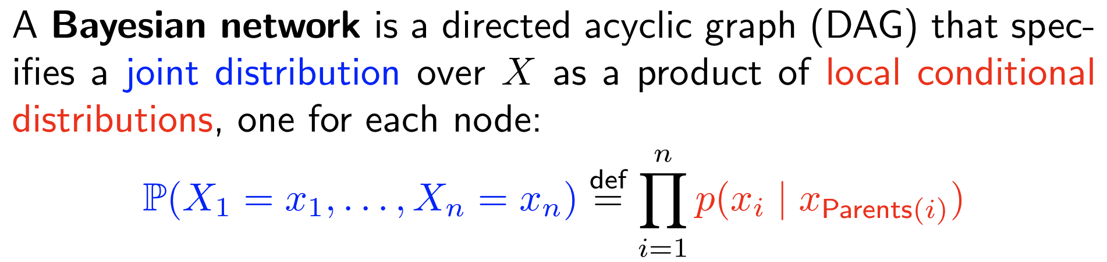
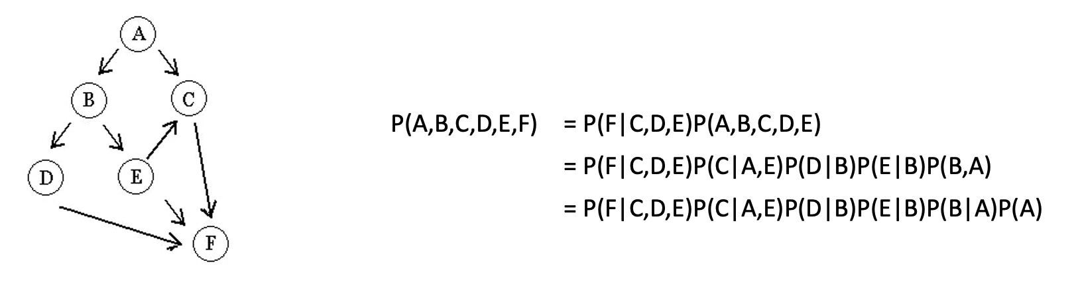
Bayesian network is a model that represent the relationship between variables
lectures.gersteinlab.org - [Gao et al. (‘24) Bioinfo. (submitted)]
Notes:
https://web.stanford.edu/class/archive/cs/cs221/cs221.1196/lectures/bayes1.pdf

Slide 28
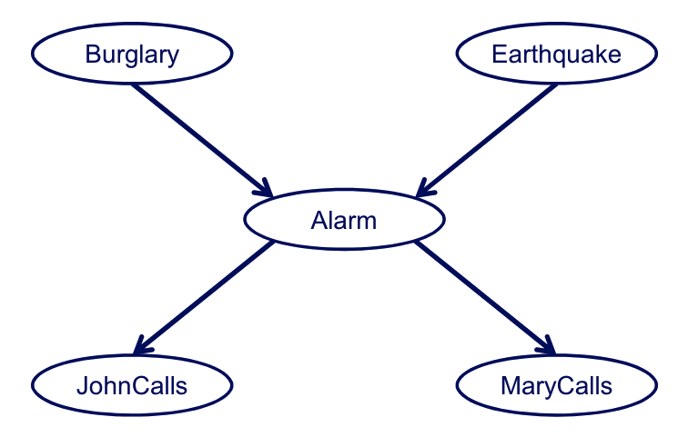
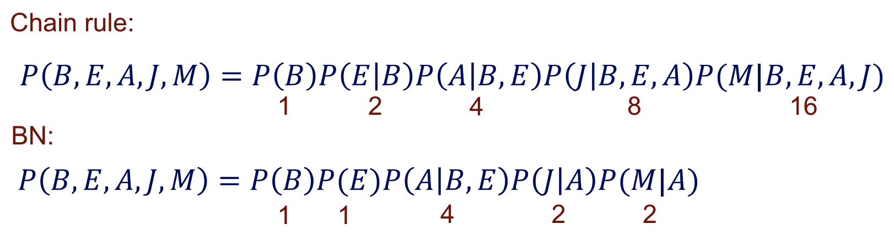
With the network structure (local conditional probabilities), the model describes the joint probability in a more compact manner
Number of parameters (assuming all variables are binary):
lectures.gersteinlab.org - [Gao et al. (‘24) Bioinfo. (submitted)]
Notes:
And structure is based on prior knowledge, or provide potential causal info
https://pages.cs.wisc.edu/~dpage/cs760/BNs1_handout.pdf

Slide 29
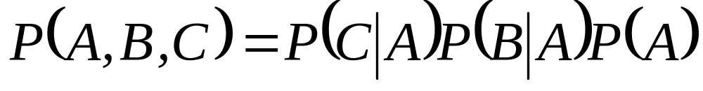
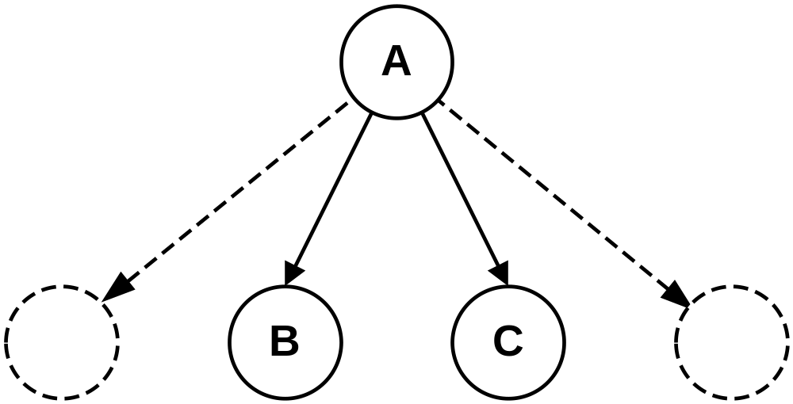
Naive Bayes

Slide 30
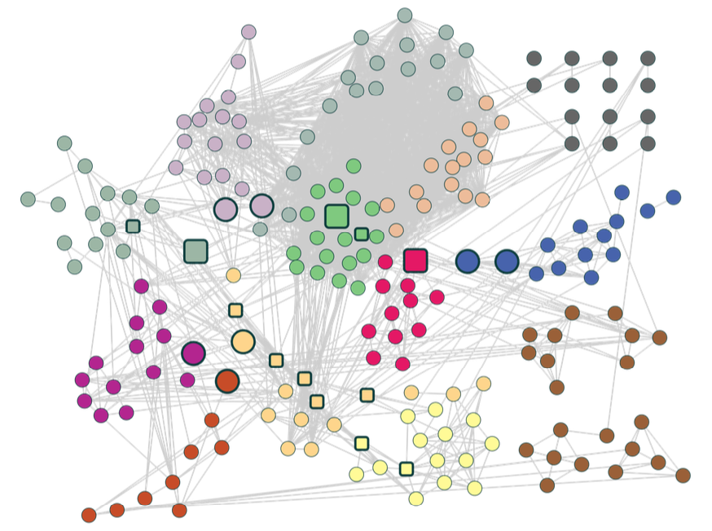
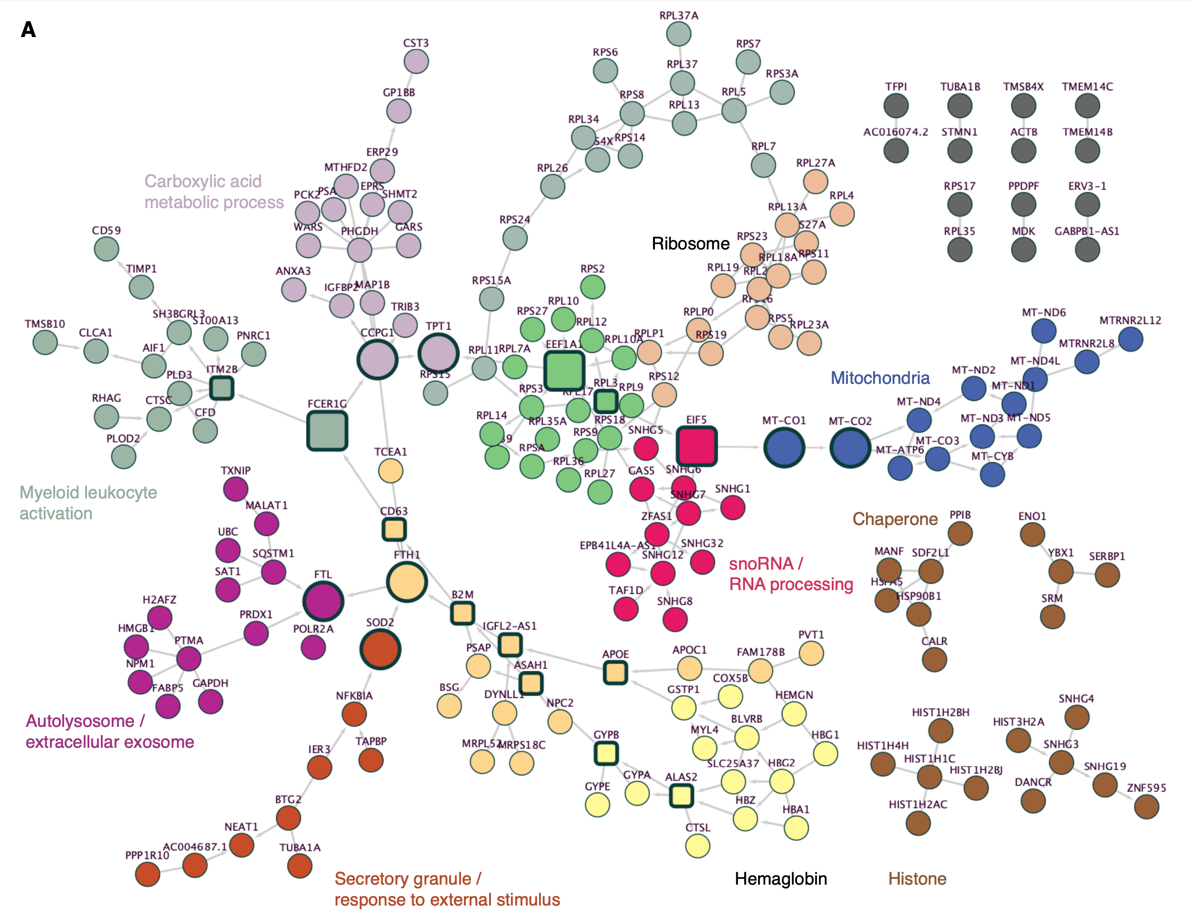
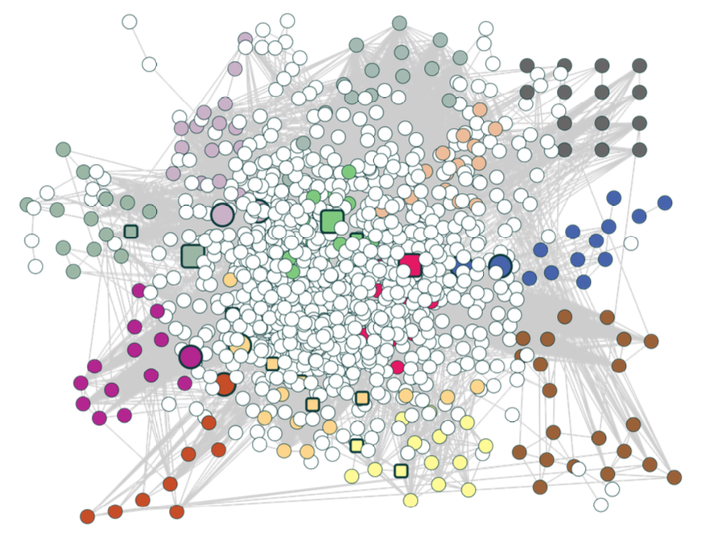
Co-expression
lectures.gersteinlab.org - [Gao et al. (‘24) Bioinfo. (submitted)]
Co-expression +
uninformative genes
Bayesian Network

Slide 31
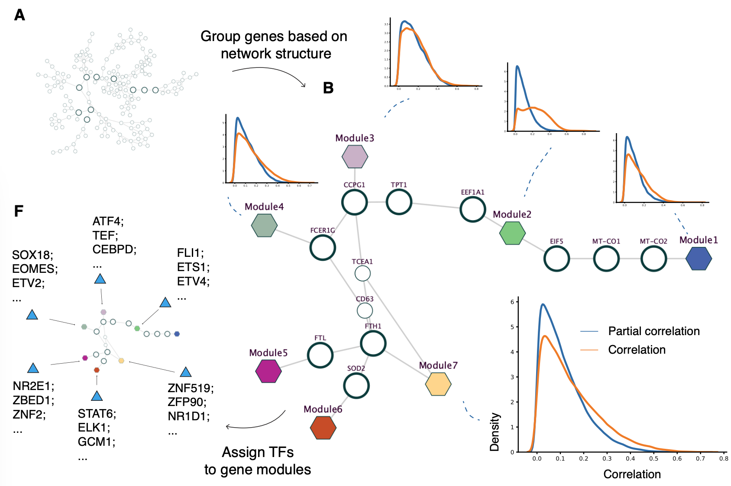
Relatively independent gene modules, after fixing the “connector” genes
(“Markov Blanket”)
lectures.gersteinlab.org - [Gao et al. (‘24) Bioinfo.]

Slide 32
References
James, Gareth, Witten, Daniela, Hastie, Trevor, Tibshirani, Robert
An Introduction to Statistical Learning: with Applications in R
[ ISLR (2nd edition) ]
https://www.amazon.com/Introduction-Statistical-Learning-Applications-Statistics/dp/1071614177/ + https://www.statlearning.com
(Chapter 4.4.4 and 4.7.5 gives background on Naive Bayes.)
Edwards et al. (2002). Trends in Genetics, 18(10), 529–536.
Bridging structural biology and genomics: assessing protein interaction data with known complexes.
https://doi.org/10.1016/s0168-9525(02)02763-4
(Relates to the worked example.)
Lectures.gersteinlab.org

