Slide 1

Biomedical Data Science (GersteinLab.org/courses/3520)
Network Topology -- Intro (26m10a)
Last edit in spring ’26. Shortened but v. similar to 2022’s 22m10a &
2021’s M10a [which has a video].
Mark Gerstein
Yale U.

Slide 2
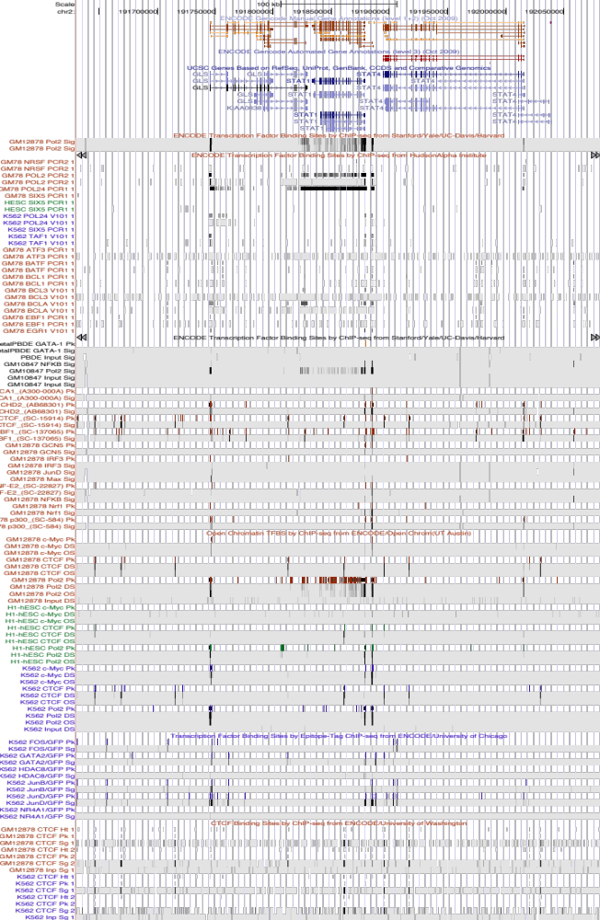
Current Annotation:
1D Browser Tracks
Will this scale to 1000+ tracks? What will next-gen annotation look like?...
Systems from Parts

Slide 3
Current Annotation:
1D Browser Tracks
Will this scale to 1000+ tracks? What will next-gen annotation look like?...
Systems from Parts

Slide 4
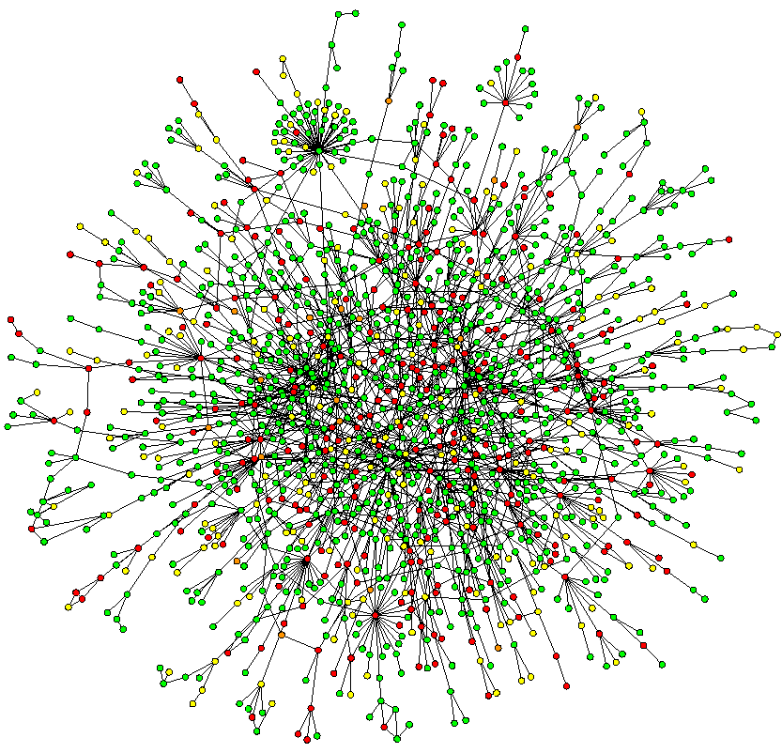
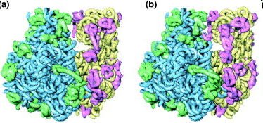
Networks occupy a midway point in terms of level of understanding
~2D: Network
Wiring Diagram of a Molecular System
3D & 4D:
Detailed structural understanding of cellular machinery
(e.g. ribosome in different functional states)
1D: Complete
Partslist
(“Elements” in genomic tracks)
[UCSC genome browser]
[Jeong et al. Nature, 41:411]
[Chiu et al. Trends in Cell Biol, 16:144]

Slide 5
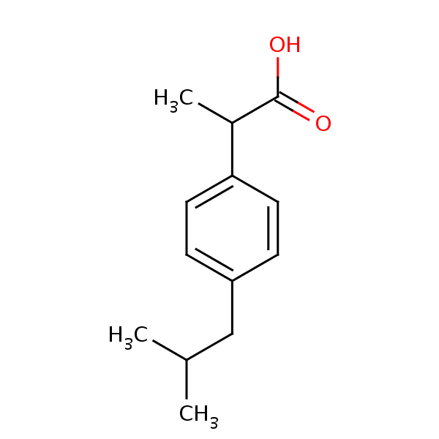
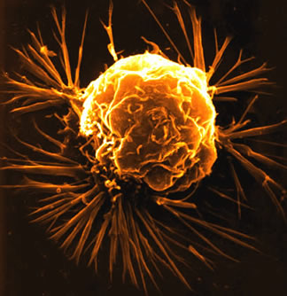
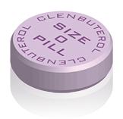
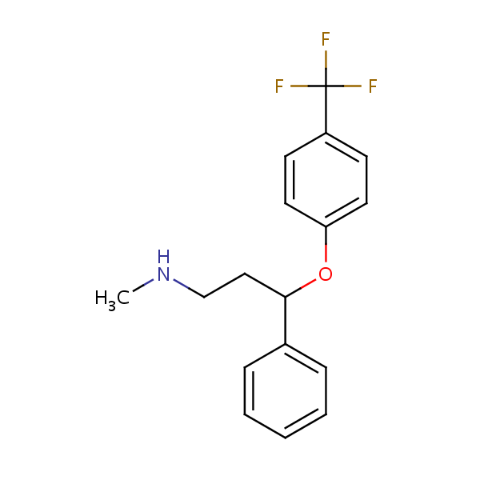
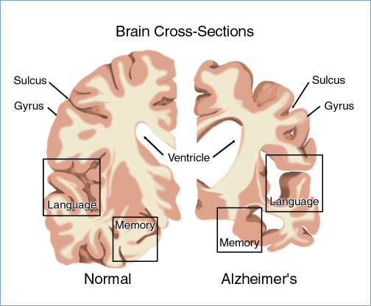
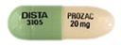
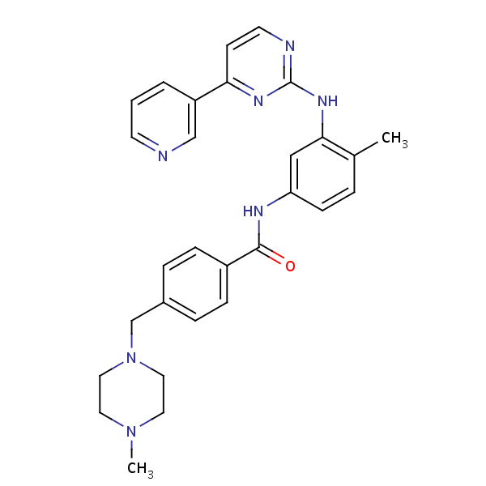

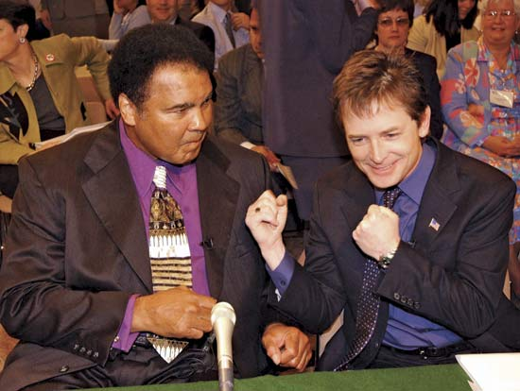
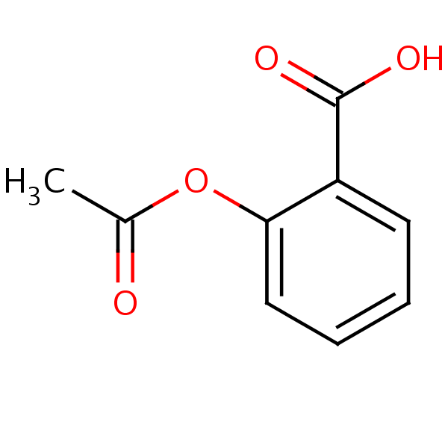
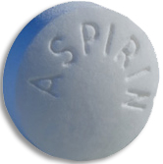
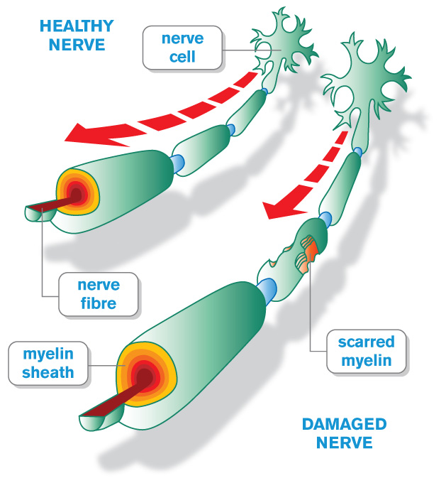
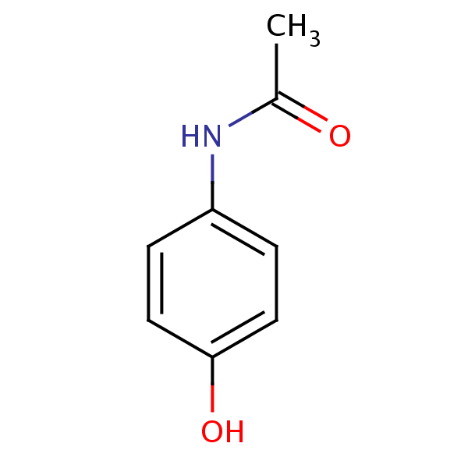
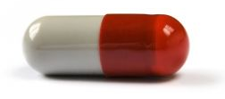
Network pathology & pharmacology
Breast
Cancer
Alzheimer’s
Disease
Parkinson’s
Disease
Multiple
Sclerosis
Interactome networks
[Adapted from H Yu]

Slide 6
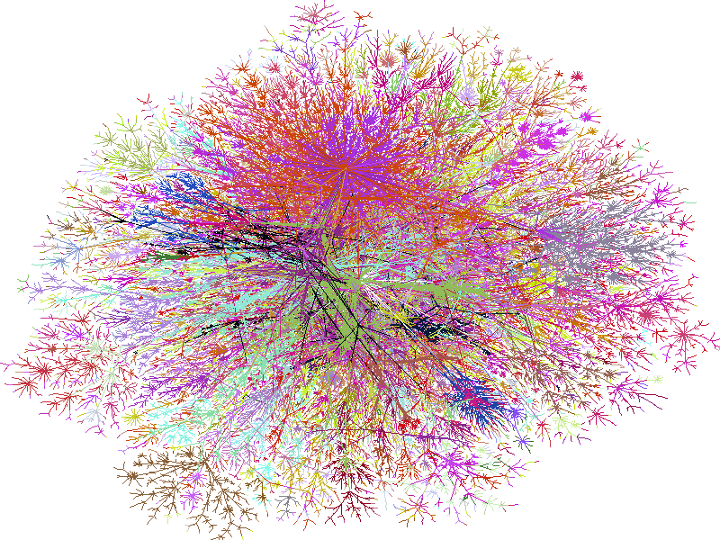
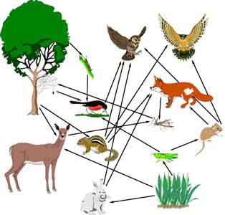
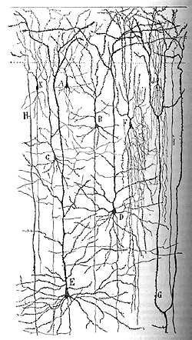
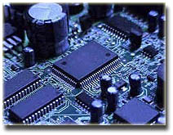
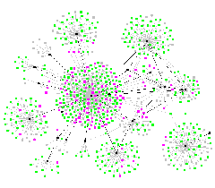
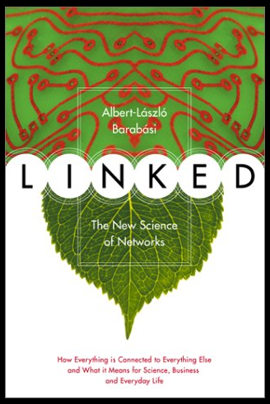
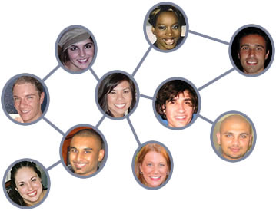
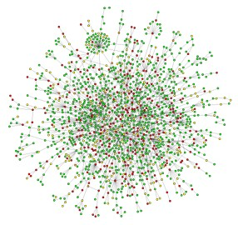
Networks as a universal language
Internet
[Burch & Cheswick]
Electronic
Circuit
Food Web
Disease Spread
[Krebs]
Neural Network
[Cajal]
Protein
Interactions
[Barabasi]
Social Network

Slide 7
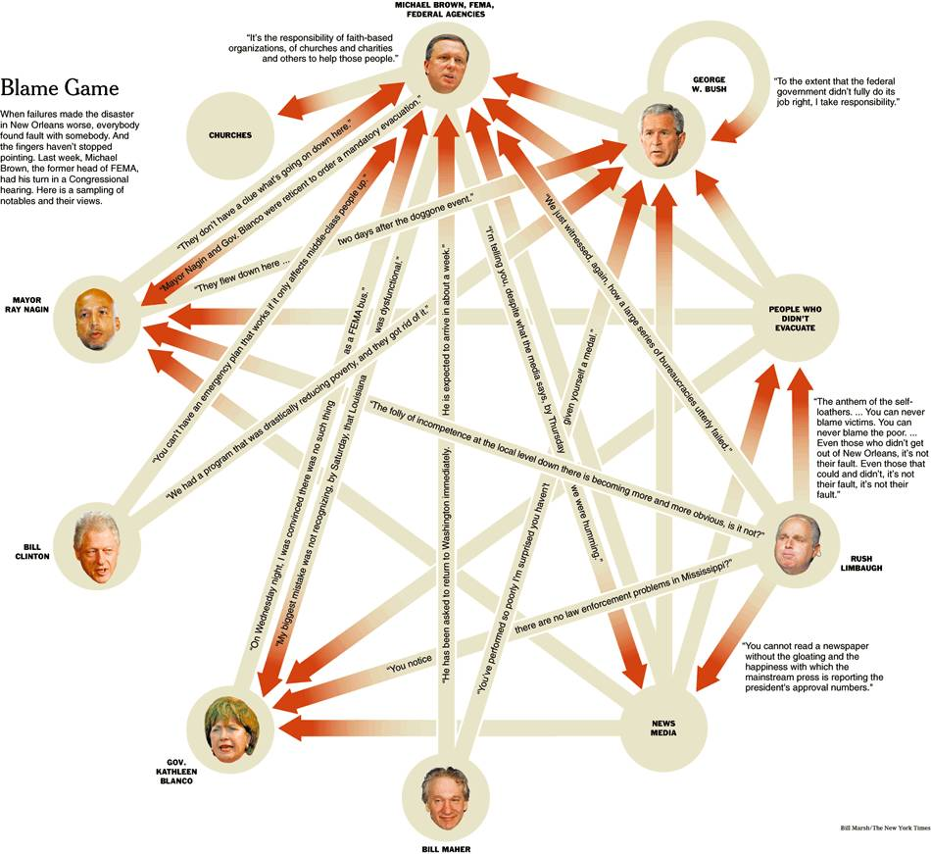
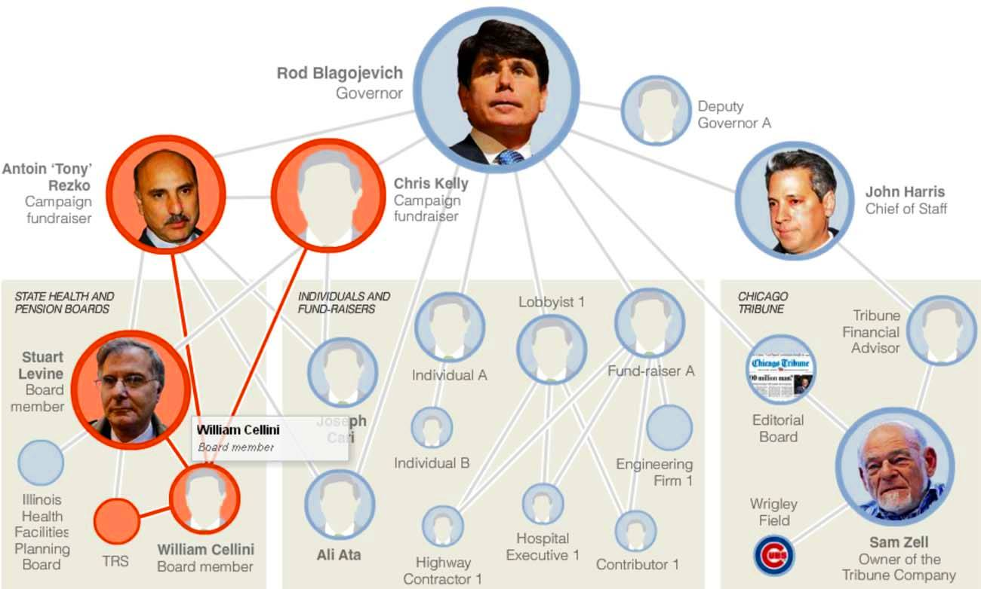
Using the position in networks to describe function
Guilt by association
Finding the causal regulator
(the "Blame Game")
[NY Times, 2-Oct-05, 9-Dec-08]

Slide 8
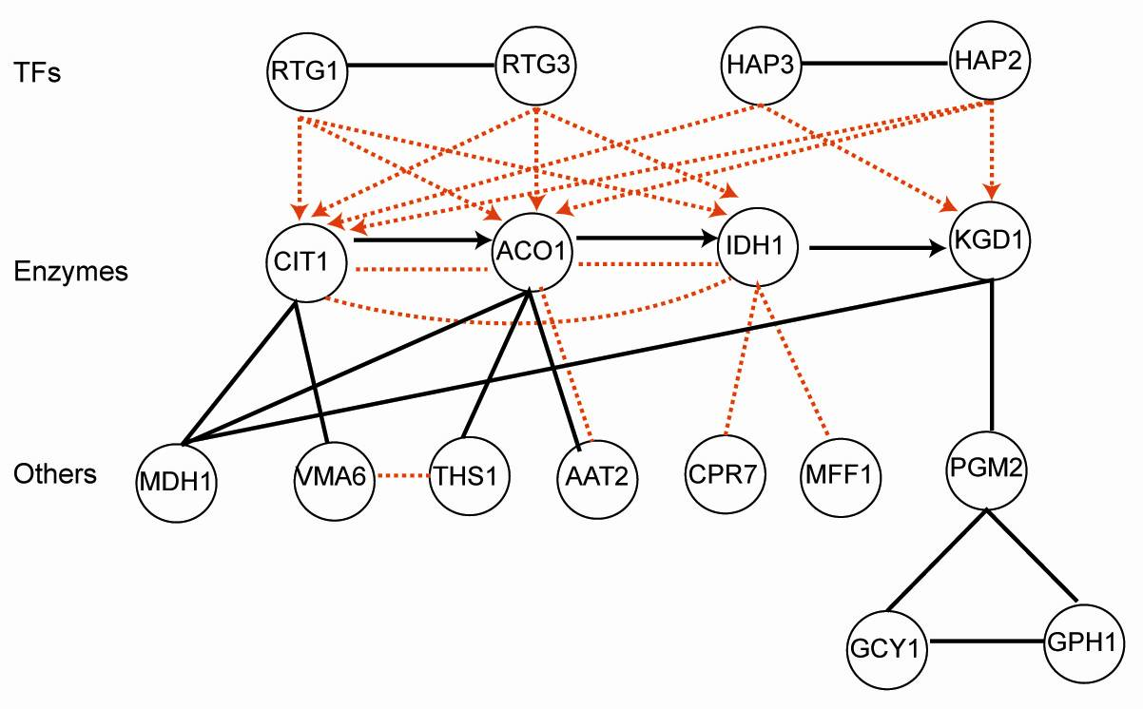
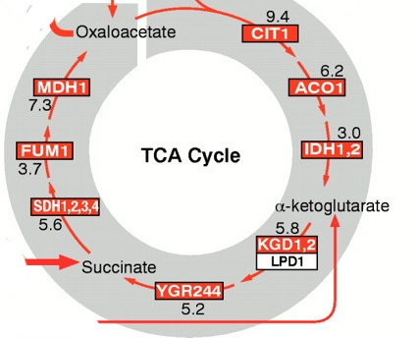
Combining networks forms an ideal way of integrating diverse information
Metabolic pathway
Transcriptional regulatory network
Physical protein-protein Interaction
Co-expression Relationship
Part of the
TCA cycle
Genetic interaction (synthetic lethal)
Signaling pathways

Slide 9
References
McGillivray, P., Clarke, D., Meyerson, W., Zhang, J., Lee, D., Gu, M., Kumar, S., Zhou, H., & Gerstein, M. (2018). Annual Review of Biomedical Data Science, 1(1), 153–180.
Network analysis as a grand unifier in biomedical data science. https://doi.org/10.1146/annurev-biodatasci-080917-013444
(Section 1.)
Lectures.gersteinlab.org

