Slide 1

Biomedical Data Science (GersteinLab.org/courses/3520)
Supervised Mining: Preliminaries + Decision Trees (26m8a+26m8b)
Last edit in spring ’26.
Very similar to ‘25 pack
[which has a videos].
Mark Gerstein
Yale U.

Slide 2
Supervised Mining:
Overview

Slide 3
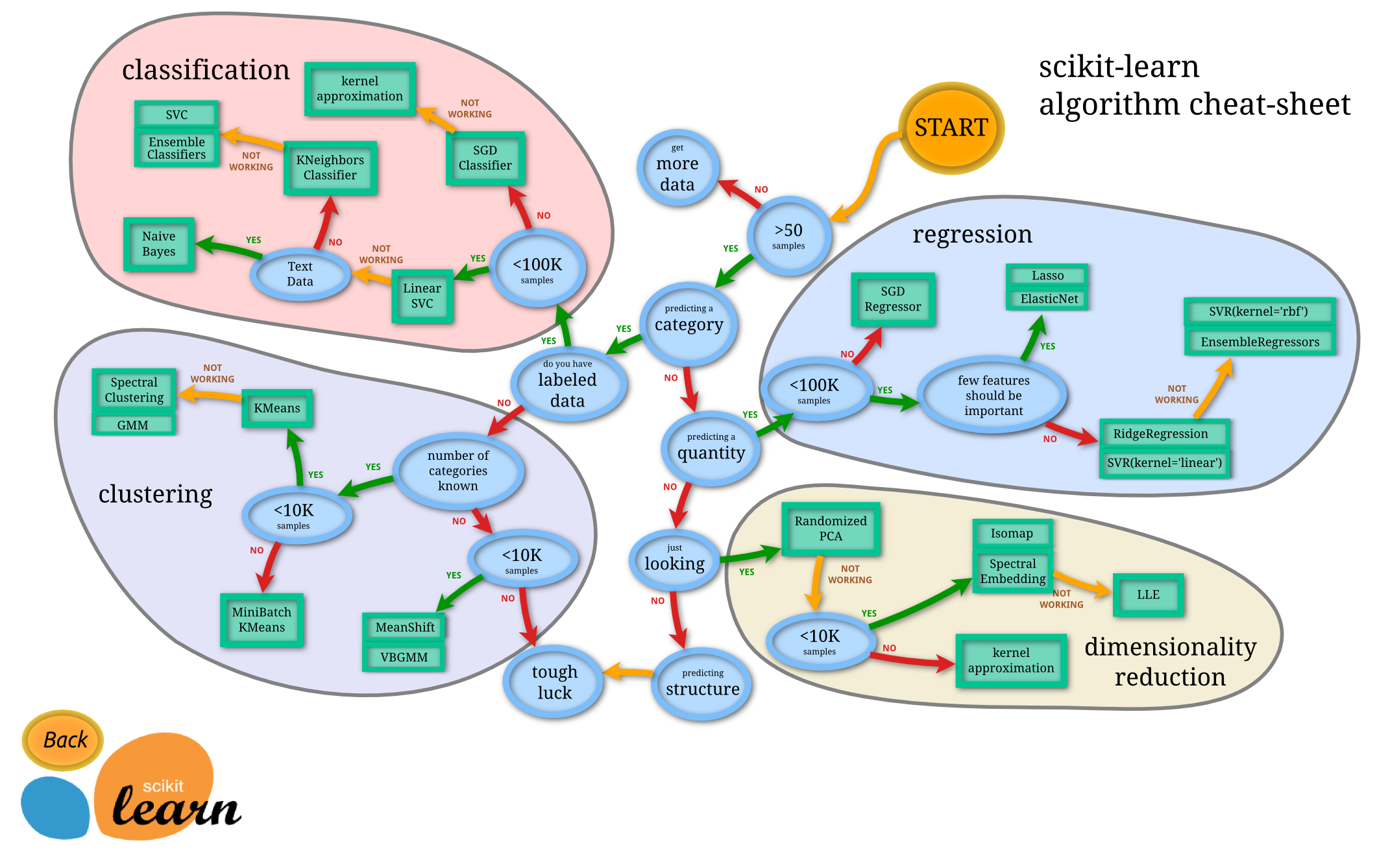
The World of “Classic” ML
SciKit learn: http://scikit-learn.org/stable/tutorial/machine_learning_map/

Slide 4
Distinctions in
Supervised Learning
Regression vs Classification
  Regression: labels are quantitative
  Classification: labels are categorical
Regularized vs Un-regularized
  Regularized: penalize model complexity to avoid over-fitting
  Un-regularized: no penalty on model complexity
Parametric vs Non-parametric
  Parametric: an explicit parametric model is assumed
  Non-parametric: otherwise
Ensemble vs Non-ensemble
  Ensemble: combines multiple models
  Non-ensemble: a single model

Slide 5
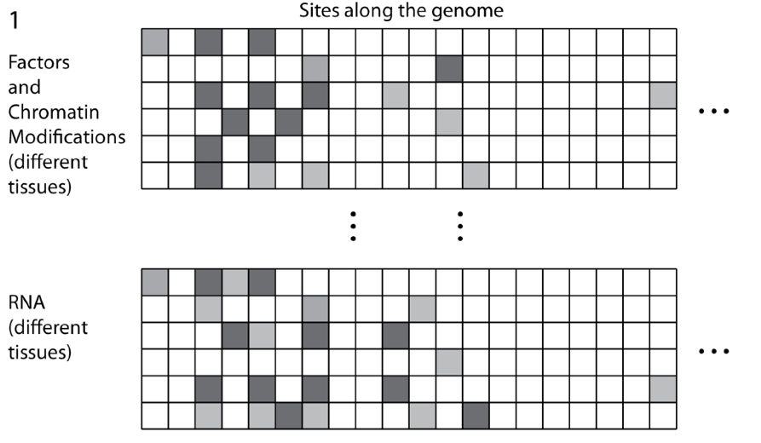
Structure of Genomic Features Matrix

Slide 6
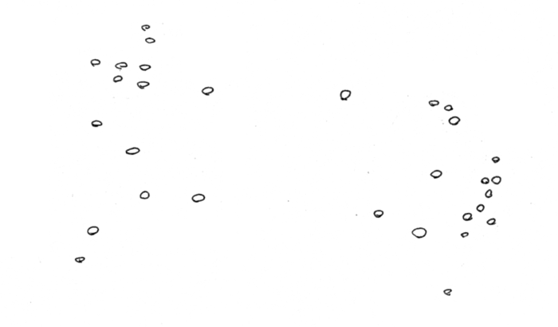
Represent predictors in abstract high dimensional space

Slide 7
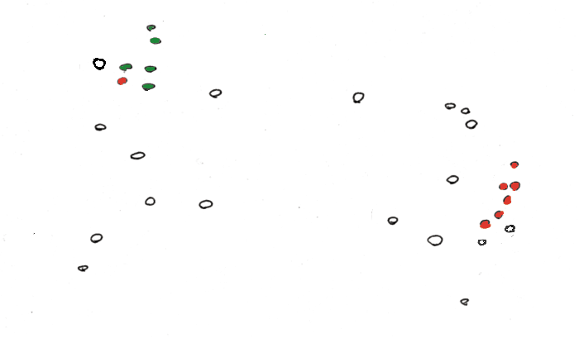
“Label” Certain Points

Slide 8
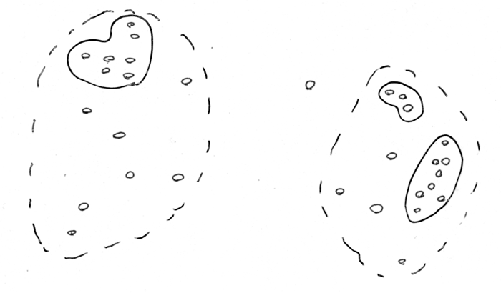
“Cluster” predictors (Unsupervised)

Slide 9
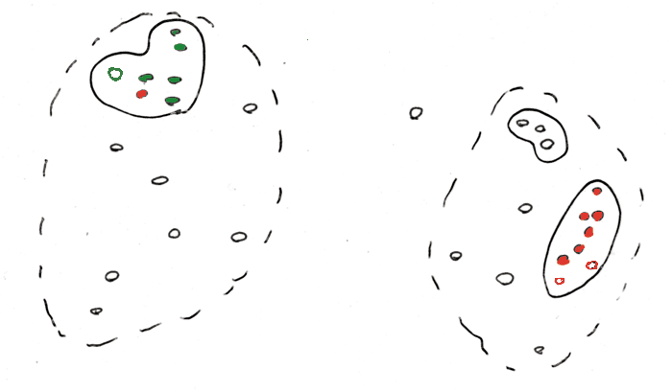
Use Clusters to predict Response (Unsupervised, guilt-by-association)

Slide 10
Find a Division to Separate Tagged Points

Slide 11
Extrapolate to Untagged Points

Slide 12
Find a Division to Separate Tagged Points

Slide 13
Supervised Mining:
Assessment, Cross-Validation & ROC Curves

Slide 14
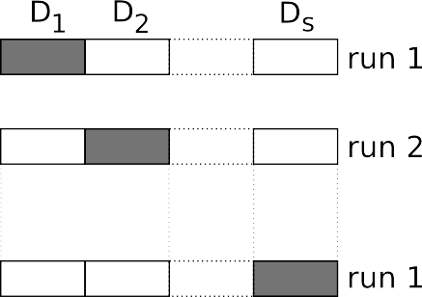
Evaluating performance: What? How?
A. What do we want to evaluate?
GENERALIZATION
Therefore, it is mandatory to divide your dataset:
Alternatively, use Cross Validation:
Slide from Alberto Paccanaro

Slide 15
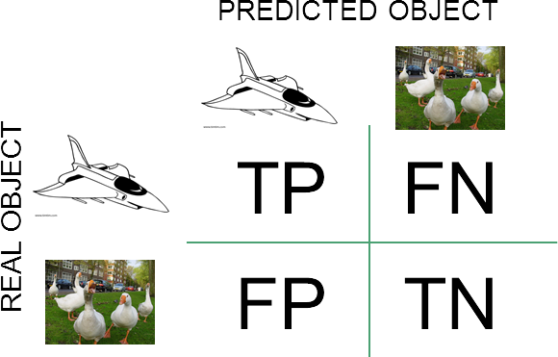
B. How do we evaluate performance?
Accuracy
1. Classification problems
(TP+TN)/(TP+FP+FN+TN)
Sensitivity (or TPR)
TP/P = TP/(TP+FN)
Specificity
TN/N = TN/(TN+FP)
False positive rate (FPR)
FP/N = 1 - Specificity
Positive predictive value (PPV)
TP/(TP+FP)
False discovery rate (FDR)
FP/(TP+FP)
gold
std
(P & N = gold-std positives & negatives
v TP+FP = total called positive)
2. Regression problems Sum of squares error
Root Mean Square error
Slide from Alberto Paccanaro
https://en.wikipedia.org/wiki/Sensitivity_and_specificity

Slide 16
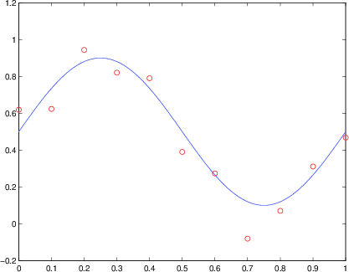
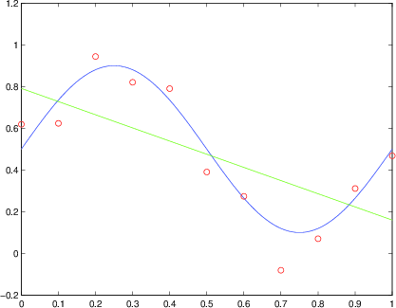
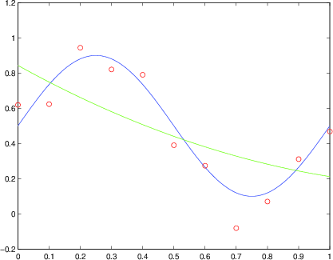
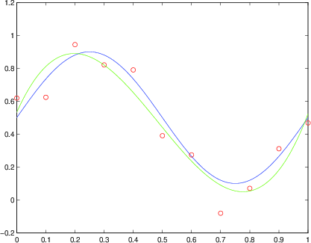
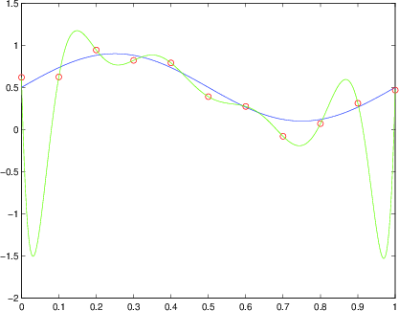
Model dimensionality and overfitting
We are given the red dots.
We assume that they are noisy samples from a signal/(function) – the blue curve – which we do not have (we only have the red dots).
We want to predict new points, i.e. the y coordinates for other values of x (e.g. x > 1)
Our model needs to approximate the blue function. We decide to do it with polynomials.
Slide from Alberto Paccanaro
Degree 1 polynomial
Degree 2 polynomial
Degree 3 polynomial
Degree 10 polynomial
Which one is best? And why?

Slide 17
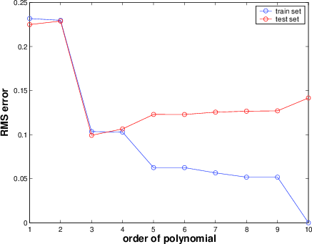
How does the GENERALIZATION performance vary, as we increase the complexity of the polynomial?
Occam's razor (William of Occam, ~1300): Accept the simplest explanation that fits the data.
We should prefer simpler models to more complex models, and this preference should be traded off against the extent to which the model fits the data.
Related to “Bias-Variance” tradeoff.
Some qualifications for deep learning (later).
Slide from Alberto Paccanaro
8

Slide 18
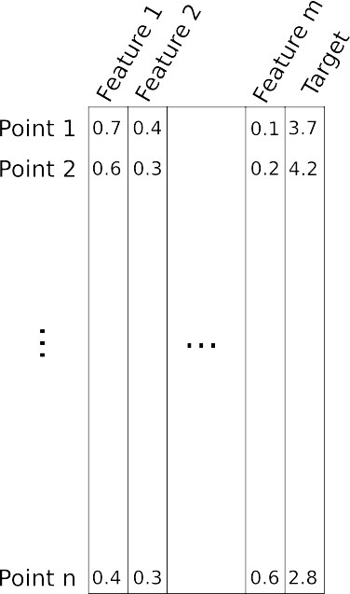
IMPORTANT: increasing the number of features may lead to a reduction in performance if the number of datapoints is not increased. Why?
Slide from Alberto Paccanaro
This is related to the “Curse of Dimensionality” Bellman, 1961.
9

Slide 19
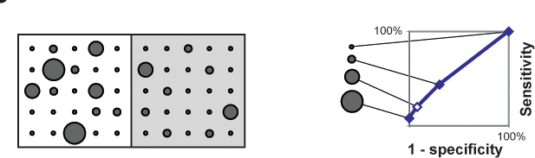
ROC plots & Comparison of Predictions against a Positive & Negative Gold Standard
R Jansen, M Gerstein (2004). Curr Opin Microbiol 7: 535
"Coverage” (TP/P)
Threshold "predictions" (strength of positive score is represented by circle size) at different levels and compare to + and - gold standards (represented by white & gray squares). 50 total instances, half + and half -. A concrete example would be doing cancer prediction 50 individuals with known cancer status.
"Error Rate” (FP/N)
ROC plot
(cross validated)

Slide 20
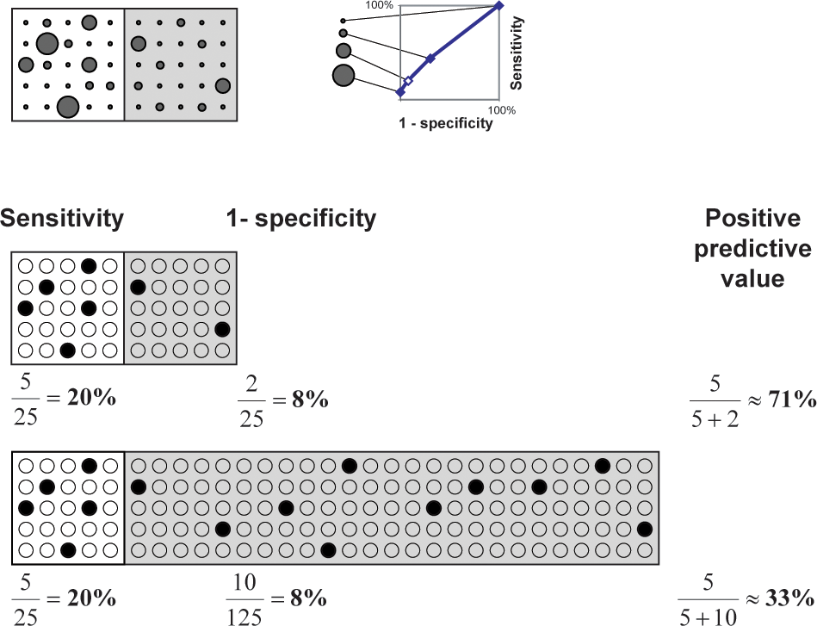
Effect on Predictions of Large Number of Negatives
(e.g. terrorist identification or breast cancer screening)
R Jansen, M Gerstein (2004). Curr Opin Microbiol 7: 535

Slide 21
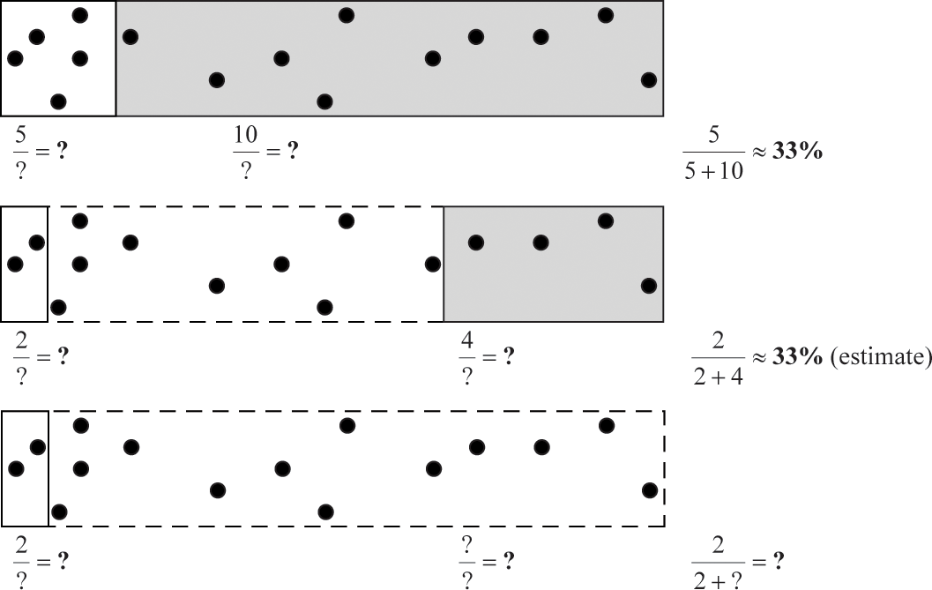
Importance of Balanced
Positive and Negative Examples
R Jansen, M Gerstein (2004). Curr Opin Microbiol 7: 535

Slide 22
Supervised Mining:
Decision Trees
(“Jumping to first method”)

Slide 23
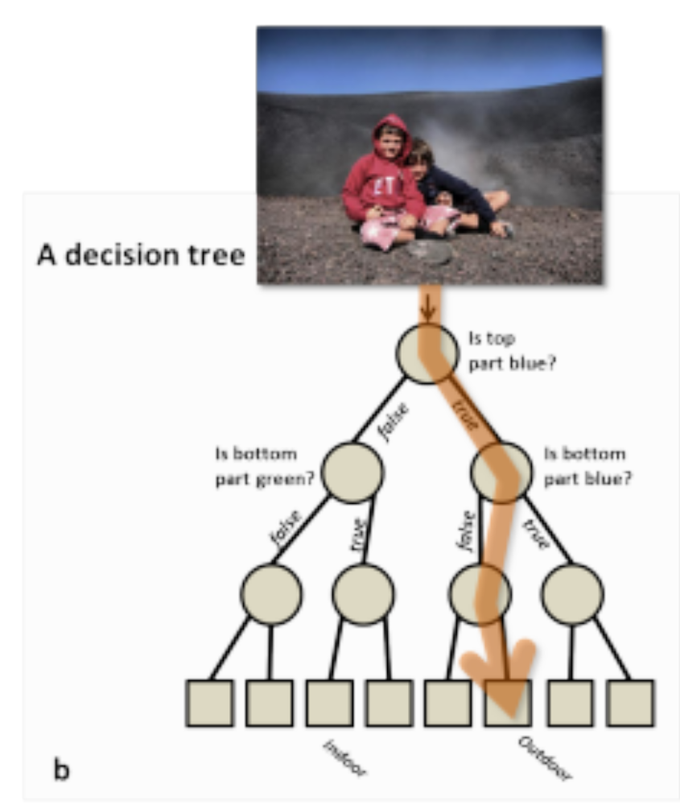
Decision Trees
Classify data by asking questions that divide data in subgroups
Keep asking questions until subgroups become homogenous
Use tree of questions to make predictions
Example: Is a picture taken inside or outside?
Criminisi, Shotton, and Konukoglu Microsoft Technical Report 2011

Slide 24
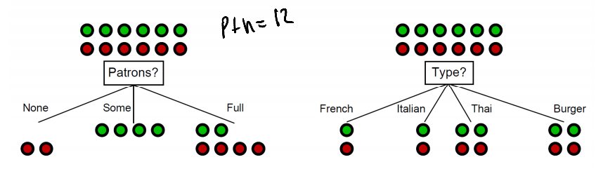
What makes a good rule?
Want resulting groups to be as homogenous as possible
Rule 1
Rule 2
All groups still 50/50
→ Unhelpful rule
2/3 Groups homogenous
→Good rule
Nando de Freitas 2012 University of British Columbia CPSC 340
Notes:
Emphasize that classification is based on underlying characteristics

Slide 25
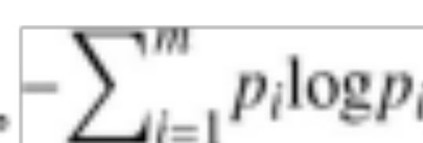
Quantifying the value of rules
Decrease in inhomogeneity
(or increase in homogeneity)
  Most popular metric: Information theoretic entropy
  Use frequency of classifier characteristic within group i as probability p_{i}
  Minimize entropy to achieve homogenous group
  Also, could use Gini Coefficient
S =

Slide 26
Algorithm
START
For each feature:
  Split into subgroups based on each possible value of the feature
Choose rule from the feature split that maximizes decrease in inhomogeneity
For each subgroup:
  if (inhomogeneity < threshold):
    STOP
  else:
    Go back to START & restart rule search (recursion)

Slide 27
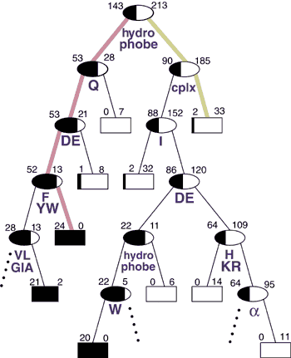
Retrospective Decision Trees
356 total
Not Expressible
Express-ible
Analysis of the Suitability of 500 M. thermo. proteins
to find optimal sequences purification
Has a hydrophobic stretch? (Y/N)
[Bertone et al. NAR (‘01)]

Slide 28
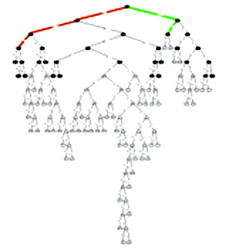
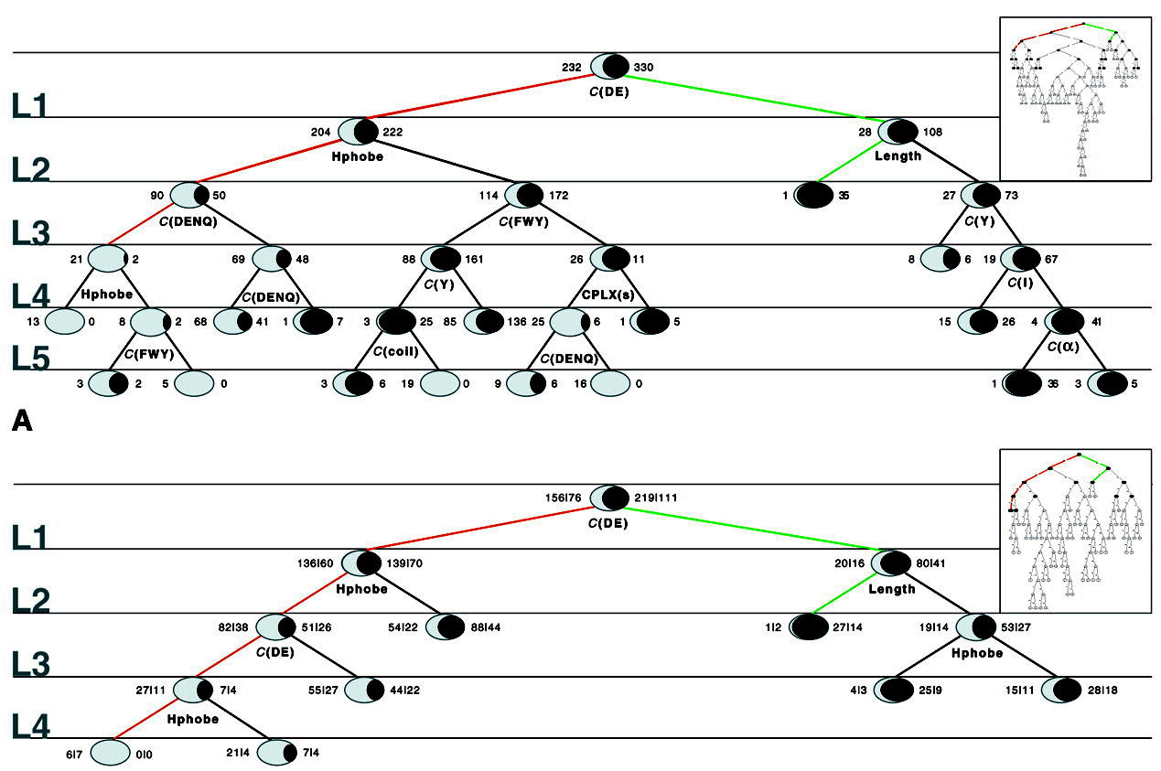
Overfitting, Cross Validation, and Pruning

Slide 29
Random Forest (RF)
Basic decision tree (DT) method is
very sensitive to dataset selection
& noise in the data
RFs are ensemble of DTs; address this issue
  Build many DTs on bootstrapped training samples. (Reduces sensitivity to noise.)
  Each time a split in a tree is considered, a random sample of m predictors is chosen as split candidates from the full set of predictors. (Decorrelates “bagged” DTs.)
  Finally, we average or vote amongst the trees
[ISLR, chap 8]

Slide 30
References
James, Gareth, Witten, Daniela, Hastie, Trevor, Tibshirani, Robert
An Introduction to Statistical Learning: with Applications in R
[ ISLR (2nd edition) ]
https://www.amazon.com/Introduction-Statistical-Learning-Applications-Statistics/dp/1071614177/ + https://www.statlearning.com
(Chap 2 gives a nice overview on key concepts in ML.
Chapter 8 to 8.2.2 gives background on DTs.)
Greener, J. G., Kandathil, S. M., Moffat, L., & Jones, D. T. (2021).
A guide to machine learning for biologists.
Nature Reviews Molecular Cell Biology, 23(1), 40–55. https://doi.org/10.1038/s41580-021-00407-0
(Good reference, but for this pack just go to up to section on “key concepts.”)
Agarwal, R. (2024, March 29).
ROC Curves and AUC: The Ultimate guide. Built In.
https://builtin.com/data-science/roc-curves-auc
(Optional extra background on ROC)
Lectures.gersteinlab.org

