Slide 1

Biomedical Data Science (GersteinLab.org/courses/3520)
Multi-omic Analyses & Endophenotypes (Biosensors) (26m7-part3)
Mark Gerstein
Yale U.
New in 2026,
with a new video

Slide 2
Outline
Part 1 : Multi-omic Annotation & Molecular Endophenotypes
  Basic RNA-seq & Chip-seq Calculations
  Integration for Genome Annotation
Part 2 : Relating Phenotypes & Endophenotypes to Variants
  ASE/ASB – Allele specific versions of basic annotation
  Traditional GWAS – regressing phenotypes onto variants
  eQTLs – like GWAS but with expression endophenotypes
Part 3 : Endophenotypes from Biosensors
& their Relation to Genotype
  Developing digital phenotypes from biosensors
  Their GWAS in comparison to traditional GWAS

Slide 3
Outline
Part 1 : Multi-omic Annotation & Molecular Endophenotypes
  Basic RNA-seq & Chip-seq Calculations
  Integration for Genome Annotation
Part 2 : Relating Phenotypes & Endophenotypes to Variants
  ASE/ASB – Allele specific versions of basic annotation
  Traditional GWAS – regressing phenotypes onto variants
  eQTLs – like GWAS but with expression endophenotypes
Part 3 : Endophenotypes from Biosensors
& their Relation to Genotype
  Developing digital phenotypes from biosensors
  Their GWAS in comparison to traditional GWAS

Slide 4
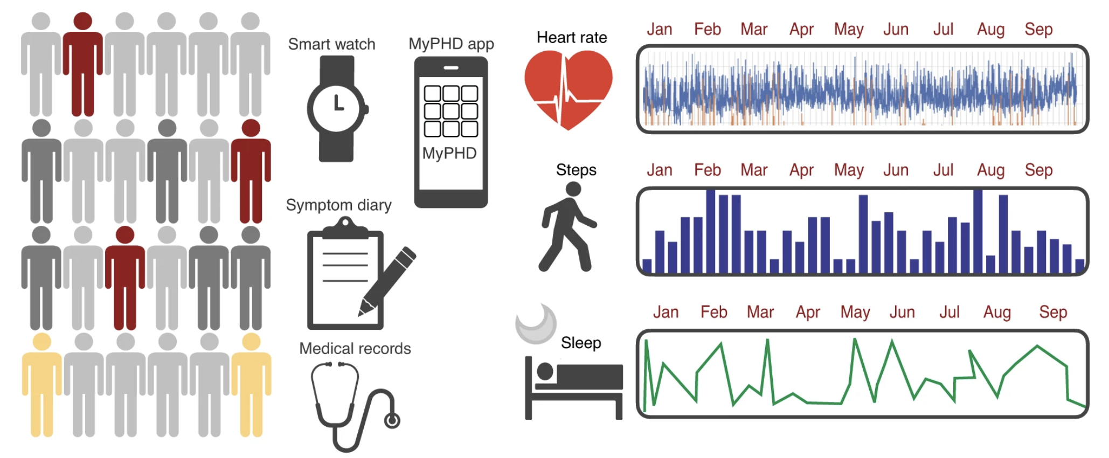
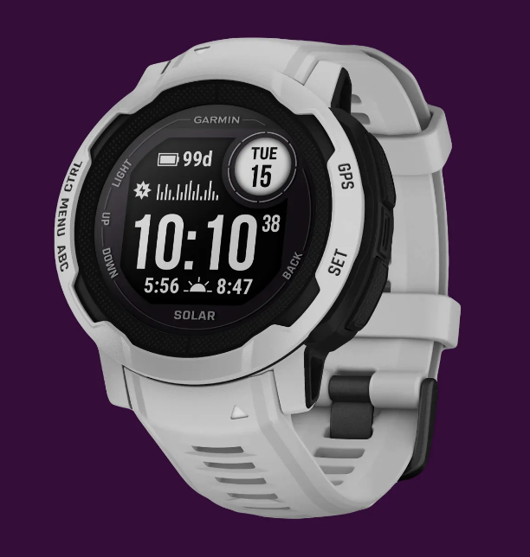
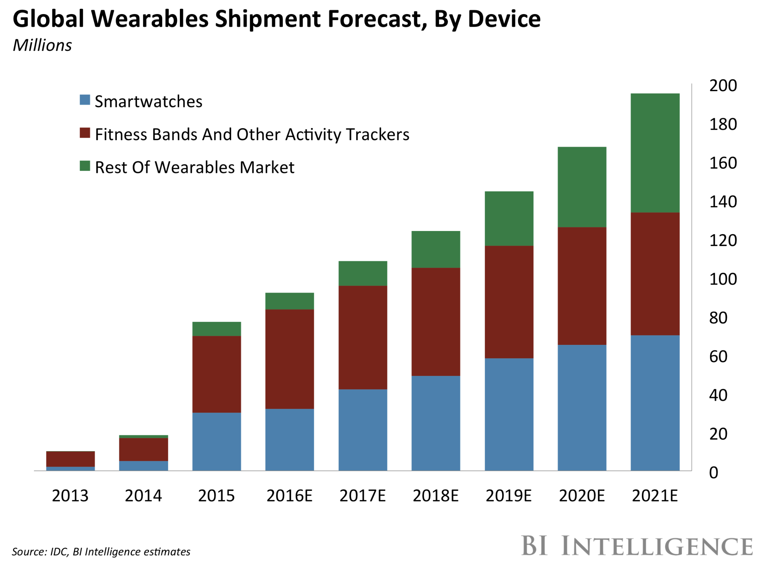
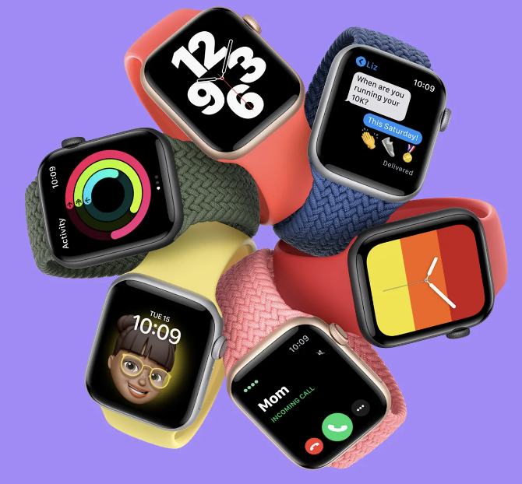
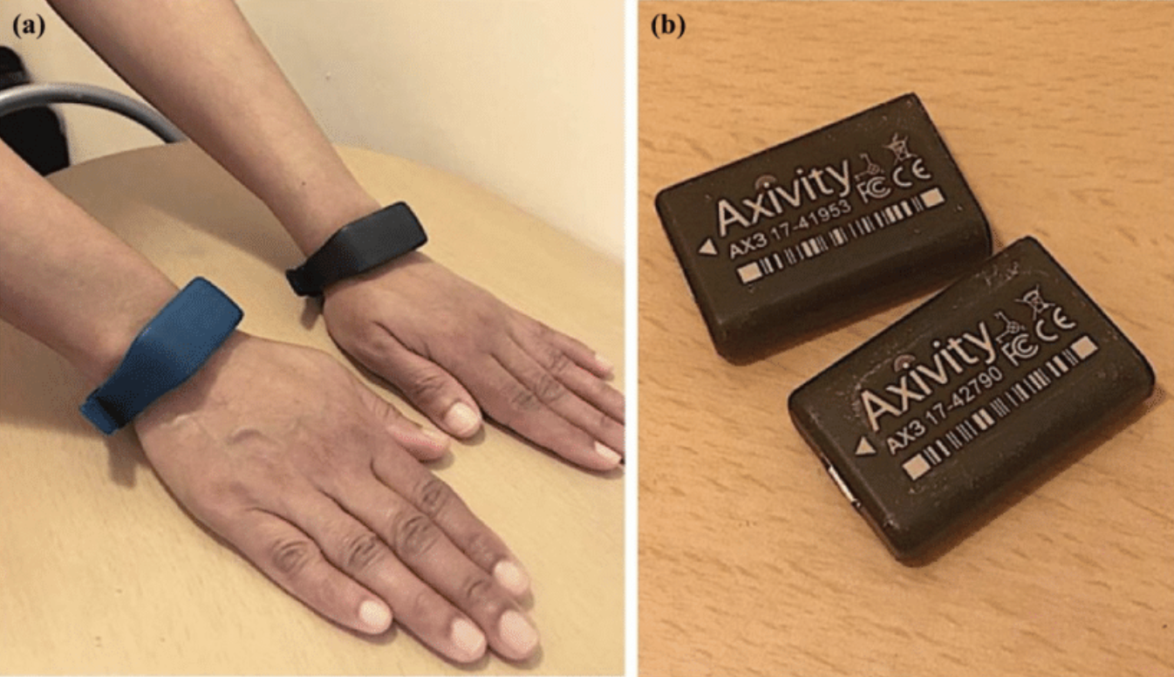
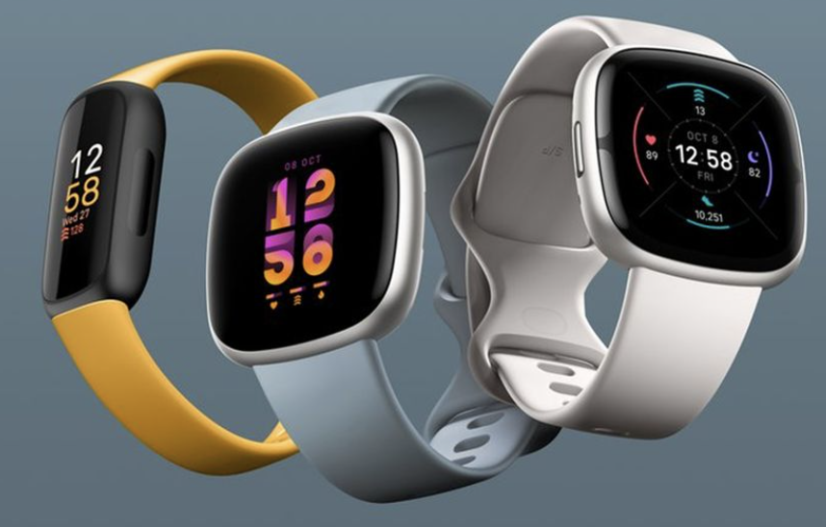
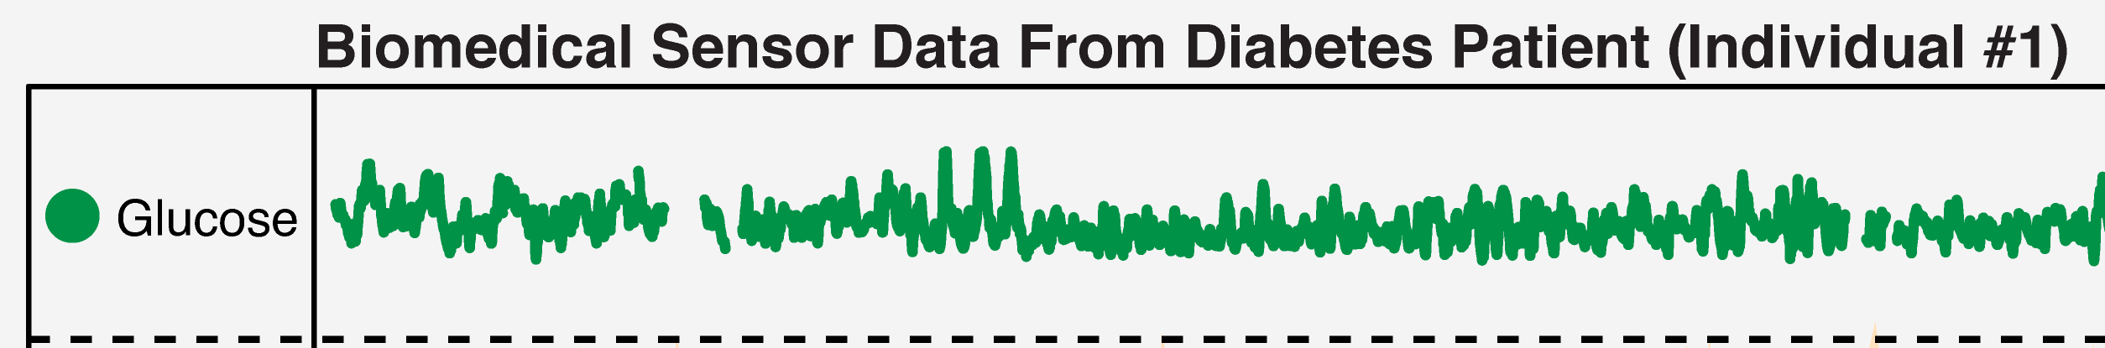
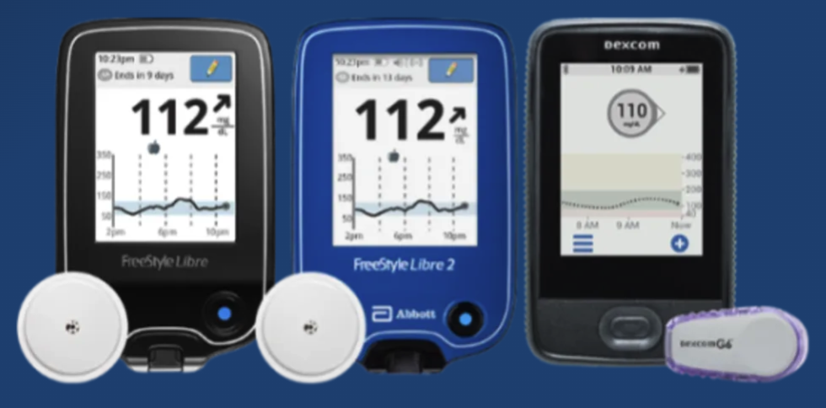
Using wearable biosensors for “digital phenotypes”
Intermediate Phenotypes
Macro Level Behavior
Garmin
Scale
Organ
Apple
Chemical
FitBit
Time

Slide 5
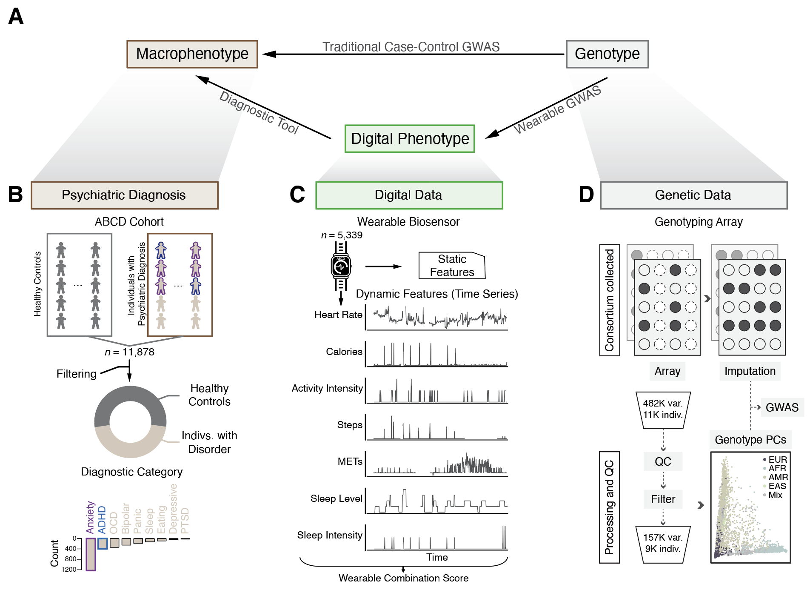

Digital Phenotyping from wearables using AI characterizes psychiatric disorders and identifies genetic associations
ABCD
dataset
~12k adolescents
21 sites in USA
Collecting clinical, genetic, and digital data
Focusing on
ADHD & Anxiety

Slide 6
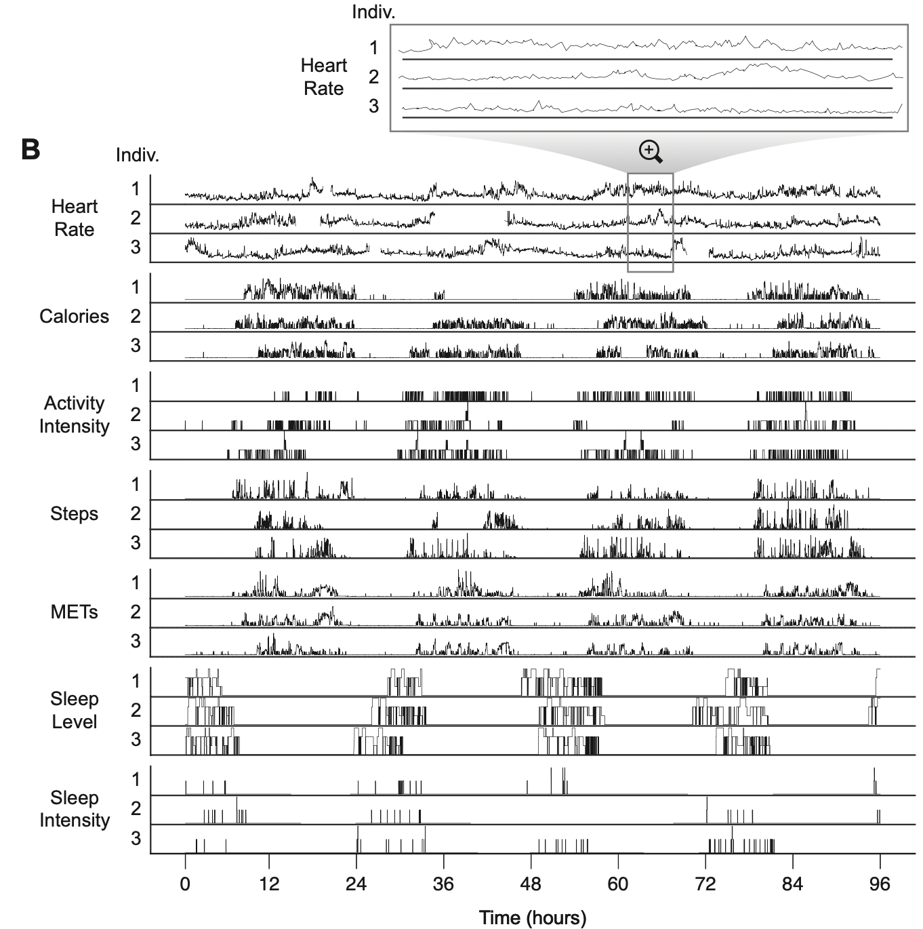
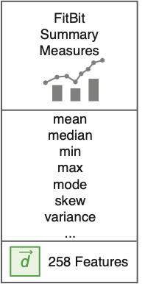
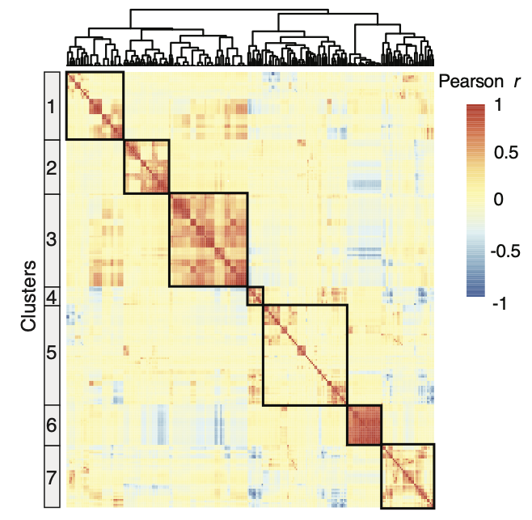
Processing Wearable Data from the ABCD Study
d
…
Feature 258
Feature 1
Feature 2
Indiv 1
Indiv 2
d
C
…
“Static Features”
Covariates
Indiv n

Slide 7
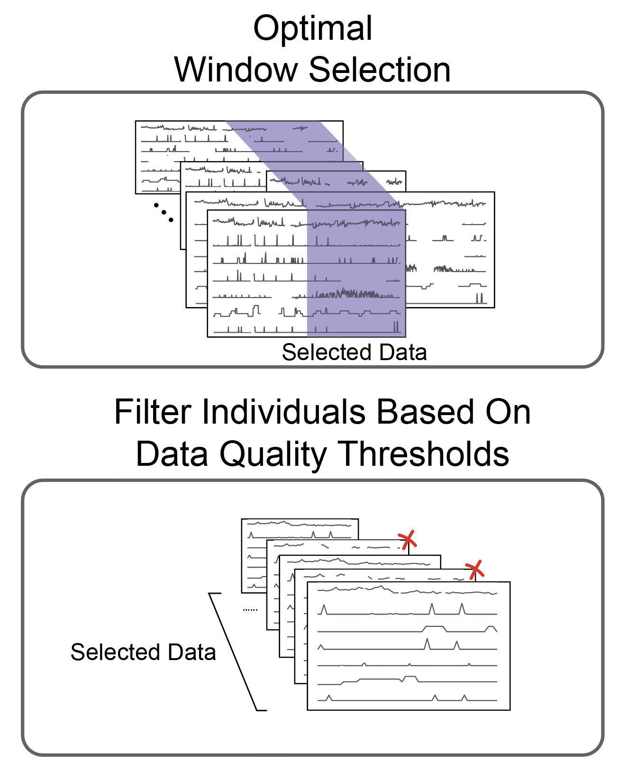
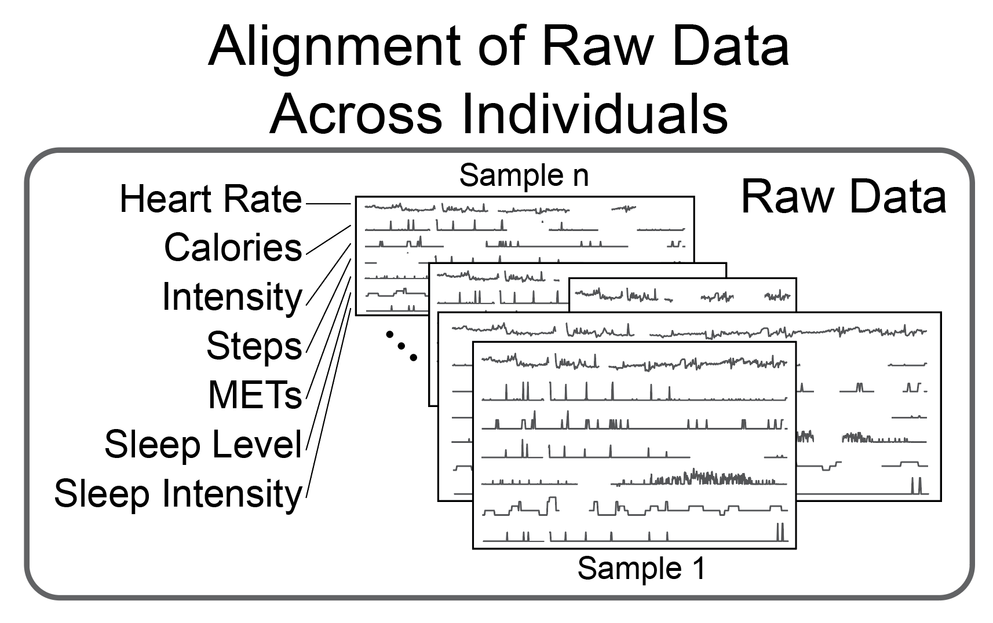
Processing Wearable Data from the ABCD Study
d

Slide 8
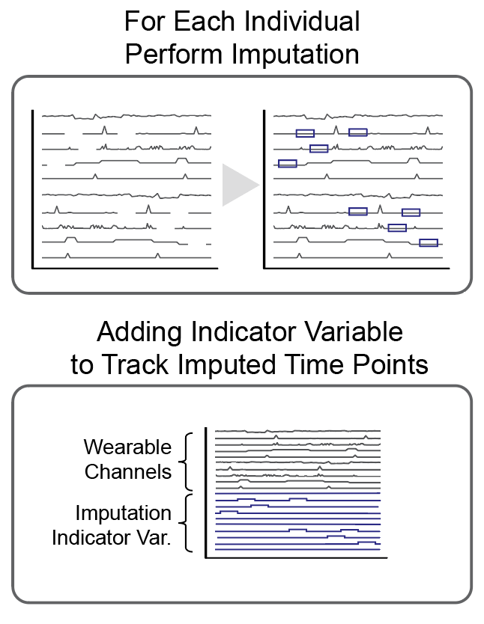
Processing Wearable Data from the ABCD Study
d

Slide 9
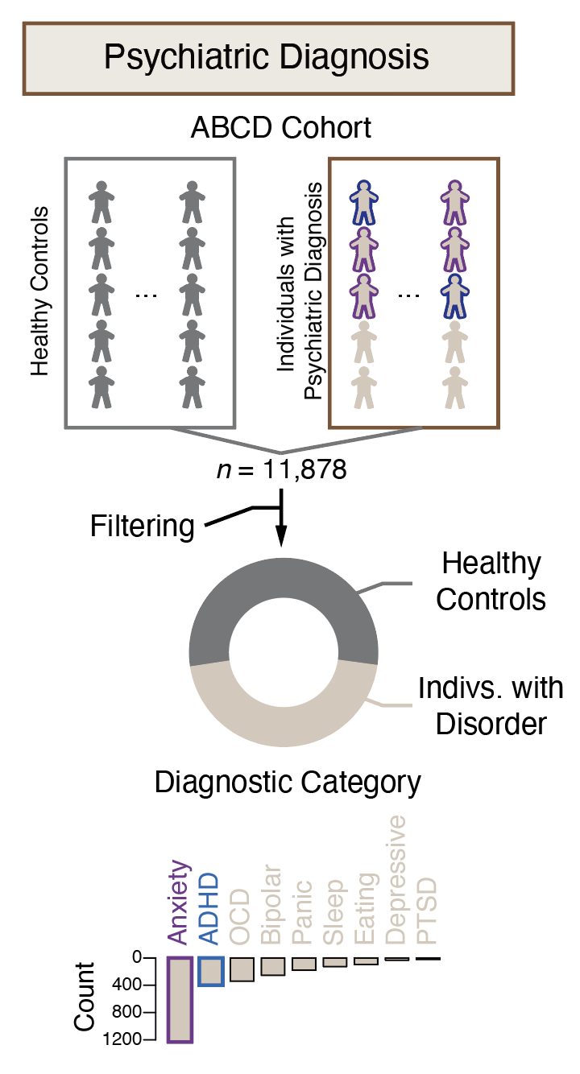
Optimal Combinations of Features
(More Later)
Diagnostic Tool / Clinical Insights
(RF will be described later.)
For now, one can think of
d_{score} as the best linear
combination of the features
for predicting Y
Macrophenotype
Digital Phenotype
Y
~
“Static Features”
+
Covariates
0
1
1
0
1
0
0.2
0.9
0.8
0.1
0.9
0.1
1 | 3 | … | 1
2 | 9 | … | 5
5 | 2 | … | 2
2 | 2 | … | 11
3 | 14 | … | 6
1 | 8 | … | 3
M | 10 | … | 2
F | 9 | … | 3
M | 12 | … | 2
M | 12 | … | 1
F | 13 | … | 5
F | 11 | … | 2
XGBoost
(RF)
Class
Balancing
~
~
+
d_{score}
Wearable Combination Score / Risk Probability

Slide 10
Outline
Part 1 : Multi-omic Annotation & Molecular Endophenotypes
  Basic RNA-seq & Chip-seq Calculations
  Integration for Genome Annotation
Part 2 : Relating Phenotypes & Endophenotypes to Variants
  ASE/ASB – Allele specific versions of basic annotation
  Traditional GWAS – regressing phenotypes onto variants
  eQTLs – like GWAS but with expression endophenotypes
Part 3 : Endophenotypes from Biosensors
& their Relation to Genotype
  Developing digital phenotypes from biosensors
  Their GWAS in comparison to traditional GWAS

Slide 11
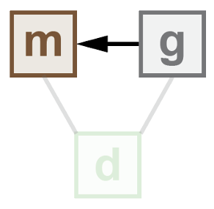
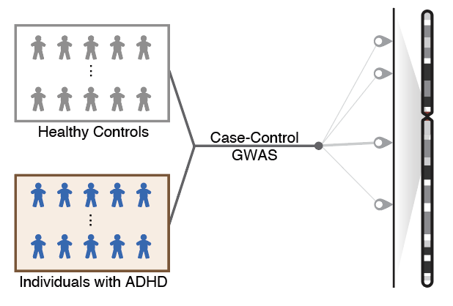
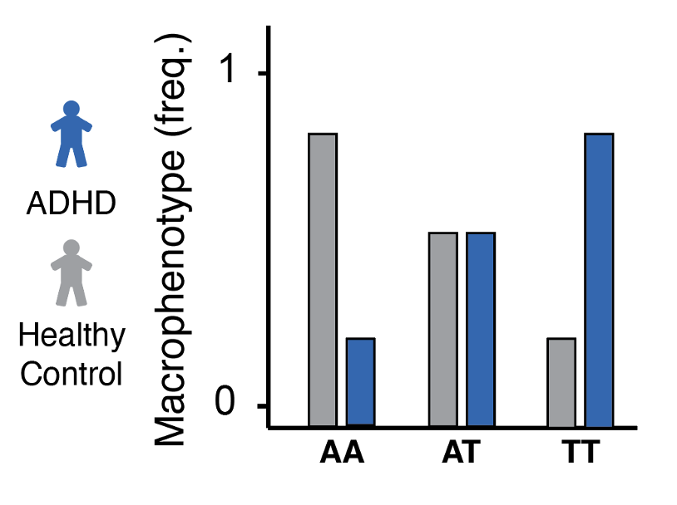
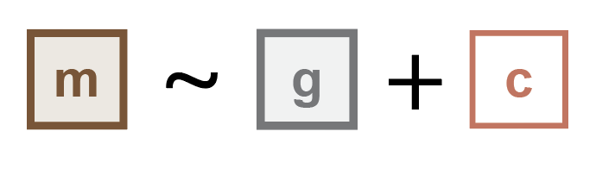
Traditional Strategy for GWAS
Case-Control
GWAS
Binary, Univariate Response Variable

Slide 12
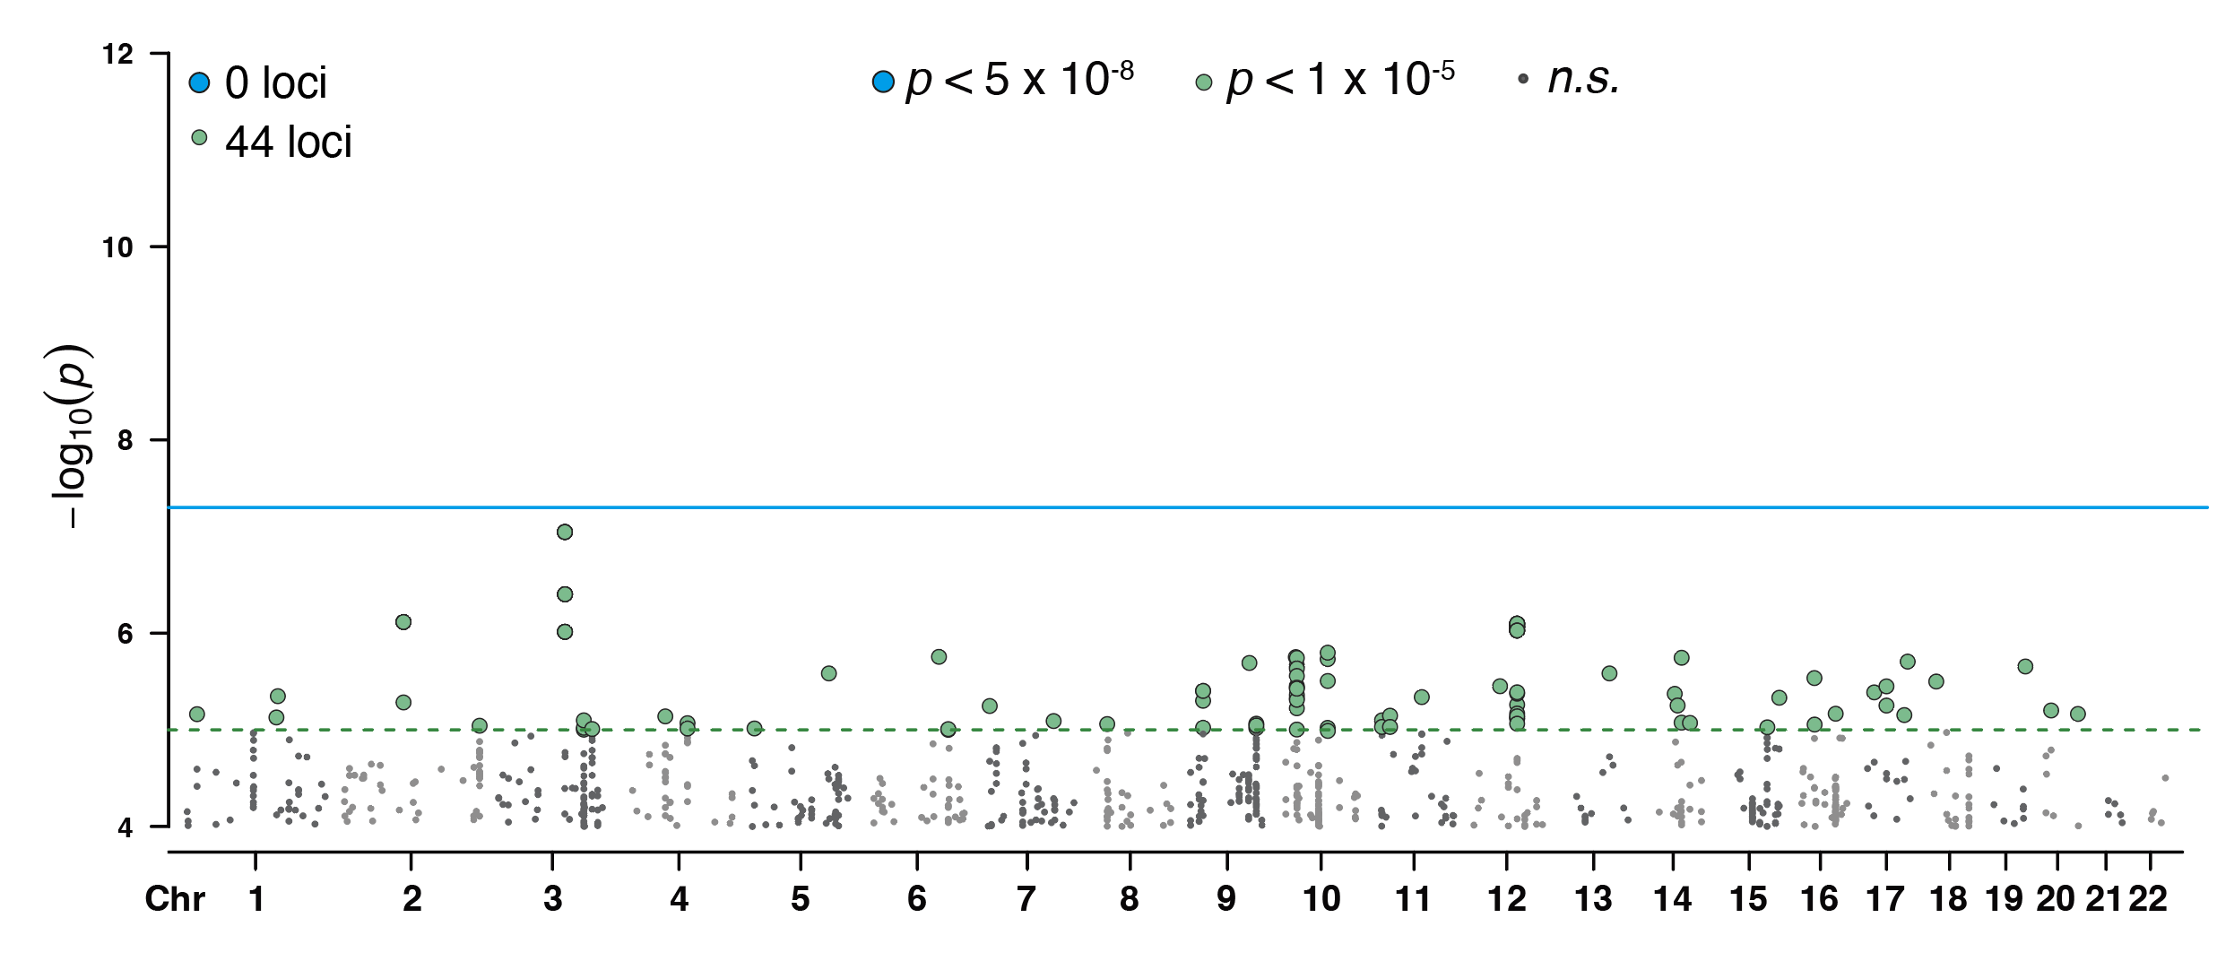
Traditional Strategy for GWAS
Univariate, Binary
Case-Control GWAS
Genome-wide significance

Slide 13
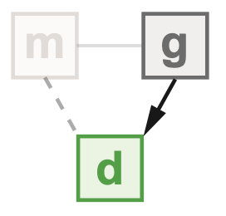
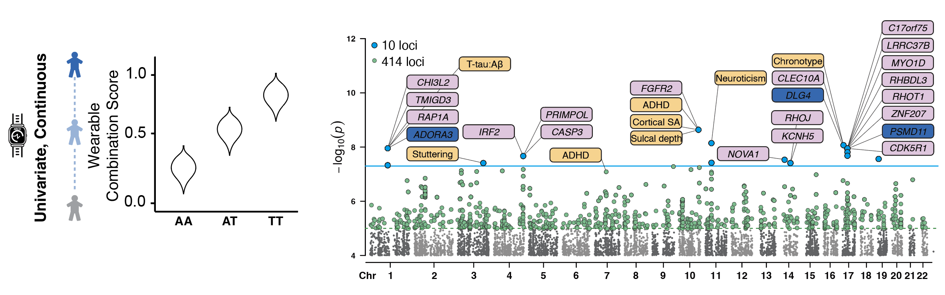
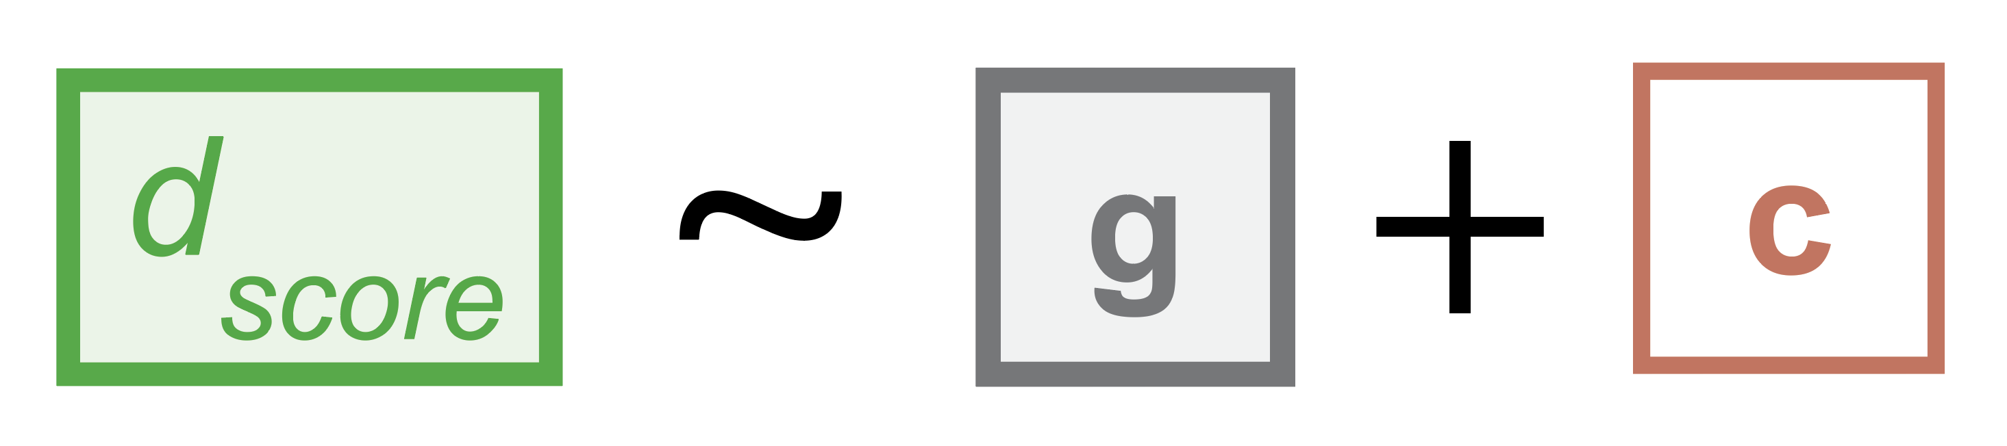
Linking Digital Phenotypes to Genotype
Continuous, Univariate
Response Variable

Slide 14
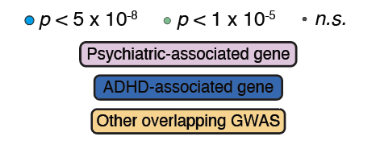
Linking Digital Phenotypes to Genotype
Continuous, Univariate
Wearable GWAS

Slide 15
References for *m7-part-3
(Biosensor Endophenotypes)
JJ Liu, B Borsari, Y Li, SX Liu, Y Gao, X Xin, S Lou, M Jensen, D Garrido-Martin, TL Verplaetse, G Ash, J Zhang, MJ Girgenti, W Roberts, M Gerstein (2025). Cell 188: 515-529e15.
Digital phenotyping from wearables using AI characterizes psychiatric disorders and identifies genetic associations
https://doi.org/10.1016/j.cell.2024.11.012
(Focus on the beginning up to end of Fig 4 section. Stop at the section entitled “Employing digital phenotypes to detect genetic associations with behavioral traits”.)

