Slide 1

Biomedical Data Science (GersteinLab.org/courses/452)
Variant Identification, Focusing on SVs (26m6a)
Last edit in spring ’26. Unchanged (but with slight edits) from 22m6a & 2021’s M6a [which has a video].
Mark Gerstein
Yale U.

Slide 2
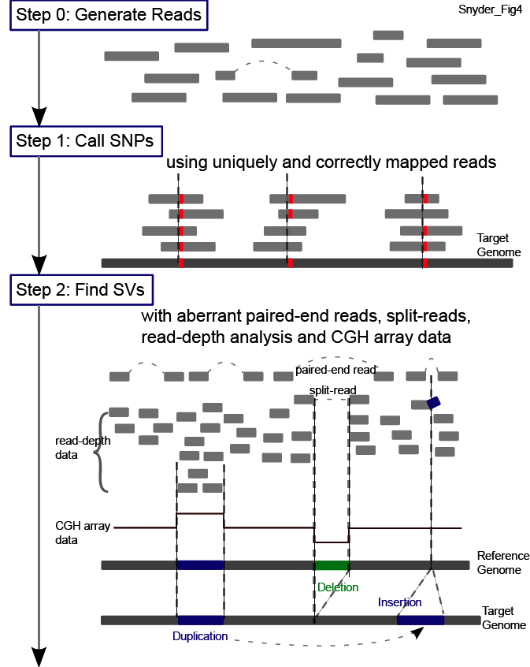
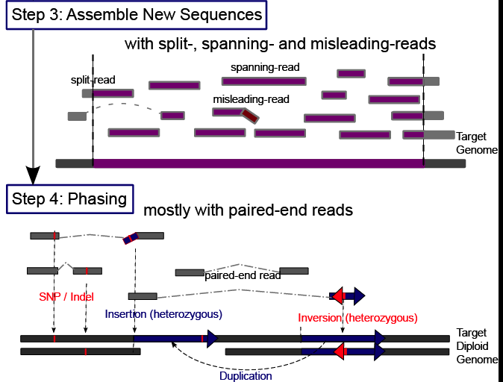
Main Steps in Genome Resequencing
[Snyder et al. Genes & Dev. ('10)]

Slide 3
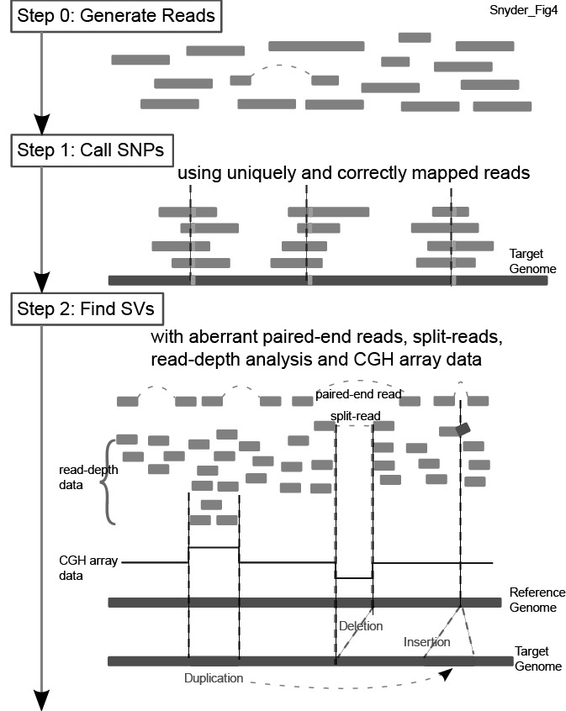
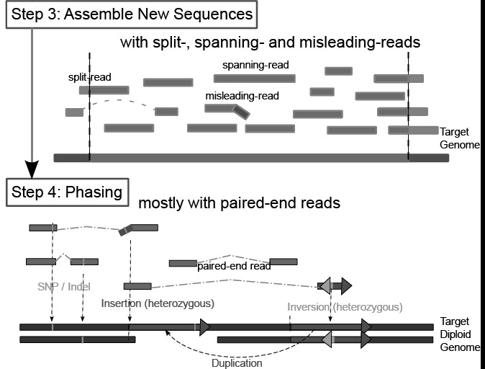
Main Steps in Genome Resequencing
[Snyder et al. Genes & Dev. ('10)]

Slide 4
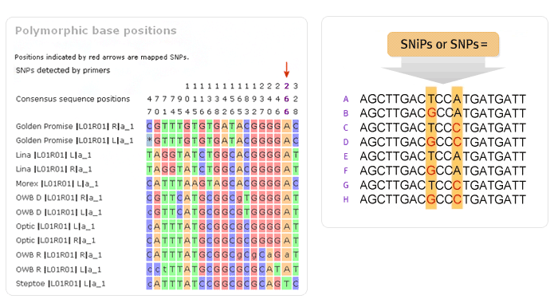
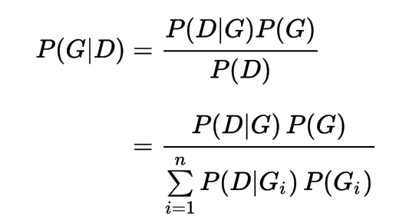
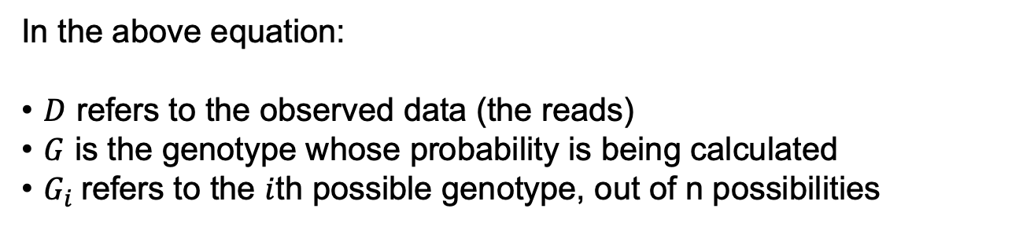
(More Later)
Bayes’ Theorem to detect genomic variant
In the above equation:
$D$ refers to the observed data (the reads)
$G$ is the genotype whose probability is being calculated
$G_{i}$refers to the $i$th possible genotype, out of n possibilities
[You et al. (‘12) Bioinformatics 28: 643 doi: 10.1093/bioinformatics/bts001]

Slide 5

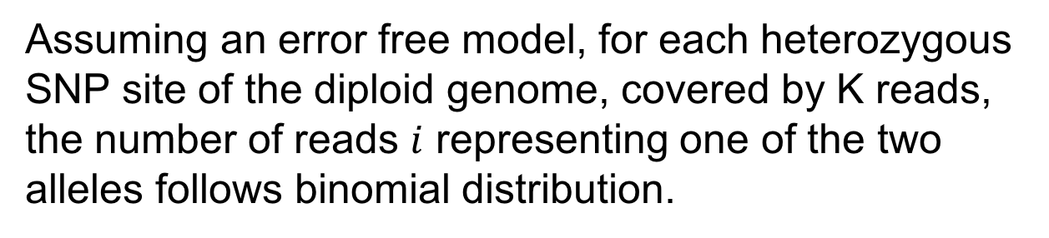
Calculating the conditional distribution $P\left(D | G\right):$
Assuming an error free model, for each heterozygous SNP site of the diploid genome, covered by K reads, the number of reads $i$ representing one of the two alleles follows binomial distribution.
$$P_{err_free}\left(D | G\right)=f\left(i | k,0.5\right)=\left({k \atop i}\right){0.5}^{k}$$
With errors, the calculation is more complicated. (However, the Bayesian formulation becomes more useful.) In general:
$$P\left(D | G\right)=P_{err_free}\left(D | G\right)+P_{err}(D|G)$$
[You et al. (‘12) Bioinformatics 28: 643 doi: 10.1093/bioinformatics/bts001]
Notes:
Change to explain the error / error free

Slide 6
Main Steps in Genome Resequencing
[Snyder et al. Genes & Dev. ('10)]

Slide 7
Methods to Find SVs
1. Paired ends
Deletion
Reference
Mapping
Genome
Sequenced paired-ends
Reference
2. Split read
3. Read depth (or aCGH)
Deletion
Deletion
Reference
Reference
Genome
Genome
Read
Reads
Mapping
Mapping
Read count
Reference
Zero level
4. Local Reassembly
[Snyder et al. Genes & Dev. ('10)]

Slide 8
Read Depth

Slide 9
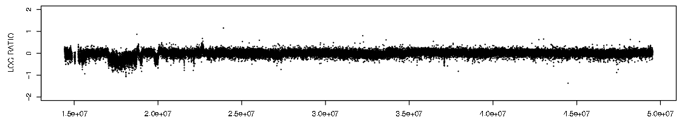
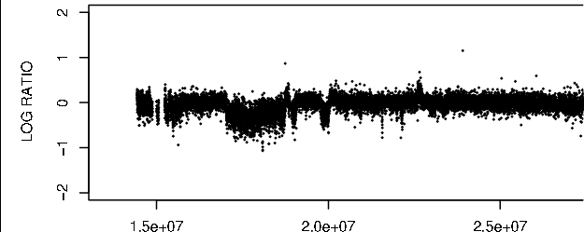
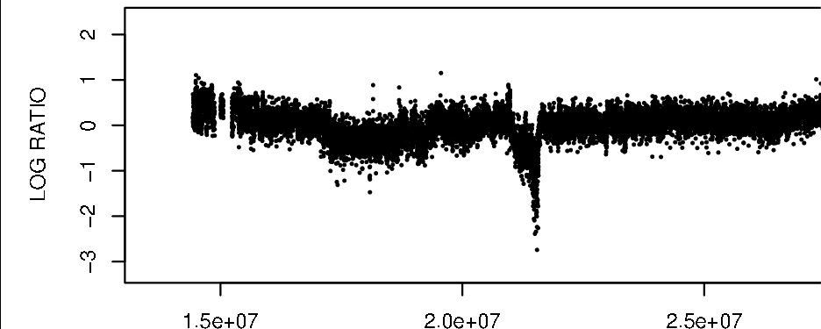
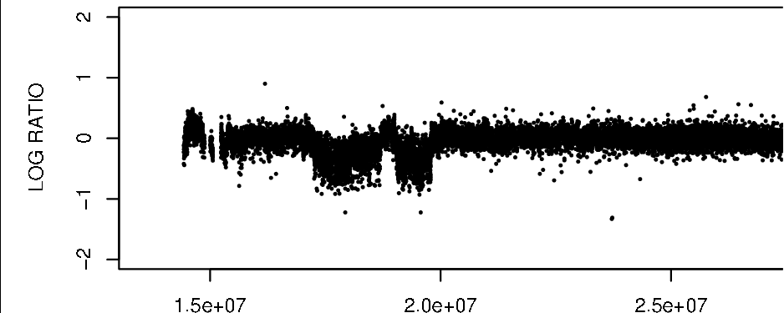
Array Signal
Read depth
Patient 98-135
Individual genome
Patient 99-199
Reads
Mapping
Patient 97-237
Reference genome
[Urban et al. ('06) PNAS; Wang et al. Gen. Res. ('09); Abyzov et al. Gen. Res. (’11)]
Counting mapped reads
Read depth signal
LCR A B C D
Zero level

Slide 10
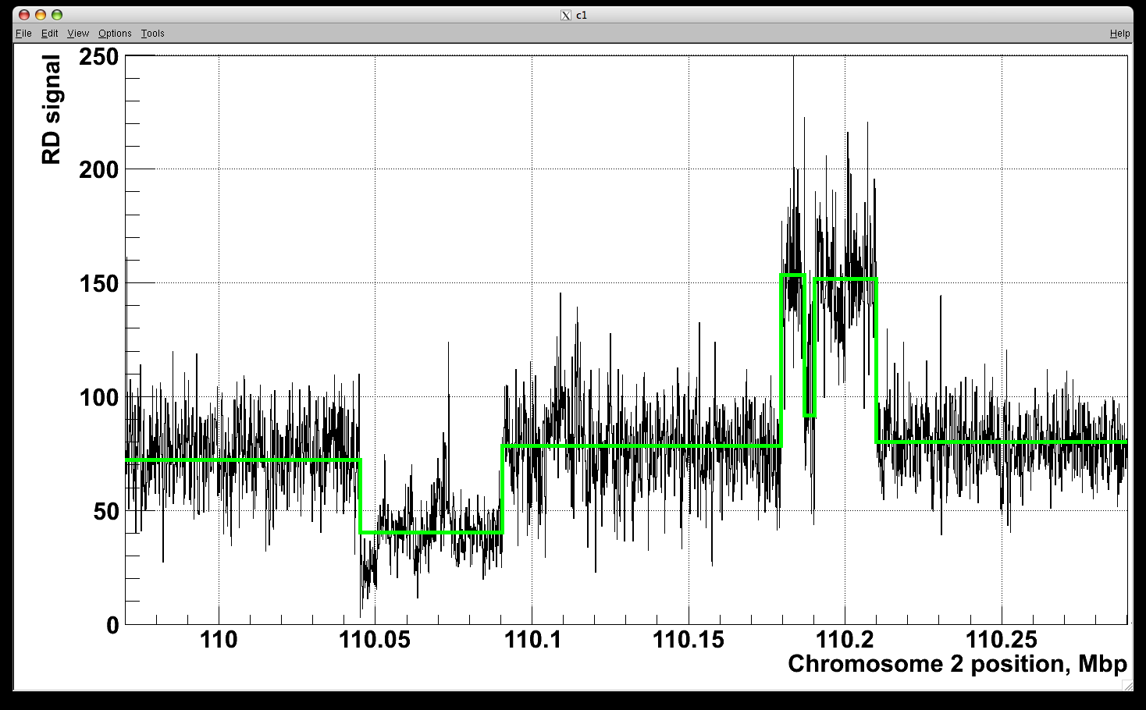
Example of Application to RD data
[Abyzov et al. Gen. Res. (’11)]
NA12878, Solexa 36 bp paired reads, ~30x coverage

Slide 11
0.5
Fluorescence
0
log2 ratio
-0.5
Korbel*, Urban* et al., PNAS (2007)
Notes:
Need illustrator + do edits

Slide 12


Statistically integrates array signal and DNA
sequence signatures
(using a discrete-valued bivariate HMM)
alues
v
y
a
r
r
A
alues
S
equen
c
e
v
y
Transition
A
Transition
B
a
r
r
A
S
equen
c
e
Duplication
Normal
Deletion
Transition
A’
Transition
B’
Korbel*, Urban* et al., PNAS (2007)
Notes:
- The y-axis captures the distribution of fluorescent intensity log2-ratios
- While the x-axis captures DNA sequence characteristics!

Slide 13
Paired-End

Slide 14
Paired-End Mapping
Breakpoint
Breakpoint
Breakpoint
Breakpoint
Breakpoint
Reference
Deletion
Inversion
Target
Insertion
Inversion
Paired-End Sequencing and Mapping
Reference
Span << expected
Span >> expected
Altered end orientation
Both paired-ends map within repeats.
Limited the distance between pairs; therefore, neither large nor very small rearrangements can be detected

Slide 15
Split Read

Slide 16
Split-read Analysis
Breakpoint
Breakpoint
Reference
Deletion
Read
Target Genome
Breakpoint
Reference
Read
Target Genome
Insertion
Notes:
This schematic shows you the idea of a split-read analysis. Its simple but powerful enough to identify nucleotide-resolution SVs. Before we talk about how it works, we should know that by convention, when say it’s a deletion, it’s a deletion relative to the reference genome. In other words, the affected sequence actually exists in the reference genome, but is deleted in the query genome. Similar idea for insertion. So a split-read analysis is straight-forward.

Slide 17
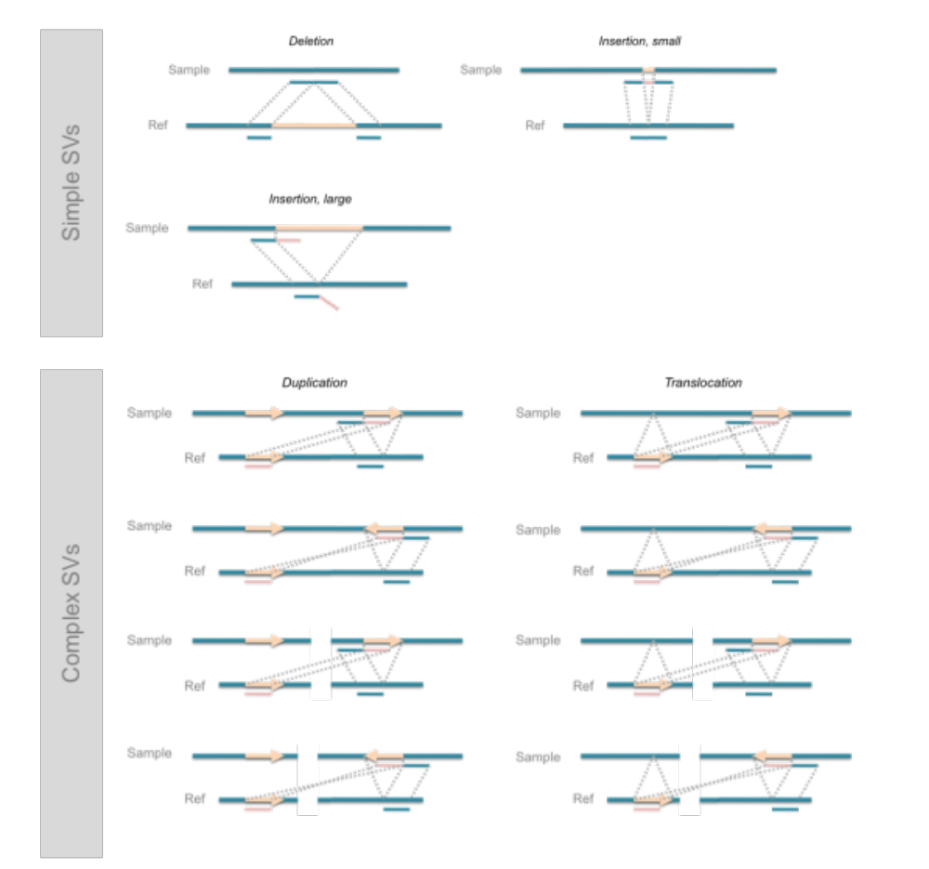
Deletions are the Easiest to Identify
[Zhang et al. ('11) BMC Genomics]

Slide 18
References
Alkan, C., Coe, B. P., & Eichler, E. E. (2011). Nature Reviews Genetics, 12(5), 363–376. Genome structural variation discovery and genotyping.
https://doi.org/10.1038/nrg2958
(Focus on Figs. 1 & 2)

