Slide 1

Biomedical Data Science (GersteinLab.org/courses/452)
Fast Alignment (26m5)
Last edit in spring ’26. Shrunk slightly from 22m5 & 2021’s M5
[which has a video].
Mark Gerstein
Yale U.

Slide 2
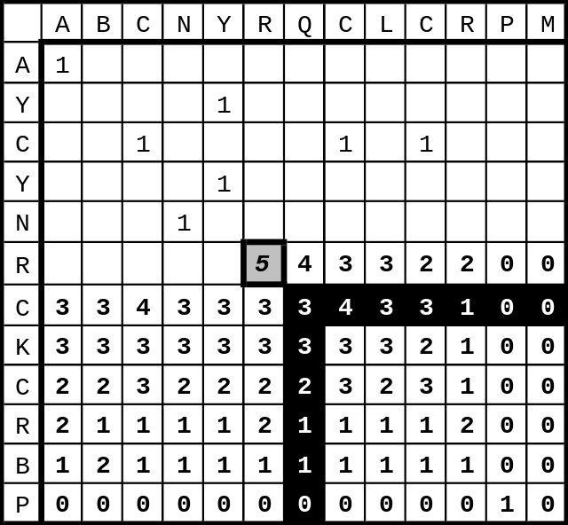
Computational Complexity
The dynamic programming alignment algorithm is
O(n m) ~ O(n²)
in speed and memory
O(n²) in speed and memory is not good enough for important applications
  database search
  short read alignment to reference genome
Note how this would scale to 3, 4, 5.... sequences
N
M
M’
N’

Slide 3
Fast sequence alignment
Alignment via dynamic programming (NW/SW)
  useful for aligning the small numbers of protein, DNA sequences available in the 1980s
1990s hundreds of thousands of protein sequences
Today thousands of genome sequences
=> need for faster, more coarse-grained alignment methods
  first application: find your favorite protein in a sequence database
  next-gen seq application: align millions of short reads to a reference database
Notes:
RA

Slide 4
Computational Complexity
Designing algorithms involves a trade-off between calculation time and memory usage & sensitivity
Steps that can be pre-calculated and stored efficiently in memory speed up the algorithm
FASTA (hashing the query)
BLAST (more efficient query hashing)
BLAT (hashing the DB)
BWA / Bowtie (BW transform of the DB)

Slide 5
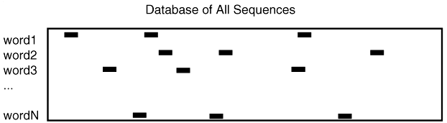
FASTA
Hash table of short words in the query sequence
Go through DB and look for matches in the query hash (linear in size of DB with const. time hash)
perl: $where{“ACT”} = 1,45,67,23....
K-tuple determines word size (k-tup 1 is single aa)
by Bill Pearson
VLICT = _
VLICTAVLMVLICTAAAVLICTMSDFFD

Slide 6
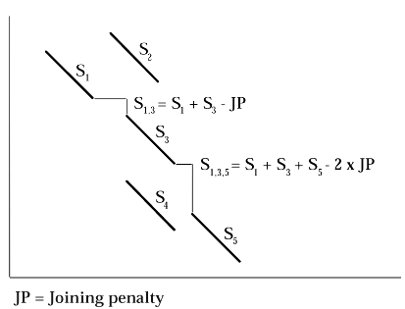
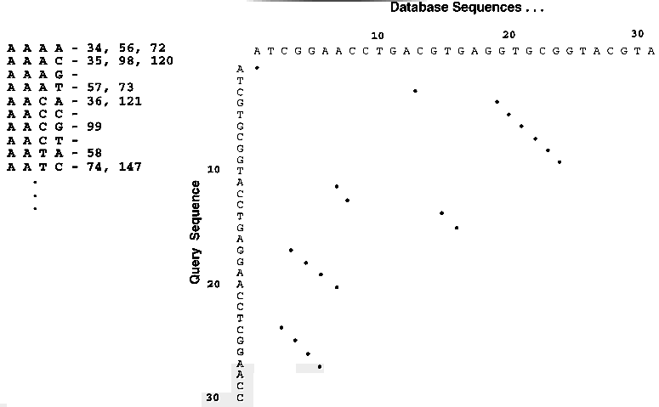
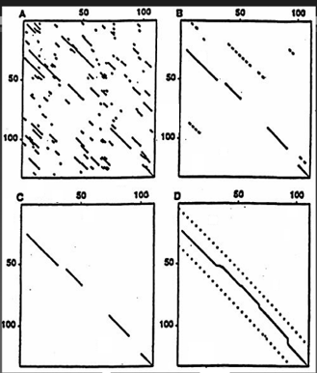
Join together query lookups into diagonals and then do a full alignment
(Adapted from D Brutlag)

Slide 7
Basic Blast
Altschul et al. J. Mol. Biol. 215, 403-410
Indexes query
Starts with all overlapping words from query
Calculates “neighborhood” of each word using PAM matrix and probability threshold matrix and probability threshold
Looks up all words and neighbors from query in database index
Extends High Scoring Pairs (HSPs) left and right to maximal length
Finds Maximal Segment Pairs (MSPs) between query and database
Blast 1 does not permit gaps in alignments

Slide 8
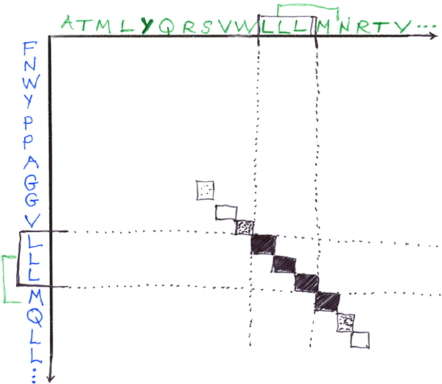
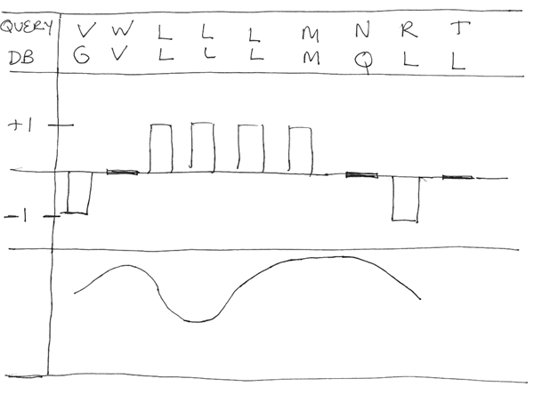
BLAST: Basic Local Alignment Search Tool
Query
DB
Extend hash hits into High Scoring Segment Pairs (HSPs)
Stop extension when total score doesn’t increase
Extension is O(N). This takes most of the time in BLAST

Slide 9
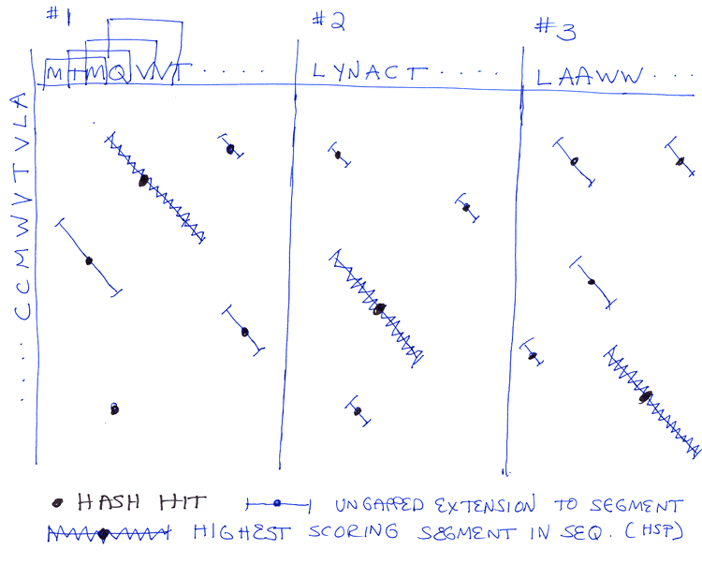
BLAST: Basic Local Alignment Search Tool
In simple BLAST algorithm, find best scoring segment in each DB sequence
Statistics of these scores determine significance
Number of hash hits
~ O(N*M*D)
where
N is query size
M is average size
of seq in DB
D is DB size

Slide 10
BLAT
“BLAST-like alignment tool”
Created by Jim Kent (UCSC) during assembly of the human genome
Most useful for short read alignment to a reference genome
Where BLAST builds an index of the query sequence, BLAT builds an index of the database.
  Obviously, this will scan more quickly through the DB at the expense of building a huge hash table of the DB initially
  DB index non-overlapping, potentially sacrificing some sensitivity for decreased memory usage
BLAT – Genome Res. (2002) 12: 656

Slide 11
Burrows Wheeler Transform
example: String = acaacg
0 acaacg$ 6 $acaacg
1 caacg$a 2 aacg$ac
2 aacg$ac 0 acaacg$
3 acg$aca => 3 acg$aca
4 cg$acaa 1 caacg$a
5 g$acaac 4 cg$acaa
6 $acaacg 5 g$acaac
What’s next: more sophisticated ways of organizing the genome pre-search to speed things up beyond building the DB hash table
Reorder the text: Add an end marker and sort all suffixes of the string so that similar contexts end up next to each other.
Keep a compact summary: Discard the suffixes themselves and keep only one character per suffix; this reordered string is the BWT and still contains all the original information.
Search efficiently: This reorganization creates structure that compresses well and allows fast exact matching, with search time driven by the query length rather than the size of the genome.
Burrows and Wheeler, A Block-sorting Lossless Data Compression Algorithm,
Digital Systems Research Center Report 124 (1994)

Slide 12
Speed v Sensitivity Tradeoff
PSI Blast as a form of Semi-supervised learning
BWA
Blast
FASTA
Smith-Waterman
PSI-Blast
Profiles
HMMs
Sensitivity
Speed

Slide 13
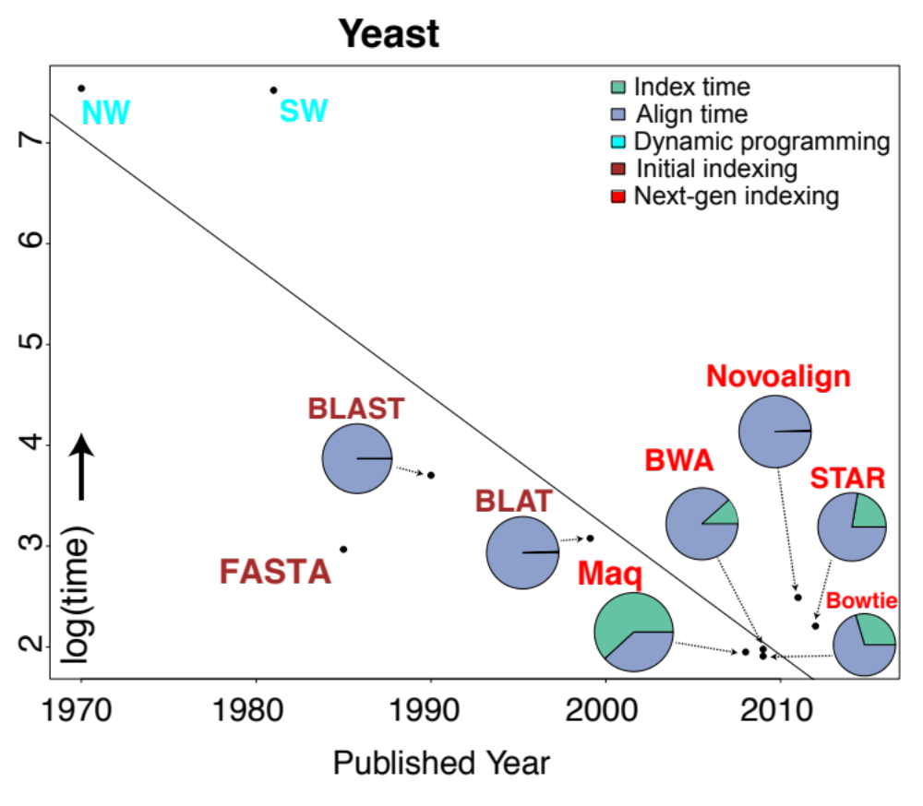
Alignment algorithms scaling to keep pace with data generation
[Sboner et al. (‘11), Muir et al. (‘15) Genome Biology]

Slide 14
References
(IJACSA) International Journal of Advanced Computer Science and Applications, Vol. 11, No. 6, 2020
A Categorization of Relevant Sequence Alignment Algorithms with Respect to Data Structures
https://pdfs.semanticscholar.org/ce61/04863eedcfaecad98ea2bd31d4c9435d2b9b.pdf
(Most Important)
Altschul, S. F., Gish, W., Miller, W., Myers, E. W., & Lipman, D. J. (1990). Journal of Molecular Biology, 215(3), 403–410.
Basic local alignment search tool.
https://doi.org/10.1016/s0022-2836(05)80360-2
(http://www.gersteinlab.org/courses/452/10-spring/pdf/Altschul.pdf)
(Just Methods Section)

