Slide 1

Biomedical Data Science (GersteinLab.org/courses/452)
Multiple Sequences (26m4)
Last edit in spring ’25. Similar to 22m4 & 2021’s M4 [which has a video]. Additions include slides on agglomerative clustering [slide 5] & HMMs [slide 28], compared to M4. Also, some slide deletions related to low-complexity regions & mult. seq. alignment issues
Mark Gerstein
Yale U.

Slide 2
Multiple Sequence Alignment Topics
Multiple Sequence Alignment
Motifs
  Fast identification methods
Profile Patterns
  Refinement via EM
  Gibbs Sampling
HMMs
Applications
  Protein Domain databases
  Regression vs expression

Slide 3
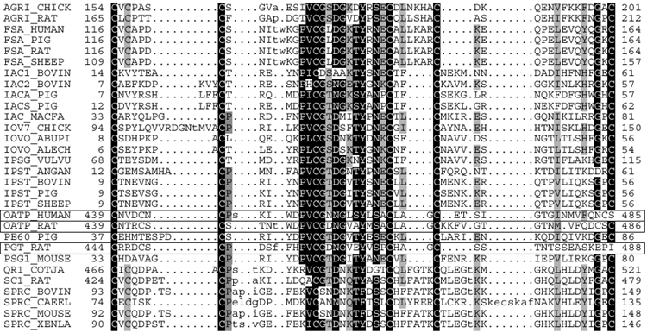
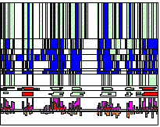
Multiple Sequence Alignments
- One of the most essential tools in molecular biology
It is widely used in:
- Phylogenetic analysis
- Prediction of protein secondary/tertiary structure
- Finding diagnostic patterns to characterize protein families
- Detecting new homologies between new genes and established sequence families
- Practically useful methods only since 1987
- Before 1987 they were constructed by hand
- The basic problem: no dynamic programming approach can be used
- First useful approach by D. Sankoff (1987) based on phylogenetics
(LEFT, adapted from Sonhammer et al. (1997). “Pfam,” Proteins 28:405-20. ABOVE, G Barton AMAS web page)

Slide 4
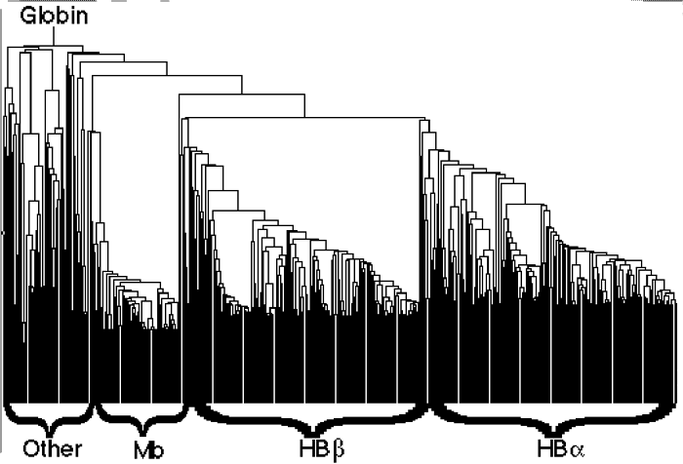
Progressive Multiple Alignments
(quick, simplified overview)
- Most multiple alignments based on this approach
- Initial guess for a phylogenetic tree based on pairwise alignments
- Built progressively starting with most closely related sequences
- Follows branching order in tree
- Sufficiently fast
- Sensitive
- Algorithmically heuristic, no mathematical property associated with the alignment
- Biologically sound, it is common to derive alignments which are impossible to improve by eye
(adapted from Sonhammer et al. (1997). “Pfam,” Proteins 28:405-20)

Slide 5
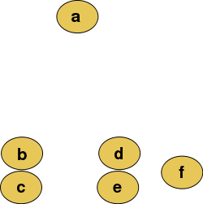
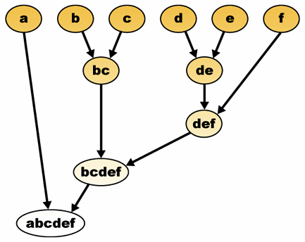
Agglomerative Clustering
(More Later)
(using Euclidean Dist.)
Ex. From Wikipedia
“Suppose we have merged the two closest elements b and c, we now have the following clusters {a}, {b, c}, {d}, {e} and {f}, and want to merge them further. To do that, we need to take the distance between {a} and
{b c}, and therefore define the distance between two clusters.”
http://commons.wikimedia.org/wiki/File:Hierarchical_clustering_diagram.png

Slide 6
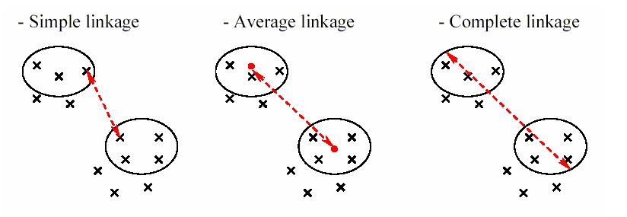
Clustering approaches for multiple sequence alignment
Clustal uses average linkage clustering
  also called UPGMA
  (Unweighted Pair Group Method with Arithmetic mean)
http://compbio.pbworks.com/f/linkages.JPG

Slide 7
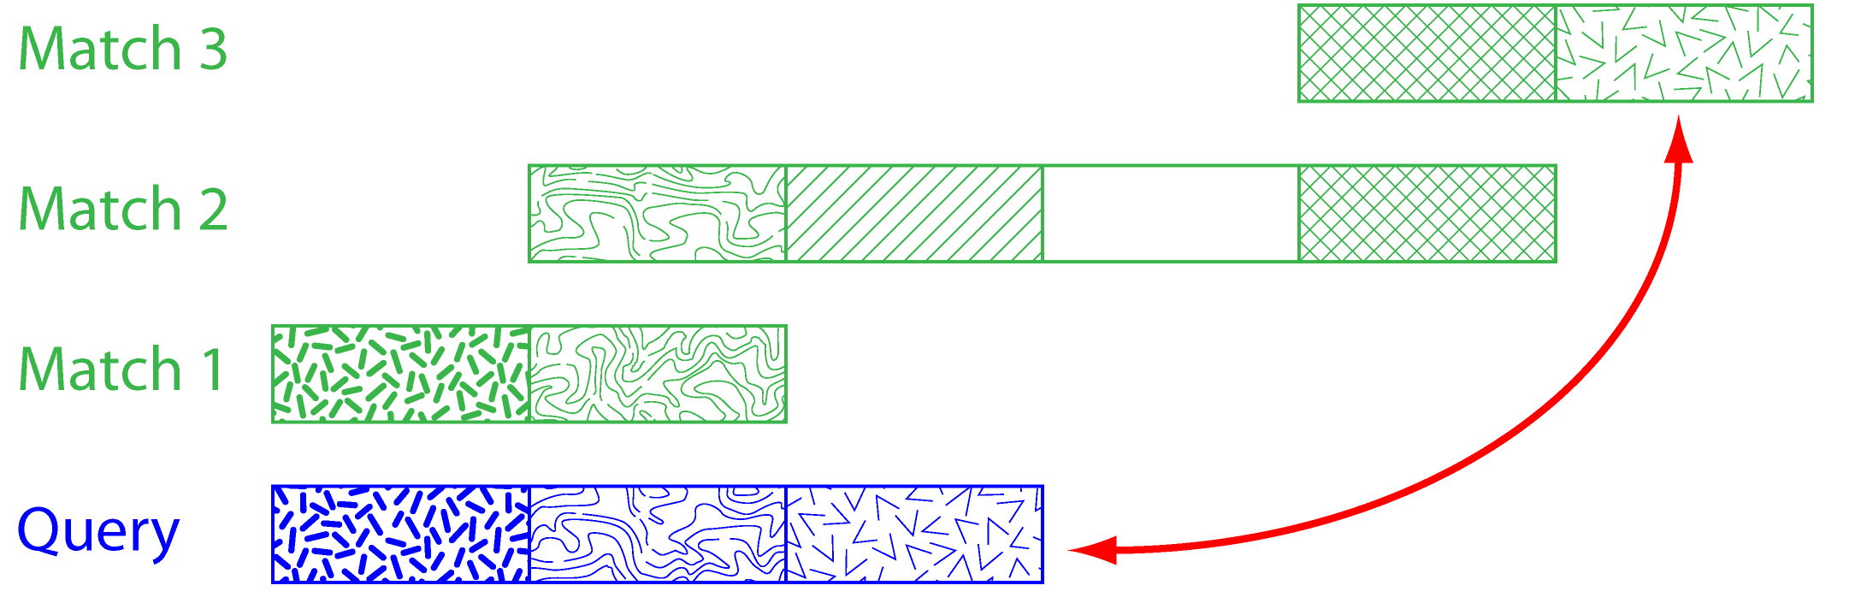
Problems in Multiple Alignment
Domain Problem
Local Minimum Problem
- Stems from greedy nature of alignment
(mistakes made early in alignment cannot be corrected later)

Slide 8
Multiple Alignment
MOTIFS

Slide 9
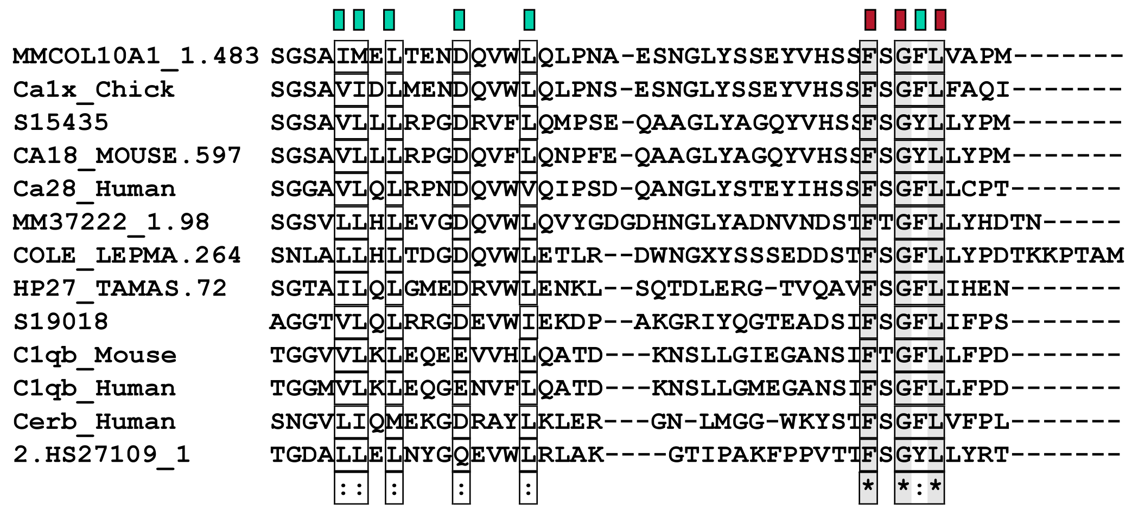
Motifs
- several proteins are grouped together by similarity searches
- they share a conserved motif
- motif is stringent enough to retrieve the family members from the complete protein database
- PROSITE: a collection of motifs (1135 different motifs)

Slide 10
Prosite Pattern -- EGF like pattern
  A sequence of about thirty to forty amino-acid residues long found in the sequence of epidermal growth factor (EGF) has been shown [1 to 6] to be present, in a more or less conserved form, in a large number of other, mostly animal proteins. The proteins currently known to contain one or more copies of an EGF-like pattern are listed below.
  - Bone morphogenic protein 1 (BMP-1), a protein which induces cartilage and bone formation.
  - Caenorhabditis elegans developmental proteins lin-12 (13 copies) and glp-1 (10 copies).
  - Calcium-dependent serine proteinase (CASP) which degrades the extracellular matrix proteins type ….
  - Cell surface antigen 114/A10 (3 copies).
  - Cell surface glycoprotein complex transmembrane subunit .
  - Coagulation associated proteins C, Z (2 copies) and S (4 copies).
  - Coagulation factors VII, IX, X and XII (2 copies).
  - Complement C1r/C1s components (1 copy).
  - Complement-activating component of Ra-reactive factor (RARF) (1 copy).
  - Complement components C6, C7, C8 alpha and beta chains, and C9 (1 copy).
  - Epidermal growth factor precursor (7-9 copies).
+-------------------+ +-------------------------+
| | | |
x(4)-C-x(0,48)-C-x(3,12)-C-x(1,70)-C-x(1,6)-C-x(2)-G-a-x(0,21)-G-x(2)-C-x
| | ************************************
+-------------------+
'C': conserved cysteine involved in a disulfide bond.
'G': often conserved glycine
'a': often conserved aromatic amino acid
'*': position of both patterns.
'x': any residue
-Consensus pattern: C-x-C-x(5)-G-x(2)-C
[The 3 C's are involved in disulfide bonds]
http://www.expasy.ch/sprot/prosite.html

Slide 11
2 common applications for motif analysis
Given a collection of binding sites (or protein sequences with binding motifs), develop a representation of those sites that can be used to search new sites and reliably predict where additional binding sites occur.
Given a set of sequences known to contain binding sites for a common factor, but not knowing where the sites are, discover the location of the sites in each sequence and a representation of the protein.
[Adapted from C Bruce, CBB752 '09]

Slide 12
Multiple Alignment
PROFILES

Slide 13
EGF Profile Generated for SEARCHWISE
Cons A C D E F G H I K L M N P Q R S T V W Y Gap
V -1 -2 -9 -5 -13 -18 -2 -5 -2 -7 -4 -3 -5 -1 -3 0 0 -1 -24 -10 100
D 0 -14 -1 -1 -16 -10 0 -12 0 -13 -8 1 -3 0 -2 0 0 -8 -26 -9 100
V 0 -13 -9 -7 -15 -10 -6 -5 -5 -7 -5 -6 -4 -4 -6 -1 0 -1 -27 -14 100
D 0 -20 18 11 -34 0 4 -26 7 -27 -20 15 0 7 4 6 2 -19 -38 -21 100
P 3 -18 1 3 -26 -9 -5 -14 -1 -14 -12 -1 12 1 -4 2 0 -9 -37 -22 100
C 5 115 -32 -30 -8 -20 -13 -11 -28 -15 -9 -18 -31 -24 -22 1 -5 0 -10 -5 100
A 2 -7 -2 -2 -21 -5 -4 -12 -2 -13 -9 0 -1 0 -3 2 1 -7 -30 -17 100
s 2 -12 3 2 -25 0 0 -18 0 -18 -13 4 3 1 -1 7 4 -12 -30 -16 25
n -1 -15 4 4 -19 -7 3 -16 2 -16 -10 7 -6 3 0 2 0 -11 -23 -10 25
p 0 -18 -7 -6 -17 -11 0 -17 -5 -15 -14 -5 28 -2 -5 0 -1 -13 -26 -9 25
c 5 115 -32 -30 -8 -20 -13 -11 -28 -15 -9 -18 -31 -24 -22 1 -5 0 -10 -5 25
L -5 -14 -17 -9 0 -25 -5 4 -5 8 8 -12 -14 -1 -5 -7 -5 2 -15 -5 100
N -4 -16 12 5 -20 0 24 -24 5 -25 -18 25 -10 6 2 4 1 -19 -26 -2 100
g 1 -16 7 1 -35 29 0 -31 -1 -31 -23 12 -10 0 -1 4 -3 -23 -32 -23 50
G 6 -17 0 -7 -49 59 -13 -41 -10 -41 -32 3 -14 -9 -9 5 -9 -29 -39 -38 100
T 3 -10 0 2 -21 -12 -3 -5 1 -11 -5 1 -4 1 -1 6 11 0 -33 -18 100
C 5 115 -32 -30 -8 -20 -13 -11 -28 -15 -9 -18 -31 -24 -22 1 -5 0 -10 -5 100
I -6 -13 -19 -11 0 -28 -5 8 -4 6 8 -12 -17 -4 -5 -9 -4 6 -12 -1 100
d -4 -19 8 6 -15 -13 5 -17 0 -16 -12 5 -9 2 -2 -1 -1 -13 -24 -5 31
i 0 -6 -8 -6 -4 -11 -5 3 -5 1 2 -5 -8 -4 -6 -2 0 4 -14 -6 31
g 1 -13 0 0 -20 -3 -3 -12 -3 -13 -8 0 -7 0 -5 2 0 -7 -29 -16 31
L -5 -11 -20 -14 0 -23 -9 9 -11 8 7 -14 -17 -9 -14 -8 -4 7 -17 -5 100
E 0 -20 14 10 -33 5 0 -25 2 -26 -19 11 -9 4 0 3 0 -19 -34 -22 100
S 3 -13 4 3 -28 3 0 -18 2 -20 -13 6 -6 3 1 6 3 -12 -32 -20 100
Y -14 -9 -25 -22 31 -34 10 -5 -17 0 -1 -14 -13 -13 -15 -14 -13 -7 17 44 100
T 0 -10 -6 -1 -11 -16 -2 -7 -1 -9 -5 -3 -9 0 -1 1 3 -4 -16 -8 100
C 5 115 -32 -30 -8 -20 -13 -11 -28 -15 -9 -18 -31 -24 -22 1 -5 0 -10 -5 100
R 0 -13 0 2 -19 -11 1 -12 4 -13 -8 3 -8 4 5 1 1 -8 -23 -13 100
C 5 115 -32 -30 -8 -20 -13 -11 -28 -15 -9 -18 -31 -24 -22 1 -5 0 -10 -5 100
P 0 -14 -8 -4 -15 -17 0 -7 -1 -7 -5 -4 6 0 -2 0 1 -3 -26 -10 100
P 1 -18 -3 0 -24 -13 -3 -12 1 -13 -10 -2 15 2 0 2 1 -8 -33 -19 100
G 4 -19 3 -4 -48 53 -11 -40 -7 -40 -31 5 -13 -7 -7 4 -7 -29 -39 -36 100
y -22 -6 -35 -31 55 -43 11 -1 -25 6 4 -21 -34 -20 -21 -22 -20 -7 43 63 50
S 1 -9 -3 -1 -14 -7 0 -10 -2 -12 -7 0 -7 0 -4 4 4 -5 -24 -9 100
G 5 -20 1 -8 -52 66 -14 -45 -11 -44 -35 4 -16 -10 -10 4 -11 -33 -40 -40 100
E 2 -20 10 12 -31 -7 0 -19 6 -20 -15 5 4 7 2 4 2 -13 -38 -22 100
R -5 -17 0 1 -16 -13 8 -16 9 -16 -11 5 -11 7 15 -1 -1 -13 -18 -6 100
C 5 115 -32 -30 -8 -20 -13 -11 -28 -15 -9 -18 -31 -24 -22 1 -5 0 -10 -5 100
E 0 -26 20 25 -34 -5 6 -25 10 -25 -17 9 -4 16 5 3 0 -18 -38 -23 100
T -4 -11 -13 -8 -1 -21 2 0 -4 -1 0 -6 -14 -3 -5 -4 0 0 -15 0 100
D 0 -18 5 4 -24 -11 -1 -11 2 -14 -9 1 -6 2 0 0 0 -6 -34 -18 100
I 0 -10 -2 -1 -17 -14 -3 -4 -1 -9 -4 0 -11 0 -4 0 2 -1 -29 -14 100
D -4 -15 -1 -2 -13 -16 -3 -8 -5 -6 -4 -1 -7 -2 -7 -3 -2 -6 -27 -12 100
Cons.
Cys

Slide 14
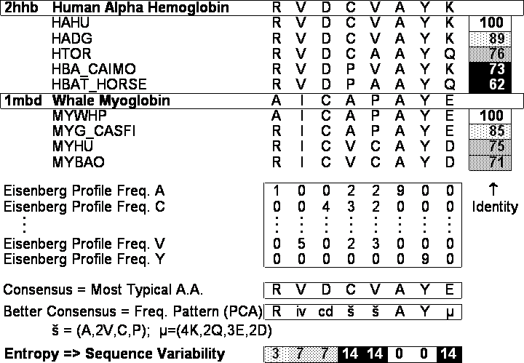
Profiles formula for position
M(p,a)
M(p,a) = chance of finding amino acid a at position p
M_{simp}(p,a) = number of times a occurs at p divided by number of sequences
However, what if don’t have many sequences in alignment? M_{simp}(p,a) might be baised. Zeros for rare amino acids. Thus:
M_{cplx}(p,a)= Σ_{b=1 to 20} M_{simp}(p,b) x Y(b,a)
Y(b,a): Dayhoff matrix for a and b amino acids
S(p,a) ~ Σ_{a=1 to 20} M_{simp}(p,a) ln M_{simp}(p,a)

Slide 15
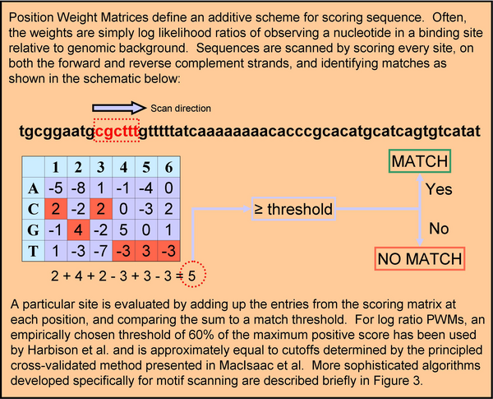
Scanning for Motifs with PWMs
[Adapted from C Bruce, CBB752 '09]
MacIsaac & Fraenkel, 2006
Notes:
15

Slide 16
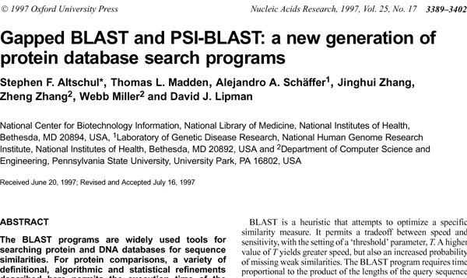
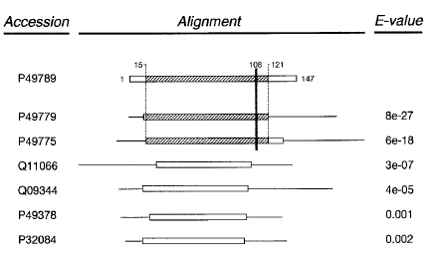
Ψ-Blast
Automatically builds profile and then searches with this
Also PHI-blast
Parameters: overall threshold, inclusion threshold, interations

Slide 17
PSI-BLAST (Position-Specific Iterative Basic Local Alignment Search Tool)
Input Query
Profile Query
Matches
New Profile Query
Finds more matches
Continue iterate and search database
DB
Convergence vs explosion (polluted profiles)
Notes:
New slide
Not definitely clear if this could be categorized as a semi-supervised method
One suggestion:
Introduce PSI-Blast during multi-seq (1 slide)
Revisit PSI-Blast when talk about semi-supervised method

Slide 18
Multiple Alignment:
Probabilistic Approaches for Determining PWMs
Expectation Maximization: Search the PWM space randomly
Gibbs sampling: Search sequence space randomly.
[Adapted from C Bruce, CBB752 '09]
Notes:
18

Slide 19
Expectation-Maximization (EM) algorithm
Used in statistics for finding maximum likelihood estimates of parameters in probabilistic models, where the model depends on unobserved latent variables.
EM alternates between performing
  an expectation (E) step, which computes an expectation of the likelihood by including the latent variables as if they were observed, and
  a maximization (M) step, which computes the maximum likelihood estimates of the parameters by maximizing the expected likelihood found on the E step.
The parameters found on the M step are then used to begin another E step, and the process is repeated.
Guess an initial weight matrix
Use weight matrix to predict instances in the input sequences
Use instances to predict a weight matrix
Repeat 2 [E-step] & 3 [M-step] until satisfied.
Another good source is Wes Craven’s 776 course: https://www.biostat.wisc.edu/~craven/776/lecture9.pdf
[Adapted from B Noble, GS 541 at UW, http://noble.gs.washington.edu/~wnoble/genome541/]
[Also Adapted from C Bruce, CBB752 '09]
Notes:
19

Slide 20
Multiple Alignment
Gibbs Sampling

Slide 21
Initialization
sequence 1
ACAGTGT
TTAGACC
GTGACCA
ACCCAGG
CAGGTTT
sequence 2
sequence 3
sequence 4
sequence 5
[Adapted from B Noble, GS 541 at UW, http://noble.gs.washington.edu/~wnoble/genome541/]
Step 1: Randomly guess an instance s_{i} from each of t input sequences {S₁, ..., S_{t}}.
Notes:
21

Slide 22
Gibbs sampler
[Adapted from B Noble, GS 541 at UW, http://noble.gs.washington.edu/~wnoble/genome541/]
Steps 2 & 3 (search):
  Throw away an instance s_{i}: remaining (t - 1) instances define weight matrix.
  Weight matrix defines instance probability at each position of input string S_{i}
  Pick new s_{i} according to probability distribution (not necessarily always the s_{i} giving the highest prob.)
Return highest-scoring motif seen
Notes:
22

Slide 23
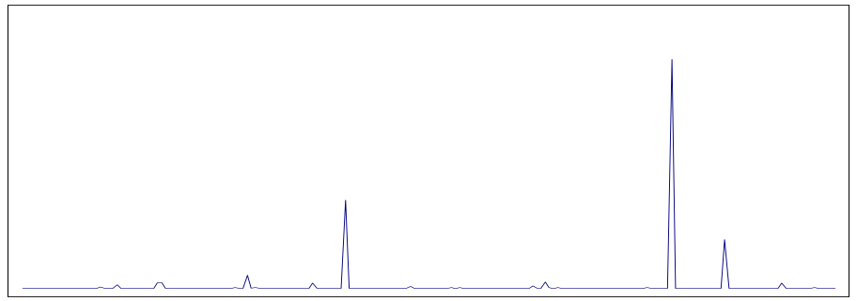
Sampler step illustration:
ACAGTGT
TAGGCGT
ACACCGT
???????
CAGGTTT
A
C
G
T
.45 | .45 | .45 | .05 | .05 | .05 | .05
.25 | .45 | .05 | .25 | .45 | .05 | .05
.05 | .05 | .45 | .65 | .05 | .65 | .05
.25 | .05 | .05 | .05 | .45 | .25 | .85
ACAGTGT
TAGGCGT
ACACCGT
ACGCCGT
CAGGTTT
sequence 4
11%
[Adapted from B Noble, GS 541 at UW, http://noble.gs.washington.edu/~wnoble/genome541/]
ACGCCGT:20%
ACGGCGT:52%
Notes:
23

Slide 24
Comparison
[Adapted from B Noble, GS 541 at UW, http://noble.gs.washington.edu/~wnoble/genome541/]
Both EM and Gibbs sampling involve iterating over two steps
Convergence:
  EM converges when the PSSM stops changing.
  Gibbs sampling runs until you ask it to stop.
Solution:
  EM may not find the motif with the highest score.
  Gibbs sampling will provably find the motif with the highest score, if you let it run long enough.
Notes:
24

Slide 25
Multiple Alignment
HMMs

Slide 26
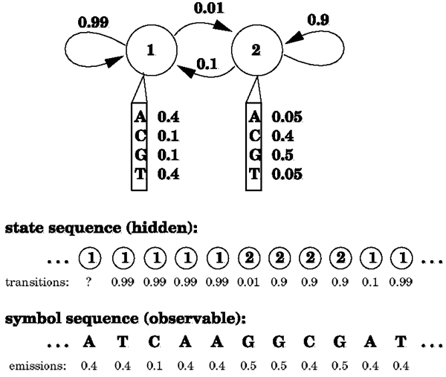
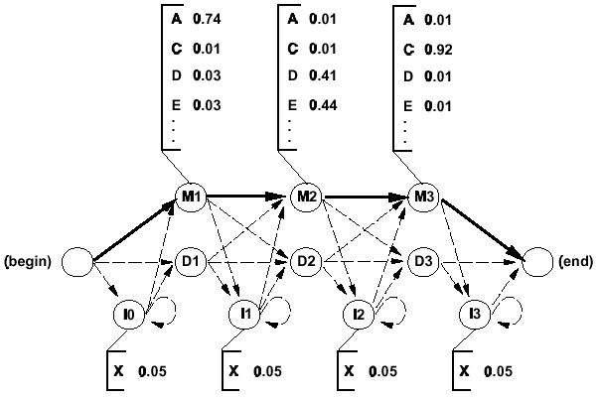
HMMs
Hidden Markov Model:
- a composition of finite number of states,
- each corresponding to a column in a multiple alignment
- each state emits symbols, according to symbol-emission probabilities
Starting from an initial state, a sequence of symbols is generated by moving from state to state until an end state is reached.
(Figures from Eddy, Curr. Opin. Struct. Biol.)

Slide 27
Algorithms
Probability of a path through the model
Viterbi maximizes for one seq.
Forward sums of all possible paths
Forward Algorithm – finds probability P that a model λ emits a given sequence O by summing over all paths that emit the sequence, the probability of that path
Viterbi Algorithm – finds the most probable path through the model for a given sequence
(Both usually just boil down to applications of dynamic programming)

Slide 28
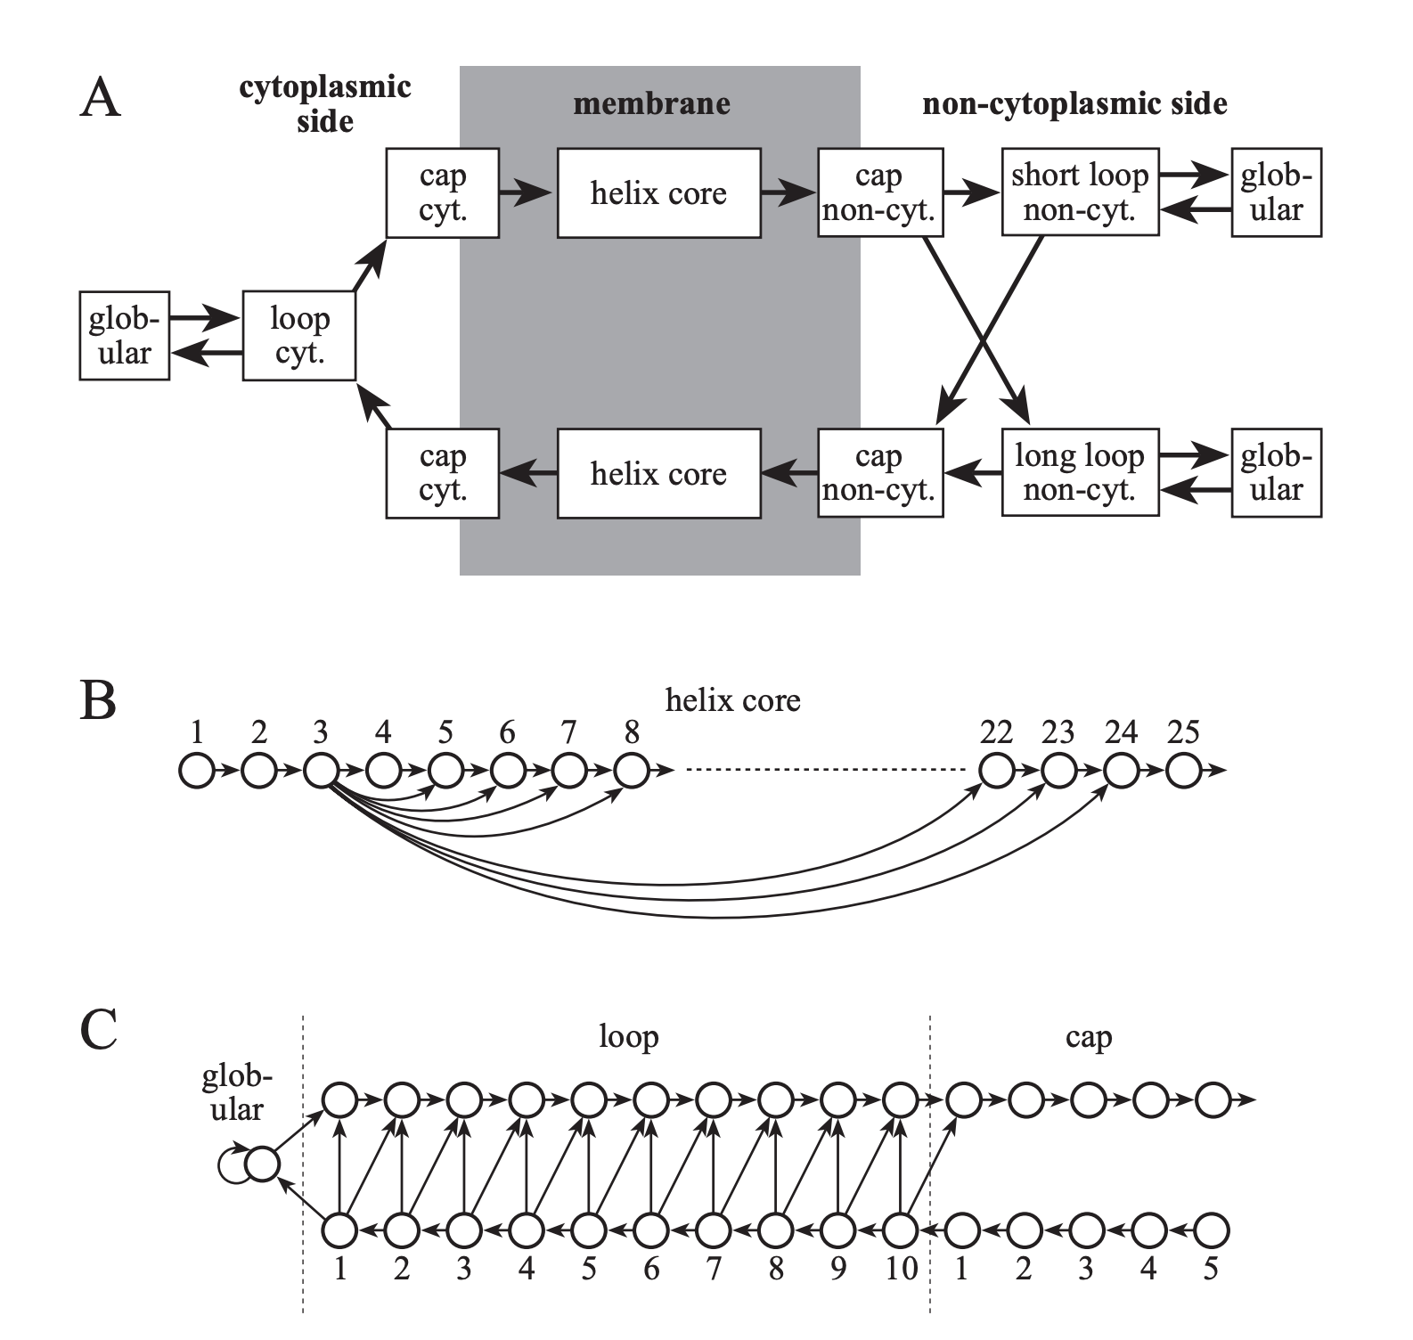
EX of Richness of the HMM Modelling Framework: Predicting Membrane Proteins
Sonnhammer et al. Proc Int Conf Intell Syst Mol Biol. 1998;6:175-82.

Slide 29
References
Stormo, G. D. (2010). Methods in Molecular Biology, 85–95.
Motif discovery using expectation maximization and Gibbs’ sampling.
https://doi.org/10.1007/978-1-60761-854-6_6
R Durbin, S Eddy, A Krogh, G Mitchison
Published by Cambridge University Press 1st (first) edition (1998)
Biological Sequence Analysis: Probabilistic Models of Proteins and Nucleic Acids
https://www.amazon.com/Biological-Sequence-Analysis-Probabilistic-University/dp/B00HQ0TD64
(http://www.mcb111.org/w06/durbin_book.pdf)
(Read Chap. 5)
James, Gareth, Witten, Daniela, Hastie, Trevor, Tibshirani, Robert
An Introduction to Statistical Learning: with Applications in R [ ISLR (2nd edition) ]
https://www.amazon.com/Introduction-Statistical-Learning-Applications-Statistics/dp/1071614177/ + https://www.statlearning.com
(Chap 12.4.2 gives a nice overview of hierarchical clustering)
Forte, Rui Miguel: 9781783982806: Amazon.com: Books.
Mastering Predictive Analytics with R: Master the craft of predictive modeling by developing strategy, intuition, and a solid foundation in essential concepts
https://www.amazon.com/Mastering-Predictive-Analytics-Miguel-Forte/dp/1783982802
(Optional: HMM sect. in chap. 8 has a simple intro to promotor prediction)

