Slide 1

Biomedical Data Science (GersteinLab.org/courses/452)
Sequence Comparison (26m3)
Last edit in spring ‘26, adding Wikipedia summary slides
similar to 25m3 & 2021’s M3
[which has a video]
Mark Gerstein
Yale U.

Slide 2
Sequence Topics (Contents)
Basic Alignment via Dynamic Programming
Suboptimal Alignment
Gap Penalties
Similarity (PAM) Matrices
Local Alignment
Notes:
RA removed FASTA, added BWA, shortened secondary structure topics listed

Slide 3
Aligning Text Strings
Raw Data ???
T C A T G
C A T T G
2 matches, 0 gaps
T C A T G
| |
C A T T G
3 matches (2 end gaps)
T C A T G .
| | |
. C A T T G
4 matches, 1 insertion
T C A - T G
| | | |
. C A T T G
4 matches, 1 insertion
T C A T - G
| | | |
. C A T T G
…But what to do for a bigger string?
SSDSEREEHVKRFRQALDDTGMKVPMATTNLFTHPVFKDGGFTANDRDVRRYALRKTIRNIDLAVELGAETYVAWGGREGAESGGAKDVRDALDRMKEAFDLLGEYVTSQGYDIRFAIEP
  KPNEPRGDILLPTVGHALAFIERLERPELYGVNPEVGHEQMAGLNFPHGIAQALWAGKLFHIDLNGQNGIKYDQDLRFGAGDLRAAFWLVDLLESAGYSGPRHFDFKPPRTEDFDGVWAS

Slide 4
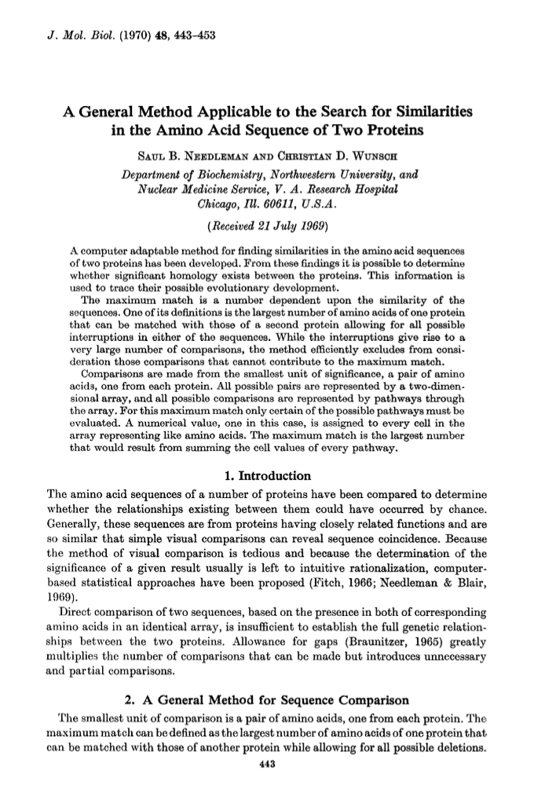
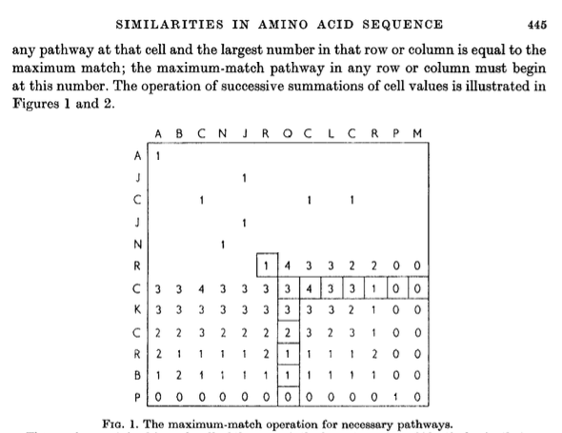
Classic Exposition of Dynamic Programming
Needleman-Wunsch (‘70) provided 1st automatic method
  A “Principia” for bioinformatics
  Finding a global alignment
  ABCNYRQCLCRPM
  AYCYNRCKCRBP
  Note: J->Y.The nomenclature predated current symbols!
  (“old English”
  for AA)

Slide 5
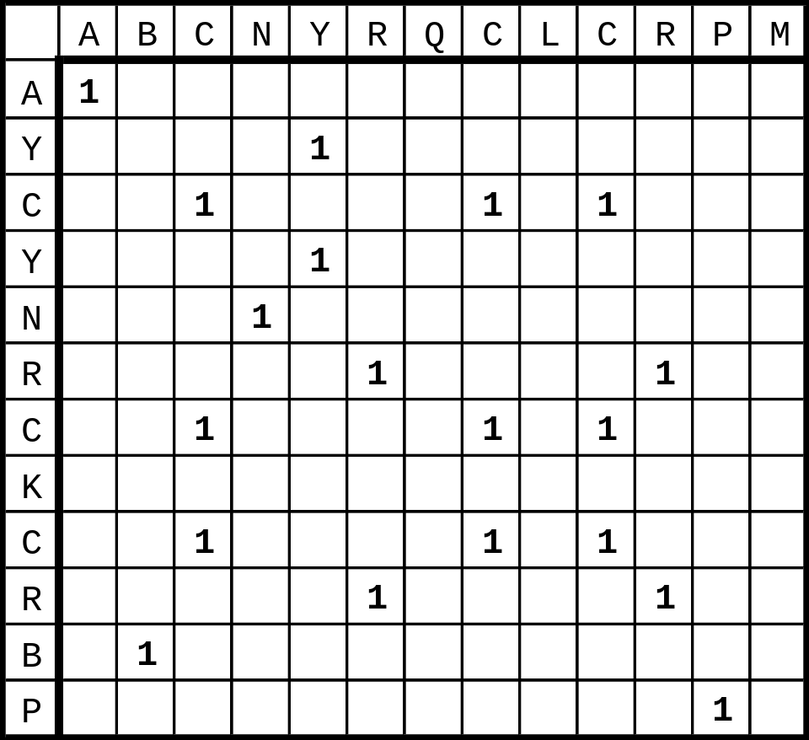
Step 1 -- Make a Dot Plot (Similarity Matrix)
Put 1's where characters are identical.

Slide 6
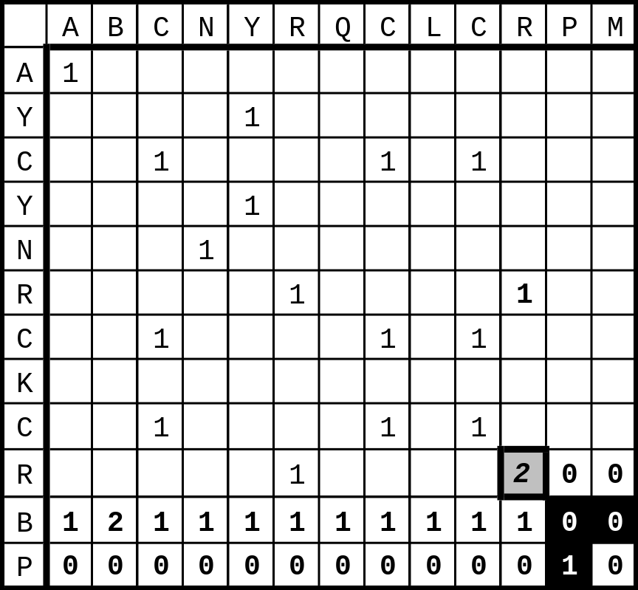
Step 2 --
Start Computing the Sum Matrix
new_value_cell(R,C) <=
cell(R,C) { Old value, either 1 or 0 }
+ Max[
cell (R+1, C+1), { Diagonally Down, no gaps }
cells(R+1, C+2 to C_max),{ Down a row, making col. gap }
cells(R+2 to R_max, C+1) { Down a col., making row gap }
]

Slide 7
Step 2 --
Start Computing the Sum Matrix
new_value_cell(R,C) <=
cell(R,C) { Old value, either 1 or 0 }
+ Max[
cell (R+1, C+1), { Diagonally Down, no gaps }
cells(R+1, C+2 to C_max),{ Down a row, making col. gap }
cells(R+2 to R_max, C+1) { Down a col., making row gap }
]

Slide 8
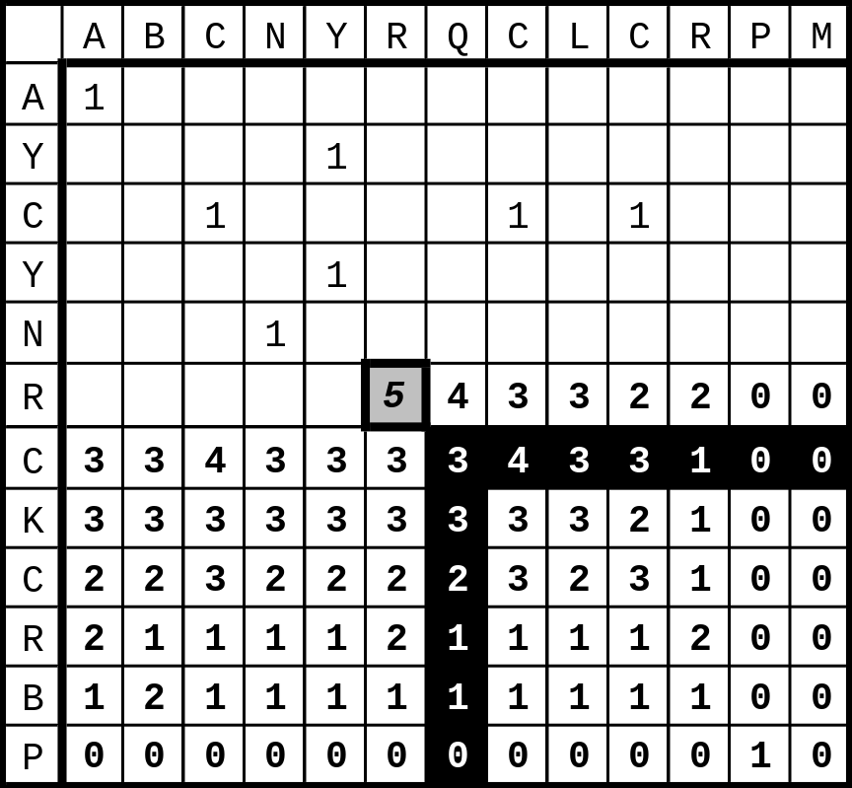
Step 3 -- Keep Going

Slide 9
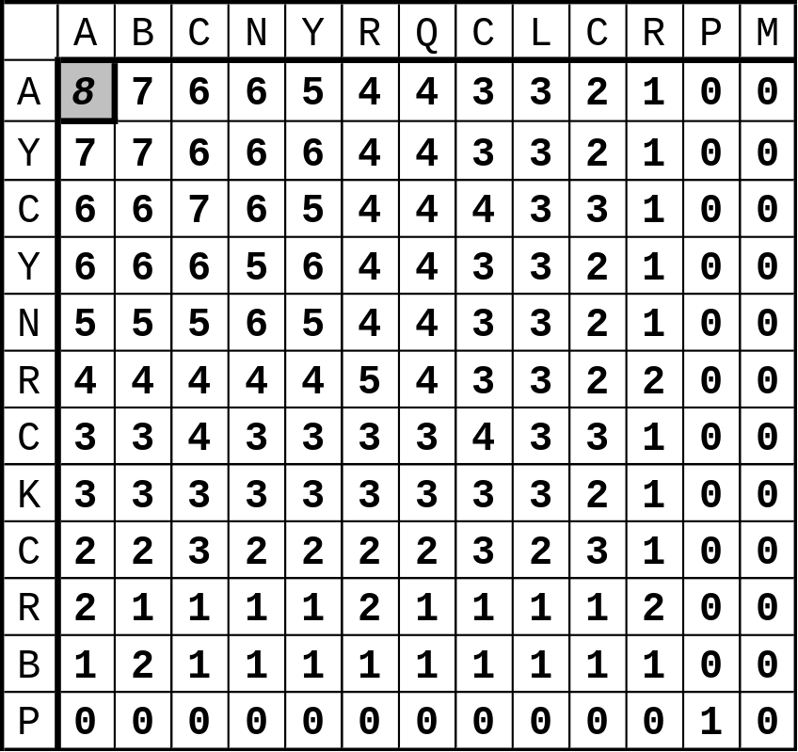
Step 4 -- Sum Matrix All Done
Alignment Score is 8 matches.

Slide 10
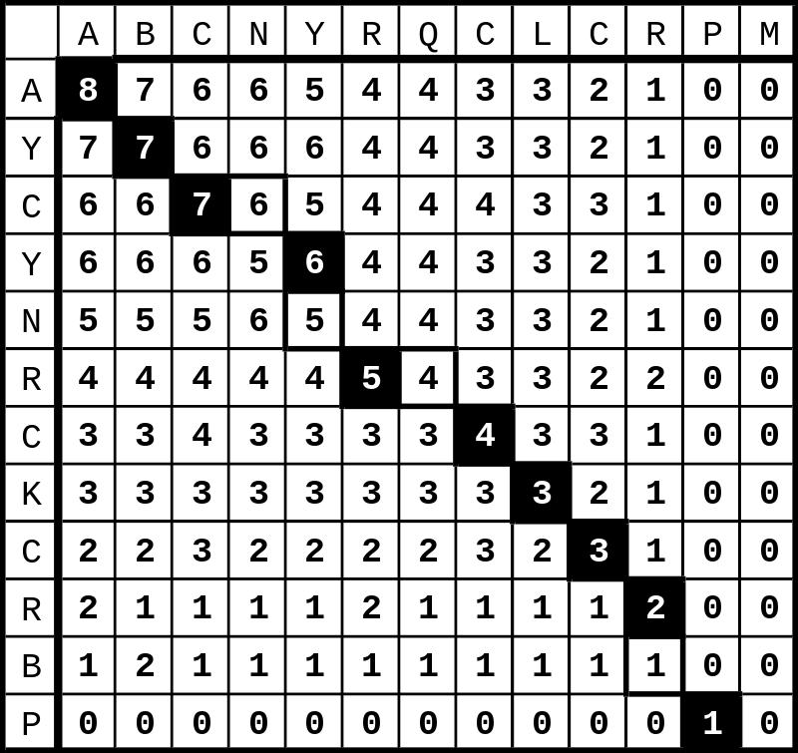
Step 5 -- Traceback
Find Best Score (8) and Trace Back
A B C N Y - R Q C L C R - P M
A Y C - Y N R - C K C R B P
Hansel & Gretel

Slide 11
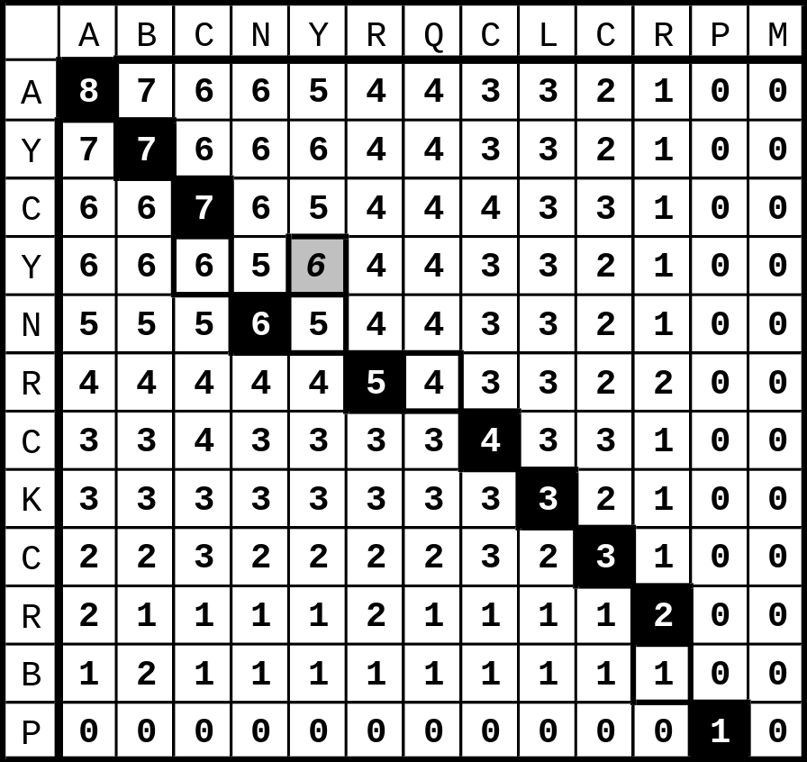
Step 6 -- Alternate Tracebacks
A B C - N Y R Q C L C R - P M
A Y C Y N - R - C K C R B P
Also,
Suboptimal
Aligments

Slide 12
Gap Penalties
The score at a position can also factor in a penalty for introducing gaps (i. e., not going from i, j to i- 1, j- 1).
Gap penalties are often of linear form:
  GAP = a + bN
  GAP is the gap penalty
  a = cost of opening a gap
  b = cost of extending the gap by one (affine)
  N = length of the gap
  (Here assume b=0, a=1/2, so GAP = 1/2 regardless of length.)
ATGCAAAAT
ATG-AAAAT .5
ATG--AAAT .5 + (1)b [b=.1]
ATG---AAT .5 + (2)(.1) =.7

Slide 13
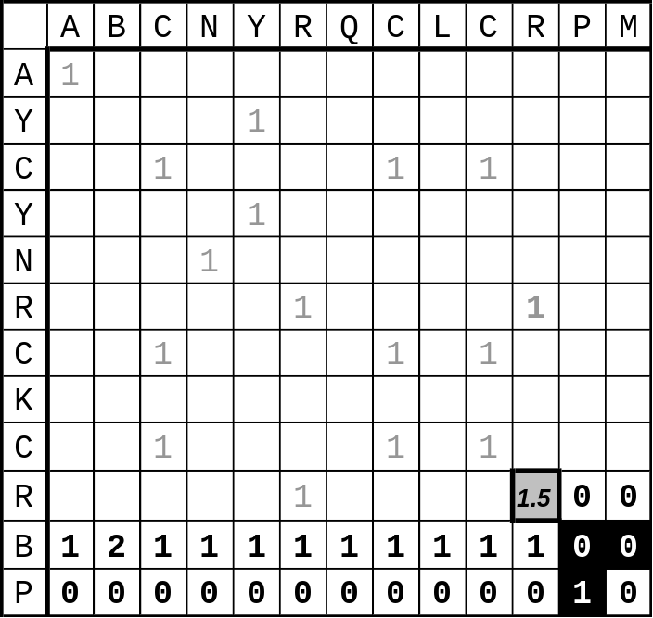
Step 2 -- Computing the Sum Matrix with Gaps
new_value_cell(R,C) <=
cell(R,C) { Old value, either 1 or 0 }
+ Max[
cell (R+1, C+1), { Diagonally Down, no gaps }
cells(R+1, C+2 to C_max) - GAP ,{ Down a row, making col. gap }
cells(R+2 to R_max, C+1) - GAP { Down a col., making row gap }
]
GAP
=1/2
1.5

Slide 14
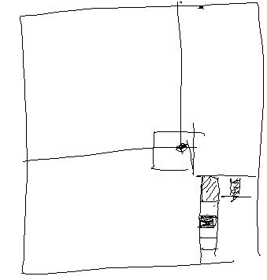
Key Idea in Dynamic Programming
  The best alignment that ends at a given pair of positions (i and j) in the 2 sequences is the score of the best alignment previous to this position PLUS the score for aligning those two positions.
  An Example Below
    Aligning R to K does not affect alignment of previous N-terminal residues. Once this is done it is fixed. Then go on to align D to E.
    How could this be violated?
    Aligning R to K changes best alignment in box.
ACSQRP--LRV-SH RSENCV
A-SNKPQLVKLMTH VKDFCV
ACSQRP--LRV-SH -R SENCV
A-SNKPQLVKLMTH VK DFCV

Slide 15
Similarity (Substitution) Matrix
A R N D C Q E G H I L K M F P S T W Y V
A 4 -1 -2 -2 0 -1 -1 0 -2 -1 -1 -1 -1 -2 -1 1 0 -3 -2 0
R -1 5 0 -2 -3 1 0 -2 0 -3 -2 2 -1 -3 -2 -1 -1 -3 -2 -3
N -2 0 6 1 -3 0 0 0 1 -3 -3 0 -2 -3 -2 1 0 -4 -2 -3
D -2 -2 1 6 -3 0 2 -1 -1 -3 -4 -1 -3 -3 -1 0 -1 -4 -3 -3
C 0 -3 -3 -3 8 -3 -4 -3 -3 -1 -1 -3 -1 -2 -3 -1 -1 -2 -2 -1
Q -1 1 0 0 -3 5 2 -2 0 -3 -2 1 0 -3 -1 0 -1 -2 -1 -2
E -1 0 0 2 -4 2 5 -2 0 -3 -3 1 -2 -3 -1 0 -1 -3 -2 -2
G 0 -2 0 -1 -3 -2 -2 6 -2 -4 -4 -2 -3 -3 -2 0 -2 -2 -3 -3
H -2 0 1 -1 -3 0 0 -2 7 -3 -3 -1 -2 -1 -2 -1 -2 -2 2 -3
I -1 -3 -3 -3 -1 -3 -3 -4 -3 4 2 -3 1 0 -3 -2 -1 -3 -1 3
L -1 -2 -3 -4 -1 -2 -3 -4 -3 2 4 -2 2 0 -3 -2 -1 -2 -1 1
K -1 2 0 -1 -3 1 1 -2 -1 -3 -2 5 -1 -3 -1 0 -1 -3 -2 -2
M -1 -1 -2 -3 -1 0 -2 -3 -2 1 2 -1 5 0 -2 -1 -1 -1 -1 1
F -2 -3 -3 -3 -2 -3 -3 -3 -1 0 0 -3 0 6 -4 -2 -2 1 3 -1
P -1 -2 -2 -1 -3 -1 -1 -2 -2 -3 -3 -1 -2 -4 6 -1 -1 -4 -3 -2
S 1 -1 1 0 -1 0 0 0 -1 -2 -2 0 -1 -2 -1 4 1 -3 -2 -2
T 0 -1 0 -1 -1 -1 -1 -2 -2 -1 -1 -1 -1 -2 -1 1 5 -2 -2 0
W -3 -3 -4 -4 -2 -2 -3 -2 -2 -3 -2 -3 -1 1 -4 -3 -2 10 2 -3
Y -2 -2 -2 -3 -2 -1 -2 -3 2 -1 -1 -2 -1 3 -3 -2 -2 2 6 -1
V 0 -3 -3 -3 -1 -2 -2 -3 -3 3 1 -2 1 -1 -2 -2 0 -3 -1 4
Identity Matrix
  Match L with L => 1
  Match L with D => 0
  Match L with V => 0??
S(aa-1,aa-2)
  Match L with L => 1
  Match L with D => 0
  Match L with V => .5
Number of Common Ones
  PAM
  Blossum
  Gonnet

Slide 16
Where do matrices come from?
+ —> More likely than random
0 —> At random base rate
- —> Less likely than random
1 Manually align protein structures
(or, more risky, sequences)
2 Look at frequency of a.a. substitutions
at structurally constant sites. -- i.e. pair i-j exchanges
3 Compute log-odds
S(aa-1,aa-2) = log₂ ( freq(O) / freq(E) )
O = observed exchanges,
E = expected exchanges
odds = freq(observed) / freq(expected)
S(i,j) = log odds
freq(expected) = f(i)*f(j)
= is the chance of getting amino acid i in a column and then having it change to j
e.g. A-R pair observed only a tenth as often as expected
90%
AAVLL…
AAVQI…
AVVQL…
ASVLL…
45%

Slide 17
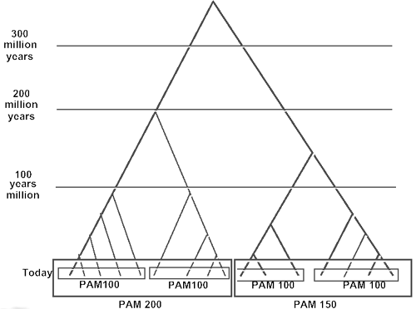
Different Matrices are Appropriate at Different Evolutionary Distances
Different gold std. sets of seq at diff ev. dist. --> matrices
Ev. Equiv. seq. (ortholog) [hb and mb]
(Adapted from D Brutlag, Stanford)

Slide 18
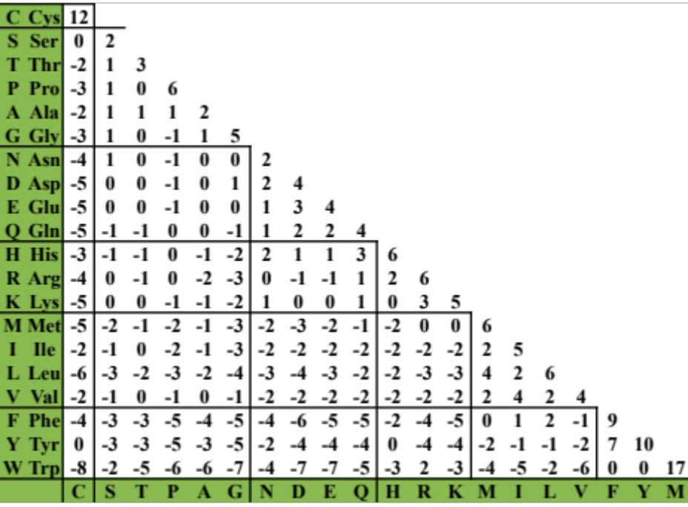
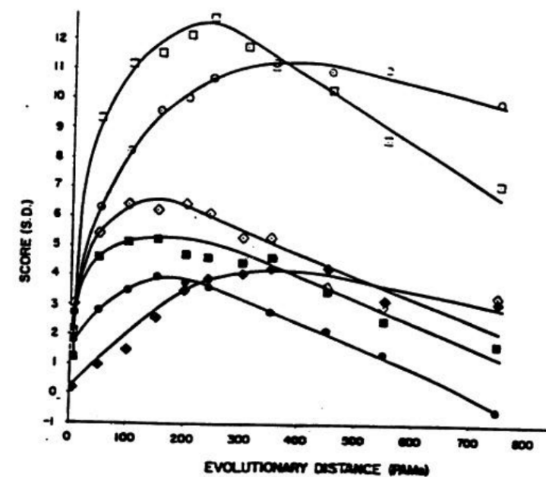
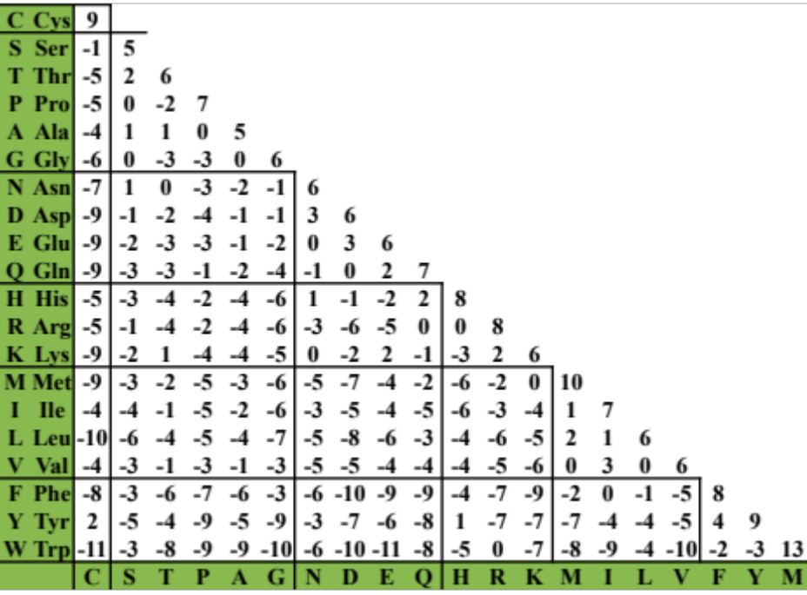
Change in Matrix with Ev. Dist.
PAM-250 (distant)
Chemistry (far) Vs. genetic code (near)
PAM-70
(Adapted from D Brutlag, Stanford)

Slide 19
Modifications for Local Alignment
1 The scoring system uses negative scores for mismatches
2 The minimum score for at a matrix element is zero
3 Find the best score anywhere in the matrix (not just last column or row)
These three changes cause the algorithm to seek high scoring subsequences, which are not penalized for their global effects (mod. 1), which don’t include areas of poor match (mod. 2), and which can occur anywhere (mod. 3)
VLALTVSTVVQM
MSTWNSTVVLMRFF
Local
Global
(Adapted from R Altman)

Slide 20
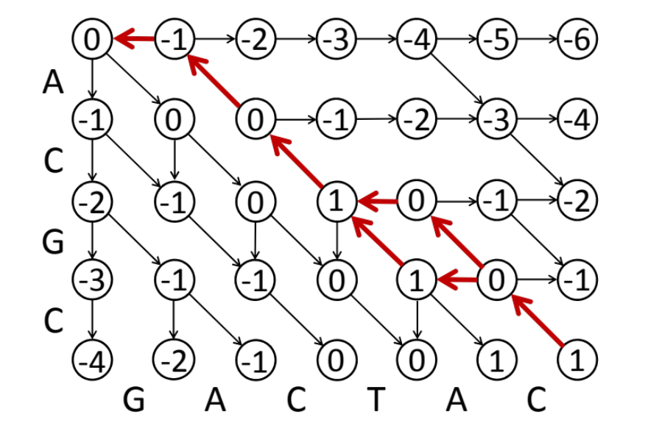
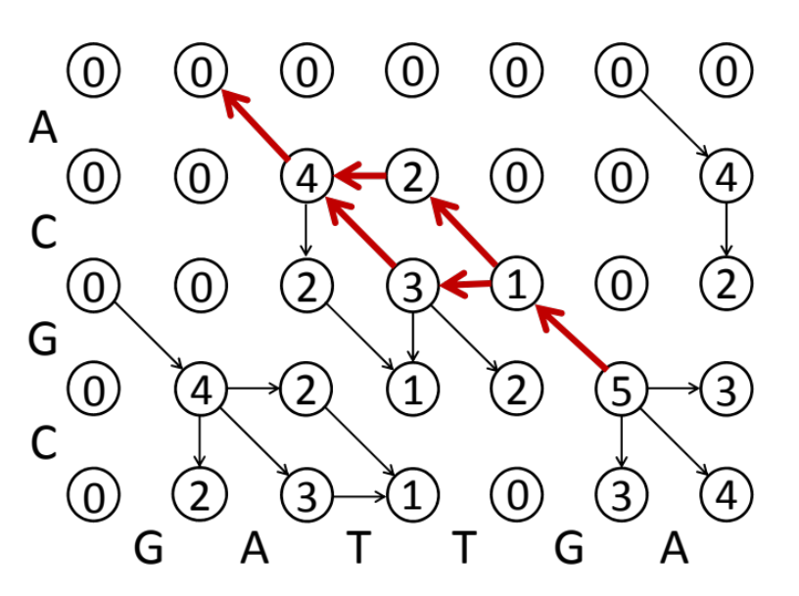
Global (NW) Vs. Local (SW) Alignments
-ACG–C
|| |
GACTAC
-AC-GC
|| |
GACTAC
AC–G
| |
GATTGA
A-CG
| |
GATTGA
or
or
Global : Match: +1 Mismatch: 0 Gap: -1
Local : Match: +4 Mismatch: -1 Gap: -2
[Slightly different sum matrix layout than in preceding slides]
(Adapted from Stephen F. Altschul)

Slide 21
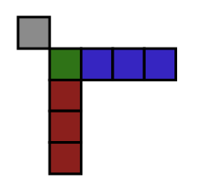
Summary of the NW’s "classic" ‘70 approach:
previous best + current entry score
Match: +2
Mismatch: 0
Gap-open: -1
Gap-extend: 0
Seq. 1
 | A | T | A | C | G | G
A | 2 | 0 | 2 | 0 | 0 | 0
A | 2 | 2 | 3 | 2 | 1 | 1
C | 0 | 2 | 2 | 5 | 2 | 2
G | 0 | 1 | 2 | 2 | 7 | 6
T | 0 | 3 | 1 | 2 | 4 | 7
G | 0 | 1 | 3 | 2 | 6 | 8
↘ Diagonally (align letters) = 4
→ Down a row.
  max{0, 3, 1, 2} → apply gap penalty -1
↓ Down a col.
  max{0, 1, 2, 7} → apply gap penalty -1
Restart: 0
Seq. 2
max{↘ diagonal, → row-scan gap, ↓ col-scan gap, 0 restart} = 6
6 + match(+2) = 8
21 - Lectures.GersteinLab.org

Slide 22
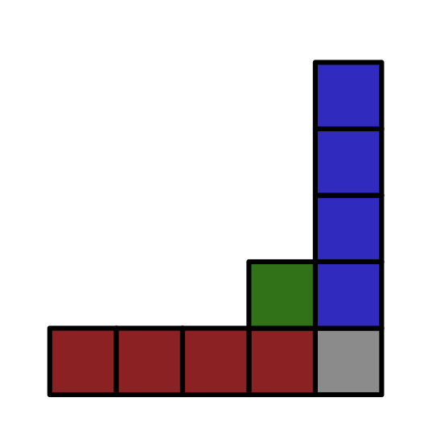
>50yrs later Wikipedia view: 3 neighbor moves + 0 restart per entry
Match: +2
Mismatch: 0
Gap-open: -1
Gap-extend: 0
Seq. 1
 | - | A | T | A | C | G | G
- | 0 | 0 | 0 | 0 | 0 | 0 | 0
A | 0 | 2 | 1 | 2 | 1 | 1 | 1
A | 0 | 2 | 2 | 3 | 2 | 2 | 2
C | 0 | 1 | 2 | 2 | 5 | 4 | 4
G | 0 | 1 | 1 | 2 | 4 | 7 | 6
T | 0 | 1 | 3 | 2 | 4 | 6 | 7
G | 0 | 1 | 2 | 3 | 4 | 6 | 8
At each cell, we choose the best local-alignment score by taking the max of 4 options:
↘ Align letters (match/mismatch): 6 +2 = 8
↓ From top (gap in seq1): 7 -1 = 6
→ From left (gap in seq2): 6 -1 = 5
Restart: 0
Seq. 2
max of {↘ Align, ↓ top-gap, → left-gap, 0 restart} = 8
[ https://en.wikipedia.org/wiki/Smith%E2%80%93Waterman_algorithm ]
22 - Lectures.GersteinLab.org
Notes:
https://en.wikipedia.org/wiki/Smith%E2%80%93Waterman_algorithm
Confusing - full smith-waterman solution: (wiki considering adding this way - show this the wiki way)
Only the “open gap” penalty - no gap length penalty.

Slide 23
References
Needleman, S. B., & Wunsch, C. D. (1970).
Journal of Molecular Biology, 48(3), 443–453.
A general method applicable to the search for similarities in the amino acid sequence of two proteins.
https://doi.org/10.1016/0022-2836(70)90057-4
(Just Algorithm Section; Note differences vs modern presentation.)
Smith, T., & Waterman. (1981).
Journal of Molecular Biology, 147(1), 195–197.
Identification of common molecular subsequences.
https://doi.org/10.1016/0022-2836(81)90087-5
(Just Algorithm Section)

