Slide 1
Biological Data Ownership
Dov Greenbaum

Slide 2


Slide 3


Slide 4

Notes:
Lawsuits

Slide 5
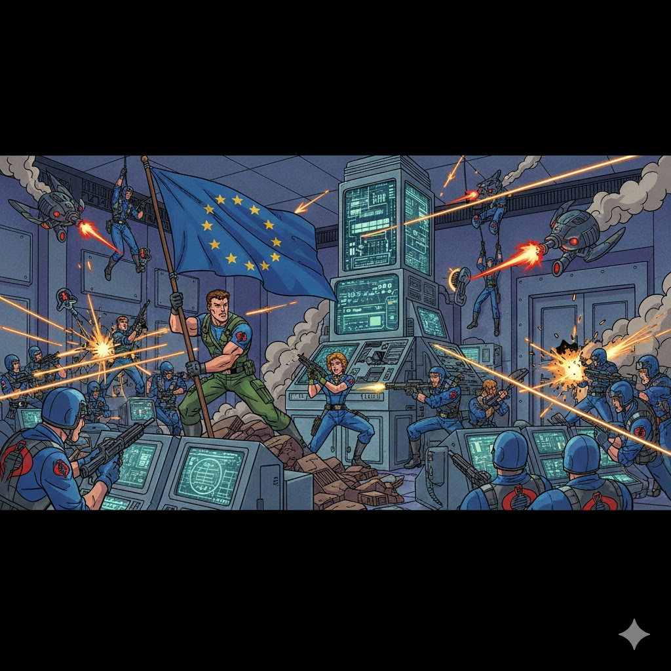
Notes:
EU was actually trying to protect Data and its databases, using The EU database directive – which effectively gave some form of ownership of data, reagardless of the type, to the collector

Slide 6

Notes:
That all changed with GDPR> What is GDRP - it’s a wrapper created by the EU to protect data it could not grant ownership too, including biological material- They had given up

Slide 7

Notes:
More recently thoug,, the EU data act represents a new effort by the EU to acknowlesge that their system wasn’t woring, and they are in the midst of tryin to re-protect this data

Slide 8
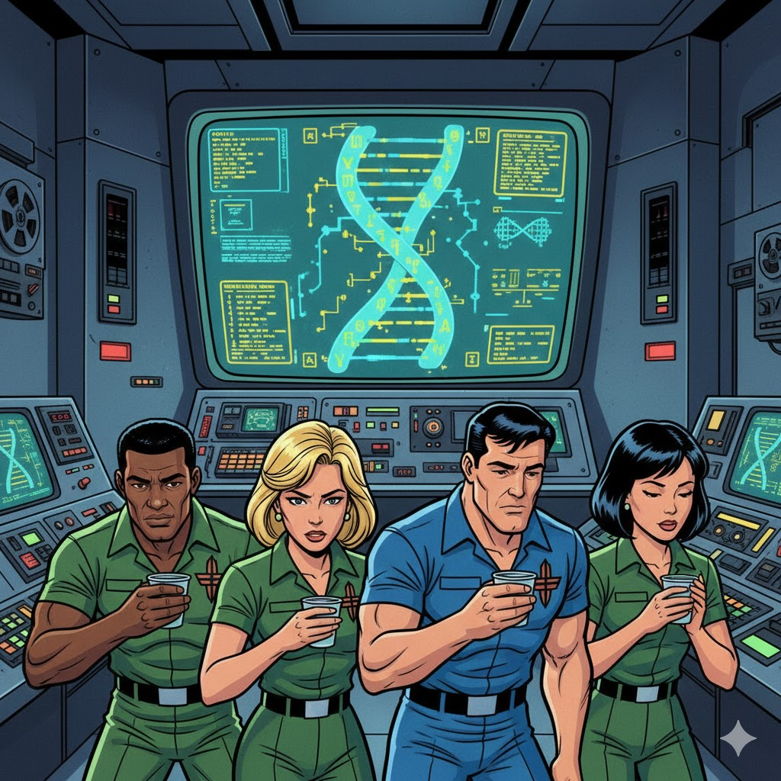
Notes:
Meanwhile, stateside, we have a new proble, 23andme was collecting DNA infomratiuon from millions of people, even selling that data, without giving the data asources any cut of the pie

Slide 9
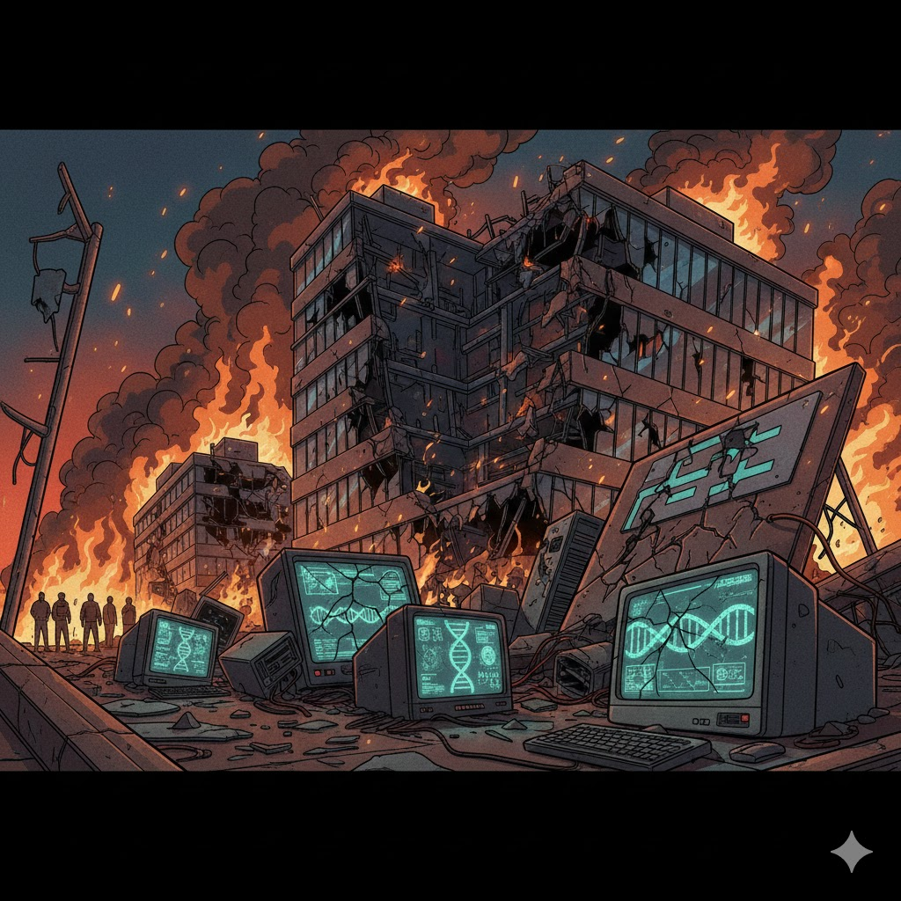
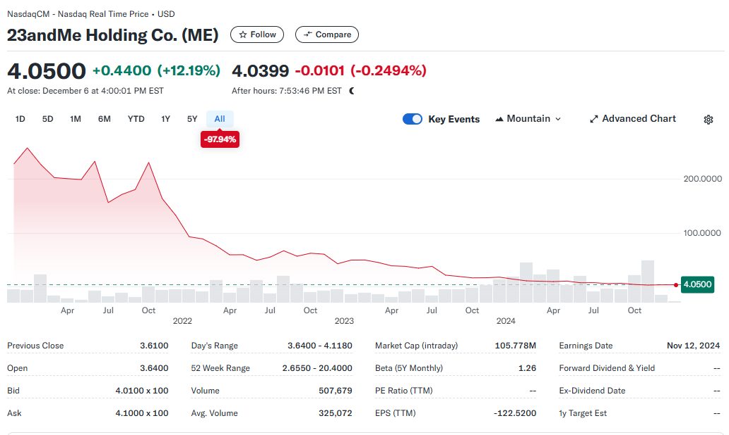
Notes:
That didn’t last long, and 23andme and many like it have failed – their data, potentially up for sale to the highest bider

Slide 10
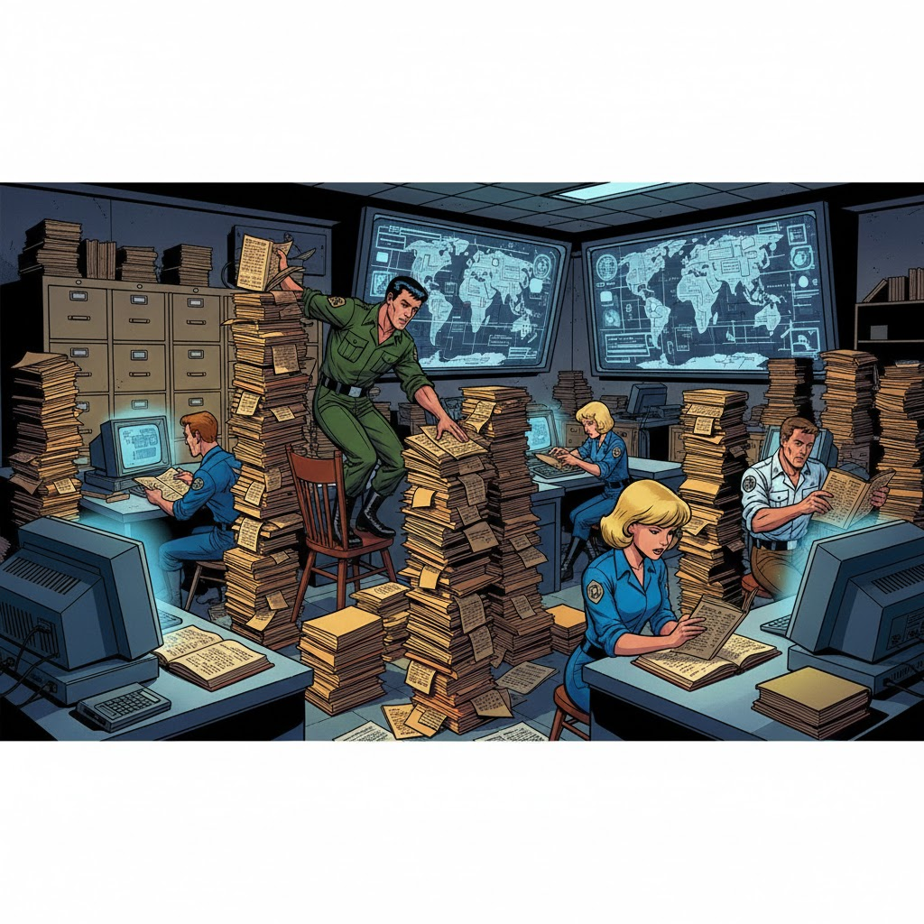
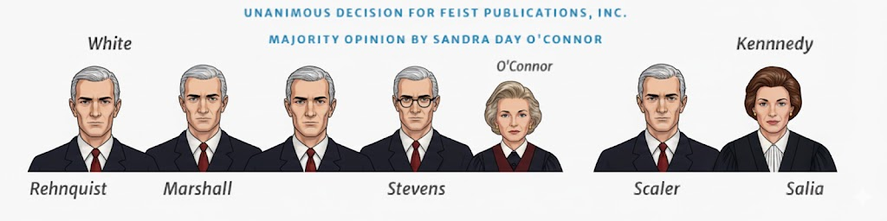
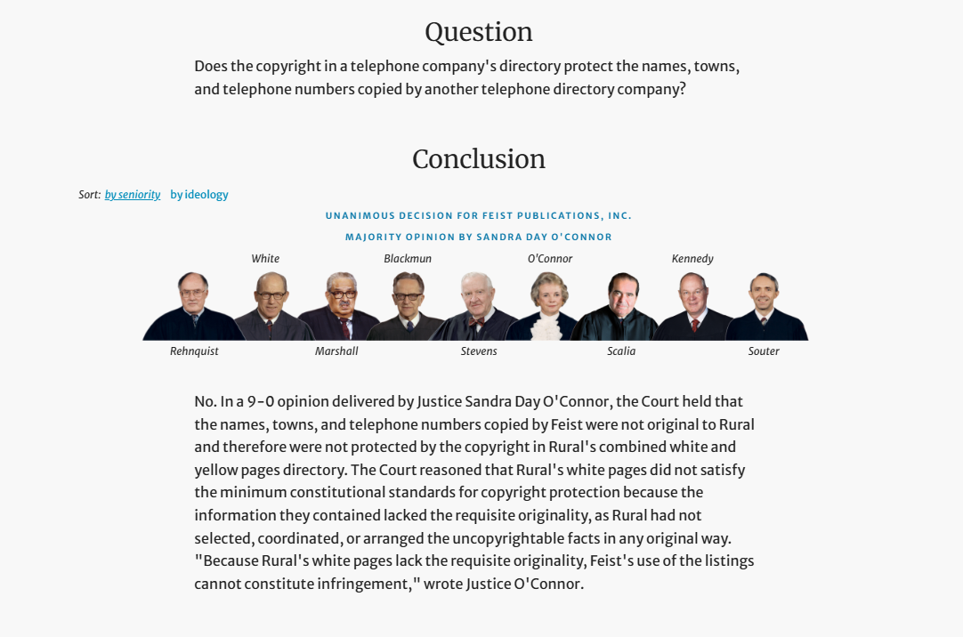
Notes:
Data ownership on the US in general has taken a different path, at the same time that the EU was providing more ownership, the US was cutting back the Feist supreme court case, a copyright case about phonebooks effectively said that there could be no clear ownership in data

Slide 11

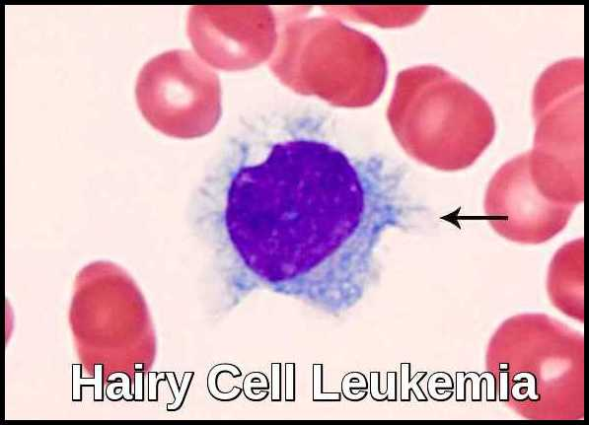
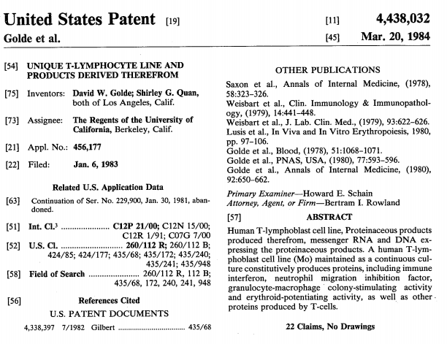
Moore v. Regents of University of California, 793 P. 2d 479 - Cal: Supreme Court 1990
Notes:
In other areas, it became a bit more confusing. In Moore, the courts said that once biological materal was taken form a donor, tjhey could not claim ownership in int – but its not clear if the Universities and companies could

Slide 12
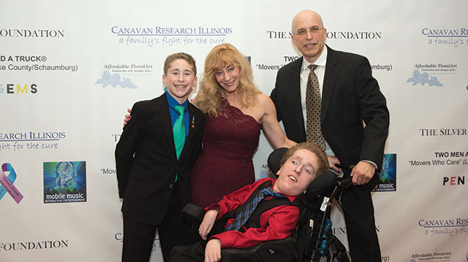

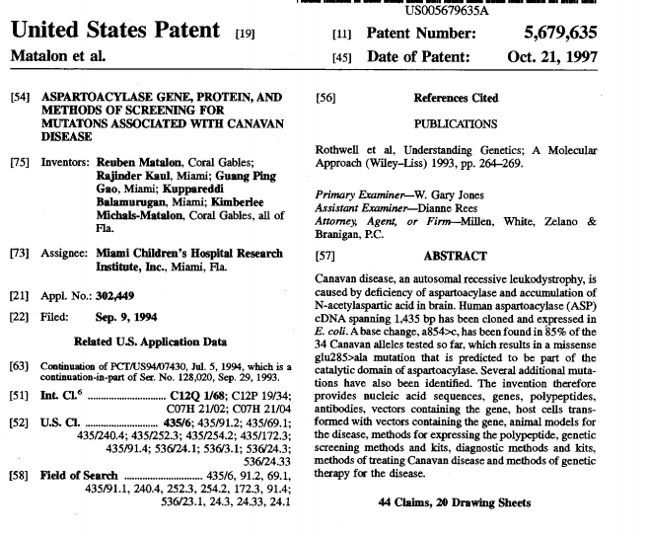
Greenberg v. Miami Children’s Hosp.
264 F. Supp. 2d 1064, (S.D. Fla. 2003)
Notes:
Most egresiouslyu, the court in Greenberg v miami, a gropup of families with children suffering from canavans disease were told that they they had no ownership rights in the material and speciifally DNA data that hey had donoated to the hospital, even though the hospital tried to make money on it, with no recompense to the familes

Slide 13
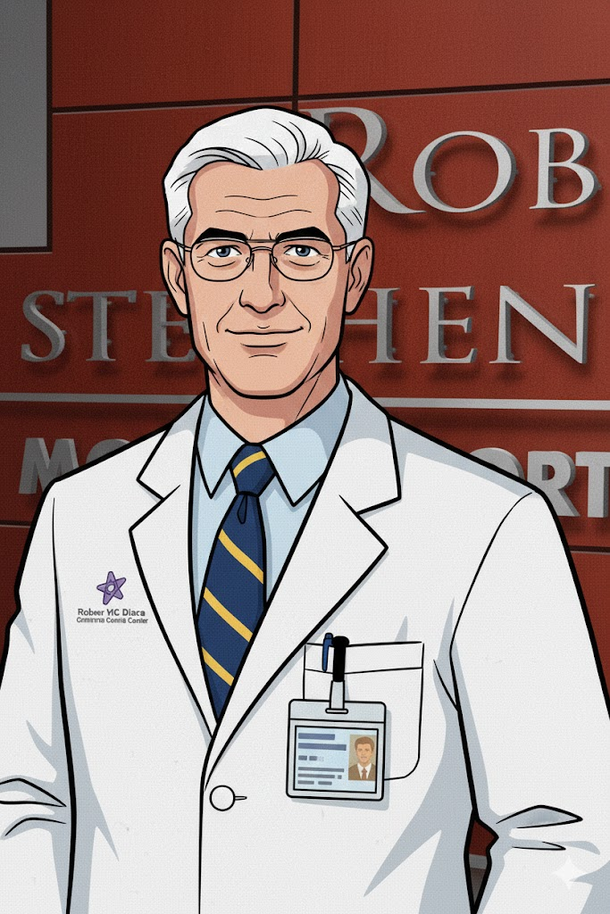
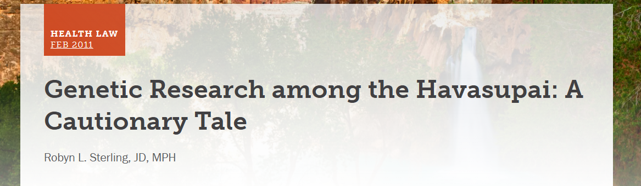
Washington University v. Catalona (490 F. 3d 667 - Court of Appeals, 8th Circuit 2007)
Notes:
Similalry in other cases, ine in washu the other with ASU, dna information was decided not the donors, but it might tbe the company’s

Slide 14
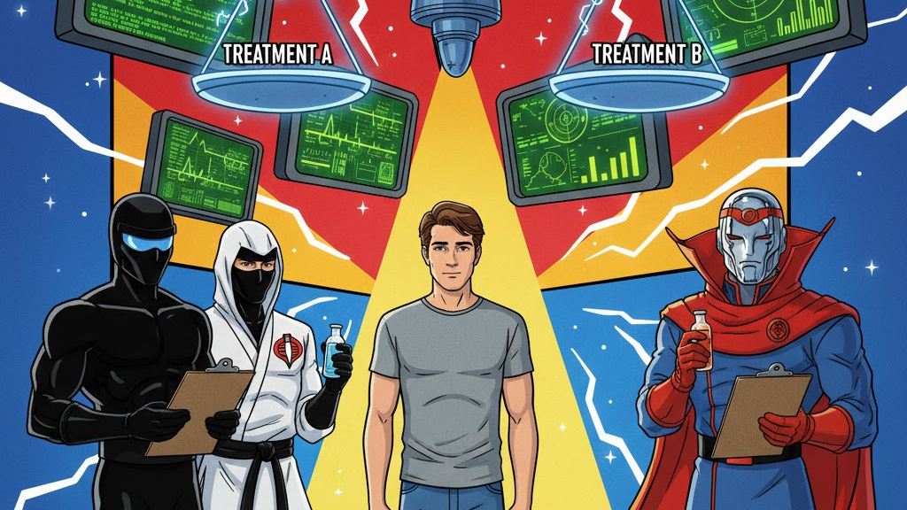
Notes:
Clinical Equipoise

Slide 15
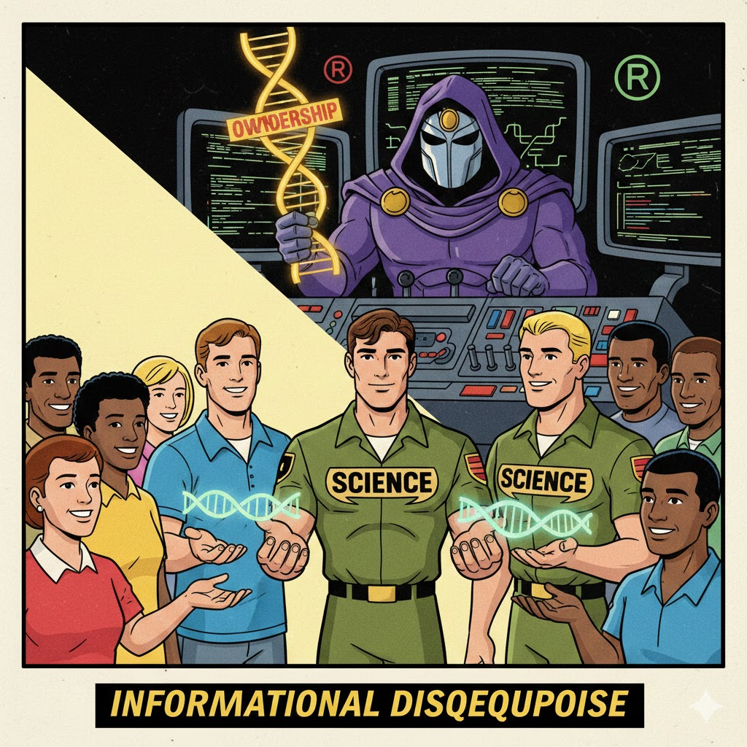
Ethical Directionality
When clinical equipoise dissolves, ethics shift toward the subject (stop the trial, offer the better treatment); when informational disequipoise dissolves, law and practice shift away from the subject, entrenching institutional control.
Moment of Resolution
In clinical trials, resolving uncertainty triggers ethical obligations; in genomic data regimes, resolving uncertainty extinguishes ethical leverage, converting contribution into uncompensated informational capital.
Notes:
Informational Disequipoise is the ethical condition in which uncertainty about the future uses, value, or implications of biological or personal data is invoked to justify initial collection, but predictably resolves in favor of researchers or institutions once informational or commercial value emerges—leaving data subjects without corresponding rights to consent, control, or benefit from downstream uses.

Slide 16
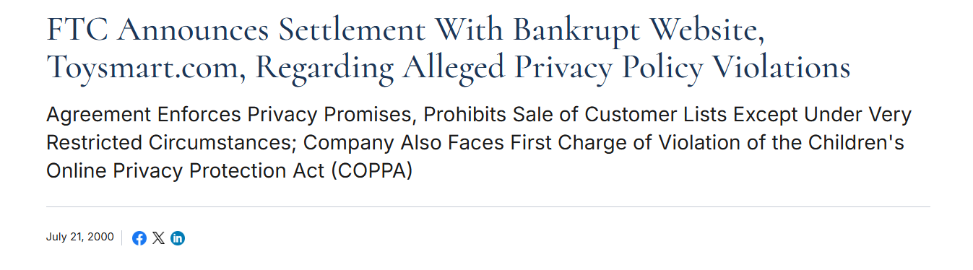
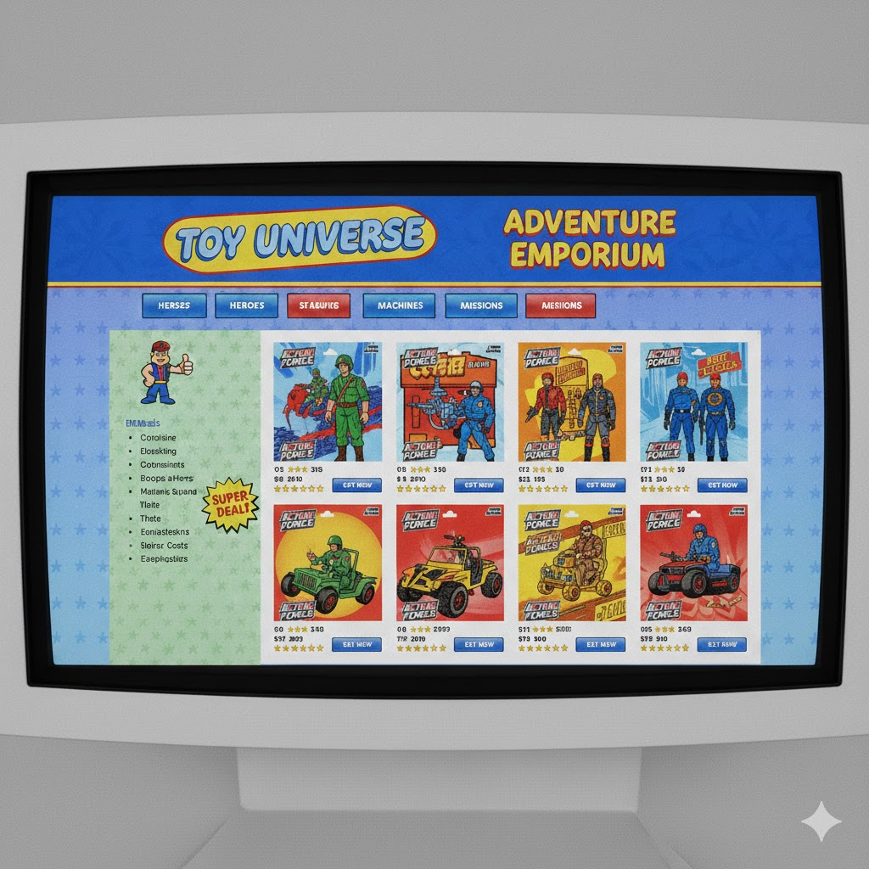
Notes:
The bankruptcy courts also got in o the action and a toy site, was allowed to effectvly sell their data as part of the ir bancruptcyu

Slide 17

Notes:
SO who cares? Here is a doctored image – could this data be used to hurt you, to track you, to make it harder to get insurance?

Slide 18
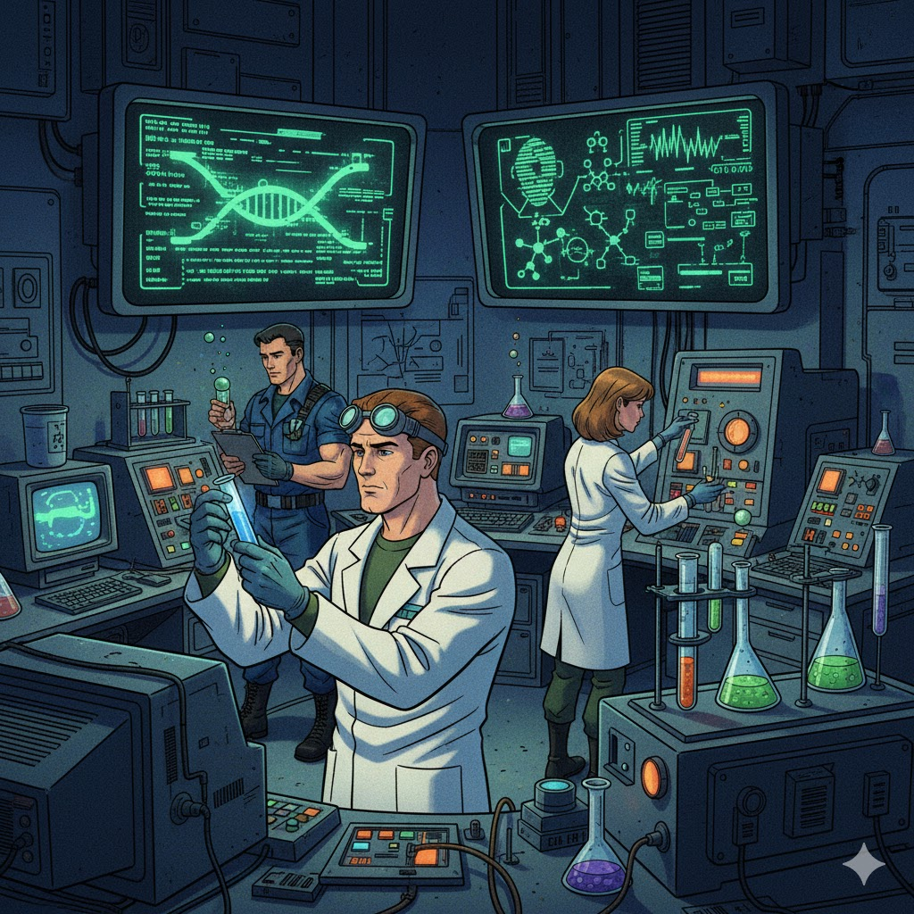
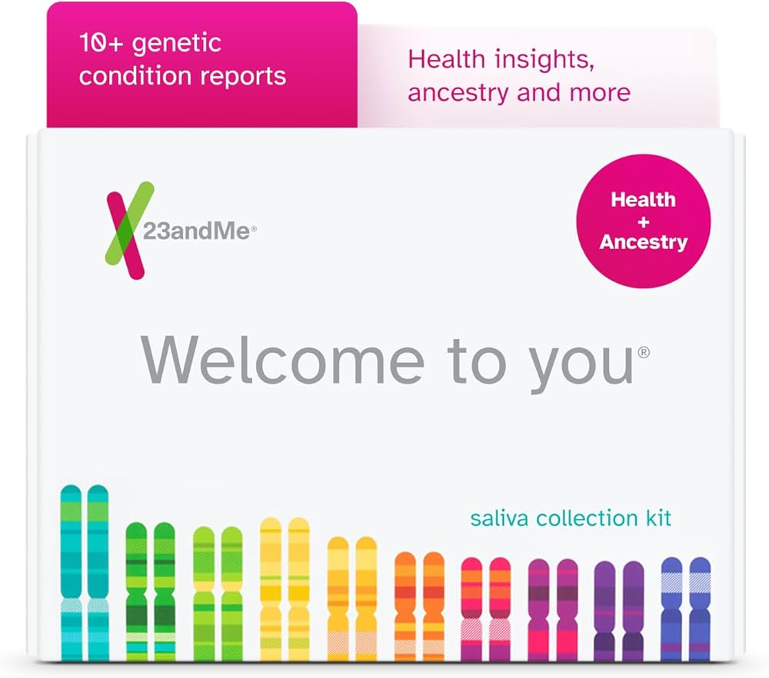
Notes:
Custody v ownership? – Maybe a new world is brewing where we can find ways to grant ownership of this data to Yen wherein companies like 23andme can buy and sell this data, that you retain owernsup over, but as custodians of the data they also have rigts

Slide 19

Notes:
SO what can you di in the meantime,? Contracts and consent – whter you areon the giving or taking side – these are your best freinds

Slide 20
