Slide 1
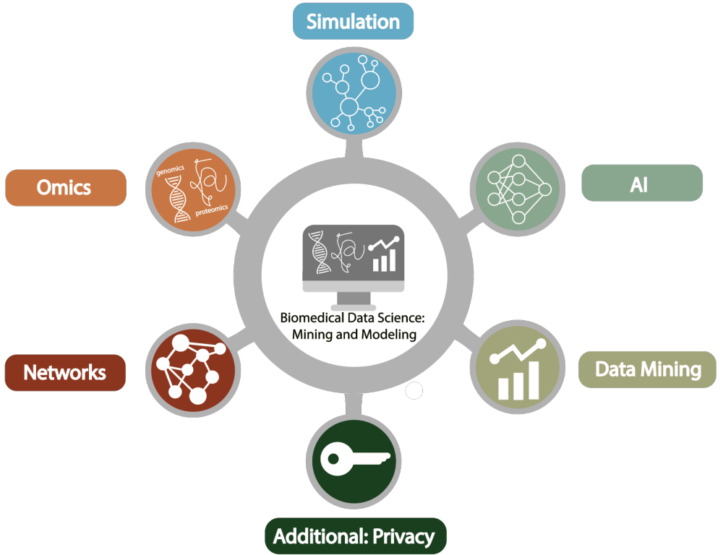
Biomedical Data Science (GersteinLab.org/courses/452)
Genome Annotation (AS, eQTL, GWAS) (25m7-part2)
Last edit in spring ’25. Just second half related to AS, eQTL & GWAS. Added in many GWAS slides relative to 2023. Now loosely related to
2nd half of 2021’s M7
[which has a video].
Mark Gerstein
Yale U.

Slide 2
Outline
Part 1 : Generic Annotation
(not related to an individual's variants)
  RNA-seq, Chip-seq
  Integration
  , Hi-C
Part 2 : Annotation related to an individual's variants
  ASE/ASB
  GWAS & eQTL
Allele-specific Events

Slide 3



Inferring Allele Specific Binding/Expression using Sequence Reads
RNA/ChIP-Seq Reads
ACTTTGATAGCGTCAATG
CTTTGATAGCGTCAATGC
CTTTGATAGCGTCAACGC
TTGACAGCGTCAATGCAC
TGATAGCGTCAATGCACG
ATAGCGTCAATGCACGTC
TAGCGTCAATGCACGTCG
CGTCAACGCACGTCGGGA
GTCAATGCACGTCGAGAG
CAATGCACGTCGGGAGTT
AATGCACGTCGGGAGTTG
TGCACGTTGGGAGTTGGC
10 x T
2 x C
…AACGC…
TF
…AATGC…
Haplotypes with a
Heterozygous Polymorphism
3 - Lectures.gersteinlab.org
Interplay of the annotation and individual sequence variants

Slide 4
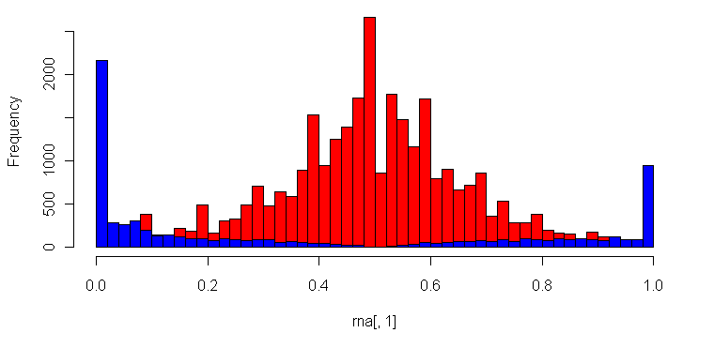
Calling AS Events
ASE/ASB Example:
…GTCAATGCAC
…GTCAATGCACG
…GTCAATGCACGTC
…GTCAATGCACGTCG
…GTCAACGCACGTCGGGA
GTCAATGCACGTCGAGAG
CAATGCACGTCGGGAGTT
AATGCACGTCGGGAGTTG
Null Example:
ACTTTGATAGCGTCAATG
CTTTGATAGCGTCAACGC
TTGACAGCGTCAATGCAC
ATAGCGTCAATGCACGT…
TAGCGTCAACGCACGT…
CGTCAACGCACGT…
CAATGCACGT…
AATGCACGT…
Allele-Specific SNPs
Binomial Null Distribution
(no allele-specific behavior)
Reference Allele
Alternate Allele
Fraction of Reads Mapping to Alternative Allele
[Rozowsky et al., MSB (‘11)]
Notes:
Alternative allele/Reference allele

Slide 5


Many Technical Issues in Determining ASE/ASB:
Reference Bias
(naïve alignment against reference v using a personal genome)
Map to reference genome
C
Reference
Genome
C
G
A
Map to diploid genome
ChIP-seq reads
C
AT
T
Personal
Genome
C
T
A
5
5

Slide 6
Outline
Part 1 : Generic Annotation
(not related to an individual's variants)
  RNA-seq, Chip-seq
  Integration
  , Hi-C
Part 2 : Annotation related to an individual's variants
  ASE/ASB
  GWAS & eQTL
GWAS (Basic Workflow)

Slide 7
Relating to Variants on a Population Level in a Cohort
Variants
Genes
Traits
[Slides by J Gao, lectures.gersteinlab.org]

Slide 8
Relating to Variants on a Population Level in a Cohort
GWAS
eQTL
Variants
Genes
Traits
Mendelian Randomization
[Slides by J Gao, lectures.gersteinlab.org]

Slide 9
  Genome-Wide Association Studies (GWAS)
The basic idea behind a GWAS is to find significant associations between genetic markers and phenotypes (disease / traits) → exploratory “genome-wide” research, non-hypothesis based
Manhattan plot
2. Testing each SNP for significant association with the trait
1. Scanning SNPs across the genome
9 - Lectures.gersteinlab.org
Slides from B Borsari & S Liu
Notes:
https://www.youtube.com/watch?v=Veq-resQOHg 32:51

Slide 10
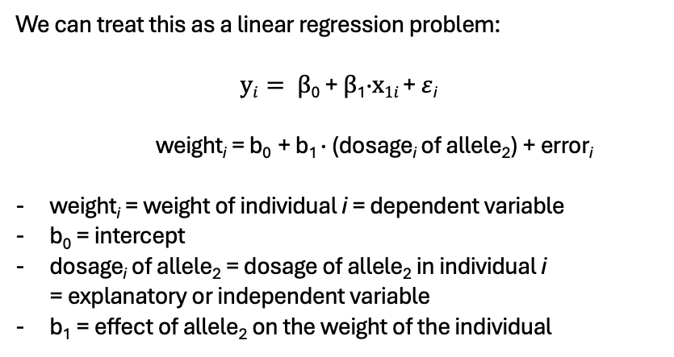
  GWAS: a (multiple) linear regression problem
Consider a quantitative trait (eg: weight)
Consider a SNP S with allele₁ = A, allele₂ = G
Define three groups of individuals with genotype AA, AG, GG
The question we try to answer when conducting a GWAS: do we see a significant difference in the weight between these three groups of individuals that correlates with the dosage of allele₂?
We can treat this as a linear regression problem:
$yi= β$₀ + $β$₁·$x1i$ + $ε$_{i}
weight_{i} = b₀ + b₁ · (dosage_{i} of allele₂) + error_{i}
weight_{i} = weight of individual i = dependent variable
b₀ = intercept
dosage_{i} of allele₂ = dosage of allele₂ in individual i
= explanatory or independent variable
b₁ = effect of allele₂ on the weight of the individual
10 - Lectures.gersteinlab.org
Slides from B Borsari & S Liu
Notes:
https://www.youtube.com/watch?v=Veq-resQOHg 32:51

Slide 11
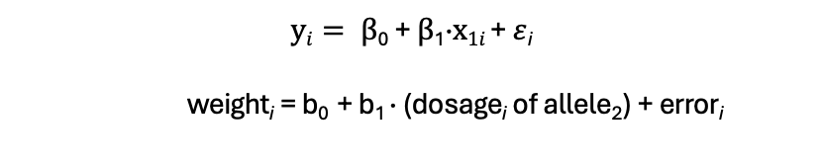
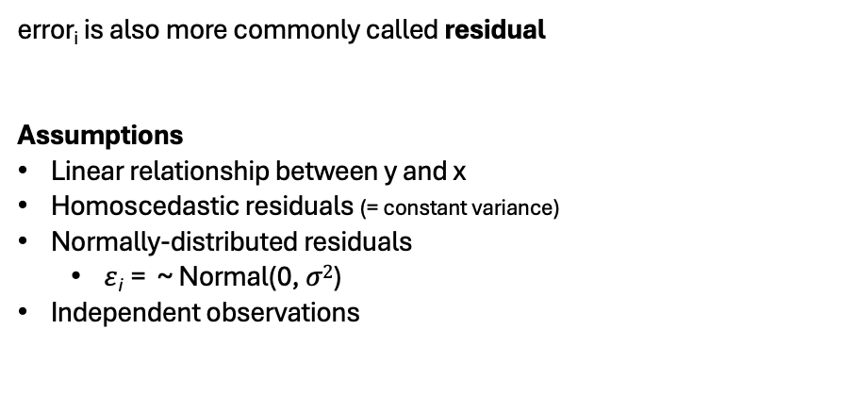
(More Later)
  Theoretical model: assumptions
$yi= β$₀ + $β$₁·$x1i$ + $ε$_{i}
weight_{i} = b₀ + b₁ · (dosage_{i} of allele₂) + error_{i}
error_{i} is also more commonly called residual
Assumptions
Linear relationship between y and x
Homoscedastic residuals (= constant variance)
Normally-distributed residuals
  $ε$_{i} = ~ Normal(0, $σ2$)
Independent observations
more stringent
less stringent
11 - Lectures.gersteinlab.org
Slides from B Borsari & S Liu
Notes:
We need to find the rotation of the line that minimizes the sum of square residuals

Slide 12
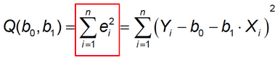
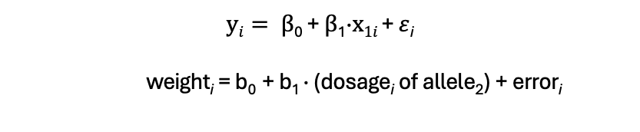
  Estimation by Least Squares
$yi= β$₀ + $β$₁·$x1i$ + $ε$_{i}
weight_{i} = b₀ + b₁ · (dosage_{i} of allele₂) + error_{i}
To solve this equation, we apply the Ordinary Least Squares criterion:
b₀ = z; b₁ = 0
b₀ < z; b₁ > 0
b₀ << z; b₁ >> 0
In other words, we need to find the combination of b₀ and b₁ that minimizes the sum of squared residuals across all individuals
z
12 - Lectures.gersteinlab.org
Slides from B Borsari & S Liu

Slide 13
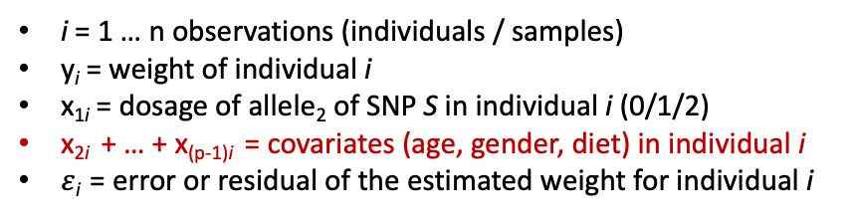

  GWAS: a (multiple) linear regression problem
A multiple regression problem:
$yi= β$₀ + $β$₁·$x1i$ + $β$₂·$x2i$ + … + $β$_{(p-1)}·$x$_{(p-1)i} + $ε$_{i}
i = 1 … n observations (individuals / samples)
y_{i} = weight of individual i
x_{1i} = dosage of allele₂ of SNP S in individual i (0/1/2)
x_{2i} + … + x_{(p-1)i} = covariates (age, gender, diet) in individual i
$ε$_{i} = error or residual of the estimated weight for individual i
weight
covariate
dosage
Caveat: a phenotype is given by the contribution of both genetic and non-genetic effects
it might be that, by coincidence, there are more males than females in the GG group, thus we can’t know a priori if the difference in weight is purely given by the effect of the SNP
it might be that, by coincidence, the diet fatty-acid content varies between the three groups
Goals when performing multiple linear regression:
Obtain the equation that models the relationship between y and the predictors x
Test if a specific explanatory variable x has a significant effect in predicting y
  We are interested in evaluating the effect of SNP S on weight
13 - Lectures.gersteinlab.org
Slides from B Borsari & S Liu

Slide 14
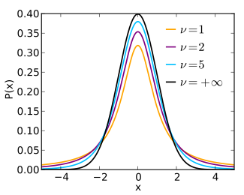




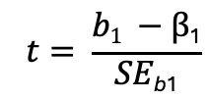
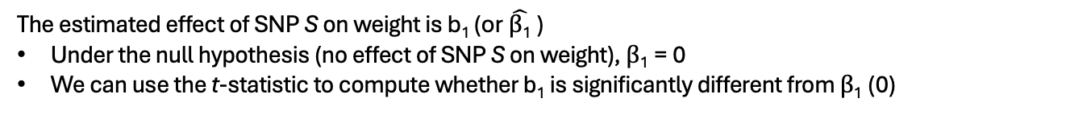
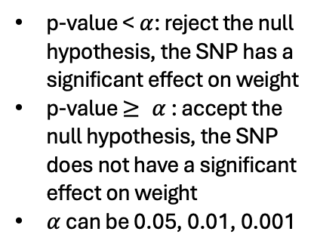
  Determining the effect of a SNP on the trait
Question: Does the genotype of SNP S (x₁) have a significant effect on the weight of an individual?
$yi= β$₀ + $β$₁·$x1i$ + $β$₂·$x2i$ + … + $β$_{(p-1)}·$x$_{(p-1)i} + $ε$_{i}
The estimated effect of SNP S on weight is b₁ (or $\hat{β\text{1}}$ )
Under the null hypothesis (no effect of SNP S on weight), $β$₁ = 0
We can use the t-statistic to compute whether b₁ is significantly different from $β$₁ (0)
p-value < $α$: reject the null hypothesis, the SNP has a significant effect on weight
p-value $≥ α$ : accept the null hypothesis, the SNP does not have a significant effect on weight
$α$ can be 0.05, 0.01, 0.001
$$t= \frac{b1 −β\text{1}}{SE\text{b}\text{1}}$$
t $\sim tSTUDENT$
$$υ=n−2$$
$$n=n of indivs.$$
14 - Lectures.gersteinlab.org
Slides from B Borsari & S Liu
Notes:
This is really the important point.
When you perform linear regression you can have two goals:
To find the equation
To study the effect of the explanatory variables on the predicted variable

Slide 15
Outline
Part 1 : Generic Annotation
(not related to an individual's variants)
  RNA-seq, Chip-seq
  Integration
  , Hi-C
Part 2 : Annotation related to an individual's variants
  ASE/ASB
  GWAS & eQTL
GWAS (Additional Considerations)

Slide 16
  GWAS workflow
Study design
Power calculations
GWAS
Downstream analysis
Replication studies
Type of study
Quantitative trait
Case-Control study (example: disease vs. healthy)
16 - Lectures.gersteinlab.org
Balding, Nat Rev Genet, 2006
Slides from B Borsari & S Liu
Notes:
https://www.youtube.com/watch?v=Veq-resQOHg
+ imputation based on LD

Slide 17
  GWAS workflow
Study design
Power calculations
GWAS
Downstream analysis
Replication studies
Type of study
Quantitative trait
Case-Control study (example: disease vs. healthy)
Population stratification
Some SNPs might have different allele frequencies in different subpopulations
EX: In comparing Asian vs. European, what if one did GWAS for “uses chopstick” without correction
Allele₁
Allele₂
allele₂ is enriched in cases
BUT cases are enriched in population 1, where allele₂ is more frequent
17 - Lectures.gersteinlab.org
Balding, Nat Rev Genet, 2006
Uffelmann et al. (2021). Nature Reviews Methods Primers
Slides from B Borsari & S Liu
Notes:
https://www.youtube.com/watch?v=Veq-resQOHg
+ imputation based on LD

Slide 18
  GWAS workflow
Study design
Power calculations
GWAS
Downstream analysis
Replication studies
Type of study
Population stratification
Some SNPs might have different allele frequencies in different subpopulations (eg. Asian vs. European)
Choice of relevant covariates
Purpose: control for indirect effects unrelated to the phenotype of interest and eliminate the influence of confounders
e.g., age, sex, genotyping batch
First 5 or 6 Principal Components based on ancestry are usually included as model covariates in order to control for ancestry-related genetic variation that could confound
results
18 - Lectures.gersteinlab.org
https://privefl.github.io/bigsnpr/articles/how-to-PCA.html
Slides from B Borsari & S Liu
Notes:
https://www.youtube.com/watch?v=Veq-resQOHg
+ imputation based on LD

Slide 19
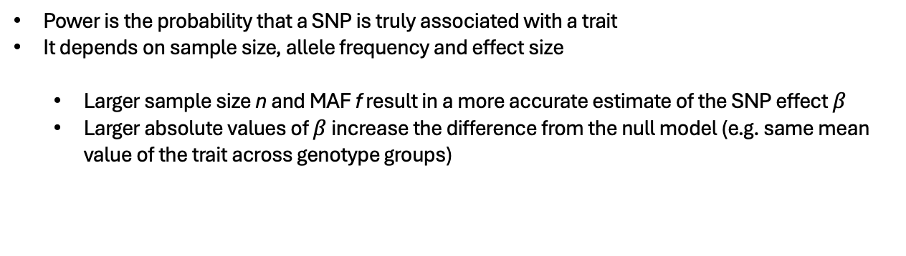
  GWAS workflow
Study design
Power calculations
GWAS
Downstream analysis
Replication studies
Power is the probability that a SNP is truly associated with a trait
It depends on sample size, allele frequency and effect size
  Larger sample size n and MAF f result in a more accurate estimate of the SNP effect $β$
  Larger absolute values of $β$ increase the difference from the null model (e.g. same mean value of the trait across genotype groups)
19 - Lectures.gersteinlab.org
Slides from B Borsari & S Liu
Notes:
https://www.mv.helsinki.fi/home/mjxpirin/GWAS_course/material/GWAS3.html

Slide 20
  GWAS workflow
Study design
Power calculations
GWAS
Downstream analysis
Replication studies
Type of study
Quantitative trait
Case-Control study
Statistical model
Linear regression (beta values)
Logistic regression (OR)
20 - Lectures.gersteinlab.org
Slides from B Borsari & S Liu
Notes:
https://www.youtube.com/watch?v=Veq-resQOHg
+ imputation based on LD

Slide 21
  GWAS workflow
Study design
Power calculations
GWAS
Downstream analysis
Replication studies
Because of LD, many significant SNPs are indeed the result of indirect associations
21 - Lectures.gersteinlab.org
Slides from B Borsari & S Liu
Notes:
https://www.youtube.com/watch?v=Veq-resQOHg
+ imputation based on LD

Slide 22
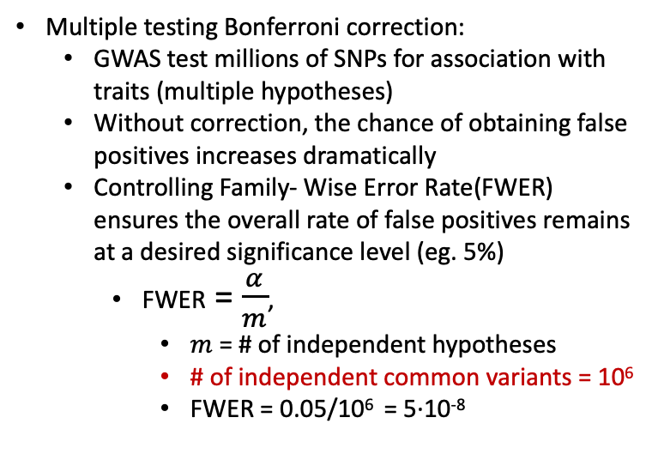
  GWAS workflow
Study design
Power calculations
GWAS
Downstream analysis
Replication studies
Multiple testing Bonferroni correction:
  GWAS test millions of SNPs for association with traits (multiple hypotheses)
  Without correction, the chance of obtaining false positives increases dramatically
  Controlling Family- Wise Error Rate(FWER) ensures the overall rate of false positives remains at a desired significance level (eg. 5%)
    FWER = $\frac{α}{m}$,
      $m$= # of independent hypotheses
      # of independent common variants = 10⁶
      FWER = 0.05/10⁶ = 5·10⁻⁸
22 - Lectures.gersteinlab.org
Slides from B Borsari & S Liu
Notes:
https://www.youtube.com/watch?v=Veq-resQOHg
+ imputation based on LD

Slide 23
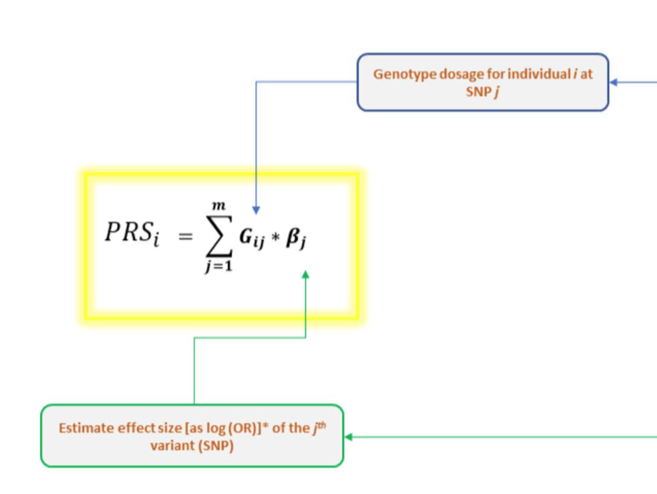
  GWAS workflow
Study design
Power calculations
GWAS
Downstream analysis
Replication studies
Constructing Polygenic Risk Score (PRS)
  Include SNPs below a p-value threshold +
  in low LD to retain independent signals
23 - Lectures.gersteinlab.org
Slides from B Borsari & S Liu
Sima et al, Human Genetics, 2024
Notes:
https://www.youtube.com/watch?v=Veq-resQOHg
+ imputation based on LD

Slide 24
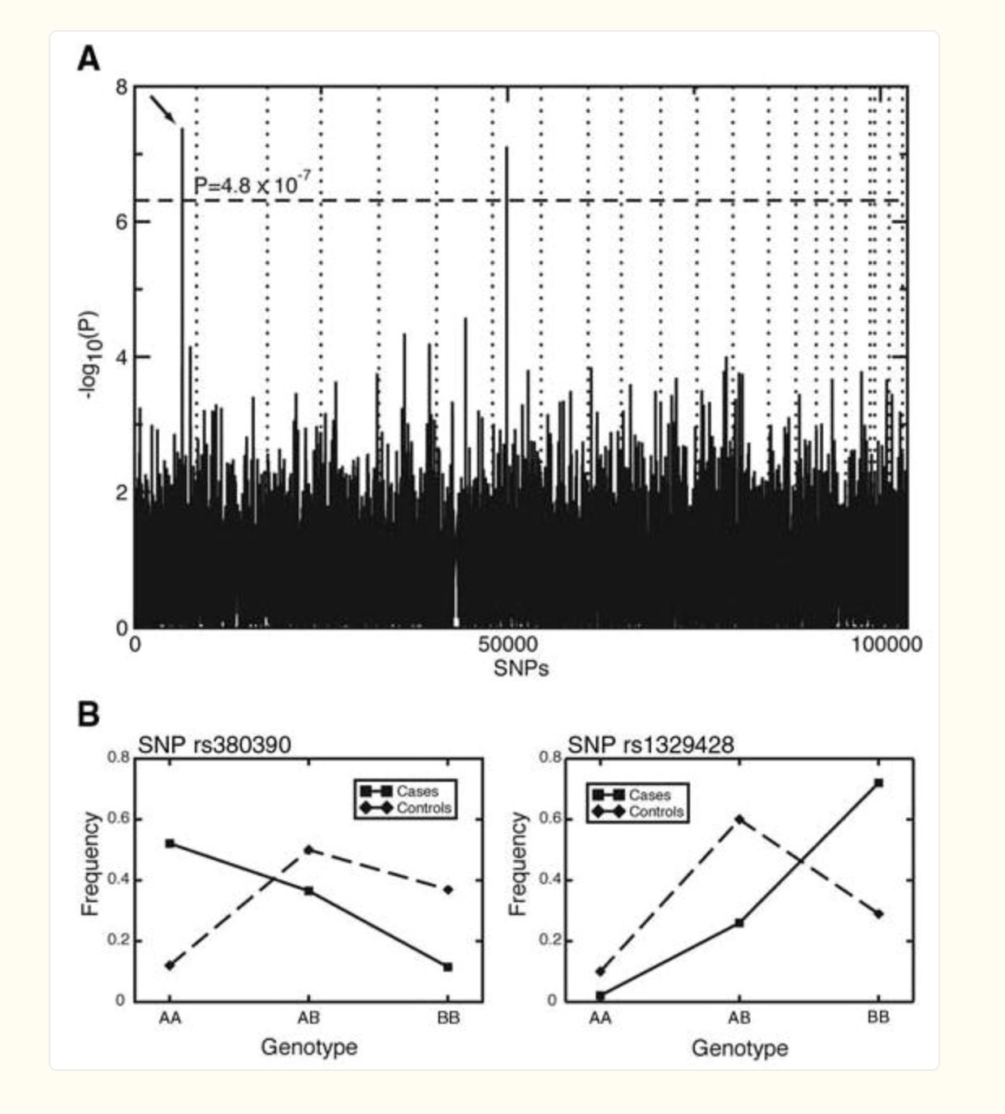
  First GWAS: at Yale
Scientists used genome-wide association to identify genes that affect the risk of developing Age – related macular degeneration
24 - Lectures.gersteinlab.org
Klein et al, Science 2006
Notes:
https://www.youtube.com/watch?v=Veq-resQOHg 32:51

Slide 25
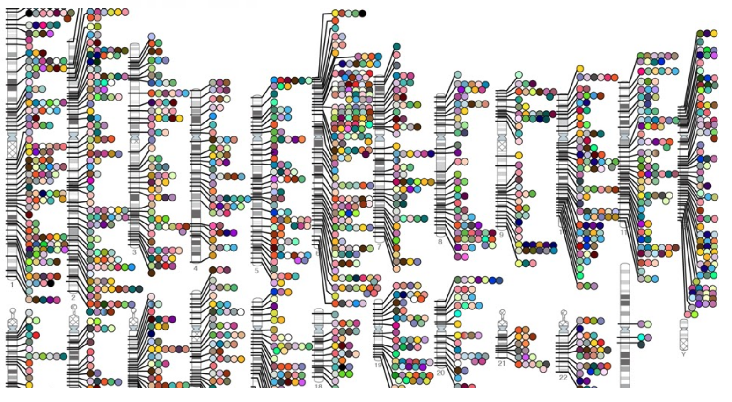
  The NHGRI-EBI GWAS Catalog
The NHGRI-EBI Catalog of human genome-wide association studies: https://www.ebi.ac.uk/gwas/
As of 2022-10-08, the GWAS Catalog contains 6041 publications and 427870 associations.
GWAS Catalog data is currently mapped to Genome Assembly GRCh38.p13 and dbSNP Build 154.
25 - Lectures.gersteinlab.org
Slides from B Borsari & S Liu

Slide 26
Outline
Part 1 : Generic Annotation
(not related to an individual's variants)
  RNA-seq, Chip-seq
  Integration
  , Hi-C
Part 2 : Annotation related to an individual's variants
  ASE/ASB
  GWAS & eQTL
eQTL

Slide 27

  Molecular quantitative trait loci
Genome sequence
Molecular phenotypes
Organismal traits / diseases
molecular quantitative trait loci (QTLs)
allele-specific (AS) events
$$✘$$
weight
Population-scale analysis
Same concept as GWAS for quantitative traits (linear models, effects modeled as beta coefficients)
number of reads,
gene expression,
…
27 - Lectures.gersteinlab.org
Slides from B Borsari & S Liu
Notes:
Contribution of variants to phenotypes
In humans, hundreds of complex phenotypic traits deter-
mine how we look and behave, and our propensity to
develop certain diseases. Each complex phenotype is
governed by a combination of inherited factors, which
are largely believed to be genetic variants, and environ-
mental influences. Full sequencing of human genomes
has shown that in any given individual there are, on aver-
age, ~4 million genetic variants encompassing ~12 mb of
sequence (BOX 1). The challenge is to determine which
of these variants underlies or is responsible for the inher-
ited components of phenotypes. Over the last decade or
so the human genetics field has debated45,46 the common
disease–common variant hypothesis, which posits that
common complex traits are largely due to common vari-
ants with small to modest effect sizes47–49
. The opposing
theory, the rare variant hypothesis, posits that common
complex traits are the summation of low-frequency,
high-penetrance variants50,51 . Overall the field is mak-
ing earnest attempts to determine the relative impor-
tance of common and rare variants in common complex
phenotypic traits.
Pleyotropy: https://www.ncbi.nlm.nih.gov/pmc/articles/PMC5501872/pdf/main.pdf

Slide 28
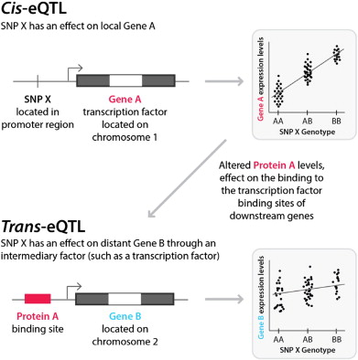
Expression quantitative trait locus (eQTL)
Biochimica et Biophysica Acta (BBA)-Molecular Basis of Disease 2014, 10:1896-1902

Slide 29
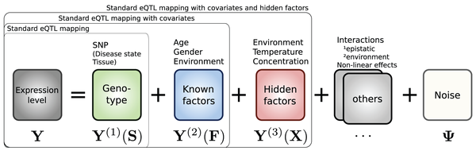
Aspects of Scaling eQTL calculation to Many SNPs & Many Samples
Taking into account covariates
General additive model for sources of gene expression variability.
Stegle O, Parts L, Durbin R, Winn J (2010) A Bayesian Framework to Account for Complex Non-Genetic Factors in Gene Expression Levels Greatly Increases Power in eQTL Studies. PLOS Computational Biology 6(5): e1000770. https://doi.org/10.1371/journal.pcbi.1000770
https://journals.plos.org/ploscompbiol/article?id=10.1371/journal.pcbi.1000770

Slide 30
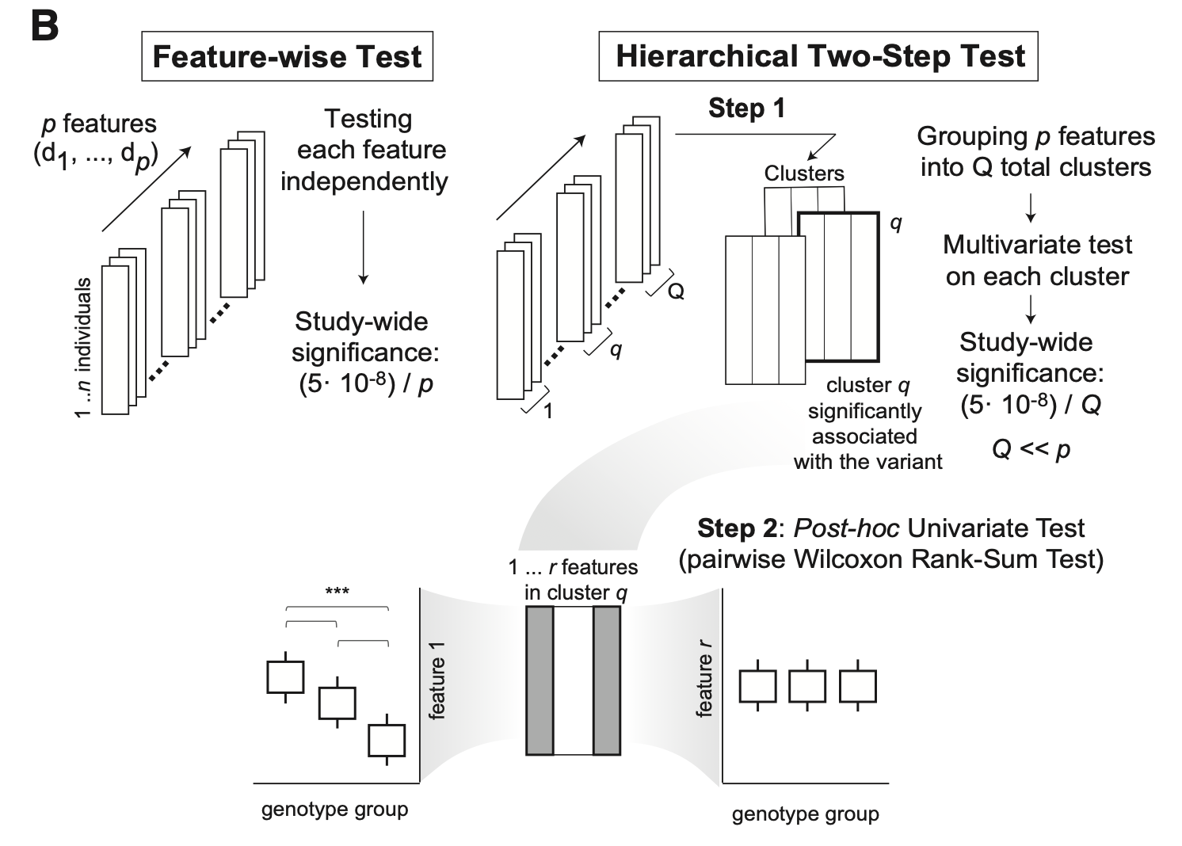
Benefits of Hierarchical Testing
30 - Lectures.gersteinlab.org
[Liu et al. (‘25). Cell]

Slide 31
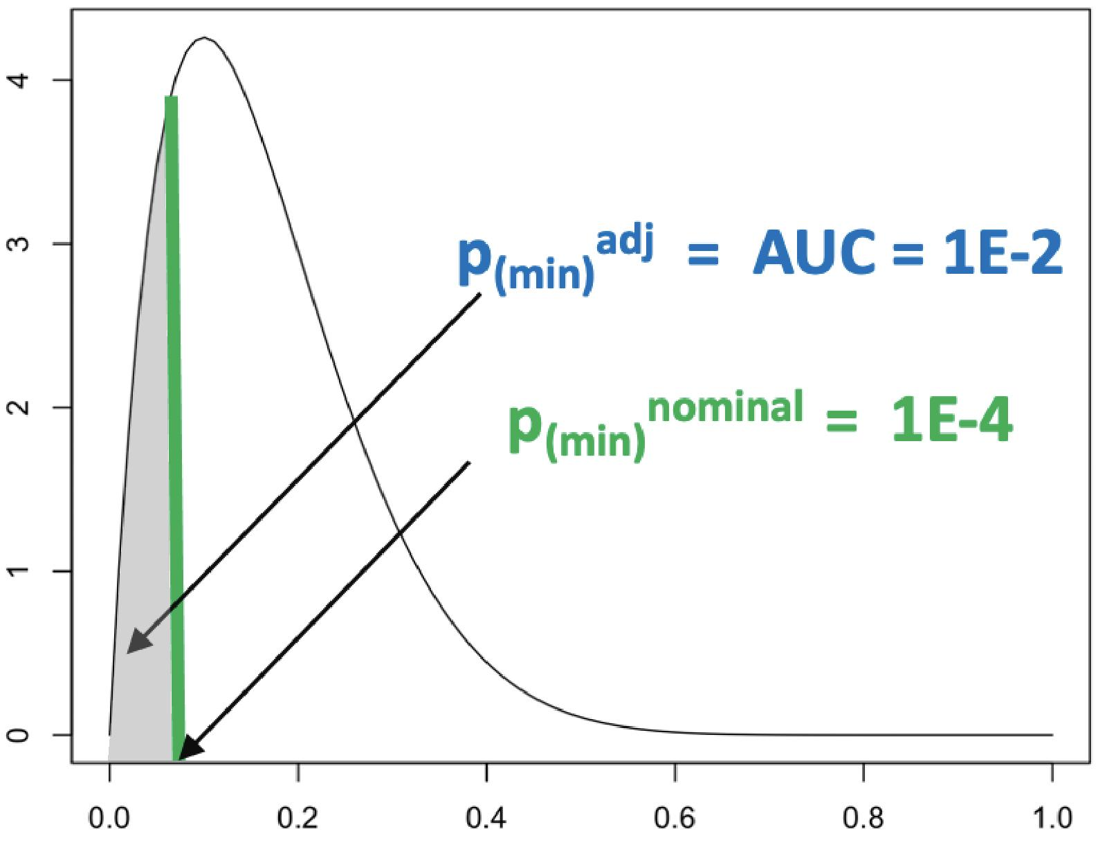
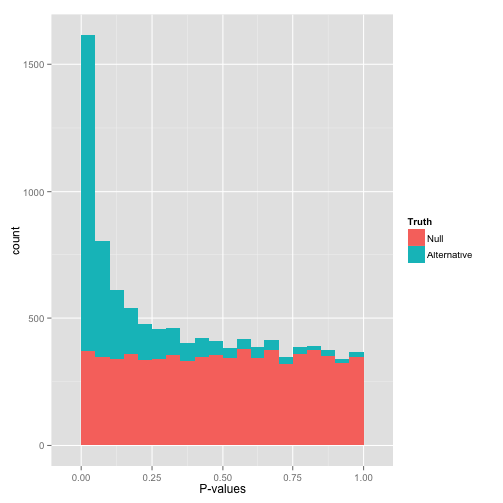
Huge burden of multiple testing in genome wide eQTLs.
Thus, use of a “cis” window around gene for cis-eQTLs +
multi-step (hierarchical) scheme to identify significant eGenes & their associated eSNPs
gene 1
gene 7,956
gene 7,956
gene 7,956
gene 2
gene 11,205
gene 11,205
gene 11,205
gene 3
gene 3,140
gene 3,140
gene 3,140
gene k
gene 509
gene 509
gene 509
gene ~20K
gene 14,053
gene 14,053
gene 14,053
genes ordered by
by name
genes ordered by
descending significance
Step 1: Identify the most significant eSNP per gene, and then correct p-values for multiple testing within each gene to derive adjusted gene-level p-values
Step 2: Multiple testing correction (BH to estimate FDR) is applied to the set of all adjusted gene-level p-values to yield the threshold for defining significant eGenes (FDR 0.05)
Step 3: Pull in all significant eSNPs associated with each significant eGene by using the scheme adopted by GTEx: for each gene, a nominal p-value threshold (derived using the beta distribution in Step 1) is used to pull in the full set of significant eSNPs for each significant eGene
count
Adapted from D. Robinson (web post)
P-values
31 - Lectures.gersteinlab.org

Slide 32
References for 25m7 part-2
(Annotation Related to Variants)
Uffelmann, E., Huang, Q. Q., Munung, N. S., De Vries, J., Okada, Y., Martin, A. R., Martin, H. C., Lappalainen, T., & Posthuma, D. (2021). Nature Reviews Methods Primers, 1(1).
Genome-wide association studies.
https://doi.org/10.1038/s43586-021-00056-9
(Focus on the beginning up to Fig 2. Stop at the results section.)
Aguet, F., Alasoo, K., Li, Y. I., Battle, A., Im, H. K., Montgomery, S. B., & Lappalainen, T. (2023).
Nature Reviews Methods Primers, 3(1).
Molecular quantitative trait loci.
https://doi.org/10.1038/s43586-022-00188-6
(Focus on the beginning. Stop at the results section.)
James, Gareth, Witten, Daniela, Hastie, Trevor, Tibshirani, Robert
An Introduction to Statistical Learning: with Applications in R [ ISLR (2nd edition) ]
https://www.amazon.com/Introduction-Statistical-Learning-Applications-Statistics/dp/1071614177/ + https://www.statlearning.com
(Chapter 3.1 & 3.2 gives basic background on linear regression.
Likewise, chap 13 (13.1 to 13.3) gives background on multiple testing.)
Chen, J., Rozowsky, J., Galeev, T. R., Harmanci, A., Kitchen, R., Bedford, J., Abyzov, A., Kong, Y., Regan, L., & Gerstein, M. (2016). Nature Communications, 7(1).
A uniform survey of allele-specific binding and expression over 1000-Genomes-Project individuals.
https://doi.org/10.1038/ncomms11101
(Methods section up to “AlleleDB” part)

