Slide 1
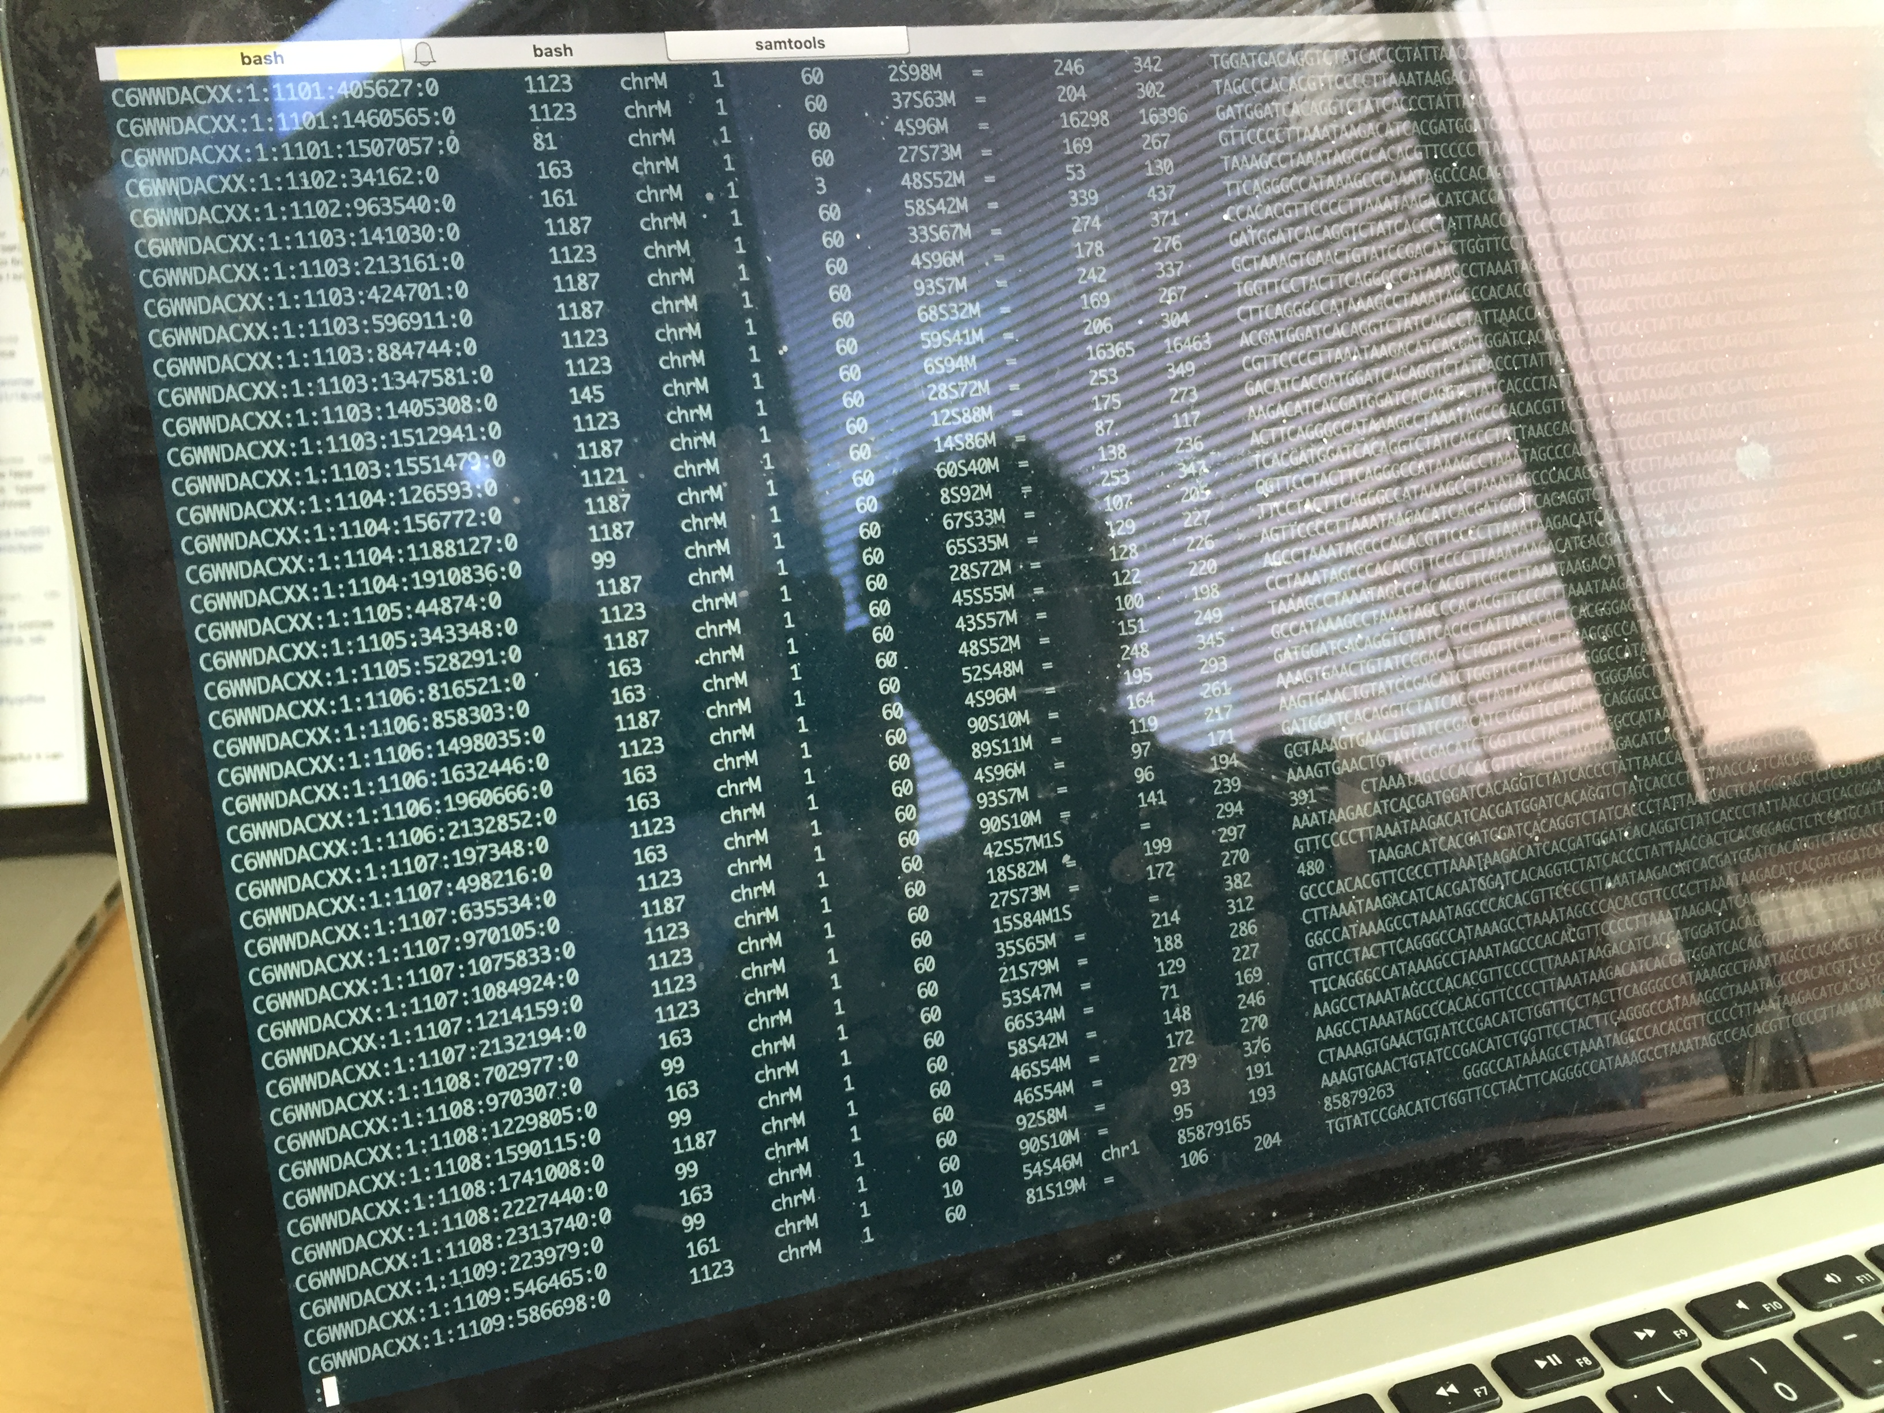
Welcome to The Age of Personal Genomes
Carl Zimmer
carlzimmer.com
February 5, 2025, Yale MBB 452

Slide 2
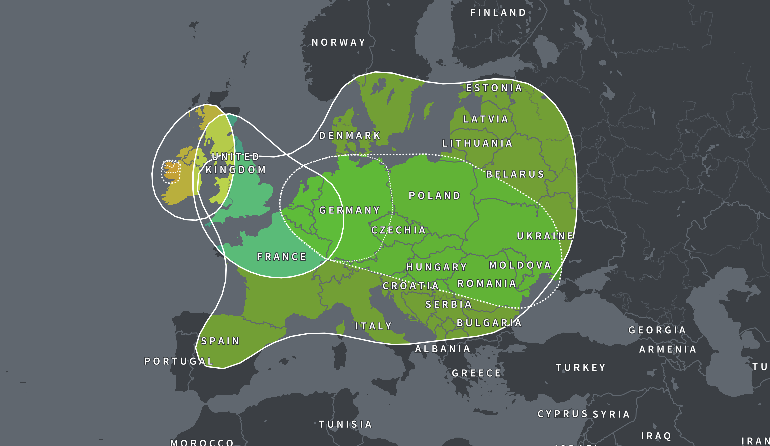

Slide 3
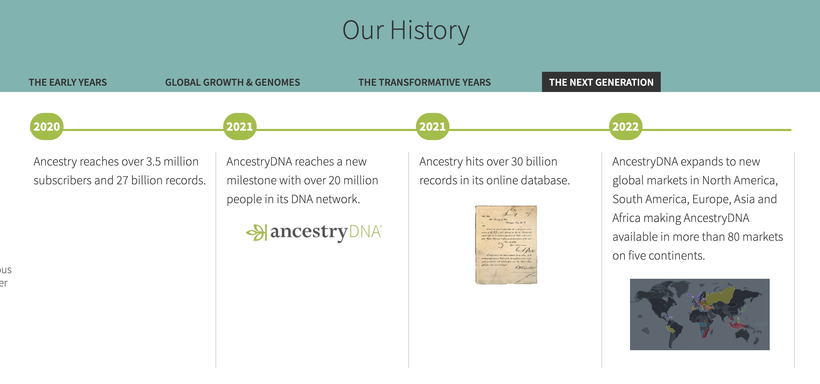
https://www.ancestry.com/corporate/about-ancestry/our-story

Slide 4
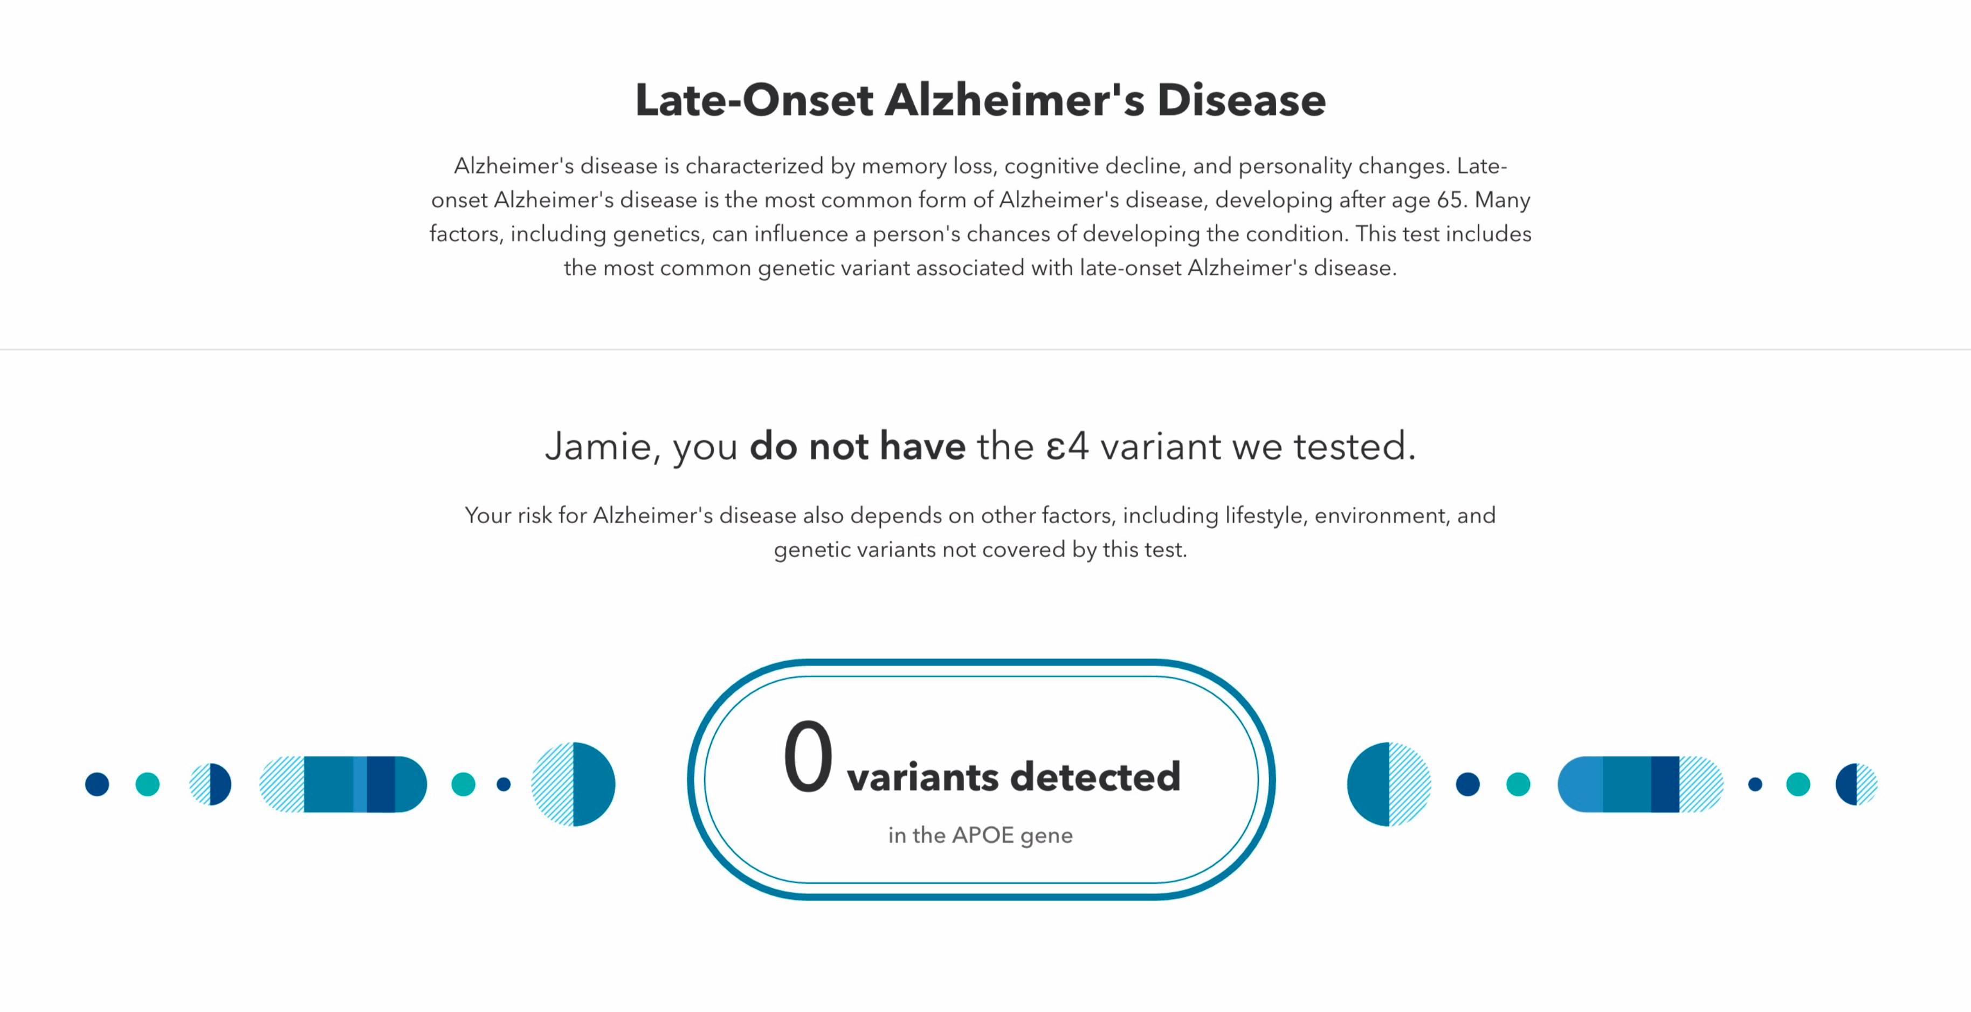
23andme.com/dna-reports-list/

Slide 5
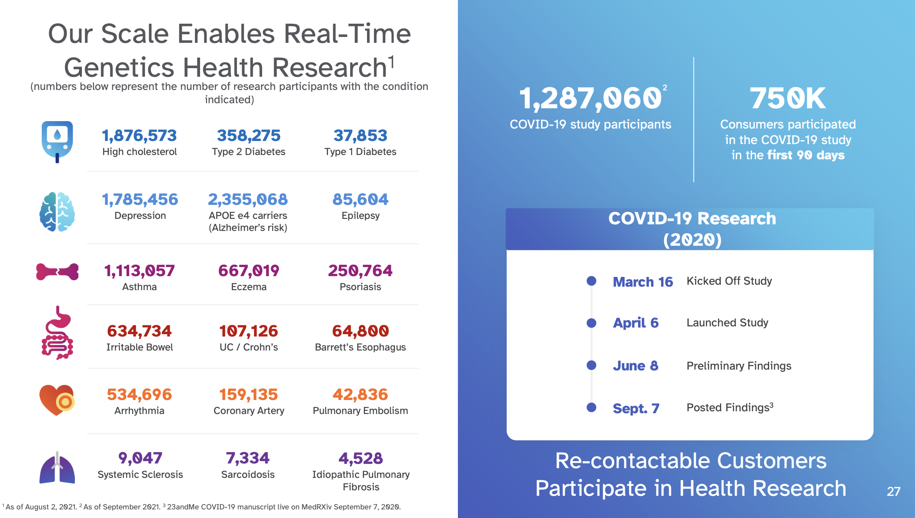
https://investors.23andme.com/

Slide 6

Notes:
How about DNA? Every cell in your body has the same molecule, a cookbook with 3 billion letters.

Slide 7
Gregor Mendel
(1822-1884)
Wikipedia

Slide 8
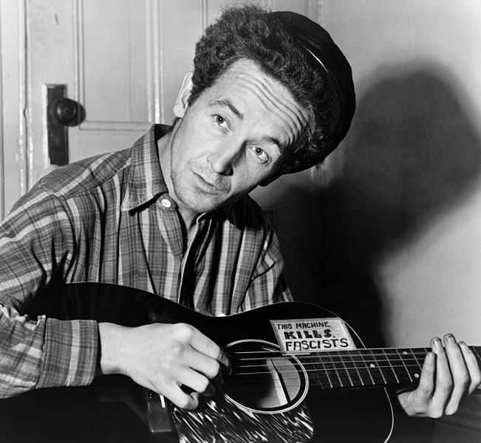
Woody Guthrie
Wikipedia

Slide 9
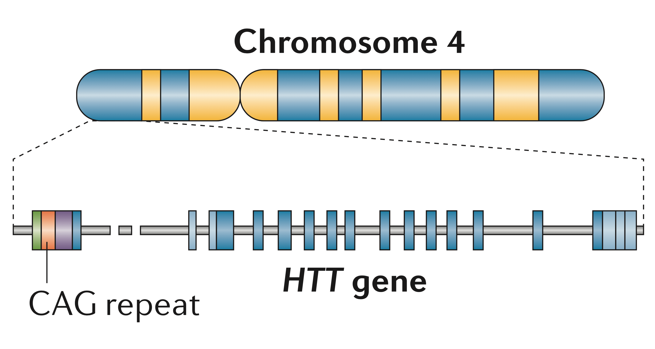
Bates et al, Nature Reviews Disease Primers 2015

Slide 10
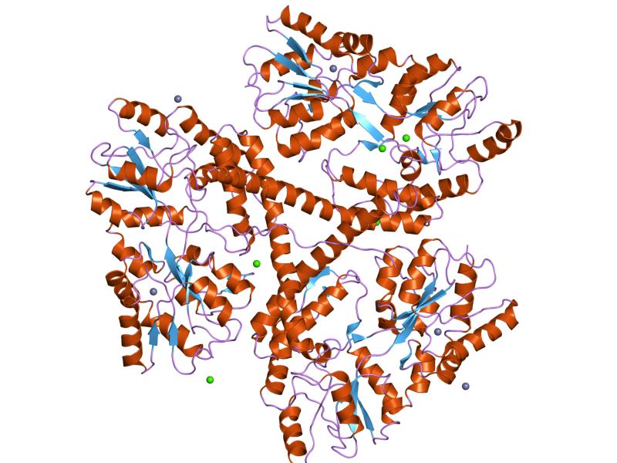
Huntingtin Protein
Wikipedia
Bates et al, Nature Reviews Disease Primers 2015

Slide 11
Miniarikova, J., Evers, M.M. and Konstantinova, P., 2018. Translation of microRNA-based huntingtin-lowering therapies from preclinical studies to the clinic. Molecular Therapy, 26(4), pp.947-962.

Slide 12
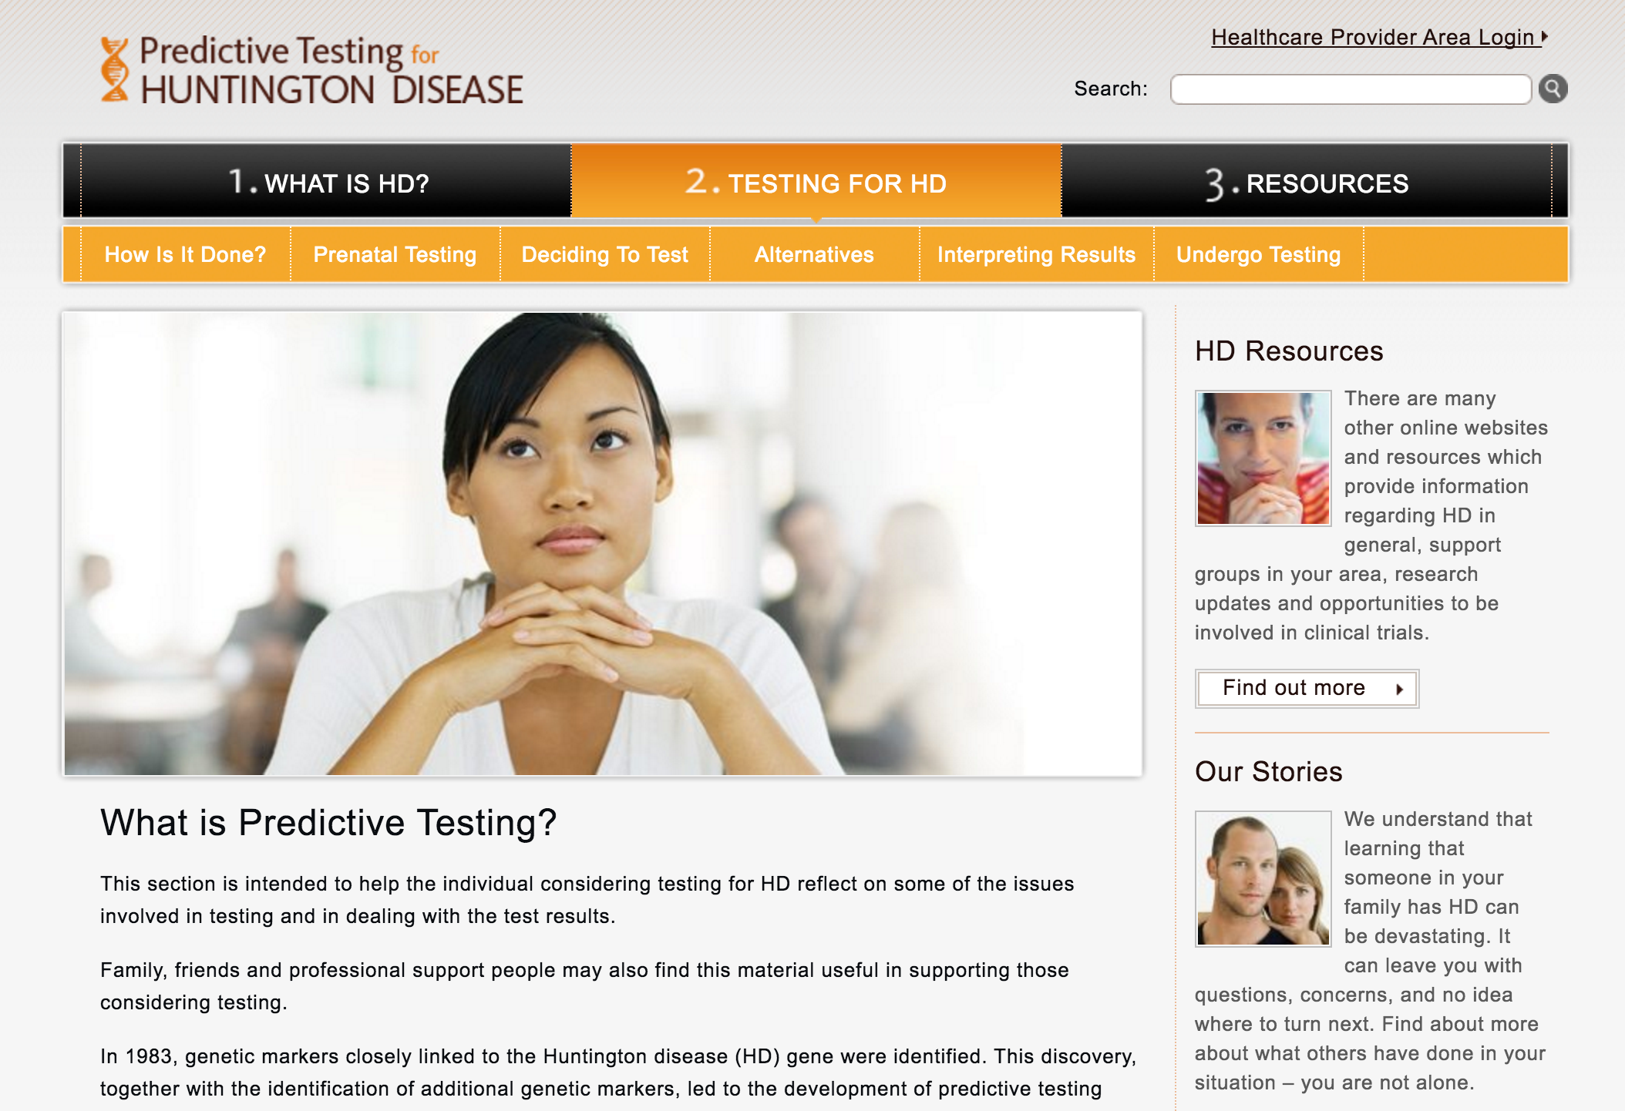
predictivetestingforhd.com/testing-for-hd/

Slide 13
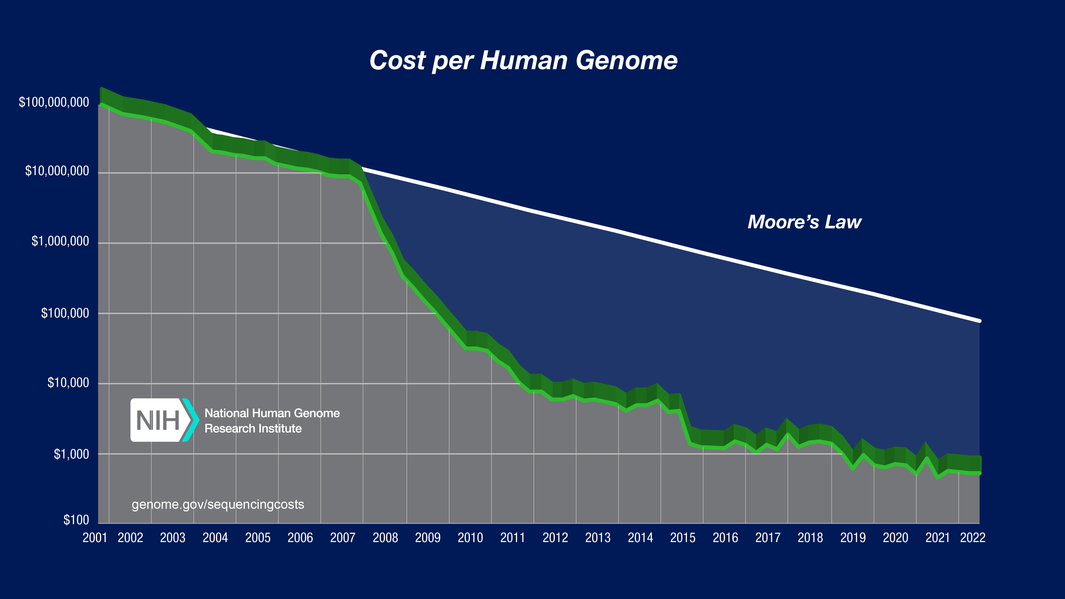

Slide 14


Slide 15

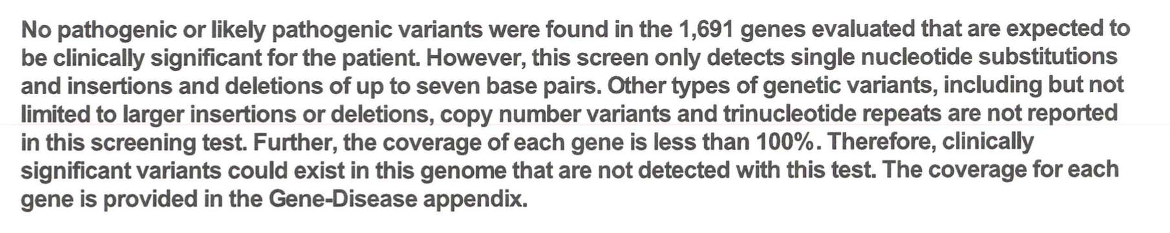

Slide 16
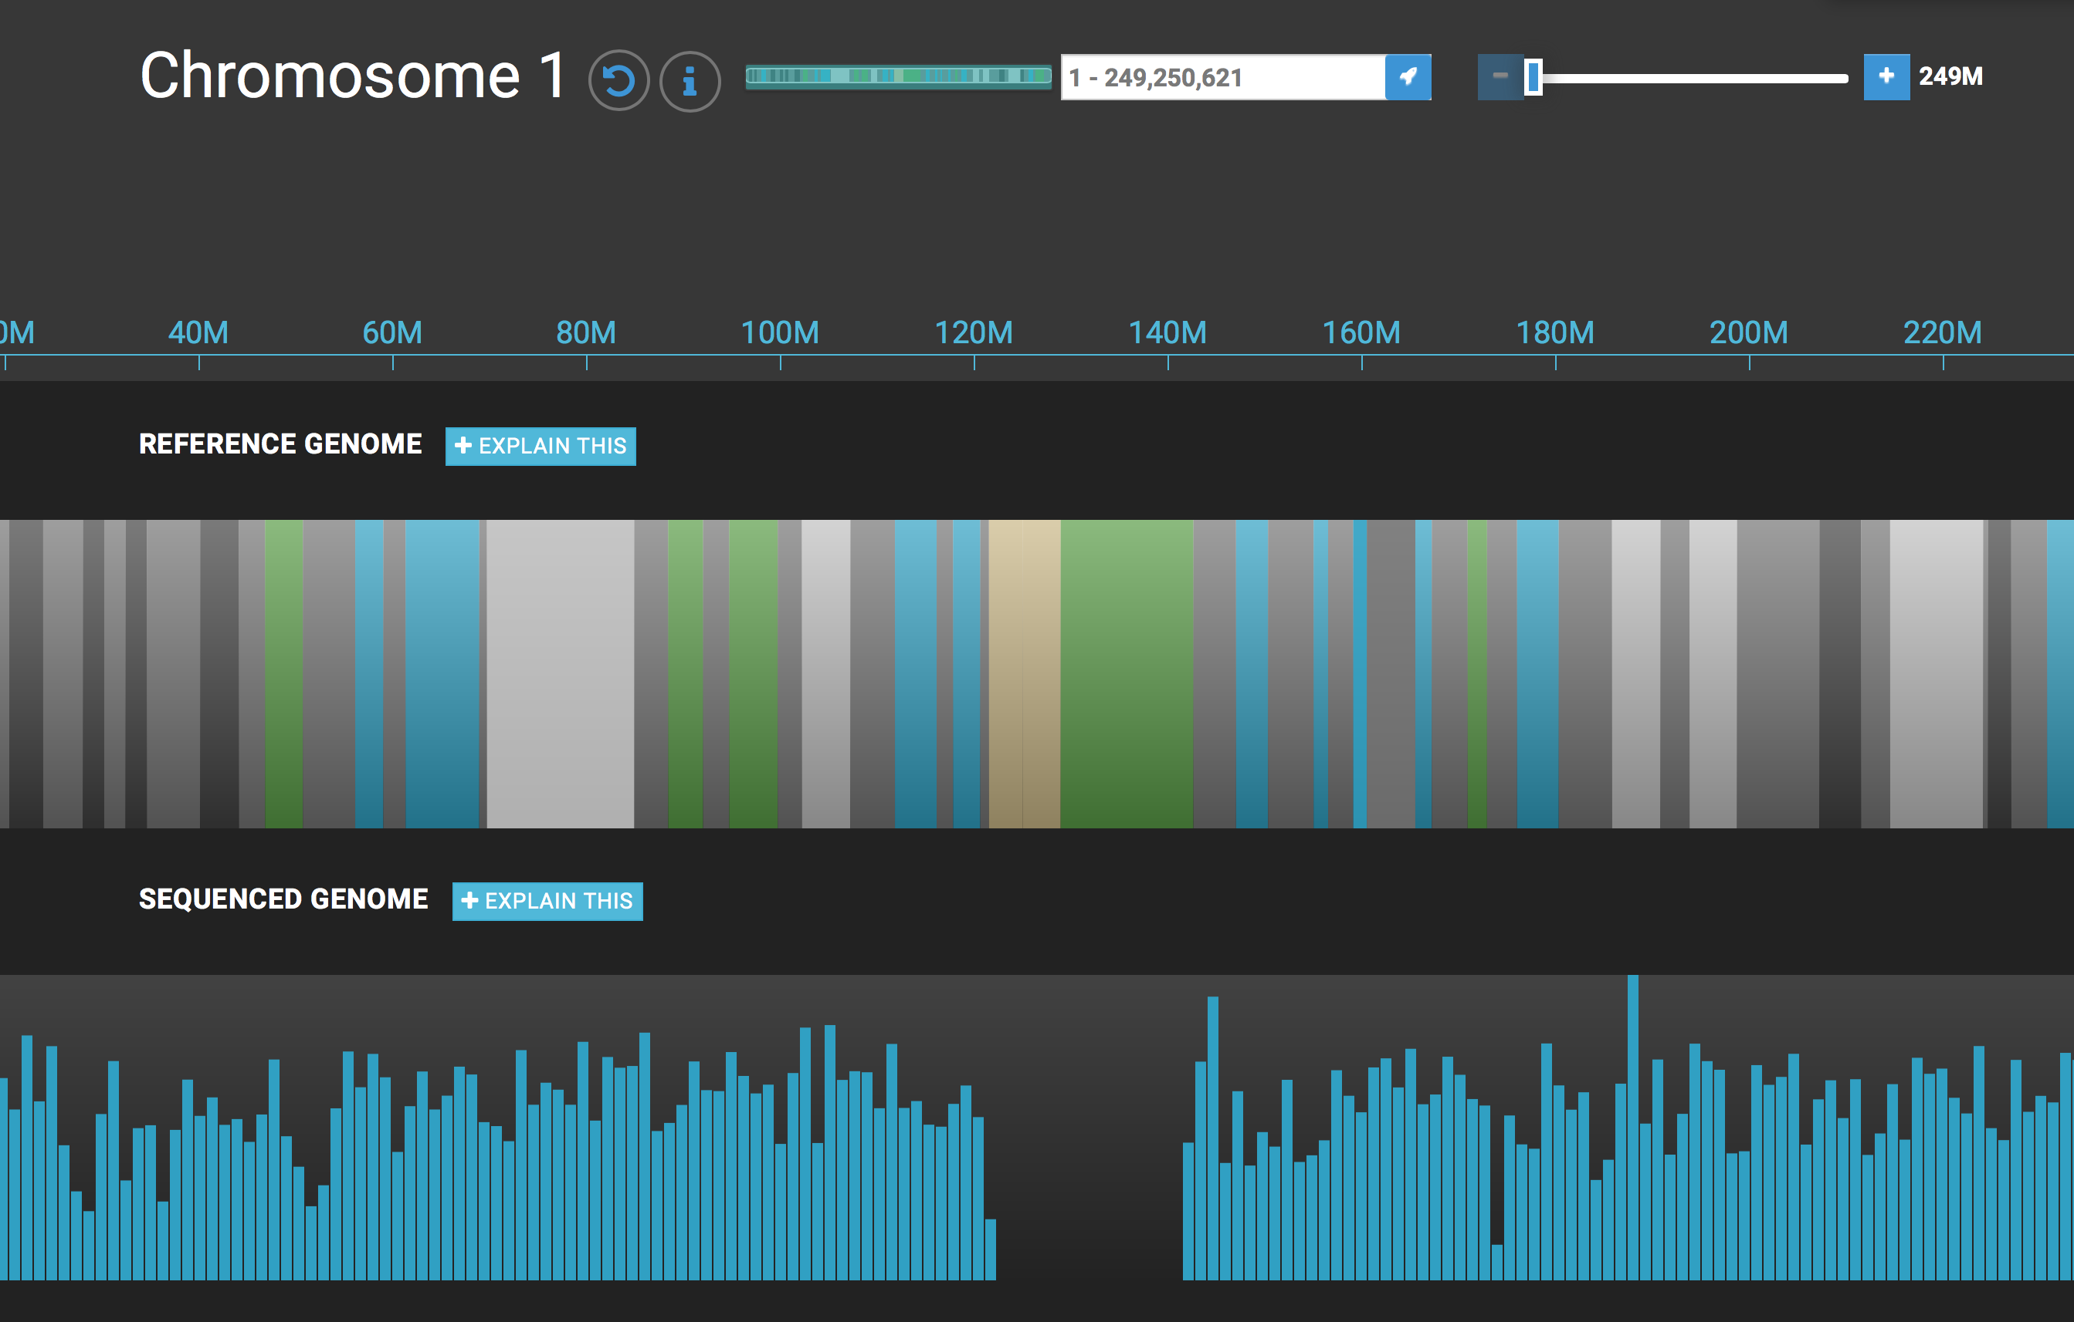
understandyourgenome.com

Slide 17
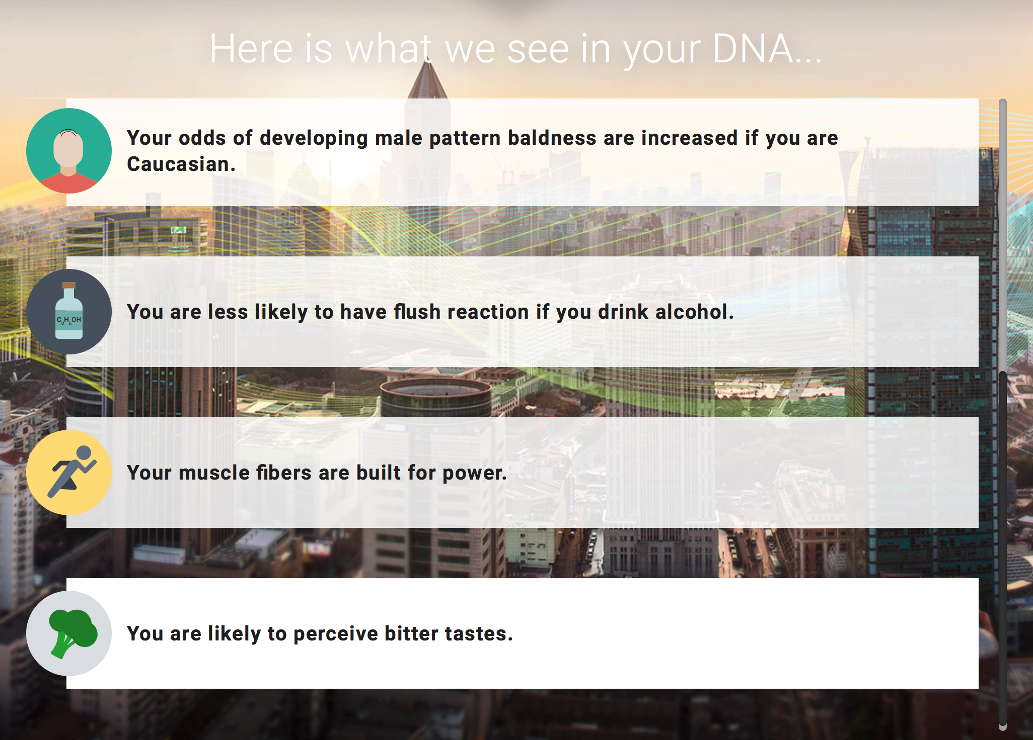
understandyourgenome.com

Slide 18
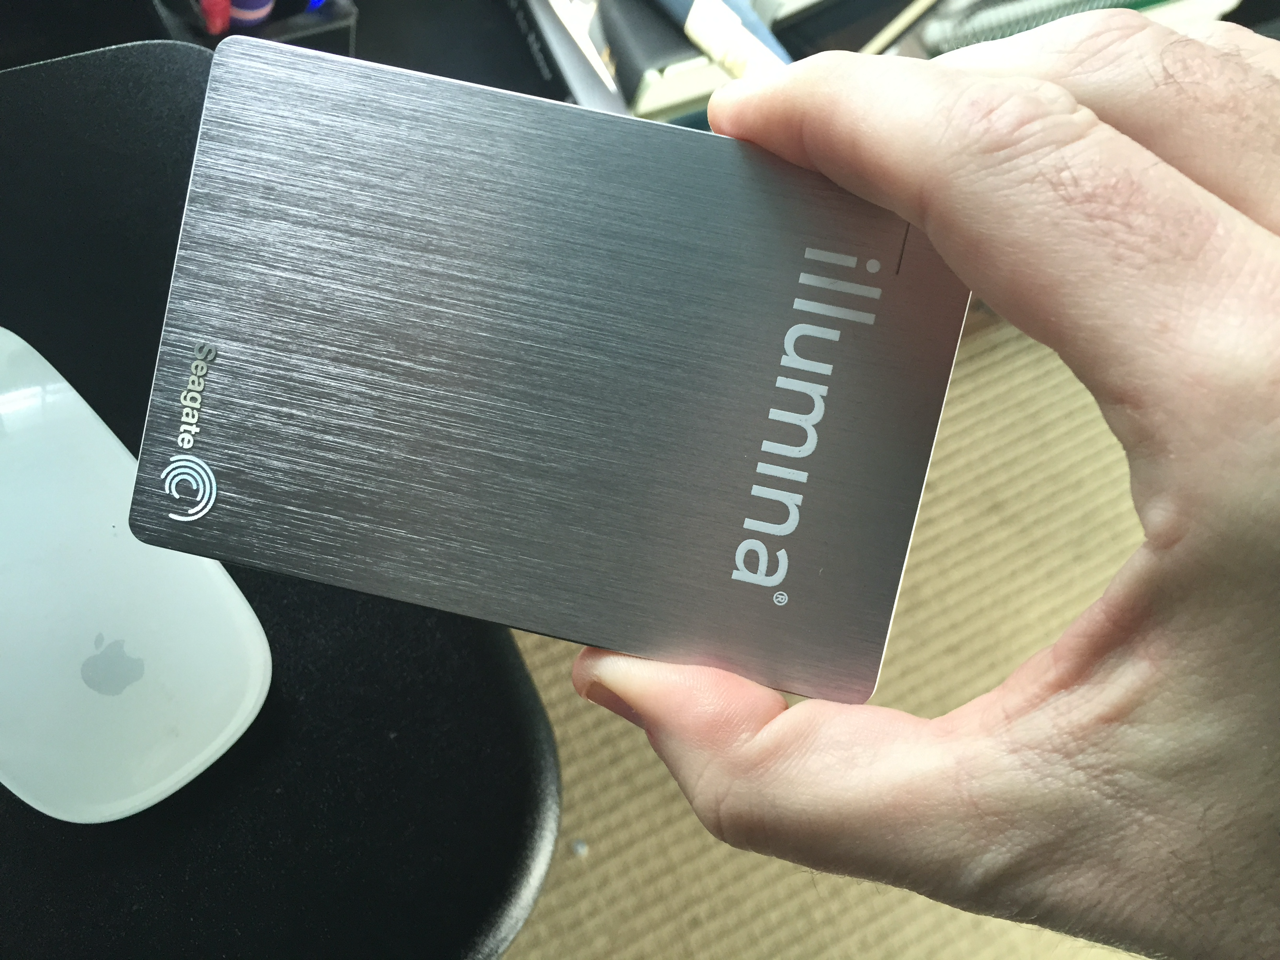

Slide 20
My variant: rs11209026
Gene: IL23R
Ali Torkamani,
Scripps Translational Science Institute

Slide 21
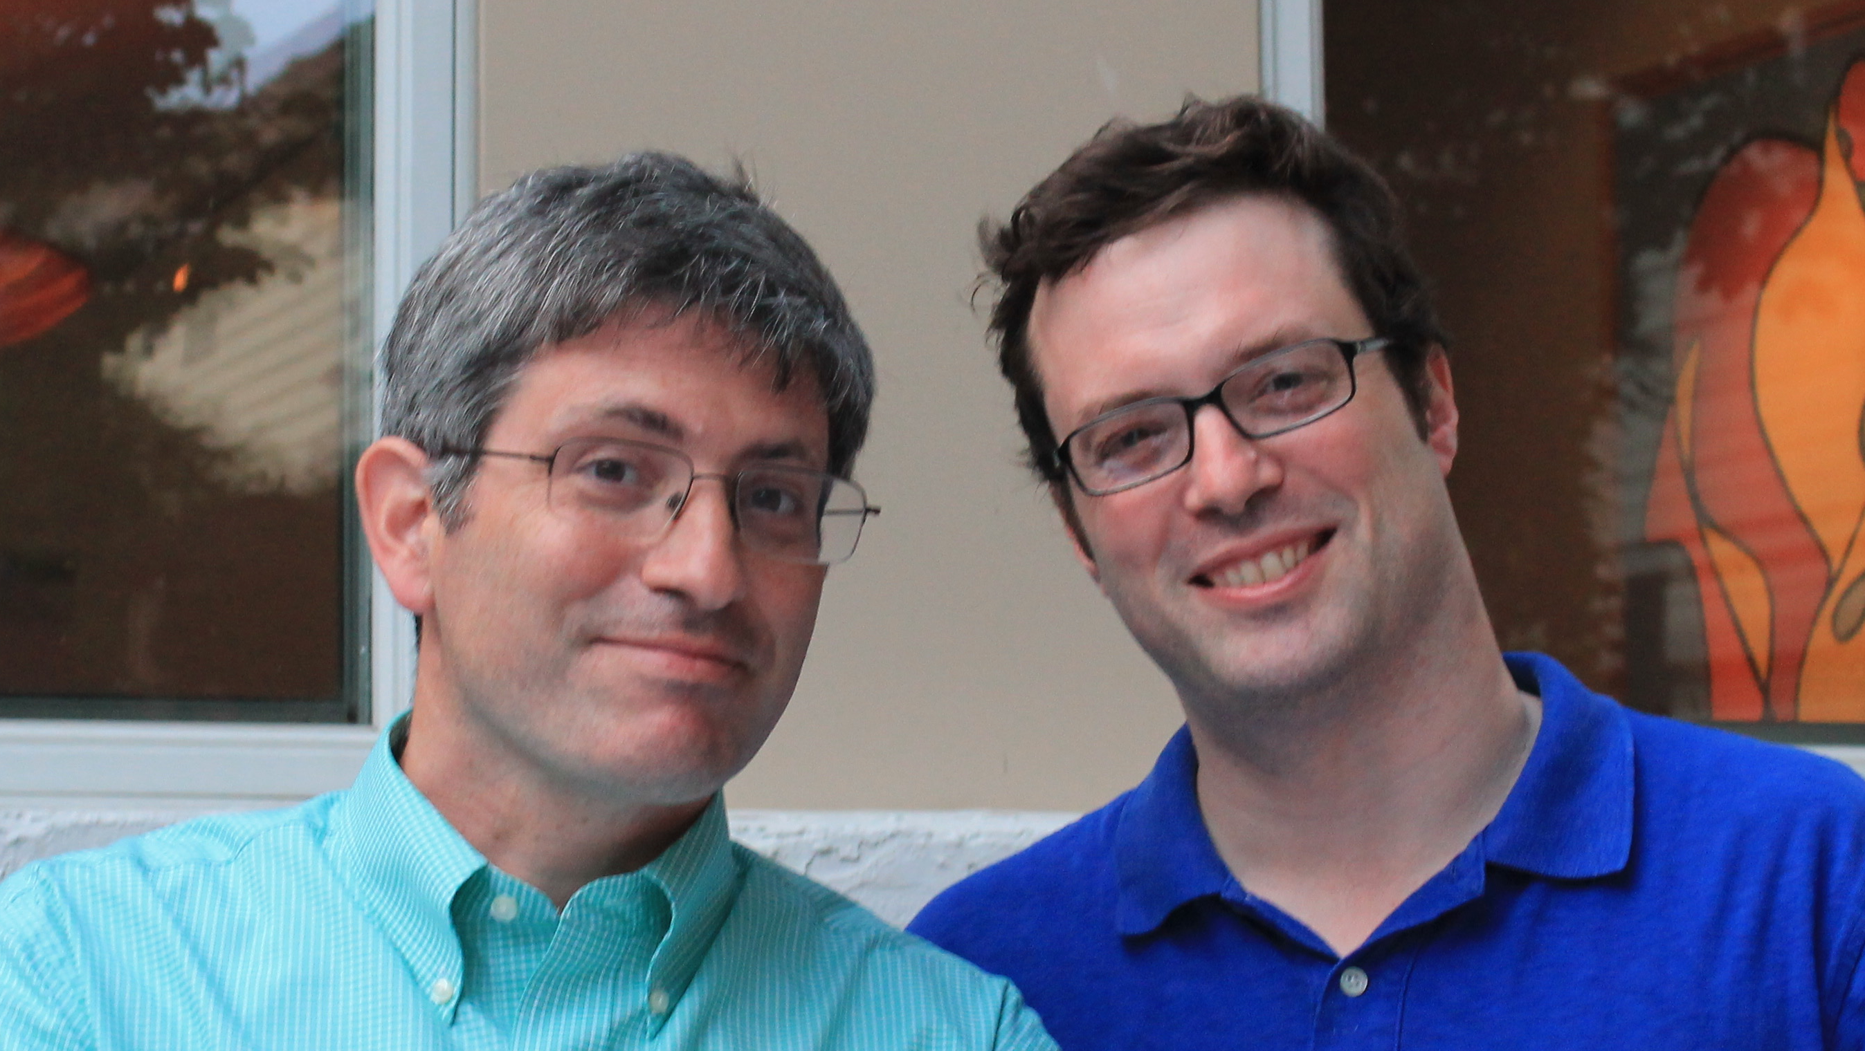
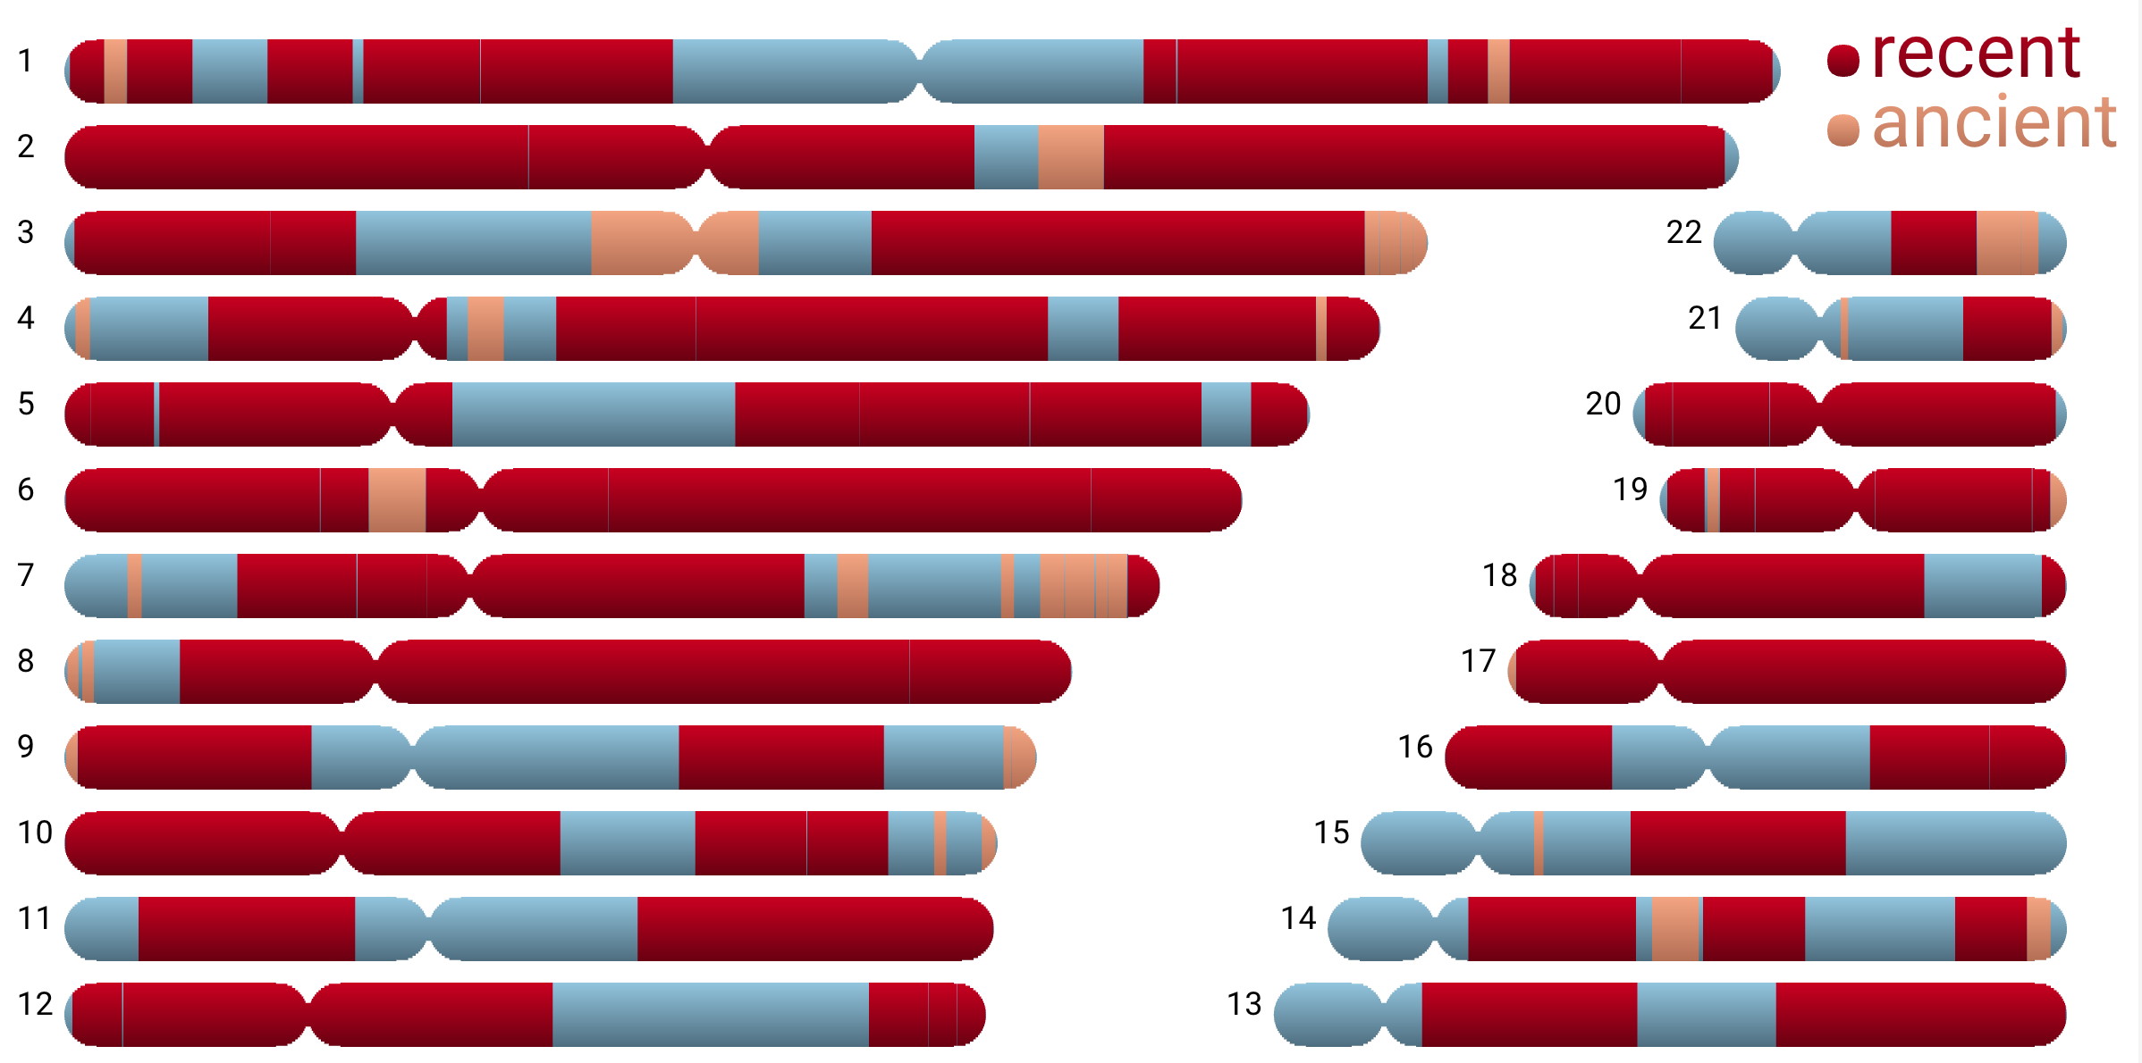
DNA.Land

Slide 22
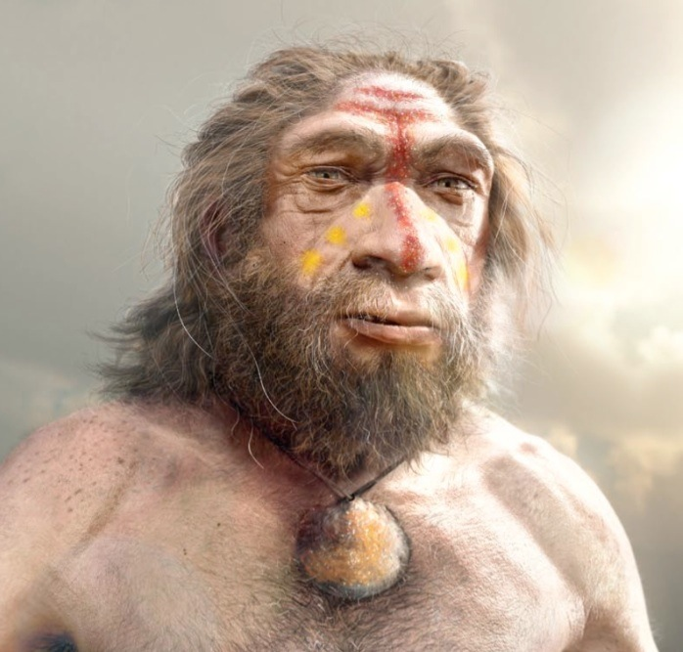
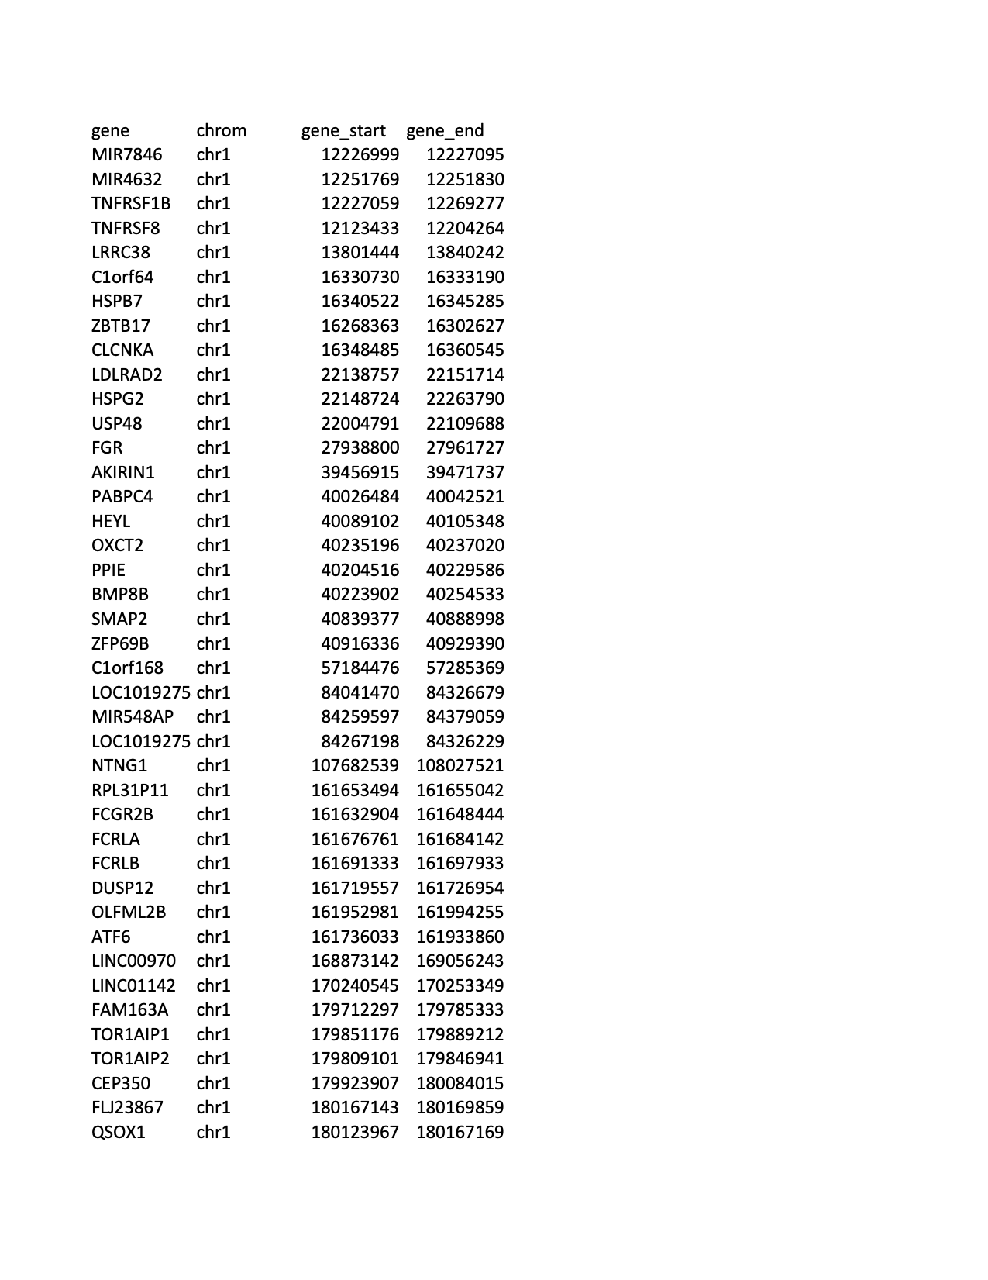
Image: Viktor Deak

Slide 23
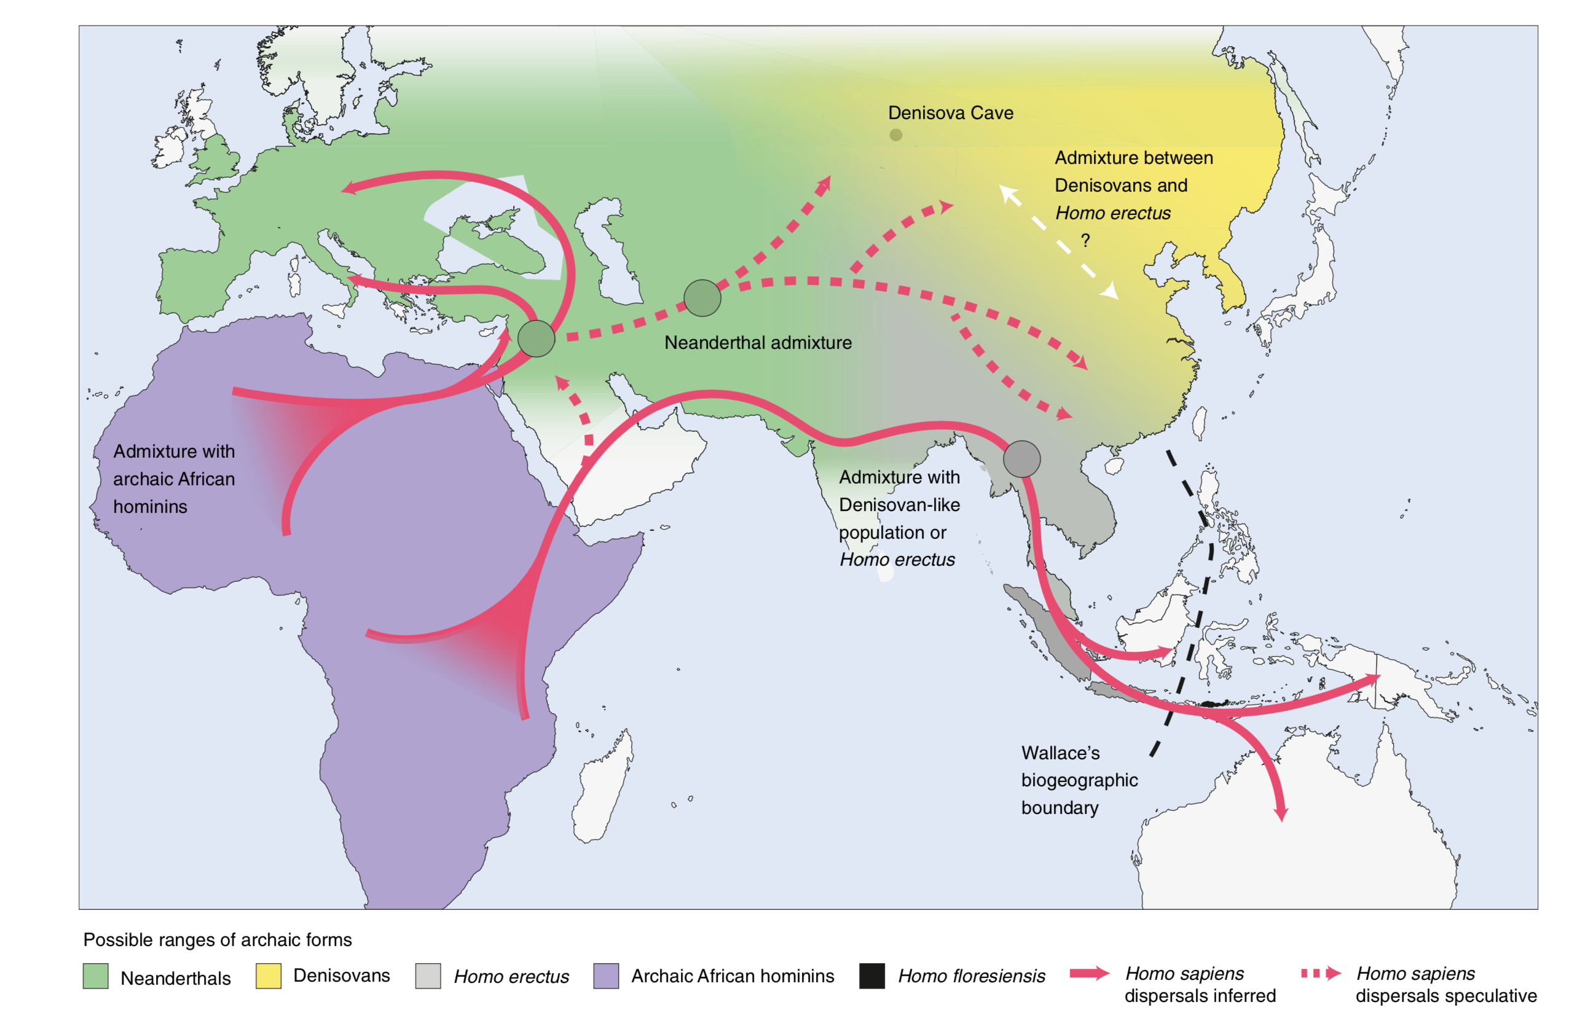
Roberts et al., Nature Human Behaviour (2018), 1

Slide 24
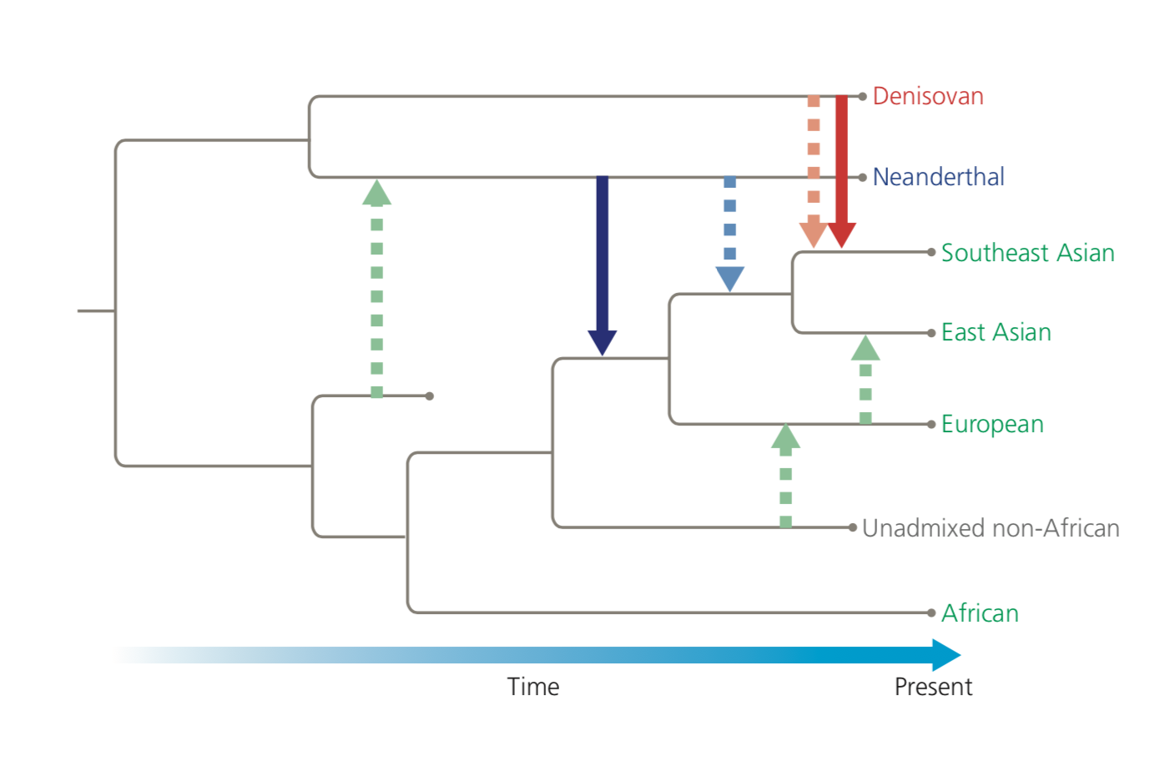
Emlen & Zimmer, Evolution: Making Sense of Life (Macmillan, 2019)

Slide 25
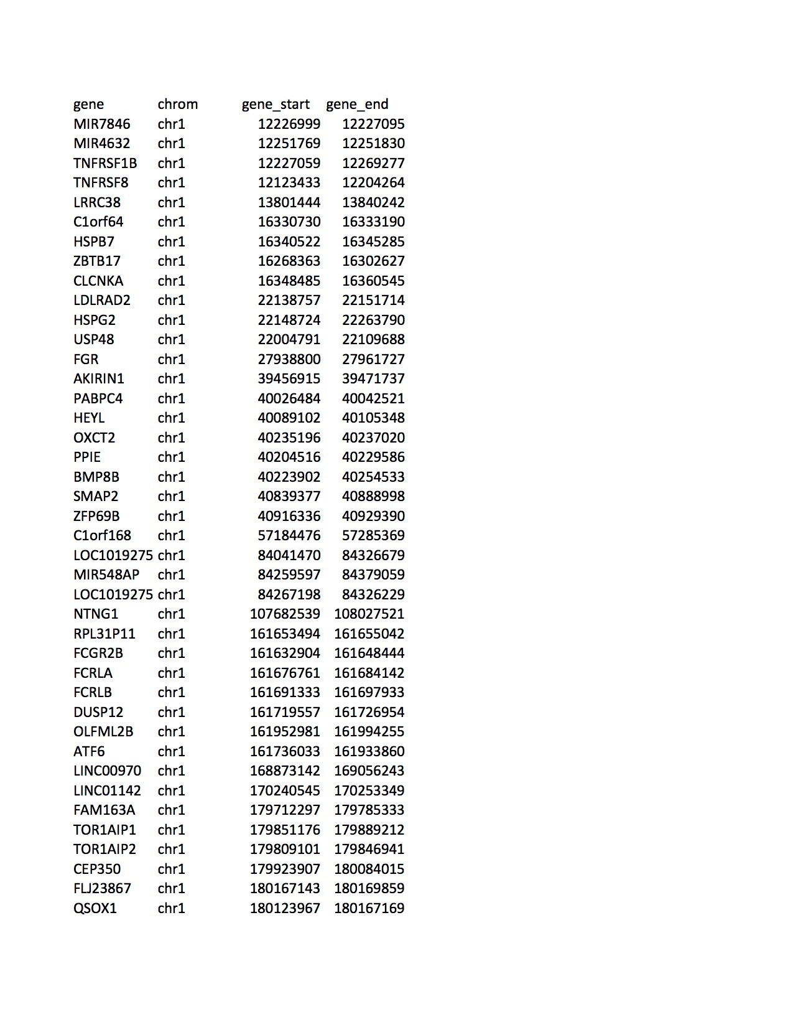
Analysis courtesy of Joshua Akey & Selina Vattathil, Princeton

Slide 26
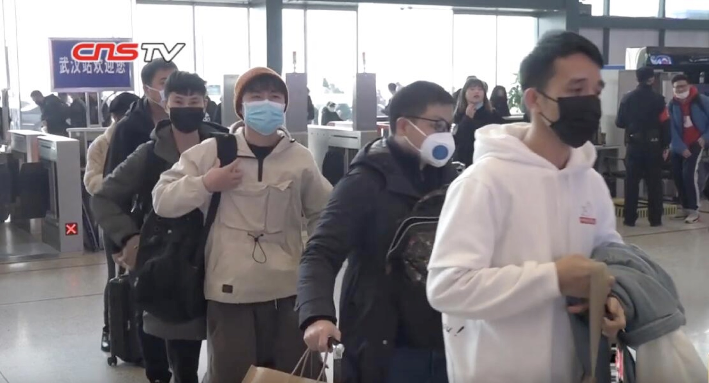

Slide 27
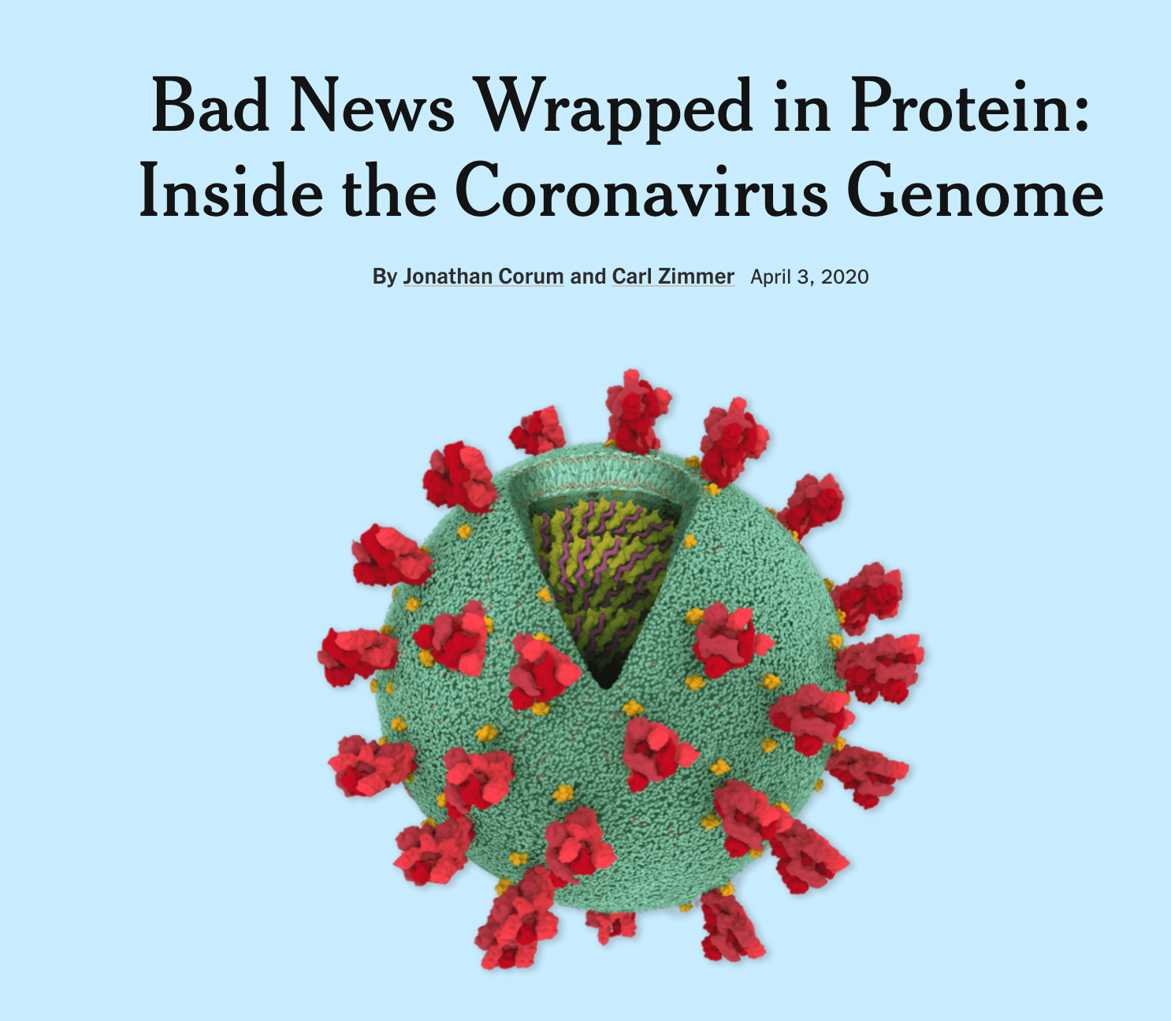
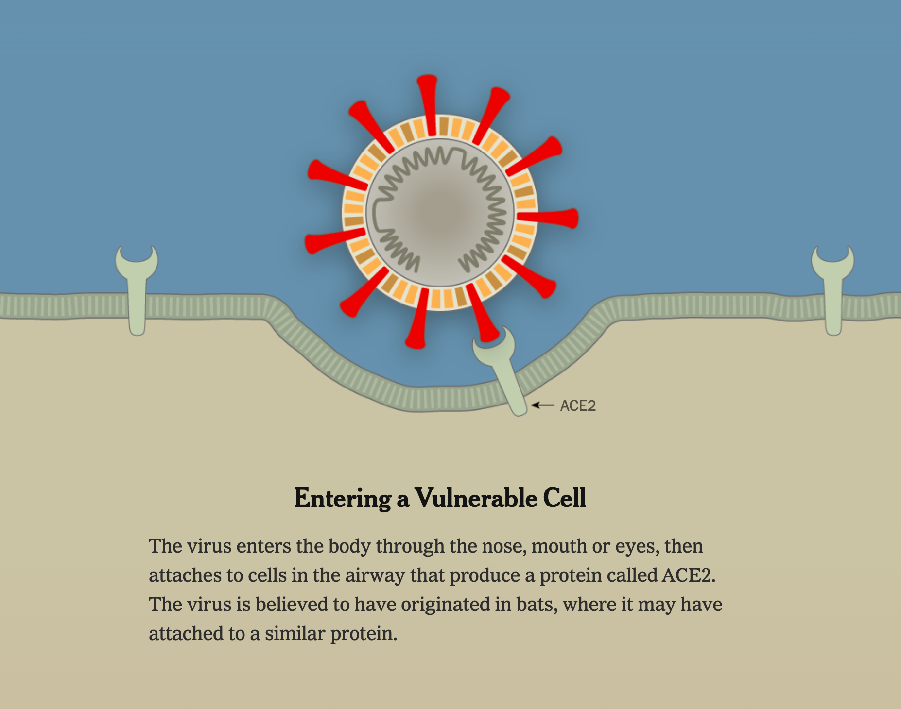
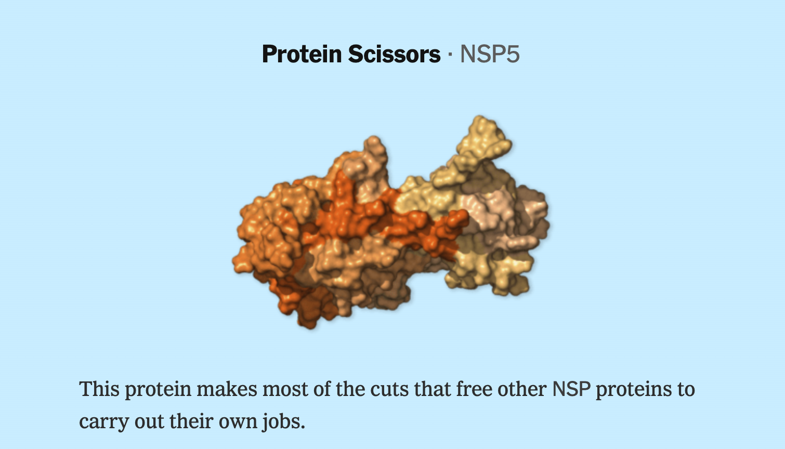
https://www.nytimes.com/interactive/2020/03/11/science/how-coronavirus-hijacks-your-cells.html
https://www.nytimes.com/interactive/2020/04/03/science/coronavirus-genome-bad-news-wrapped-in-protein.html

Slide 28
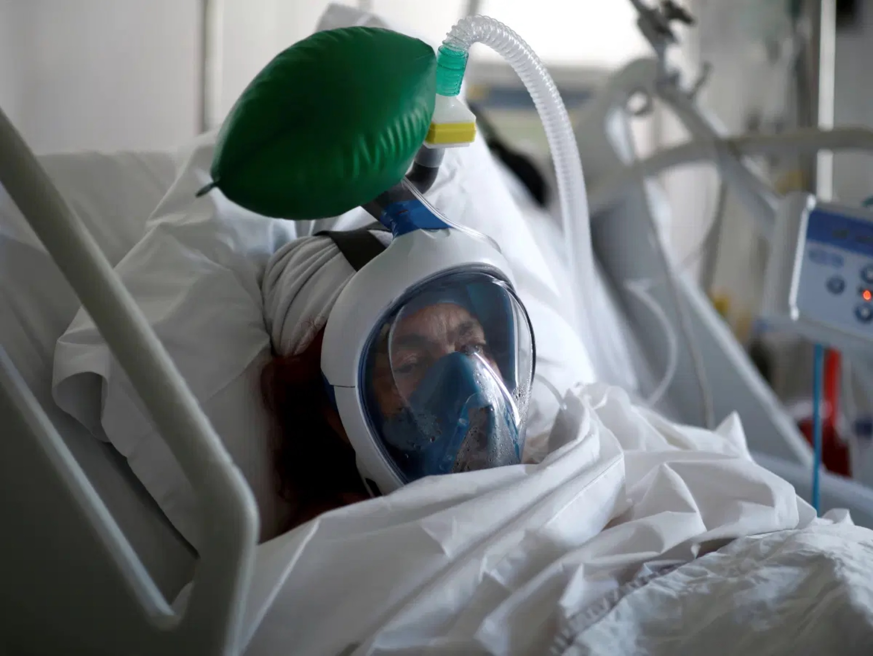

Slide 29
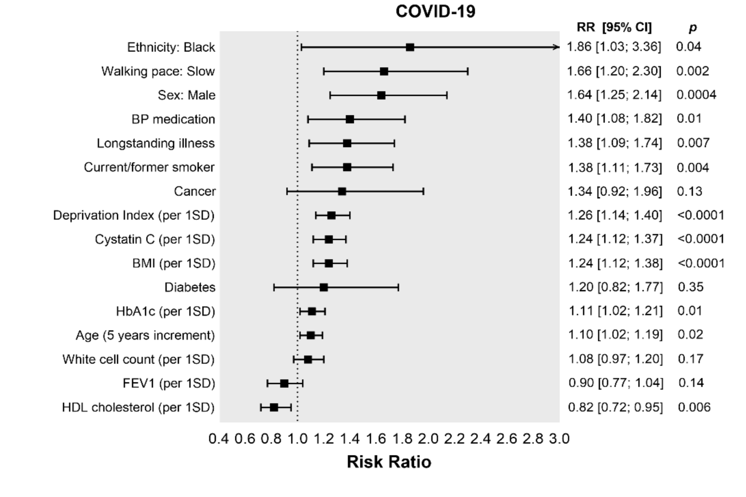
medrxiv.org/content/10.1101/2020.04.28.20083295v1

Slide 30
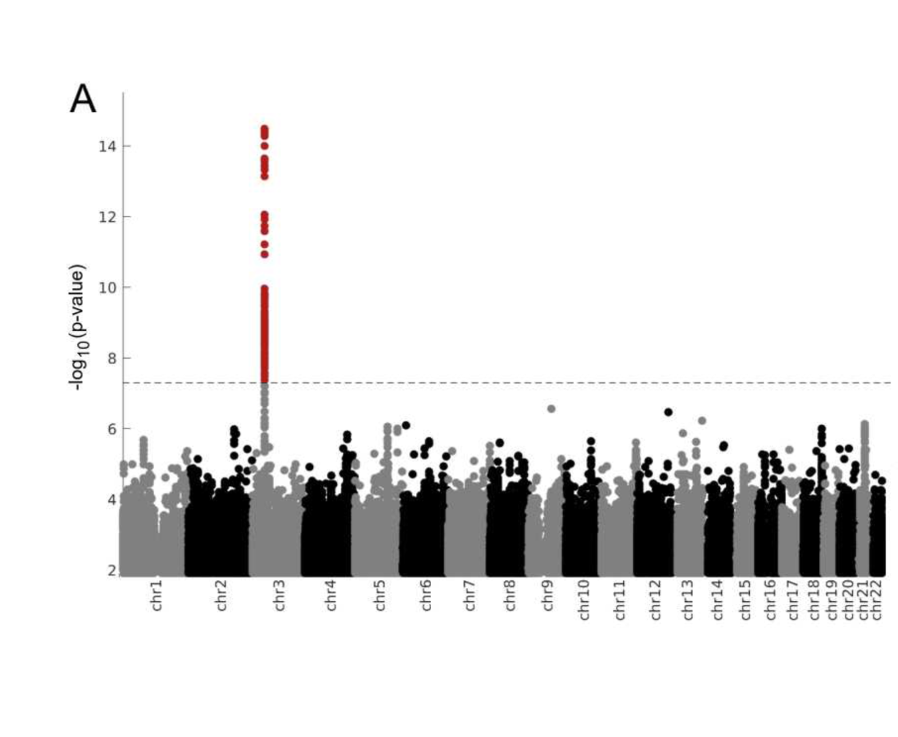
biorxiv.org/content/10.1101/2020.07.03.186296v1

Slide 31
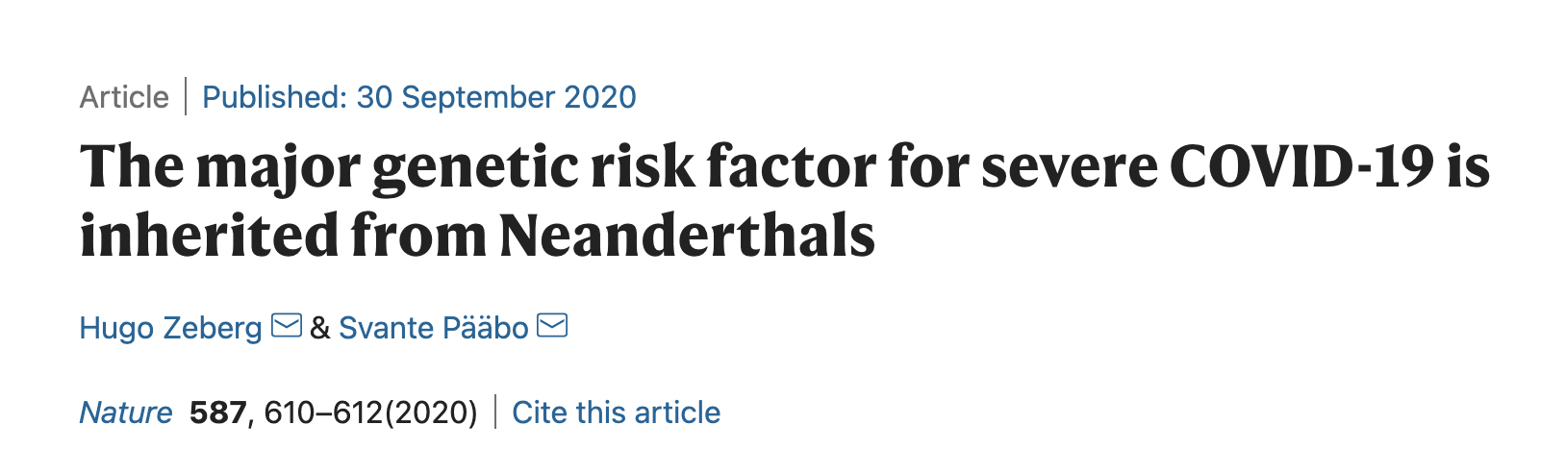

Slide 32
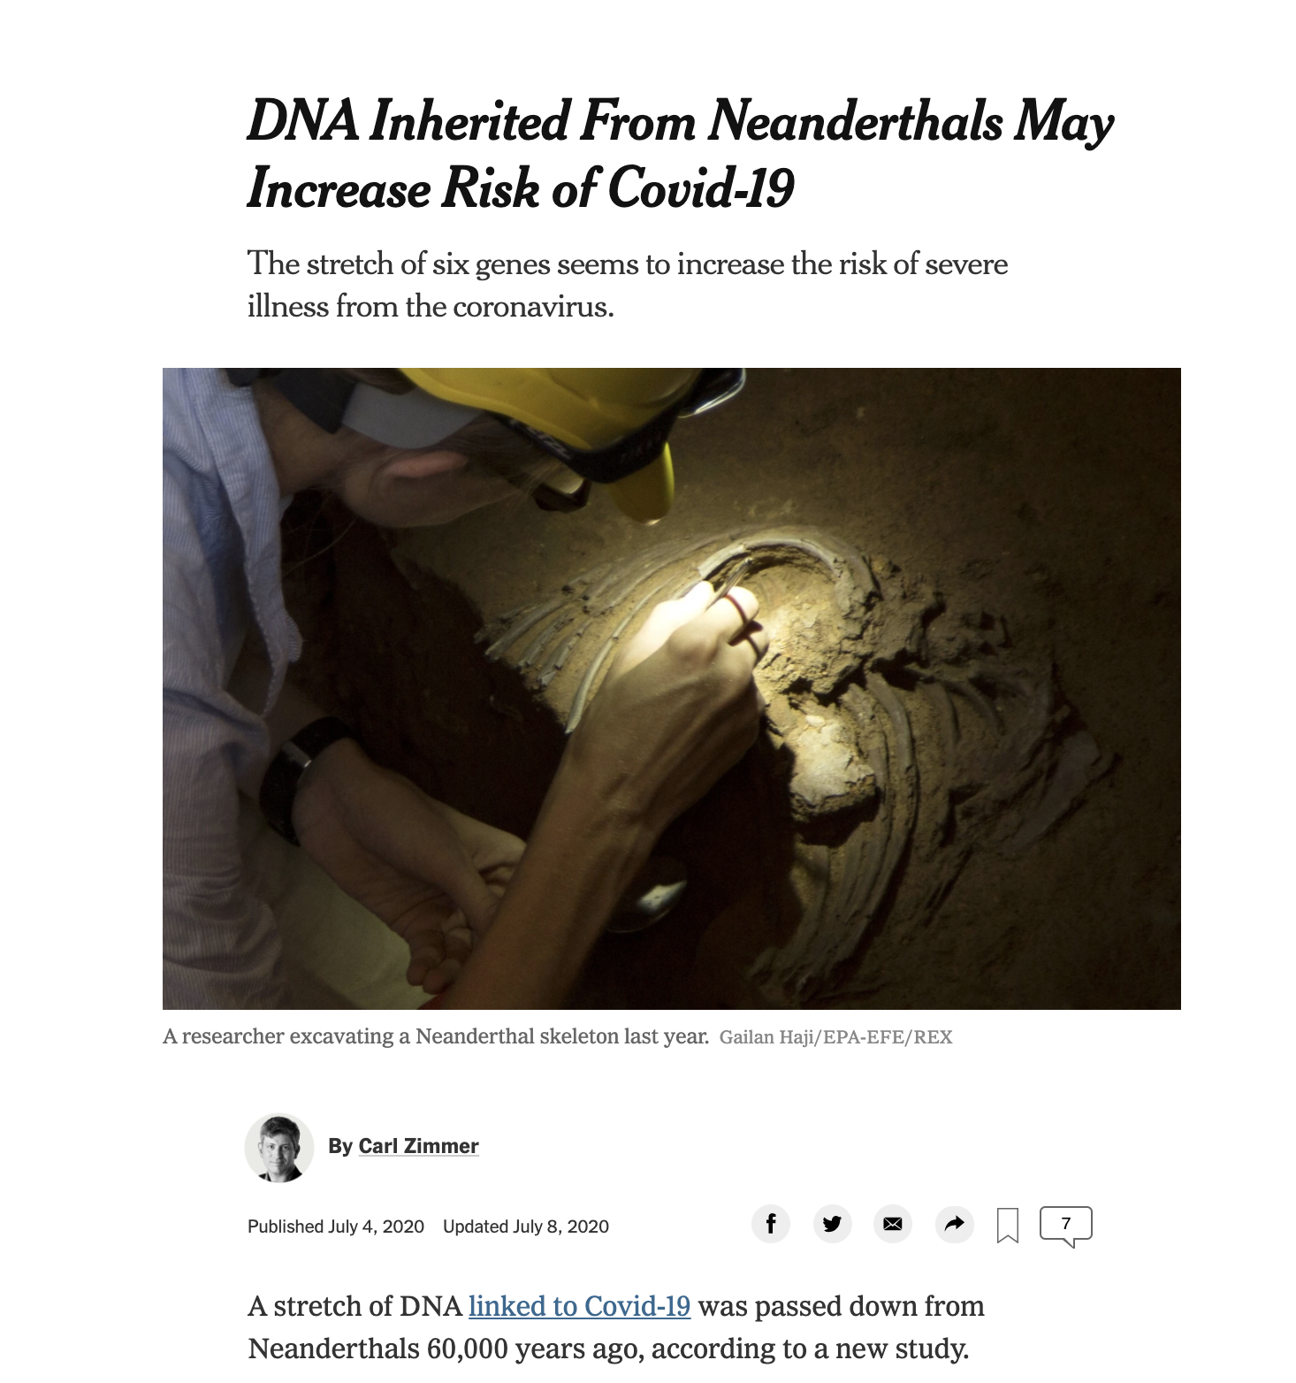

Slide 33
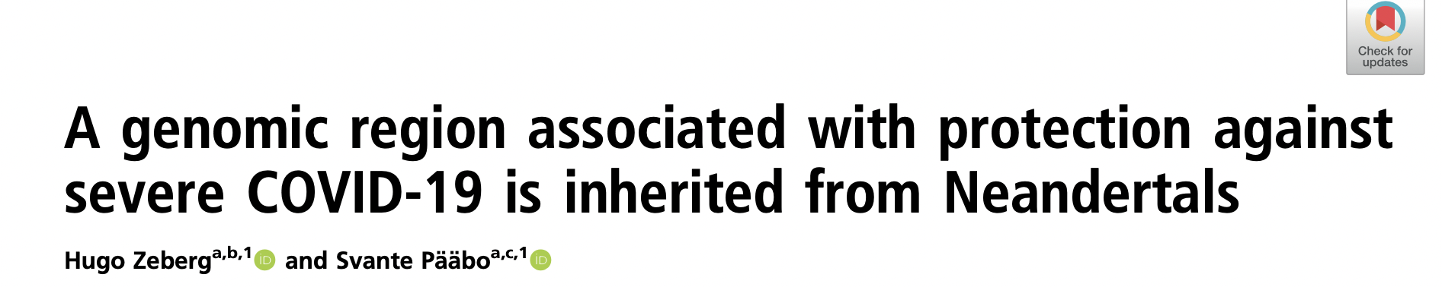
OAS1
OAS3 (green)
Double-stranded RNA (orange and purple)
pnas.org/content/118/9/e2026309118
https://www.ebi.ac.uk/pdbe/

Slide 35
Alleles for increased risk on chromosome 13: NONE
Alleles for decreased risk on chromosome 12: Two heterozygous SNPs
On balance, a good inheritance?
Courtesy of Jiahao Gao
Image: Viktor Deak

Slide 36
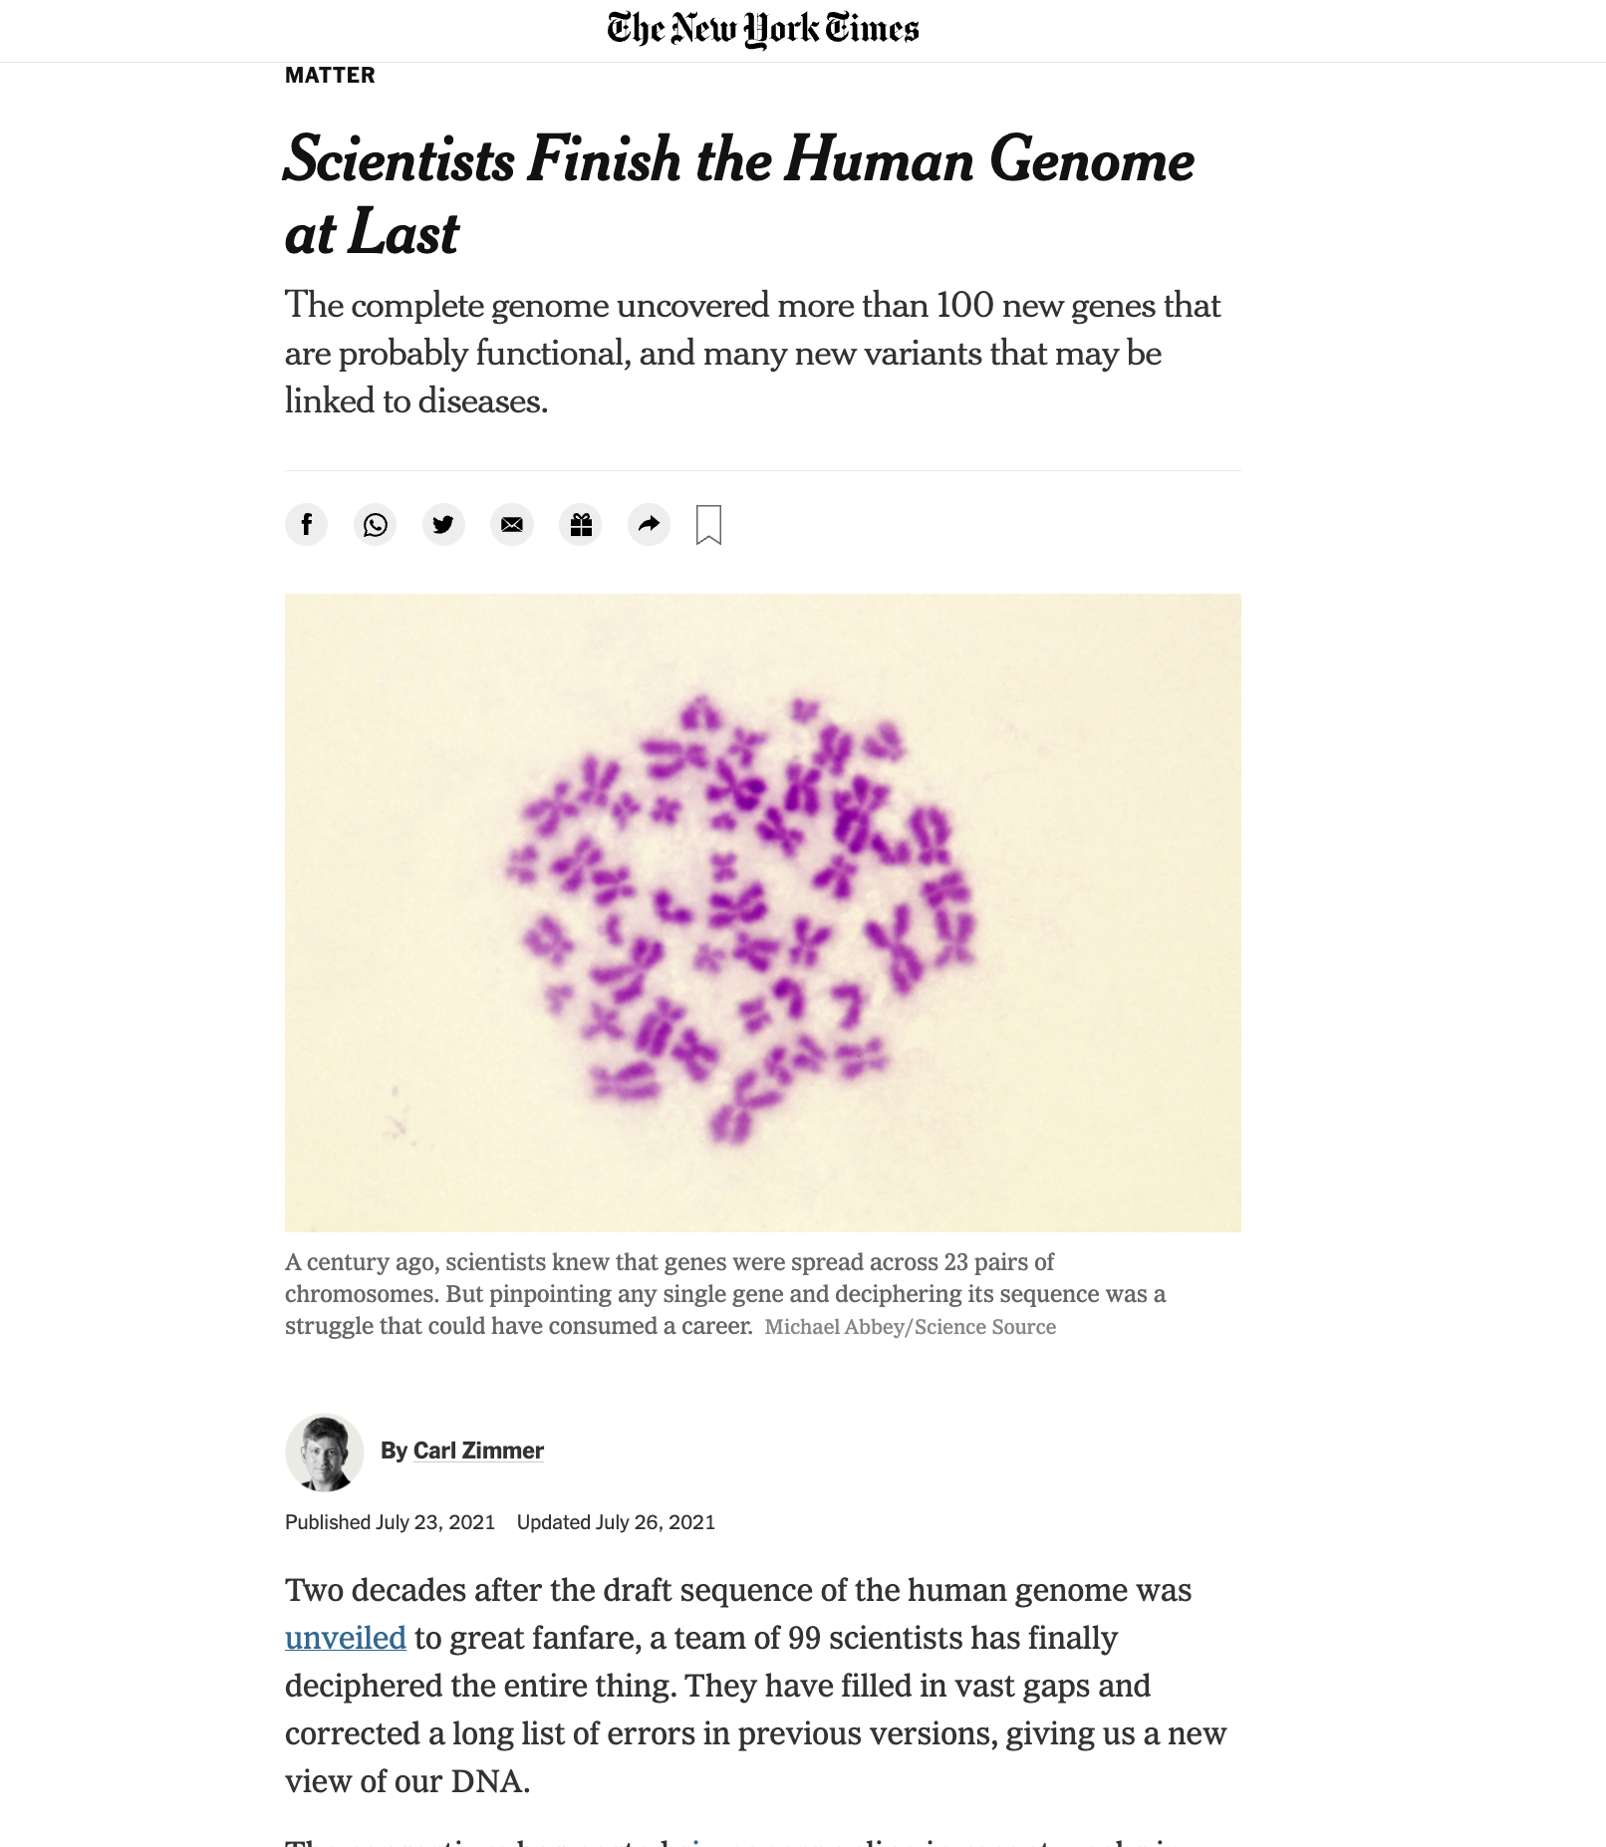

Slide 37
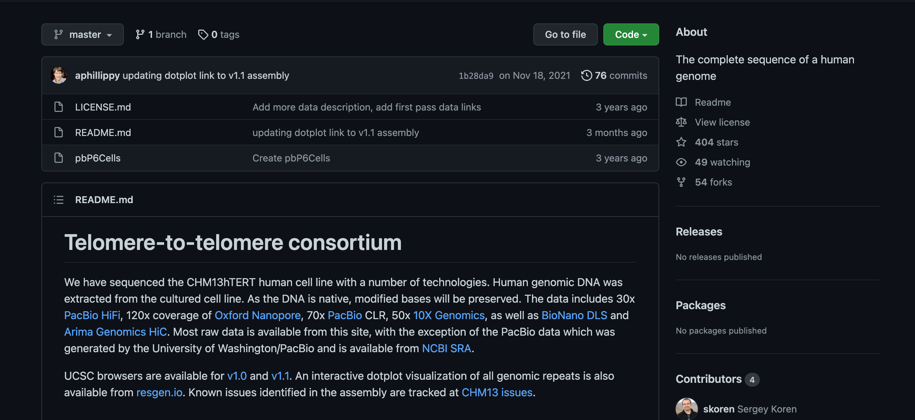
github.com/marbl/CHM13

Slide 38
Charles Byrne (1761–1783)
“Mr. O'Brien the Irish Giant the Tallest Man in the Known World Being Near Nine Feet High”
whitney.med.yale.edu

Slide 39
Joel Hirschhorn
Harvard Medical School

Slide 40
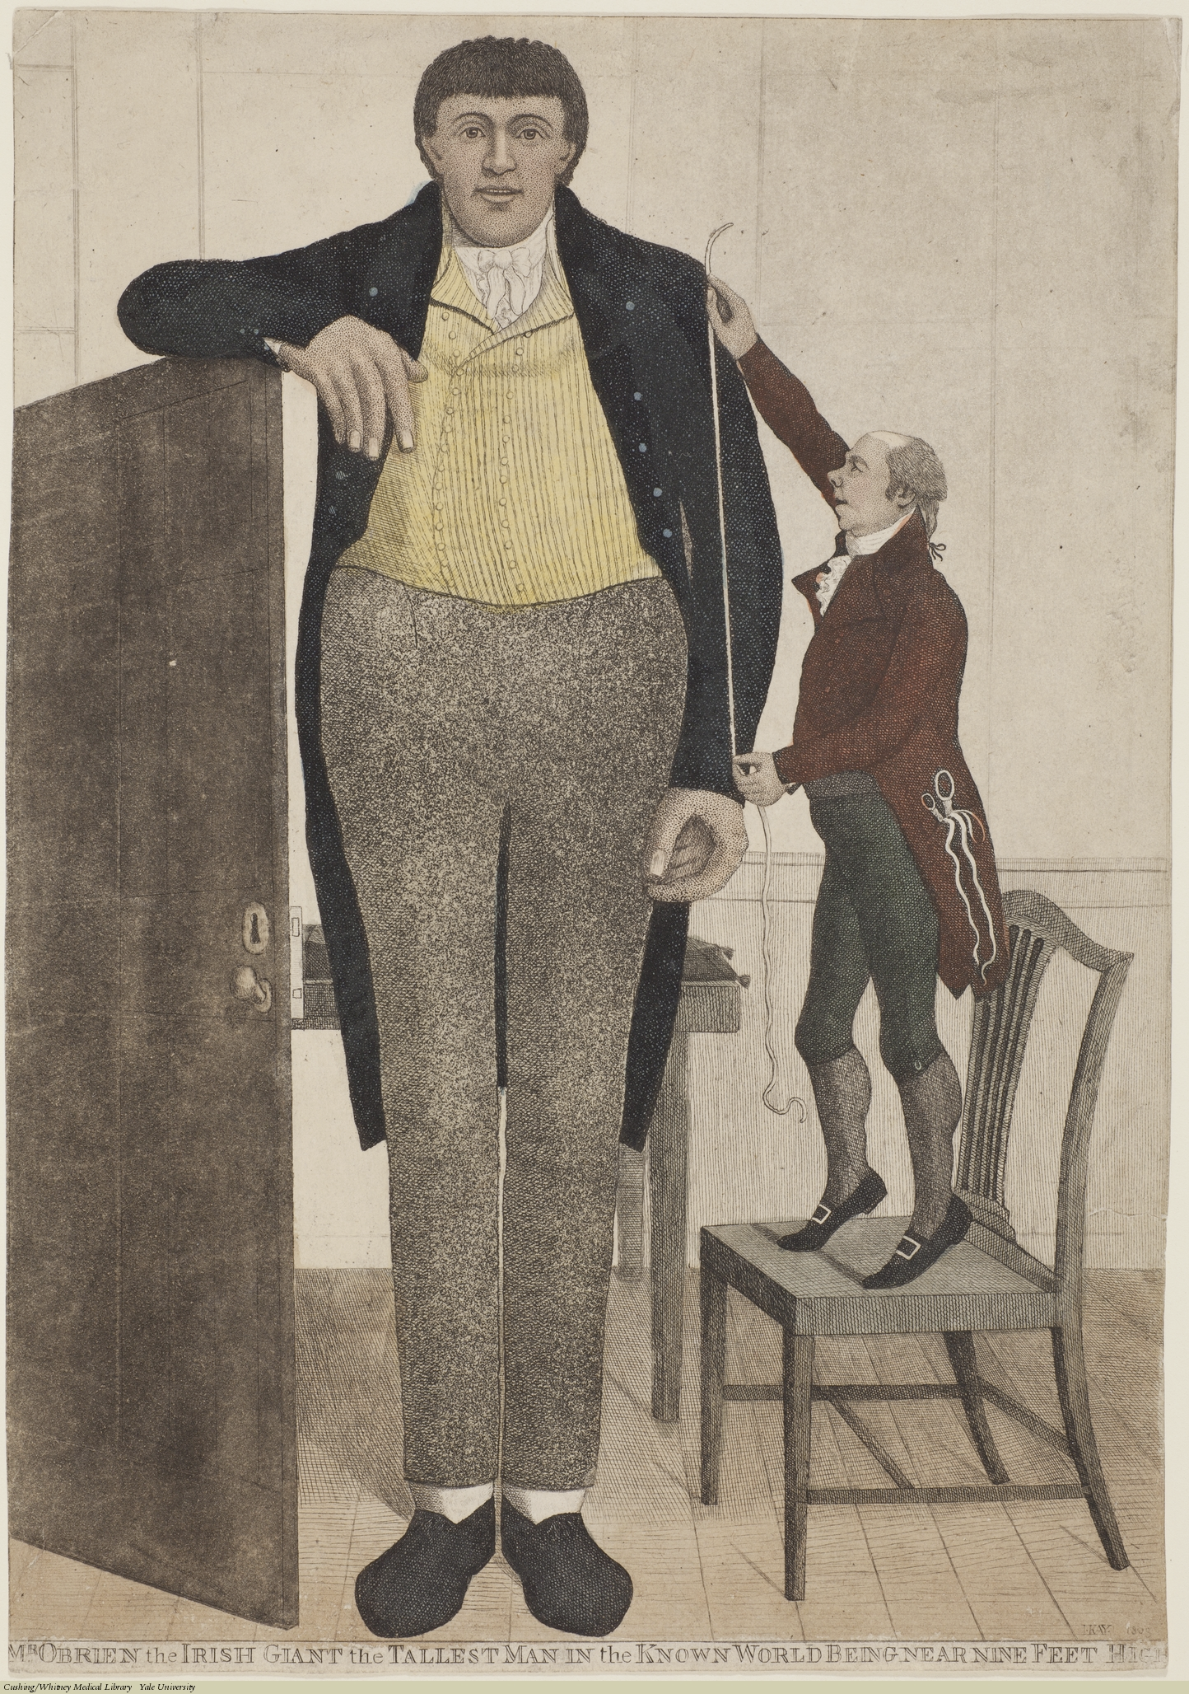
2022
2020
12,111
variants
9900
variants
2018
2014
2010
3290
variants
2007
697
variants
180
variants
1
variant
4921 people
183,727 people
253,288 people
693,529 people
4.1 million people
5.4 million people
Weedon et al
Lango Allen et al
Wood et al
Yengo et al
Yengo et al
Yengo et al

Slide 41
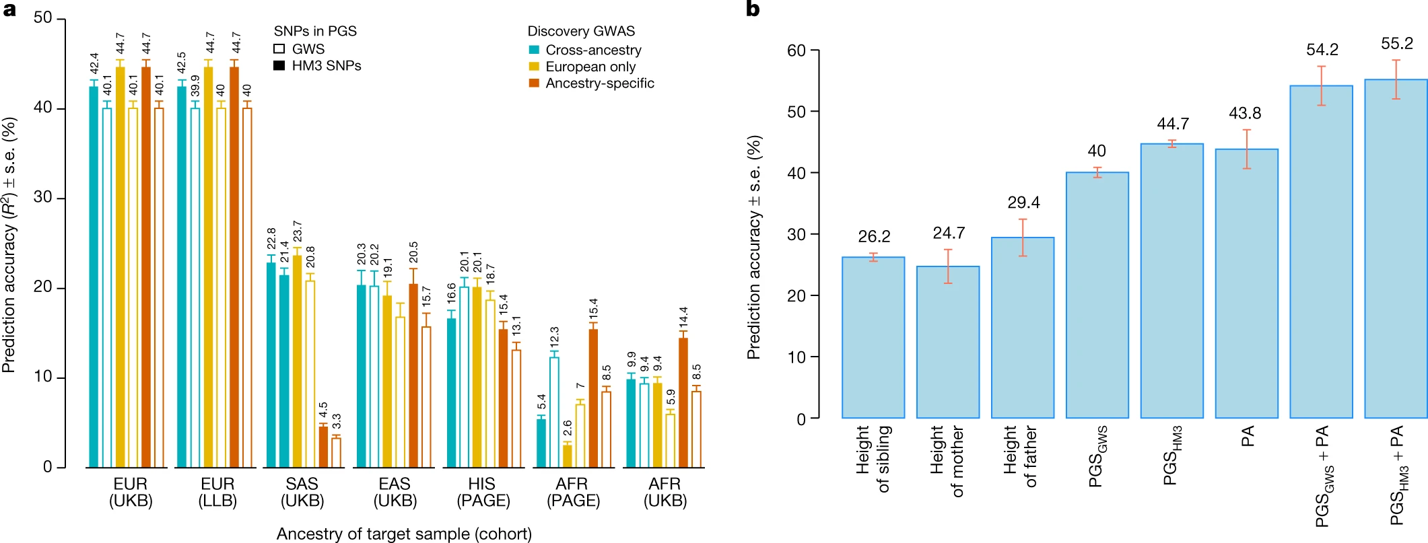
Yengo, et al. "A saturated map of common genetic variants associated with human height." Nature 610.7933 (2022): 704-712.

Slide 42
AVERAGE WOMEN’S HEIGHT (cm)
Canada
157.6
Barbados
152.1
http://ncdrisc.org/height-mean-ranking.html

Slide 43
AVERAGE WOMEN’S HEIGHT (cm)
165.3
163.9
1996
Canada
157.6
Barbados
152.1
1896
http://ncdrisc.org/height-mean-ranking.html

Slide 44
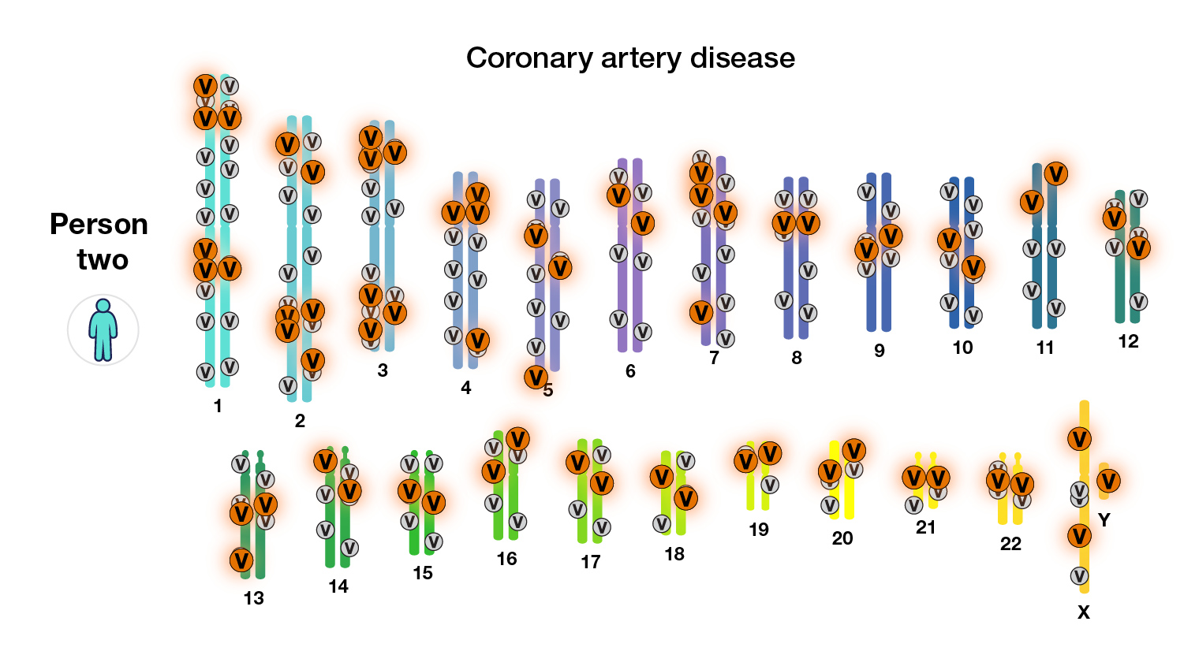
Polygenic risk scores: future medicine?
genome.gov/Health/Genomics-and-Medicine/Polygenic-risk-scores

Slide 45
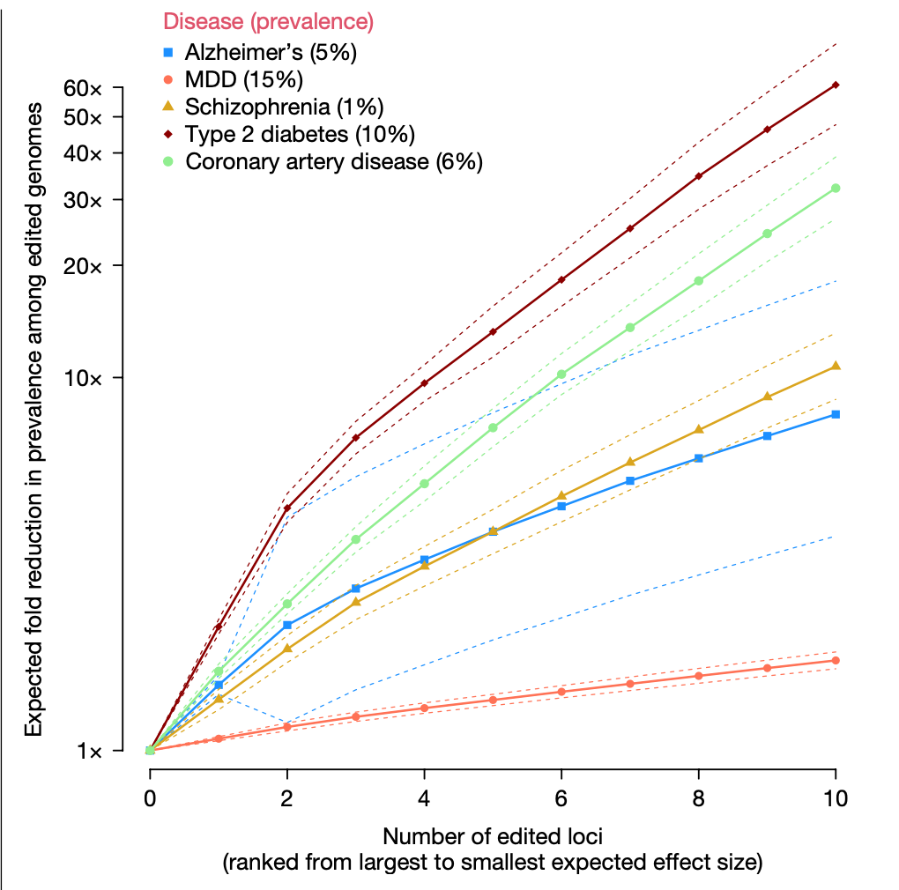
Should we change our genomes?
Visscher, Peter M., et al. "Heritable polygenic editing: the next frontier in genomic medicine?." Nature (2025): 1-9.

Slide 46

Yale Library Book Talk
with Prof. Brandon Ogbunu
April 9, 2025
Wednesday, 4 p.m.–5:30 p.m.
Sterling Memorial Library, Lecture Hall, 120 High Street
library.yale.edu/event/yale-library-book-talk-air-borne-carl-zimmer
Notes:
How about DNA? Every cell in your body has the same molecule, a cookbook with 3 billion letters.

