Slide 1
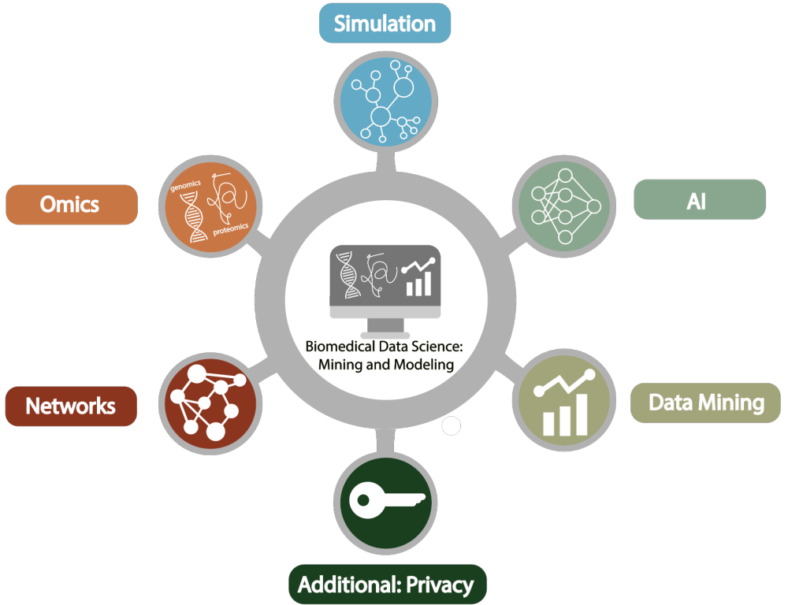
Biomedical Data Science (GersteinLab.org/courses/452)
Introduction (25i1+25i2a)
Last edit in spring ’25.
Combines & integrates i1 [which has a video] & i2a from previous years.
Takes ~50’ with rest of class going over website syllabus
Mark Gerstein
Yale U.

Slide 2

Please Fill Out Course Web Forms –
Right now, if you haven’t already!
Course Web Form
Due Today （1/13）
Link is also available from class website: GersteinLab.org/courses/452

Slide 3
Overview: what is
Biomed. Data science?
(in the context of Data Science, in general)

Slide 4
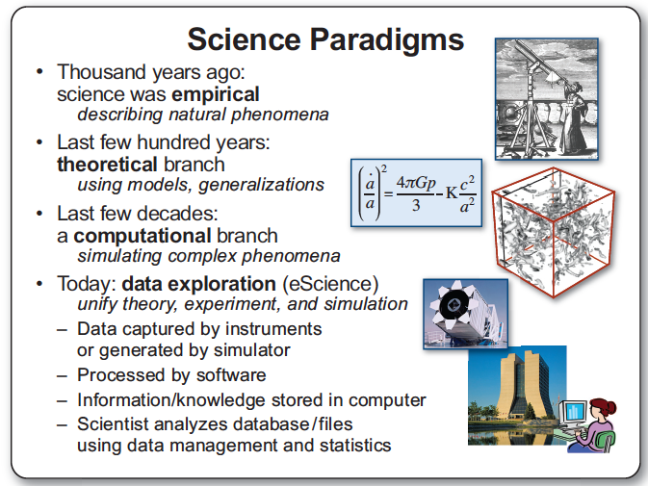
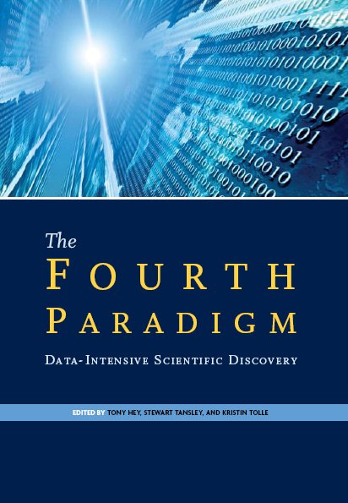
Jim Gray’s 4th Paradigm

Slide 5
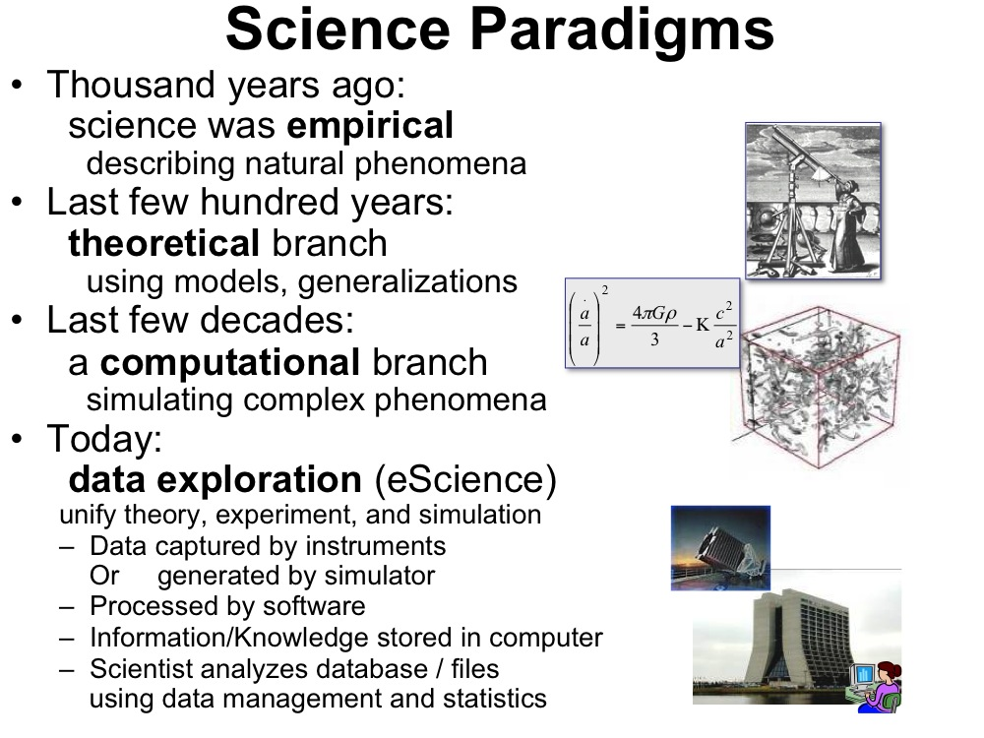
Jim Gray’s 4th Paradigm
#3 - Simulation
  Prediction based on physical principles (eg Exact Determination of Rocket Trajectory)
  Emphasis on: Supercomputers
#4 - Data Mining
  Classifying information & discovering unexpected relationships
  Emphasis: networks, “federated” DBs
Gray died in ’07.
Book about his ideas came out in ‘09…..
[Slide from : http://research.microsoft.com/en-us/um/people/gray/talks/stanford%2520symbolic%2520systems%2520seminar.ppt]

Slide 6
What is Data Science? An overall, bland definition…
Data Science encompasses the study of the entire lifecycle of data
  Understanding of how data are gathered &
  the issues that arise in its collection
  Knowledge of what data sources are available
  & how they may be synthesized to solve problems
  The storage, access, annotation, management, &
  transformation of data
Data Science encompasses many aspects of data analysis
  Statistical inference, machine learning, & the design of algorithms and computing systems that enable data mining
  Connecting this mining where possible with physical modeling
  The presentation and visualization of data analysis
  The use of data analysis to make practical decisions & policy
Secondary aspects of data, not its intended use – eg the data exhaust
  The appropriate protection of privacy
  Creative secondary uses of data – eg for Science of science
  The elimination of inappropriate bias in the entire process

Slide 7
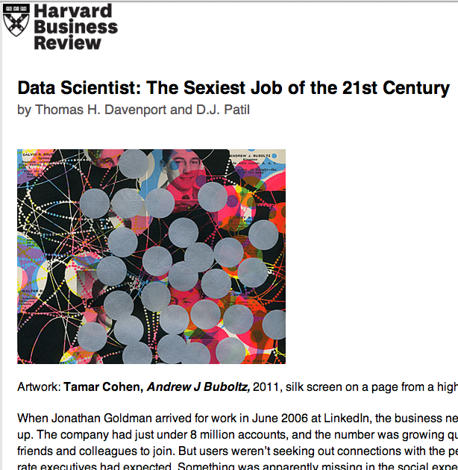
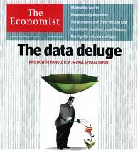
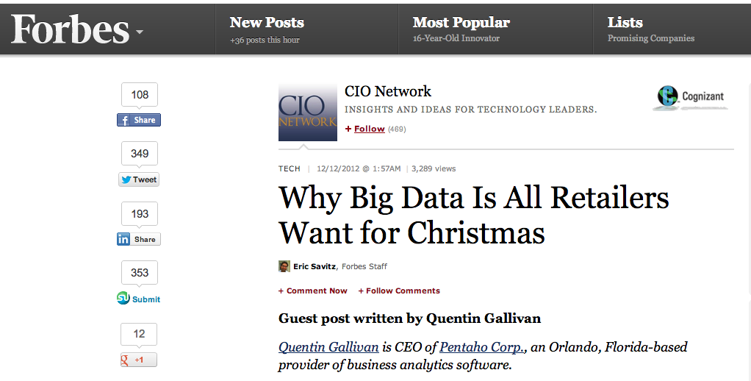
Data Science in the wider world: a buzz-word for successful Ads
Ads, media, product placement,
supply optimization,
Integral to success of GOOG, FB, AMZN, WMT…
[Oct. ‘12 issue]

Slide 8
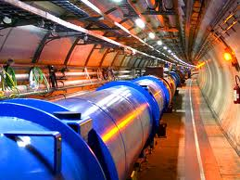
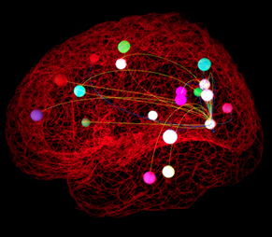
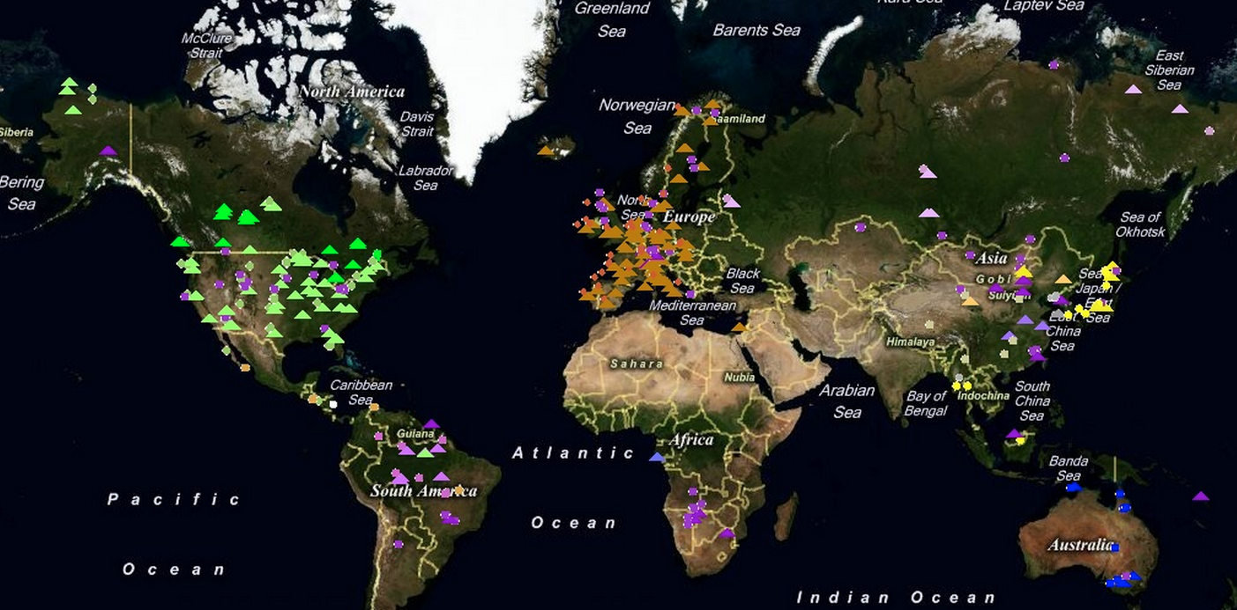
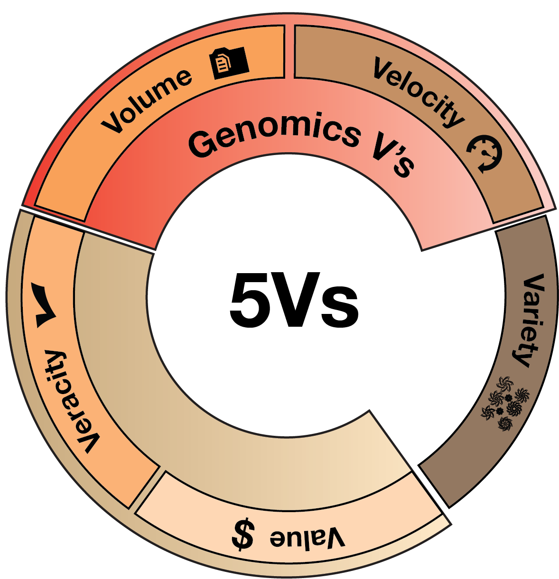
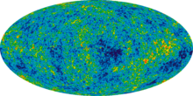
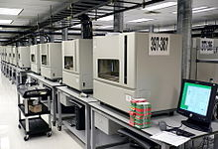
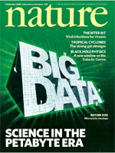

Data Science in Traditional Science
Pre-dated commercial mining
Instrument generated
Large data sets often created by large teams not to answer one Q but to be mined broadly
Often coupled to a physical/biological model
Interplay w/ experiments
[Navarro et al. GenomeBiol. (’19, in press)]
Ecology
& Earth Sci.
- Fluxnet
High energy physics -
Large Hadron Collider
Neuroscience -
The Human Connectome Project
Astronomy -
Sloan Digital Sky survey
Genomics
DNA sequencer

Slide 9
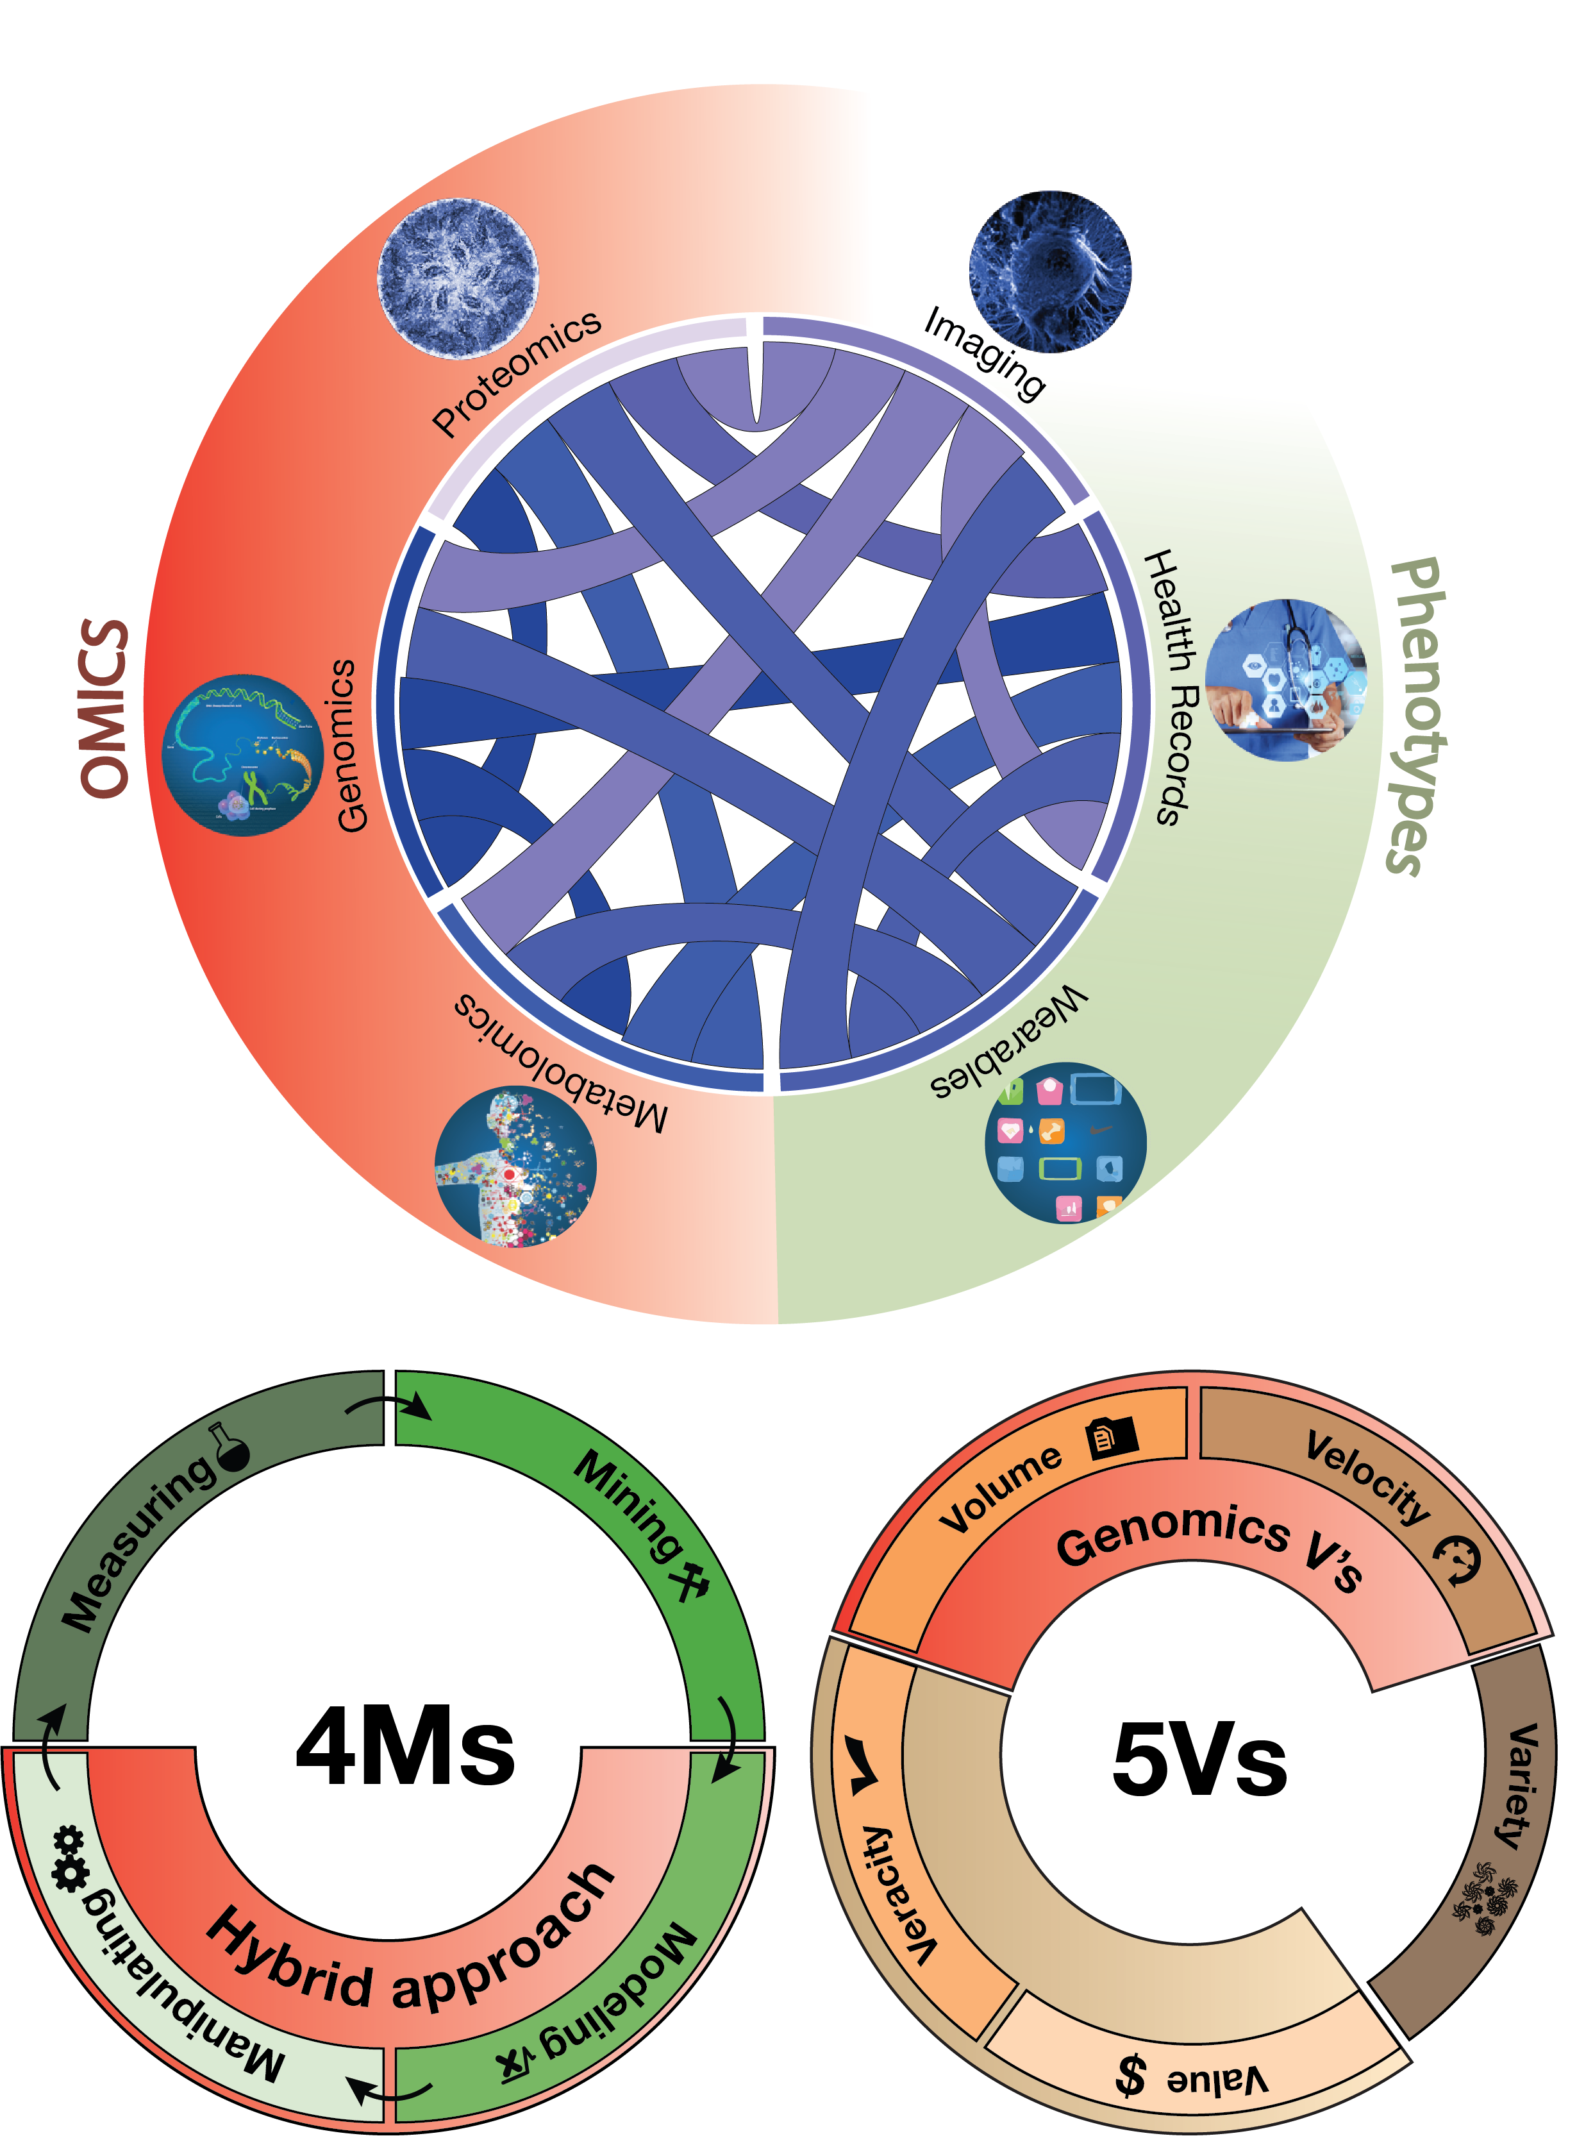
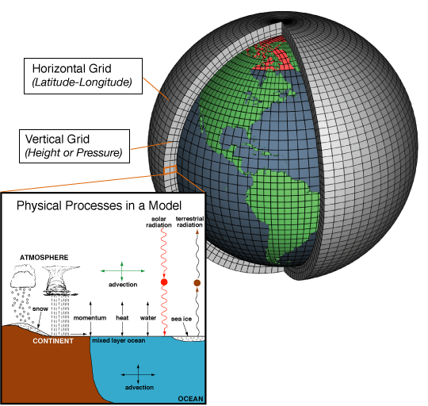
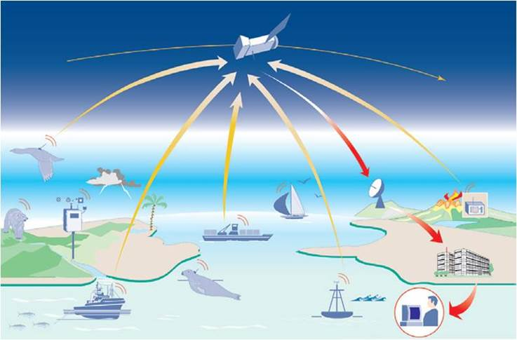
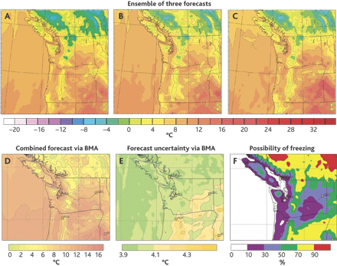
Coupling of Scientific Data to Models & Experiments
  Scientific data often coupled to a physical/biological model
Lauffenburger’s Sys. Biol. 4Ms:
Measurement, Mining, Modeling & Manipulation
(Ideker et al.’06. Annals of Biomed. Eng.)
Weather forecasting as an exemplar
  Physical models & simulation useful but not sufficient (“butterfly” effect)
  Success via coupling to large-scale sensor data collection
Models + Data Mining
Forecasts
[Navarro et al. GenomeBiol. (’19,
in press)]
Image from http://web.aibn.uq.edu.au/cssb/ResearchProjects.htm
NOAA

Slide 10
Biomed. Data science:
Scaling & Integration

Slide 11
Drivers of Biomedical Data Science
Integration across data types
Scaling
of individual data types
[Navarro et al. GenomeBiol. (’19, in press)]

Slide 12


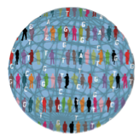

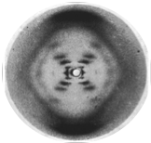
Case Study: Amazing Progress in Scaling & Integration with Genotype-Phenotype Relationships
2015
2008
Integrated health data
1995
1000
Genomes
UKBB study with over 500K participants, genotypes to phenotypic details & clinical information
1953
Sequenced Genome
Catalogue
of human variation
Double Helix
H.
influenzae
Watson
& Crick

Slide 13
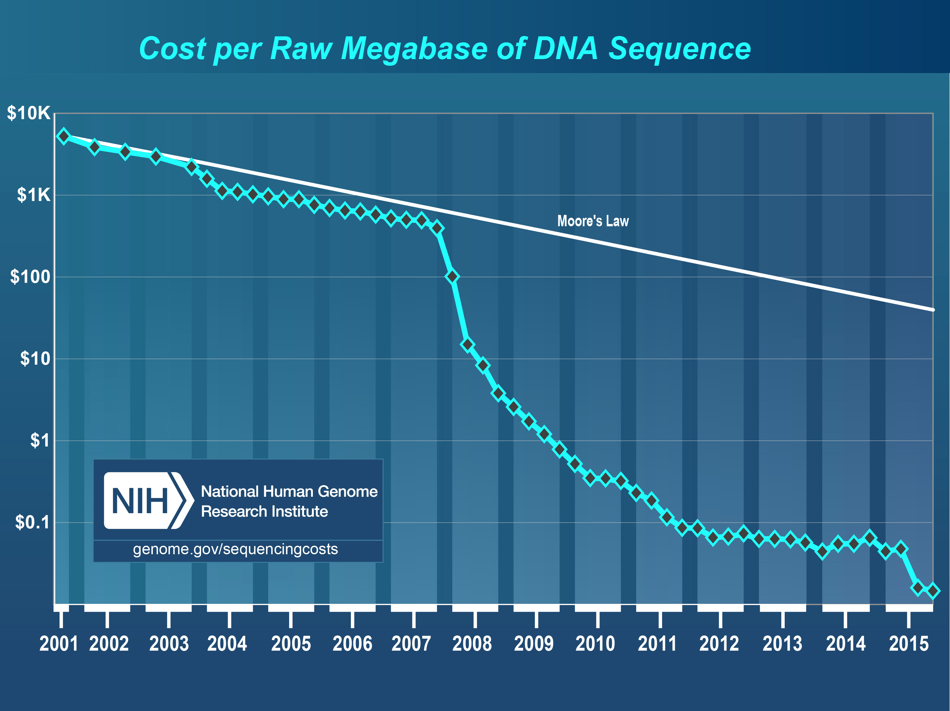
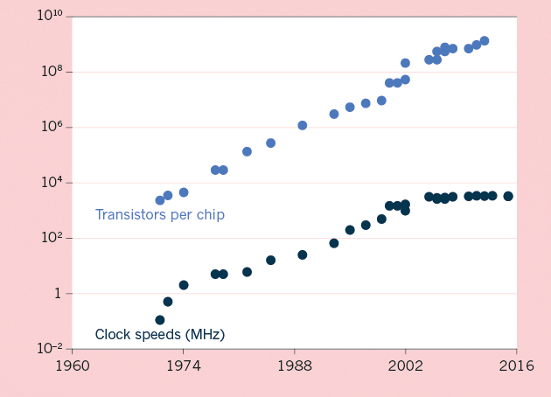
The Scaling of Genomic Data Science:
Powered by exponential increases in data & computing
(Moore’s Law)
[NHGRI website + Waldrop (‘15) Nature]

Slide 14
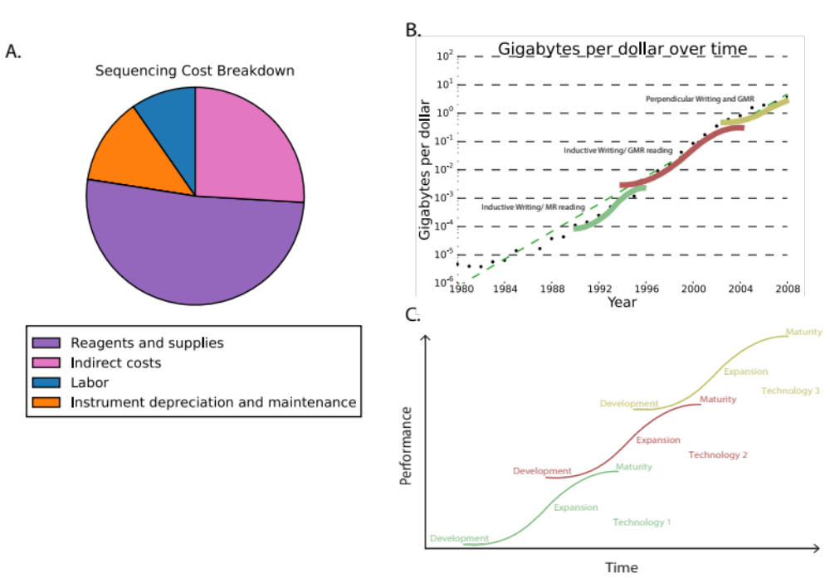
Kryder’s Law and S-curves underlying exponential growth
Moore’s & Kryder’s Laws
  As important as the increase in computer speed has been, the ability to store large amounts of information on computers is even more crucial
Exponential increase seen in Kryder’s law is a superposition of
S-curves (sigmoids) for different technologies
[Muir et al. (‘15) GenomeBiol.]

Slide 15
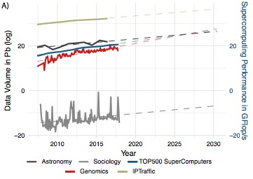
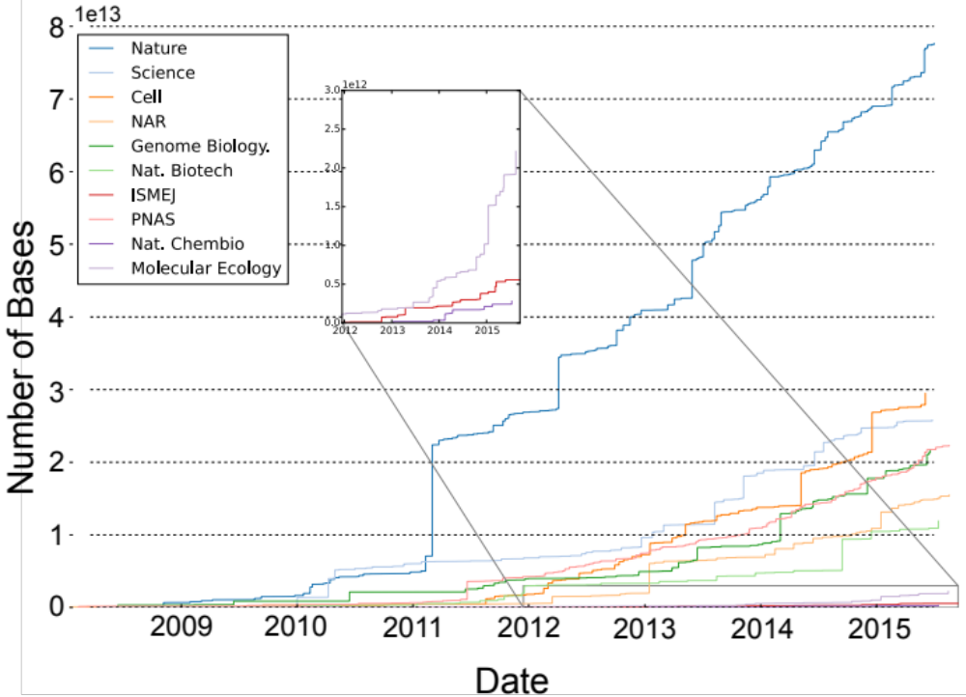
Sequencing cost reductions have resulted in an explosion of data
The type of sequence data deposited has changed as well.
[Muir et al. (‘15) GenomeBiol.]

Slide 16
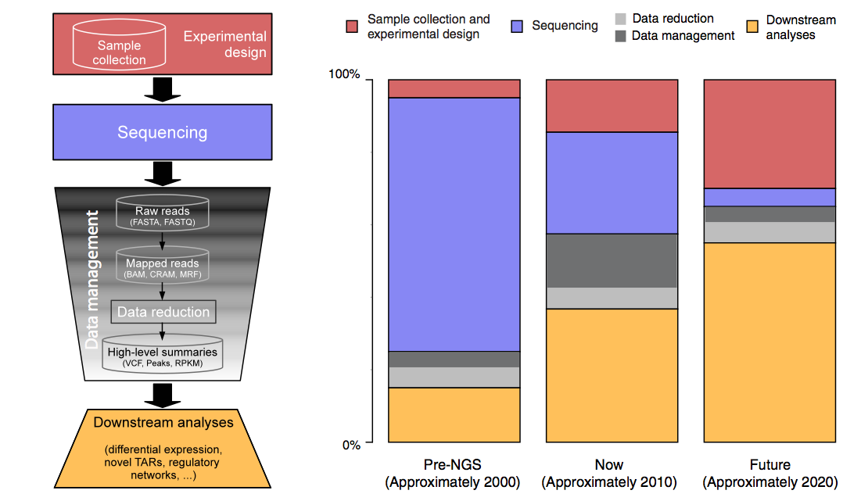
The changing costs of a sequencing pipeline
From ‘00 to ~’20,
cost of DNA sequencing expt. shifts from the actual seq. to sample
collection & analysis
[Sboner et al. (‘11), Muir et al. (‘15) Genome Biology]

Slide 17
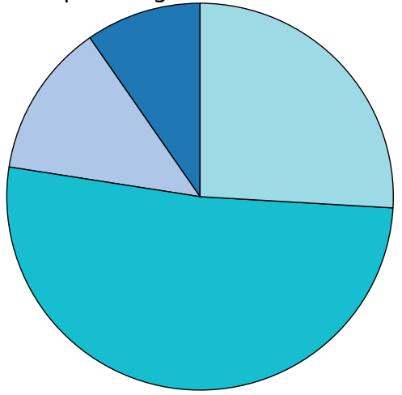
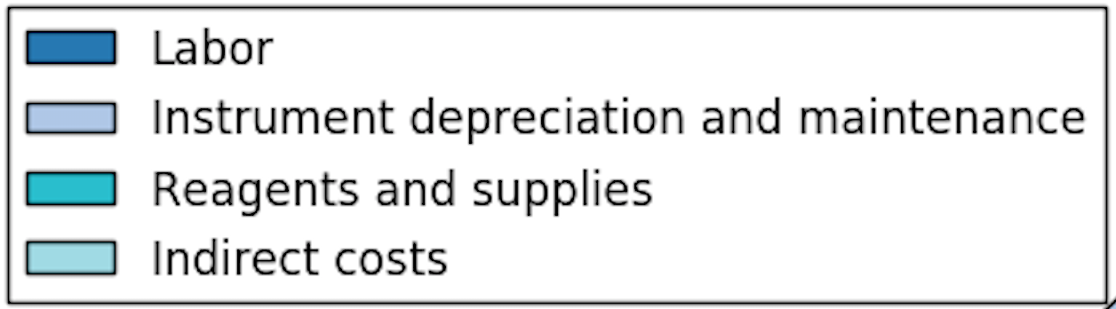
The changing costs of a sequencing pipeline
From ‘00 to ~’20,
cost of DNA sequencing expt. shifts from the actual seq. to sample
collection & analysis
[Sboner et al. (‘11), Muir et al. (‘15) Genome Biology]

Slide 18
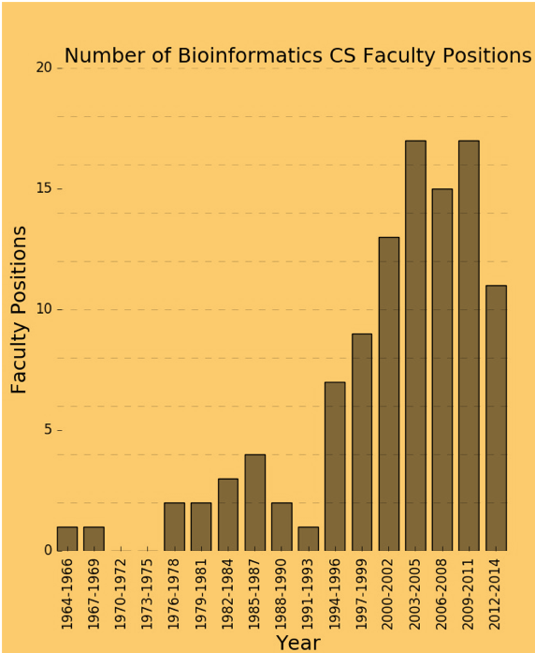
The changing costs of a sequencing pipeline
From ‘00 to ~’20,
cost of DNA sequencing expt. shifts from the actual seq. to sample
collection & analysis
[Sboner et al. (‘11), Muir et al. (‘15) Genome Biology]

Slide 19
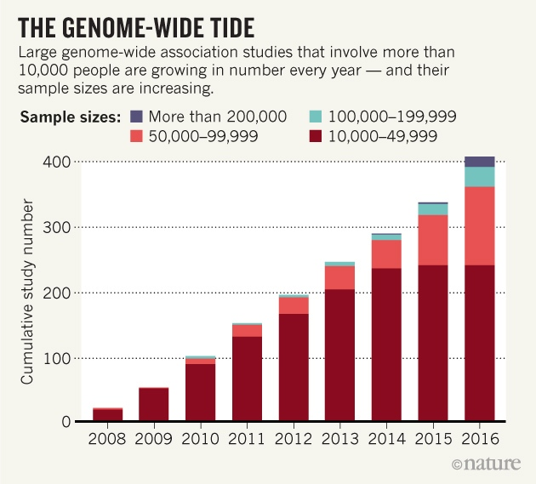
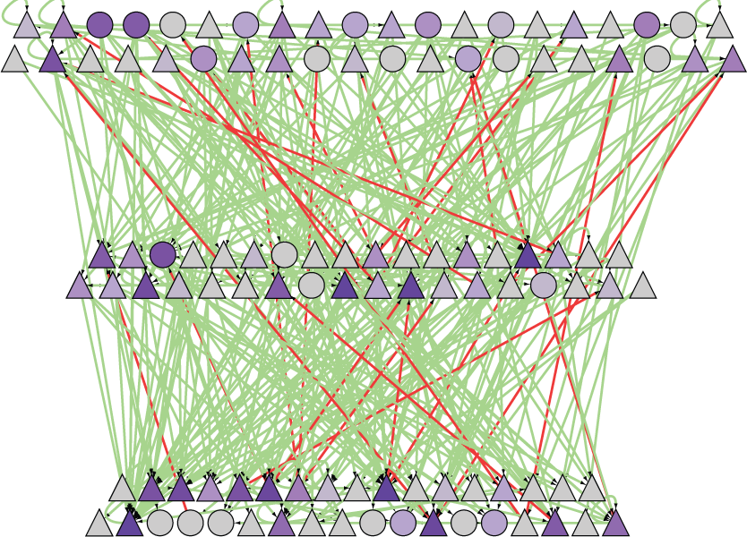
A Success of
Scale & Integration:
Many GWAS variants found, most not in genes, but affecting regulatory network
A 1st GWAS done at Yale, for AMD:
(Klein et al. 05, Science)
Many since then
Most SNVs fall into non-coding regulatory regions
(major contributions by Yale groups to this ENCODE annotation effort)
[Nature 489: 91]

Slide 20
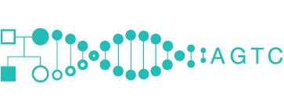
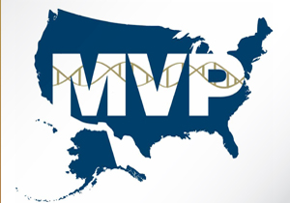




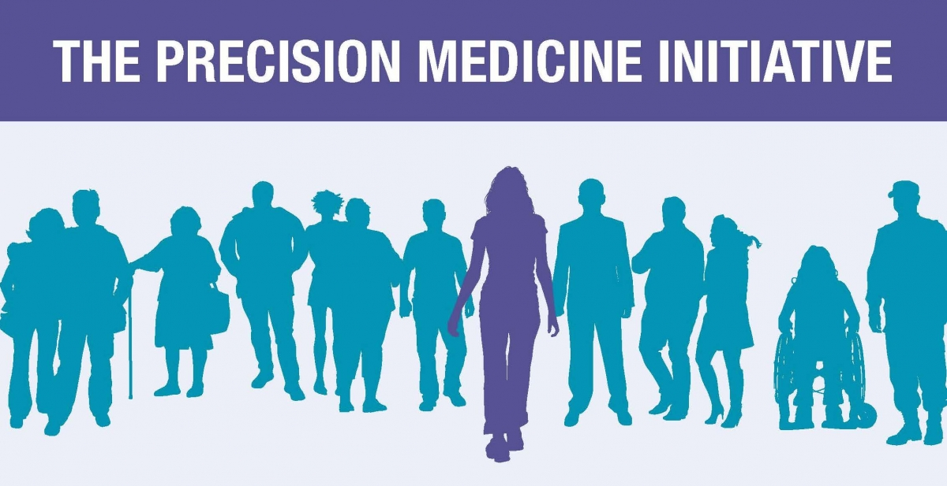
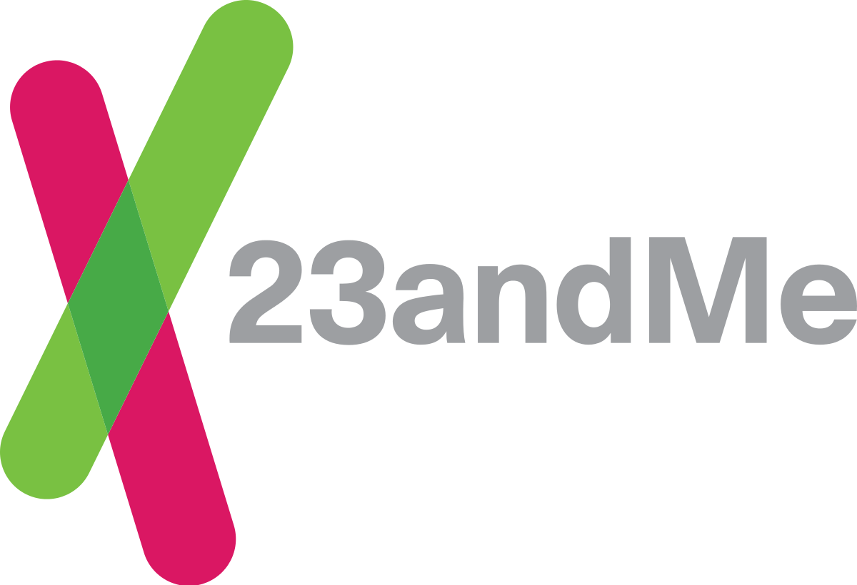



Basic Science to Medicine
INITIATIVES
Large-scale ‘omics data as an anchor to organize phenotypic data – EMRs, wearables…
1st [‘05-]: Exomes & chips of disease-focused cohorts – init. GWAS, TCGA, PGC
2nd [‘15-]: Integration of full WGS with rich & diverse phenotypes - UKBiobank, TopMed, Genomics England, PCAWG, All of Us
STARTUPS
Medical Big Data: Promise and Challenges (Lee and Yoon , Kidney Res. Clin. Pract., 2017)

Slide 21
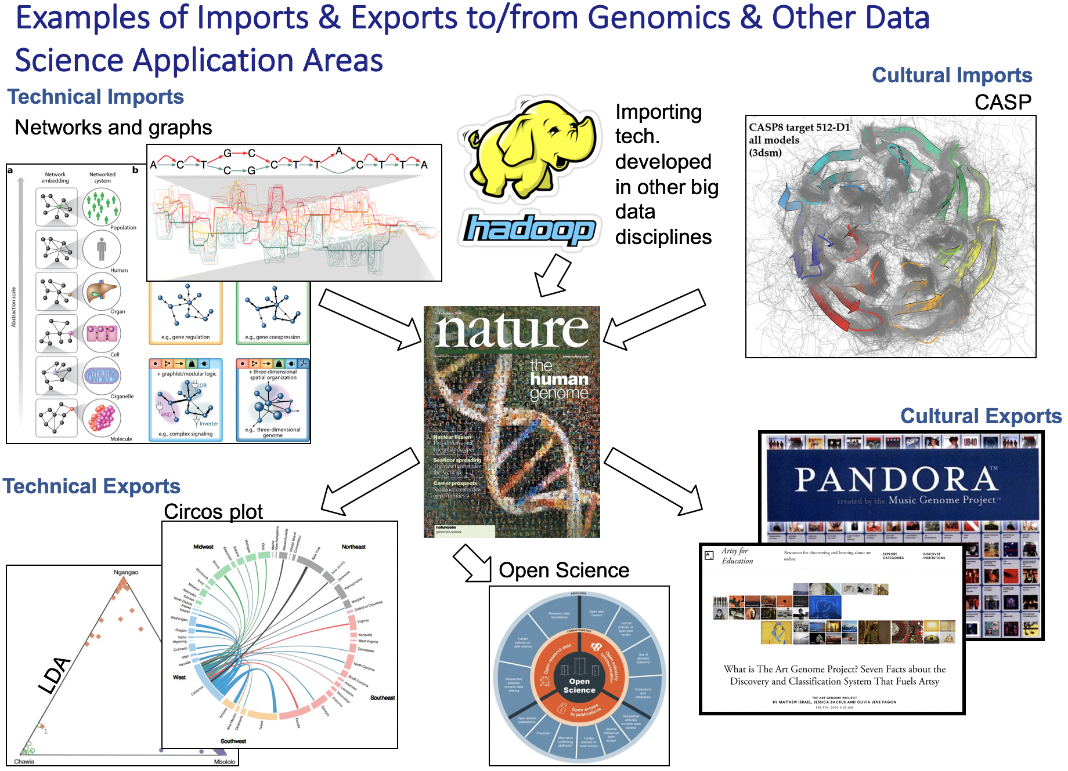
[Navarro et al. GenomeBiol. (’19, in press)]

Slide 22
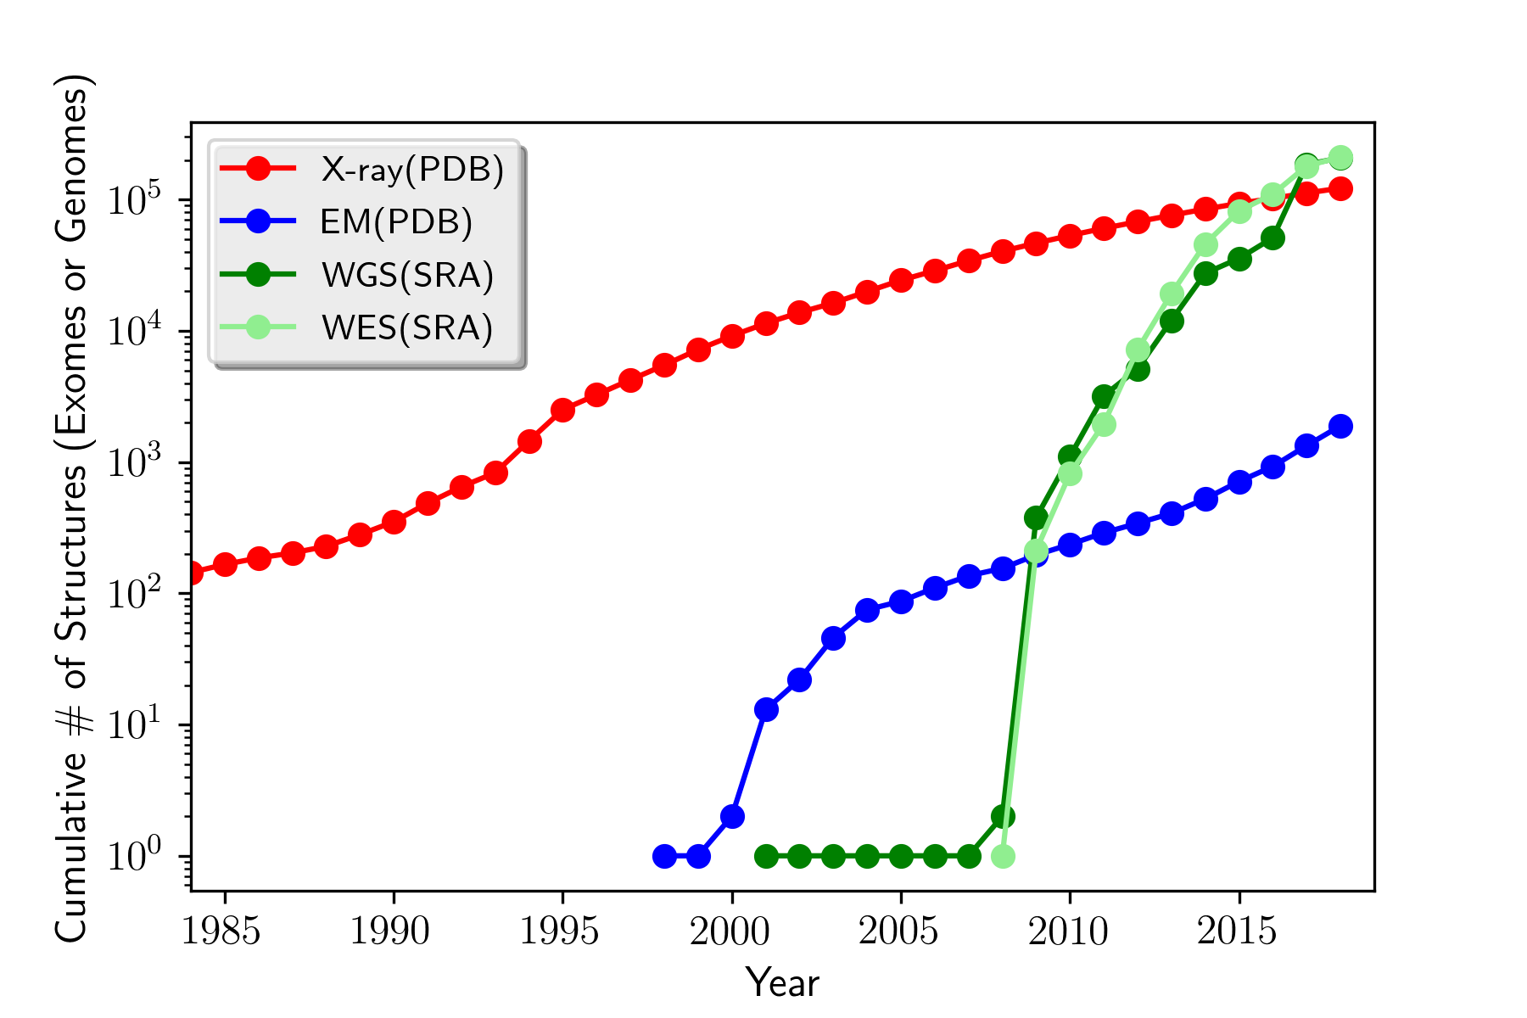
How will the Data Scaling Continue?
The Past, Present & Future Ecosystem of Large-scale Biomolecular Data
Molecular Structures
Seqences (Human WGS & WES)
Images (Cryo-EM)

Slide 23
Biomed. Data science:
Applications

Slide 24
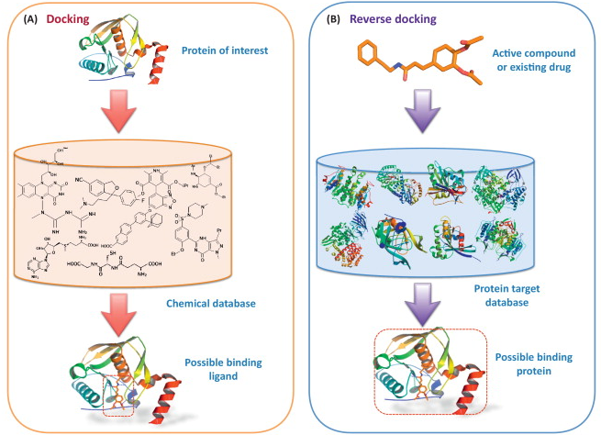
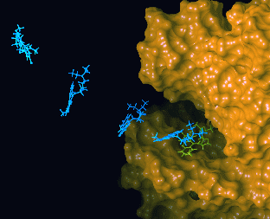
Major Application I:
Designing Drugs from Structural Targets
Understanding how structures bind other molecules
Designing inhibitors using docking, structure modeling
In silico screens of chemical and protein databases
  (From left to right, figures adapted from Olsen Group Docking Page at Scripps, Zheng et al. Trends in Pharmacological Sciences 2013)

Slide 25
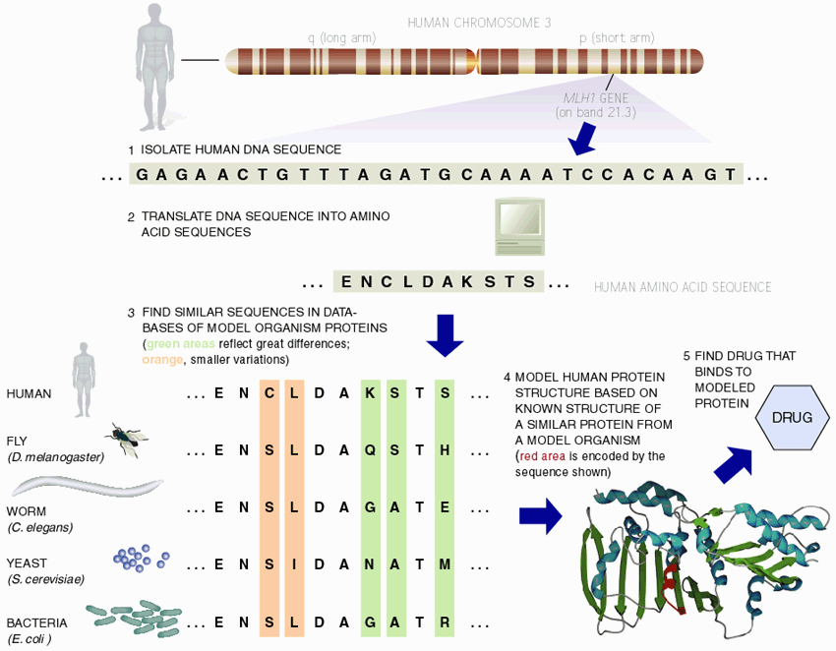
Major Application II: Finding Homologs, to Find Experimentally Tractable Gene Targets
[Adapted from Sci. Am.]

Slide 26
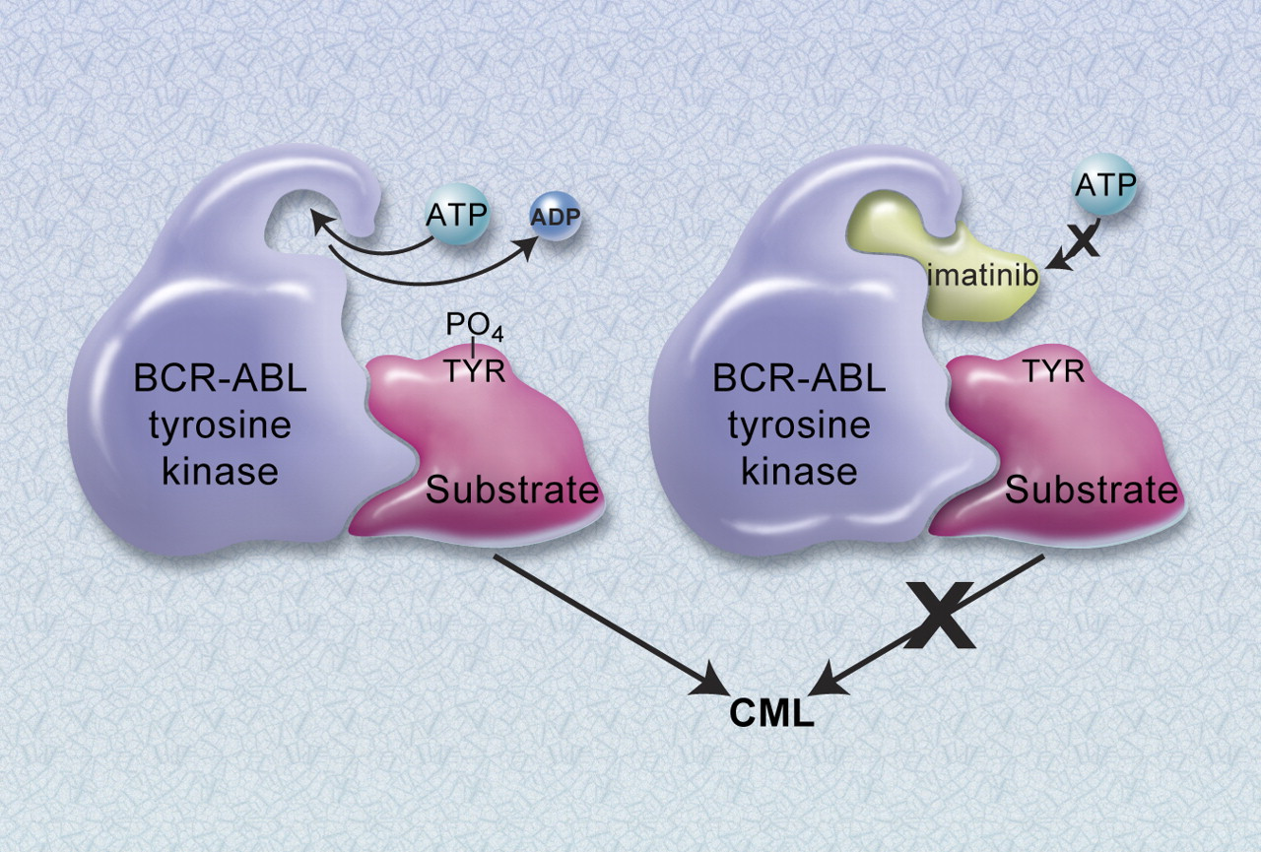
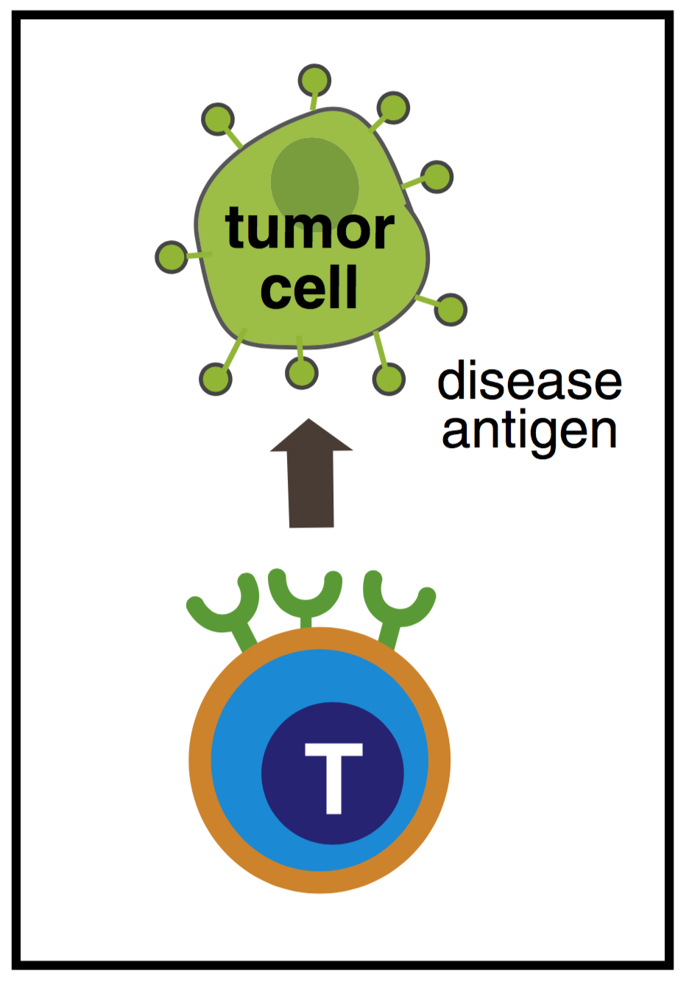
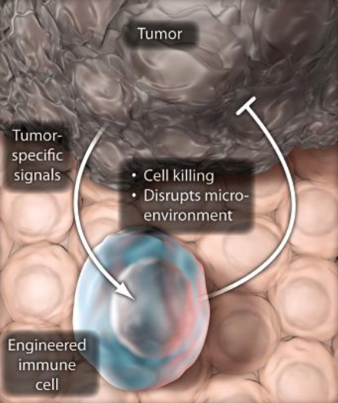
Major Application III:
Customizing treatment in oncology
Identifying disease causing mutations in individual patients
Designing targeted therapeutics
  e.g. BCR-abl and Gleevec
  Cancer immunotherapies targeting neoantigens
  (From left to right, figures adapted from Druker BJ. Blood 2008 and the Lim Lab at UCSF)

Slide 27
Major Application IV:
Finding molecular mechanisms & drug targets for diseases we know little about (Neuro-psychiatic Diseases)
Disease | Heritability* | Molecular Mechanisms
Schizophrenia | 81% | -
Bipolar disorder | 70% | -
Alzheimer's disease | 58 - 79% | Apolipoprotein E (APOE), Tau
Hypertension | 30% | Renin–angiotensin–aldosterone
Heart disease | 34-53% | Atherosclerosis, VCAM-1
Stroke | 32% | Reactive oxygen species (ROS), Ischemia
Type-2 diabetes | 26% | Insulin resistance
Breast Cancer | 25-56% | BRCA, PTEN
Phenotype
SCZ
BPD
AGE
…
*https://www.snpedia.com/index.php/Heritability
pathways, circuits
Cell types
Modules
Regulatory elements
Genes
Genotype
Many psychiatric conditions are highly heritable
  Schizophrenia: up to 80%
But we don’t understand basic molecular mechanisms underpinning this association
(in contrast to many other diseases such as cancer & heart disease)
Moreover, current models substantially underestimate heritability using genetic data
  Schizophrenia : ~25%
Thus, interested in developing predictive models of psychiatric traits which:
  Use observations at intermediate (molecular levels) levels to inform latent structure.
  Use the predictive features of these “molecular endo phenotypes” to begin to suggest actors involved in mechanism

Slide 28
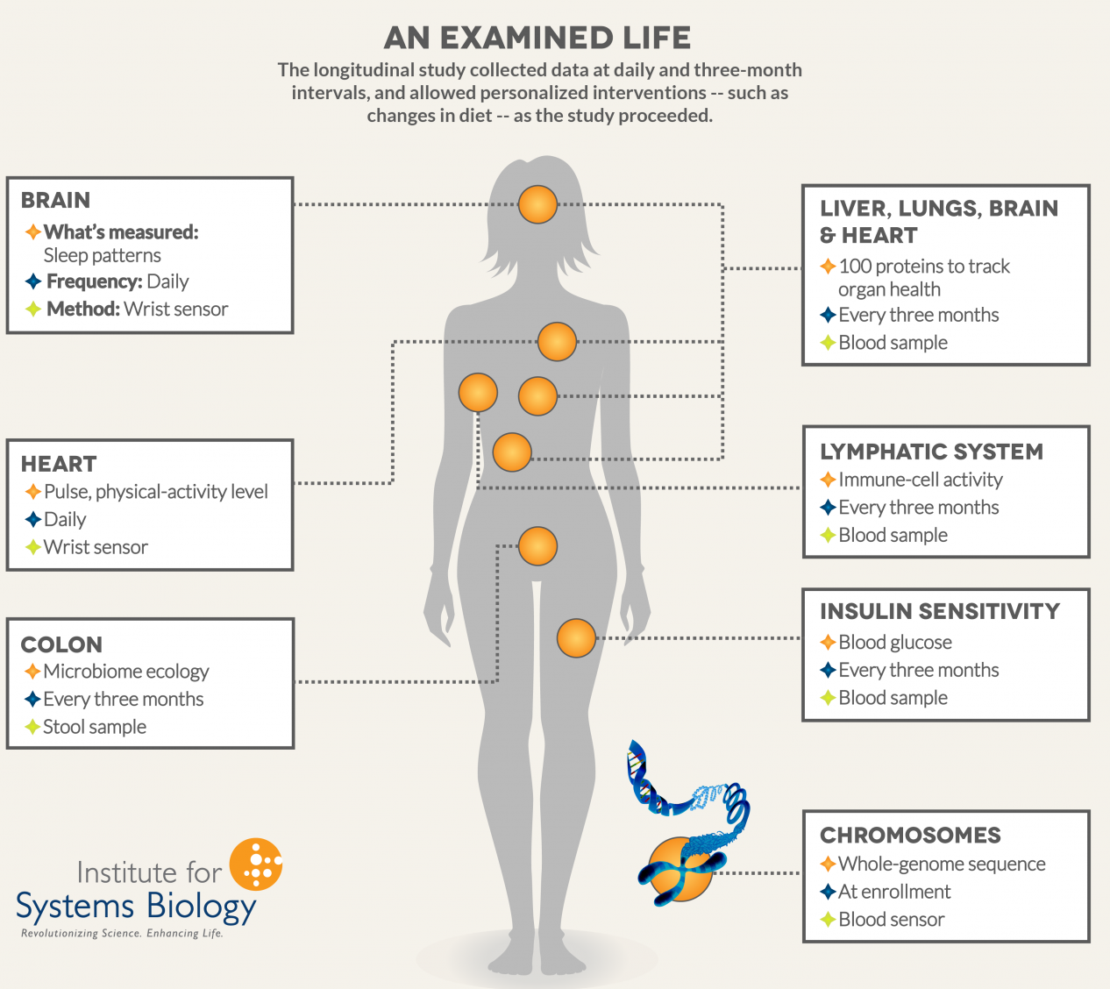
Major Application V: Holistic Personal Genome Characterization, in Normal Individuals
Mental disease & cancer are two extremes with respect to genomics (CEN, 92: 26)
  Many other conditions in between, often involving interaction with the environment
Pers. Genome Characterization
  Identify mutations in personal genomes (SNPs, SVs, &c)
  Estimate phenotypic (deleterious or protective) impact of variants.
  Compare one person to wider population.
Track changes over time & consider interaction w/ environment
  Transcriptome studies
  Longitudinal health studies
  (e.g. 100K wellness project,
  Framingham Heart Study)
(Figure from Institute for Systems Biology)

Slide 29
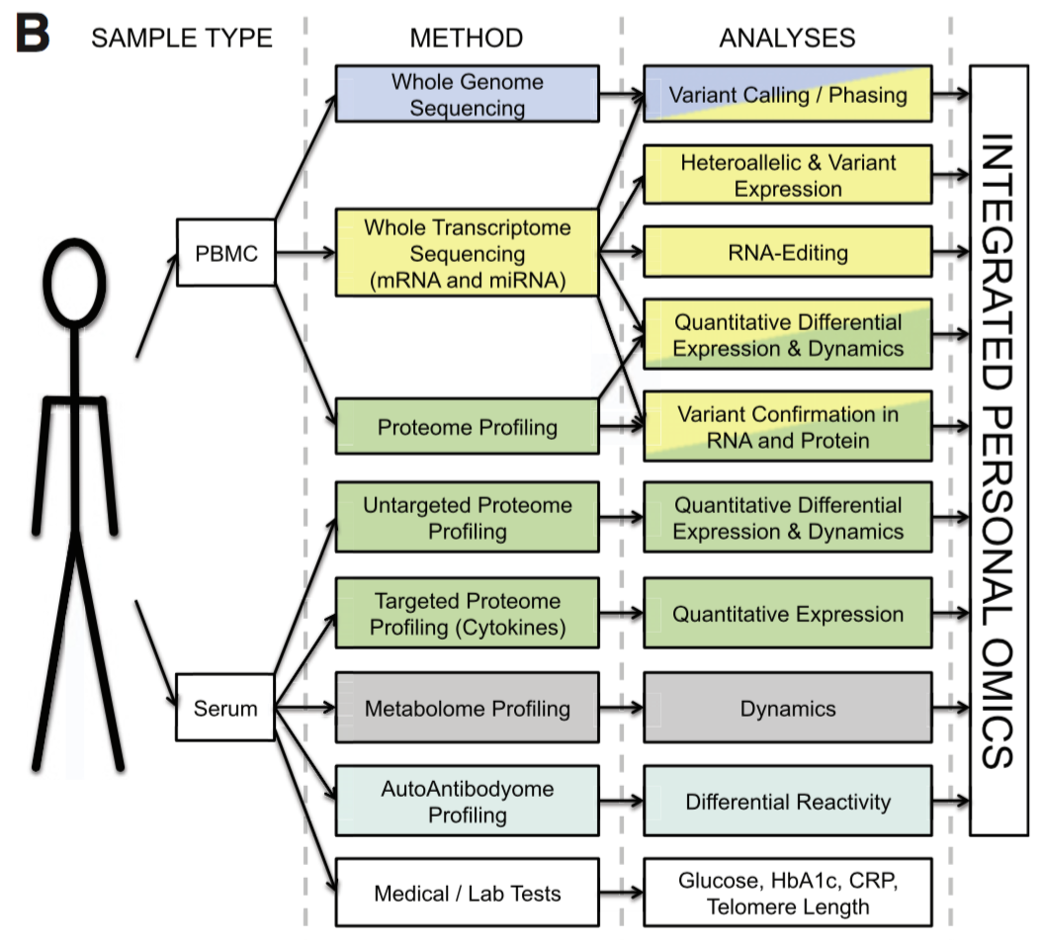
Integrated personal omics profile (iPOP)
Numerous types of data were collected, primarily from blood samples. The datasets include:
  Transcriptomic
  Proteomic
  Metabolomic
  Cytokine profiling
  Autoantibody profiling
  Medical exams
Chen et al. Cell 2012. - https://www.cell.com/cell/fulltext/S0092-8674(12)00166-3

Slide 30
Expanding personalized medicine beyond the genome.
An integrated personal omics profile (iPOP) is an example of a more comprehensive version of personalized medicine.
Michael Snyder had his genome sequenced and collected many other large scale datasets over an extended period of time.
https://med.stanford.edu/news/all-news/2017/01/wearable-sensors-can-tell-when-you-are-getting-sick.html

Slide 31
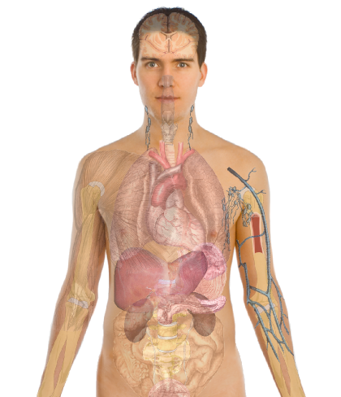
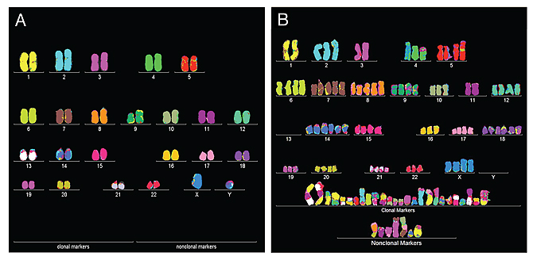
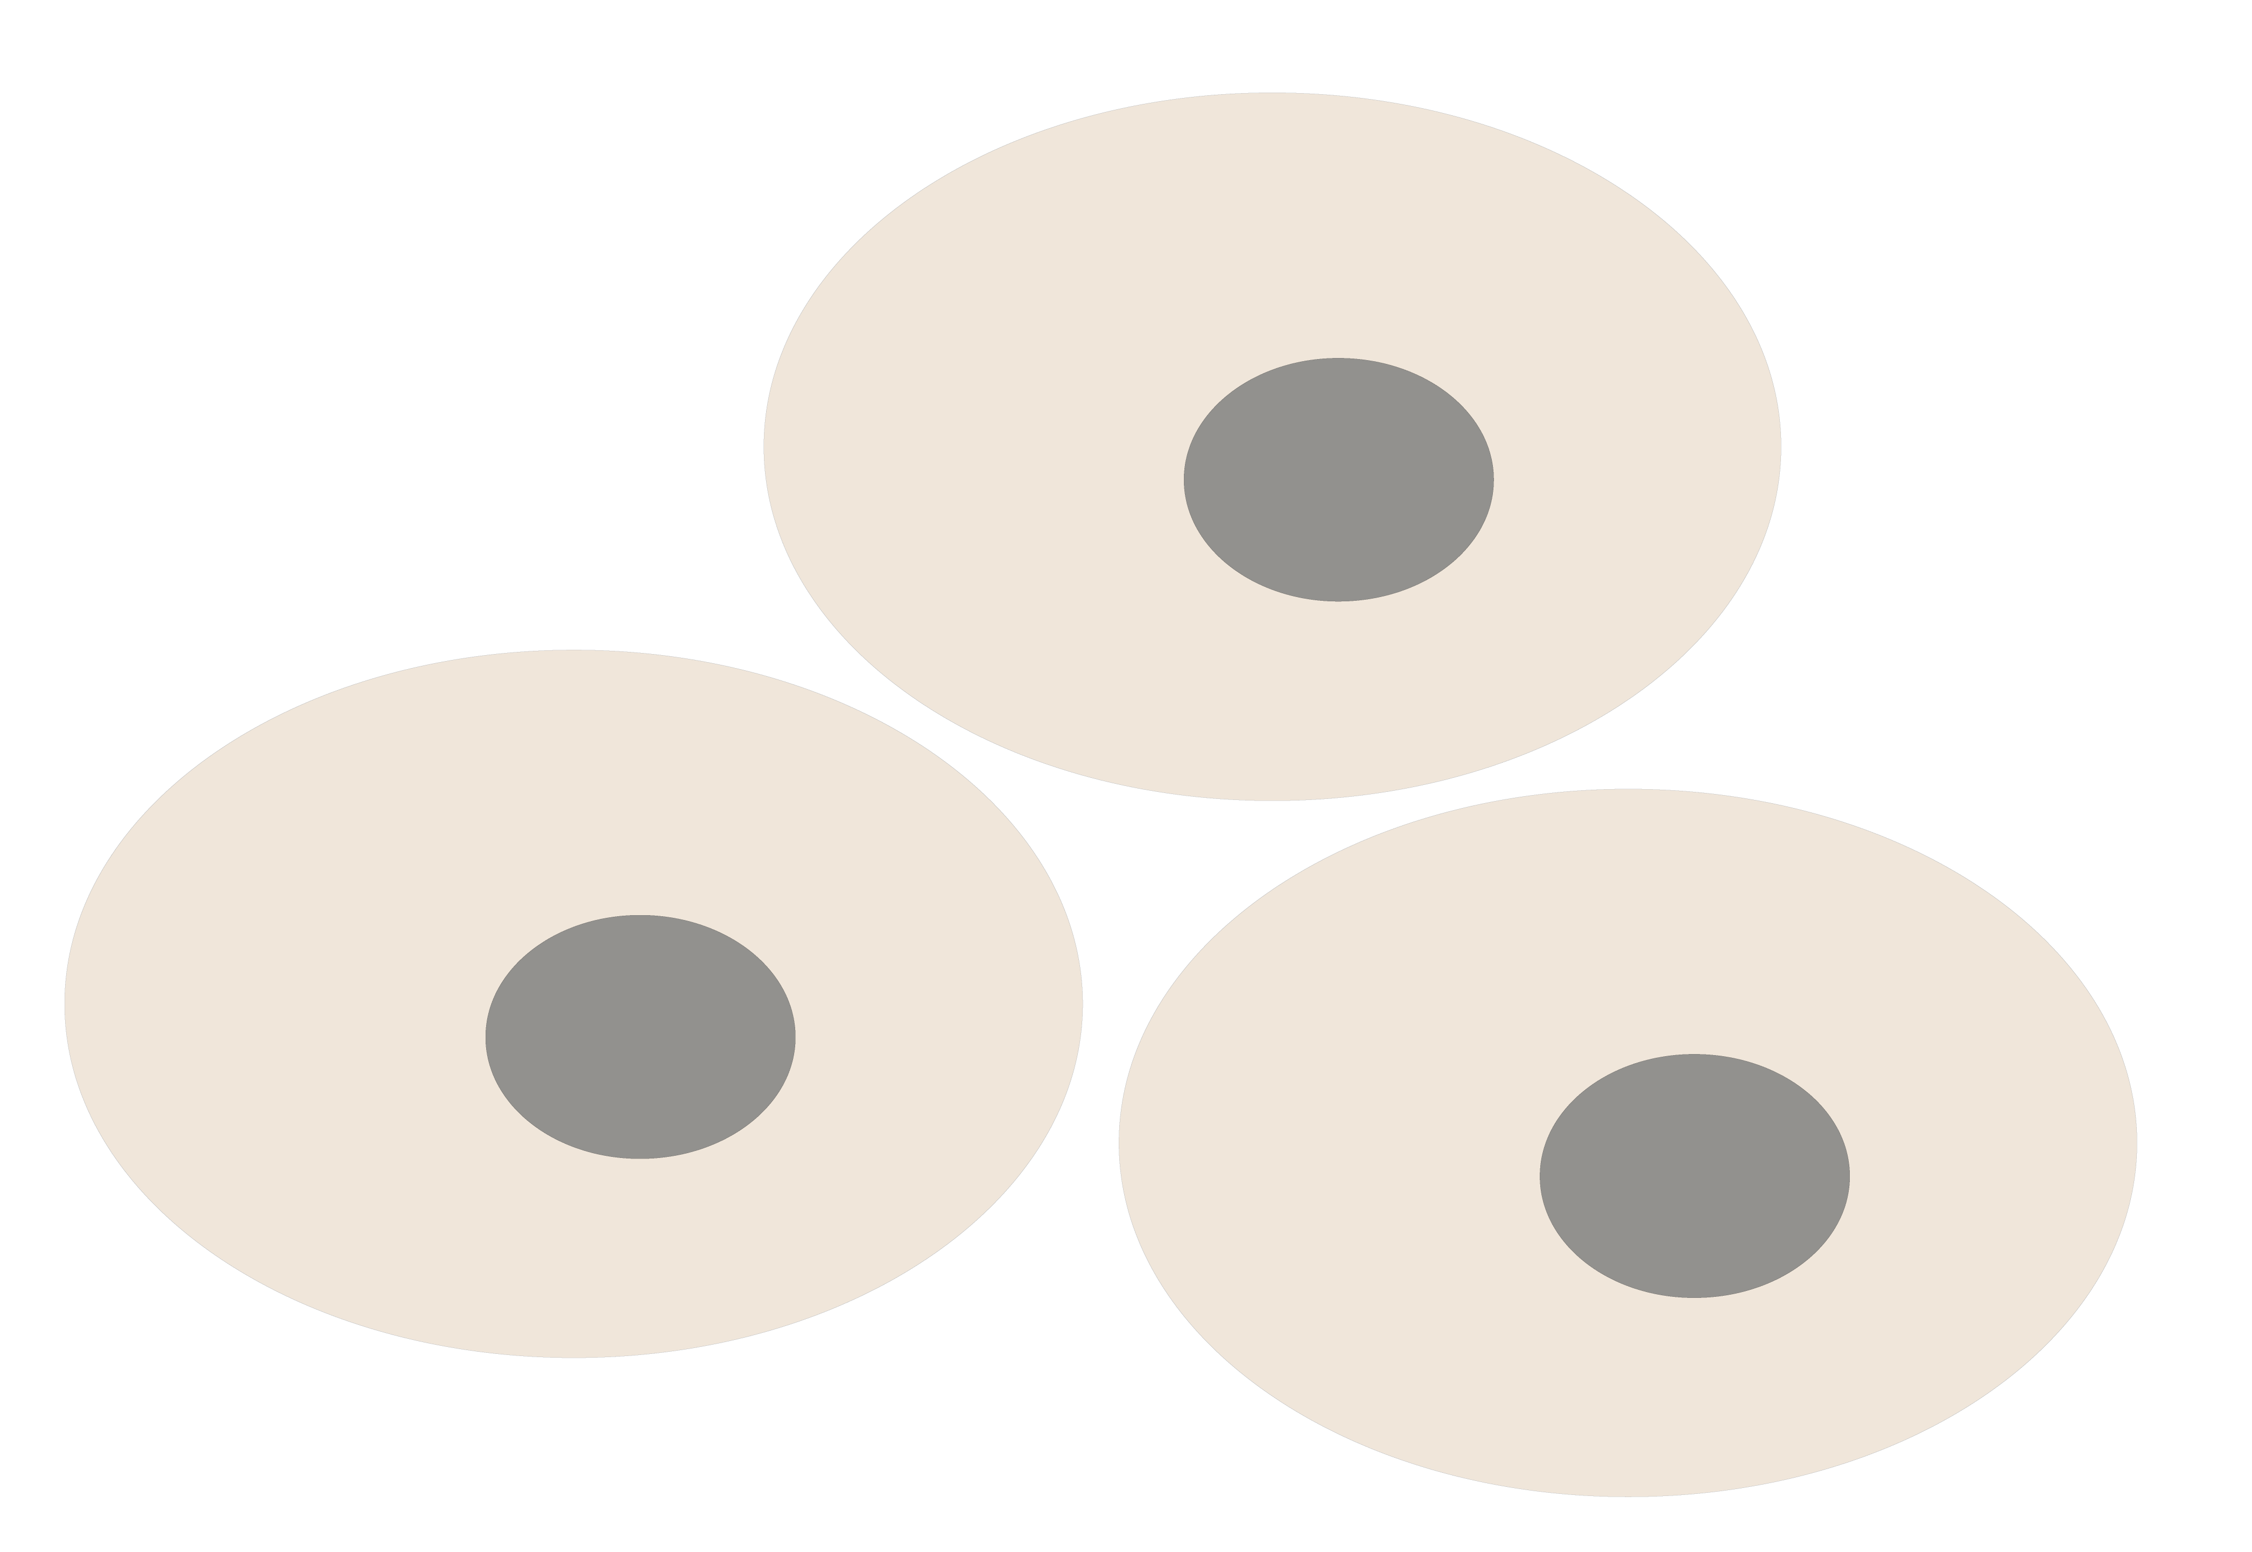
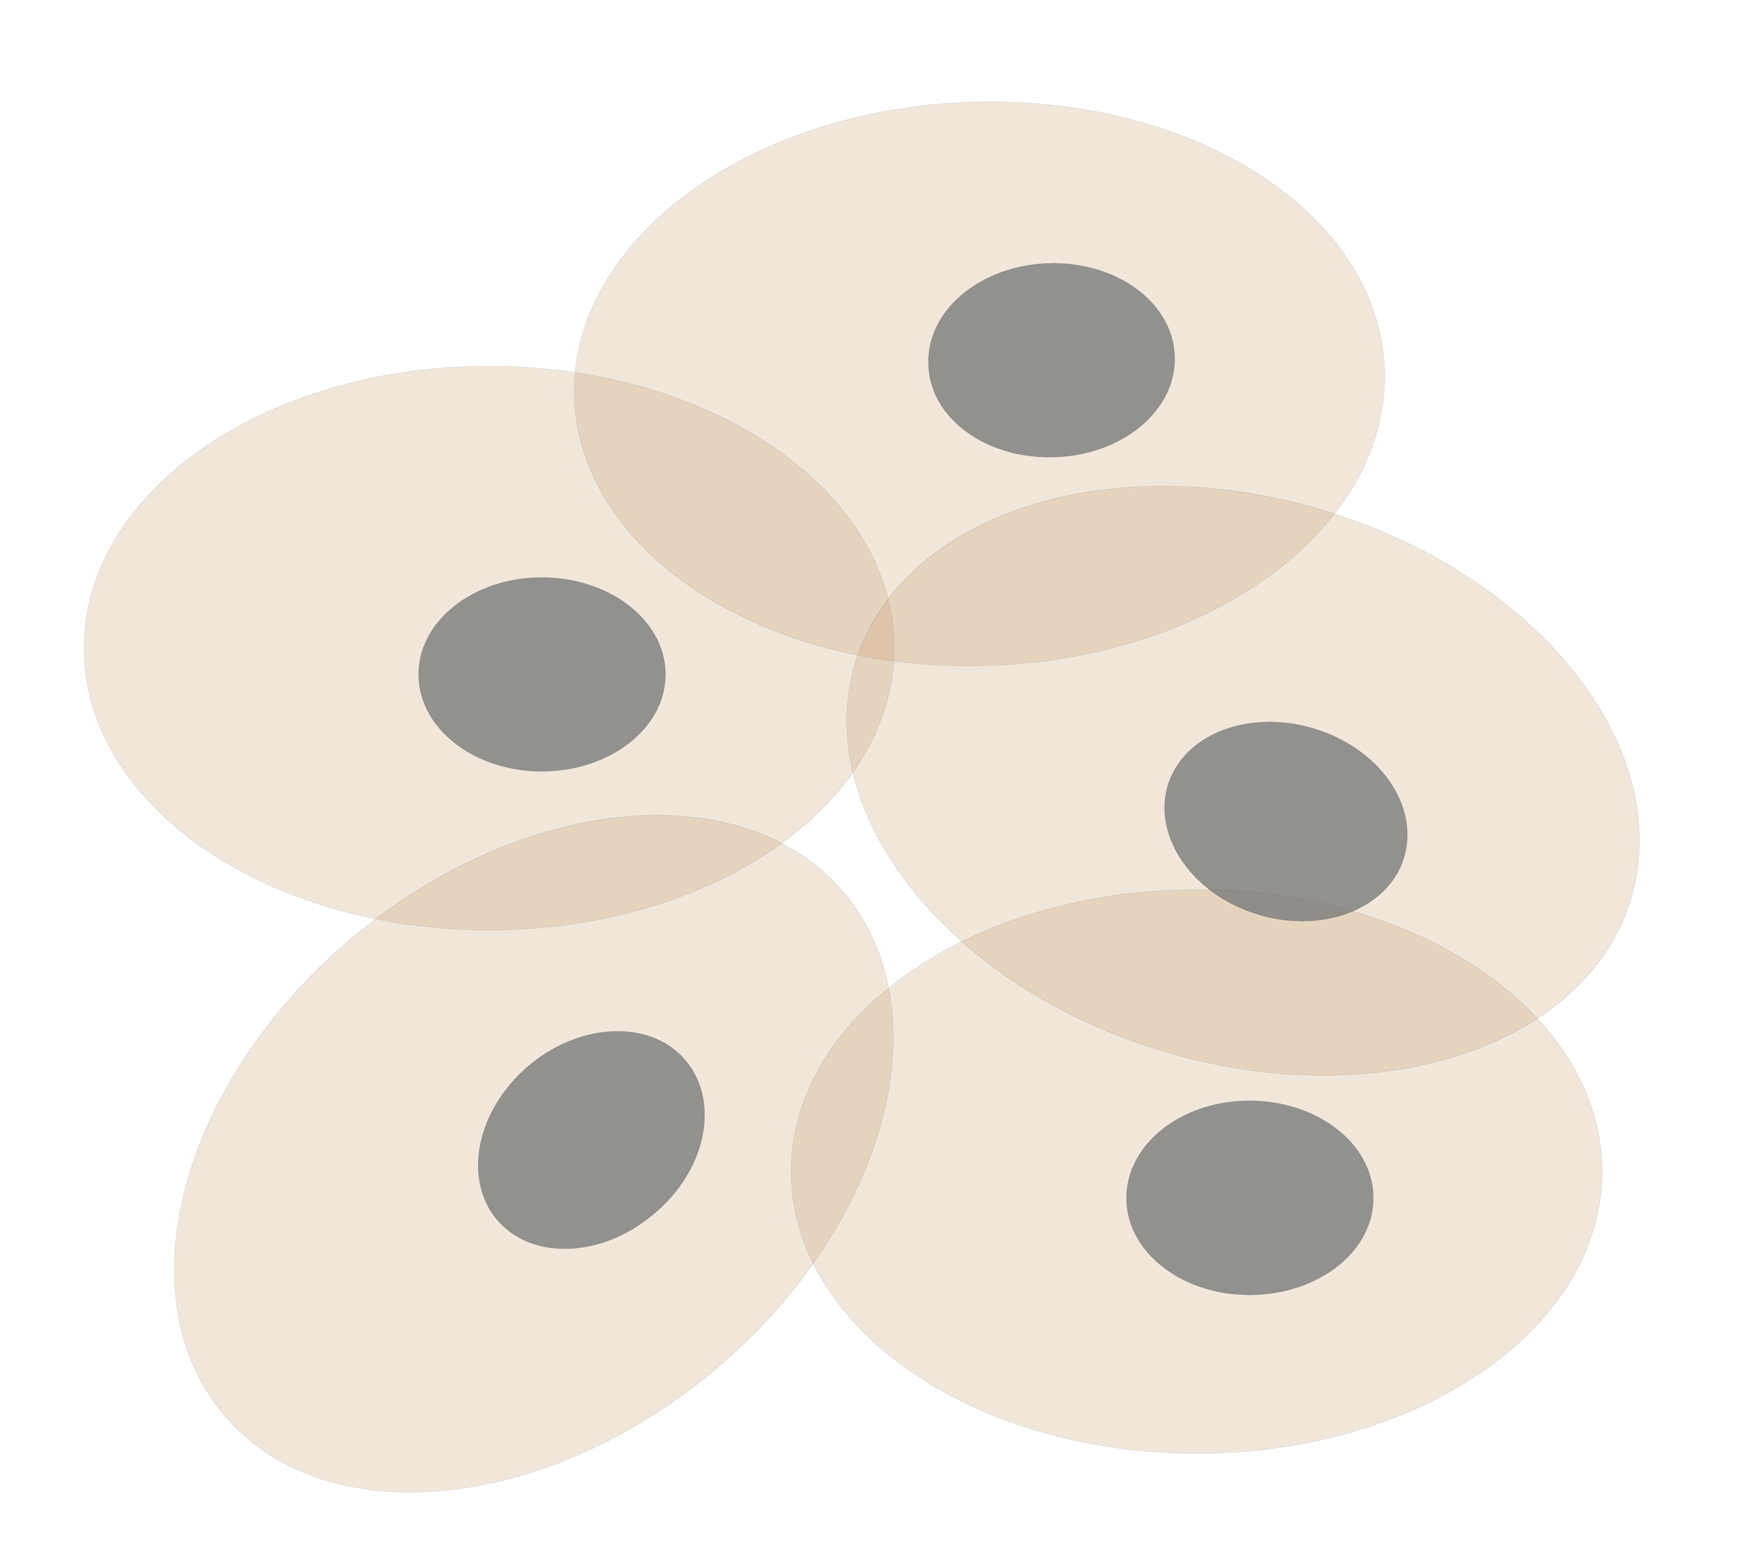
Our field as future Gateway –
Personal Genomics
as a Gateway into Biology
Personal genomes soon will become a commonplace part of medical research & eventually treatment (esp. for cancer). They will provide a primary connection for biological science to the general public.
normal
tumor

Slide 32
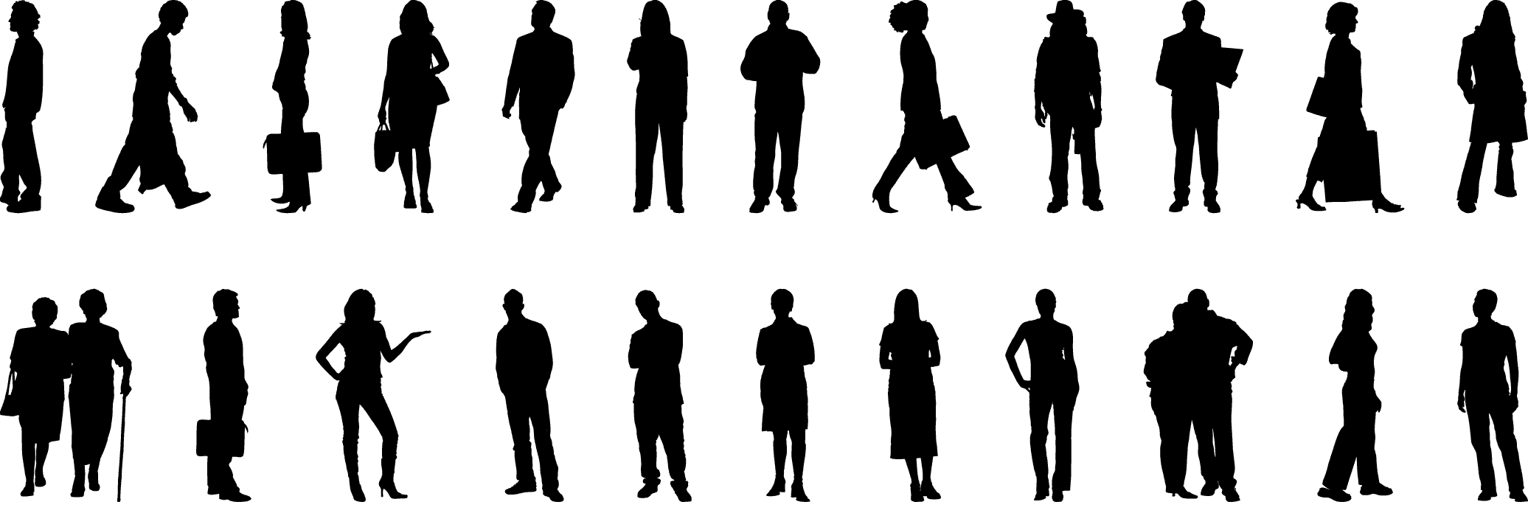
Placing the individual into the context of the population
&
using the population to build a interpretative model

Slide 33
Biomed. Data science:
The Course

Slide 34

Defining the field – by crowd-sourced judgement
Bioinformatics
  Related terms
    Biological Data Science
    Bioinformatics & / or / vs Computational Biology
    Bio-computing
    Systems Biology
    “Qbio”
What are its boundaries
  Determining the "Support Vectors”

Slide 35
Overview of Topics Surveyed
Introduction
& Overview of the Data
Genomics & Sequencing
Proteomics & Structure
Databases
Data Mining & Machine Learning
”Classic” Supervised & Unsupervised Approaches
  Decision Tree & SVMs
  Clustering & SVD
Application to ’Omics Data
  Comparing sequences
  Processing single cell & epigenomic data
Network Analysis
Topology & Connectivity
Gene Networks
Deep Learning
Basic Theory & Applications
Physical Modeling
Macromolecular Simulation
Markov Models
Molecular Packing
Additional Topics
Privacy
Personal Genome Analysis
Image Analysis

Slide 36
What is Bioinformatics?
(Molecular) Bio - informatics
One idea for a definition?
Bioinformatics is conceptualizing biology in terms of molecules (in the sense of physical-chemistry) and then applying “informatics” techniques (derived from disciplines such as applied math, CS, and statistics) to organize, mine, model & understand the information associated with these molecules, on a large-scale.
Bioinformatics is a practical discipline with many applications.
[Luscombe et al. ('01). Methods Inf Med 40: 346 ]

Slide 37
Thoughts on the Class
GersteinLab.org/courses/452
(Class Web Page)
Broad overview with a few deep dives
  Fundamentally interdisciplinary field
  Here, focusing on molecular bioinformatics
  Some deep dives into sequence comparison, Bayesian approaches, low-dimensional representations
  Steering away from material in related Yale classes
Goal is good intuition on approaches & the application area
  Apply to related problems
Lectures provide structure of knowledge to be assimilated
  Varied backgrounds
  Variety of learning approaches
Sections for interaction & more hands-on treatment
Quizzes & homework for individual command of basic knowledge
Final Project for teamwork
cbb752@gersteinlab.org
for issues

Slide 38

Lectures (& Readings)
Lectures form the backbone of what you need to know
  We will post final pptx & pdf AFTER the lecture
  Also, will have current, lecture-hall recorded videos put up quickly on canvas
  Class-produced lecture summaries about a week after each lecture
  (see course website)
No book
  Key readings for each lecture listed in the slides
  ISLR as close as we can
  get to a text
  Section papers
Past Year’s As a Guide
  Convention for numbering lectures:
  YYMN = (Y)ear, (M)odule, (N)umber
  e.g. 23m3, 22m3, (21) M3
  If you want to look ahead, we will mostly follow the flow in 2021-2023 (See the notations at the top of each slide pack for key differences.)
  Mostly 2021 has well-produced videos, with a few from following years

Slide 39
Key References for i1+i2a
(ranked from most #1 to least important)
Navarro et al (2019) Genome Biology
https://genomebiology.biomedcentral.com/articles/10.1186/s13059-019-1724-1
(Read Abstract & Introduction)
Muir et al (2016) Genome Biology
https://genomebiology.biomedcentral.com/articles/10.1186/s13059-016-0917-0
(Read first 3 sections)
Zimmer (2023). STAT
https://www.statnews.com/feature/game-of-genomes/season-one
(Just look at the first season & read more if you want.)
Luscombe et al (2001) Methods Inform Med
http://archive.gersteinlab.org/papers/e-print/whatis-mim/text.pdf
(Read Introduction)
Babu et al. (2023). Annual Review of Medicine
https://doi.org/10.1146/annurev-med-052422-020437
(Just Skim)

Slide 40
Biomed. Data science:
The Final Project

Slide 41




Analyzing Carl Zimmer’s genome
SNV
AAGCT
ACGCT
Protein Structure
Ancestry

Slide 42
2017
History of the Analysis of the “Zimmerome” in the Class
2018
Each group created a GitHub page detailing the work of each team
  Additionally, each group has a power point presentation:
Topics of projects include:
  Comparative analysis of personal genomes
  Personal genomes and personalized medicine (CRISPR)
  Network analysis of personal genomes
  Structure analysis
Each group had a power point presentation and a writeup
Topics of projects include:
  Finding how much of your genetic material comes from the Neanderthals
  Using carl's genome to predict differences in gene expression from the average human and infer possible changes in physiology from these differences (GTEx analysis)
  Predicting gene expression values from Carl’s SNP information
  Finding a common variant associated with inflammatory response in Carl
  Calculating Zimmer's risk for Alzheimer's disease
  Identifying significant protein-coding mutations in Carl's genome
  polygenic risk score prediction in coronary artery disease, type II diabetes, and schizophrenia for Carl

Slide 43


2019 –
2023
Each group had a power point presentation and a write-up
Started analyzing Carl’s gene chromosome by chromosome
  Part 1: Prioritization of 10 genes
  Part 2: In-depth Analysis of prioritized genes:
    Gene expression analysis
    Network analysis
    Protein structure analysis
    Text mining analysis
2019
2020
2021
2022
2023
2025+
History of Analyzing the “Zimmerome” in Class
Genes prioritized

Slide 44
History of the Analysis of the “Zimmerome” in the Class
26 groups (2019-2022)
10 groups identified SNPs
Total of 36 SNPs are disease associated
Notes:
susanna

Slide 45


This year’s Zimmerome Assignment: Investigate and Analyze a Personal Genome Using Bioinformatic/Biomedical Tools
Team based approach
Assigned Teams (4-5 people in your section, assigned by TFs)
Each team focuses on a single chromosome
Cross-disciplinary
1. Computational
Leveraging tools to prioritize genes or variants
Pipeline Development
2. Biological/Biomedical
Interpretation of prioritized genes or loci
3. Written and Oral
Communication of project and results through written report

Slide 46

1. Computational Pipeline Development
Computational Pipeline
Full code/software/script package
GitHub
Data files
readme

Slide 47

2. Biological/Biomedical Interpretation
Interpretation of Results
Biological interpretation of prioritized genes or loci
Leveraging public omics or biomedical data
Further discussion of results

Slide 48


3. Oral Presentation and Written Report
Oral Presentation
April 23
  2 to 3 minute mp4 recording per group (nominate 1 person to make the recording)
  We will play these recordings in class on 4/23
- in your Discussion Section of Week April 23
  Approximately 10 minute presentation by other members of the group
Written Report
Due: May 5, 2025
At least 1000 words
Summary Slide
1 summary slide giving an overview of your project
Summary Metadata File
A single text file containing relevant information
More description in assignment file

Slide 49


Slide 50


Slide 51
Notes on the Course
Surveys: Please make sure these
are done quickly
- will count in overall grade
- Available from GersteinLab.org/courses/452
Sections:
  Discussion section assignments will be sent out shortly
  Will start next week
  Lecture summaries will start on Wed.
For issues, please discuss with TFs right after class
or email cbb752@gersteinlab.org
  e.g. for students registered as “guest student” on canvas

