Slide 1

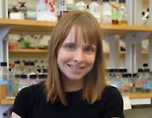



Molecular simulations of intrinsically disordered proteins
Elizabeth Rhoades,
Chemistry, UPenn
Wendell Smith
Physics
W. W. Smith, P.-Y. Ho, and CSO, “Calibrated Langevin-dynamics simulations
of intrinsically disordered proteins,” Phys. Rev. E 90 (2014) 042709.

Slide 2
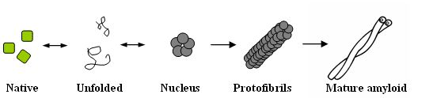

Protein Aggregation
Self-assembled structures that grow into large, insoluble aggregates
Aggregation more likely for unfolded/partially folded protein;
exposed hydrophobic regions on separate monomers bind
Aggregation caused by protein overproduction, stress, mutation
Variables that affect aggregation: amino acid sequence,
environmental factors such as pH, temperature, protein
concentration, chaperones
Types of aggregates: amyloid fibrils (in vivo, in vitro, rich in beta-
sheet, ordered, 10-nm diameter, origin-amylose), inclusion bodies
(in vivo disordered aggregates, 1μm), disordered aggregates (in vitro)
Amyloid fibril formation ubiquitous in polypeptides in nonnative
conditions
2

Slide 3
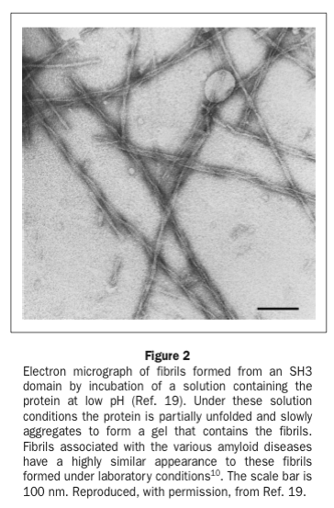
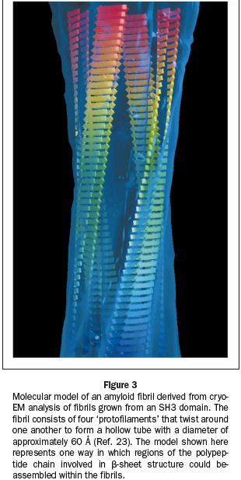
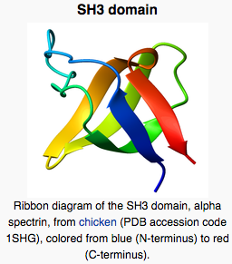
Amyloid Fibrils
100 nm

Slide 4
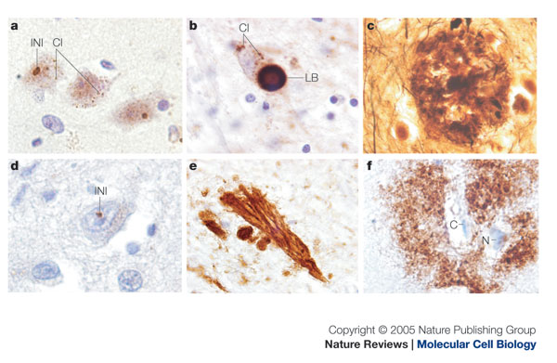
Plaques and Inclusions in Diseased Brains
Intranuclear (INI) and cytoplasmic inclusions (CI) in motor cortex of Huntington's disease brain recognized with
1C2 antibody. (b) Lewy body (LB) and other cytoplasmic inclusions (CI) that contain alpha-synuclein within a neuron
of the substantia nigra of Parkinson's disease brain. (c) Neuritic plaque of Alzheimer's disease in cerebral cortex.
Hirano silver stain identifies intracellular and extracellular protein aggregates. (d) Intranuclear inclusion in frontal
cortex of Huntington's disease brain recognized with anti-ubiquitin antibody. (e) Neurofibrillary tangles of
Alzheimer's disease in hippocampus immunostained with antibody specific for phosphorylated tau. (f) Diffuse
plaque of Alzheimer's disease in cerebral cortex. Amyloid beta (Abeta)-specific antibody recognizes extracellular
deposits of Abeta (surrounding a neuron (N) and a capillary (C)).
4

Slide 5
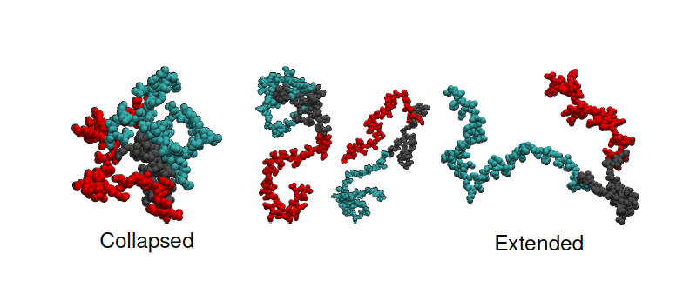

Slide 6
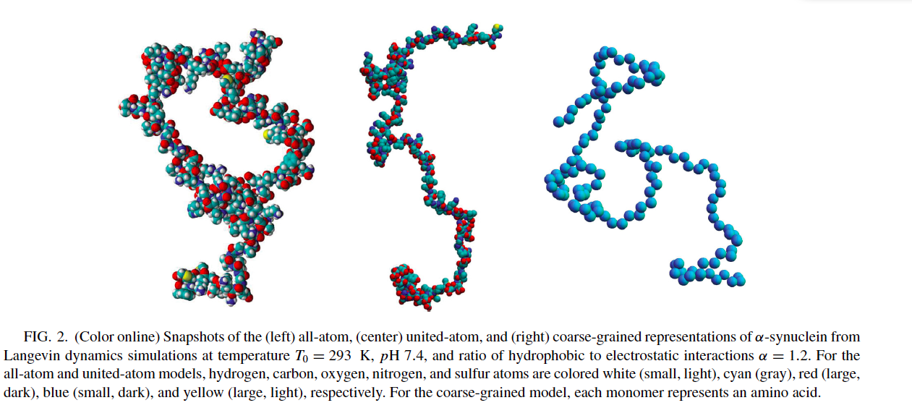

Slide 7
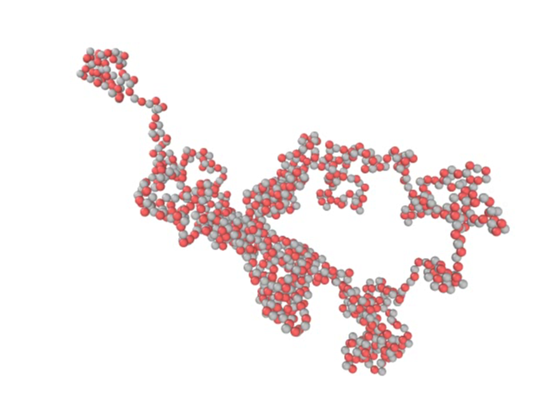

Slide 8
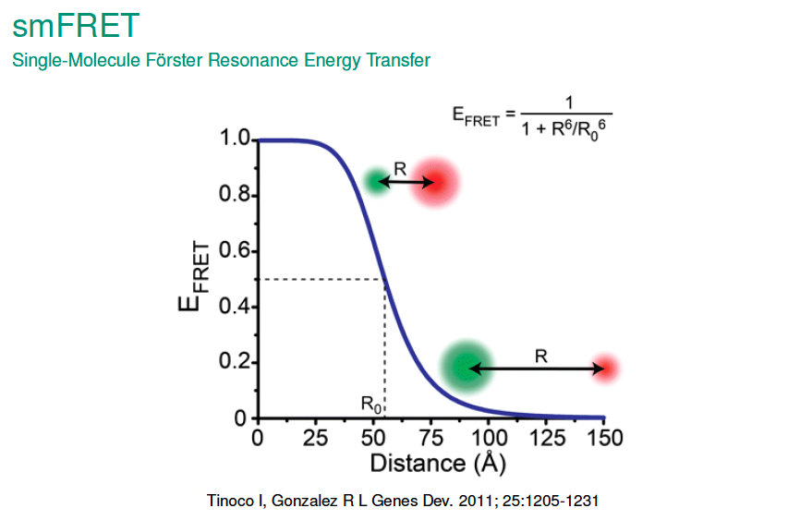

Slide 9
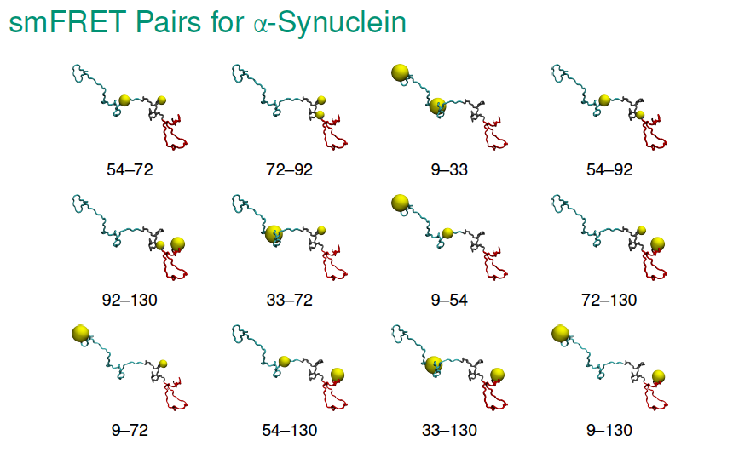

Slide 10
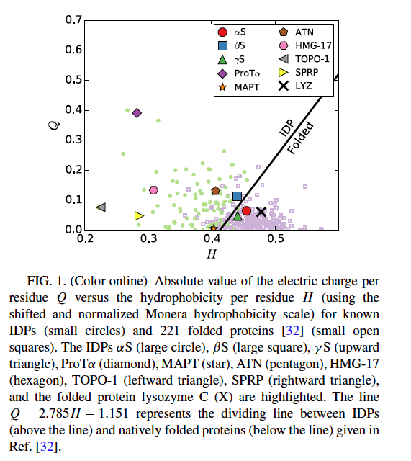
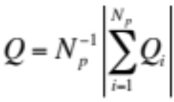
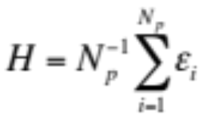
ε_{i} >0

Slide 11
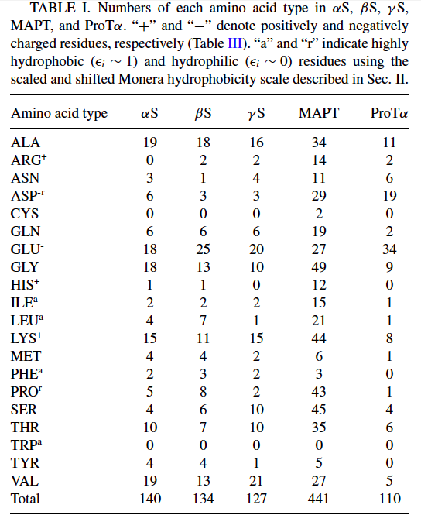

Slide 12
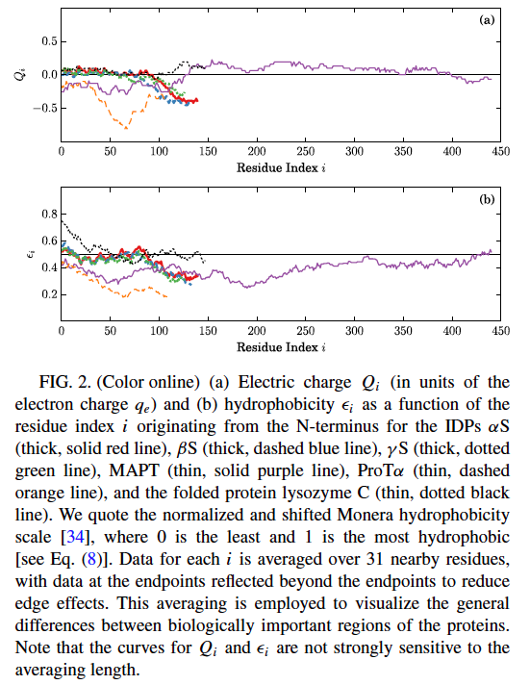
hydrophobic
hydrophilic

Slide 13
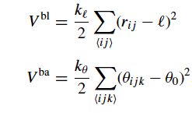

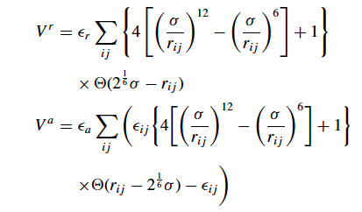


Coarse-grained model
i
M_{i}, σ_{i}, ε_{i}, Q_{i}
l=3.9Å
θ₀=2.12 rad
λ=9Å
α_{CG}=ε_{A}/ε_{es}

Slide 14
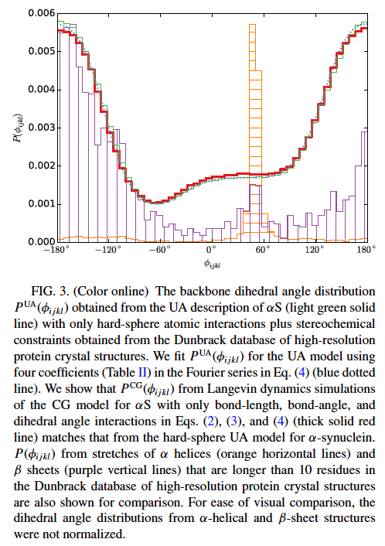

Slide 15
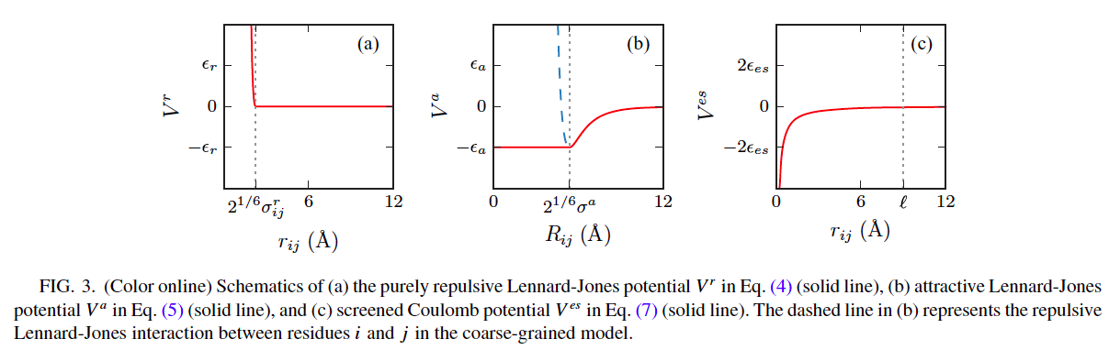

Slide 16
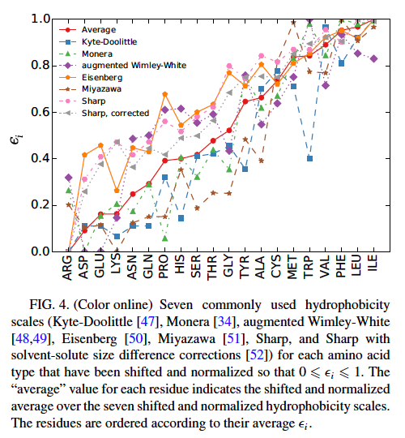

Slide 17


Slide 18
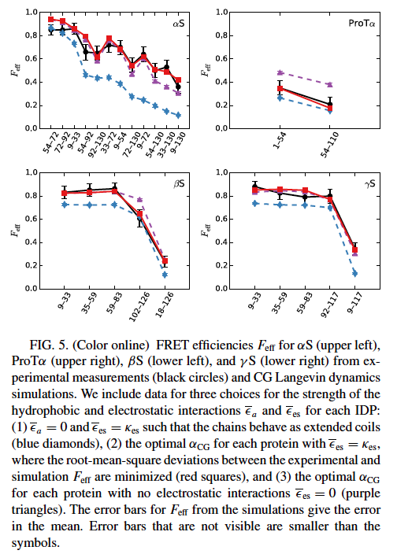

Slide 19
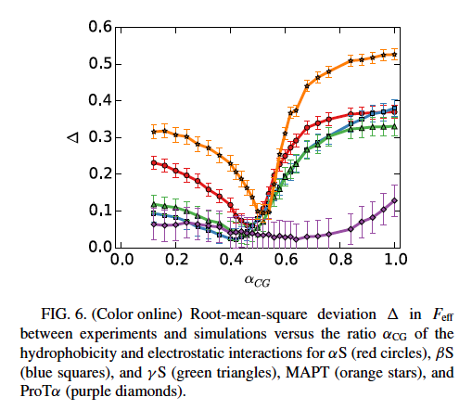

Slide 20
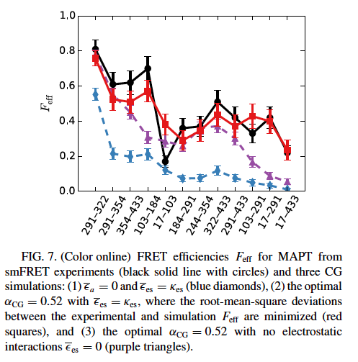
MAPT

Slide 21
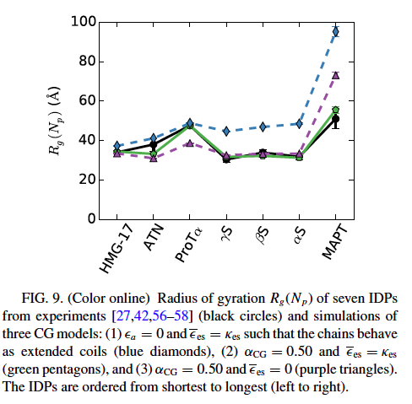
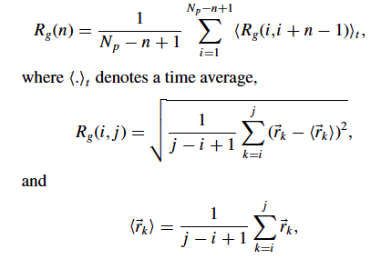

Slide 22
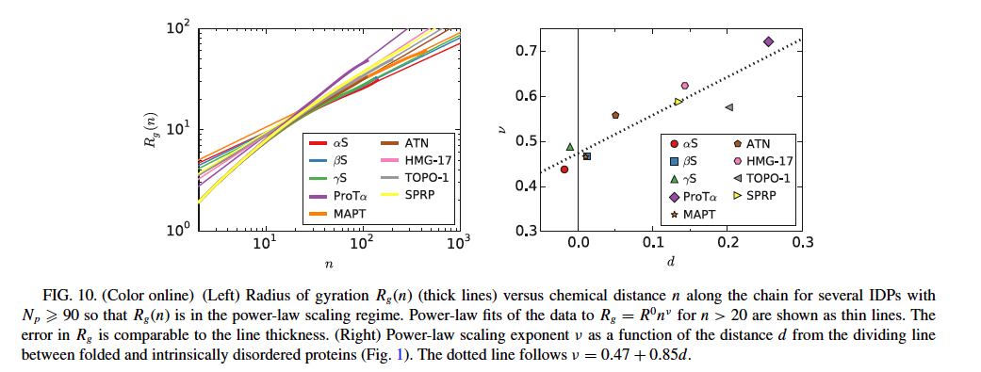
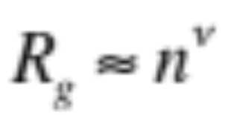

Slide 23
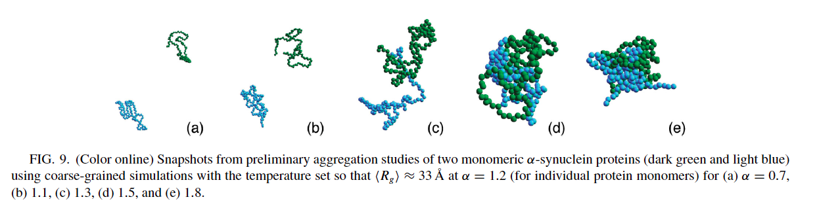

Slide 24
Conclusions
Coarse-grained model that accurately captures Feff and Rg
of IDPs
MAPτ is somewhat different than other IDPs
Studies of multiple IDPs

