Slide 1








Random close packing in protein cores
Corey S. O’Hern
Department of Mechanical Engineering & Materials Science
Department of Applied Physics
Department of Physics
Graduate Program in Computational Biology & Bioinformatics
Yale University, New Haven, CT USA
Lynne Regan,
MB&B,
Chemistry
Jennifer Gaines,
CBB
Diego Caballero
Physics
Wendell Smith
Physics
Alex Virrueta
MEMS

Slide 2
Recent Publications
Z. Mei, J. D. Treado, A. Grigas, Z. A. Levine, L. Regan, and C. S. O’Hern, “Analyses of protein cores
Reveal fundamental differences between solution and crystal structures,” Proteins: Structure, Function, and
Bioinformatics (2020).
2. A. Grigas, Z. Mei, J. D. Treado, Z. A. Levine, L. Regan, and C. S. O’Hern, “Using physical features of
protein core packing to distinguish real proteins from decoys,” Protein Science (2020).
3. J. D. Treado, Z. Mei, L. Regan, and C. S. O’Hern, “Void distributions reveal structural link between
jammed packings and protein cores,” Phys. Rev. E 99 (2019) 022416.
4. J. C. Gaines S. Acebes, A. Virrueta, M. Butler, L. Regan, and C. S. O’Hern, “Comparing side chain
repacking in soluble proteins, protein-protein interfaces, and transmembrane proteins,” Proteins: Structure,
Function, and Bioinformatics 86 (2018) 581.
5. J. C. Gaines, A. Virrueta, D. A. Buch, S. J. Fleishman, C. S. O’Hern, and L. Regan,“Collective repacking
reveals that the structures of protein cores are uniquely specified by steric repulsive interactions,” Protein
Eng. Des. Sel. 30 (2017) 387.
6. J. C. Gaines, A. H. Clark, L. Regan, and C. S. O’Hern, “Packing of protein cores,” J. Phys.: Condens.
Matter 29 (2017) 293001.
7. D. Caballero, A. Virrueta, C. S. O’Hern, and L. Regan, “Steric interactions alone determine side chain
conformations in protein cores,” Protein Eng. Des. Sel. 29 (2016) 367.
8. J. C. Gaines, W. W. Smith, L. Regan, and C. S. O’Hern, “Random close packing in protein cores,” Phys.
Rev. E 93 (2016) 032415.
9. A. Virrueta, C. S. O’Hern, and L. Regan, “Understanding the physical basis for the side chain
conformations of Met,” Proteins: Structure, Function, and Bioinformatics 84 (2016) 900.
10. D. Caballero, W. W. Smith, C. S. O’Hern, and L. Regan, “Equilibrium transitions between side chain
conformations in leucine and isoleucine,” Proteins, Structure, Function, and Bioinformatics 83 (2015) 1488.

Slide 3
Important questions for protein packing
1. Can the structural properties of protein cores
be quantitatively modeled using hard-spheres?
2. What is the packing fraction in protein cores?
3. Can simple hard-sphere model improve
computational design of protein-protein
interactions?

Slide 4
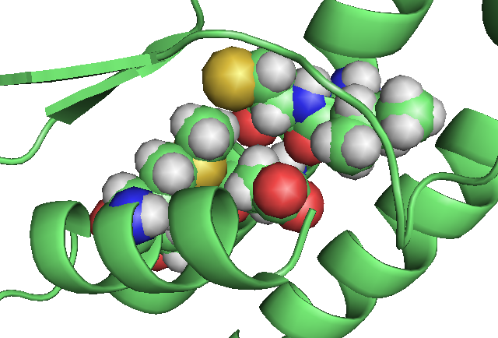
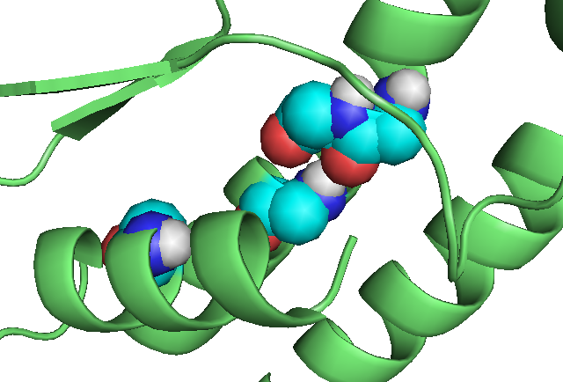
Protein Re-packing
1G4I; with sidechains
Met, Tyr, Asp, Ile, Cys, Asp, Ala
1G4I; without sidechains

Slide 5
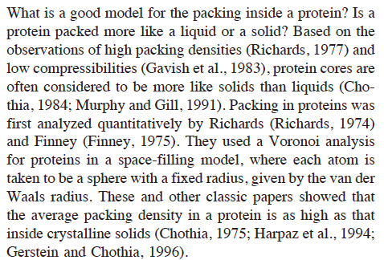
J. Liang and K. A. Dill, “Are proteins well-packed,” Biophys. J. 81 (2001) 751.
Notes:
In this talk, I would like to break several long-held paradigms.
Proteins are as densely packed as crystalline solids and
Complex or knowledged-based force-fields (i.e. CHARMM and AMBER) are necessary to quantitatively model protein structure.
For the first, see this excerpt from a paper Liang and Dill. In this talk, I will show that protein cores are not crystal close packed.

Slide 6
What is a hard-sphere model for protein structure? How
does one choose the atom sizes? Does one need explicit
hydrogens?
Why does the packing fraction of protein cores have
to satisfy ϕ<0.74?

Slide 7
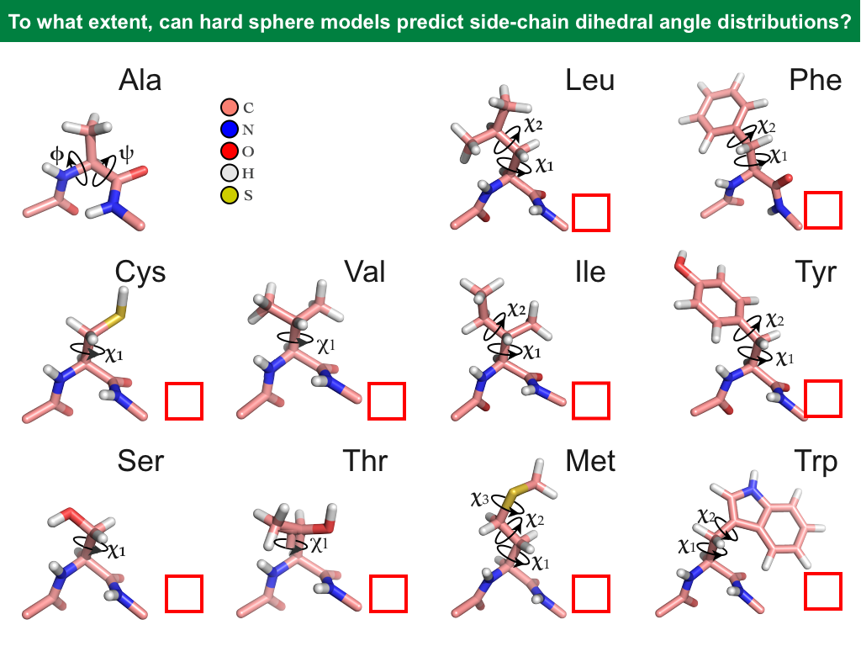
Notes:
Here are stick diagrams for 11/20 naturally occurring amino acids that make up proteins. These are hydrophobic residues that typically occur in protein cores.
All amino acids have a backbone formed by N, C, O atoms, at the Calpha atom, there is a side chain and its structure differentiates one amino acid from another.

Slide 8
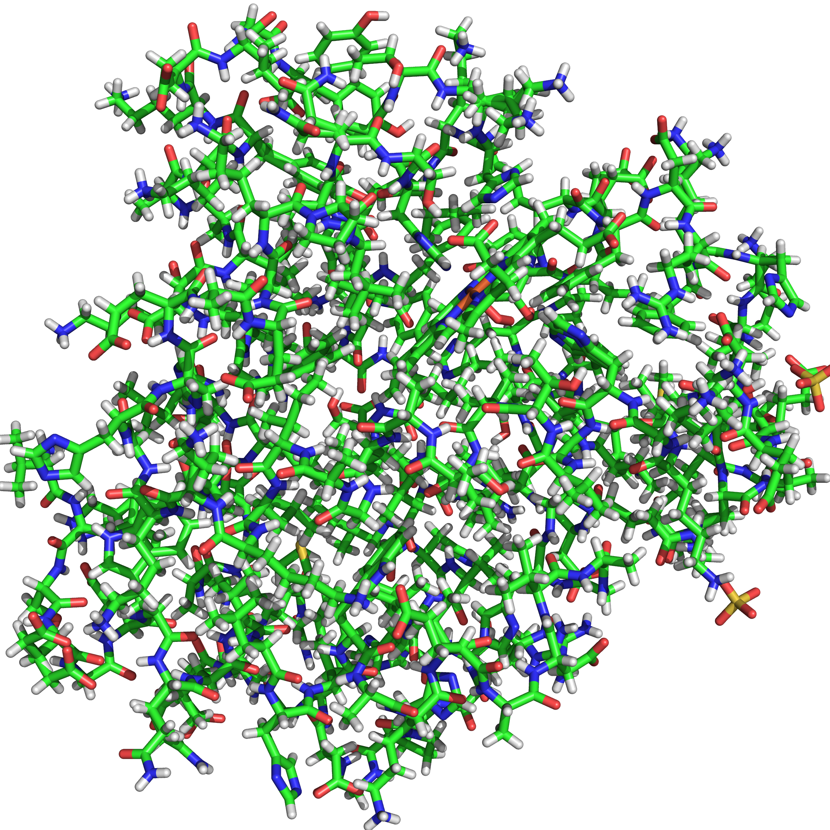
“Dunbrack” database of high-resolution protein crystal structures
Residue Type | Number
Ala | 3471
Gly | 3457
Leu | 2958
Val | 2744
Ser | 2624
Thr | 2542
Asp | 2427
Lys | 2190
Glu | 2158
Residue Type | Number
Ile | 2068
Asn | 1884
Pro | 1776
Arg | 1653
Phe | 1451
Gln | 1436
Tyr | 1409
His | 853
Met | 695
Cys | 623
Trp | 597
PDB:1A6M Oxy-Myoglobin
792 structures; resolution ≤ 1.0Å; sequence identity < 50%; B-factor
per residue ≤ 30Å²
G. Wang and R. L. Dunbrack, Bioinformatics 19 (2003) 1589.
Notes:
Our models are compared to and use structural information from the Dunbrack database of high resolution protein crystal structures. It contains 792 protein structures at resolution better than 1A with thousands of instances of each residue.

Slide 9
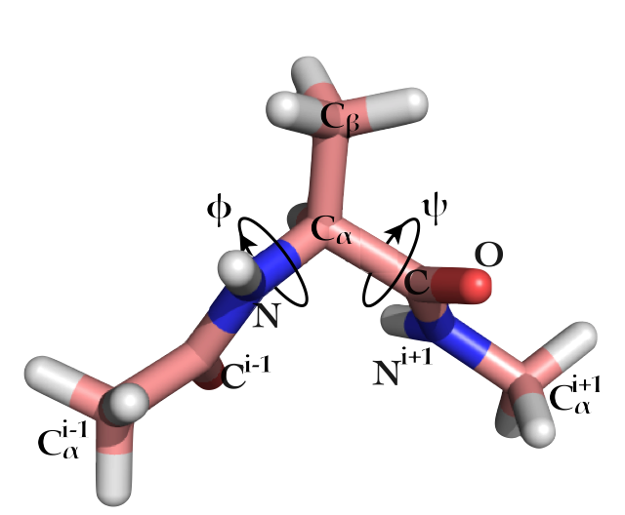
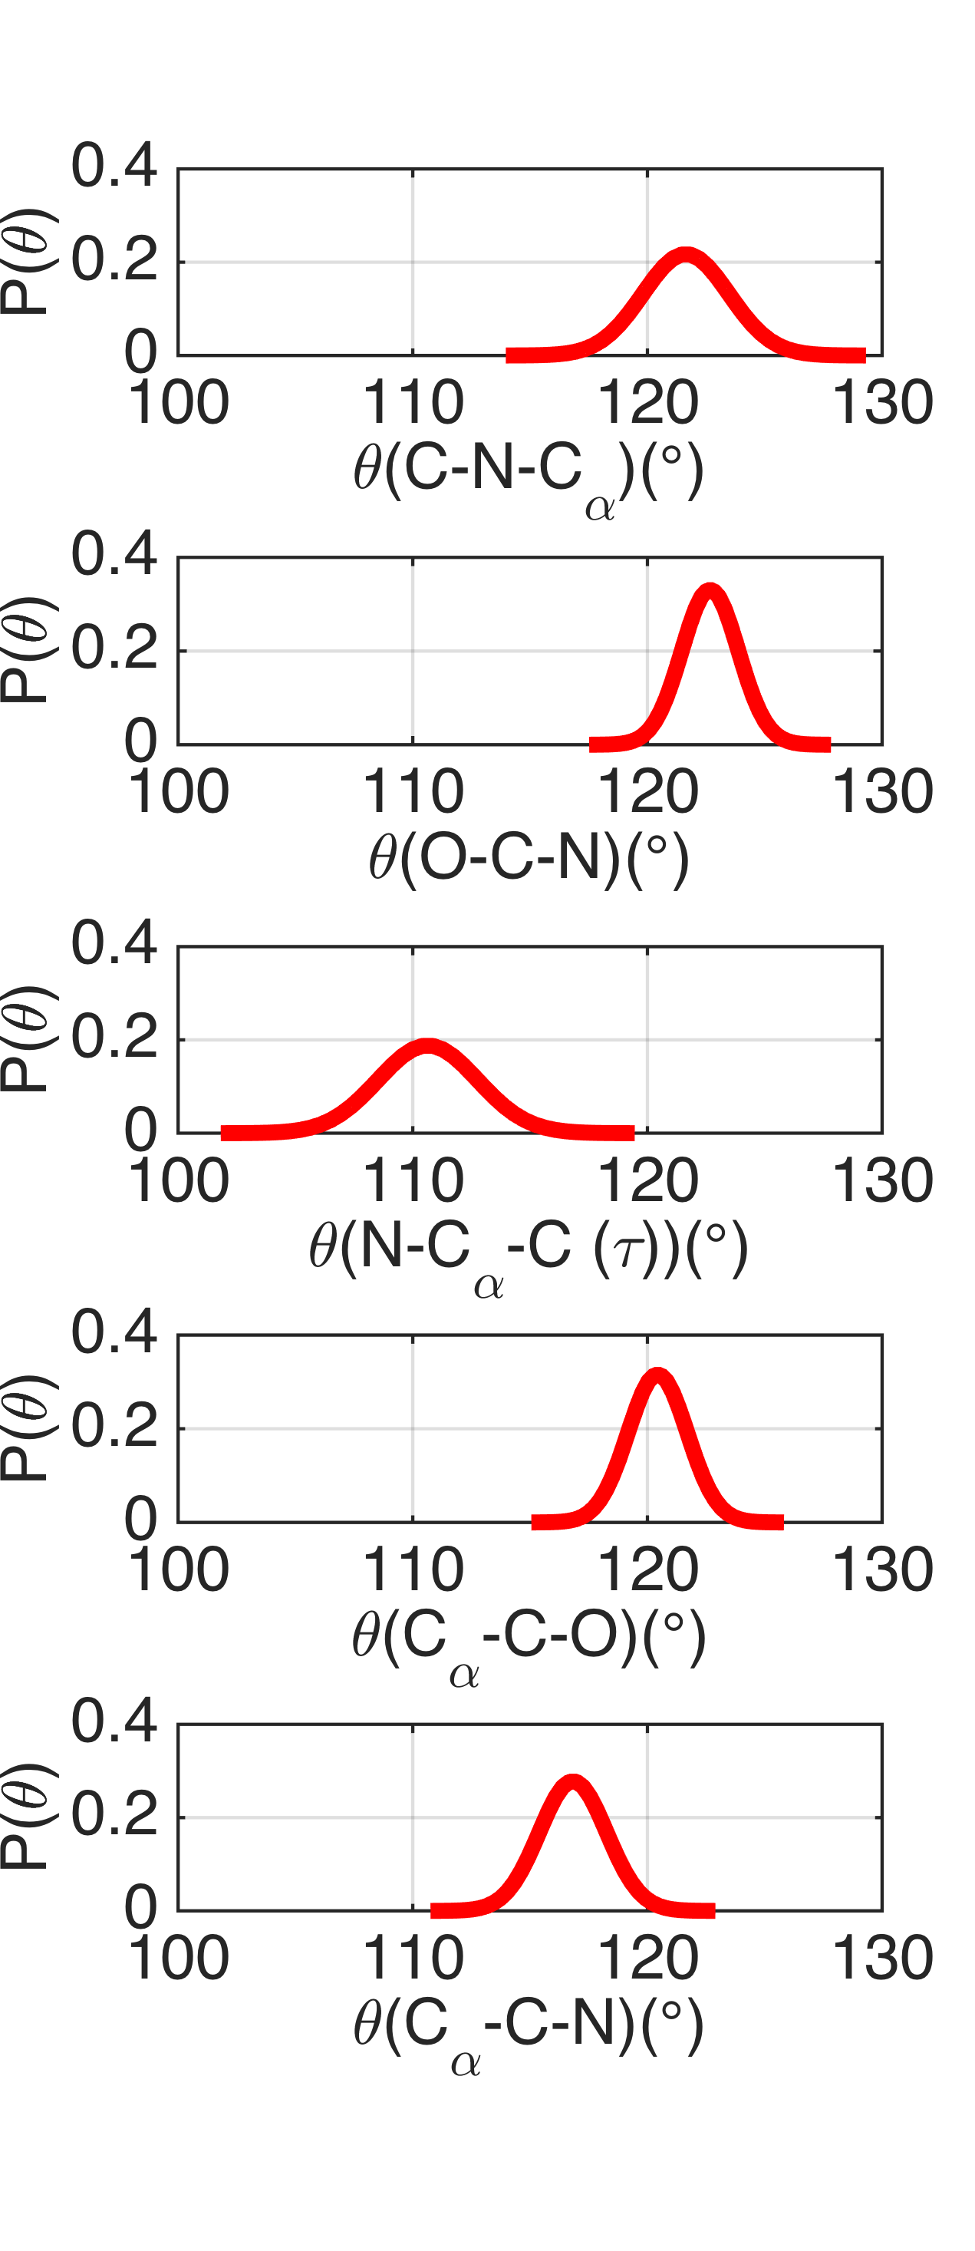
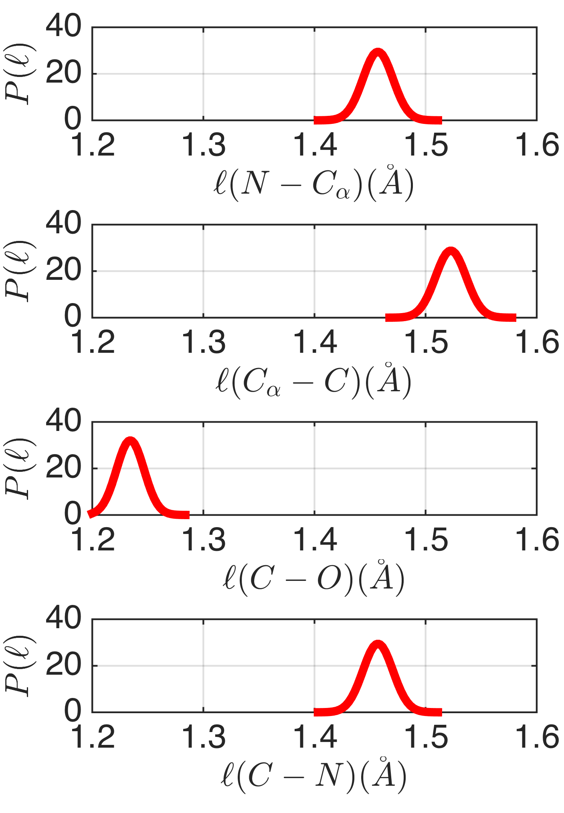
Bond angles, θ
Bond lengths, l
Ala
Notes:
Here I show an Alanine dipeptide to show the geometrical parameters that we take as given/constrained by small molecule or protein crystal data: bond angles among three bonded atoms, and bond lengths between adjacent bonded atoms.
Amino acids
Phi: C N C_alpha C
Omega: C_alpha C N C_alpha
Psi: N C_alpha C N

Slide 10
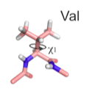
Observed Side-chain Dihedral Angle Distributions
Val
P(χ₁)
χ₁

Slide 11
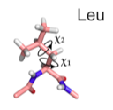
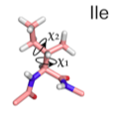
Leu
Ile
χ₂
χ₂
χ₁
χ₁
χ₁

Slide 12
In recent work, Peterson and coworkers (Peterson et al. 2014) performed side chain recovery for ~200 proteins using six different protein design software suites (SCWRL (Krivov et al., 2009), OSCAR (Liang et al., 2011), RASP (Miao et al., 2011), Rosetta (Kuhlman et al., 2000), Sccomp (Eyal et al., 2004), and FoldX (Guerois et al., 2002)). The key component of computational protein design software is the energy function, which can include many terms: stereochemistry (potentials that enforce equilibrium bond lengths and angles derived from small molecule crystal structures) plus up to eight additional terms---statistical potentials derived from backbone-dependent side chain rotamer libraries (Dunbrack and Cohen 1997, Shapovalov and Dunbrack 2011); repulsive and attractive van der Waals atomic interactions; hydrogen bonding; electrostatics; desolvation energies; disulfide bond energy (RASP-specific), and an ad hoc pairwise residue potential (Rosetta-specific). The energy functions differ in the relative weights assigned to each of these terms.

Slide 13
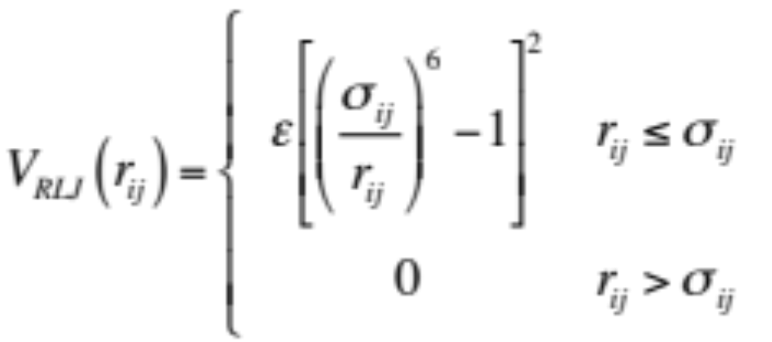
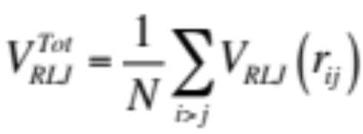
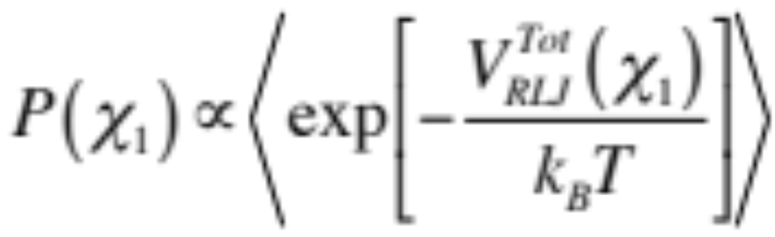
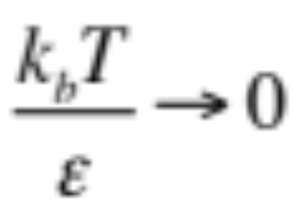
Calculate Distribution of Side-chain Dihedral Angles
σ_{ij}=(σ_{i}+σ_{j})/2
Notes:
Here is a generalization of the hard-sphere model that Jennifer described. We use a purely repulsive Lennard-Jones interaction potential between non-bonded atoms. Repulsive when atoms overlap, zero when they do not overlap. For each conformation, we calculate the total potential energy between non-bonded atoms and the Boltzmann weight to get the probability for a conformation at a given diehdral angle conformation. In the limit kT/epsilon -> 0 we recover the hard sphere limit.

Slide 14
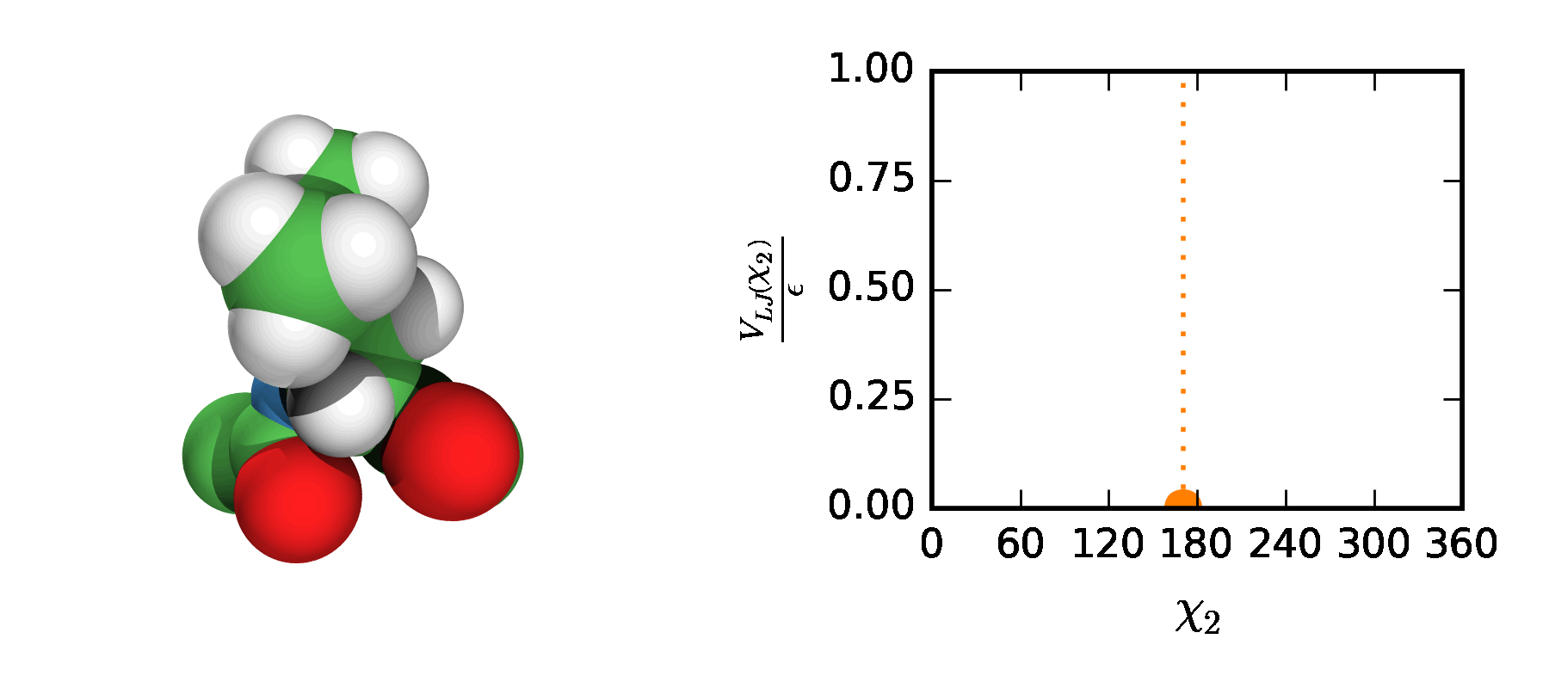
Leu
O
C
H
N
Notes:
Here is a pictorial description of what we do for a Leu residue from the Dunbrack database. Here we show a residue at a fixed phi, psi, and chi_1, and rotate chi_2. Simultaneously, we plot the potential energy as a function of chi_2, whenever there is a clash, the molecule turns orange and VRLJ > 0. As we expect, the crystal structure of this Leu has no clashes and VRLJ = 0.
Phi=-64.72
Psi=-38.52
(alpha helical)
Chi1=-68.28
Chi2 = 170.5
See IW poster

Slide 15
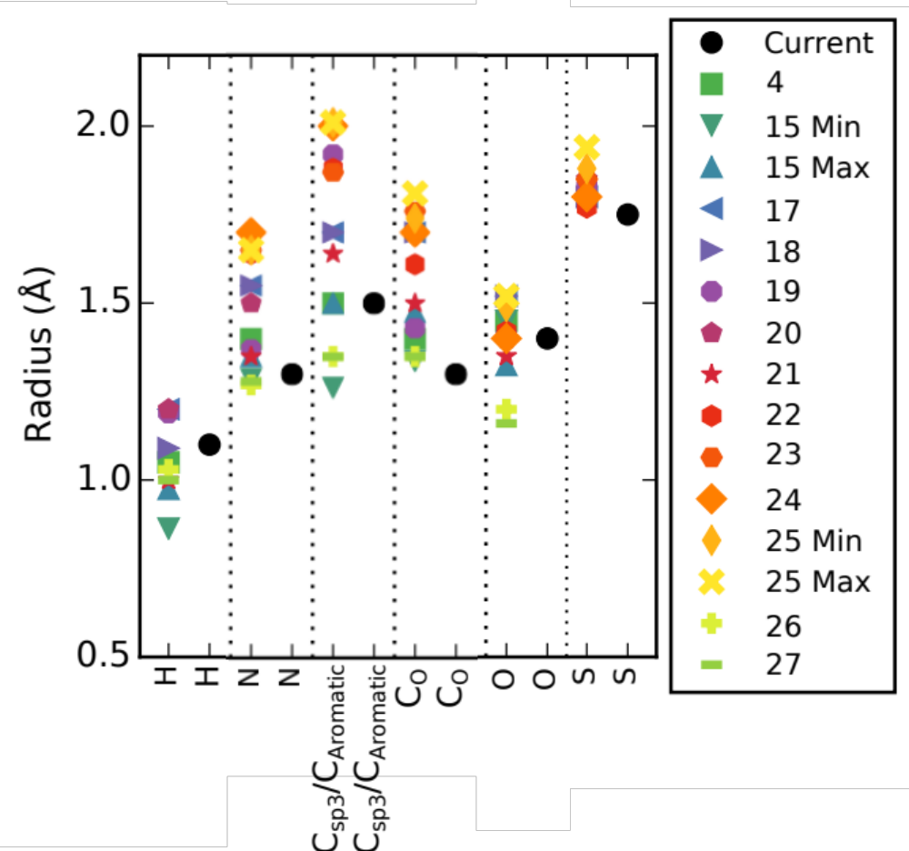

Slide 16
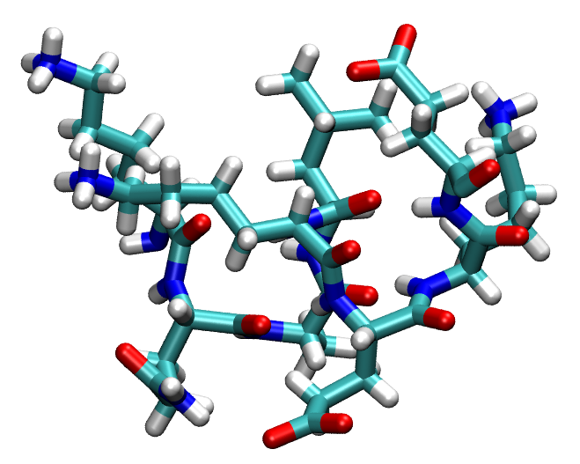



Notes:
A key point for calculating the packing fraction of the core of proteins is to determine the core residues. These residues on not on the surface and not near voids. We have several algorithms that all agree on core residues. As an example, we enclose the protein and throw down random points. If the closest atom to the point is more than 1.4A, it is a surface atom. No core residues have any surface atoms.

Slide 17
Core Residues
Residue Type | % in Core | % on Surface
Leu | 17.5 | 7.5
Ala | 13.2 | 7.2
Val | 12.7 | 6.2
Ile | 12.2 | 4.6
Gly | 9.9 | 7.9
Phe | 8.0 | 3.7
Cys | 5.1 | 1.5
Thr | 3.9 | 6.4
Ser | 3.7 | 6.4
Residue Type | % in Core | % on Surface
Met | 3.2 | 1.1
Tyr | 2.2 | 4.0
Pro | 1.9 | 4.5
Trp | 1.4 | 1.7
Asn | 1.4 | 5.3
Asp | 1.0 | 6.7
Gln | 0.7 | 4.0
His | 0.7 | 2.1
Glu | 0.5 | 6.7
Lys | 0.5 | 7.2
Arg | 0.3 | 5.2
Notes:
Here are the results. The core residues have higher % in core than on surface. We will focus on Leu, Ala, Val, Ile, Gly…
Equal probability gives 1/20=0.05
3048 residues in core; 35,968 on surface

Slide 18
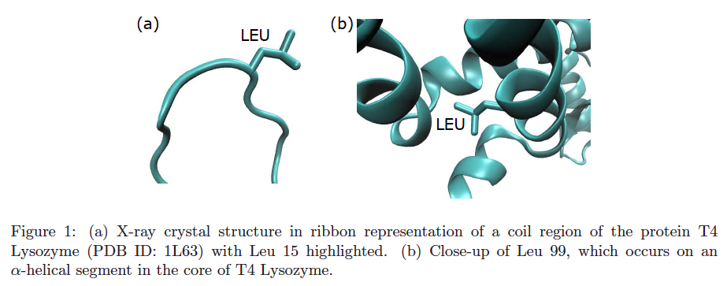
Intra-residue
contacts
Inter-residue
contacts

Slide 19
Ile in proteins
Ile hard-sphere dipeptide prediction

Slide 20
Ile56 in PDB 2NWD
Hard-sphere dipeptide
Hard-sphere protein environment

Slide 21
Hard-sphere dipeptide
Hard-sphere protein environment
Phe
Val

Slide 22
Ile in Protein Environment
PDB-HiQ54
Hard-sphere protein environment

Slide 23
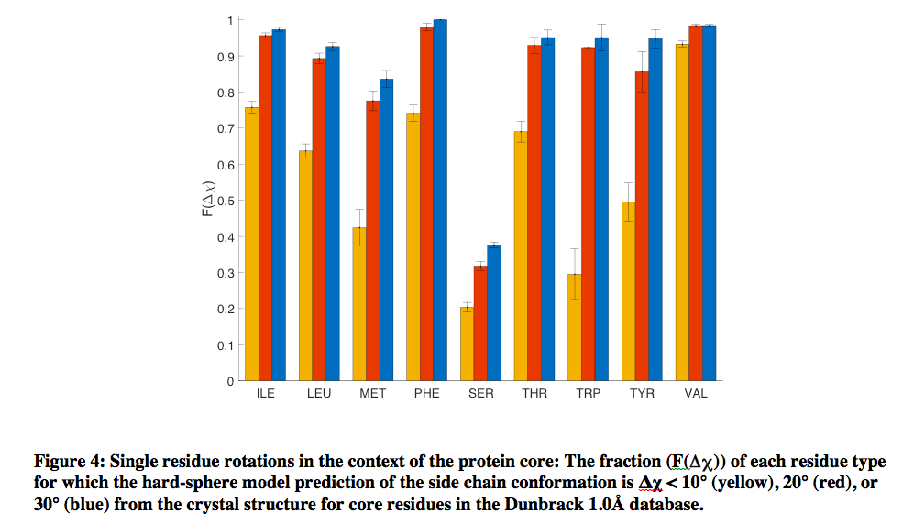
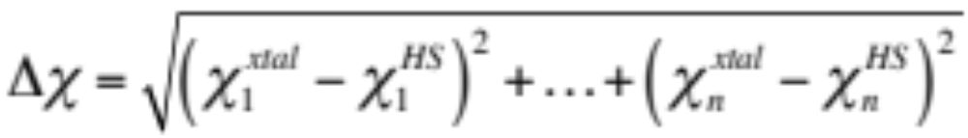
Comparison between xtal structure and hard-sphere prediction

Slide 24
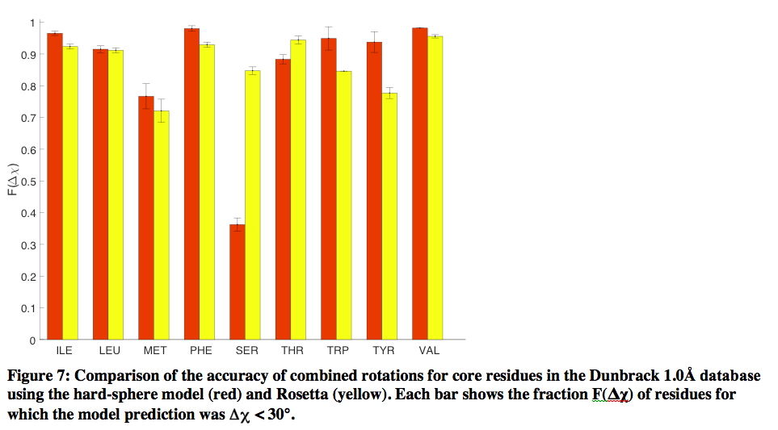

Slide 25
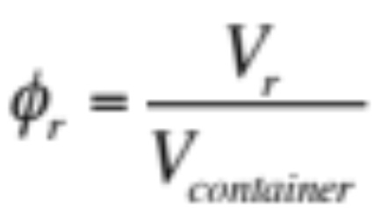
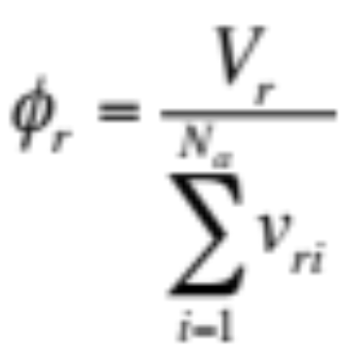
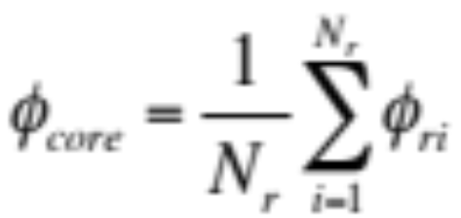
Studies of Packing in Protein Cores
F. M. Richards, “The interpretation of protein structures: Total
volume, group volume distributions, and packing fraction,”
J. Mol. Biol. 82 (1974) 1.
J. Liang and K. A. Dill, “Are proteins well-packed,” Biophys. J.
81 (2001) 751.
v_{ri}=Voronoi volume of
atom i in residue r
Notes:
So now we have a complete hard-sphere atomistic model for all core residues and are ready to calculate the packing fraction of protein cores. The packing fraction of each residue is the volume of the residue divided by the volume that confines the residue. We will determine the volume of the container by summing of the volumes of the Voronoi polyhedra that enclose each atom in the residue.

Slide 26
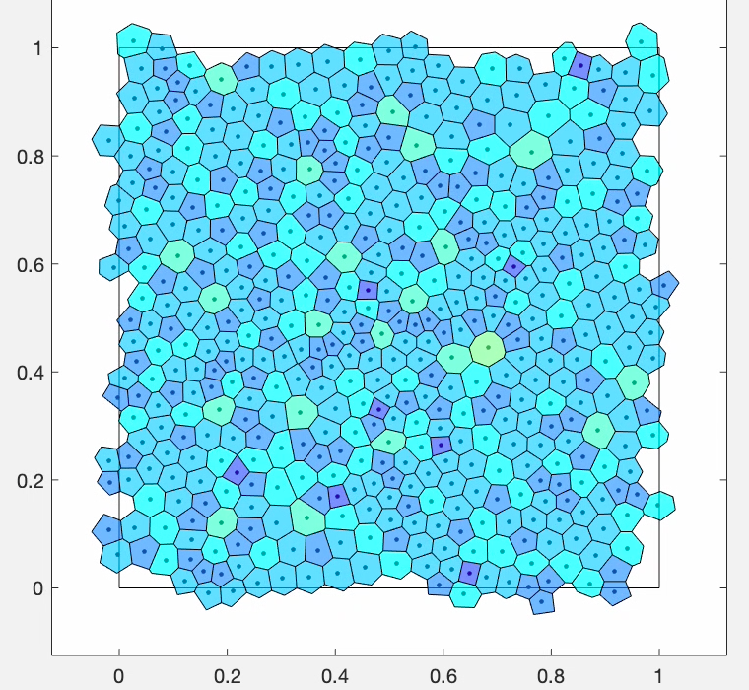

Slide 27
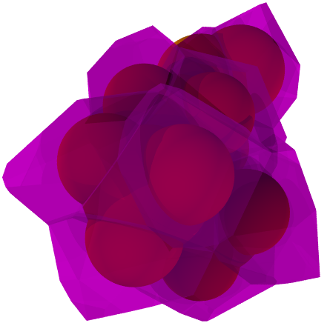
Voronoi Tessellation

Slide 28
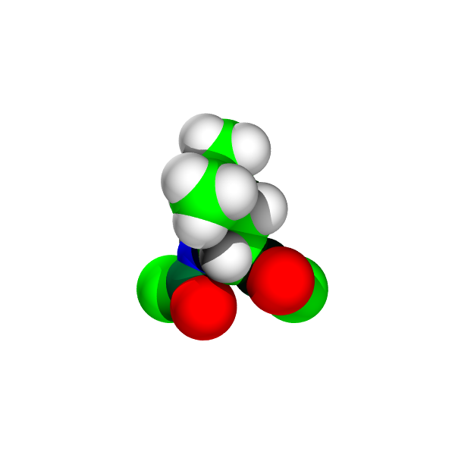
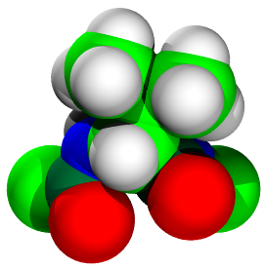
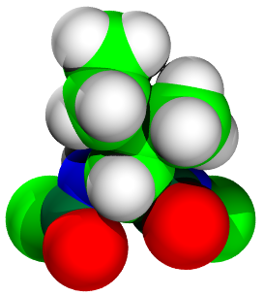
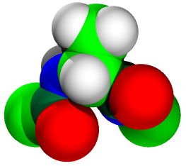
(Non-overlap) Volumes of Core Residues w/ Explicit Hydrogens
Residue Type | Volume V_{r} (Å³)
Leu | 88.06
Ala | 43.62
Val | 72.45
Ile | 88.13
Gly | 30.46
Phe | 100.66
Cys | 61.20
Met | 87.49
Leu
Val
O
C
H
Ile
Ala
N
Notes:
The volumes of the residues with explicit hydrogens can be calculated exactly. Residue volumes with backbone, i.e. including N, C_alpha, C-O
See table.

Slide 29
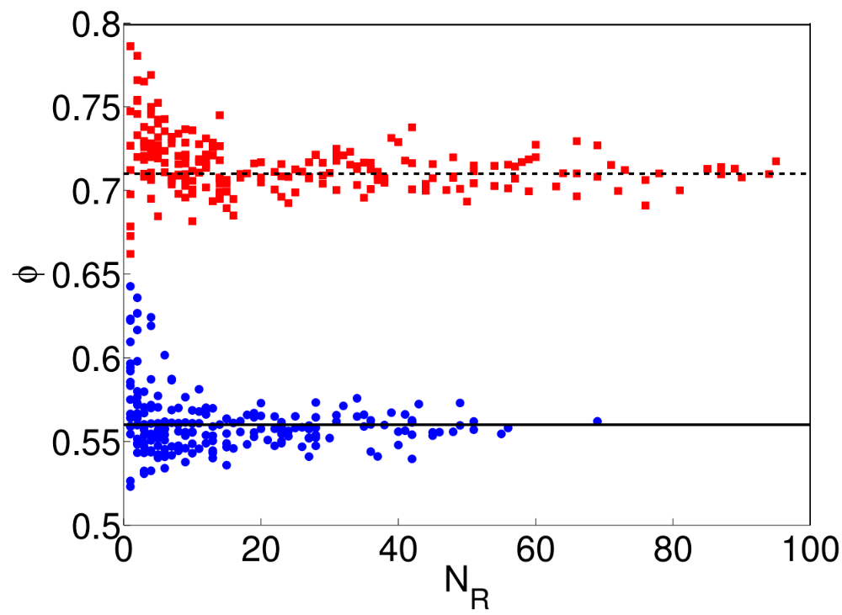
Protein Cores
extended atom
ϕ_{core}
explicit hydrogen

Slide 30
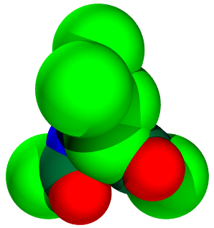
Leu
extended atom
Leu
explicit hydrogens
O
C
V_{r}=107.2Å³
V_{r}=88.1Å³
H
N
Notes:
To show an explicit example, we show the extended atom representation of Leu and our explicit hydrogen representation.

Slide 31
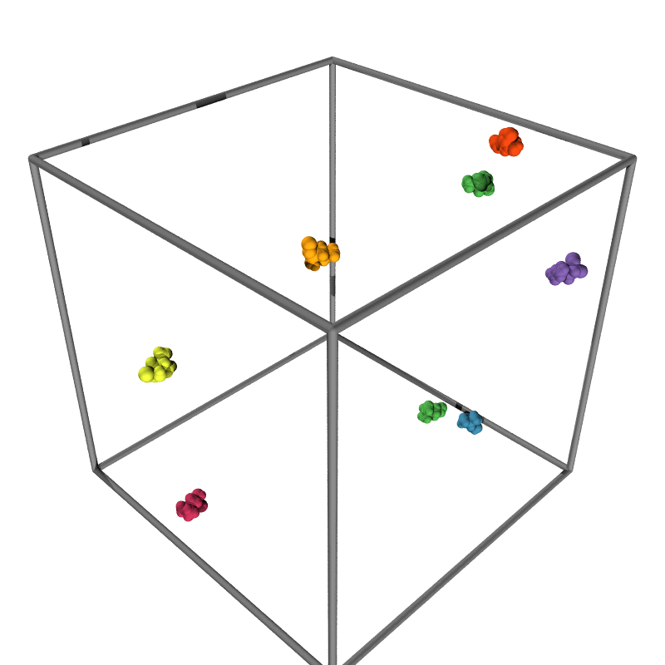

Packing Simulations
Notes:
A novel aspect of our work is that we have developed a model system that is able to recapitulate the packing fraction observed in protein cores. We performed isotropic compression studies of independent amino acids with the correct stereochemistry (bond lengths, bond angles, backbone and side chain dihedral angles taken from protein crystal structures) that interact via purely repulsive contact interactions. We compress the system by a small amount, relax the energy, compress the system, relax… until the overlap energy changes from zero to nonzero.
3D; 1x1x1 cube, periodic boundary conditions;
N amino acids with N C_alpha C-O,
Fraction of each type of residue matches fraction that appears in core of proteins
Quasi-static compression until system jams (i.e. goes from p=0 to p>0)
Bond lengths, bond angles, phi, psi, chi1, chi2 are chosen randomly for each residue from observed
distributions and fixed throughout simulations
Phi_i=0.0001
(phi-phi_J)/phi_J = 10^-6

Slide 32
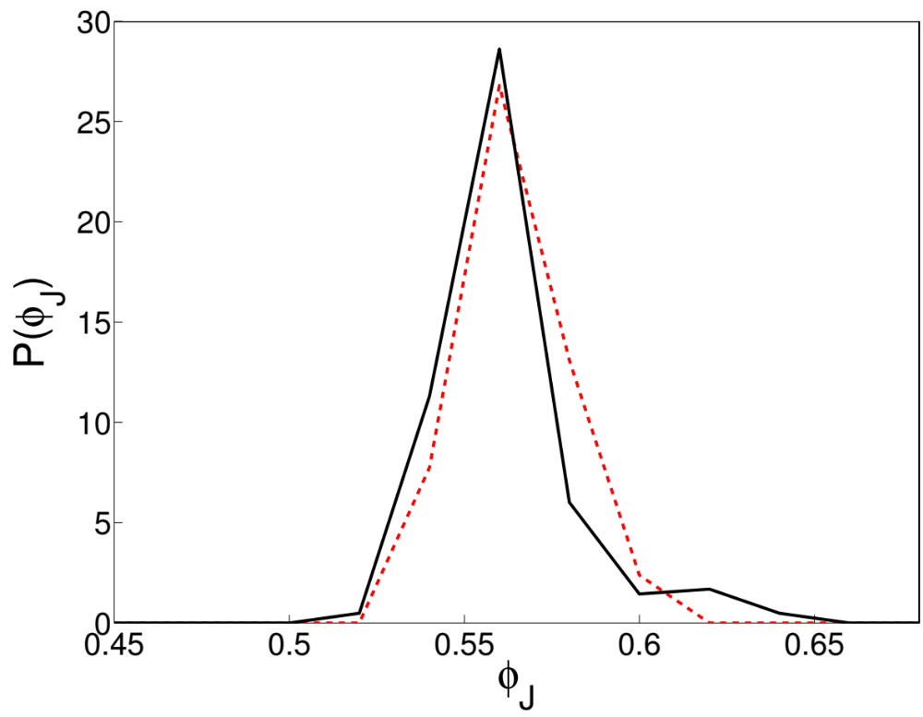
protein cores
packing simulation

Slide 33
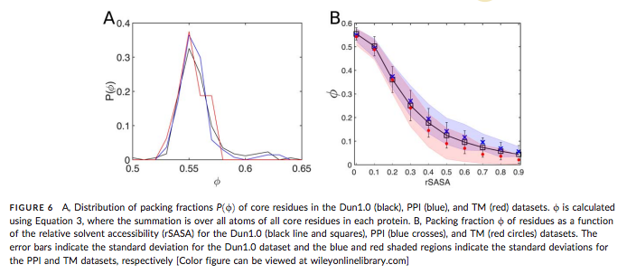

Slide 34
Why is the packing fraction of protein cores ϕ<0.74?

Slide 35
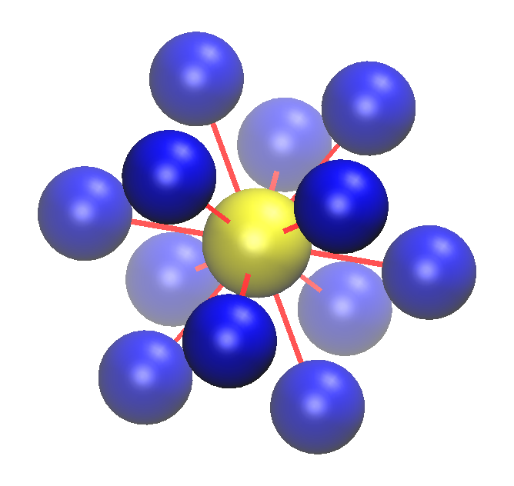
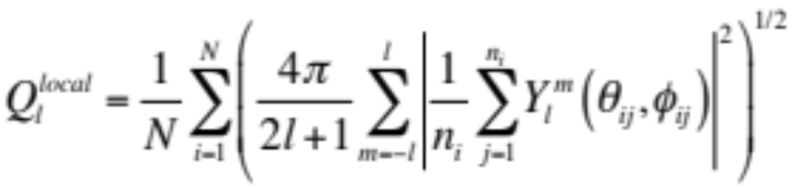
Bond-orientational order parameter Q_{l}
i
j

Slide 36
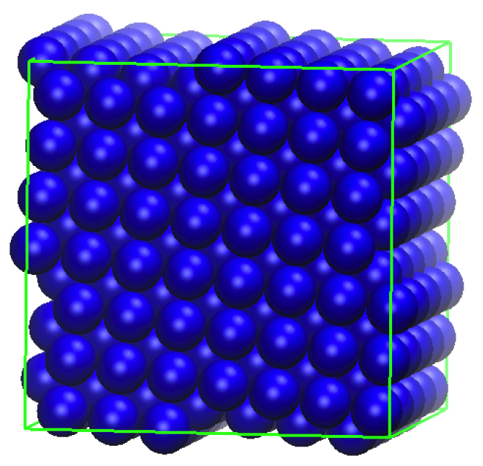
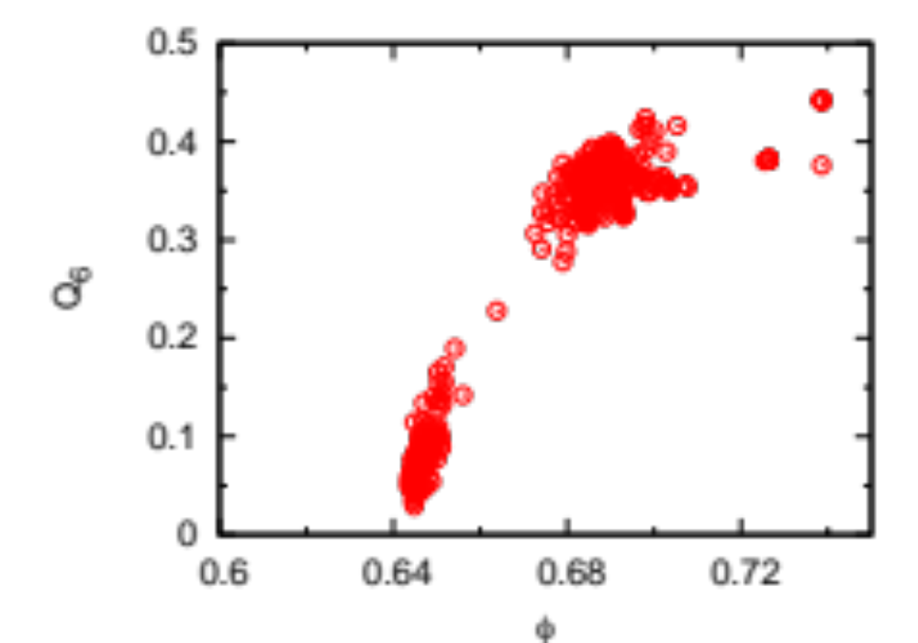
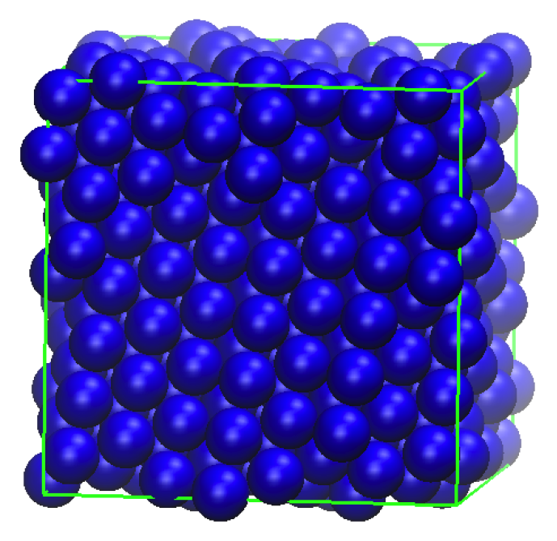
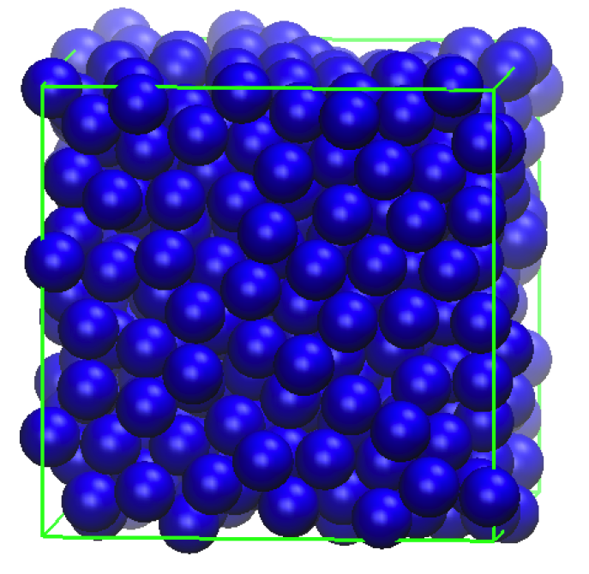
Packing of monodipserse spheres
unjammed;
floppy
jammed; rigid
FCC
Bond orientational order Q₆
RCP
0.74
ϕ

Slide 37
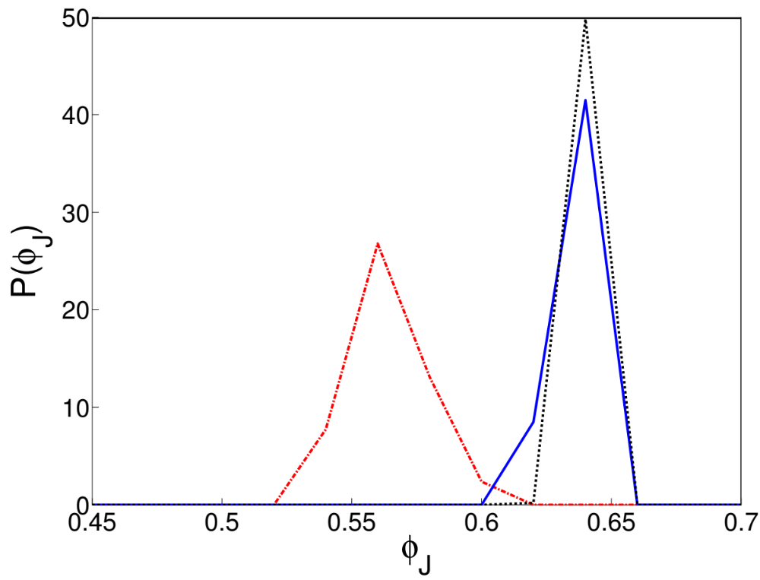
Amino acids
Polydisperse spheres
Monodisperse spheres

Slide 38
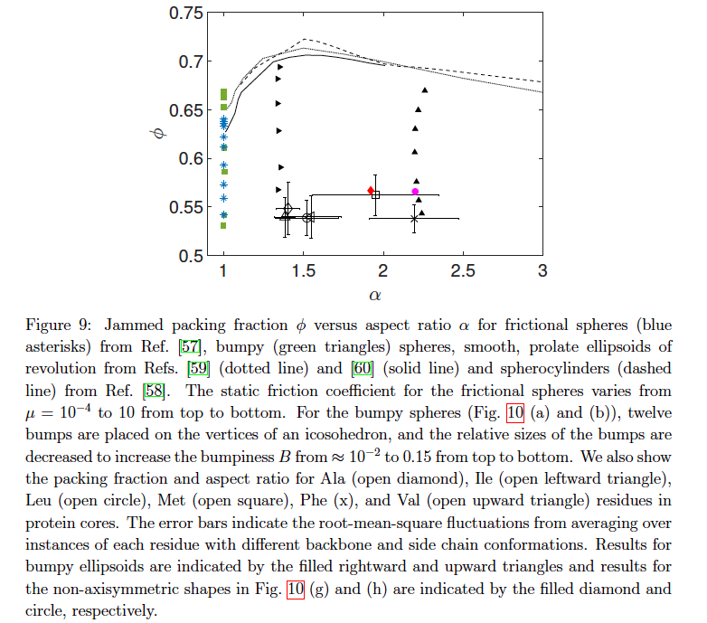

Slide 39
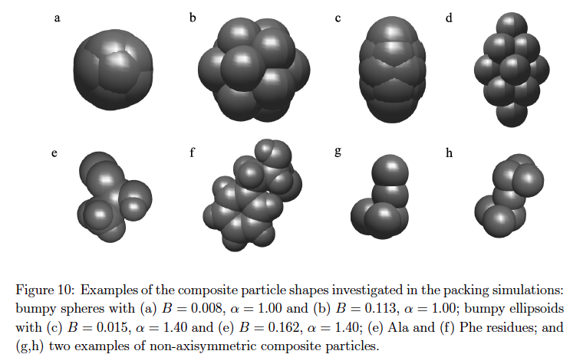

Slide 40
Conclusions
Previous calculations of ϕ_{core}~0.70-0.74, are likely too high
for protein core packing; would imply structural order
We predict ϕ_{core}~0.56 using a hard-sphere model with
explicit hydrogens and atomic radii calibrated to observed
side-chain dihedral angle distributions
Showed that ϕ_{core}~0.56 can be obtained from hard-particle
simulations of individual amino acids under isotropic compression
Apply results to mutations of protein cores and interfaces

Slide 41
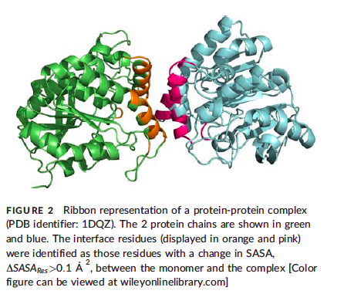

Slide 42
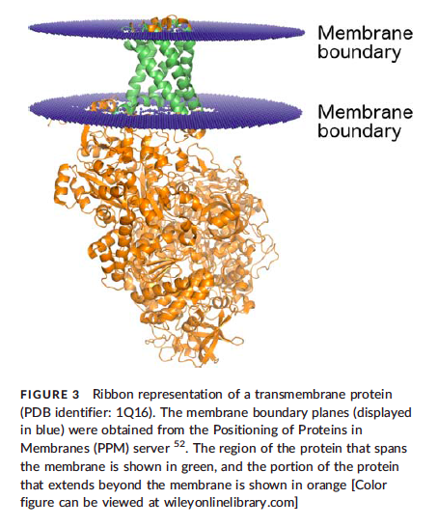

Slide 43
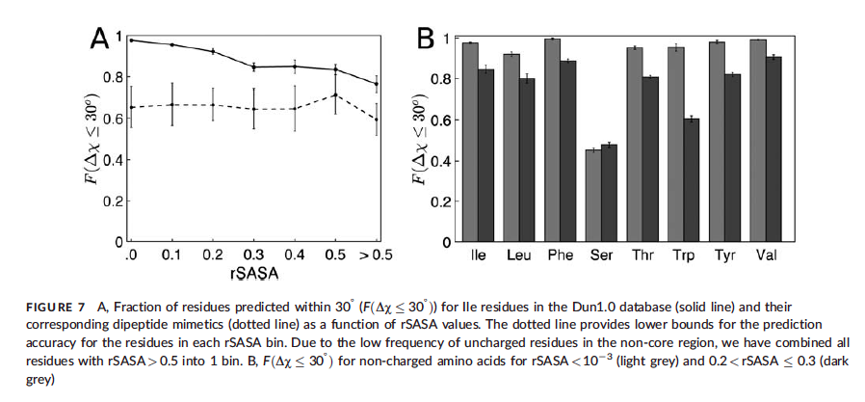

Slide 44
