Slide 1
Biomedical Data Science:
Single Cell Workshop
Donglu Bai
TA Lecture for CBB 752
Biomedical Data Science: Mining and Modeling
Spring, 2023
Yale University
1

Slide 2
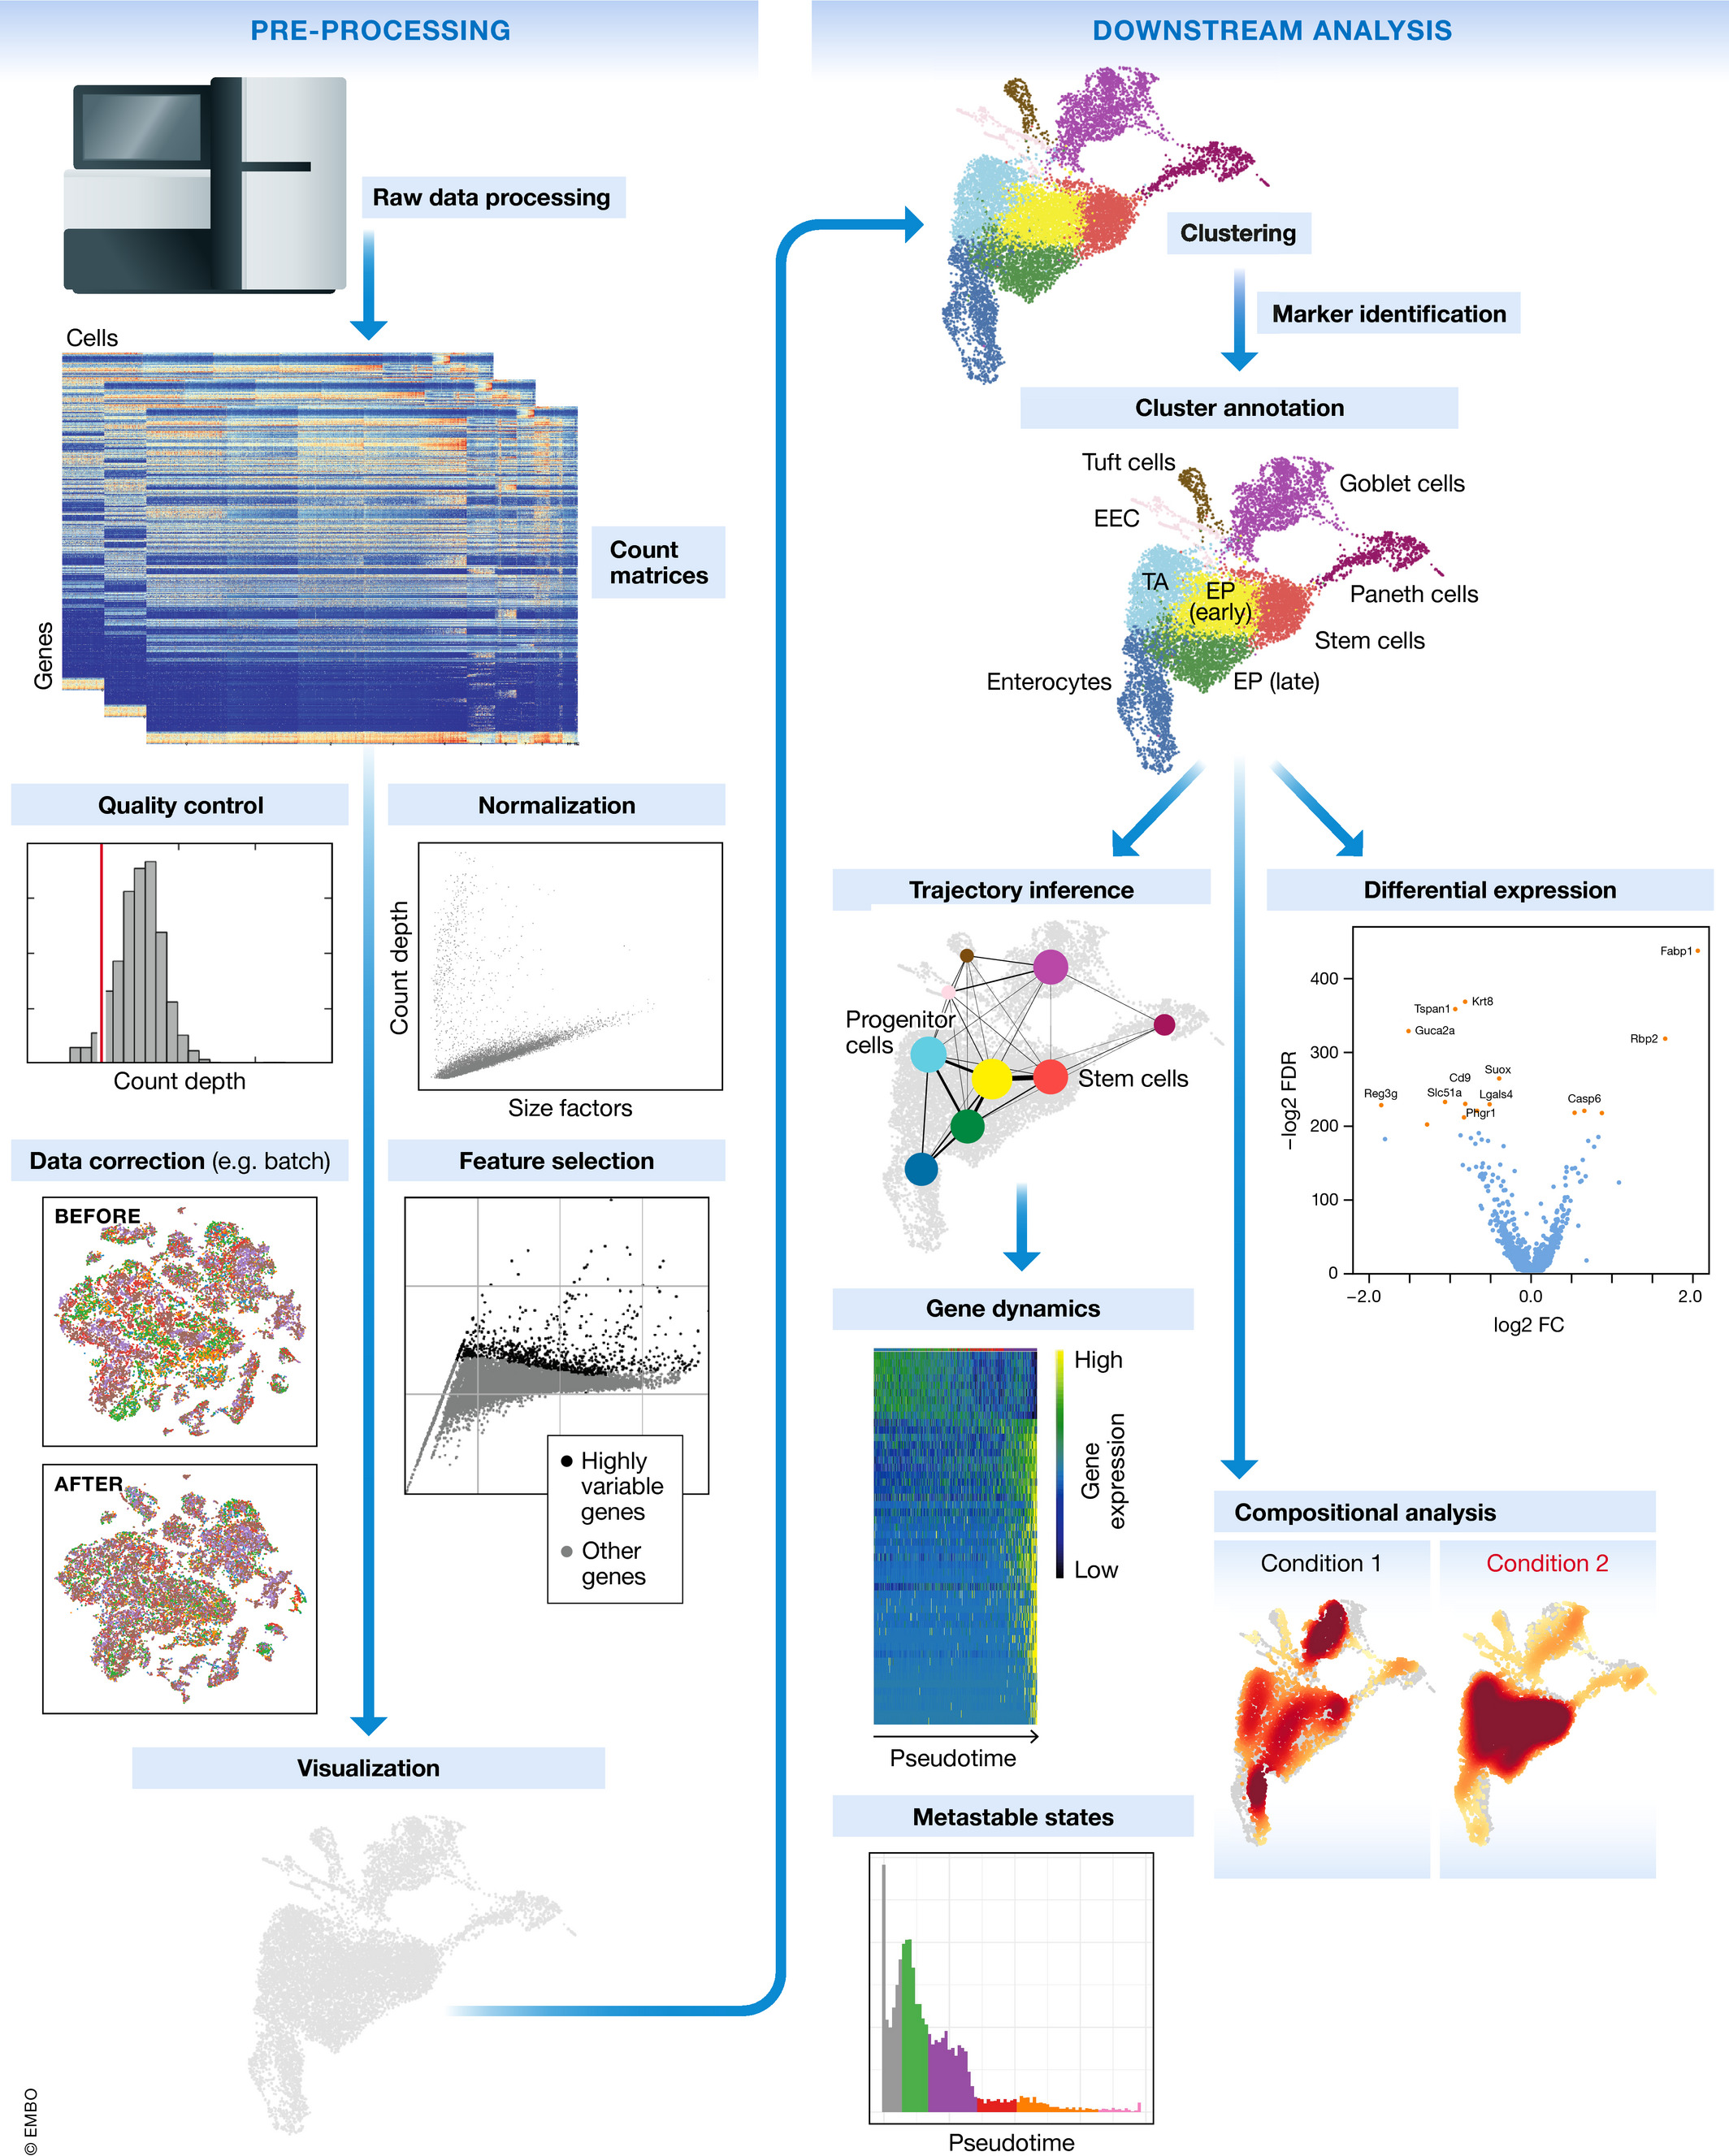
Single-cell RNA-seq workflow
Generation of the count matrix
Quality control of the raw counts – filter out poor quality cells
Clustering of filtered counts: (cell types = different clusters)
Marker identification and cluster annotation: identify gene markers for each cluster
Biological replicates are needed!
Luecken, MD and Theis, FJ. Current best practices in single‐cell RNA‐seq analysis: a tutorial, Mol Syst Biol 2019 (doi: https://doi.org/10.15252/msb.20188746)
2

Slide 3
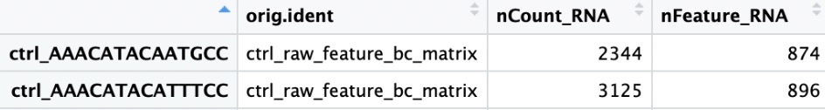
Quality control set up
Goal:
To filter the data to only include true cells that are of high quality
To identify any failed samples
Example dataset: comprised of pooled peripheral blood mononuclear cells from eight lupus patients, split into control and interferon beta-treated (stimulated) conditions
Generate quality metrics
Sample id
# of UMIs/cell
# of genes/cell
Additional metrics:
Number of genes detected per UMI (novelty score)
Mitochondrial ratio
https://hbctraining.github.io/scRNA-seq_online/lessons/04_SC_quality_control.html
3
Notes:
Merged metadata
This metrics will give us an idea of the complexity of our dataset (more genes detected per UMI, the more complex our data is)
Mitochondrial ratio will give us a percentage of cell reads originating from the mitochondrial genes

Slide 4
Quality control set up
Novelty score
# of detected genes/UMI = # of genes/cell / # of UMIs per cell
Mitochondrial Ratio
- PercentageFeatureSet() searches for gene identifiers that begin with MT-
Questions to consider:
Why aren’t we checking for doublets?
What does high mitochondrial gene expression indicate?
https://hbctraining.github.io/scRNA-seq_online/lessons/04_SC_quality_control.html
4
Notes:
Doublets are obviously undesirable when the aim is to characterize populations at the single-cell level. In particular, they can incorrectly suggest the existence of intermediate populations or transitory states that do not actually exist. Thus, it is desirable to remove doublet libraries so that they do not compromise interpretation of the results.
Many workflows use maximum thresholds for UMIs or genes, with the idea that a much higher number of reads or genes detected indicate multiple cells. While this rationale seems to be intuitive, it is not accurate. Also, many of the tools used to detect doublets tend to get rid of cells with intermediate or continuous phenotypes, although they may work well on datasets with very discrete cell types
When we have identified markers for each of the clusters, we suggest exploring the markers to determine whether the markers apply to more than one cell type.
Generally, we assume that cells with high detection of mitochondrial RNAs have undergone degradation of the mitochondrial membrane as a result of apoptosis. This may be from stress during dissociation, culture, or really anywhere in the experimental pipeline. As with the high and low library size cells, we want to remove the long tail from the distribution. In a successful experiment, it's typical for 5-10% of the cells to have this apoptotic signature.

Slide 5
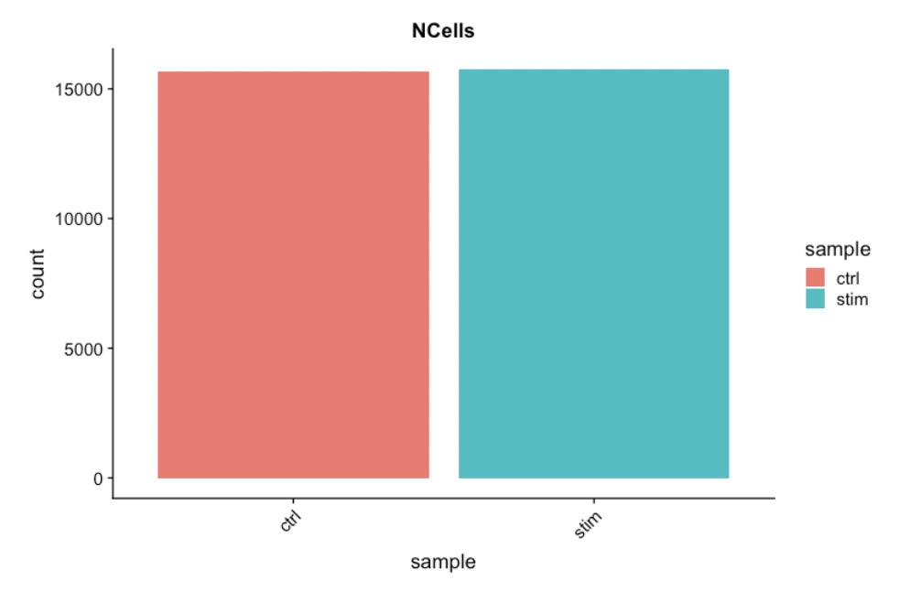
Assess the quality metrics
Cell counts
-For this experiment, between 12,000-13,000 cells are expected
-We see over 15,000 cells per sample, which is quite a bit more than the 12-13,000 expected. We have some junk ‘cells’ present.
https://hbctraining.github.io/scRNA-seq_online/lessons/04_SC_quality_control.html
5
Notes:
Cell counts are determined by the number of unique cellular barcodes
Expected cell numbers are dependent on the number of cells you load, capture efficiency and the protoal.
The cell numbers can also be higher than what we loaded with the 10X protocol there is a chance of obtaining only a barcoded bead in the emulsion droplet (GEM) and no actual cell in addition to the presence of dying cells can lead to a higher number of cellular barcodes than cells.

Slide 6
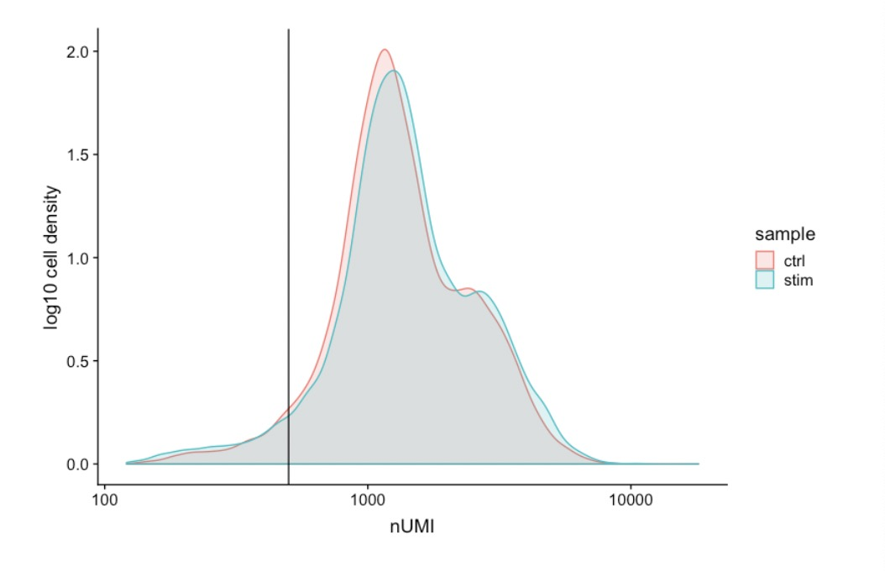
Assess the quality metrics
UMI counts (transcripts) per cell
-The UMI counts per cell should generally be above 500, that is the low end of what we expect.
-Most cells in both samples have 1000 UMIs or greater
https://hbctraining.github.io/scRNA-seq_online/lessons/04_SC_quality_control.html
6
Notes:
If UMI counts are between 500-1000 counts, it is usable but the cells probably should have been sequenced more deeply.

Slide 7
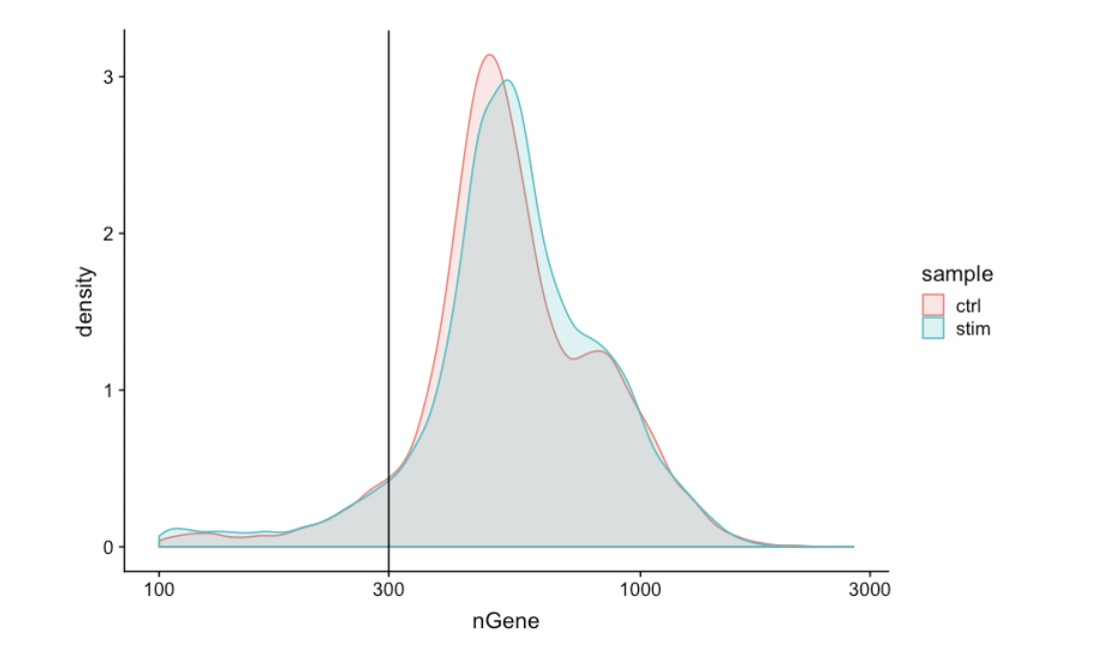
Assess the quality metrics
Genes detected per cell
-Similar expectations for gene detection as for UMI detection
https://hbctraining.github.io/scRNA-seq_online/lessons/04_SC_quality_control.html
7
Notes:
or high quality data, the proportional histogram should contain a single large peak that represents cells that were encapsulated. in the droplets with a single cell
If we see a small shoulder to the left of the major peak (not present in our data), or a bimodal distribution of the cells, that can indicate a couple of things. It might be that there are a set of cells that failed for some reason. It could also be that there are biologically different types of cells Therefore, this threshold should be assessed with other metrics that we describe in this lesson.

Slide 8
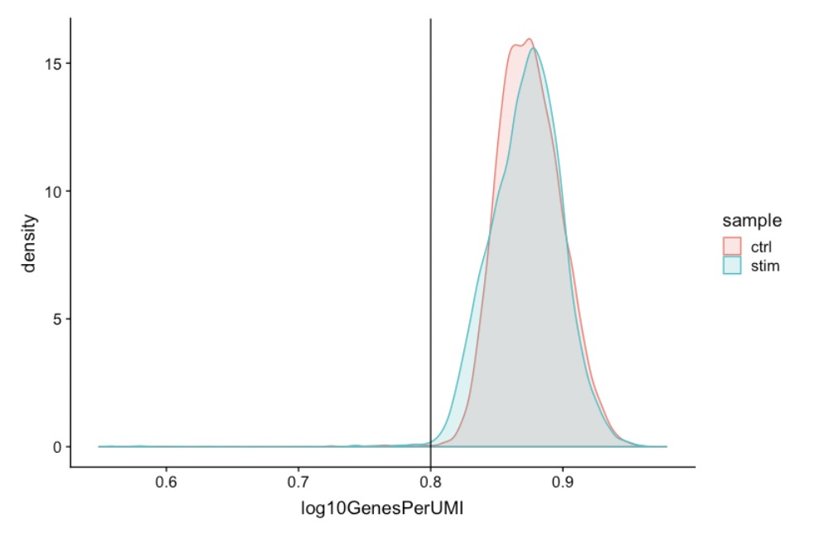
Assess the quality metrics
Complexity
-Novelty score for assessing how complex the RNA species are
-Generally, we expect the novelty score to be above 0.8 for good quality cells
https://hbctraining.github.io/scRNA-seq_online/lessons/04_SC_quality_control.html
8
Notes:
this likely means that you only captured a low number of genes and simply sequenced transcripts from those lower number of genes over and over again. These low complexity (low novelty) cells could represent a specific cell type
i.e. red blood cells which lack a typical transcriptome), or could be due to an artifact or contamination.

Slide 9
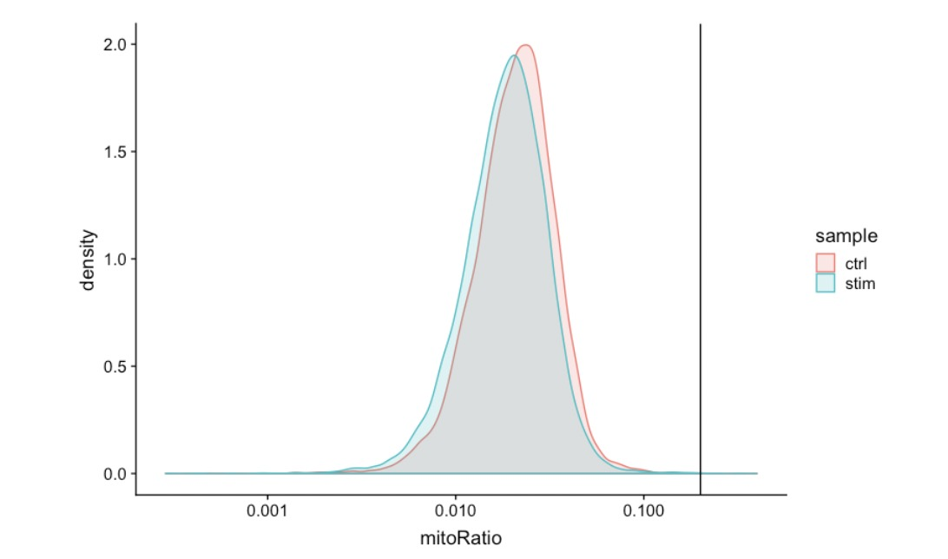
Assess the quality metrics
Mitochondrial counts ratio
-define poor quality samples for mitochondrial counts as cells which surpass the 0.2 mitochondrial ratio mark
https://hbctraining.github.io/scRNA-seq_online/lessons/04_SC_quality_control.html
9
Notes:
This metric can identify whether there is a large amount of mitochondrial contamination from dead or dying cells.

Slide 10
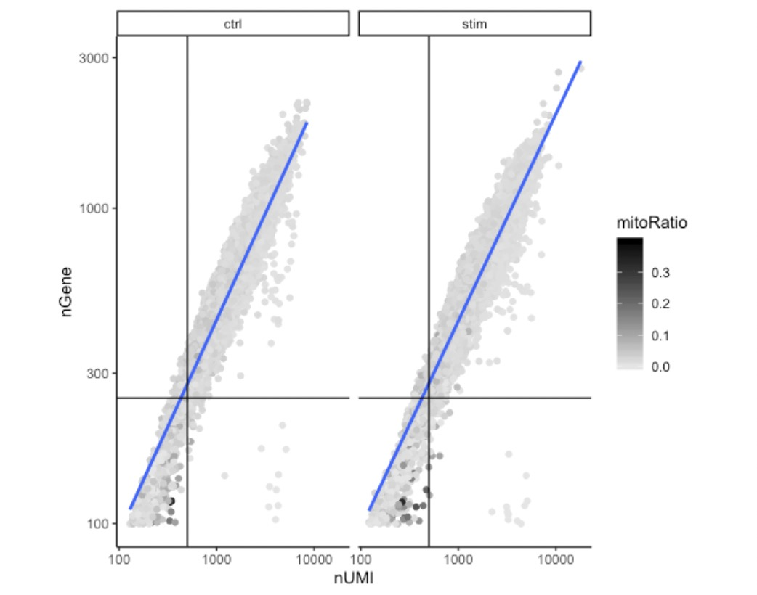
Assess the quality metrics
Joint filtering effects
-A general rule of thumb is to set thresholds for individual metrics as permissive as possible and consider the joint effects of these metrics
Dying cells/low complexity cell types
Cells with poor quality
High mitochondrial read fractions
https://hbctraining.github.io/scRNA-seq_online/lessons/04_SC_quality_control.html
10
Notes:
Considering any of these QC metrics in isolation can lead to misinterpretation of cellular signals. For example, cells with a comparatively high fraction of mitochondrial counts may be involved in respiratory processes and may be cells that you would like to keep. Likewise, other metrics can have other biological interpretations.
Here, we have plotted the number of genes versus the number of UMIs coloured by the fraction of mitochondrial reads
and correspond to the data points in the bottom left quadrant of the plot.
This could be indicative of damaged/dying cells whose cytoplasmic mRNA has leaked out through a broken membrane, and thus, only mRNA located in the mitochondria is still conserved. We can see from the plot, that these cells are filtered out by our count and gene number thresholds.
data points in the bottom right hand quadrant of the plot. These cells have a high number of UMIs but only a few number of genes. These could be dying cells, but also could represent a population of a low complexity celltype (i.e red blood cells).

Slide 11

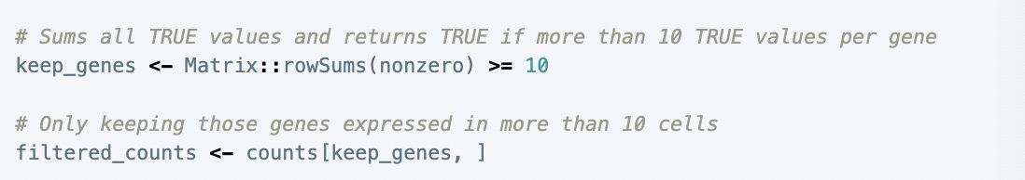
Filtering
Cell-level filtering
-# of UMI >500
-# of Gene >250
-log10GenesPerUMI >0.8
-mitoRatio <0.2
Gene-level filtering
-remove genes with zero counts from our data
-output a logical matrix for each gene on if there are more than zero counts per cell
-keep only genes which are expressed in 10 or more cells; remove zero count
https://hbctraining.github.io/scRNA-seq_online/lessons/04_SC_quality_control.html
11
Notes:
. If a gene is only expressed in a handful of cells, it is not particularly meaningful as it still brings down the averages for all other cells it is not expressed in

Slide 12
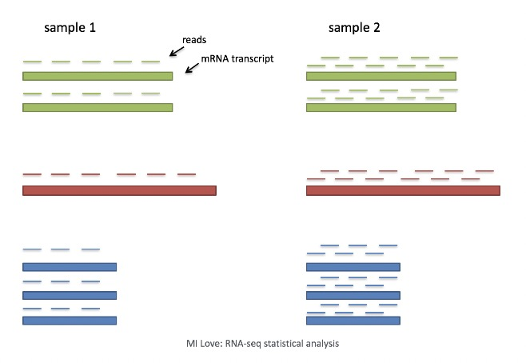
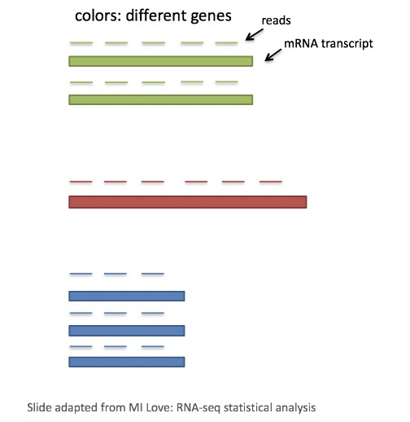
Normalization and regressing out unwanted variation
Main factors to consider
-Sequencing depth
-Gene length
https://hbctraining.github.io/scRNA-seq_online/lessons/04_SC_quality_control.html
12
Notes:
In the example below, each gene app
Each cell in scRNA-seq will have a differing number of reads associated with it. So to accurately compare expression between cells, it is necessary to normalize for sequencing depth.ears to have doubled in expression in cell 2, however this is a consequence of cell 2 having twice the sequencing depth.
The number of reads mapped to a longer gene can appear to have equal count/expression as a shorter gene that is more highly expressed.

Slide 13
Normalization and regressing out unwanted variation
Methods for scRNA-seq normalization
-Scaling
multiply each UMI count by a cell specific factor to get all cells to have the same UMI counts
(not interested in comparing absolute counts between cells)
-Transformation
Pearson residuals for transformation
(construct GLM for each gene with UMI as the response and sequencing depth as the explanatory variable to obtain residuals with normalized data values)
https://hbctraining.github.io/scRNA-seq_online/lessons/04_SC_quality_control.html
13
Notes:
Different cells have different amounts of mRNA; this could be due to differences between cell types or variation within the same cell type depending on how well the chemistry worked in one drop versus another
The method not only normalizes data, but it also performs a variance stabilization and allows for additional covariates to be regressed out.
(Measurements are multiplied by a gene-specific weight; each gene is weighted by how much evidence there is that it is non-uniformly expressed across cells)

Slide 14
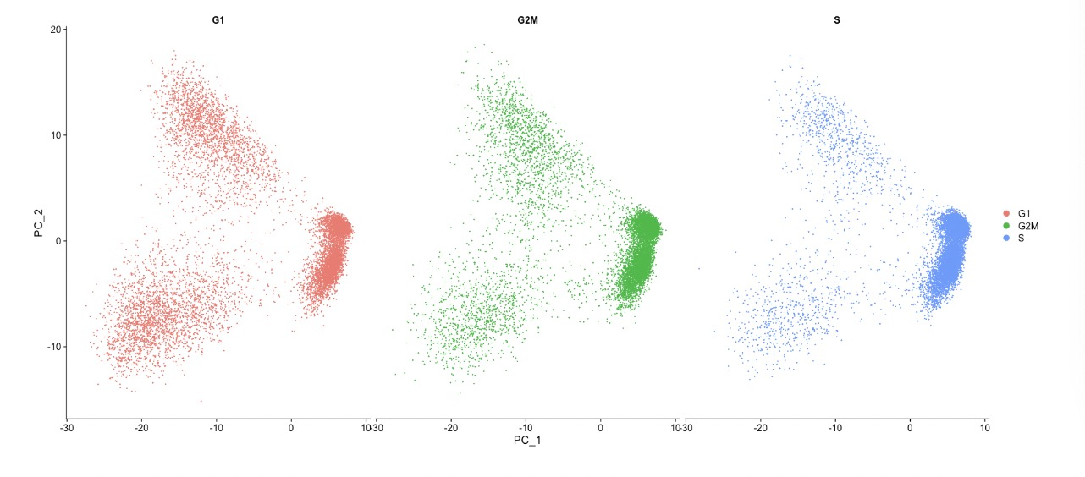
Normalization and regressing out unwanted variation
Explore sources of unwanted variation
-One most common biological data correction (uninteresting variation) is the effects of the cell cycle on the transcriptome
-Explore effects of cell cycle (CellCycleScoring() calculates cell phase scores)
-Determine if cell cycle is a major source of variation in our dataset using PCA
Not regress out the variation due to cell cycle
https://hbctraining.github.io/scRNA-seq_online/lessons/04_SC_quality_control.html
14
Notes:
We do not see large differences due to cell cycle phase
Mitochondrial expression is another factor which can greatly influence clustering. Oftentimes, it is useful to regress out variation due to mitochondrial expression. However, if the differences in mitochondrial gene expression represent a biological phenomenon that may help to distinguish cell clusters, then we advise not regressing this out.

Slide 15
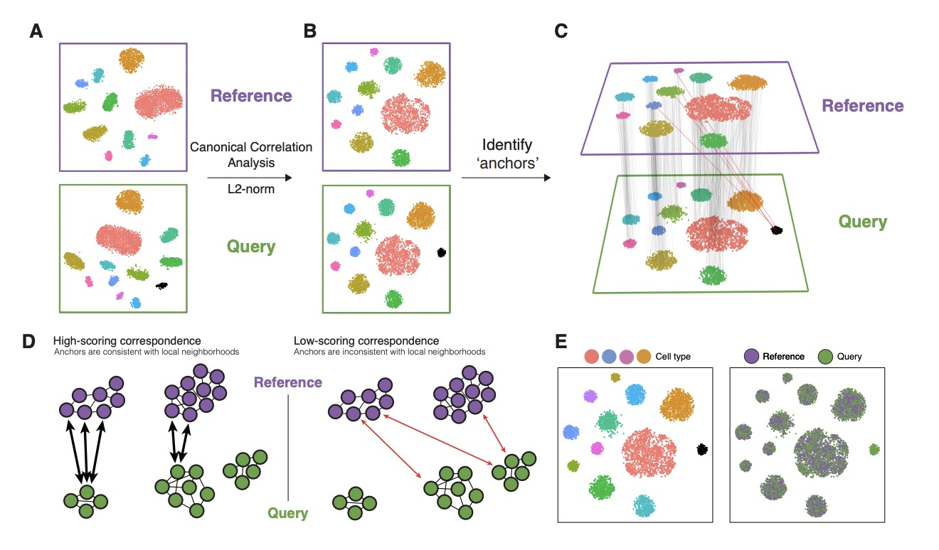
Integration
-Integrate the cells across conditions to ensure that cells of the same cell type cluster together (identify cell types that are present in all conditions for interpretable downstream analysis)
https://hbctraining.github.io/scRNA-seq_online/lessons/04_SC_quality_control.html
15
Notes:
uses these shared sources of greatest variation to identify shared subpopulations across conditions or datasets
The goal of integration is to ensure that the cell types of one condition/dataset align with the same celltypes of the other conditions/datasets (e.g. control macrophages align with stimulated macrophages).
Perform canonical correlation analysis (CCA):
in that it identifies the greatest sources of variation in the data, but only if it is shared or conserved across the conditions/groups
The shared highly variable genes are used because they are the most likely to represent those genes distinguishing the different cell types present.
Identify anchors or mutual nearest neighbors (MNNs) across datasets (sometimes incorrect anchors are identified):
t in practice we observe "incorrect" anchors at low frequency (red lines).
Filter anchors to remove incorrect anchors:
Assess the similarity between anchor pairs by the overlap in their local neighborhoods
Integrate the conditions/datasets:

Slide 16
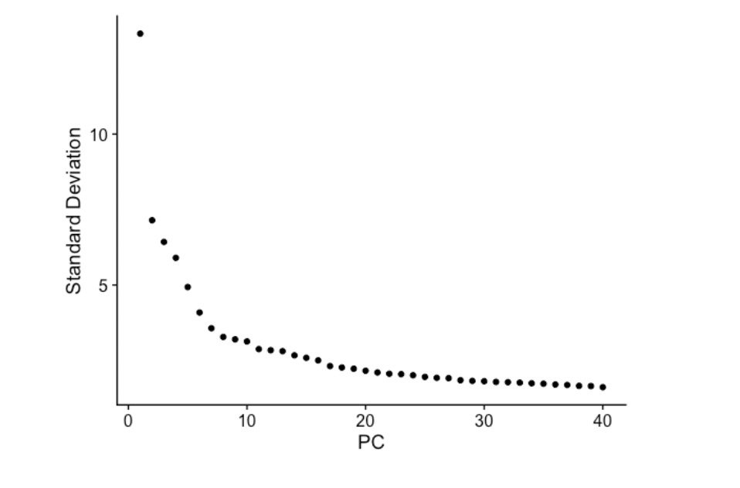
Clustering
Identify significant PCs
Clustering methods
-K-means clustering
Measure of similarity: Euclidean distance
Quality function: Within cluster distance
-Graph-based clustering
Memory effectiveness: Current methods aim to build sparse graphs
Curse of dimensionality: All data become sparse in high-dimensional space
https://hbctraining.github.io/scRNA-seq_online/lessons/04_SC_quality_control.html
16
Notes:
Based on this plot, we could roughly determine the majority of the variation by where the elbow occurs around PC8 - PC10, or one could argue that it should be when the data points start to get close to the X-axis, PC30 or so.
applied to scRNA-seq data by building a graph where each vertice represents a cell and (weight of) the edge measures similarity between two cells.
therefore similarities measured by Euclidean distances etc are generally low between all objects.

Slide 17
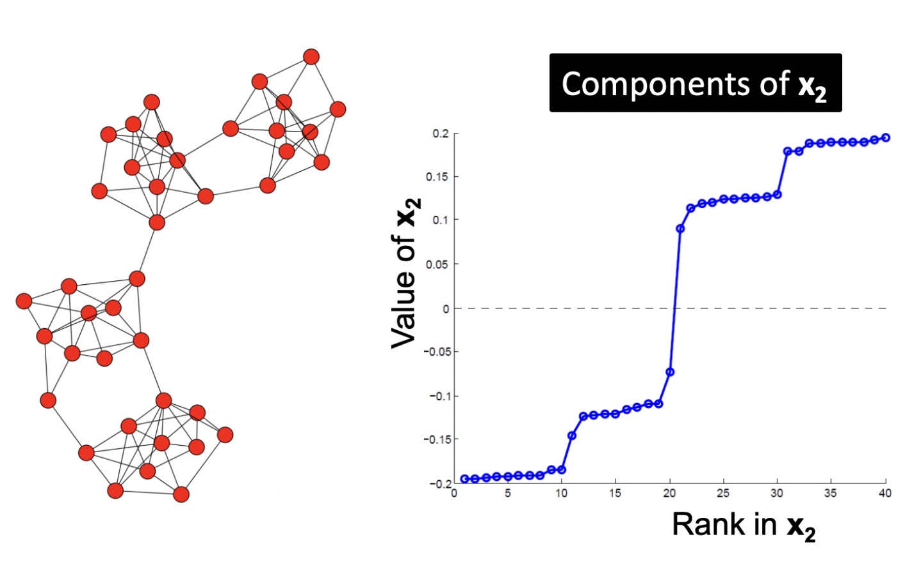
Spectral clustering
-Pre-processing
build Laplacian matrix L of the graph G
-Decomposition
Find eigenvalues and eigenvectors
Map vertices to corresponding components of second smallest eigenvectors
-Grouping
Identify clusters by splitting the sorted vector in two (split at 0 or median value)
Partition into k clusters
-Recursive bi-partitioning
-Cluster multiple eigenvectors
Avoids the curse of dimensionality by projecting
data into lower-dimensional space
https://wandb.ai/syllogismos/machine-learning-with-graphs/reports/5-Spectral-Clustering--VmlldzozNzcwMDU
17
Notes:
Embed nodes on line assign positive and negativevalues
Build a reduced space from multiple eigenvectors and do k means

Slide 18
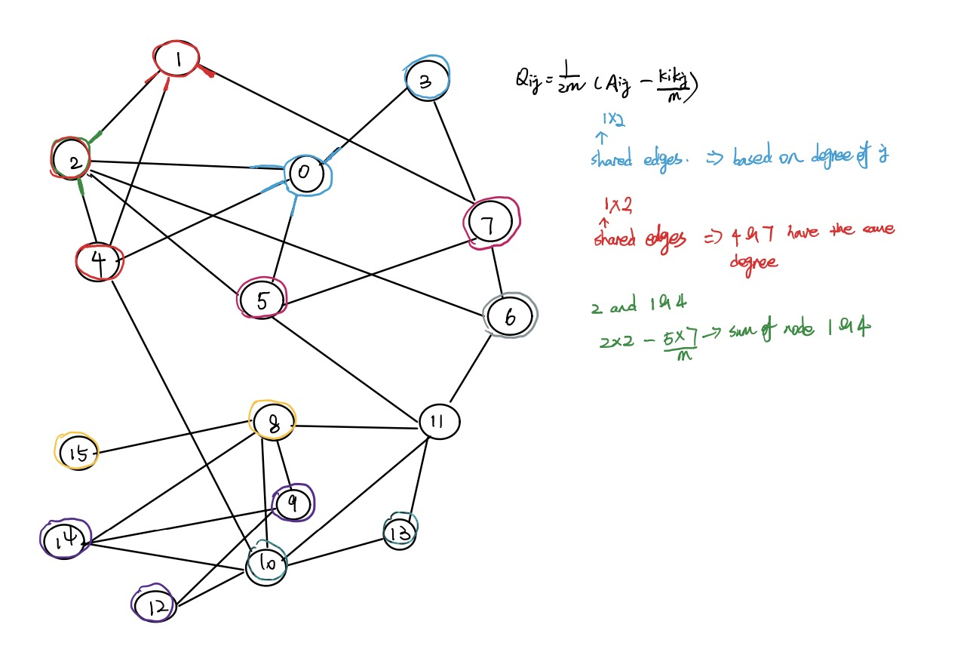
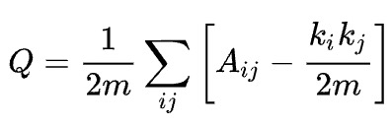
Louvain clustering
-The optimization of modularity
First small communities are found by optimizing modularity locally on all nodes; then each small community is grouped into one node and the first step is repeated
Fast
No need to specify k
18
Notes:
Modularity is a scale value between −0.5 (non-modular clustering) and 1 (fully modular clustering) that measures the relative density of edges inside communities with respect to edges outside communities. Optimizing this value theoretically results in the best possible grouping of the nodes of a given network
M is the number of edges
Shared degree of d I and j

Slide 19
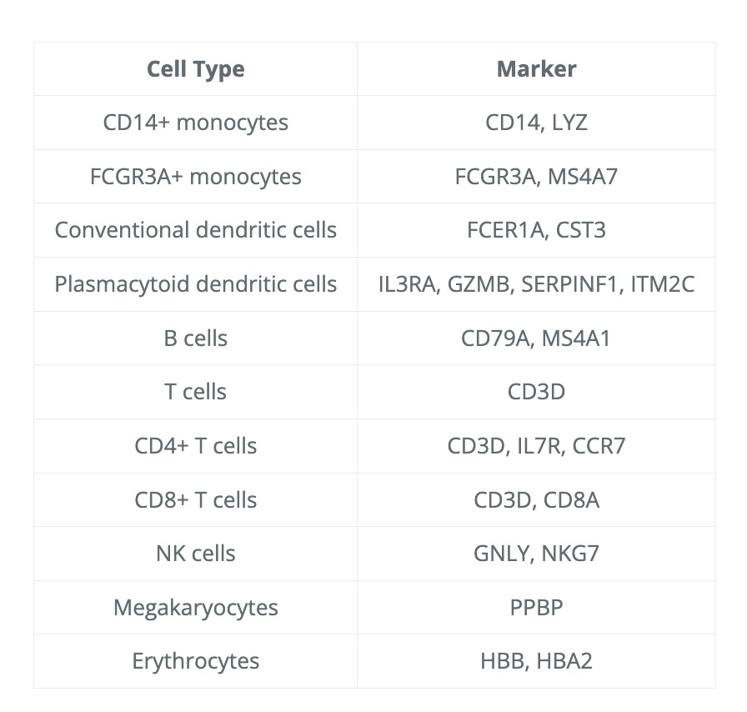
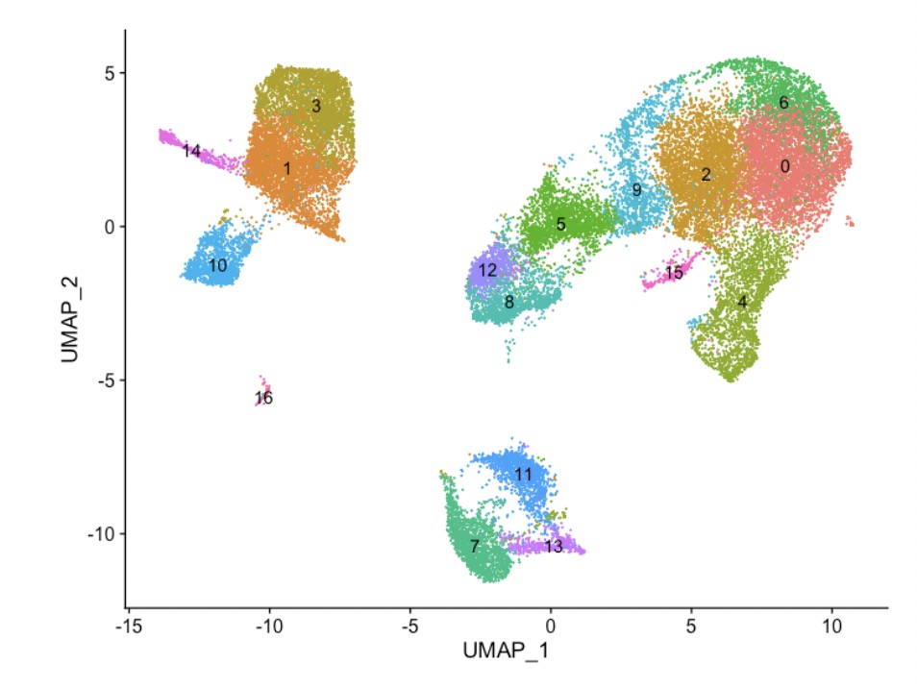
Clustering quality control
Exploring known cell type markers
Explore cell type identities by looking for known markers
https://hbctraining.github.io/scRNA-seq_online/lessons/04_SC_quality_control.html
19

Slide 20
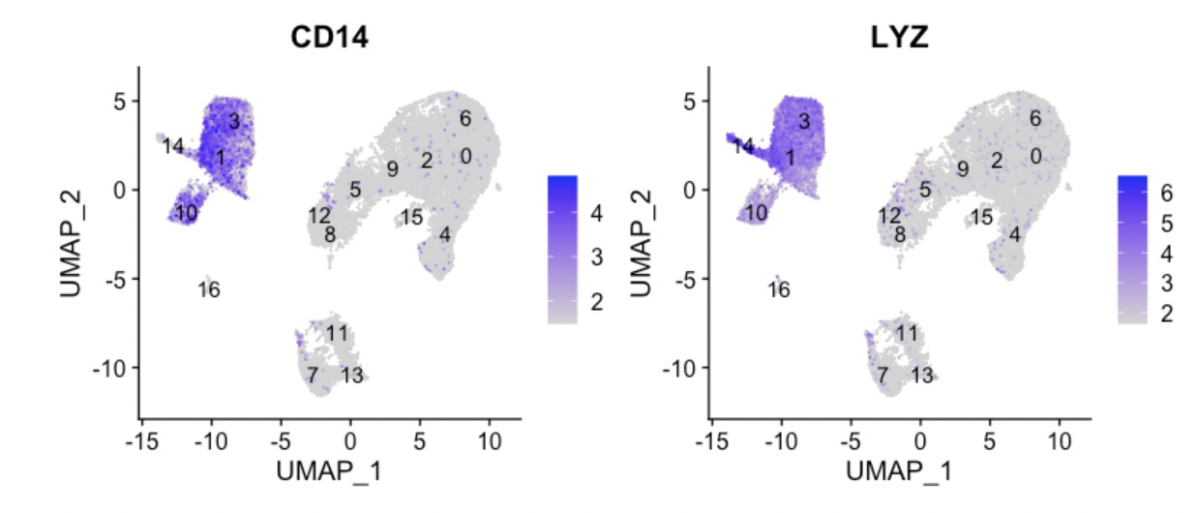
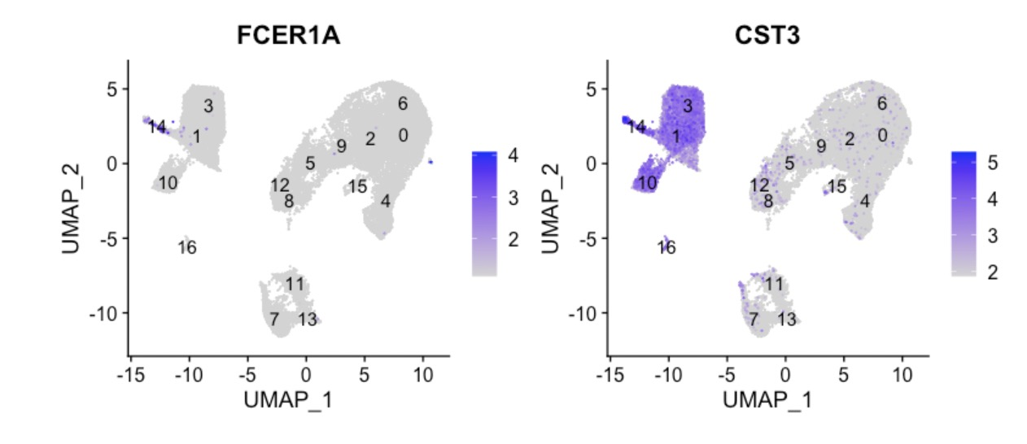
Clustering
Exploring known cell type markers
-The FeaturePlot() from Seurat makes it easy to visualize a handful of genes
-The combined expression of our chosen positive or negative markers should give us an idea of which cluster corresponds to which cell type
CD14+ monocytes appear to correspond to clusters 1 and 3
Conventional dendritic cell markers identify cluster 14
https://hbctraining.github.io/scRNA-seq_online/lessons/04_SC_quality_control.html
20

Slide 21
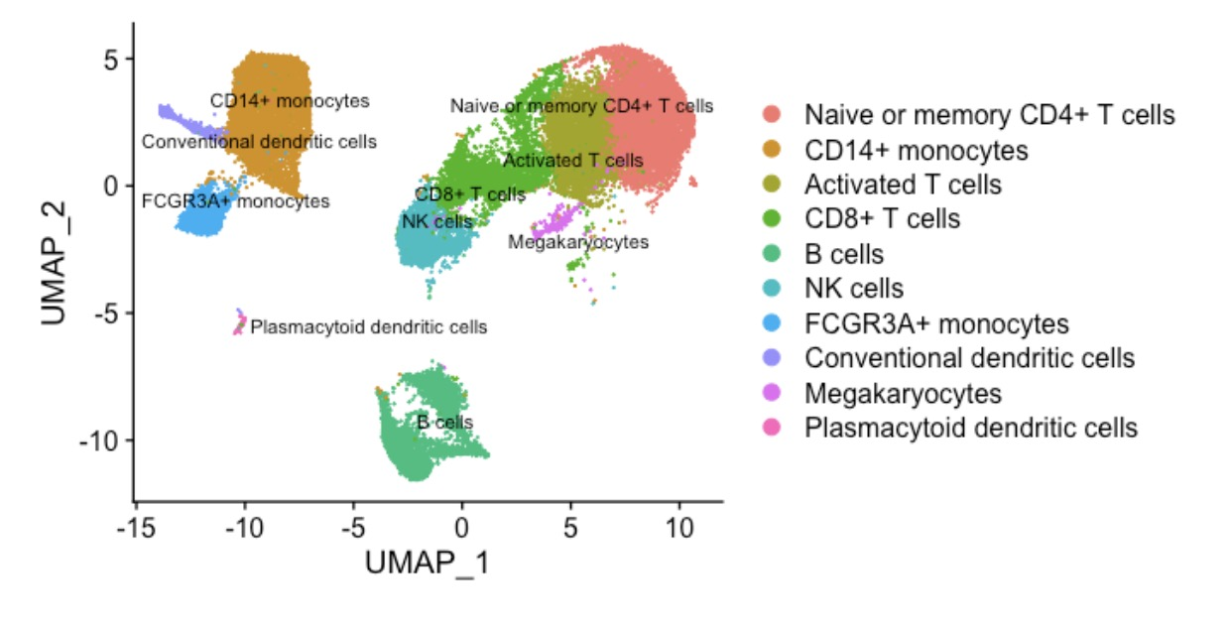
Clustering
Exploring known cell type markers
-Experimentally validate intriguing markers
-Explore a subset of cell types to discover subclusters of cells
-Perform differential expression analysis between control and stimulations
-Trajectory analysis or lineage tracing
https://hbctraining.github.io/scRNA-seq_online/lessons/04_SC_quality_control.html
21

Slide 22
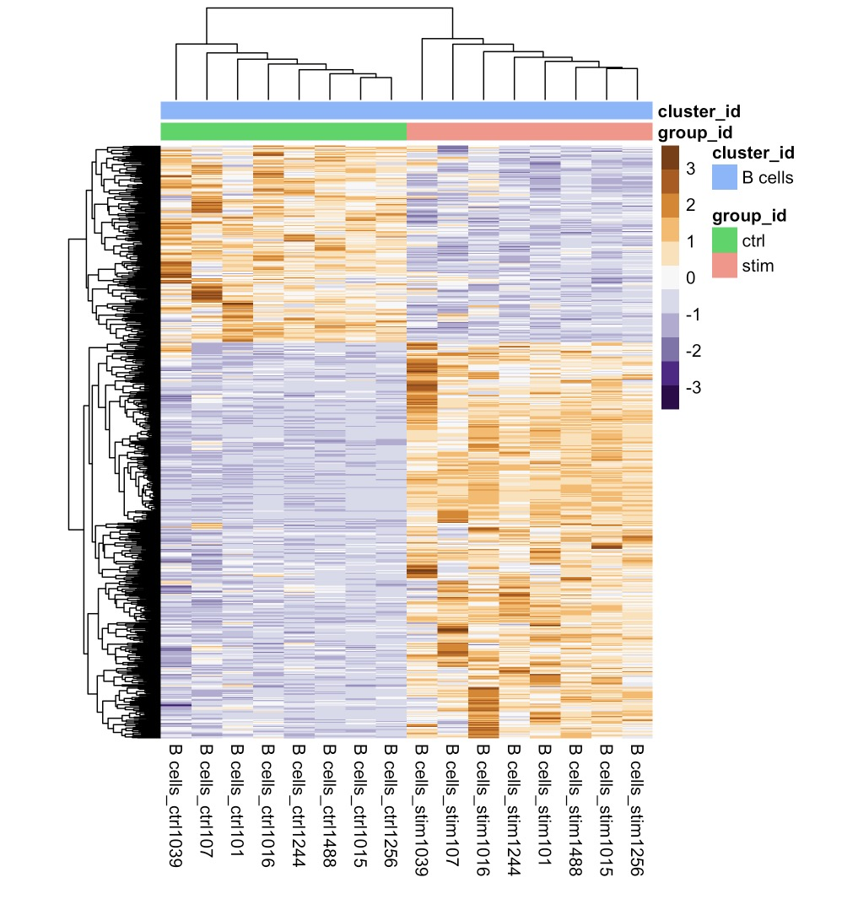
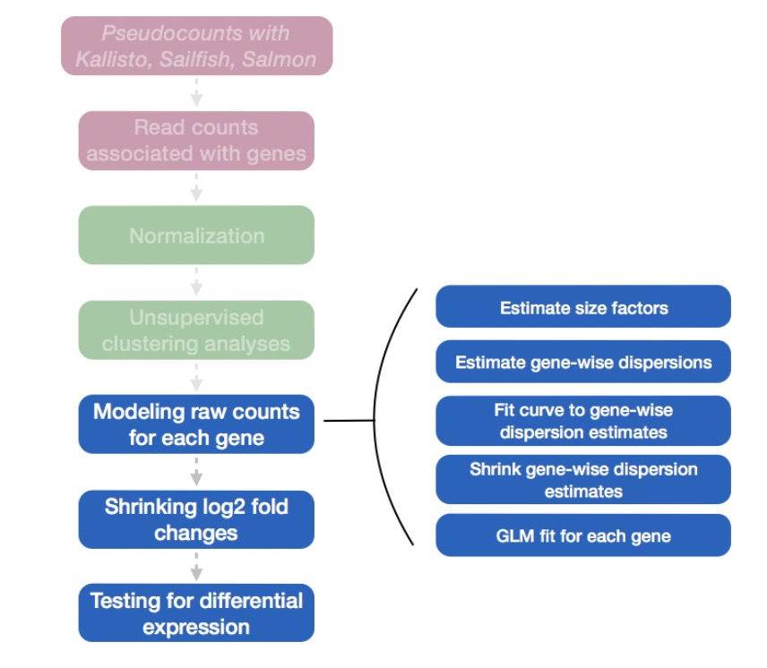
DE analysis
DESeq2 for pseudobulk DE analysis
-normalizes the count data to account for differences in library sizes and RNA composition between samples
Two clear modules of genes emerge
https://hbctraining.github.io/scRNA-seq_online/lessons/04_SC_quality_control.html
22
Notes:
Then, it will estimate the gene-wise dispersions and shrink these estimates to generate more accurate estimates of dispersion to model the counts. Finally, DESeq2 will fit the negative binomial model and perform hypothesis testing using the Wald test or Likelihood Ratio test.
, emphasizing the genes that are upregulated in the stimulated samples versus those that are downregulated

Slide 23
Any question?
Thanks for attention!
23

