Slide 1
Protein function prediction is improved by creating synthetic feature samples with generative adversarial networks
Cen Wan and David T. Jones
Nature Machine Intelligence, 2020
Notes:
Nature, machine intelligence

Slide 2
Outline
Motivation
Data
Structure
Results
Conclusion

Slide 3
Motivation
Challenges:
  Difficult function
    High-dimensionality of input
    Complex relationship among sequence and function
  Insufficient samples
    Unreliable annotation
Objective:
  Propose a novel deep learning algorithm (GAN) that can learn the distribution of protein sequence and generate hi-quality samples.

Slide 4
Data
CAFA 3:
301 items, corresponding to each GO terms
(602 models, for whether annotated by corresponding GO terms or not)
Notes:
We train two FFPred-GAN models for each GO term by using two different sets of protein samples with different class labels. The first FFPred-GAN model is trained by using the protein samples that are annotated with that GO term (hereafter we denote those proteins as positive samples). The other FFPred-GAN model is trained by using the protein samples that are not annotated by that GO term (hereafter we denote those proteins as negative samples). Therefore, in total, we train 602 FFPred-GAN models for all 301 GO terms in the FFPred-fly library.

Slide 5
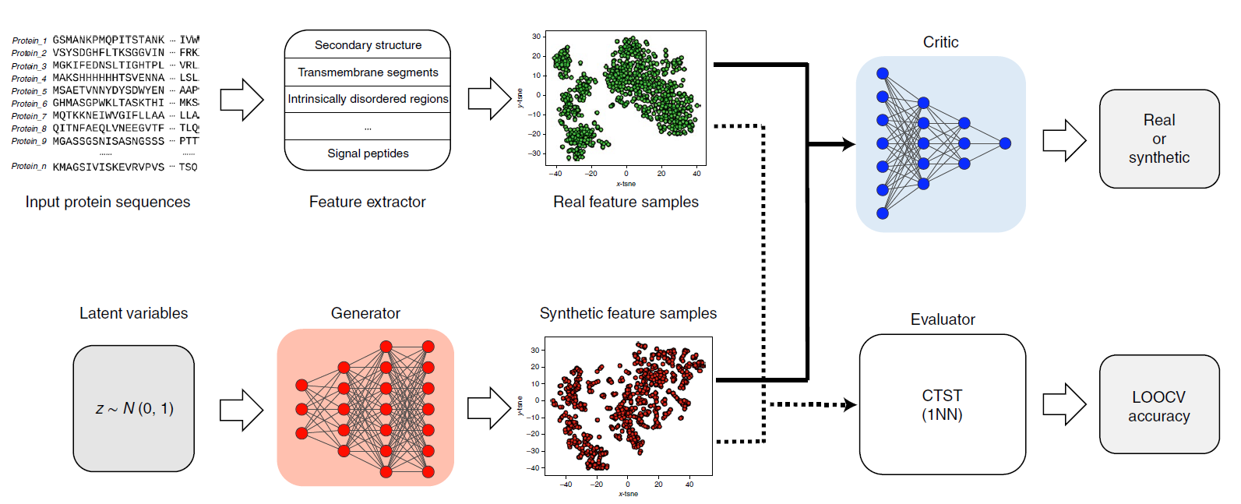
Structure (overview)
Notes:
CTST:
Classifier two-sample tests are statistical methods used to determine whether two sets of samples, each containing labeled data, are drawn from the same underlying distribution. The samples can be from different classes, and the goal is to determine whether the feature distributions are different enough between the two classes to allow accurate classification. These tests use machine learning classifiers to differentiate between the two classes and evaluate the statistical significance of the classification accuracy. Commonly used classifier two-sample tests include the Linear Discriminant Analysis (LDA) test and the Support Vector Machine (SVM) test. These tests can be useful in various fields, such as bioinformatics, neuroscience, and computer vision, for comparing feature distributions between two groups of data.
CTST:
one-nearest-neighbour classification algorithm and leave-one-out cross-validation (LOOCV)

Slide 6
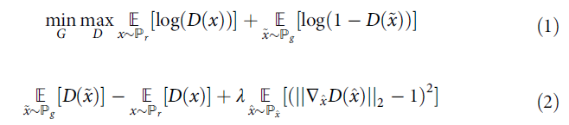
GAN
The adversarial function
The objective function, left 2 terms critic loss, right is regularizer term
Notes:
The objective is shown in equation (2), where the left two terms denote the loss of the critic and the right term denotes the gradient penalty term (that is, ensuring the L2 norm penalty to be around 1.00)

Slide 7

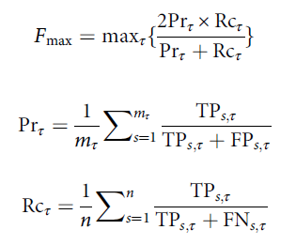
Evaluation|Evaluators
MCC:

Slide 8
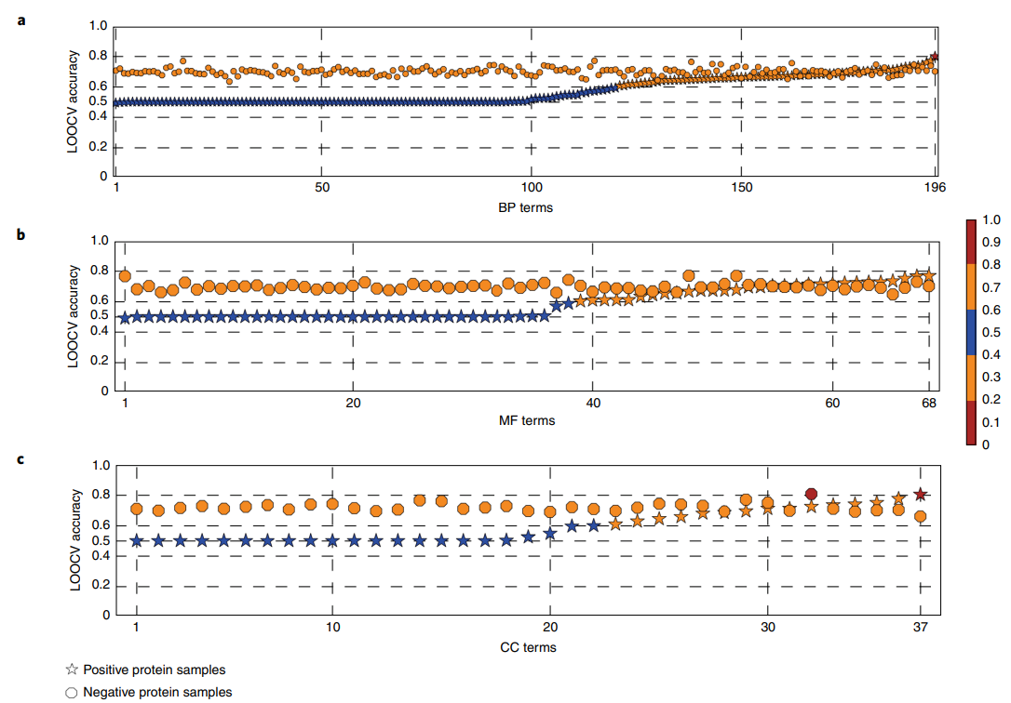
Performance - distribution (LOOCV accuracy)
Notes:
the LOOCV accuracies obtained for synthetic positive and negative protein feature samples (denoted as stars and circles, respectively) generated by individual GO term-based FFPred-GANs.
The x axis denotes the index of each GO term, while the y axis denotes the LOOCV accuracy, which ranges from 0.000 to 1.000.
The closer to 0.5, the better.

Slide 9
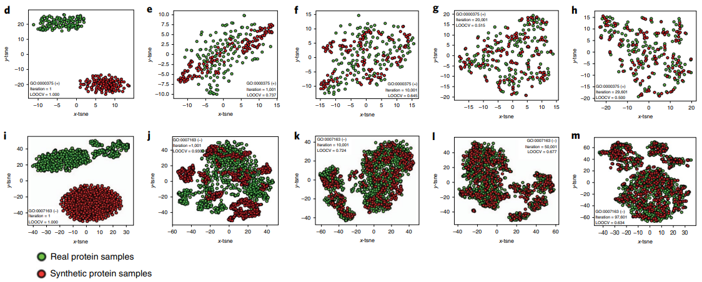
Visualization
Notes:
t-SNE (t-distributed stochastic neighbour embedding) transformed two-dimensional (2D) visualization of real and synthetic positive protein feature samples that are generated during different training stages of FFPred-GAN for the BP term GO:0000375
Positive = annotated
As epochs increases, they gradually mixed together (29,601 iterations)
Owing to the much higher diversity of negative feature samples, in that there are few ways of representing a positive case but many ways of representing a negative case, the accuracy for negative cases is lower, ~0.65 instead 0.5)
Biological process (BP) molecular function (MF) (b) and cellular component

Slide 10
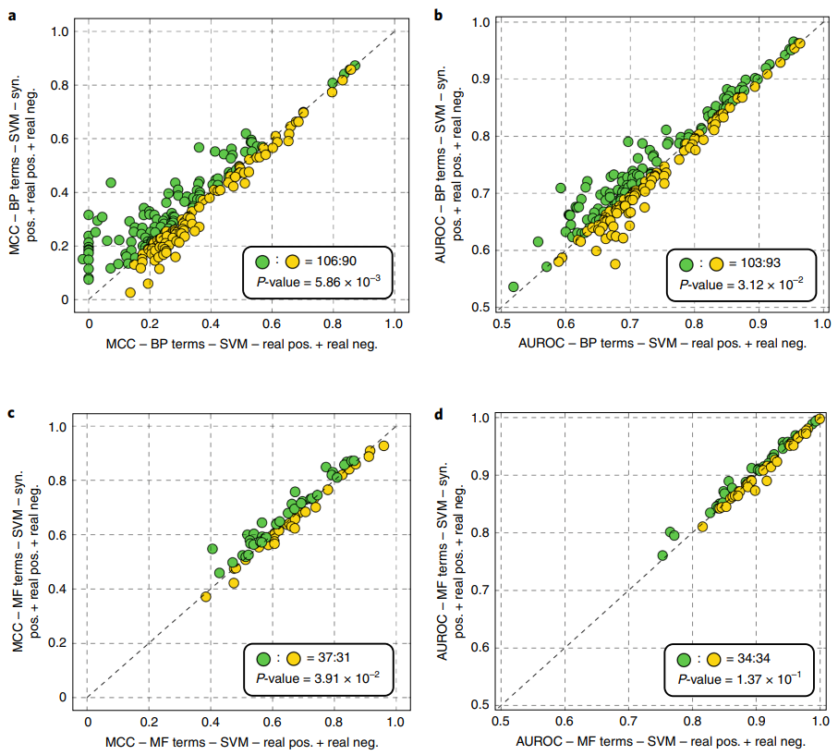
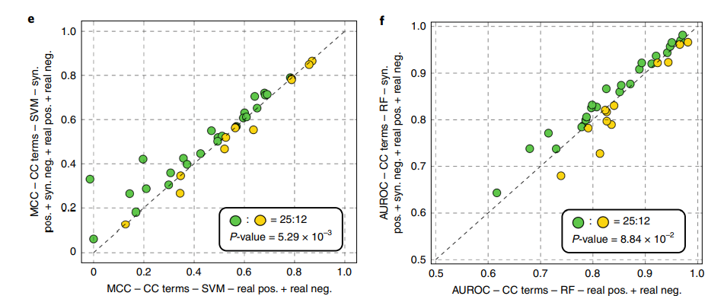
Performance - Prediction
Notes:
evaluated the predictive power of using synthetic protein feature samples on the task of protein function prediction applied to Drosophila. (a kind of flies)
On different combinations as augmentation
Tried on SVM, RF, and kNN
Comparison of predictive accuracy obtained by augmented training samples and the original training samples.
a–f, Scatter plots of the MCC (a,c,e) and AUROC (b,d,f) values obtained by the optimal combination of real and synthetic protein samples and the benchmark combination of real protein samples (as indicated on the axes) for predicting three domains of GO terms using SVM (a–e) and RF (f) classification algorithms.
The green dots indicate those GO terms whose MCC or AUROC values obtained by training samples A (as shown by the y axis) are higher than the ones obtained by training samples B (as shown by the x axis); vice versa,
The yellow dots indicate those GO terms whose MCC or AUROC values obtained by training samples A are lower or equal to the ones obtained by training samples B
Matthews correlation coefficient (MCC) and area under receiver operating characteristic curve (AUROC) values (AUROC=AUC)
(These combinations somehow like -- cherry picking.)

Slide 11
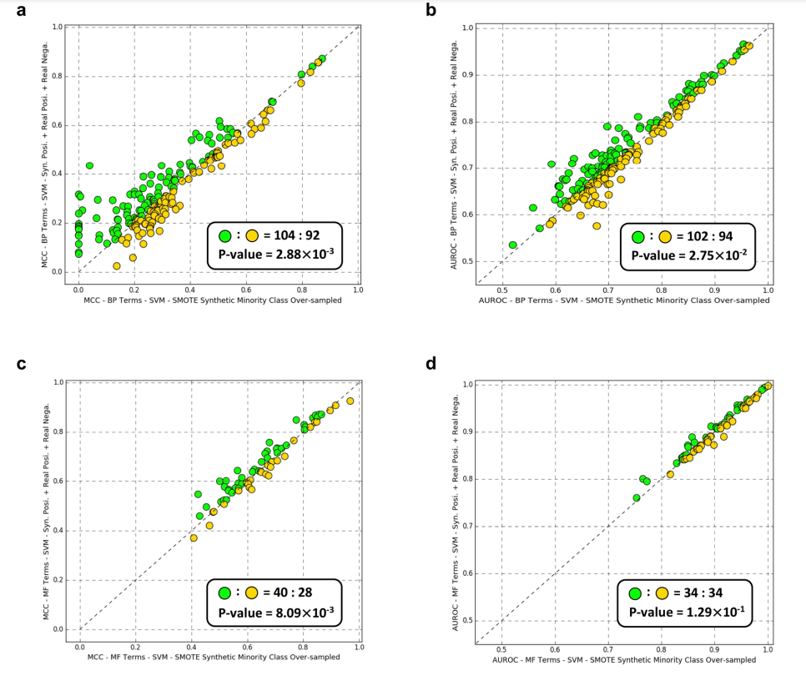
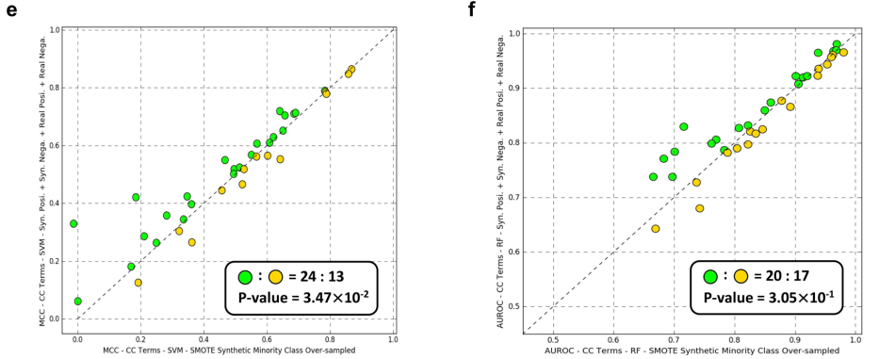
Performance - Augmentation Comparison
Notes:
compared FFPred-GAN with a well-known data augmentation method—the ‘synthetic minority over-sampling technique’ (SMOTE)—which performs over-sampling on the minority class by creating synthetic samples between each individual minority class sample and their corresponding randomly selected k nearest neighbours.

Slide 12
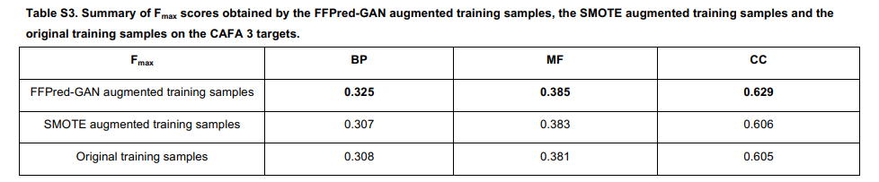
Performance - Augmentation Comparison
Notes:
compared FFPred-GAN with a well-known data augmentation method—the ‘synthetic minority over-sampling technique’ (SMOTE)—which performs over-sampling on the minority class by creating synthetic samples between each individual minority class sample and their corresponding randomly selected k nearest neighbours.

Slide 13
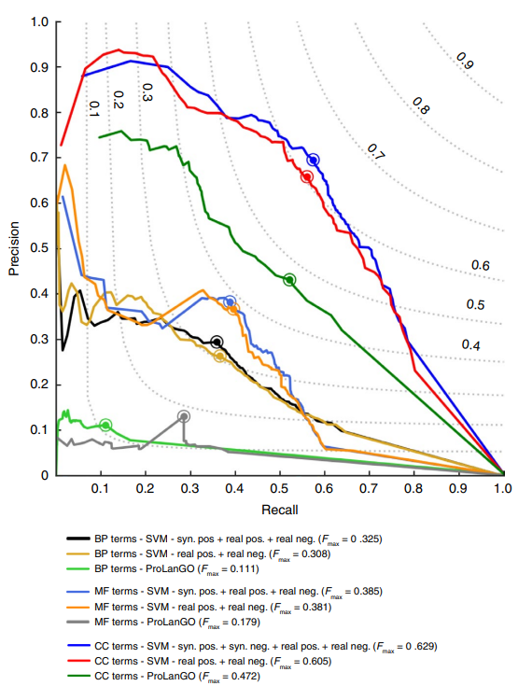
Performance - Prediction
Evaluated on a new set of CAFA3
(not seen by classifiers)
-> higher accuracy
Notes:
further evaluated the performance of the FFPred-GAN augmented training samples using a new set of CAFA 3 (3rd Critical Assessment of protein Function Annotation)4 targets that do not overlap with any protein samples used for training the classifiers
Higher -accuracy
ProLanGo is a method using RNN

Slide 14
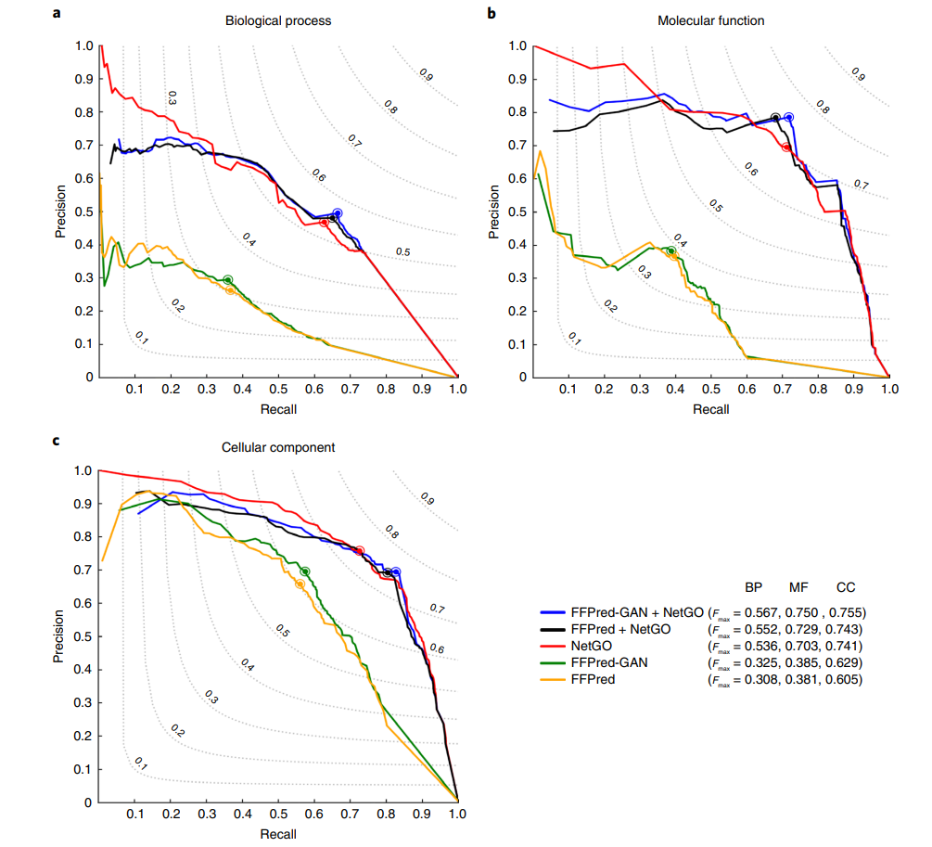
Performance -
Boosting SOTA
method
Combine predictions from
FFPred-GAN and NetGO
-> higher accuracy
Notes:
integrating with the state-of-the-art protein function prediction method NetGO37, which is an improved version of GOLabeler38, the top-ranked method in the recent CAFA 3 competition.
Analogous to GOLabeler, NetGO makes predictions of GO terms by using the learning-to-rank approach based on different component classifiers trained by multiple data sources, for example protein sequence, structure and protein–protein interaction network.
The paper evaluates the performance of FFPred-GAN, a method for generating high-quality synthetic protein feature samples, by integrating it with the state-of-the-art protein function prediction method NetGO. The integration is done by back-propagating the predictions of individual GO terms made by both methods and training logistic regression models for those GO terms receiving predictions from both methods simultaneously. The logistic regression models are optimized through a grid search and used to obtain predictions for corresponding GO terms during testing. The results show that FFPred-GAN augmented training samples improve the prediction accuracy of NetGO for GO terms in all three domains.

Slide 15
Conclusion
GAN is able to learn the distribution and generate high-quality synthetic samples
The generated samples can improve prediction accuracy
  Drosophila (a type of insect) protein function annotation using FFPred-fly.
  SOTA protein function prediction method.
Resulting accuracy is higher than SMOTE
Reasonable computational cost
Notes:
GO term
stands for Gene Ontology term. The Gene Ontology (GO) is a standardized, hierarchical system for representing gene and gene product attributes across all species. The GO consists of three categories: biological process, molecular function, and cellular component. Each of these categories is further divided into more specific terms, which describe a gene or gene product's function, location, and involvement in biological processes. GO terms are assigned to genes and gene products by curators based on experimental evidence or computational predictions. They are widely used in bioinformatics and genomics research to annotate and analyze large datasets, such as those generated by high-throughput experiments. By using GO terms to describe the functional properties of genes and gene products, researchers can gain insights into biological processes and identify potential targets for further study.

