Slide 1
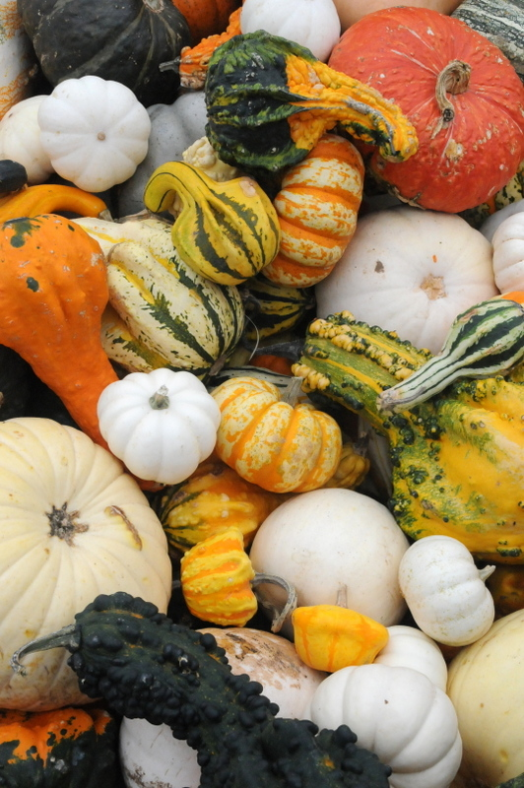
Personal Genomics
& Data Science:
Using population-scale functional genomics to understand mental disease
& interpreting the data exhaust from this activity
Mark Gerstein
Yale
Slides freely downloadable from Lectures.GersteinLab.org
& “tweetable” (via @markgerstein).
See last slide for more info.

Slide 2
Transcriptome = Gene Activity of All Genes in the Genome, usually quantified by RNA-seq
Genes (DNA)
Transcription
Regulation
RNA transcripts
Non-coding regulatory RNAs
Protein coding mRNA
Gene Expression measured by RNA-seq
Translation
Proteins
Expression of genes is quantified by transcription:
RNA-Seq measures mRNA transcript amounts
[ NATURE 459: 927; NAT. REV. GEN. 10: 57 ]

Slide 3
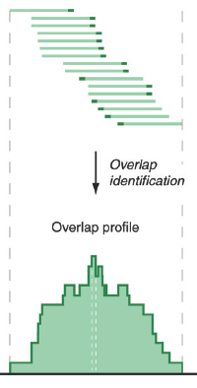
RNA-Seq Overview
ATACAAGCAAGTATAAGTTCGTATGCCGTCTT
GGAGGCTGGAGTTGGGGACGTATGCGGCATAG
TACCGATCGAGTCGACTGTAAACGTAGGCATA
ATTCTGACTGGTGTCATGCTGATGTACTTAAA
Fastq sequence files
~5-10 GB
Index-building + Alignment to reference genome
BAM files
~1-2-fold reduction
Successive steps of Data Reduction
Conversion to signal track by overlapping reads
BigWig files
~25-fold reduction
Mapping to genes
Gene/Transcript expression matrix
~20-fold reduction
Quantitative information from RNA-seq signal: average signals at exon level (RPKMs)
Reads => Signal
[NAT. REV. 10: 57; PLOS CB 4:e1000158; PNAS 4:107: 5254 ]

Slide 4

Activity Patterns
RNA Seq. gives rise to activity patterns of genes & regions in the genome

Slide 5
Some Core Science Qs Addressed by RNA-seq
Gene activity as a function of:
  Developmental stage: basic patterns of co-active genes across development
  Cell-type & Tissue: relationship to specialized functions
  Evolutionary relationships: behavior preserved across a wide range of organisms; patterns in model organisms in relation to those in humans
  Individual, across the human population
  Disease phenotypes: disruption of patterns in disease
Some overarching Qs:
Are there core patterns of gene activity ?
How do they vary across individual ?
Are they disrupted by disease?

Slide 6

Studying large-scale transcriptome data also produces
Data Exhaust
Metadata
Core scientific purposes
Front End
Data collection and analysis
Back end
Data Exhaust
Data on Collaboration, publication and Infrastructure
Data Exhaust = Exploitable byproducts of big data collection and analysis
Creative use of Data is key to Data Science !
[PHOTO: RELAXNEWS; from http://www.lapresse.ca]

Slide 7
Personal Genomics & Data Science: Using population-scale functional genomics to understand mental disease & interpreting the data exhaust from this activity
[Core] PsychENCODE:
Population-level analysis of functional genomics data related to mental disease
  Consortium intro & construction of an adult brain resource w/ 1866 individuals
  Explanation of across-population variation via changing proportions of cell types (using single-cell deconvolution)
  Generation of a large QTL resource (~2.5M eQTLs)
  Regulatory network construction using QTLs, Hi-C & activity relationships. Using this to link GWAS SNPs to genes.
  Embedding the reg. network in a deep-learning model (DSPN) to predict psychiatric disease phenotype from genotype & transcriptome
[Exhaust] Genomic Privacy & RNA-seq
  Introduction to Genomic Privacy
    The dilemma: The genome as fundamental, inherited info that’s very private v. need for large-scale mining for med. research
    2-sided nature of RNA-seq presents particularly tricky privacy issues
  eQTLs: Quantifying & removing further variant info from expression levels w/ ICI & predictability. Instantiating a practical linking attack w/ noisy quasi-identifiers
  Signal Profiles: Manifest appreciable leakage from large & small deletions. Linking attacks possible but additional complication of SV discovery in addition to genotyping
[Exhaust] Publication Patterns
from data producing consortia
  Co-authorship network stats relate to publication rollouts & show gradual adoption by community
  Key role of brokers in data dissemination

Slide 8
Personal Genomics & Data Science: Using population-scale functional genomics to understand mental disease & interpreting the data exhaust from this activity
[Core] PsychENCODE:
Population-level analysis of functional genomics data related to mental disease
  Consortium intro & construction of an adult brain resource w/ 1866 individuals
  Explanation of across-population variation via changing proportions of cell types (using single-cell deconvolution)
  Generation of a large QTL resource (~2.5M eQTLs)
  Regulatory network construction using QTLs, Hi-C & activity relationships. Using this to link GWAS SNPs to genes.
  Embedding the reg. network in a deep-learning model (DSPN) to predict psychiatric disease phenotype from genotype & transcriptome
[Exhaust] Genomic Privacy & RNA-seq
  Introduction to Genomic Privacy
    The dilemma: The genome as fundamental, inherited info that’s very private v. need for large-scale mining for med. research
    2-sided nature of RNA-seq presents particularly tricky privacy issues
  eQTLs: Quantifying & removing further variant info from expression levels w/ ICI & predictability. Instantiating a practical linking attack w/ noisy quasi-identifiers
  Signal Profiles: Manifest appreciable leakage from large & small deletions. Linking attacks possible but additional complication of SV discovery in addition to genotyping
[Exhaust] Publication Patterns
from data producing consortia
  Co-authorship network stats relate to publication rollouts & show gradual adoption by community
  Key role of brokers in data dissemination

Slide 9
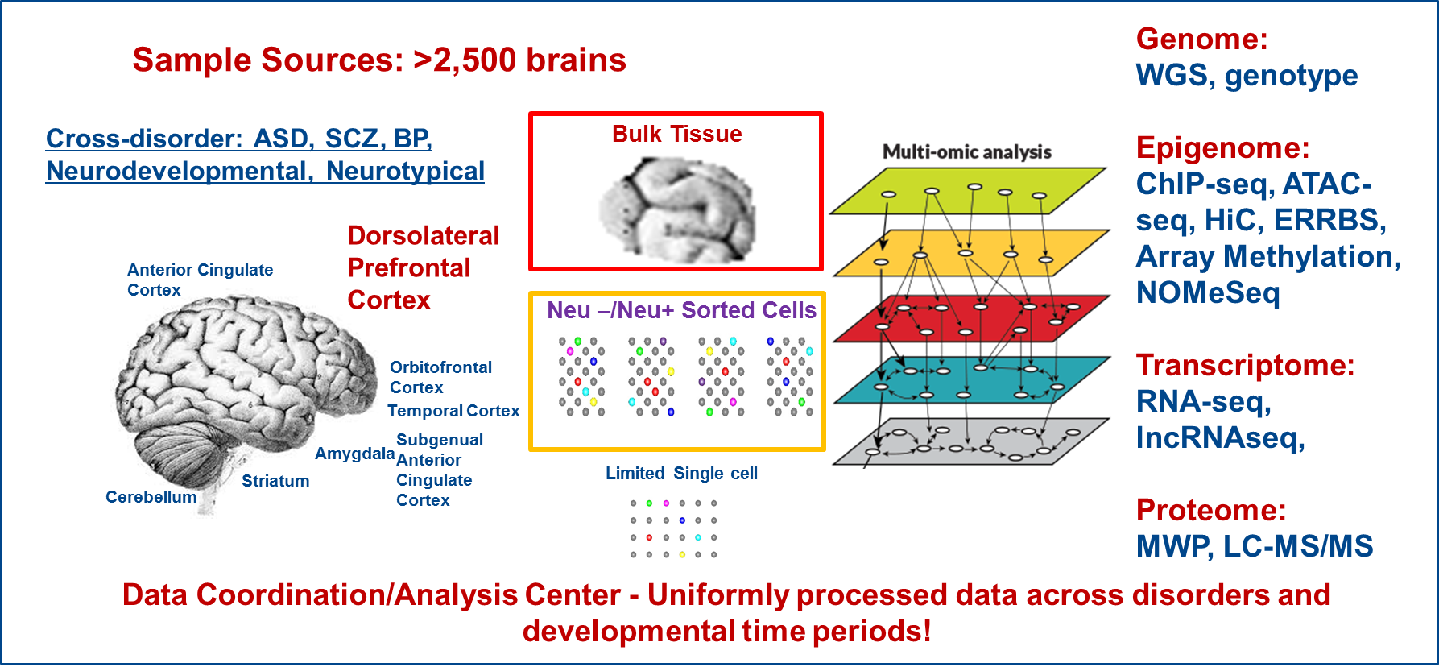
The PsychENCODE consortium
Notes:
Current phase is wrapping up- we have uniformly processed data across disorders and time periods on now up to >2500 frozen postmortem brains from brain banks.
Data generation has focus on mostly DLFPC with a few other brain regions also covered.
Analyses were primarily bulk tissues with some sorted NeuN+/- cells and a limited amount of ss data generation.
Multiple assays – WGS, SNP genotypes Epigenome: ChIP-seq, ATAC-seq, HiC, ERRBS, Array Methylation, NOMeSeq Transcriptome: RNA-seq, lncRNAseq, Proteome: RPPA.
The analyses have focused on identifying brain enhancers relevant and disease-specific eQTLs and epigenomic variation.
An invaluable public resource of multidimensional genomic data
They are also collaborating with GTEX, ENCODE and other related consortia to enhance the power and impact of their analyses.

Slide 10
A core issue addressed by PsychENCODE:
Using functional genomics to reveal molecular mechanisms between genotype and phenotype in brain disorders
Disease | Heritability* | Molecular Mechanisms
Schizophrenia | 81% | -
Bipolar disorder | 70% | -
Alzheimer's disease | 58 - 79% | Apolipoprotein E (APOE), Tau
Hypertension | 30% | Renin–angiotensin–aldosterone
Heart disease | 34-53% | Atherosclerosis, VCAM-1
Stroke | 32% | Reactive oxygen species (ROS), Ischemia
Type-2 diabetes | 26% | Insulin resistance
Breast Cancer | 25-56% | BRCA, PTEN
Phenotype
SCZ
BPD
AGE
…
*https://www.snpedia.com/index.php/Heritability
pathways, circuits
Cell types
Modules
Regulatory elements
Genes
Genotype
Many psychiatric conditions are highly heritable
  Schizophrenia: up to 80%
But we don’t understand basic molecular mechanisms underpinning this association
(in contrast to many other diseases such as cancer & heart disease)
Moreover, current models substantially underestimate heritability using genetic data
  Schizophrenia : ~25%
Thus, interested in developing predictive models of psychiatric traits which:
  Use observations at intermediate (molecular levels) levels to inform latent structure
  Use the predictive features of these “molecular endo phenotypes” to begin to suggest actors involved in mechanism

Slide 11
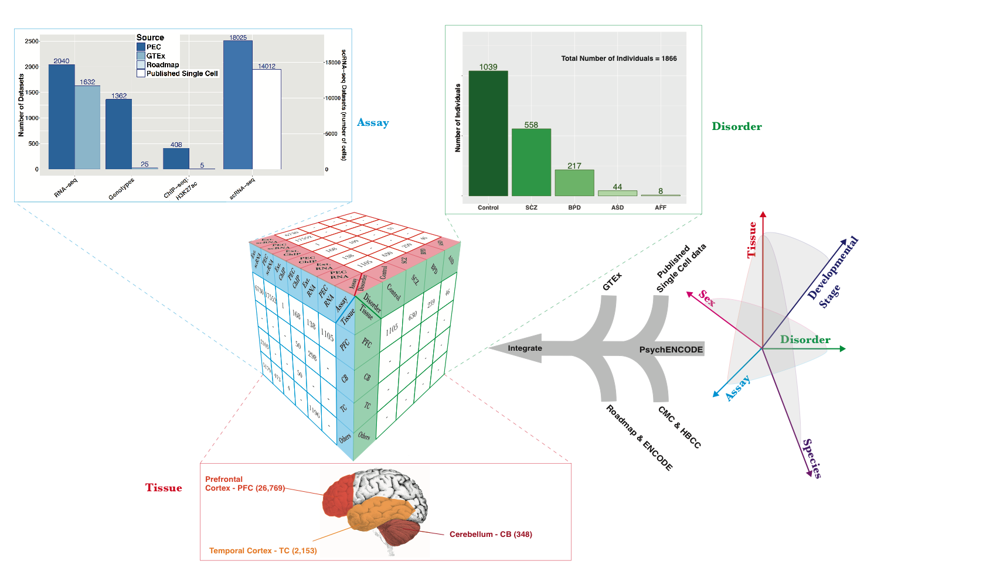
Collecting functional genomic datasets for the adult brain from PsychENCODE, other large consortia & single cell studies
1866
Individuals
~3.7K bulk RNA-seq
~32K single-cells

Slide 12
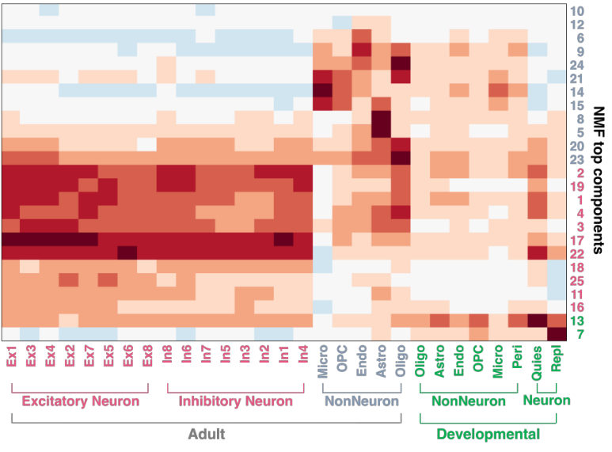
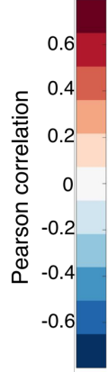
Single-cell deconvolution
Step 1:
Unsupervised learning to determine relevant cell types
1866 individuals
25 top components
Unsupervised
decomposition
(NMF)
1866 individuals
Bulk
expression
(B)
NMF
comp
(V)
NMF comp fractions
(H)
All genes (∼20K)
≈
All genes
25 top components
×
Single cell signatures, from:
~14K cells
(Lake et al.,‘16 & ‘18)
~400 cells
(Darmanis et al., PNAS, ‘15)
~18K cells (PsychENCODE)

Slide 13
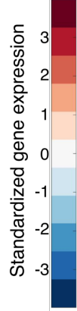
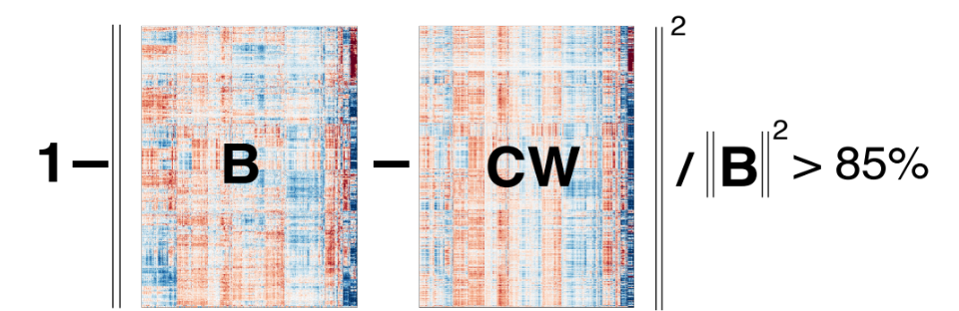
24 selected cell types
(Neuronal, NonNeuronal, Developmental)
1866 individuals
1866 individuals
Bulk
expression
(B)
Deconvolution
All genes
24 selected cell types
Single-cell deconvolution
Step 2:
Supervised learning to estimate cell fractions
All genes (∼20K)
≈
×
Cell fractions (W)
Single cell expression (C)
88%±4%
Individual and cross-population reconstruction accuracy via deconvolution

Slide 14
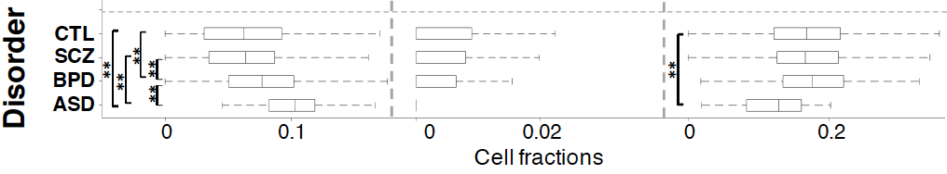
Different neuronal & glial cell fractions across disorders
Ex5
In6
Oligo
Excitatory to Inhibitory imbalance at neuronal subtype level for ASD*
* Rubenstein et al., Model of autism: increased ratio of excitation/inhibition in key neural systems, Genes Brain Behav. 2003
Notes:
* Rubenstein et al., Model of autism: increased ratio of excitation/inhibition in key neural systems, Genes Brain Behav. 2003
** Gandal et al., Shared molecular neuropathology across major psychiatric disorders parallels polygenic overlap, Science 2018

Slide 15
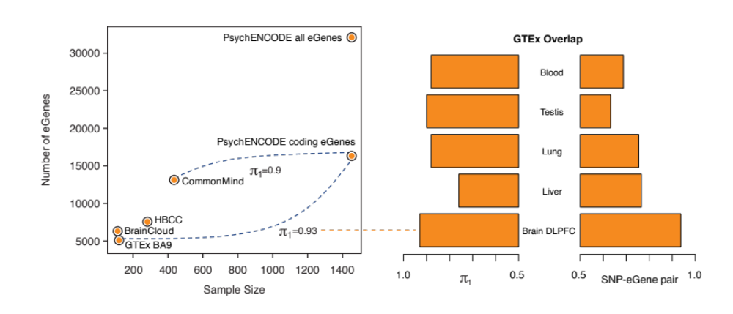
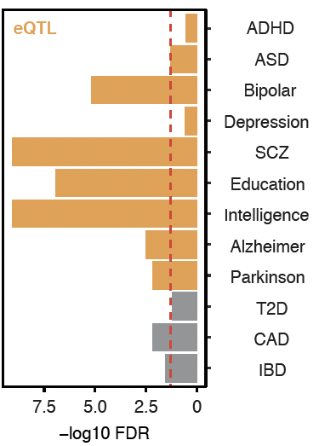
Larger Brain eQTL sets than previous studies
GWAS enrichment
2,542,908 eQTLs (FDR< 0.05)
Notes:
Brain eQTLs
32944(75%) eGenes
2,542,908 eQTLs (3% out of 66,441,766 total pairs)
1,341,182 unique cis-eSNP (~20%) (~238K independent SNPs after linkage-disequilibrium (LD) pruning)

Slide 16
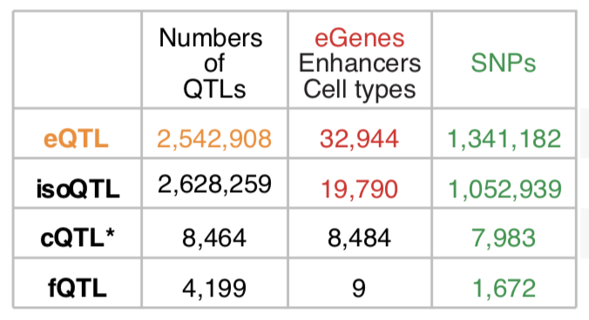
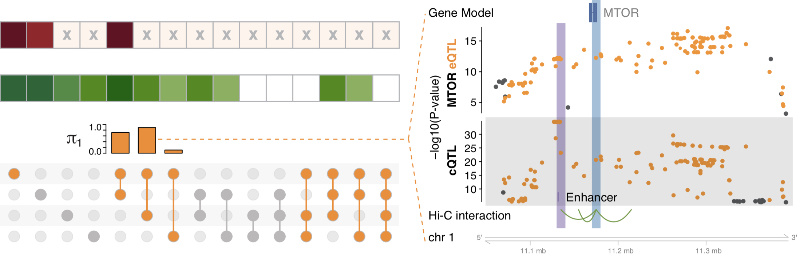
multi-QTLs from overlapping different types of QTLs: cQTL, fQTL, eQTL & isoQTL
eQTLs for mTOR mediated by cQTLs
eQTL
isoQTL
cQTL
fQTL
eQTLs and cQTLs significantly overlap
1391 SNPs (multi-QTLs)
in at least three types
among eQTLs, isoQTLs, cQTLs, fQTLs
Notes:
*top SNPs for each enhancer
To evaluate this precisely, we calculated π₁ statistics and found that the eQTL overlap with cQTLs was the most significant while that with fQTLs was lowest (0.89 vs 0.11). Moreover, eQTL-cQTL overlaps often suggested that the expression-modulating function of an eQTL derived from chromatin changes (e.g. for MTOR, Fig. 4F). Finally, 119 SNPs, which we dubbed multi-QTLs, functioned as QTLs in more than 3 different capacities (e.g. as eQTLs, cQTLs and isoQTLs).
https://www.nature.com/articles/nrn3068

Slide 17
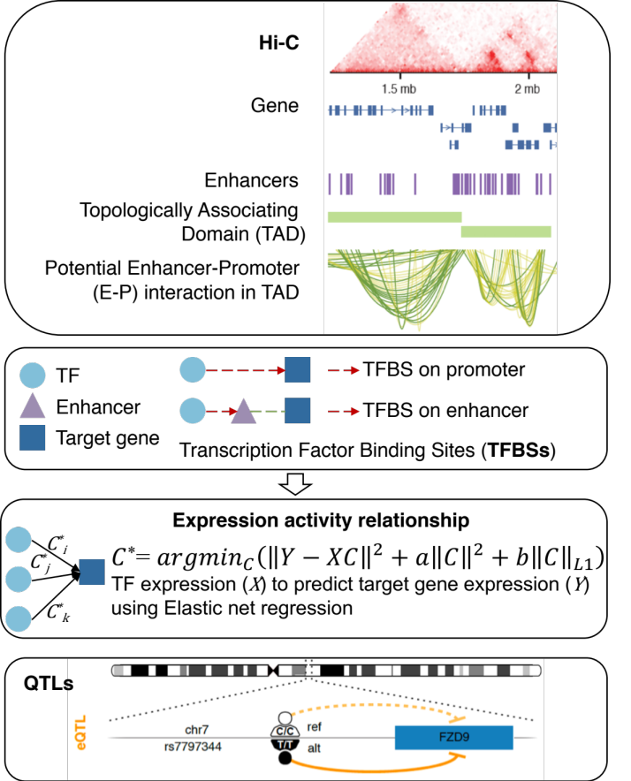
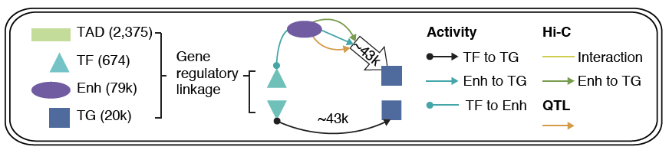
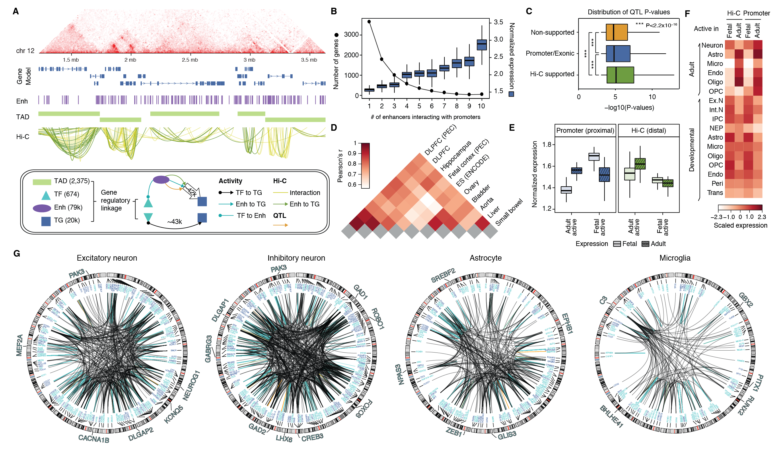
Gene regulatory network inference from Hi-C, QTLs & Activity Correlations
Imputed gene regulatory network linking TFs, enhancers and genes plus QTLs
subnetworks targeting single cell marker genes

Slide 18
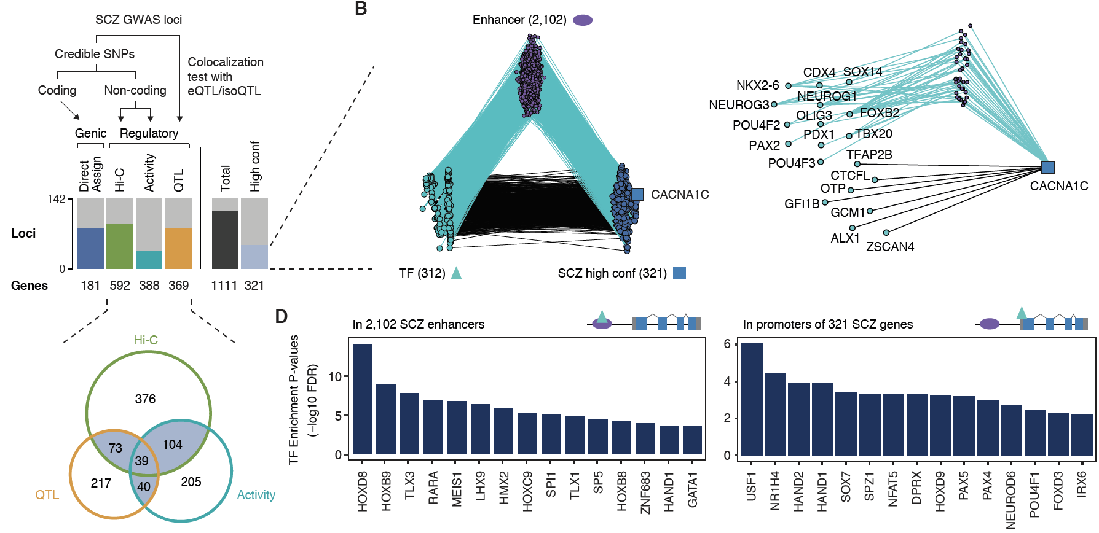
Linking GWAS SNPs to disease genes using the regulatory network
142
321
high-confident SCZ genes
Activity
Notes:
* A. F. Pardinas et al., Common schizophrenia alleles are enriched in mutation-intolerant genes and in regions under strong background selection. Nat Genet 50, 381-389 (2018)
For example, we found a set of TFs having enriched binding sites (TFBSs) on the promoters of SCZ genes, revealing potential cis-regulatory mechanisms of TFs to SCZ gene expression (Fig. 6D). Also, we found additional TFs that have enriched binding sites on the enhancers that overlap with SCZ credible SNPs (Fig. 6D), suggesting potential distal regulatory mechanisms of SCZ credible SNPs via affecting TFBSs on enhancers. In particular, these TFs include REST, a transcriptional repressor for neuronal genes \cite{16150588}, and SOX7, a TF that promotes neuronal apoptosis \cite{25847511}.

Slide 19
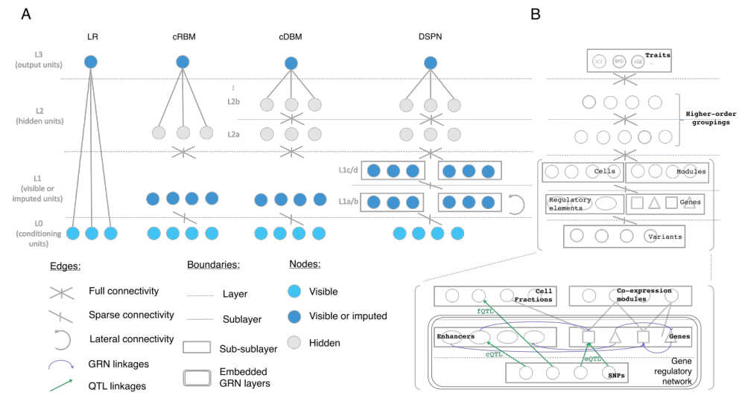

Deep Structured Phenotype Network
(DSPN)
Boltzmann machine
y: phenotypes
h: hidden units (e.g., circuits)
x: intermediate phenotypes (e.g., genes, enhancers)
z: genotypes (e.g., SNPs)
W: weights
(e.g., regulatory network)
Gene
regulatory network
builds
skeleton
Energy model:
$$p\left(x,y,h|z\right)∝\exp\left(−E\left(x,y, h|z\right)\right)$$
$$E\left(x,y, h|z\right)={−z}^{T}W_{1}x{−x}^{T}W_{2}x−x^{T}W_{3}h−h^{T}W_{4}h−h^{T}W_{5}y−Bias$$

Slide 20
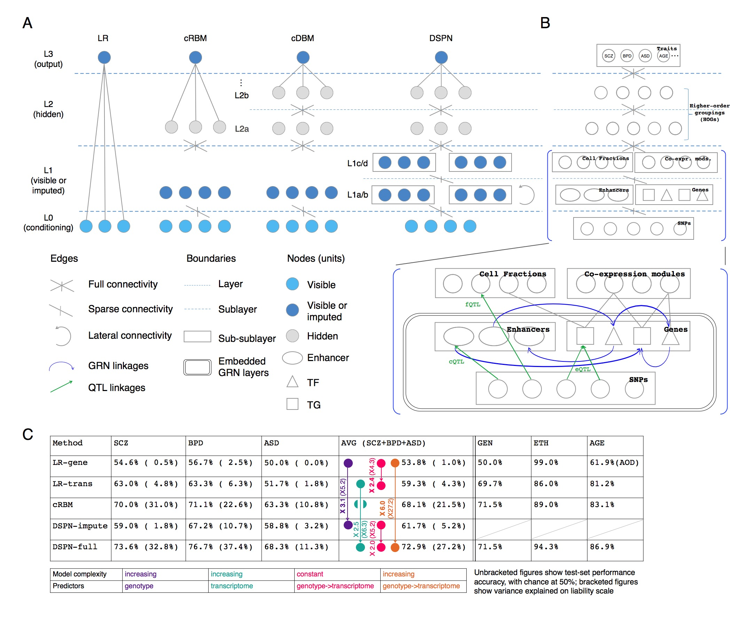
DSPN improves brain disease prediction by adding deep layers
Method | LR-genotype | LR-transcriptome | cRBM | DSPN-imputation | DSPN-full
Schizophrenia | 54.6% | 63.0% | 70.0% | 59.0% | 73.6%
Bipolar Disorder | 56.7% | 63.3% | 71.1% | 67.2% | 76.7%
Autism Spectrum Disorder | 50.0% | 51.7% | 67.2% | 62.5% | 68.3%
X 6.0
Accuracy = chance to correctly predict disease/health

Slide 21
DSPN improves brain disease prediction by adding deep layers
Method | LR-genotype | LR-transcriptome | cRBM | DSPN-imputation | DSPN-full
Schizophrenia | 54.6% | 63.0% | 70.0% | 59.0% | 73.6%
Bipolar Disorder | 56.7% | 63.3% | 71.1% | 67.2% | 76.7%
Autism Spectrum Disorder | 50.0% | 51.7% | 67.2% | 62.5% | 68.3%
X 2.5
Accuracy = chance to correctly predict disease/health

Slide 22
DSPN improves brain disease prediction by adding deep layers
Method | LR-genotype | LR-transcriptome | cRBM | DSPN-imputation | DSPN-full
Schizophrenia | 54.6% | 63.0% | 70.0% | 59.0% | 73.6%
Bipolar Disorder | 56.7% | 63.3% | 71.1% | 67.2% | 76.7%
Autism Spectrum Disorder | 50.0% | 51.7% | 67.2% | 62.5% | 68.3%
X 3.1
Accuracy = chance to correctly predict disease/health

Slide 23
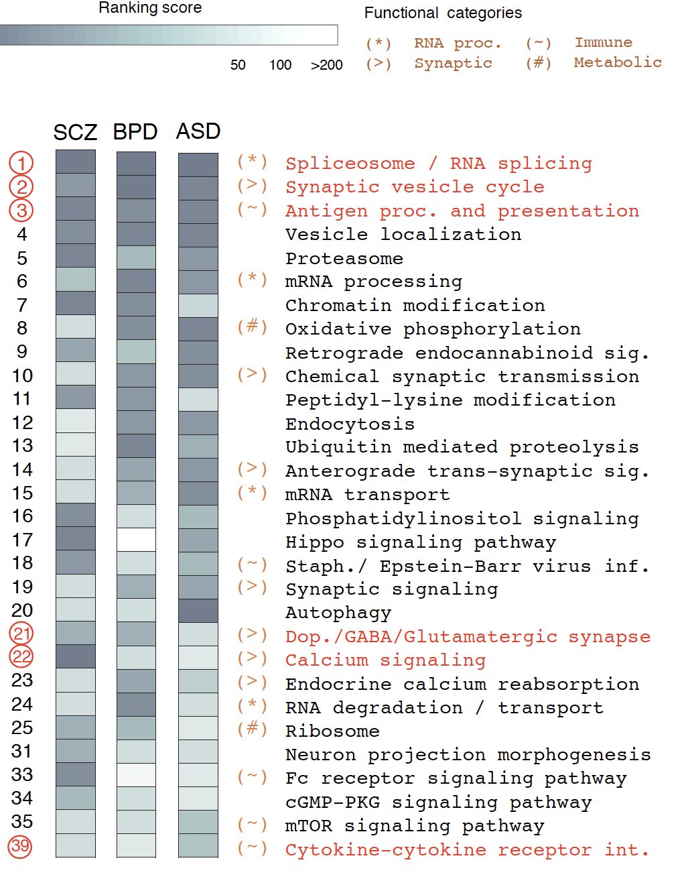
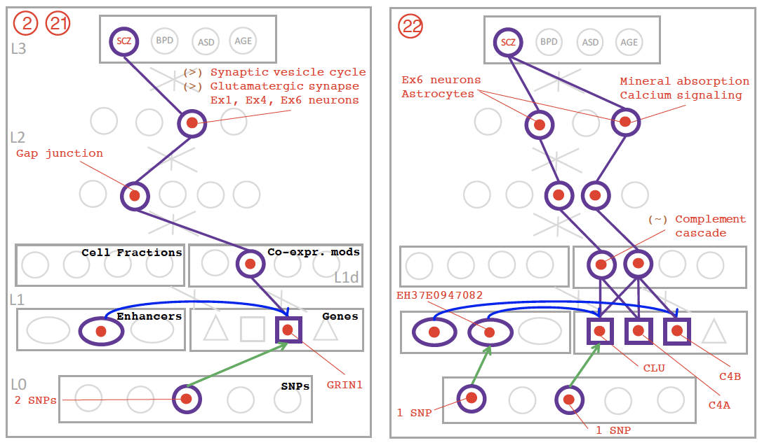
DSPN discovers molecular pathways from genotype to phenotype

Slide 24
Personal Genomics & Data Science: Using population-scale functional genomics to understand mental disease & interpreting the data exhaust from this activity
[Core] PsychENCODE:
Population-level analysis of functional genomics data related to mental disease
  Consortium intro & construction of an adult brain resource w/ 1866 individuals
  Explanation of across-population variation via changing proportions of cell types (using single-cell deconvolution)
  Generation of a large QTL resource (~2.5M eQTLs)
  Regulatory network construction using QTLs, Hi-C & activity relationships. Using this to link GWAS SNPs to genes.
  Embedding the reg. network in a deep-learning model (DSPN) to predict psychiatric disease phenotype from genotype & transcriptome
[Exhaust] Genomic Privacy & RNA-seq
  Introduction to Genomic Privacy
    The dilemma: The genome as fundamental, inherited info that’s very private v. need for large-scale mining for med. research
    2-sided nature of RNA-seq presents particularly tricky privacy issues
  eQTLs: Quantifying & removing further variant info from expression levels w/ ICI & predictability. Instantiating a practical linking attack w/ noisy quasi-identifiers
  Signal Profiles: Manifest appreciable leakage from large & small deletions. Linking attacks possible but additional complication of SV discovery in addition to genotyping
[Exhaust] Publication Patterns
from data producing consortia
  Co-authorship network stats relate to publication rollouts & show gradual adoption by community
  Key role of brokers in data dissemination

Slide 25

2-sided nature of functional genomics data: Analysis can be very General/Public or Individual/Private
General quantifications related to overall aspects
of a condition – ie gene activity as a function of:
  Developmental stage, Evolutionary relationships, Cell-type, Disease
Above are not tied to an individual’s genotype. However, data is derived from individuals & tagged with their genotypes
(Note, a few calculations aim to use explicitly genotype to derive general relations related to sequence variation & gene expression - eg allelic activity)

Slide 26












Genomics has similar "Big Data" Dilemma in the Rest of Society
Sharing & "peer-production" is central to success of many new ventures, with the same risks as in genomics
  EG web search: Large-scale mining essential
We confront privacy risks every day we access the internet
[Seringhaus & Gerstein ('09), Hart. Courant (Jun 5); Greenbaum & Gerstein ('11), NY Times (6 Oct)]

Slide 27
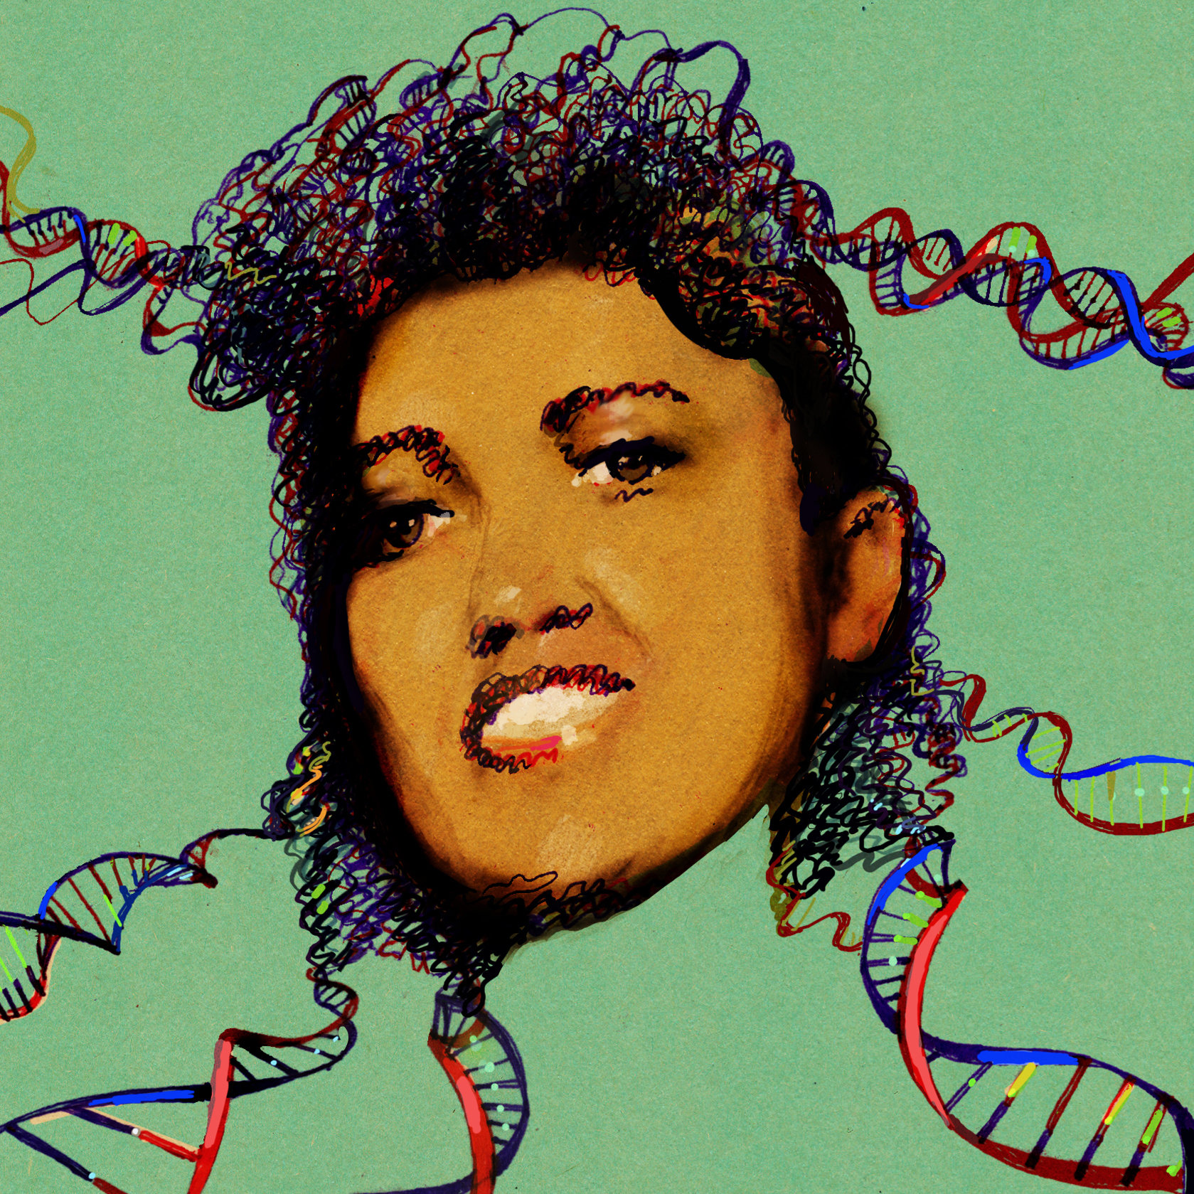
Tricky Privacy Considerations in Personal Genomics
Genetic Exceptionalism :
The Genome is very fundamental data, potentially very revealing about one’s identity & characteristics
Personal Genomic info. essentially meaningless currently but will it be in 20 yrs? 50 yrs?
  Genomic sequence very revealing about one’s children. Is true consent possible?
  Once put on the web it can’t be taken back
Culture Clash:
Genomics historically has been a proponent of “open data” but not clear personal genomics fits this.
  Clinical Medline has a very different culture.
Ethically challenged history of genetics
  Ownership of the data & what consent means (Hela)
    Could your genetic data give rise to a product line?
[D Greenbaum & M Gerstein (’08). Am J. Bioethics; D Greenbaum & M Gerstein, Hartford Courant, 10 Jul. '08 ; SF Chronicle, 2 Nov. '08;
Greenbaum et al. PLOS CB (‘11) ; Greenbaum & Gerstein ('13), The Scientist; Photo from NY Times]

Slide 28

The Other Side of the Coin:
Why we should share
Sharing helps speed research
  Large-scale mining of this information is important for medical research
  Privacy is cumbersome, particularly for big data
Sharing is important for reproducible research
Sharing is useful for education
  More fun to study a known person’s genome
    Eg Zimmer’s Game of Genomes in STAT
[Yale Law Roundtable (‘10). Comp. in Sci. & Eng. 12:8; D Greenbaum & M Gerstein (‘09). Am. J. Bioethics; D Greenbaum & M Gerstein (‘10). SF Chronicle, May 2, Page E-4;
Greenbaum et al. PLOS CB (‘11)]

Slide 29
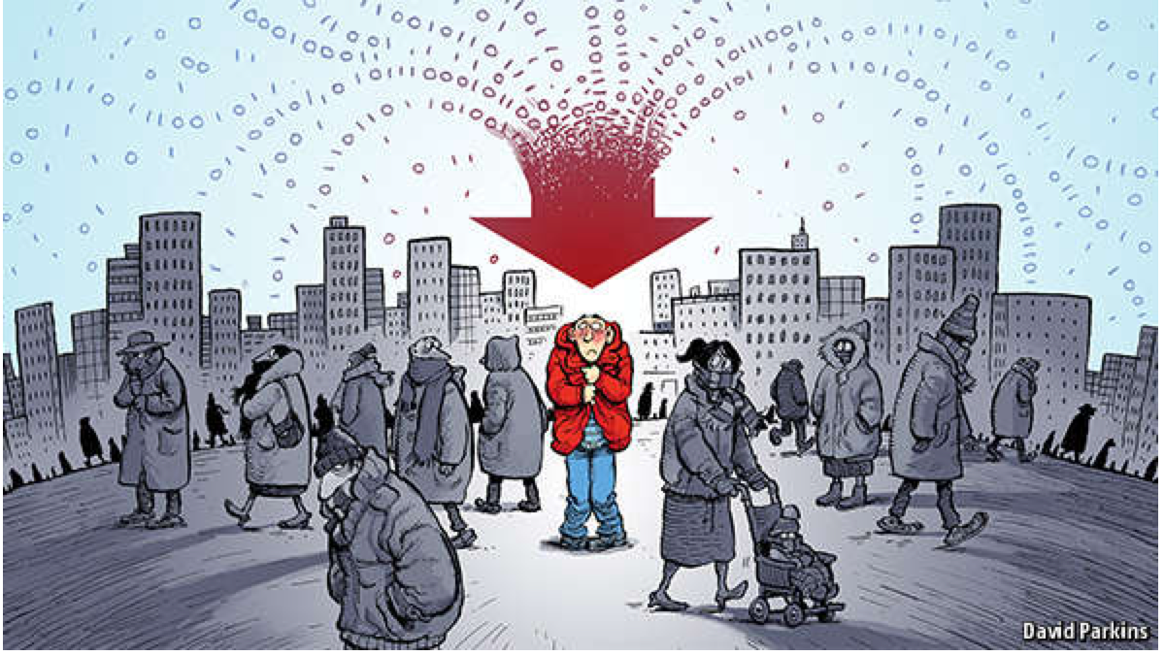
The Dilemma
[Economist, 15 Aug ‘15]
The individual (harmed?) v the collective (benefits)
  But do sick patients care about their privacy?
How to balance risks v rewards - Quantification
  What is acceptable risk?
  Can we quantify leakage?
    Ex: photos of eye color
  Cost Benefit Analysis

Slide 30
Current Social & Technical Solutions
Closed Data Approach
  Consents
  “Protected” distribution via dbGAP
  Local computes on secure computer
Issues with Closed Data
  Non-uniformity of consents & paperwork
    Different international norms, leading to confusion
  Encryption & computer security creates burdensome requirements on data sharing & large scale analysis
  Many schemes get “hacked”
Open Data
  Genomic "test pilots” (ala PGP)?
    Sports stars & celebrities?
  Some public data & data donation is helpful but is this a realistic solution for an unbiased sample of ~1M
[Greenbuam et al ('04), Nat. Biotech; Greenbaum & Gerstein ('13), The Scientist]

Slide 31
Strawman Hybrid Social & Tech Proposed Solution?
Fundamentally, researchers have to keep genetic secrets.
  Need for an (international) legal framework
  Genetic Licensure & training for individuals
  (similar to medical license, drivers license)
Technology to make things easier
  Cloud computing & enclaves (eg solution of Genomics England)
Technological barriers shouldn't create a social incentive for “hacking”
Quantifying Leakage & allowing a small amounts of it
Careful separation & coupling of private & public data
  Lightweight, freely accessible secondary datasets coupled to underlying variants
  Selection of stub & "test pilot" datasets for benchmarking
  Develop programs on public stubs on your laptop, then move the program to the cloud for private production run
[D Greenbaum, M Gerstein (‘11). Am J Bioeth 11:39. Greenbaum & Gerstein, The Scientist ('13)]

Slide 32
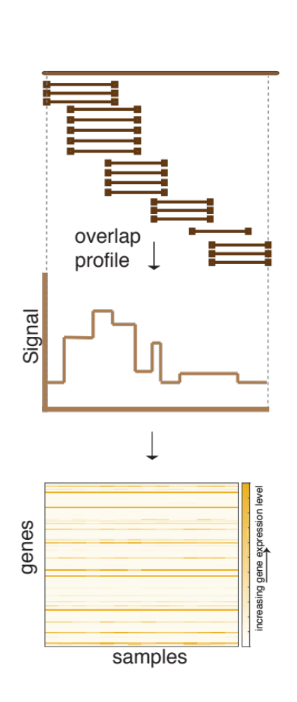
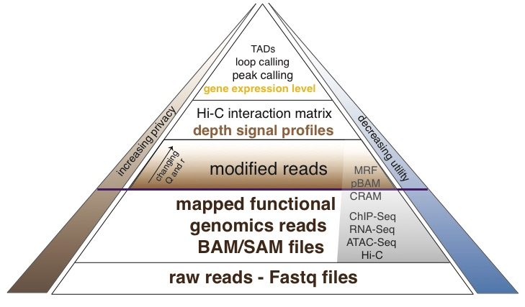
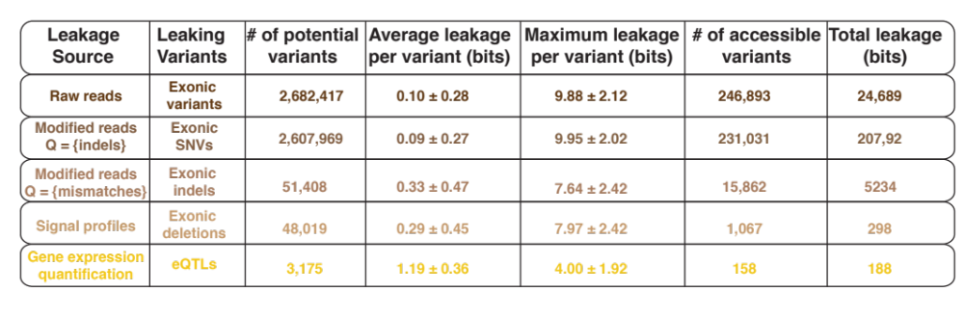
Functional genomics data comes with a great deal of sequencing;
We can quantify amount of leakage at every step of the data summarization process.
NA12878 as case study - 1000 genomes variants are used as gold standard
[Gursoy et al, Bioarvix]

Slide 33
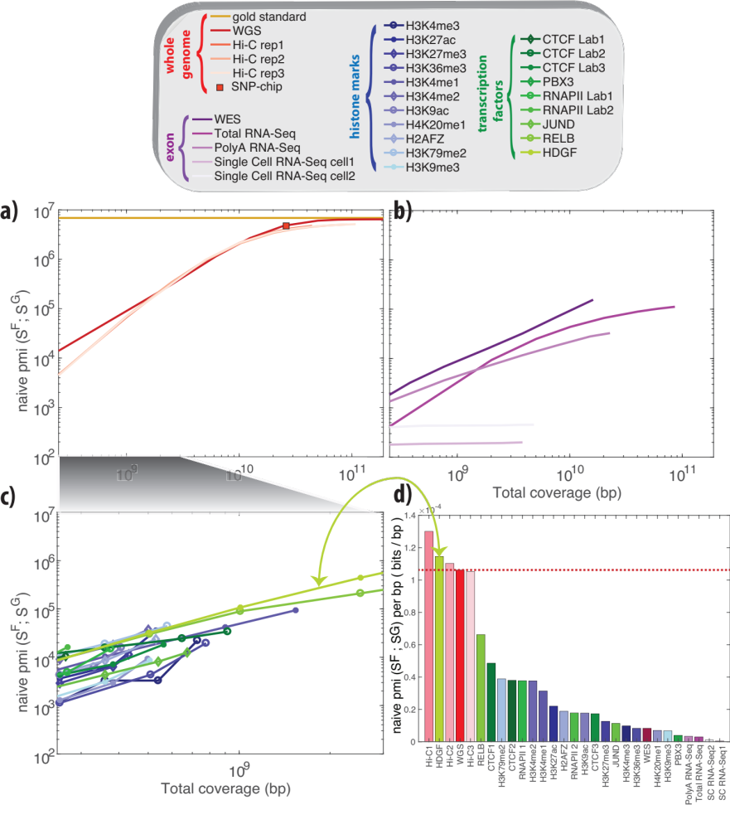
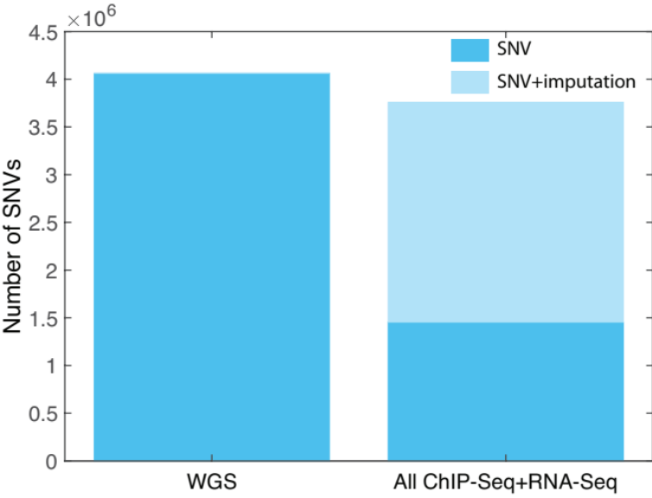
How much information, for example, do RNA-Seq reads (or ChIP-Seq) reads contain? Does that information enough to identify individuals?
It might seem like we don’t infer much information from single ChIP-Seq and RNA-Seq experiments compared to WGS
  However putting 10 different ChIP-Seq experiments and RNA-Seq together with imputation provides a great deal of information about the individual
[Gursoy et al, Bioarvix]

Slide 34
Personal Genomics & Data Science: Using population-scale functional genomics to understand mental disease & interpreting the data exhaust from this activity
[Core] PsychENCODE:
Population-level analysis of functional genomics data related to mental disease
  Consortium intro & construction of an adult brain resource w/ 1866 individuals
  Explanation of across-population variation via changing proportions of cell types (using single-cell deconvolution)
  Generation of a large QTL resource (~2.5M eQTLs)
  Regulatory network construction using QTLs, Hi-C & activity relationships. Using this to link GWAS SNPs to genes.
  Embedding the reg. network in a deep-learning model (DSPN) to predict psychiatric disease phenotype from genotype & transcriptome
[Exhaust] Genomic Privacy & RNA-seq
  Introduction to Genomic Privacy
    The dilemma: The genome as fundamental, inherited info that’s very private v. need for large-scale mining for med. research
    2-sided nature of RNA-seq presents particularly tricky privacy issues
  eQTLs: Quantifying & removing further variant info from expression levels w/ ICI & predictability. Instantiating a practical linking attack w/ noisy quasi-identifiers
  Signal Profiles: Manifest appreciable leakage from large & small deletions. Linking attacks possible but additional complication of SV discovery in addition to genotyping
[Exhaust] Publication Patterns
from data producing consortia
  Co-authorship network stats relate to publication rollouts & show gradual adoption by community
  Key role of brokers in data dissemination

Slide 35


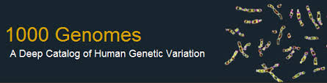
Representative Functional Genomics, Genotype, eQTL Datasets
Genotypes are available from the 1000 Genomes Project
mRNA sequencing for 462 individuals from gEUVADIS and ENCODE
  Publicly available quantification for protein coding genes
Functional genomics data (ChIP-Seq, RNA-Seq, Hi-C) available from ENCODE
Approximately 3,000 cis-eQTL (FDR<0.05)

Slide 36
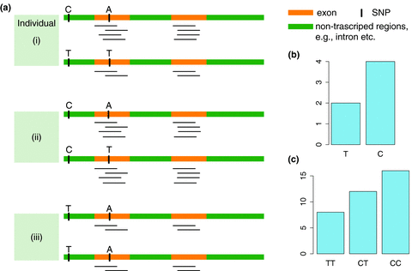
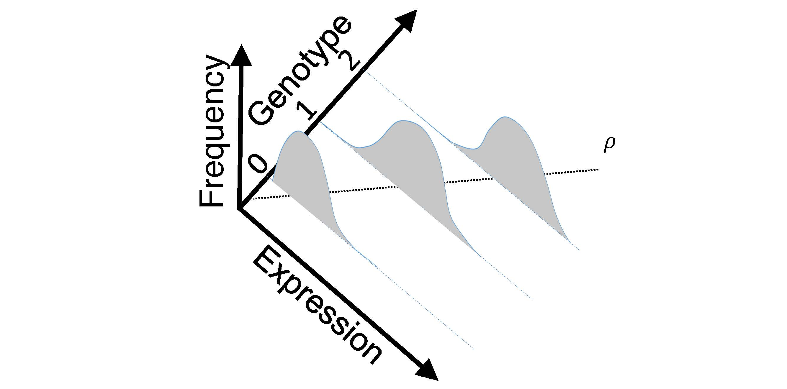
eQTL Mapping Using RNA-Seq Data
eQTLs are genomic loci that contribute to variation in mRNA expression levels
eQTLs provide insights on transcription regulation, and the molecular basis of phenotypic outcomes
eQTL mapping can be done with RNA-Seq data
[Biometrics 68(1) 1–11]
Notes:
A diagram to illustrate the RNA‐seq count variation of one gene due to an cis‐eQTL. (a) RNA‐seq measurements of a hypothetic gene with two exons in three diploid individuals. The target SNP which we test for association has the genotype CT, CC, and TT for the three individuals. There is an SNP on the first exon, which has genotype AT, AT, and AA for the three individuals. ASE can be measured by those sequence reads that overlap with a heterozygous exonic SNP. Therefore we can measure ASE for individuals (i) and (ii). However, association testing by ASE is only possible if the target SNP is heterozygous, thus only individual (i) can be used to test for eQTL by ASE (b) ASE measurements for individual (i). (c) TReC measured for the three individuals across the two exons of this gene.
© IF THIS IMAGE HAS BEEN PROVIDED BY OR IS OWNED BY A THIRD PARTY, AS INDICATED IN THE CAPTION LINE, THEN FURTHER PERMISSION MAY BE NEEDED BEFORE ANY FURTHER USE. PLEASE CONTACT WILEY'S PERMISSIONS DEPARTMENT ON PERMISSIONS@WILEY.COM OR USE THE RIGHTSLINK SERVICE BY CLICKING ON THE 'REQUEST PERMISSION' LINK ACCOMPANYING THIS ARTICLE. WILEY OR AUTHOR OWNED IMAGES MAY BE USED FOR NON-COMMERCIAL PURPOSES, SUBJECT TO PROPER CITATION OF THE ARTICLE, AUTHOR, AND PUBLISHER.

Slide 37
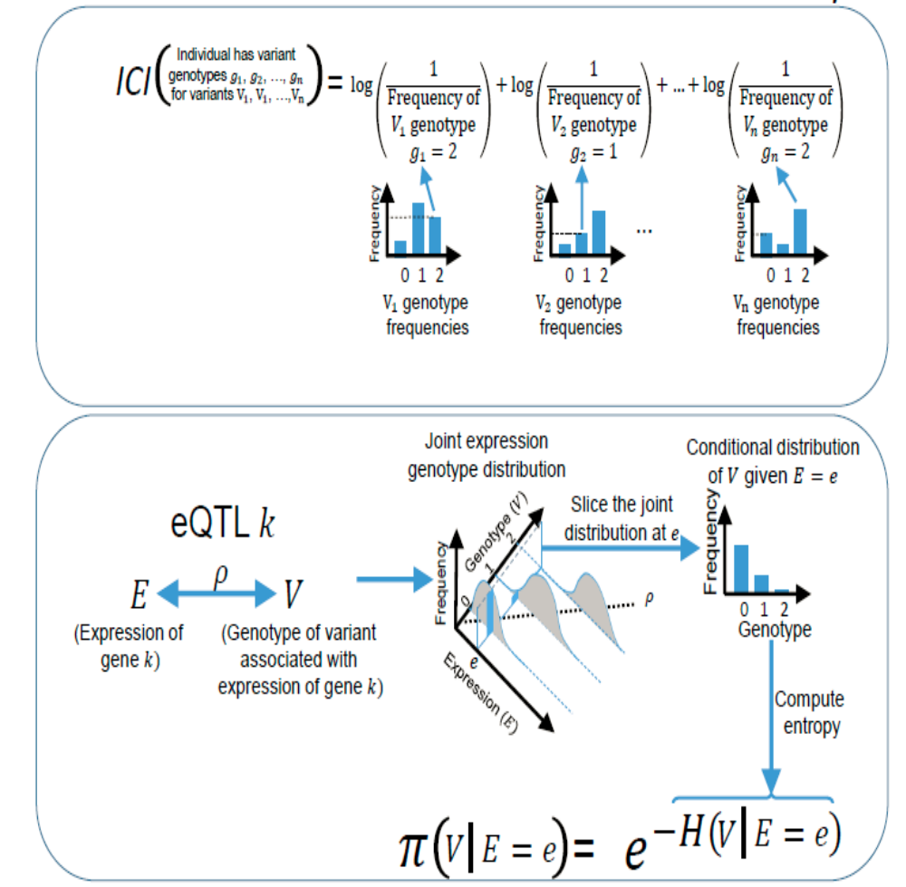
Information Content and Predictability
Naive measure of information (no LD, distant correlations, pop. struc., &c)
Higher frequency: Lower ICI
Additive for multiple variants
Condition specific entropy
Higher cond. entropy: Lower predictability
Additive for multiple eQTLs
[Harmanci et al. Nat. Meth. 2016]

Slide 38
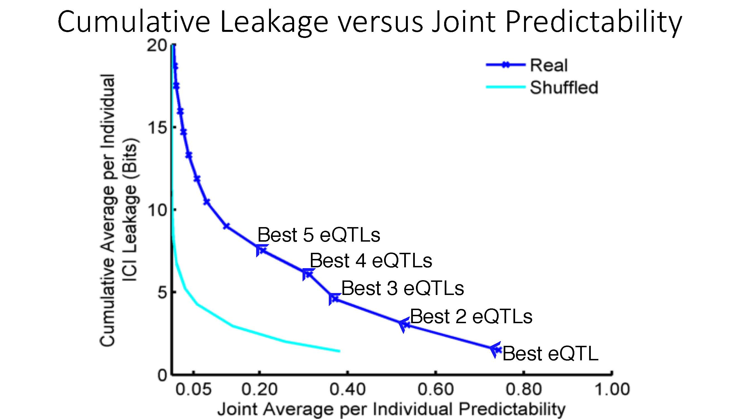
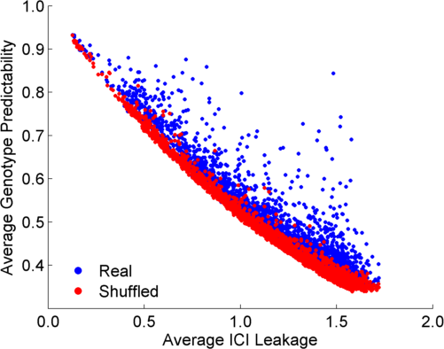
ICI Leakage versus Genotype Predictability
[Harmanciet al. Nat. Meth. (‘16]

Slide 39
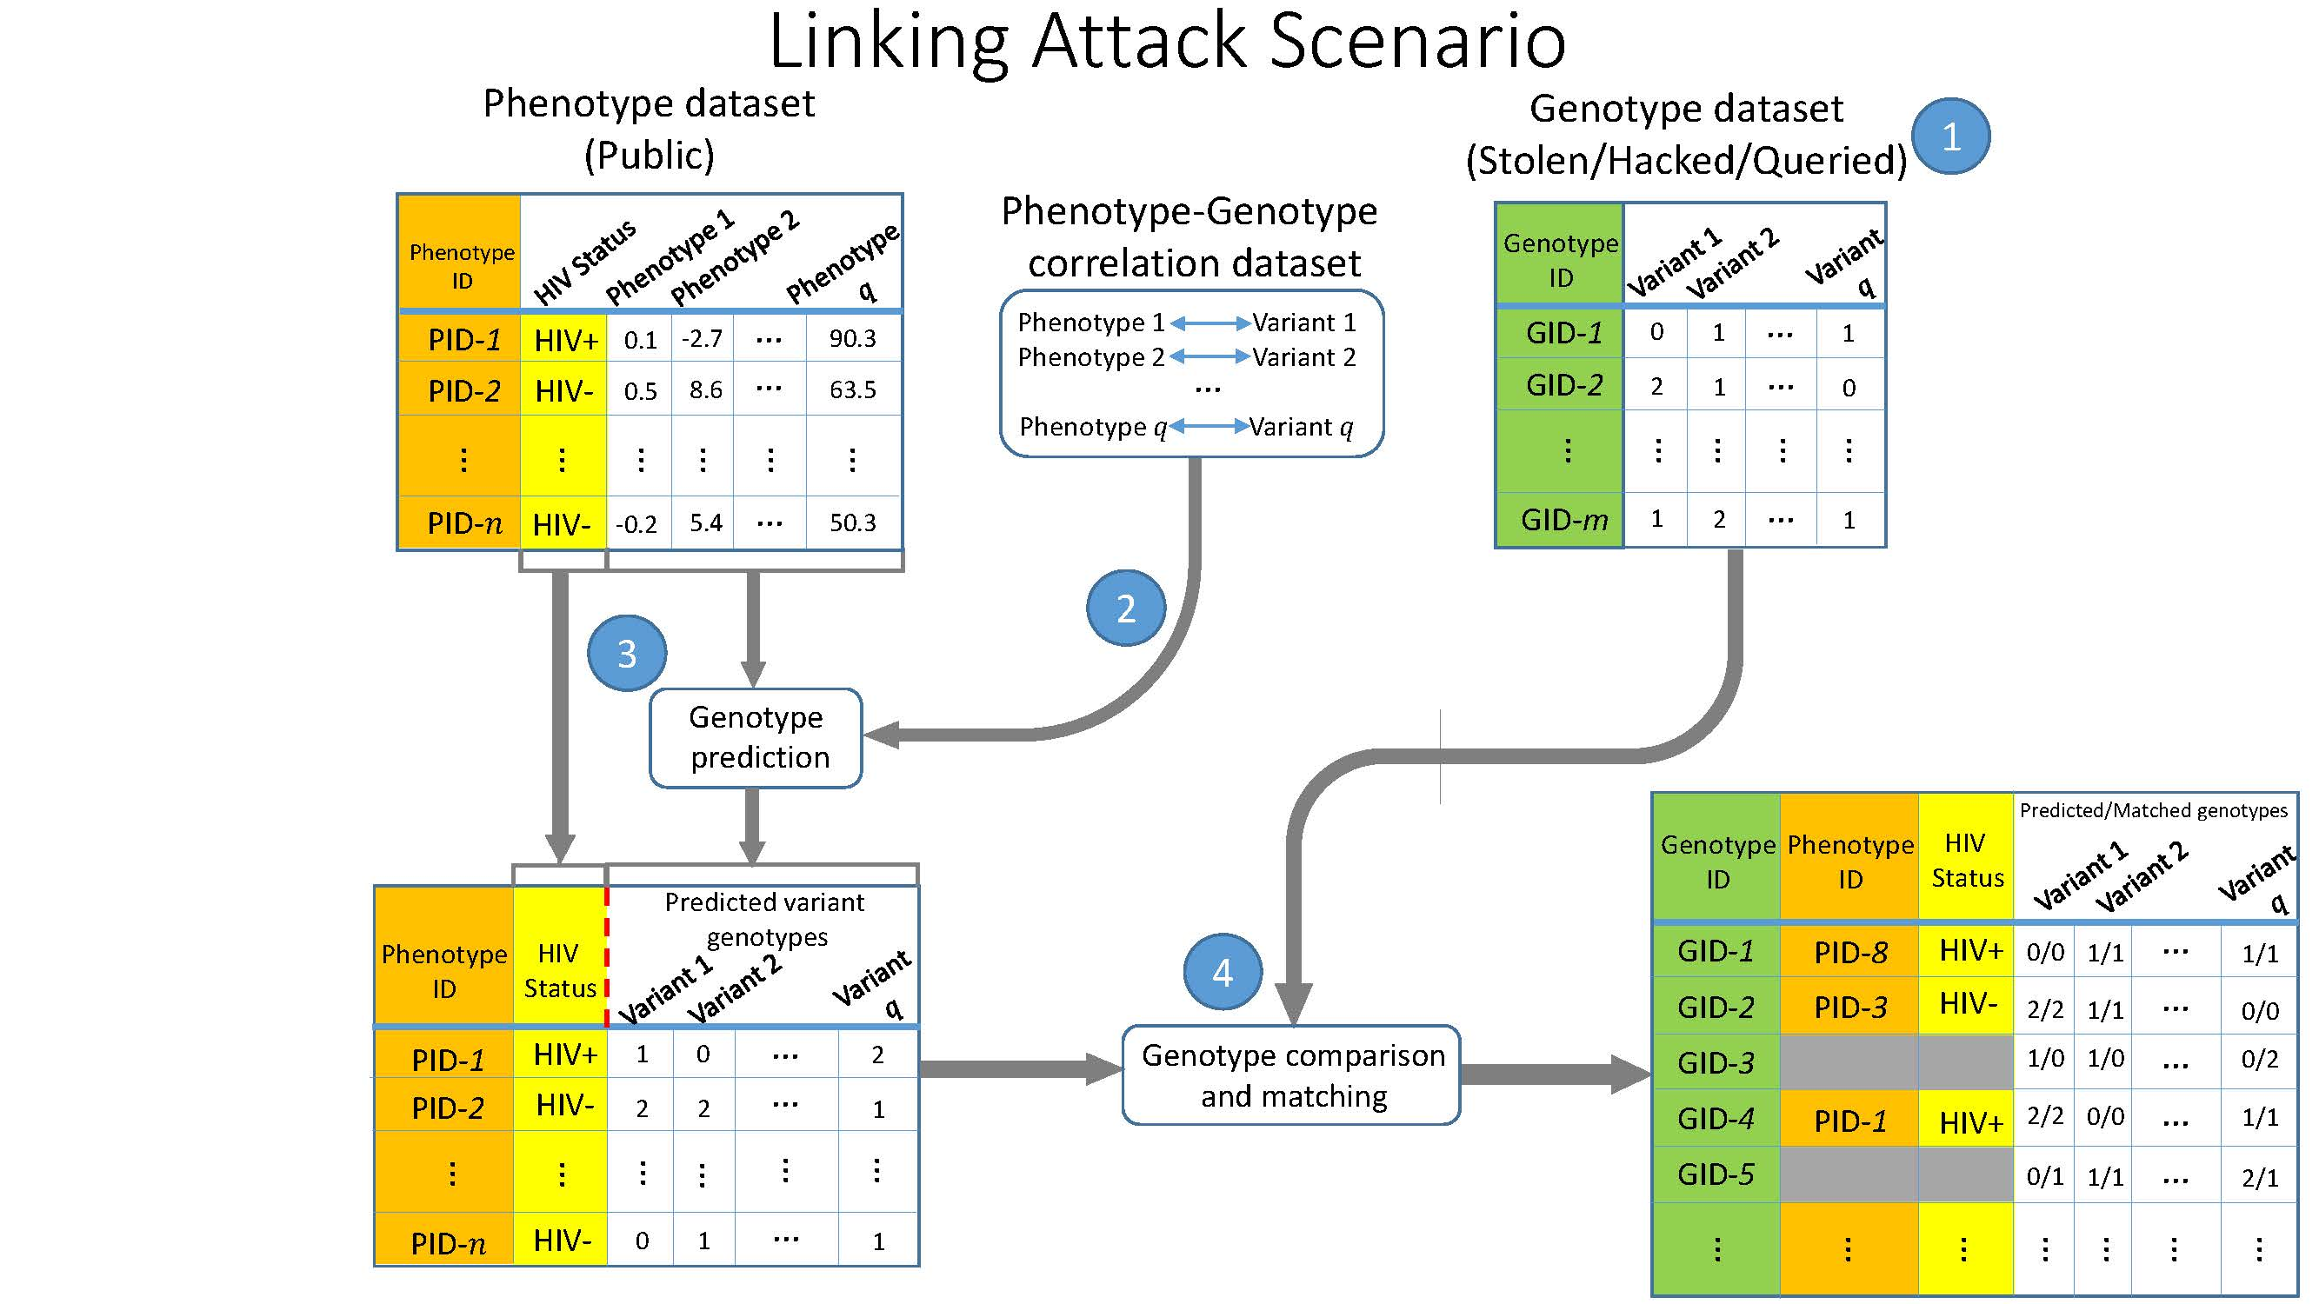
Linking Attack Scenario
[Harmanciet al. Nat. Meth. (in revision)]

Slide 40


Linking Attacks: Case of Netflix Prize
Names available for many users!
User (ID) | Movie (ID) | Date of Grade | Grade [1,2,3,4,5]
NTFLX-0 | NTFLX-19 | 10/12/2008 | 1
NTFLX-1 | NTFLX-116 | 4/23/2009 | 3
NTFLX-2 | NTFLX-92 | 5/27/2010 | 2
NTFLX-1 | NTFLX-666 | 6/6/2016 | 5
… | … | … | …
… | … | … | …
User (ID) | Movie (ID) | Date of Grade | Grade [0-10]
IMDB-0 | IMDB-173 | 4/20/2009 | 5
IMDB-1 | IMDB-18 | 10/18/2008 | 0
IMDB-2 | IMDB-341 | 5/27/2010 | -
… | … | … | …
… | … | … | …
… | … | … | …
Many users are shared
The grades of same users are correlated
A user grades one movie around the same date in two databases
Anonymized Netflix Prize Training Dataset
made available to contestants
Notes:
This figure illustrates what these datasets look like. The movie titles can be matched directly. Date of ratings and rating values are expected to be similar to each other

Slide 41
Linking Attacks: Case of Netflix Prize
Names available for many users!
User (ID) | Movie (ID) | Date of Grade | Grade [1,2,3,4,5]
NTFLX-0 | NTFLX-19 | 10/12/2008 | 1
NTFLX-1 | NTFLX-116 | 4/23/2009 | 3
NTFLX-2 | NTFLX-92 | 5/27/2010 | 2
NTFLX-1 | NTFLX-666 | 6/6/2016 | 5
… | … | … | …
… | … | … | …
User (ID) | Movie (ID) | Date of Grade | Grade [0-10]
IMDB-0 | IMDB-173 | 4/20/2009 | 5
IMDB-1 | IMDB-18 | 10/18/2008 | 0
IMDB-2 | IMDB-341 | 5/27/2010 | -
… | … | … | …
… | … | … | …
… | … | … | …
Many users are shared
The grades of same users are correlated
A user grades one movie around the same date in two databases
IMDB users are public
NetFLIX and IMdB moves are public
Notes:
As you can see, Netflx-1 user can be matched to IMDB-0 user since the date of rating is very close and the ratings are very similar. The rating in imdb is from 0 to 10. So 5 is a similar score to 3 in Netflix rating system.

Slide 42
Linking Attacks: Case of Netflix Prize
Names available for many users!
User (ID) | Movie (ID) | Date of Grade | Grade [1,2,3,4,5]
NTFLX-0 | NTFLX-19 | 10/12/2008 | 1
NTFLX-1 | NTFLX-116 | 4/23/2009 | 3
NTFLX-2 | NTFLX-92 | 5/27/2010 | 2
NTFLX-1 | NTFLX-666 | 6/6/2016 | 5
… | … | … | …
… | … | … | …
User (ID) | Movie (ID) | Date of Grade | Grade [0-10]
IMDB-0 | IMDB-173 | 4/20/2009 | 5
IMDB-1 | IMDB-18 | 10/18/2008 | 0
IMDB-2 | IMDB-341 | 5/27/2010 | -
… | … | … | …
… | … | … | …
… | … | … | …
Many users are shared
The grades of same users are correlated
A user grades one movie around the same date in two databases
Notes:
The key idea is that in imdb, the names are available for many users. Also,
Secondly, although another movie in Netflix system is not rated by this user in imdb system, namely the netflx666, the adversary can see the rating of the individual for this movie.

Slide 43
Linking Attack Scenario
[Harmanciet al. Nat. Meth. (in revision)]

Slide 44
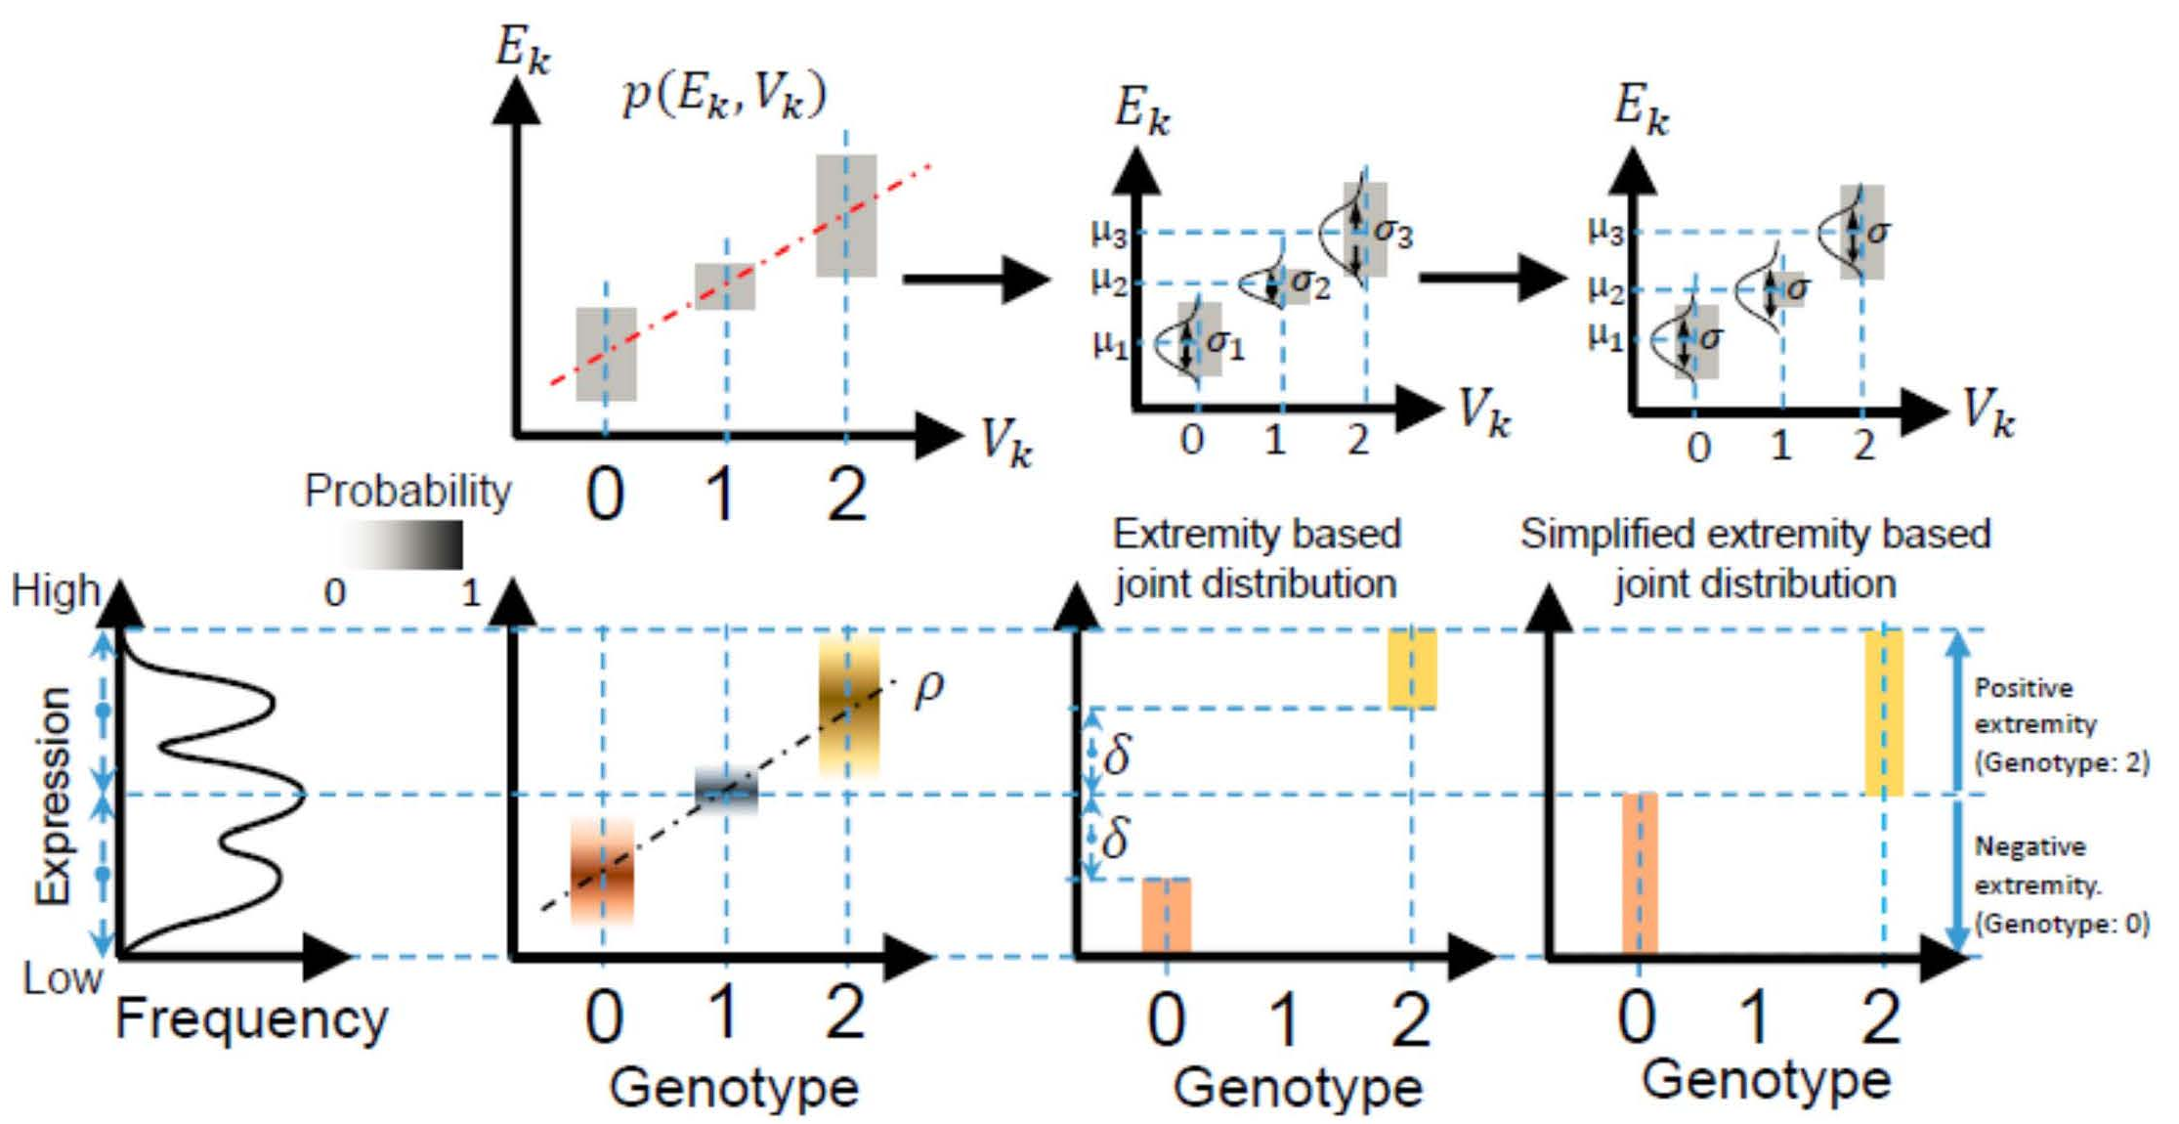
Levels of Expression-Genotype Model Simplifications for Genotype Prediction
[Harmanci et al. Nat. Meth. (16)]

Slide 45
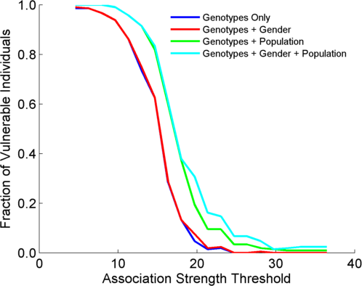
Success in Linking Attack with Extremity based Genotype Prediction
200 individuals eQTL Discovery
200 individuals in Linking Attack
High
Sensitivity
Low
Sensitivity
High Number
Of eQTLs
Low Number
Of eQTLs
[Harmanci et al. Nat. Meth. (16)]

Slide 46
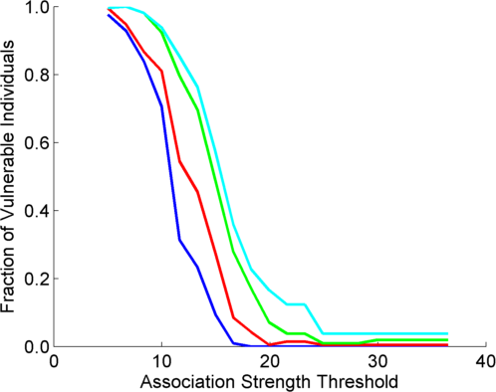
Success in Linking Attack with Extremity based Genotype Prediction
200 individuals eQTL Discovery
200 individuals in Linking Attack
200 individuals eQTL Discovery
100,200 individuals in Linking Attack
[Harmanci et al. Nat. Meth. (16)]

Slide 47
Personal Genomics & Data Science: Using population-scale functional genomics to understand mental disease & interpreting the data exhaust from this activity
[Core] PsychENCODE:
Population-level analysis of functional genomics data related to mental disease
  Consortium intro & construction of an adult brain resource w/ 1866 individuals
  Explanation of across-population variation via changing proportions of cell types (using single-cell deconvolution)
  Generation of a large QTL resource (~2.5M eQTLs)
  Regulatory network construction using QTLs, Hi-C & activity relationships. Using this to link GWAS SNPs to genes.
  Embedding the reg. network in a deep-learning model (DSPN) to predict psychiatric disease phenotype from genotype & transcriptome
[Exhaust] Genomic Privacy & RNA-seq
  Introduction to Genomic Privacy
    The dilemma: The genome as fundamental, inherited info that’s very private v. need for large-scale mining for med. research
    2-sided nature of RNA-seq presents particularly tricky privacy issues
  eQTLs: Quantifying & removing further variant info from expression levels w/ ICI & predictability. Instantiating a practical linking attack w/ noisy quasi-identifiers
  Signal Profiles: Manifest appreciable leakage from large & small deletions. Linking attacks possible but additional complication of SV discovery in addition to genotyping
[Exhaust] Publication Patterns
from data producing consortia
  Co-authorship network stats relate to publication rollouts & show gradual adoption by community
  Key role of brokers in data dissemination

Slide 48
Detection & Genotyping of small & large
SV deletions from signal profiles
RNA-Seq
Signal
Genomic
Coordinate
ChIP-Seq
Signals
A C G T A C G
Large Deletion
Genomic
Coordinate
Small Deletion
RNA-seq also shows large deletions
[Harmanci & Gerstein, Nat. Comm. (‘18)]

Slide 49
Example of Small Deletion Evident in Signal Profile
[Harmanci & Gerstein, Nat. Comm. (‘18)]

Slide 50
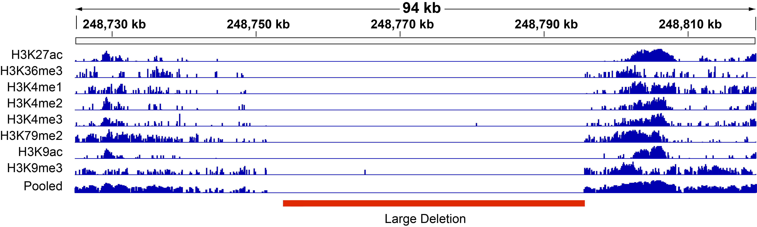
Example of Large Deletion Evident in Signal Profile
[Harmanci & Gerstein, Nat. Comm. (‘18)]

Slide 51
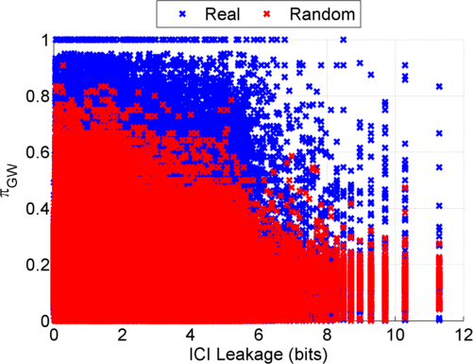
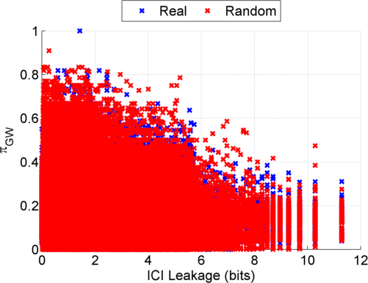
Information Leakage from SV Deletions
Before Anonymization
b) After Anonymization
Simple anonymization procedure (filling in deletion by value at endpoints) has dramatic effect
[Harmanci & Gerstein, Nat. Comm. (‘18)]
Notes:
GEUVADIS ICI-\Pi_GW estimates:

Slide 52
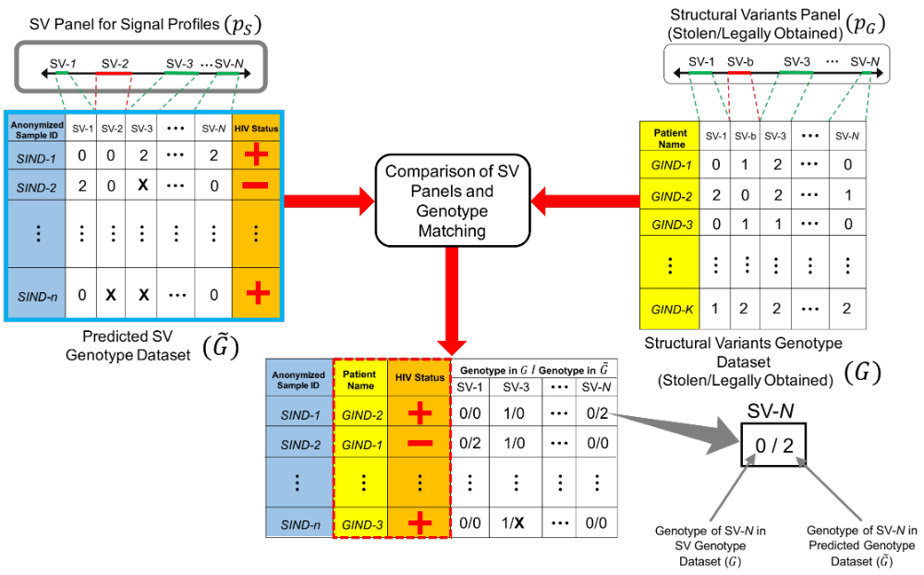
Another type of Linking Attack:
Linking based on SV Genotyping
[Harmanci & Gerstein, Nat. Comm. (‘18)]

Slide 53
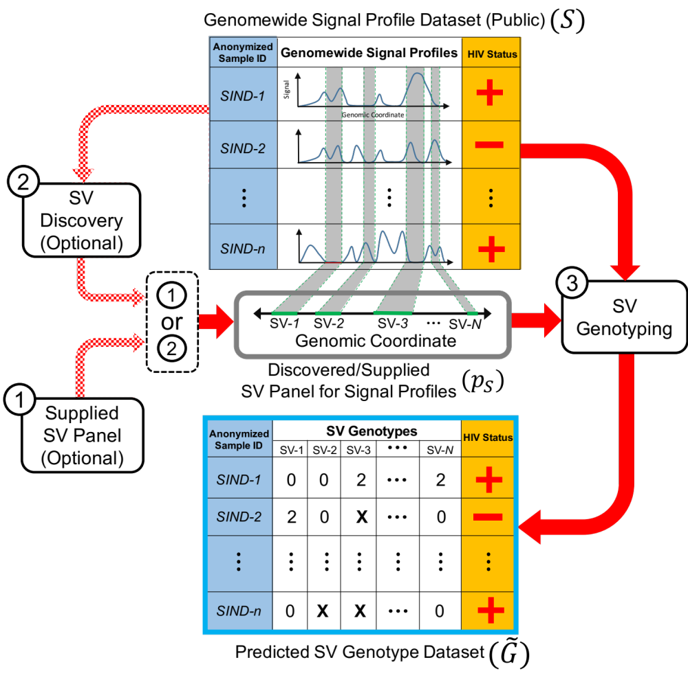
Another type of Linking Attack:
First Doing SV Genotyping
[Harmanci & Gerstein, Nat. Comm. (‘18)]

Slide 54
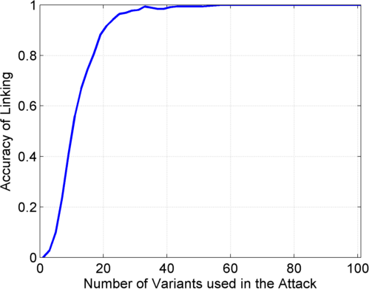
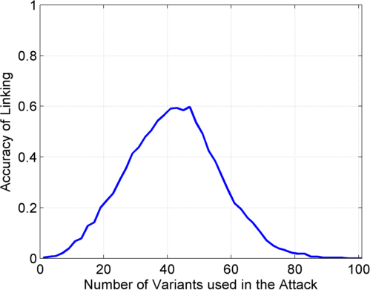
Linking Attack Based on SV Deletions in gEUVADIS Dataset
c) Genotyping
(1kG MAF>0.01)
d) Discovery + Genotyping
Sorted in Decreasing
Predictability
Sorted in Decreasing
Predictability
[Harmanci & Gerstein, Nat. Comm. (‘18)]

Slide 55
Personal Genomics & Data Science: Using population-scale functional genomics to understand mental disease & interpreting the data exhaust from this activity
[Core] PsychENCODE:
Population-level analysis of functional genomics data related to mental disease
  Consortium intro & construction of an adult brain resource w/ 1866 individuals
  Explanation of across-population variation via changing proportions of cell types (using single-cell deconvolution)
  Generation of a large QTL resource (~2.5M eQTLs)
  Regulatory network construction using QTLs, Hi-C & activity relationships. Using this to link GWAS SNPs to genes.
  Embedding the reg. network in a deep-learning model (DSPN) to predict psychiatric disease phenotype from genotype & transcriptome
[Exhaust] Genomic Privacy & RNA-seq
  Introduction to Genomic Privacy
    The dilemma: The genome as fundamental, inherited info that’s very private v. need for large-scale mining for med. research
    2-sided nature of RNA-seq presents particularly tricky privacy issues
  eQTLs: Quantifying & removing further variant info from expression levels w/ ICI & predictability. Instantiating a practical linking attack w/ noisy quasi-identifiers
  Signal Profiles: Manifest appreciable leakage from large & small deletions. Linking attacks possible but additional complication of SV discovery in addition to genotyping
[Exhaust] Publication Patterns
from data producing consortia
  Co-authorship network stats relate to publication rollouts & show gradual adoption by community
  Key role of brokers in data dissemination

Slide 56
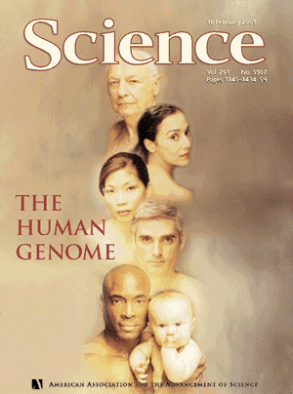
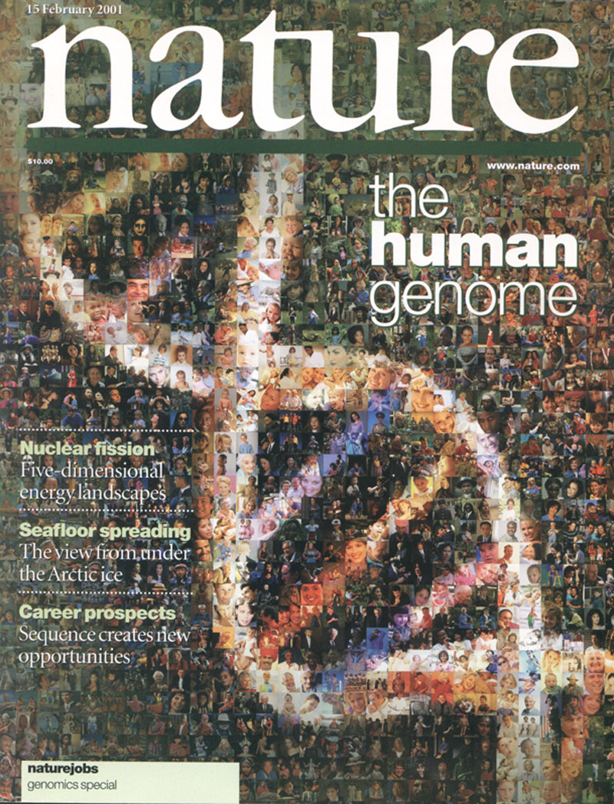

The Human
Genome Project
2000
2005
2010
2015
Worm
Genome

Slide 57
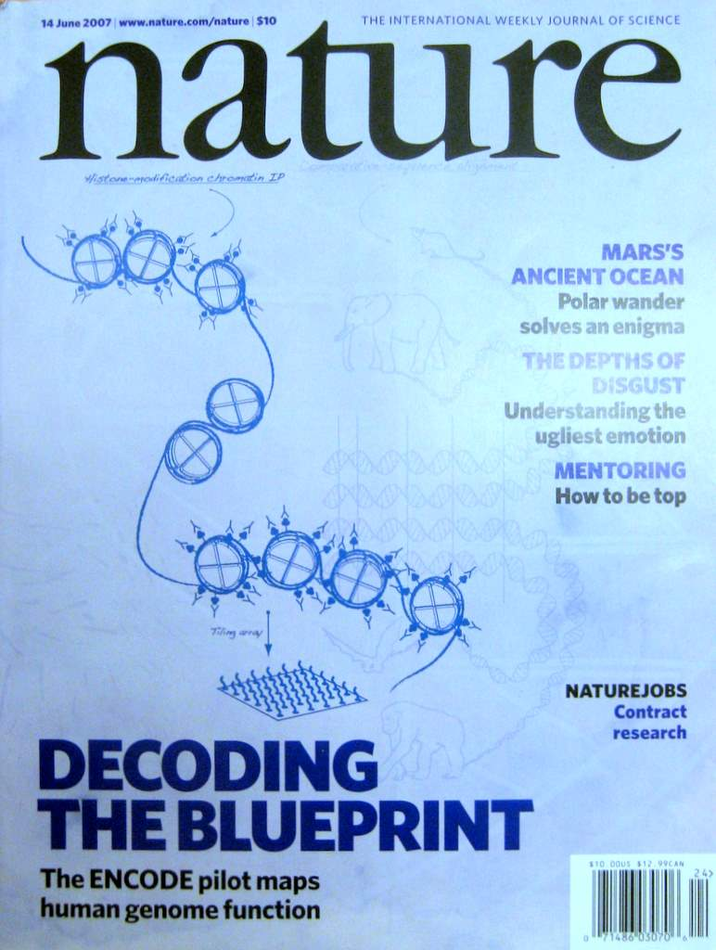

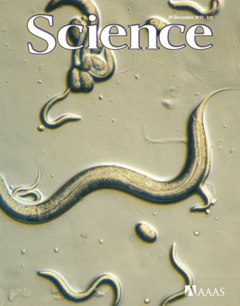
The Human
Genome Project
ENCODE
Pilot
ENCODE
Production
2000
2005
2010
Worm
Genome
modENCODE

Slide 58
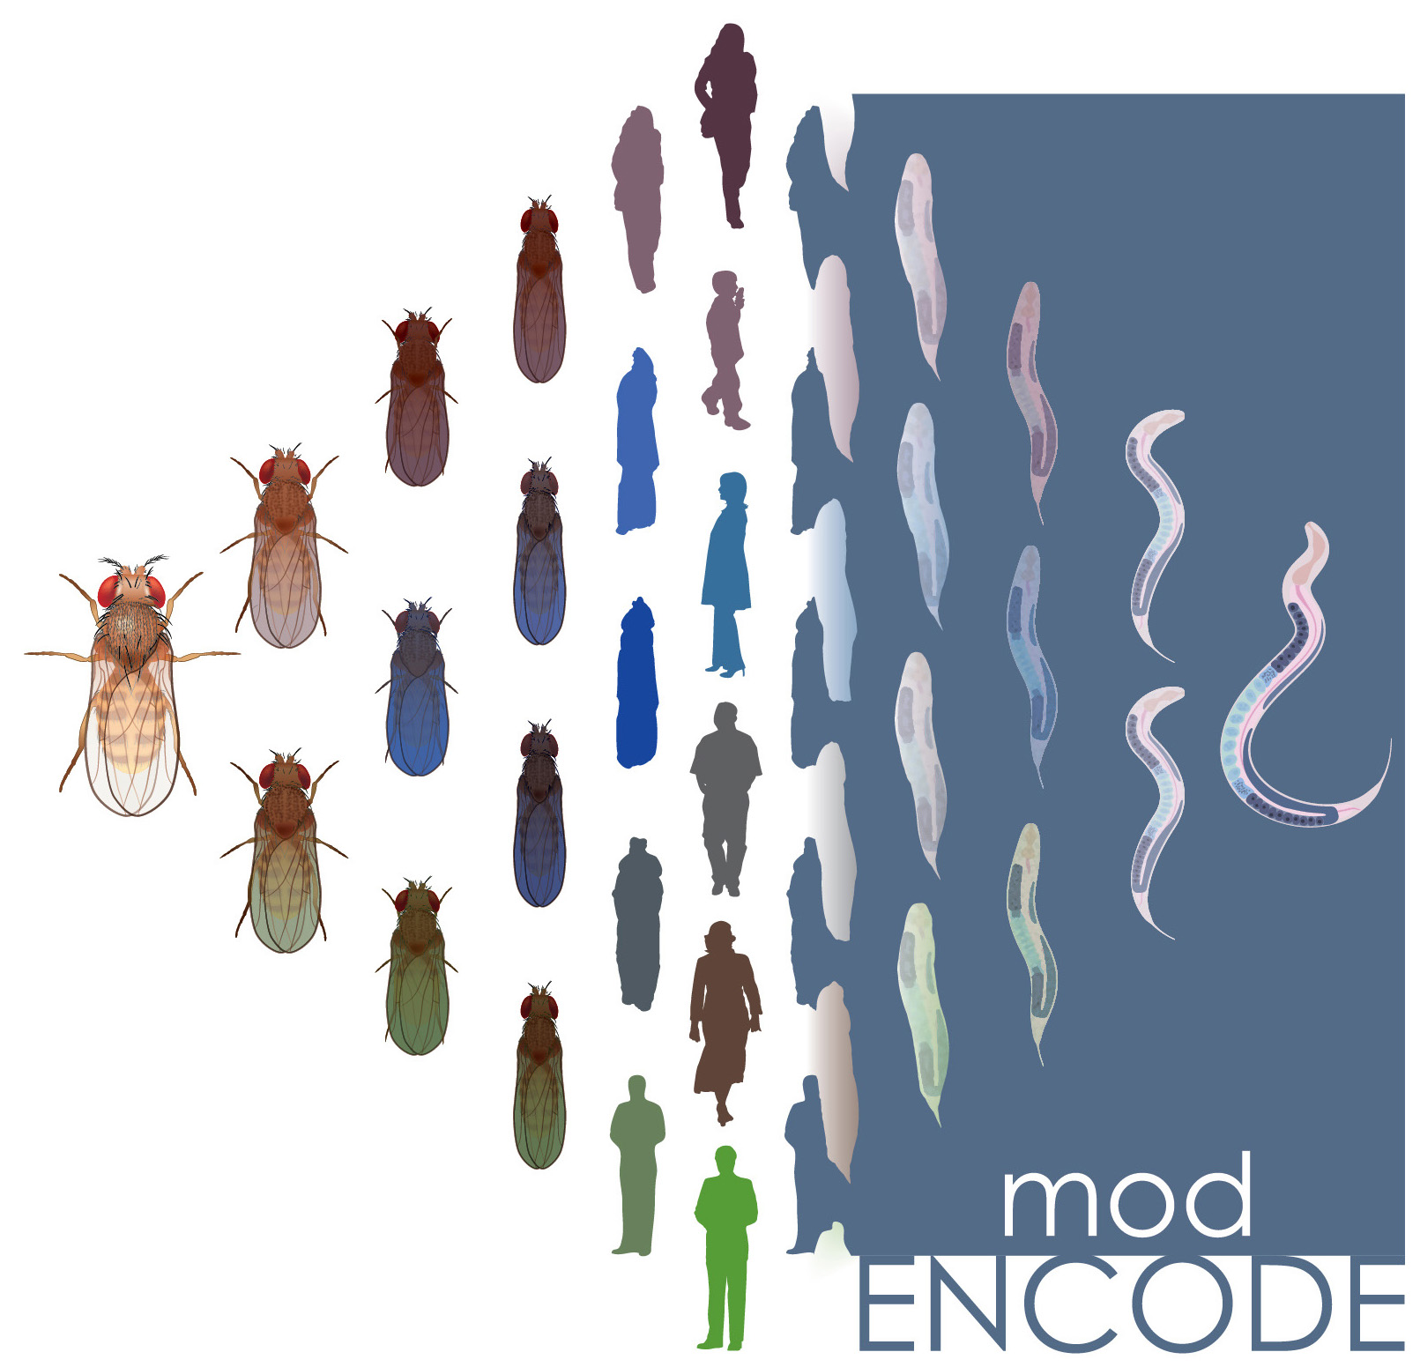

The Human
Genome Project
ENCODE
Pilot
ENCODE
Production
Comparative
ENCODE
2000
2005
2010
2015
Worm
Genome
modENCODE

Slide 59


The Human
Genome Project
ENCODE
Pilot
ENCODE
Production
Comparative
ENCODE
2000
2005
2010
2015
Worm
Genome
modENCODE
1000 Genomes
Pilot
1000 Genomes
Production

Slide 60


The Human
Genome Project
ENCODE
Pilot
ENCODE
Production
Comparative
ENCODE
Epigenome
Roadmap
2000
2005
2010
2015
Worm
Genome
modENCODE
1000 Genomes
Pilot
1000 Genomes
Production
GTEx

Slide 61

With help of M Pazin at NHGRI, identified: 702 community papers that used ENCODE data but were not supported by ENCODE funding &
558 consortium papers supported by ENCODE funding
(https://www.encodeproject.org/search/?type=Publication for up-to-date query)
Then identified 1,786 ENCODE members & 8,263 non-members .
<= # Papers
# Authors Yr. (‘04 to ‘15)
[Wang et al., TIG (’16)]
Notes:
1 slides from dw encode authors

Slide 62


Co-authorship Network of ENCODE members
& Data Users
co-authorship
2014
[Wang et al., TIG (’16)]

Slide 63

Co-authorship Network of ENCODE members
& Data Users
# neighbors: ENCODE ==>
co-authorship
# neighbors: non-ENCODE ==>
2014
[Wang et al., TIG (’16)]

Slide 64
Co-authorship Network of ENCODE members
& Data Users
co-authorship
2014
[Wang et al., TIG (’16)]

Slide 65
Dynamics of co-authorship network
2014
co-authorship
[Wang et al., TIG (’16)]

Slide 66










Dynamics of co-authorship network
2009
2010
2011
2008
2007
2012
2006
2005
2013
2004
2014
co-authorship
[Wang et al., TIG (’16)]

Slide 67

Dynamics of co-authorship network
2009
2010
2011
2008
2007
2012
“Modularity”
2006
2005
2013
2004
2014
co-authorship
[Wang et al., TIG (’16)]

Slide 68
Personal Genomics & Data Science: Using population-scale functional genomics to understand mental disease & interpreting the data exhaust from this activity
[Core] PsychENCODE:
Population-level analysis of functional genomics data related to mental disease
  Consortium intro & construction of an adult brain resource w/ 1866 individuals
  Explanation of across-population variation via changing proportions of cell types (using single-cell deconvolution)
  Generation of a large QTL resource (~2.5M eQTLs)
  Regulatory network construction using QTLs, Hi-C & activity relationships. Using this to link GWAS SNPs to genes.
  Embedding the reg. network in a deep-learning model (DSPN) to predict psychiatric disease phenotype from genotype & transcriptome
[Exhaust] Genomic Privacy & RNA-seq
  Introduction to Genomic Privacy
    The dilemma: The genome as fundamental, inherited info that’s very private v. need for large-scale mining for med. research
    2-sided nature of RNA-seq presents particularly tricky privacy issues
  eQTLs: Quantifying & removing further variant info from expression levels w/ ICI & predictability. Instantiating a practical linking attack w/ noisy quasi-identifiers
  Signal Profiles: Manifest appreciable leakage from large & small deletions. Linking attacks possible but additional complication of SV discovery in addition to genotyping
[Exhaust] Publication Patterns
from data producing consortia
  Co-authorship network stats relate to publication rollouts & show gradual adoption by community
  Key role of brokers in data dissemination

Slide 69
Personal Genomics & Data Science: Using population-scale functional genomics to understand mental disease & interpreting the data exhaust from this activity
[Core] PsychENCODE:
Population-level analysis of functional genomics data related to mental disease
  Consortium intro & construction of an adult brain resource w/ 1866 individuals
  Explanation of across-population variation via changing proportions of cell types (using single-cell deconvolution)
  Generation of a large QTL resource (~2.5M eQTLs)
  Regulatory network construction using QTLs, Hi-C & activity relationships. Using this to link GWAS SNPs to genes.
  Embedding the reg. network in a deep-learning model (DSPN) to predict psychiatric disease phenotype from genotype & transcriptome
[Exhaust] Genomic Privacy & RNA-seq
  Introduction to Genomic Privacy
    The dilemma: The genome as fundamental, inherited info that’s very private v. need for large-scale mining for med. research
    2-sided nature of RNA-seq presents particularly tricky privacy issues
  eQTLs: Quantifying & removing further variant info from expression levels w/ ICI & predictability. Instantiating a practical linking attack w/ noisy quasi-identifiers
  Signal Profiles: Manifest appreciable leakage from large & small deletions. Linking attacks possible but additional complication of SV discovery in addition to genotyping
[Exhaust] Publication Patterns
from data producing consortia
  Co-authorship network stats relate to publication rollouts & show gradual adoption by community
  Key role of brokers in data dissemination

Slide 70
PsychENCODE Acknowledgment
“Adult Capstone” Team – 1 of 3 capstones
Daifeng Wang, Shuang Liu, Jonathan Warrell, Hyejung Won, Xu Shi, Fabio Navarro, Declan Clarke, Mengting Gu, Prashant Emani,
Yucheng T. Yang, Min Xu, Michael Gandal, Shaoke Lou, Jing Zhang, Jonathan J. Park, Chengfei Yan, Suhn Kyong Rhie, Kasidet Manakongtreecheep, Holly Zhou, Aparna Nathan, Mette Peters, Eugenio Mattei, Dominic Fitzgerald, Tonya Brunetti, Jill Moore, Yan Jiang, Kiran Girdhar, Gabriel Hoffman, Selim Kalayci, Zeynep Hulya Gumus
PsychENCODE Consortium,
Panos Roussos, Schahram Akbarian, Andrew E. Jaffe,
Kevin White, Zhiping Weng, Nenad Sestan,
Daniel H. Geschwind, James A. Knowles
Geetha Senthil
Lora Bingaman
David Panchision
Alexander Arguello
Thomas Lehner
Dedicated to Pamela Sklar
The PsychENCODE Consortium: Allison E Ashley-Koch, Duke University; Gregory E Crawford, Duke University; Melanie E Garrett, Duke University; Lingyun Song, Duke University; Alexias Safi, Duke University; Graham D Johnson, Duke University; Gregory A Wray, Duke University; Timothy E Reddy, Duke University; Fernando S Goes, Johns Hopkins University; Peter Zandi, Johns Hopkins University; Julien Bryois, Karolinska Institutet; Andrew E Jaffe, Lieber Institute for Brain Development; Amanda J Price, Lieber Institute for Brain Development; Nikolay A Ivanov, Lieber Institute for Brain Development; Leonardo Collado-Torres, Lieber Institute for Brain Development; Thomas M Hyde, Lieber Institute for Brain Development; Emily E Burke, Lieber Institute for Brain Development; Joel E Kleiman, Lieber Institute for Brain Development; Ran Tao, Lieber Institute for Brain Development; Joo Heon Shin, Lieber Institute for Brain Development; Schahram Akbarian, Icahn School of Medicine at Mount Sinai; Kiran Girdhar, Icahn School of Medicine at Mount Sinai; Yan Jiang, Icahn School of Medicine at Mount Sinai; Marija Kundakovic, Icahn School of Medicine at Mount Sinai; Leanne Brown, Icahn School of Medicine at Mount Sinai; Bibi S Kassim, Icahn School of Medicine at Mount Sinai; Royce B Park, Icahn School of Medicine at Mount Sinai; Jennifer R Wiseman, Icahn School of Medicine at Mount Sinai; Elizabeth Zharovsky, Icahn School of Medicine at Mount Sinai; Rivka Jacobov, Icahn School of Medicine at Mount Sinai; Olivia Devillers, Icahn School of Medicine at Mount Sinai; Elie Flatow, Icahn School of Medicine at Mount Sinai; Gabriel E Hoffman, Icahn School of Medicine at Mount Sinai; Barbara K Lipska, Human Brain Collection Core, National Institutes of Health, Bethesda, MD; David A Lewis, University of Pittsburgh; Vahram Haroutunian, Icahn School of Medicine at Mount Sinai and James J Peters VA Medical Center; Chang-Gyu Hahn, University of Pennsylvania; Alexander W Charney, Mount Sinai; Stella Dracheva, Mount Sinai; Alexey Kozlenkov, Mount Sinai; Judson Belmont, Icahn School of Medicine at Mount Sinai; Diane DelValle, Icahn School of Medicine at Mount Sinai; Nancy Francoeur, Icahn School of Medicine at Mount Sinai; Evi Hadjimichael, Icahn School of Medicine at Mount Sinai; Dalila Pinto, Icahn School of Medicine at Mount Sinai; Harm van Bakel, Icahn School of Medicine at Mount Sinai; Panos Roussos, Mount Sinai; John F Fullard, Mount Sinai; Jaroslav Bendl, Mount Sinai; Mads E Hauberg, Mount Sinai; Lara M Mangravite, Sage Bionetworks; Mette A Peters, Sage Bionetworks; Yooree Chae, Sage Bionetworks; Junmin Peng, St. Jude Children's Hospital; Mingming Niu, St. Jude Children's Hospital; Xusheng Wang, St. Jude Children's Hospital; Maree J Webster, Stanley Medical Research Institute; Thomas G Beach, Banner Sun Health Research Institute; Chao Chen, Central South University; Yi Jiang, Central South University; Rujia Dai, Central South University; Annie W Shieh, SUNY Upstate Medical University; Chunyu Liu, SUNY Upstate Medical University; Kay S. Grennan, SUNY Upstate Medical University; Yan Xia, SUNY Upstate Medical University/Central South University; Ramu Vadukapuram, SUNY Upstate Medical University; Yongjun Wang, Central South University; Dominic Fitzgerald, The University of Chicago; Lijun Cheng, The University of Chicago; Miguel Brown, The University of Chicago; Mimi Brown, The University of Chicago; Tonya Brunetti, The University of Chicago; Thomas Goodman, The University of Chicago; Majd Alsayed, The University of Chicago; Michael J Gandal, University of California, Los Angeles; Daniel H Geschwind, University of California, Los Angeles; Hyejung Won, University of California, Los Angeles; Damon Polioudakis, University of California, Los Angeles; Brie Wamsley, University of California, Los Angeles; Jiani Yin, University of California, Los Angeles; Tarik Hadzic, University of California, Los Angeles; Luis De La Torre Ubieta, UCLA; Vivek Swarup, University of California, Los Angeles; Stephan J Sanders, University of California, San Francisco; Matthew W State, University of California, San Francisco; Donna M Werling, University of California, San Francisco; Joon-Yong An, University of California, San Francisco; Brooke Sheppard, University of California, San Francisco; A Jeremy Willsey, University of California, San Francisco; Kevin P White, The University of Chicago; Mohana Ray, The University of Chicago; Gina Giase, SUNY Upstate Medical University; Amira Kefi, University of Illinois at Chicago; Eugenio Mattei, University of Massachusetts Medical School; Michael Purcaro, University of Massachusetts Medical School; Zhiping Weng, University of Massachusetts Medical School; Jill Moore, University of Massachusetts Medical School; Henry Pratt, University of Massachusetts Medical School; Jack Huey, University of Massachusetts Medical School; Tyler Borrman, University of Massachusetts Medical School; Patrick F Sullivan, University of North Carolina - Chapel Hill; Paola Giusti-Rodriguez, University of North Carolina - Chapel Hill; Yunjung Kim, University of North Carolina - Chapel Hill; Patrick Sullivan, University of North Carolina - Chapel Hill; Jin Szatkiewicz, University of North Carolina - Chapel Hill; Suhn Kyong Rhie, University of Southern California; Christoper Armoskus, University of Southern California; Adrian Camarena, University of Southern California; Peggy J Farnham, University of Southern California; Valeria N Spitsyna, University of Southern California; Heather Witt, University of Southern California; Shannon Schreiner, University of Southern California; Oleg V Evgrafov, SUNY Downstate Medical Center; James A Knowles, SUNY Downstate Medical Center; Mark Gerstein, Yale University; Shuang Liu, Yale University; Daifeng Wang, Stony Brook University; Fabio C. P. Navarro, Yale University; Jonathan Warrell, Yale University; Declan Clarke, Yale University; Prashant S. Emani, Yale University; Mengting Gu, Yale University; Xu Shi, Yale University; Min Xu, Yale University; Yucheng T. Yang, Yale University; Robert R. Kitchen, Yale University; Gamze Gürsoy, Yale University; Jing Zhang, Yale University; Becky C Carlyle, Yale University; Angus C Nairn, Yale University; Mingfeng Li, Yale University; Sirisha Pochareddy, Yale University; Nenad Sestan, Yale University; Mario Skarica, Yale University; Zhen Li, Yale University; Andre M.M. Sousa, Yale University; Gabriel Santpere, Yale University; Jinmyung Choi, Yale University; Ying Zhu, Yale University; Tianliuyun Gao, Yale University; Daniel J Miller, Yale University; Adriana Cherskov, Yale University; Mo Yang, Yale University; Anahita Amiri, Yale University; Gianfilippo Coppola, Yale University; Jessica Mariani, Yale University; Soraya Scuderi, Yale University; Anna Szekely, Yale University; Flora M Vaccarino, Yale University; Feinan Wu, Yale University; Sherman Weissman, Yale University; Tanmoy Roychowdhury, Mayo Clinic Rochester; Alexej Abyzov, Mayo Clinic Rochester;.

Slide 71

Acknowledgements
papers.gersteinlab.org/subject/privacy
PrivaSig.gersteinlab.org
PrivaSeq.gersteinlab.org
A Harmanci, D Greenbaum, G Gürsoy, F Navarro, M Green
Publication patterns [“encode authors”]
D Wang, KK Yan, J Rozowsky, E Pan
Hiring Postdocs. See JOBS.gersteinlab.org !

Slide 72

Extra

Slide 73
Info about content in this slide pack
General PERMISSIONS
  This Presentation is copyright Mark Gerstein,
  Yale University, 2017.
  Please read permissions statement at
  www.gersteinlab.org/misc/permissions.html .
  Feel free to use slides & images in the talk with PROPER acknowledgement
  (via citation to relevant papers or link to gersteinlab.org).
  Paper references in the talk were mostly from Papers.GersteinLab.org.
PHOTOS & IMAGES. For thoughts on the source and permissions of many of the photos and clipped images in this presentation see http://streams.gerstein.info .
  In particular, many of the images have particular EXIF tags, such as kwpotppt , that can be easily queried from flickr, viz: http://www.flickr.com/photos/mbgmbg/tags/kwpotppt

